Slide 1
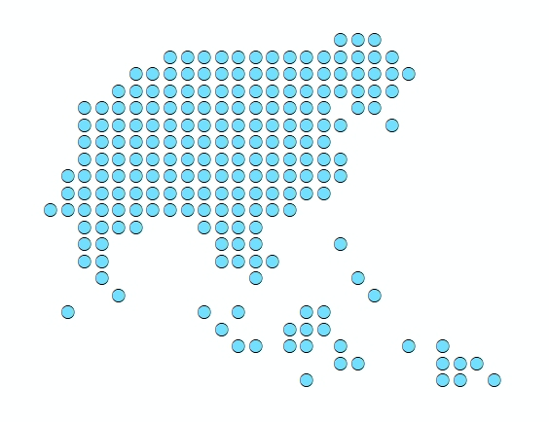





Session 8 - Preparing the data for its use in a GIS software
Sokna Sek – MOH/DPHI
Leng Ing – MOH/DPHI
Sat Chab – MOH/DPHI
Steeve Ebener – HGLC
Izay Pantanilla – HGLC

Slide 2

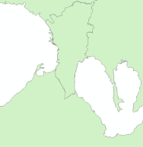
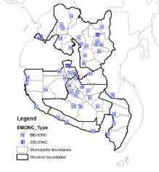
What is needed?
Preparing the data for its use in a GIS software
1. Fixed objects that can be represented by a point (health facility, village, school, …)
1
Master list
Master list with unique identifier, admin divisions and geographic coordinates
2
Unique identifier included in the statistics/information table
Coordinates used to create a
GIS layer (points)
Statistics/information table
Unique identifier allows joining the statistics/information with the map

Slide 3

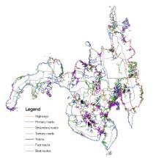
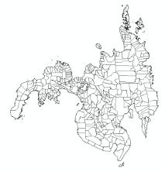
Preparing the data for its use in a GIS software
What is needed?
2. Fixed objects that can be represented by a line or polygons to which information/statistics can be linked (admin boundaries, road, river,…)
1
Master list
Complete, up-to-date master list
with unique identifier
+
identifier included in the attribute table of the GIS layer
3
identifier included in the
Statistics/information table
GIS Layer (shape file)
2
Identifier allows joining the statistics/information with the GIS layer

Slide 4





What is needed?
Preparing the data for its use in a GIS software
3. “Mobile” objects (patients, health workers, vehicle,…)
Complete, up-to-date master list
with unique identifier and fields to capture the place of care, of residence,… through other fixed objects respective unique identifier
Village
But you might want to track some of these objects…
174000001
HF12034
174000000

Slide 5
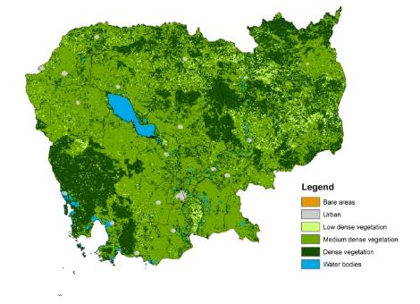
What is needed?
Preparing the data for its use in a GIS software
4. Continuous geospatial data (Digitial Elevation Model (DEM), landcover,…)
The GIS Layer
The classification if not already included in the layer itself
5. Basemaps
Nothing needed except the access to the basemap layer which is most likely going to be through internet

Slide 6
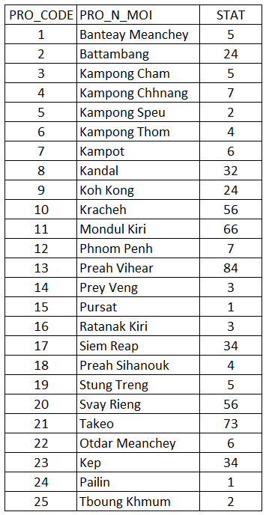
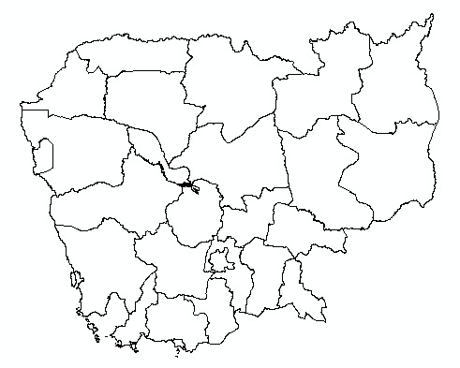
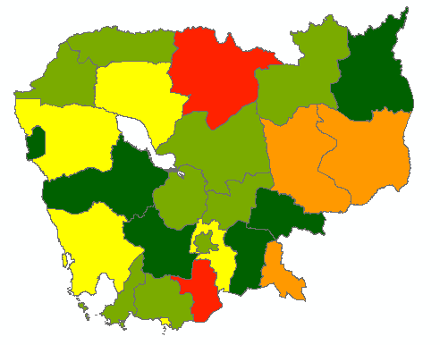
Preparing the data for its use in a GIS software
What is needed?
What you will mostly be doing is to link statistics/information to a shape file to create a thematic map
+
The unique identifier is key!
6

Slide 7
Geospatial data
Preparing the data for its use in a GIS software
The compilation is meant to have led to shape files that are presenting:
  The same geographic coordinate system if more than one layer to be included on the map (good practice to also use the same projected coordinate system)
  An attribute table that present the same structure and content (especially the unique identifier) than the corresponding master list
  The geography in the shape file that matches the geography of the statistical/information data that you want to represent on the map
This will be practiced during exercise 4

Slide 8
Statistical/information data – Things to avoid
Preparing the data for its use in a GIS software
Columns used for spacing
Merged cells
Information stored at the top of the table itself
Long headers
Duplicates of record
Numbers displayed as text
Spaces, special characters hyphens, or symbols in the header name
Multiple information stored in a single column
Data inconsistency between records

Slide 9
Preparing the data for its use in a GIS software
Statistics/information – Proper data structure
GIS software expect:
  Well formatted data organized in rows and columns:
    One record (health facility, village,..) per row
    One statistic/information per column
  The use of the same unique identifier as in the attribute table from the shape file
    Important to use the unique identifier from the master list like in the shape file

Slide 10
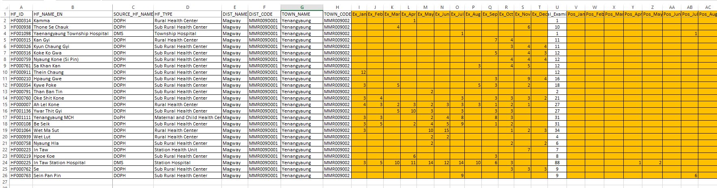
Preparing the data for its use in a GIS software
Statistics/information – Proper data structure
Unique identifier from the master list
Other useful information from the master list
Statistics/information
One record (health facility) per line
One statistic/information per column
This will be practiced during exercise 3

Slide 11
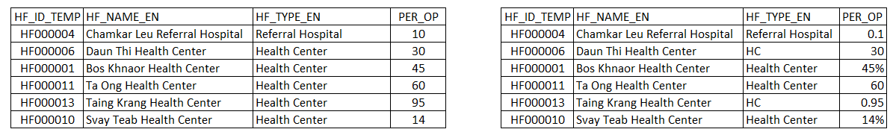


Preparing the data for its use in a GIS software
Statistics/information – Data consistency between records
The way the Statistics/information is captured should be consistent between records to allow for proper representation on the map:
  Names should always spelled the same way
  Number should use the same format

Slide 12

Preparing the data for its use in a GIS software
Statistics/information – Data confidentiality
Concerns both the statistical data /information and geospatial data
The statistical data/information should be anonymized before being linked to geospatial data
Precisely locating certain information on a map might allow locating the person in question even without mentioning its name (sexe, age, marital status, job,…)
Great attention should be put on this issue

Slide 13
Preparing the data for its use in a GIS software
In conclusion
Preparing a good map might require for you to spend:
70% of your available time to prepare good data
  Collecting, checking, cleaning, validating, formatting, linking with other data
20% to create the map
10% to check the resulting map, make potential adjustments
A good map is made of good data!

