Slide 1





GIS training workshop
for MOH staffs
Hanoi, 29-31 May 2018

Slide 2
Welcome and Opening remark

Slide 3
Acknowledgments
This training is made possible thanks to the support of:
Thank you !

Slide 4
Context of the training - HIS geo-enabling
An Information System that fully benefits from the power of geography, geospatial data and technologies through the proper integration of geography and time across its business processes
Geography: The study of the natural features of the Earth, such as mountains and rivers – The Science
Geospatial data: Also referred to as spatial data, information about the locations and shapes of geographic features and the relationships between them, usually stored as coordinates and topology – The Content
Geospatial technologies: Refers to equipment used in visualization, measurement, and analysis of earth's features, typically involving such systems as Global Navigation Satellite System (GNSS), Geographical Information Systems (GIS), and remote sensing (RS) – The Tools
4

Slide 5
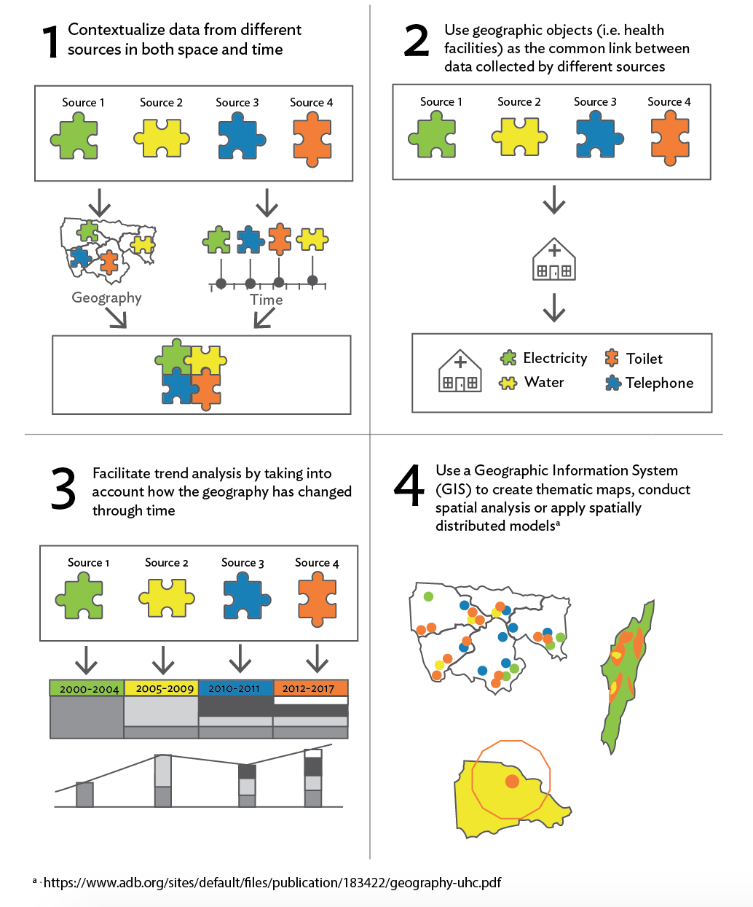
HIS geo-enabling benefits
Benefits of a geo-enabled HIS
Extracted from: https://www.adb.org/publications/building-capacity-geo-enabling-health-information-systems
5

Slide 6
HIS geo-enabling benefits
Extracted from: https://www.adb.org/publications/building-capacity-geo-enabling-health-information-systems
6

Slide 7
Objectives of the training
Strength the geospatial data management and technologies technical capacity of the Ministry of Health of Vietnam
Sustain the use of the Esri bundles sponsored by ADB
Learning objectives
Learm how to create good thematic maps
Use Esri technology (survey 123, ArcGIS desktop and online) to collect data in the field and create thematic maps

Slide 8
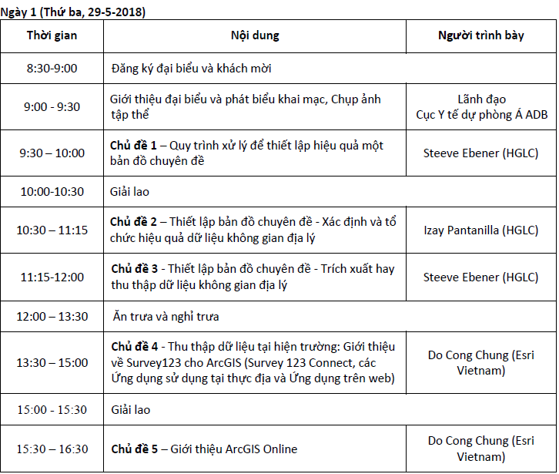
Agenda – Day 1

Slide 9

Agenda – Day 2

Slide 10
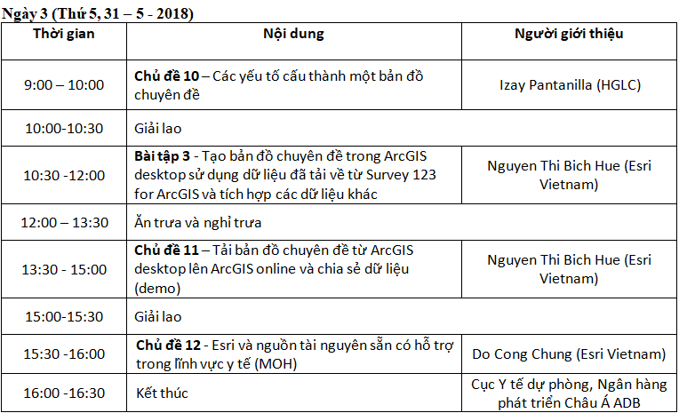
Agenda – Day 3

Slide 11




The Facilitators
Esri Vietnam
Nguyen Thi Bich Hue huentb@esrivn.com
Do Cong Chung chungdc@esrivn.com
Health Geolab Collaborative
Izay Pantanilla
izay.pantanilla@healthgeolab.net
Steeve Ebener
steeve.ebener@healthgeolab.net

Slide 12


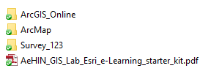

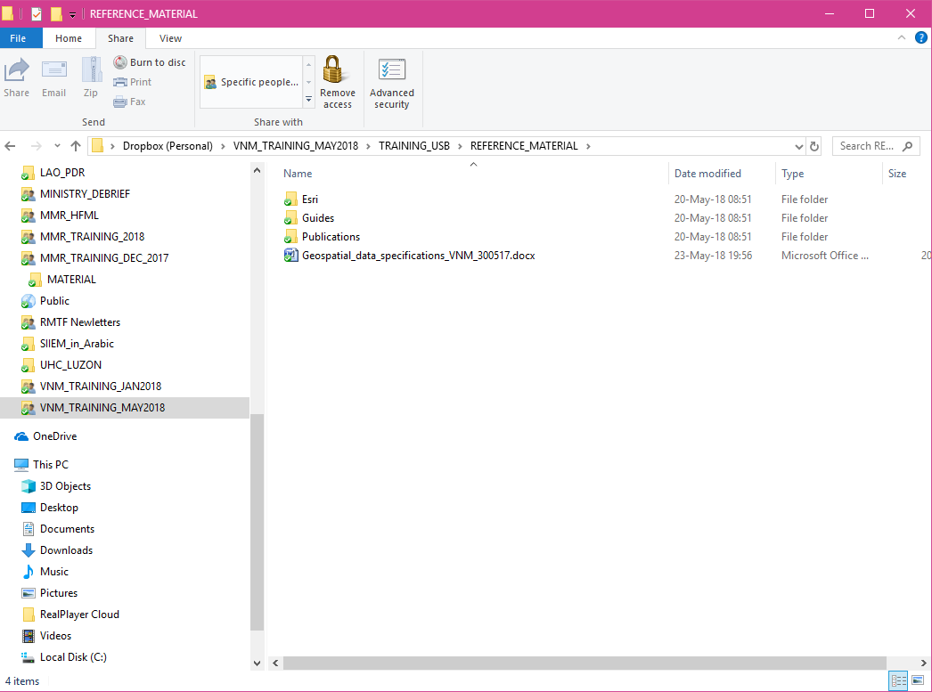
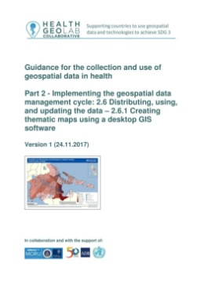
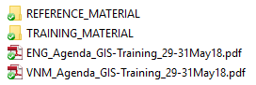
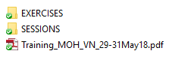




Content of the USB key
Starter
kits
Guides

Slide 13
Acknowledgments
Material used in the training based on the:
Introduction to GIS for Communicable Disease Surveillance Technical Training Workshop (Naypyidaw, 24-25 April and 27-29 December 2017), Introduction to geospatial data management and technologies for PHDs (Kampong Cham, 6 - 8 February 2018) and the Capacity building on the use of Geospatial Data and Technologies For Immunization Planning and Health System Strengthening training (Naypyitaw, 12-16 March 2018)
AeHIN GIS Lab/Health GeoLab Collaborative guidelines: https://healthgeolab.net/resources/reference-materials/
Source of the definitions being used (if not mentioned):
  GIS wiki: wiki.gis.com/wiki/index.php/GIS_Glossary
  Esri GIS dictionary: support.esri.com/en/other-resources/gis-dictionary
  Wikipedia: en.wikipedia.org

Slide 14

Round of introduction and expectations from participants
Name, position, location
Your experience with maps, GIS, GPS,..
Expectations for this training
Thematic mapping ?
GIS ??
Don’t hesitate to ask questions!

