Slide 1
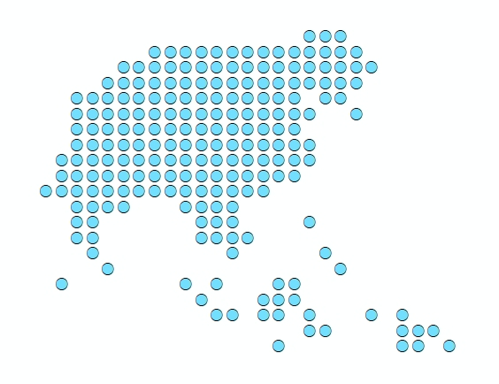
Session 2 –
The microplanning process as currently implemented in Myanmar
Dr Tin Tun Win- MOHS

Slide 2
Defining the Vocabulary
Key terminology used throughout this workshop
Term | Definition
EPI Community | Any inhabited place observed in the country
RHC | Rural Health Centre
SRHC | Sub-Rural Health Centre
Session | Activity of delivering vaccination within an EPI community within a specific time
Crash/REC | Immunization strategy for geographically hard to reach EPI communities
“POPULATION DATA” | Microplanning form including projected population calculated from population headcounts by midwives
“PRIORITIZED AREA” | Microplanning form including data on doses of vaccine administered and unimmunized children recorded by midwives from preceeding 12 months

Slide 3
The Microplanning Process
Microplanning is the process of identify local problems and find corrective solutions to immunization delivery using local data
It was developed and introduced under the Reach Every District (RED) strategy* by WHO, UNICEF and other partners in 2002, later followed by the Reach Every Community (REC) strategy **
Since 2002, several countries worldwide have started implementing RED strategies to varying degrees, and country evaluations in 2005 and 2007 have shown that implementation of the RED strategy results in significantly more infants being reached by immunization services
REC is applied in Myanmar as one of the strategies to address the strategic needs of the Expanded Program on Immunization Multi Year Plan 2017-2021
WHO_REC_Microplanning_guide.pdf
WHO_Microplanning_Immunization_RED_2009

Slide 4
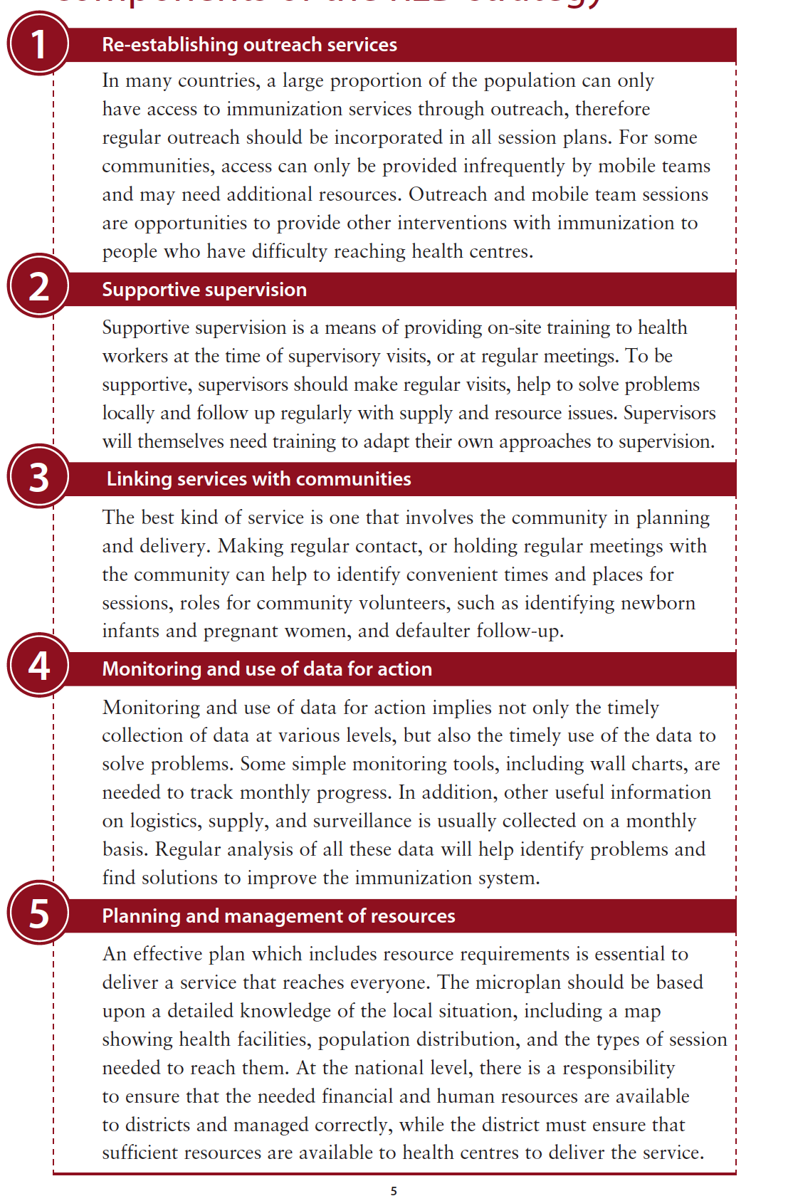
The Microplanning Process
Five main operational components of the RED approach
CYMP 2017-2021
Objective 1:
to strengthen immunization program management, human resources, financing and
service delivery to provide equitable service to all target population including special strategy for peri-urban,
slum, migrant population, geographically and socially hard to reach
Strategy 1.1 ensure every township has an updated “reach every community
Activity 1.1.1 microplanning in townships and state/region with involvement of community
*http://www.who.int/immunization/programmes_systems/service_delivery/red/en/

Slide 5
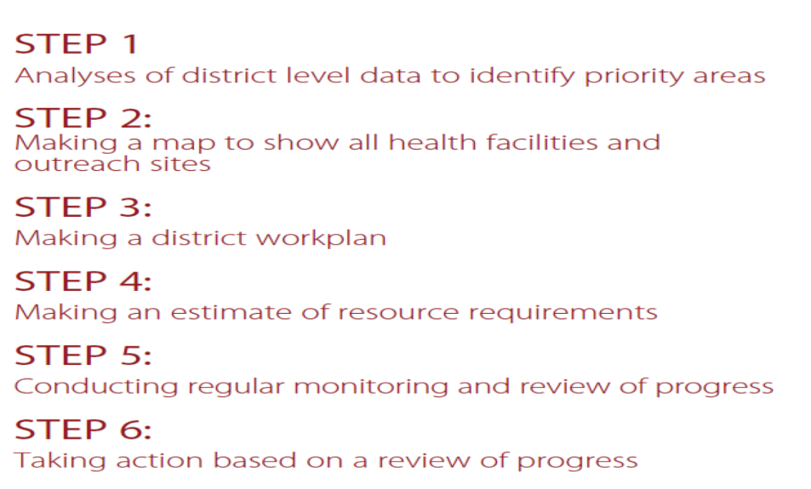
The Microplanning Process
The RED and REC strategies suggests 2 main stages and associated activities:
1) Preparing a health facility microplan
2) Preparing a township microplan
How is this process applied in Myanmar?

Slide 6
The microplanning process as currently implemented in Myanmar
Main stages of the microplanning process in Myanmar
Microplanning Step | What? | When? | At what level? | Who?
1. Collection of target population head counts | Projection of target population to next year | December | RHC/SRHC | Supervisor & Midwives
2. Analysis of Immunization data from preceding 12 months | Prioritize SRHC and communities according to the nr of unvaccinated children | December | RHC/SRHC | Supervisor & Midwives
3. Production/Update of RHC and SRHC maps | Display SRHC areas characteristics (handrawn maps) | December | RHC/SRHC | Midwives
4. Identification of barriers to access and utilization | Identify factors that might be responsible for low performance of vaccination services in priority communities (i) geographic barriers (e.g. distances, rugged terrain, flooded area during rainy season, conflict areas) or (ii) other barriers (e.g. programmatic, socio-economic , community-related issues, etc..) | January | RHC/SRHC | Midwives & RHC Supervisor
5. Identification of solutions and preparation of a workplan | Identify activities in order to solve or overcome barriers (e.g. community sensibilization, better communications with community, provision of transport for vaccinators etc..) | January | RHC/SRHC | Midwives & RHC Supervisor

Slide 7
The microplanning process as currently implemented in Myanmar
Main stages of the microplanning process in Myanmar
Microplanning Step | What? | When? | At what level? | Who?
6. Making a session plan | Choosing immunization strategy (frequency of sessions) and session type for each EPI community depending on target population, accessibility and other logistic considerations | to be completed by end of January | RHC/SRHC | midwives will propose & RHC supervisor will make adjustment
7. Making a session outreach plan | Scheduling dates for each months at which each EPI community of type Mobile, Outreach will be visited based on each community’s immunization strategy, distance/travel times, seasonal accessibility, availability of adequate transport, and other logistic considerations Estimating the supplies of vaccines needed to vaccinate the expected target population on each date | to be completed by end of January | RHC/SRHC | midwives will propose & RHC supervisor will make adjustment
8. Township level monitoring and evaluation for 6-months and annual review | Evaluation the RHC’s performance of previous 1 year (no of unimmunized children, area coverage, session conducted, identify the barriers and potential solutions), review microplans resources, and develop township level annual plan | February | Township | TMO and EPI focus

Slide 8
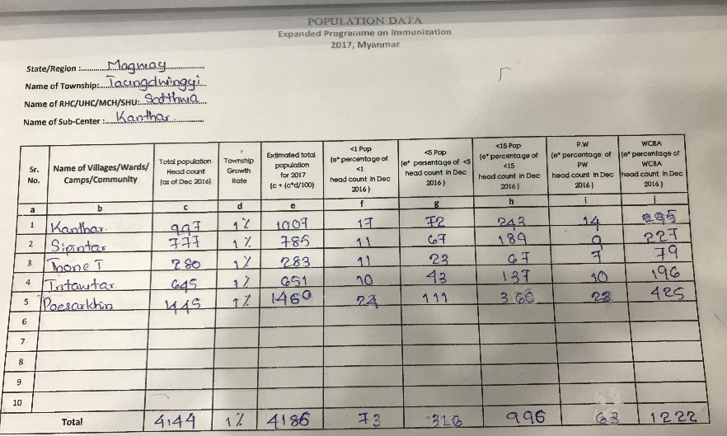
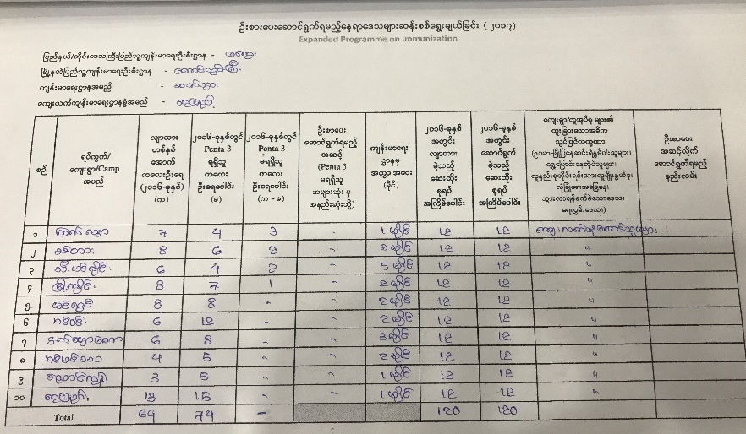
The microplanning process as currently implemented in Myanmar
Forms used to record and report microplanning
1. Collection of target population headcounts
→ Form “POPULATION DATA”
Midwives project target population for coming year using population headcounts and township growth rate
2. Analysis of Immunization data from preceding 12 months
Midwives analyse previous year’s immunization data and assign a priority ranking to each EPI communities according to the nr of unvaccinated children (penta 3)
→ Form “PRIORITIZED AREA”

Slide 9
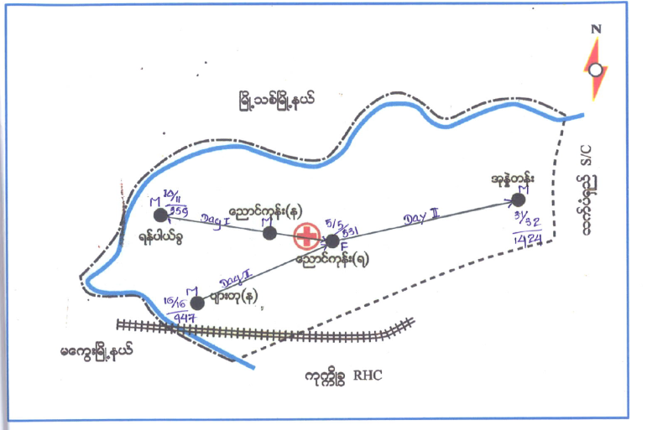
The microplanning process as currently implemented in Myanmar
→ Hand-drawn maps of SRHC areas
3. Production of RHC and SRHC area maps
Midwives update SRHC maps with approximate location of EPI communities, health facilities and geographic characteristics of SRHC areas
4. Identification of barriers to access and utilization
Midwives Identify factors that might be responsible low performance of vaccination services in priority communities (i) geographic barriers (e.g. distances, rugged terrain, flooded during rainy season, conflict areas) or (ii) other barriers (e.g. programmatic, socio-economic , community-related issues, etc..)
→ Form “PRIORITIZED AREA”
5.Identification of solutions and preparation of a workplan
Midwives determine immunization strategy and session type for each EPI community taking into account target population and geographic accessibility issues of each site

Slide 10
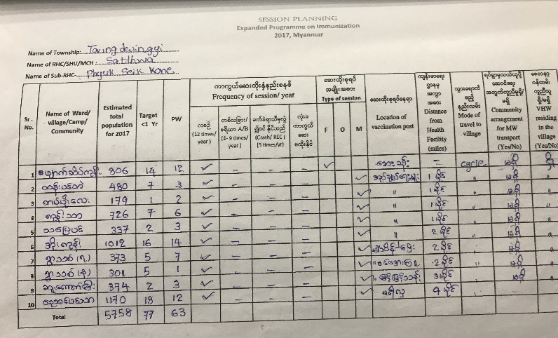
The microplanning process as currently implemented in Myanmar
6. Making a session plan
Choosing a session type and immunization strategy for each EPI community
Session type
Fixed: immunization provided at health facility
Outreach: immunization provided at outreach site in EPI community within 5km distance from SRHC, or reachable within one day
Mobile: Immunization provided at mobile sites in EPI community > 5km distance from SRHC, or not reachable within one day due to difficult accessibility (overnight stay required)
Immunization strategy
Monthly (12 times/year): standard session frequency for all EPI communities
Area A/B (4-9 times/year): selected if resources or logistical constraints limits monthly frequency for specific EPI community
“crash/REC” (3 times/year): for geographically hard to reach EPI communities (difficult terrain, conflict areas)
Uncovered: inaccessible areas
→ Form “SESSION PLAN”

Slide 11
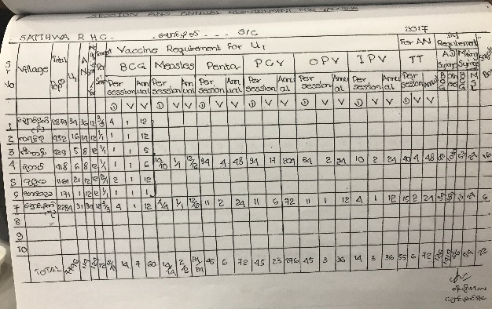
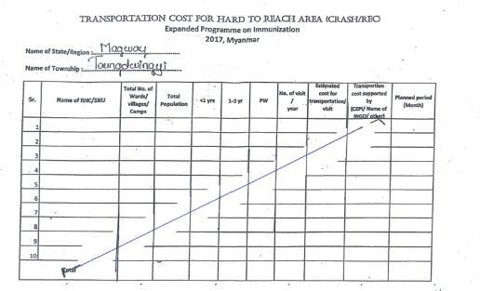
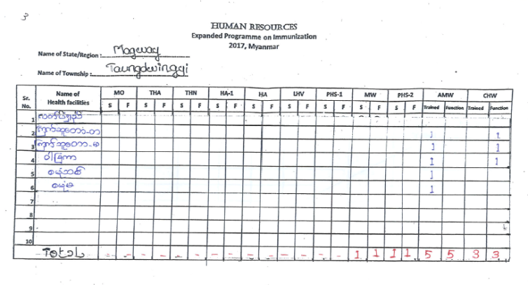
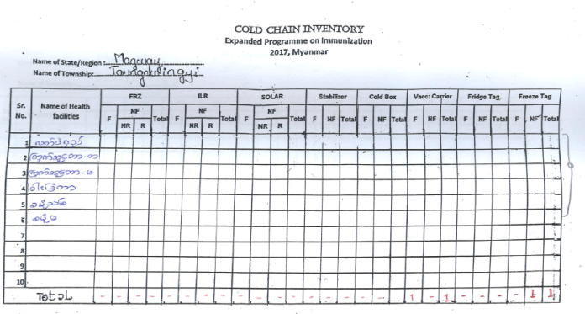
The microplanning process as currently implemented in Myanmar
Outreach session plan
Scheduling dates for each months from Mobile and Outreach session types based on each EPI community immunization strategy, distance/travel times, geographic accessibility, availability of adequate transport
→ Session outreach plan are mainly indicated on Hand-drawn maps of SRHC areas
→ Form ANNUAL VACCINE AND OTHER LOGISTIC REQUIREMENTS
Estimation of vaccine and other logistics needs
Midwives estimate annual supplies of vaccines and other logistics needed to vaccinate the expected target population based on the immunization strategy
6. Making a session outreach plan
→ Form TRANSPORTATION COST FOR HARD TO REACH AREAS
Travel allowance
Midwives calculate travel allowance – currently midwives are getting travel allowance for “crash/REC” sessions
→ Forms HUMAN RESOURCES and COLD CHAIN INVENTORY
Inventory or resources
Human resources and cold chain inventory

Slide 12
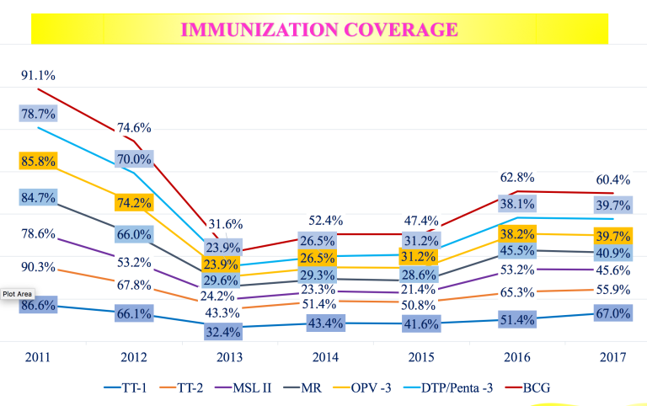
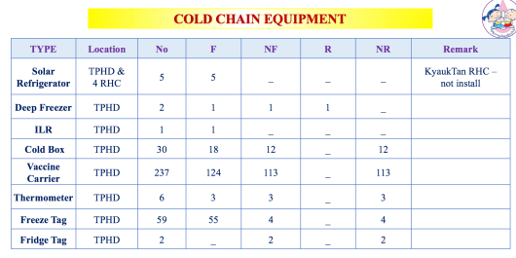
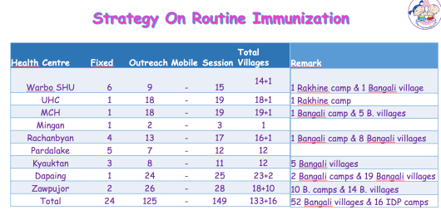
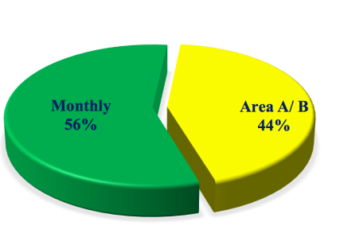
The microplanning process as currently implemented in Myanmar
Microplans are sent to township for township level monitoring & evaluation for 6-months and annual review
POPULATION DATA
SESSION PLAN
PRIORITIZED AREA
8. Township level monitoring & evaluation
ANNUAL VACCINE AND OTHER LOGISTIC REQUIREMENTS
HUMAN RESOURCES
COLD CHAIN INVENTORY
Notes:
Rocco asked about township level monitoring
Microplanning done at the beginning of the year
+ Monthly vaccine request done monthly is done based on the microplannin
(ONLY THESE 3 FORM ARE COMMUNICATED TO RHC) (i) monthly compilation report + (i) annual vaccine request + maps (if necessary)
Confirmed that Finally RHC FORMS ARE THEN SEND TO TOWNSHIP LEVEL that analyse the folowing
NR OF UNIMMUNIZED CHILDREN
% COVERAGE FROM MONTHLY COMPILATION →
COLD CHAIN
Agreed with Nay and Lei Lei to include township level maps:
Agreed with Steve to plot these township level map by attaching information to health facilities, and say that this ahs to be done since we cannot produce reporting division (hold on till new Master list is available) → got most of all the RHC excel data from Lei Lei

