Slide 1
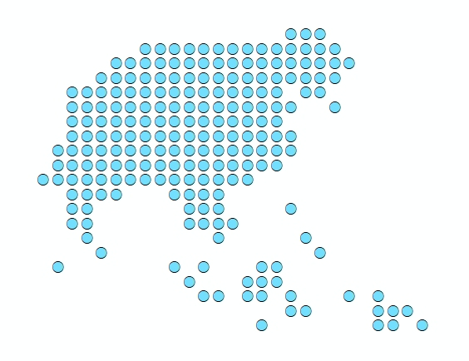
Session 16 –
Recap on the role of the state/regions geospatial data manager
Nay Myo Thu- UNICEF

Slide 2
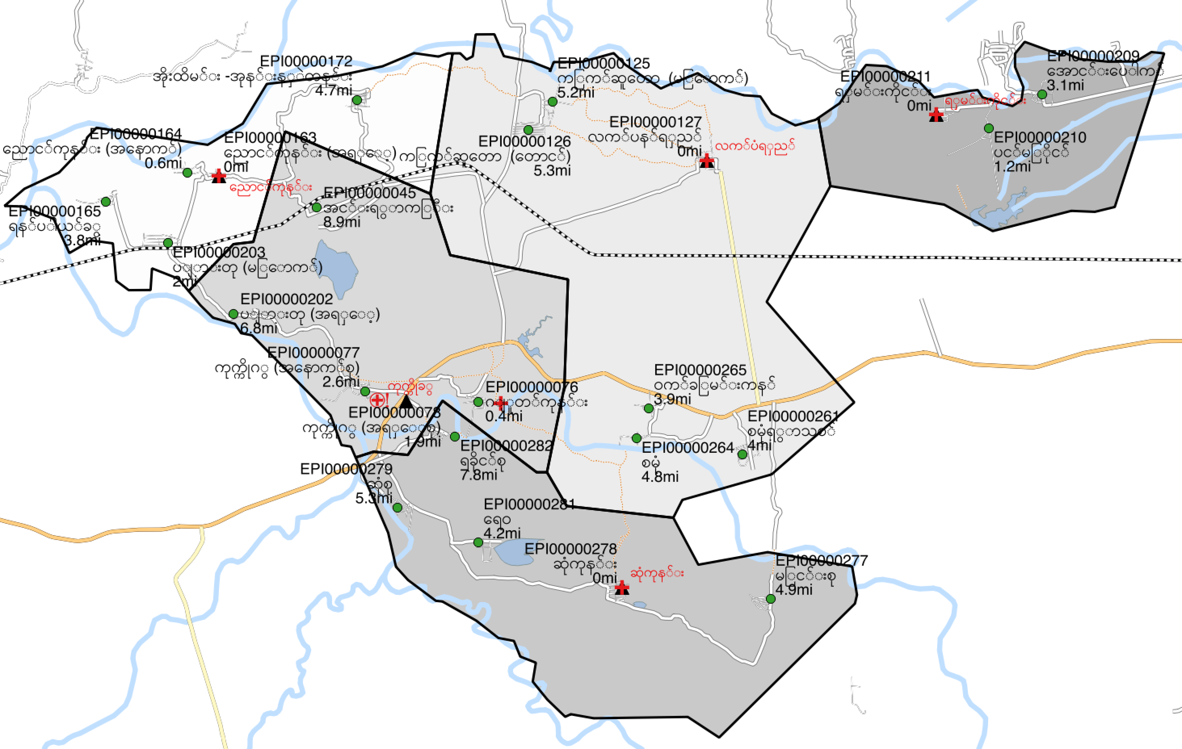
Role during the microplanning phase
Central
State/Region
Township
RHC/SRCH
Central
State/Region
Township
RHC/SRCH
S/R geospatial data manager supports updating of master lists
In collaboration with township focal person
Central level geospatial data manager maintain, complete and regularly update master lists and core geospatial layers + create travel time/distance matrices
-->Before Dec
Updated data communicated to S/R
S/R geospatial data manager undertakes annual update of base microplanning map
Base microplanning maps are distributed to townships
Dec
3. RHC/SRHC personnel use base microplanning maps for decision-making and supervision of microplanning
S/R geospatial data manager answers verification requests using geospatial data & base microplanning maps
Jan
TMO and EPI focal verify and approve microplans using previous 1 year M&E report (including M&E maps)
Feb
Request of GIS support
Microplans
(forms & completed base microplanning map)
S/R EPI officer verify and approve microplans using previous 2 years M&E report (including M&E maps)
Central officer EPI officer verify and approve microplans using previous 2 years M&E report (including M&E maps)
Mar

Slide 3
Role during the microplanning phase
S/R geospatial data manager supports updating of master lists
In collaboration with township focal person
Answer requests from the central level for completing, checking, validating,... information to be included in the health facility and EPI communities master list
When missing, collect the geographic coordinates of health facilities or EPI communities either in the field or through the use of online tools such as google map
Submit request for updates to be implemented in the master lists based on information received from or collected in the field

Slide 4
Role during the microplanning phase
S/R geospatial data manager undertakes annual update of base microplanning map
S/R geospatial data manager answers verification requests using geospatial data & base microplanning maps
Use the master lists, the geospatial data and the travel time/distances matrices provided by the central level to generate the RHC and SubRHC base macroplanning maps
Use satellite images and other geospatial data to answer requests from the Township, Region/State or central level during the microplanning validation process
Map Type 1: Base microplanning maps
Purpose: to support the microplanning process at RHC and SRHC level
Audience: RHC supervisor and SRHC midwives
Medium: hardcopy

Slide 5
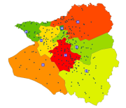
Role during M&E phase
Central
State/Region
Township
RHC/SRCH
Monthly report
(January – June)
Monthly report
(January – December)
Central level EPI officers maintain, complete and regularly update master lists and core geospatial layers
SubRHC/RHC personnel collects population headcounts and immunization data from proceeding 12 months and project target population
June
S/R geospatial data manager produces 6-months M & E Evaluation maps
Current year’s microplans
(forms & completed base microplanning map)
Updated master lists is communicated to S/R
TMO and EPI focal use 6 months evaluation maps to support mid-term EPI evaluation of microplanning
Dec
S/R geospatial data manager produces 12-months M & E Evaluation maps
TMO and EPI focal verify and approve microplans using previous 1 year M&E report (including M&E maps)
Feb
Evaluation maps are distributed to townships
Back to microplanning maps

Slide 6
Role during M&E phase
S/R geospatial data manager produces 6-months M & E Evaluation maps
S/R geospatial data manager produces 12-months M & E Evaluation maps
Use the master lists and the geospatial data provided by the central level as well as the data collected at the Township lel during the implementation of the microplan to generate the thematic maps supporting the 6- and 12-months reviews
Map Type 2: M & E maps
Purpose: to support M&E of microplanning at township level for the 6-months and annual reviews
Audience: TMO and EPI focal
Medium: hardcopy & electronic

