Slide 1
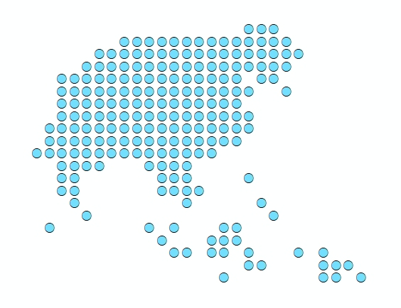
Exercise 2 –
Preparing the EPI program statistical data for the microplanning process
Lei Lei Mon – WHO

Slide 2
Summary
Two types of maps have been identified to support the microplanning process in Myanmar
Map Type 1: Base microplanning maps
Geospatial data:
Location of health facilities with names
location of EPI communities
Transportation networks
Landscape features/geographic barriers (rivers and water bodies)
Boundaries of SubRHC and RHC reporting areas
Attributes:
Distances between EPI communities and health facilities
Attributes
need to be prepared for linking to
geographic objects!
Map Type 2: Monitoring & Evaluation maps
Geospatial data
Location of health facilities
Boundaries of RHC reporting areas
Attributes
Cold chain equipment,
Human resources
RHC performance (e.g. immunization coverage, nbr of unimmunized children, target population)

Slide 3
Summary
Where we are in the process of map production and use
You are here

Slide 4
Summary
Requirements for linking attributes (statistics and/or information) data to geographic objects:
Availability of properly formatted master lists for geographic objects
Availability of properly formatted attributes (statistics and/or information) for input into GIS software
Availability of unique identifiers in the statistics and information data that matches the unique identifiers of the master list of geographic objects

Slide 5
Summary
Data that has been compiled for a focus RHC in Taunwindgyi Township (Koke ko kwha RHC):
Master list of EPI communities (MOHS/cEPI & UNICEF)
Sample table of distances between each EPI communities and each health facilities (MOHS)
Excel template of microplanning forms for sample SRHC
Data placed in the TRAINING_MATERIAL\EXERCISES\ EXERCISE_2\Data folder on your USB key → download data folder on your computer
in the folder you will also find this additional material:
List of formatting requirement for statistic and information data
Paper-based microplanning forms for sample SRHC

Slide 6
Exercise 2 – Part I
Availability of properly formatted master list for EPI communities master list
Open the file in excel (KokeKoKhwaRHC_EPI_Communities_master _list.xlsx)
Look at the structure and content of the file
How many worksheets?
What is in each worksheet?
Identify the following information across the worksheets:
The source of the data
The year of validity
The explanation of the content of each column
The geographic coordinates of each EPI community
Are the data in the data table organized properly to allow its use in a GIS software? → see list of formatting requirements in supportive document

Slide 7
Exercise 2 – Part I (cont’ed)
Availability of properly formatted master list for EPI communities master list
Do the fields included allow to uniquely identify, define, and locate each community?
What do the different color represent?
What kind of entities does “EPI community” refers to?
Does the scheme used for the unique code comply with good practices for choosing an appropriate coding scheme?
No embedded codes or other semantic meaning that could change through time
using a check digit, such as the luhn algorithm (e.g., 1000001-3) or a specific set of characters at the beginning of the sequence (e.g. “HF”)
Notes:
Hint: Using a check digit, such as the luhn algorithm (e.g., 1000001-3) or a specific set of characters at the beginning of the sequence (e.g. “HF”) to avoid the problems linked to having a “0” in front of it

Slide 8
Exercise 2 – Part II
Conversion of AccessMod distances and travel times
Open the file in excel (Sample_table_distance_traveltimes_kokekokhwa.xlsx)
Look at the structure and content of the file
How many worksheets?
What is in each worksheet?
Identify the following information across the worksheets:
The source of the data
The year of validity
The explanation of the content of each column
Are the data in the data table organized properly to allow its use in a GIS software? → see list of formatting requirements in supportive document
Notes:
yes

Slide 9
Exercise 2 – Part II
Conversion of AccessMod distances and travel times
PROBLEM:
The file currently contains the distances and travel times between EPI community in the Koke Ko Kwha focus RHC and an example RHC
For the microplanning maps, we are interested only in the distances and travel times between EPI communities and the health facilities they report to (Level 1)
EXERCISE
Using the printed EPI communities master list as a reference, modified the excel table so that it contains only the records of the distances between EPI community and the health facility they report to
Notes:
NOTE: the name of Nyaung Kone (East) is incorrectly “Samon Thit”. Good if they indicate it

Slide 10
Exercise 2 – Part III
Conversion of scanned paper-based microplanning forms to excel format for focus RHC
Open the pdf filecontaining the form “POPULATION DATA” for Let Pan shae R/C
Look at the structure and content of the tables
Are these tables organized properly to allow the use of population data information in the GIS software? → see list of formatting requirements in supportive document
Notes:
Issues
Complex headers
Wrong headers (name of SRHC instead of EPI community not explained anywhere
Information at the top and bottom of the table
Lack of unique idntifier
Name not available in english

Slide 11
Exercise 2 – Part III (cont’ed)
Conversion of scanned paper-based microplanning forms to excel format for focus RHC
Open the excel template provided “Population_data_Excel_format.xls”
Look at the structure and content of the file
How many worksheets?
What is in each worksheet?
Can you find a clear explanation of the content of each column?
is the data organized properly to allow its use in a GIS software? → see list of formatting requirements in supportive document

Slide 12
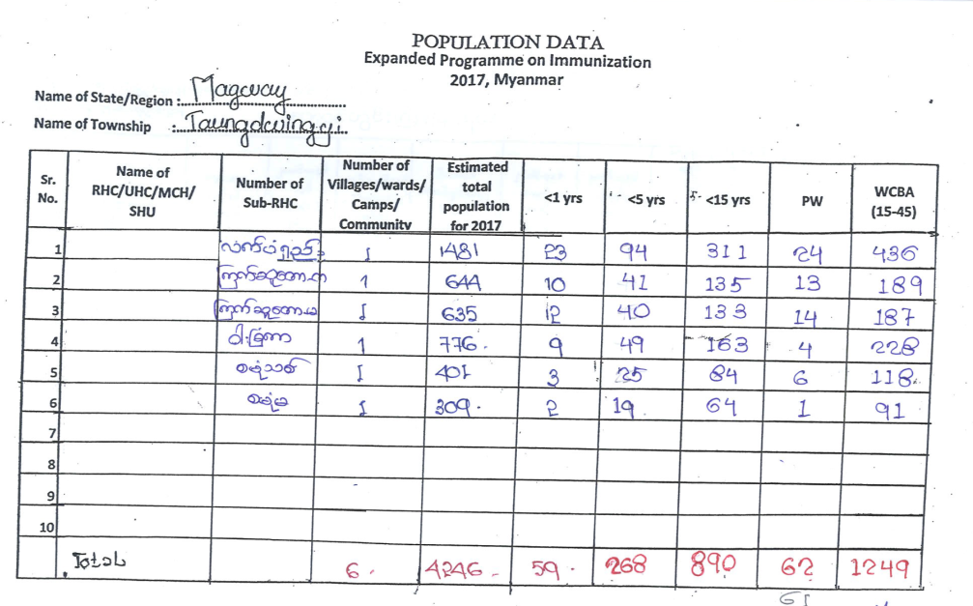
Exercise 2 – Part III (cont’ed)
Conversion of scanned paper-based microplanning forms to excel format for focus RHC
Use the provided excel template to convert the POPULATION DATA from the printed microplan to the excel format
Fill all the field in the template

Slide 13
Exercise 2 – Part III (cont’ed)
Conversion of scanned paper-based microplanning forms to excel format for focus RHC
Did you encounter any issues in doing the matching?
What could have simplified this matching operation?
Notes:
Doubtful due to matching villages misspelling issue, EPI community not uniquely identified as typeBetter would be to have the EPI community code directly in there

Slide 14
Exercise 2 – Part III (cont’ed)
Observations on converting paper-based microplans to excel format
The microplanning form is organized properly for GIS but needs some adjustments to be implemented at the data entry time
Adjust column headers
Eliminate information below and above the table
Including EPI community unique identifier in the form will facilitate data entry and identification of villages
Proper organization of the fields in the template will facilitate data entry
Incomplete EPI community master list can result in inability to match statistical data to geographic objects
Loss of data

Slide 15
Exercise 2 - Conclusion
Re-organizing statistical data that are not properly organized in the first place might be very time consuming and prone to errors
Not using a master list as the reference for data collection and sharing (unique identified, name,…) can results in significant difficulties or loss of data when trying to do the match with a master list

Slide 16
Exercise 2 - Conclusion
It is easy to join the statistics and information data to the corresponding shapefile once the data is well organize and contain the same unique identifier than in the attribute table of the shape file
Statistical information is now ready for mapping!

