Slide 1
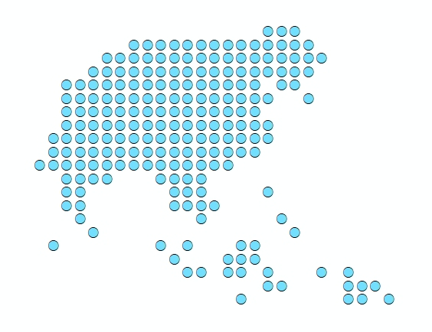
Session 8 - Data for the different analyses over Vanuatu
Port Vila, Vanuatu
3 December 2019

Slide 2
Parameters to ensure data consistency
Parameters used for Vanuatu
Projected coordinate system:
Extent of the study area:
Resolution: 91.9 meters
2

Slide 3
Islands
 | Number of islands
In the shapefile | 202
Unnamed | 47
Included in VNSO’s list | 155
Temporary code | 60
Started from the layer presenting the best match with satellite images (Health zones)
Coastline was cleaned from rivers
Island names and codes have been attributed using the 2009 VNSO shapefile
Last cleaning performed after finalizing the road network layers
3

Slide 4
Administrative boundaries
 | Number of divisions
Provinces | 6
Area Councils (ACs) | 66
Not the current structure
Used the islands shapefile as the starting coastline
Two cases;
Used the 2009 VNSO shapefile for islands with several ACs
Attributed the other islands to the corresponding AC
Merged the ACs to get the Provinces
Provinces
4

Slide 5
Health Zones
 | Number of zones
Health zones | 49
Inaccessible areas | 3
Used the islands shapefile as the starting coastline
Two cases;
Used the Health Zones shapefile from the Ministry of Health for islands with several of these Zones
Attributed the other islands to the corresponding Health Zone
Current situation
Health zones
5

Slide 6
Location of health facilities
Health facility type | Number of facilities
Aid Post | 187
Dispensary | 103
Health Centre | 42
Provincial Hospital | 4
Referral Hospital | 2
Master list updated in collaboration with Provinces
Original geographic coordinates collected from different sources
Coordinates for all the health facilities, except the aid posts, checked using Google map
Potential issues with Aid Posts location
6

Slide 7
Hydrographic network
The OpenStreetMap river network layer has been used as starting point
Used satellite images to:
Make sure no major rivers were missing
Clean any potential major disconnects
Extend the rivers until the sea as considered as barriers
7

Slide 8
Transportation network
The road segments recently collected by the Vanuatu Public Works Department (PWD) have been used as starting point
Segments were reclassified into sealed, unsealed and urban roads
Trails were added from OSM and other datasets
Boat routes were added based on local knowledge and the location of anchor points
Disconnects smaller than 60 m have not been fixed
8

Slide 9
Digital Elevation model
The freely accessible 90 meters resolution Shuttle Radar Topography Mission (SRTM) dataset produced in 2000 by the NASA as been used as the starting point
Altitudes below 0 meters and NoData Cells have been reclassified to 0 meters to allow movement by boat
Reference for all the raster format layers used in the present study
9

Slide 10
Landcover
The landcover shapefile accessible from PCRAFI’s web site has been used as starting point
After rasterization (same resolution as the DEM), the classification has been simplified to align with the travel scenario
The resulting layer has been clipped to the islands coastlines for consistency
Originally extracted from images collected in 2004 but updated with LiDAR data in 2013
10

Slide 11
Population distribution (Total 2019)
Province | Population
Malampa | 42,664
Penama | 34,304
Sanma | 58,519
Shefa | 108,336
Tafea | 39,338
Torba | 10,362
Total | 293,522
The Facebook dataset released for 2018 has been used as the starting point
The grid has been resampled to match the DEM resolution
The whole grid has been adjusted to the AC level population projected for
2019 from the 2016 VNSO
figures
11

Slide 12
Exclusion zones
 | Number
Volcanoes | 6
Two types of exclusion zones have been considered based on information provided by NDMO:
A 3-km buffer from the crater of the 6 volcanoes observed in Vanuatu
A 20-meter buffer from the coastline
Will be used for the scaling up analysis
12

Slide 13
Airports/ Airfields
Type | Number of airports
Commercial | 27
Emergency | 7
The list of commercial flights operated by Air Vanuatu has been used as starting point
The geographic coordinates for each commercial airports was taken from OSM or extracted from Google Map
Additional airfields that could be identified from satellite images were added as emergency airfields
13

Slide 14
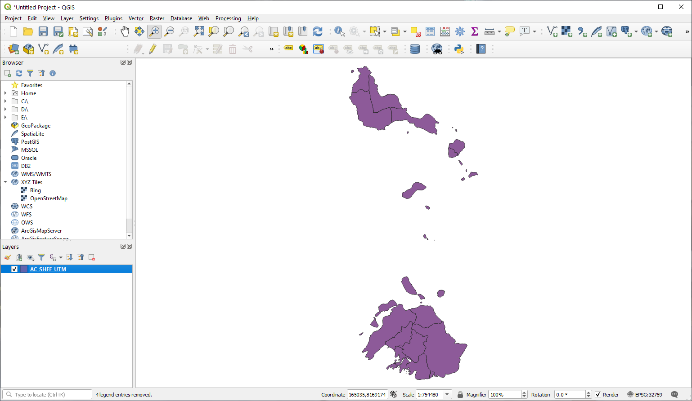
Geospatial data
Let’s have a look at these different layers in QGIS!
We will only cover the Province of Shefa in the context of the present training
Start by copying the TRAINING_MATERIAL\DATA folder from the USB to your computer
14

Slide 15
Checking geospatial data in QGIS
Area Councils shapefile
Launch QGIS
Click the Add Vector Layer button
Browse to the location of the TRAINING_MATERIAL\DATA\ADMIN_DIV folder on your computer
Select the AC_SHEF_UTM.shp file and click on the Add button
Close the Data Source Manager window
The Area Councils for the Province of Shefa should appear in the map canvas of QGIS
15

Slide 16
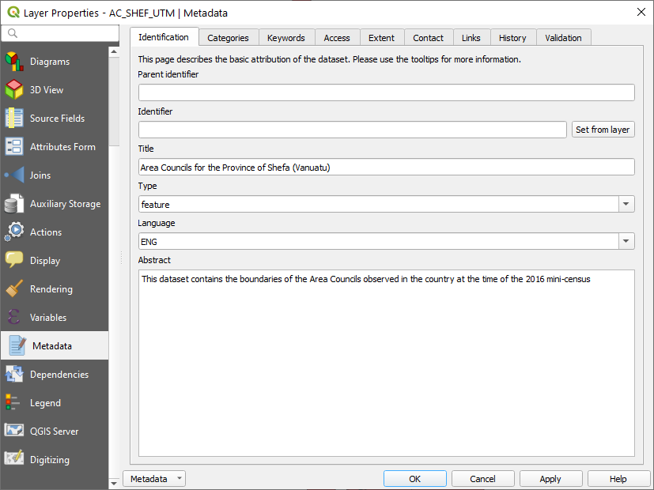
Checking geospatial data in QGIS
Area Councils shapefile
Click on the save icon
Browse to the folder where you want to save your QGIS project
Enter a file name and click Save
Area Councils shapefile - Metadata
Right click on the Area Councils boundaries layer and select properties
Select Metadata in the list and have a look at information reported there
Ideally, all the information you need to know if the data is appropriate for the use should be there or in a separate file provided with the layer
16

Slide 17
Checking geospatial data in QGIS
Area Councils shapefile - Projection
Right click on the layer
Select Properties in the menu
Click on Source
The information about the geographic coordinate and projection system is stored under “Geometry and Coordinate reference system”
Projected layer based on the WGS 84 geographic coordinate system
Check if this matches the specifications set for the project
17

Slide 18
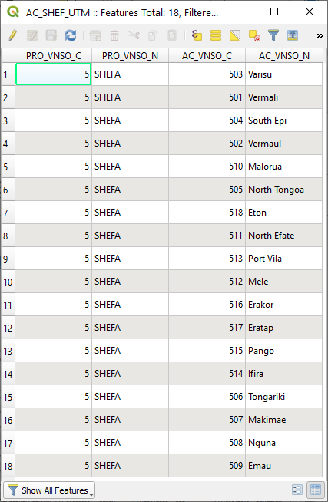
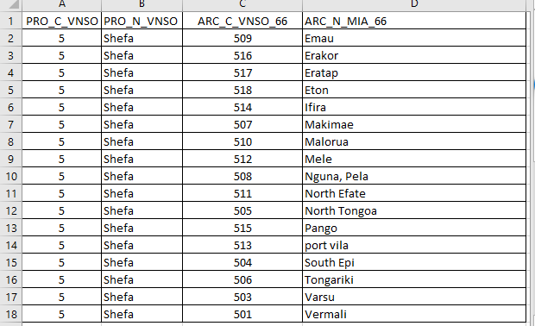
Checking geospatial data in QGIS
Area Councils shapefile – Attribute table
Right click on the layer
Select Open Attribute Table in the menu
Take some time to look at how the attribute table is structured (rows, columns)
Check if the structure reported here corresponds to the one included in the master list (Admin_div_Shefa_260919.xlsx under TRAINING_MATERIAL\DATA\ADMIN_DIV)
18

Slide 19
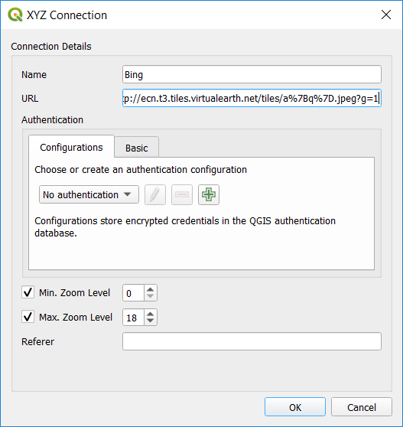
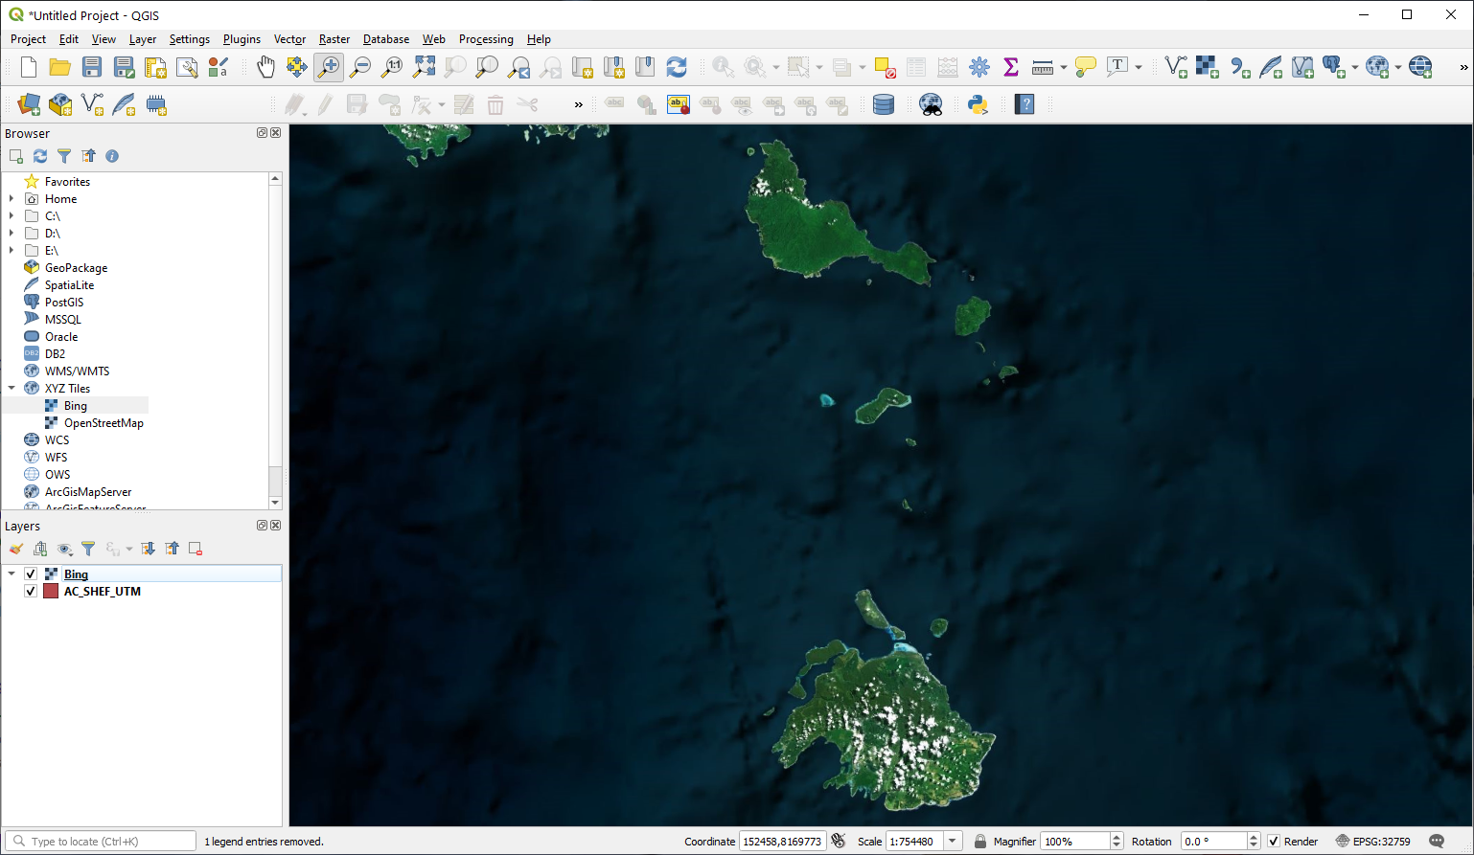
Checking geospatial data in QGIS
Area Councils shapefile – Consistency with the satellite image used as ground reference
In the Browser Panel, right click on XYZ Tiles then choose New Connection…
In the window that opens:
Indicate the name under which you want to see this layer appear in the list
Enter the URL of the WMS you want to use (LINK_BING_SATELLITE.txt file)
Do not change the other settings in the window. Click OK.
Double click on the layer name under the XYZ Tiles
Save the project!
The satellite images should appear in the map canvas
19

Slide 20
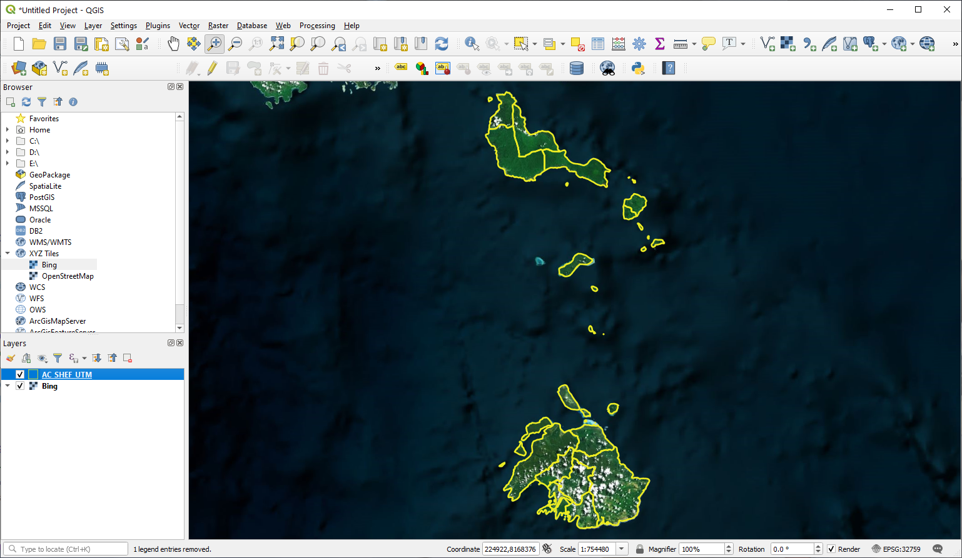
Checking geospatial data in QGIS
Area Councils shapefile – Consistency with the satellite image used as ground reference
Move the satellite image basemap to the back of the Area Councils boundaries
Change the symbology of the Area Councils boundaries layer so that we can see the satellite images through them
Zoom on some areas to visually judge the accuracy of the boundaries and coastlines
Uncheck the basemap and Area Councils layer
Repeat the same process with the health facilities and other vector format layers
Save the project!
20

Slide 21
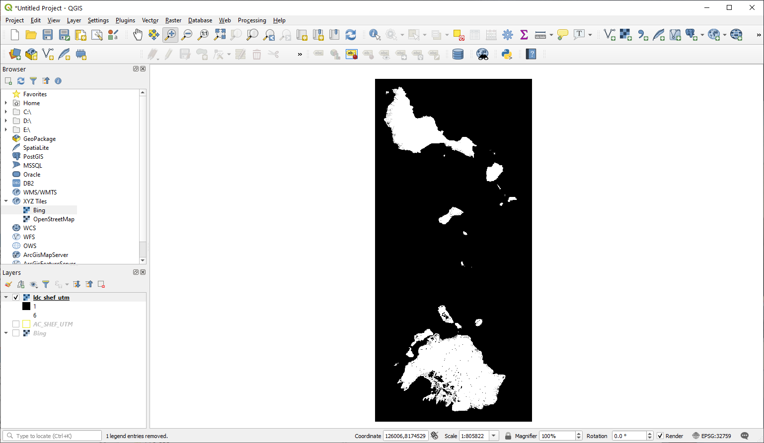
Checking geospatial data in QGIS
Land cover distribution grid
Click the Add Raster Layer button
Browse to the location of the TRAINING_MATERIAL\DATA\LAND_COVER folder on your computer
Open the ldc_shef_utm sub folder and select any of the file you see in there
Click on the Add button
Close the Data Source Manager window.
The Landcover distribution grid should appear in the map canvas of QGIS
21
Save the project!

Slide 22
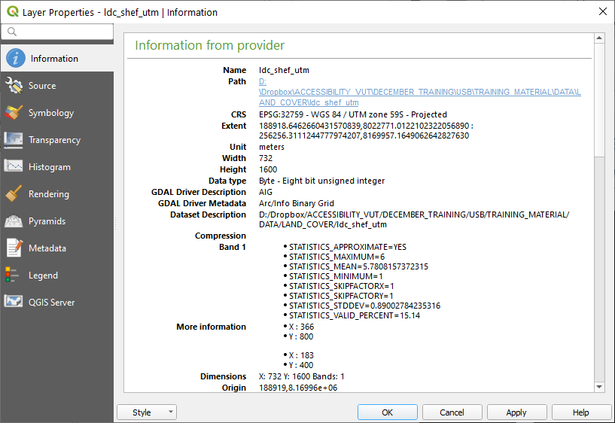
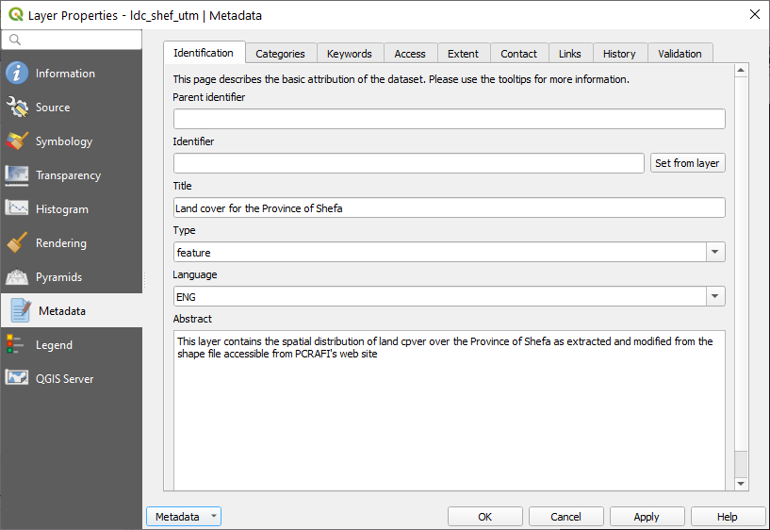
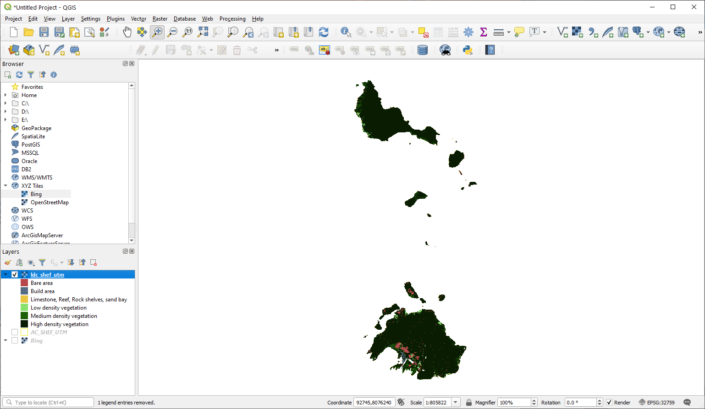
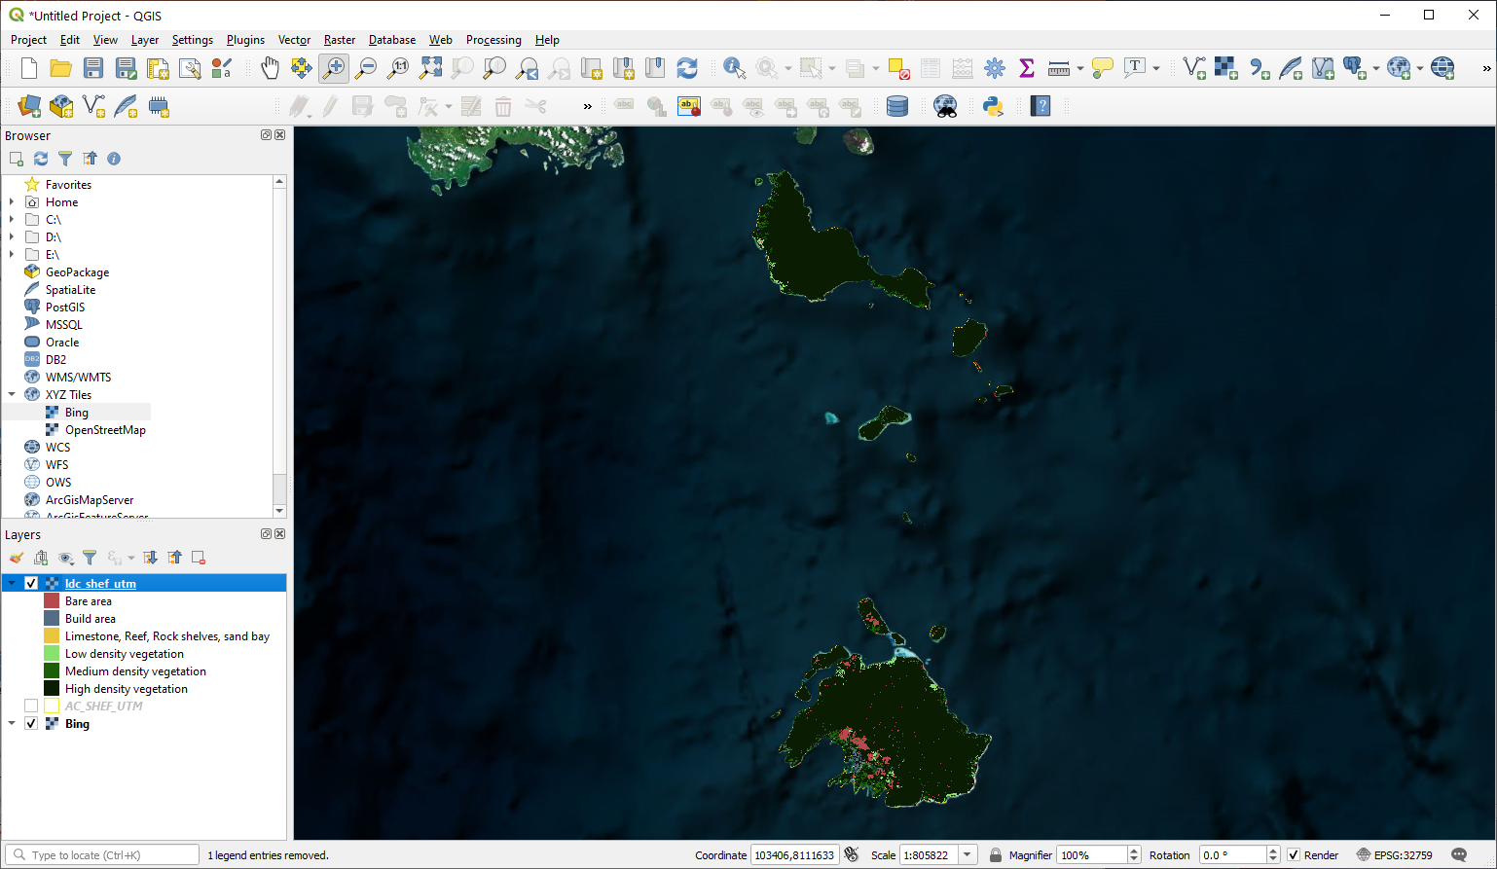
Checking geospatial data in QGIS
Exercise 4 – Part6
Land cover distribution grid – Information and metadata
Right click on the layer
Select Properties in the menu
Click on Information
In the window that opens, identify and check if the following matches the specifications set for the project: CRS, number of cells, resolution
Have a look at the metadata (need to load it)
Change the symbology based on the classification reported in the LDC_table.xlsx file
Check consistency with the satellite imagery
Repeat the same steps for the other raster format grids (DEM, population)
22
Save the project!

Slide 23
Travel scenario and norms
Travel scenarios
Bare/built area: 5 km/h
Walking only
Combined walking + motorized vehicle
Limestone, Reef, Rock shelves,
sand bay: 4
Low dens. Veg. : 4
Med. dens. Veg. : 3
High dens. Veg.: 2
Walk
Use a motorized vehicle
Sealed roads : 50 km/h
Unsealed roads : 25 km/h
Urban roads : 30 km/h
Boat route : 15 km/h
Trail : 5 km/h
Based on expert knowledge and/or report
23

Slide 24
Travel scenario and norms
Norms (MOH Role Delineation policy)
“80% of people in the catchment area can access a health centre or dispensary within one hour (By the most common mode of access eg walking, paddling, truck etc)”
“80% of people in the catchment area can access a health centre within 4 hours (by the most common mode of access eg walking, paddling, truck etc)”
80% of population coverage for different travel time
Used as benchmark in the different analysis
24

Slide 25
Data preparation time
Data availability, quality, and accessibility issues have a big impact on a physical accessibility analysis project
Spending time on improving data quality remains nevertheless key to relevant results
25

