Slide 1
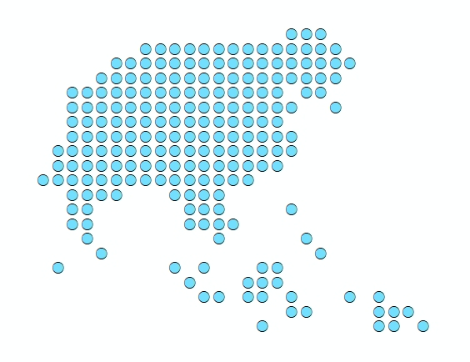
Session 5 - Introduction to AccessMod 5.0 modules
Port Vila, Vanuatu
2 December 2019

Slide 2
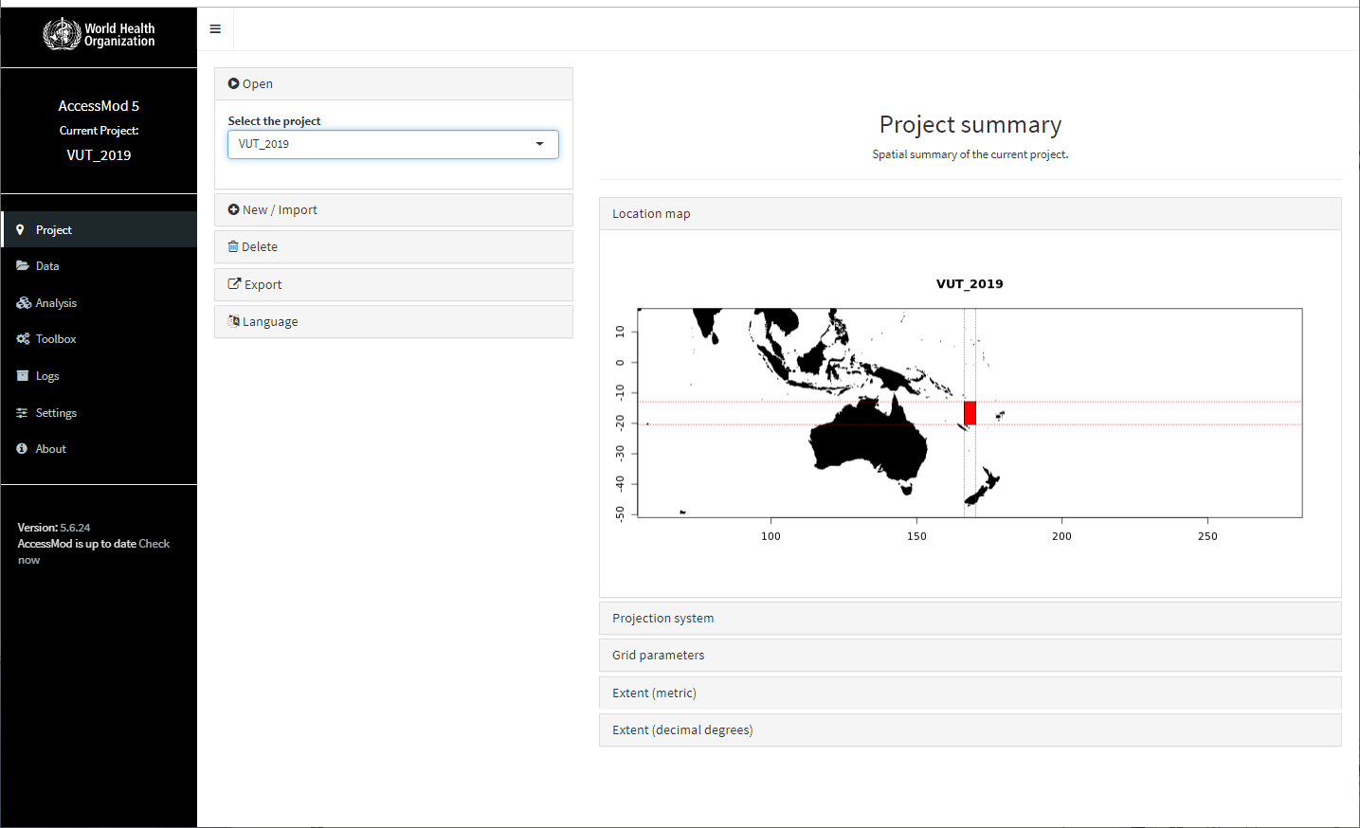
AccessMod 5.0 window, modules, panels and sections
AccessMod window
Panel
Section
Modules
Demo (see Section 5.2 to 5.9 in the user guide)
2

