Slide 1
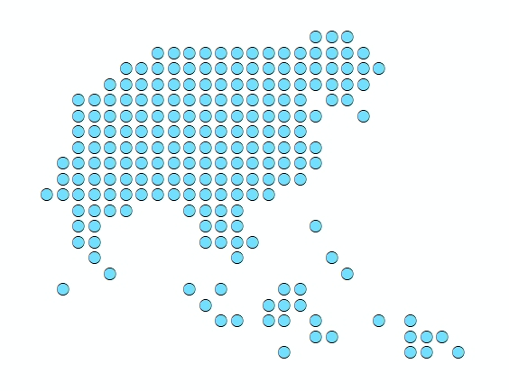


Session 2 - Introduction to the use of GIS-based approaches to measure physical accessibility to health services
Port Vila, Vanuatu
2 December 2019

Slide 2
Why measure physical accessibility to health care services?
Availability of care and physical accessibility to health care services are important components of an overall health system
Measuring such accessibility contributes to a wider understanding of the performance of the health system and the identification of potential gaps
Allows for a better planning of resources to respond to the needs of individuals and communities
Direct impact on health outcomes
Can be transposed to other sectors
2

Slide 3
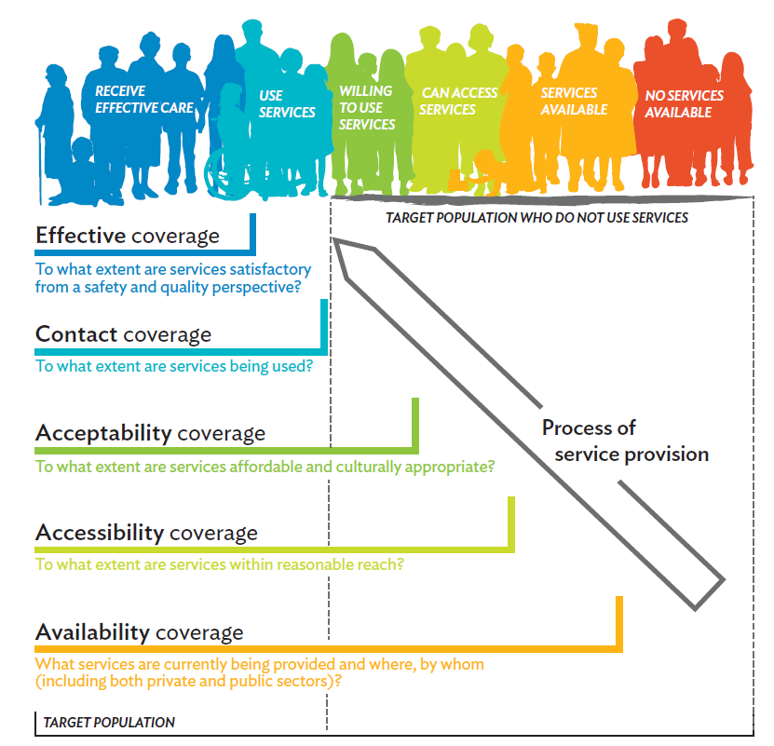
Tanahashi framework (1978)
Strong geographic dimension
Modified from Tanahashi, T. (1978) "Health service coverage and its evaluation", Bulletin of the World Health Organization, 56(2) : 295-303.
3

Slide 4
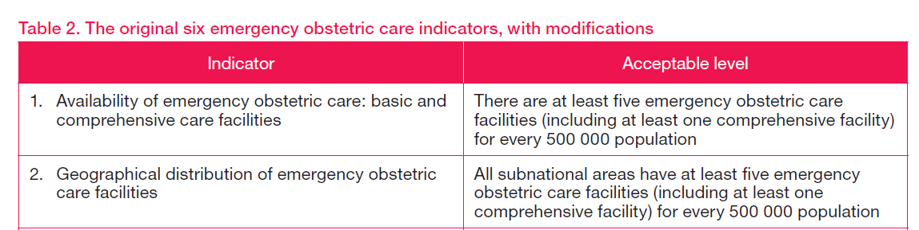
Availability coverage
Measures the availability of the necessary capacity to provide a given service to the target population
Calculation: Ratio between the capacity and the size of the target population
Examples:
Advantage: Easier to measure that the other dimensions from the Tanahashi framework
World Health Organization, United Nations Population Fund, United Nations Children's Fund, Averting Maternal Death and Disability. Monitoring emergency obstetric care: A handbook. Geneva: World Health Organization, 2009.
4

Slide 5
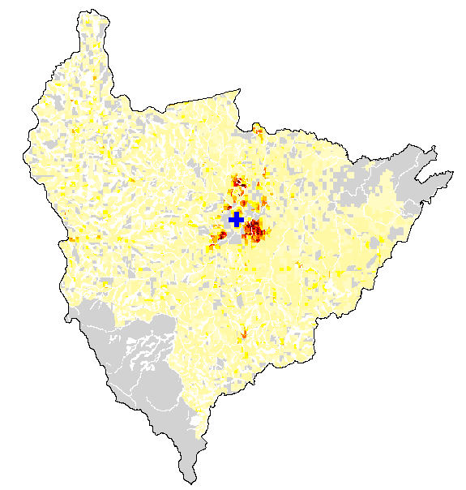


Availability coverage
Major limitations:
These two scenarios give the same ratio while:
  The proportion of the population having access to the service will be different
  This approach considers that the considered country, or administrative division, is a closed system (no cross-border movements
5

Slide 6
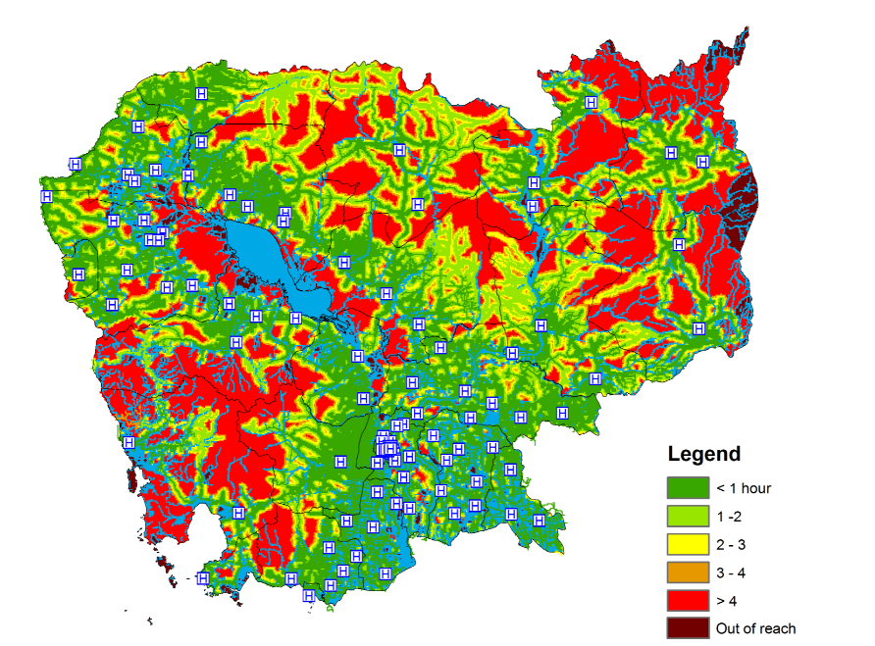
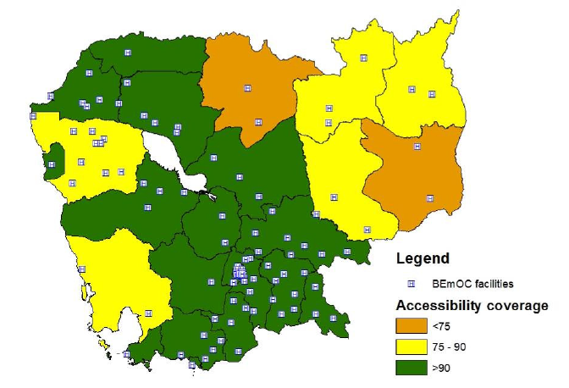

Accessibility coverage
Measures how physically accessible a health service is to the target population
Calculation: Proportion of the target population that can physically access a given health service for a specific travel time (unit: %)
Example:
Travel time to the nearest health facility
Accessibility coverage
World Health Organization, Investing the Marginal Dollar for Maternal and Newborn Health: Geographic Accessibility Analysis for Emergency Obstetric Care services in Cambodia. WHO/HIS/HGF/GIS/2016.2, 2016
6

Slide 7
Accessibility coverage
Advantages:
  The measurement considers:
  How the health services are geographically distributed compared to the spatial distribution of the target population and the environment such population has to cross to reach the services
  Cross-borders movements
Address the major limitations of the availability coverage measure
Major limitations:
  Data intensive approach to measure the spatial distribution of travel time in a realistic way
  Does not take the availability of services into account
7

Slide 8
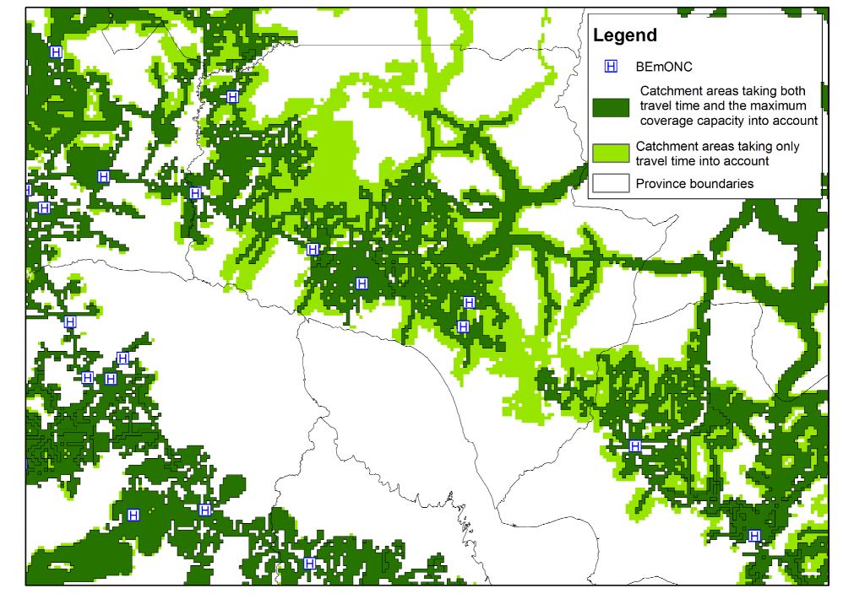
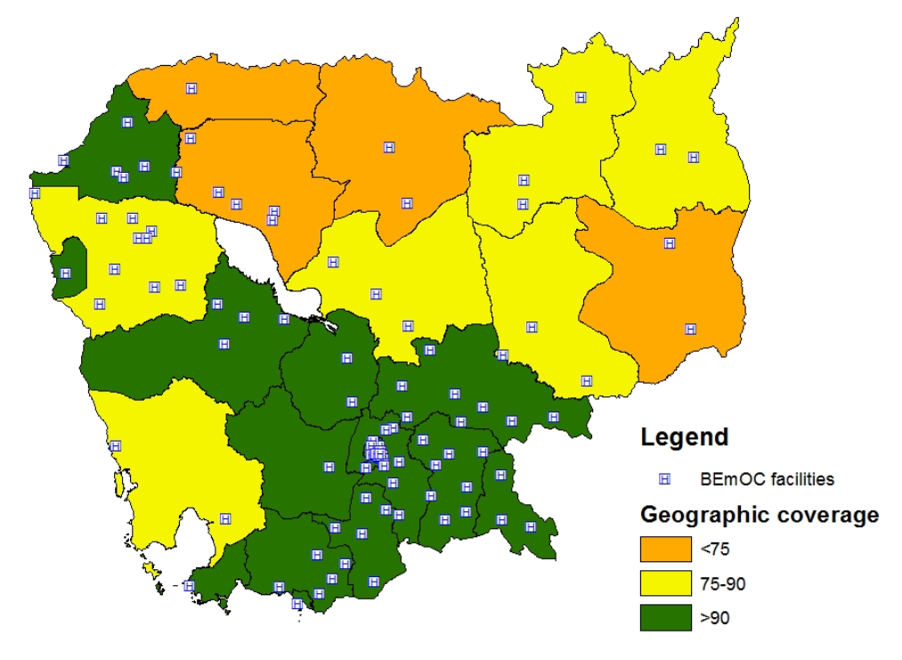
Geographic coverage
Measures how physically accessible a health service is to the target population taking the capacity of each health facility providing the service into account
Calculation: Proportion of the target population that can physically access and receive a given health service for a specific travel time (unit: %)
Example:
World Health Organization, Investing the Marginal Dollar for Maternal and Newborn Health: Geographic Accessibility Analysis for Emergency Obstetric Care services in Cambodia. WHO/HIS/HGF/GIS/2016.2, 2016
8

Slide 9
Geographic coverage
Advantages:
  The measurement considers:
  How the health services are geographically distributed compared to the spatial distribution of the target population and the environment such population has to cross to reach the services
  Cross-borders movements
  The capacity of each health facility
Address the major limitations and complement the measure of the accessibility coverage measure
Major limitation:
  Adds the need to have information about the capacity of each health facility
9

Slide 10
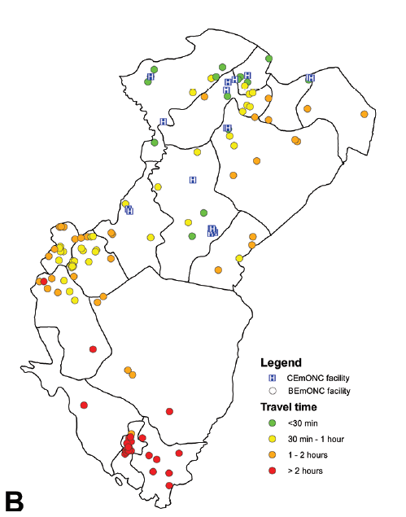
Referral travel time (not in Tanahashi)
Measures how long it would take for a patient to be transported from one given level of care to the upper one in case of emergency
Calculation: Proportion of referral linkages between considered facilities for which the travel time is below a set threshold (unit: %)
Example:
81.5%
7.4%
World Health Organization, Investing the Marginal Dollar for Maternal and Newborn Health: Geographic Accessibility Analysis for Emergency Obstetric Care services in Cambodia. WHO/HIS/HGF/GIS/2016.2, 2016
10

Slide 11
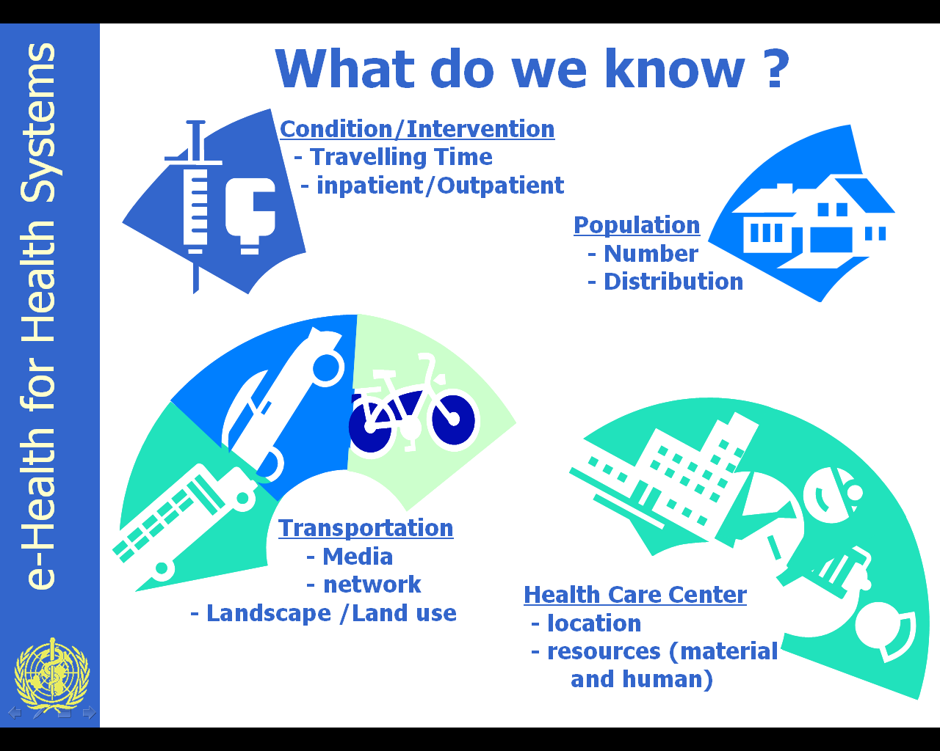

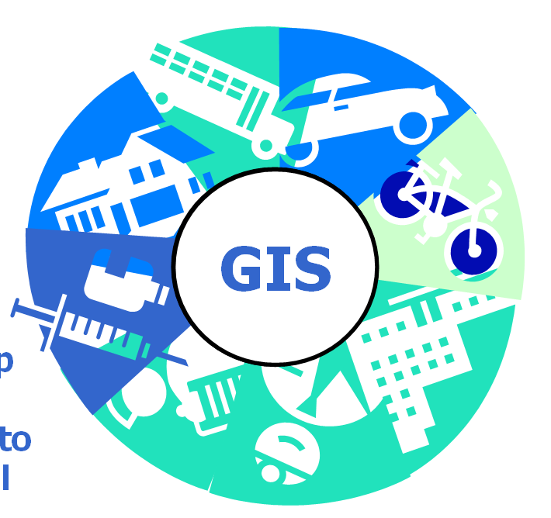
Using GIS-based approaches to measure physical accessibility to health care services
Need to be able to combine different data and information to assess how physically accessible services are
Strong geographic component
Use GIS to take all of
them into account
when measuring physical accessibility
GIS
11
Notes:
Malawi
Rwanda
Nigeria
Mexico
Kosovo
Kazakhstan
Philippines
Kashmir (Inde)
Burkina Faso
Laos
Iran
+ les pays des articles postés sur le site d'AccessMod
The analysis makes use of Accessmod, which is WHO Geographic Information System (GIS) software that works of the standard GIS ESRI ArcGIS platform but performs additional analytical functions, such as examining the capacity of each facility to deliver services, and to run scale up scenarios. These are important functions related to strategic planning and forecasting population health needs.
Accesmod allows for taking into account conjointly the location and the maximum coverage capacity of each health care provider, the geographic distribution of the population, the environment that the patient will have to cross to reach the care provider, as well as the transportation mode s/he will be using, and the capacity of each facility to provide services (i.e., up to a threshold or saturation point).
Over the years, two versions of AccessMod have been freely shared with the public (Version 3.0, released in 2008, has been downloaded more than 1'000 times from ESRI’s ArcScript web site), and Version 4.0 for ArcGIS 9.3.1 has been downloaded 466 times since its release in June 2012, also accessible from ArcGIS online). AccessMod has been used to measure physical accessibility and geographic coverage in many low- and middle income countries including Rwanda, Namibia and Sao Tomé and Principe.

Slide 12
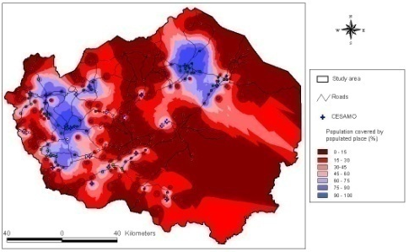
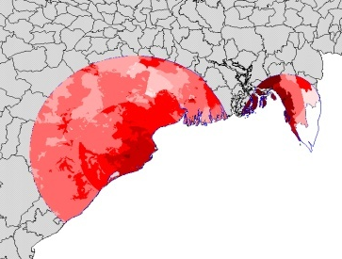
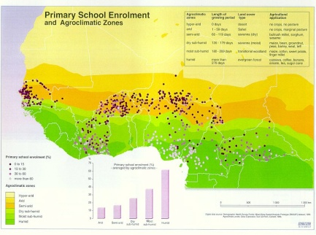
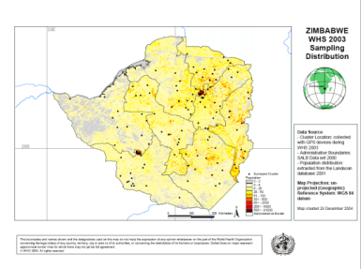
Using GIS-based approaches to measure physical accessibility to health care services
Complexity
Spatial Modelling
Data quality
Physical Accessibility
Poverty Mapping
Hazard Mapping
Spatial Analysis
Location (e.g. altitude)
Distance
Travelling Time
Thematic Mapping
12
Notes:
Spatial Analysis looks at the relationship between geographical objects
Spatial modelling allows us to model phenomena based on geographical information
Poverty and hazard mapping are part of vulnerability mapping

Slide 13




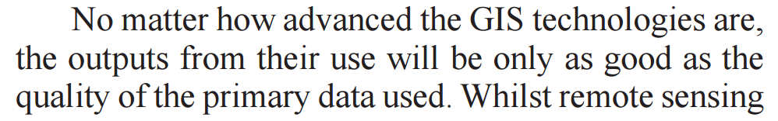
Using GIS-based approaches to measure physical accessibility to health care services
Garbage in
Garbage Out
Model
Mendis K. (2009) Spatial technology & malaria control. Indian J Med Res 130, November 2009, pp 498-500
13
Notes:
Spatial Analysis looks at the relationship between geographical objects
Spatial modelling allows us to model phenomena based on geographical information
Poverty and hazard mapping are part of vulnerability mapping

Slide 14
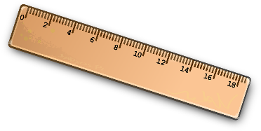
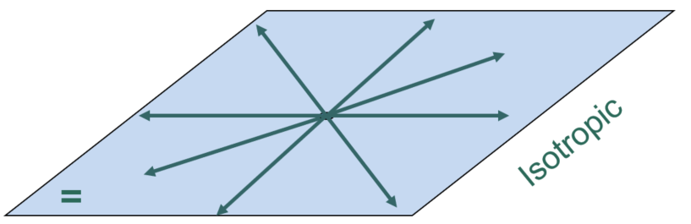
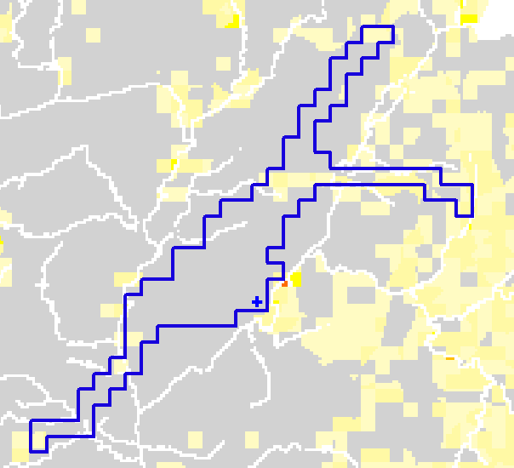
GIS-based approaches to measure physical accessibility to health care services
Few important concepts
Distance versus travel time
Isotropic versus anisotropic movement
Direction of travel
Catchment area
14

Slide 15
GIS-based approaches to measure physical accessibility to health care services
Distance versus travel time
Peoples are better at estimating time than distances
Time is a more comparable measure than distances (e.g.: urban vs rural)
Distance can be derived from geography while time is dependent on the transportation media, condition of the patient and other factors such as climate,...
In emergency context, physical accessibility is being measured in time not in distance
The above advocates for using time and not distance for measuring physical accessibility
15

Slide 16
GIS-based approaches to measure physical accessibility to health care services
Isotropy versus anisotropy
Isotropic
=
Equal in all the directions
Anisotropic
=
Value depends on the direction
16

Slide 17


GIS-based approaches to measure physical accessibility to health care services
Direction of travel
To, from, and round trip
To
From
To = from
Round trip = to + waiting time + from
Will produce different catchment areas
17

Slide 18
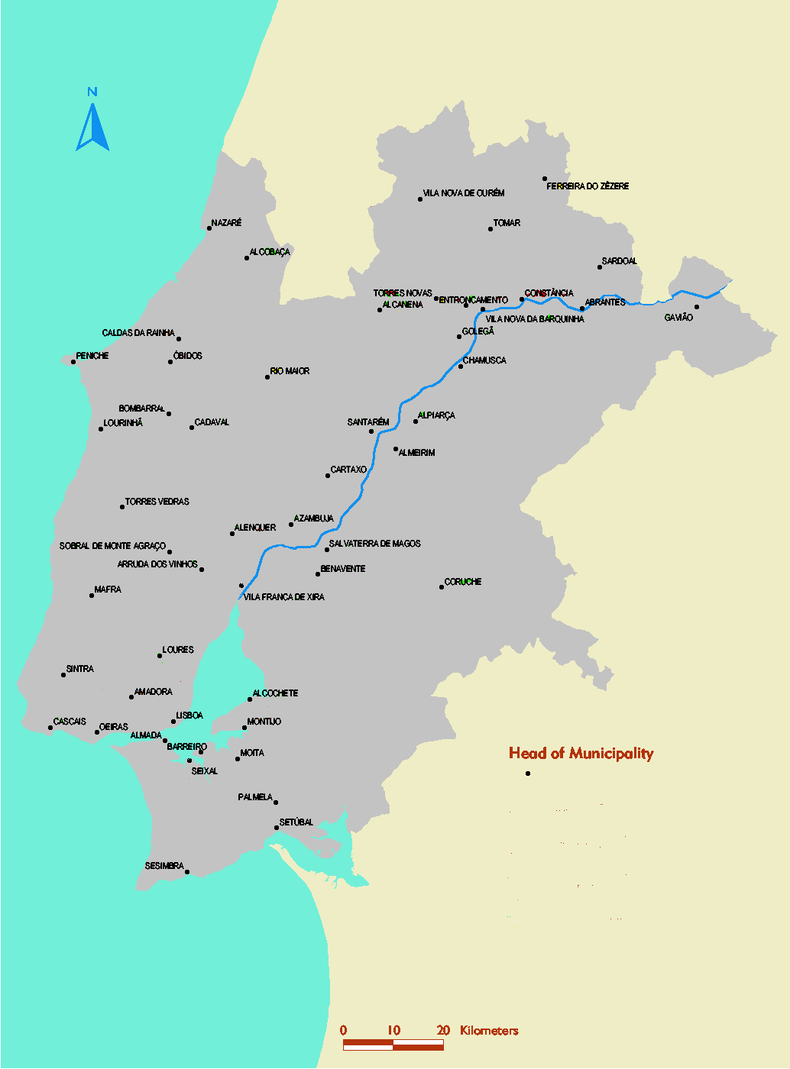
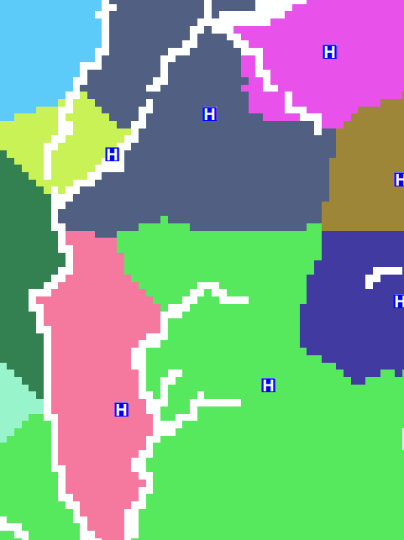
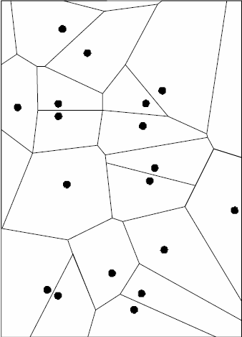
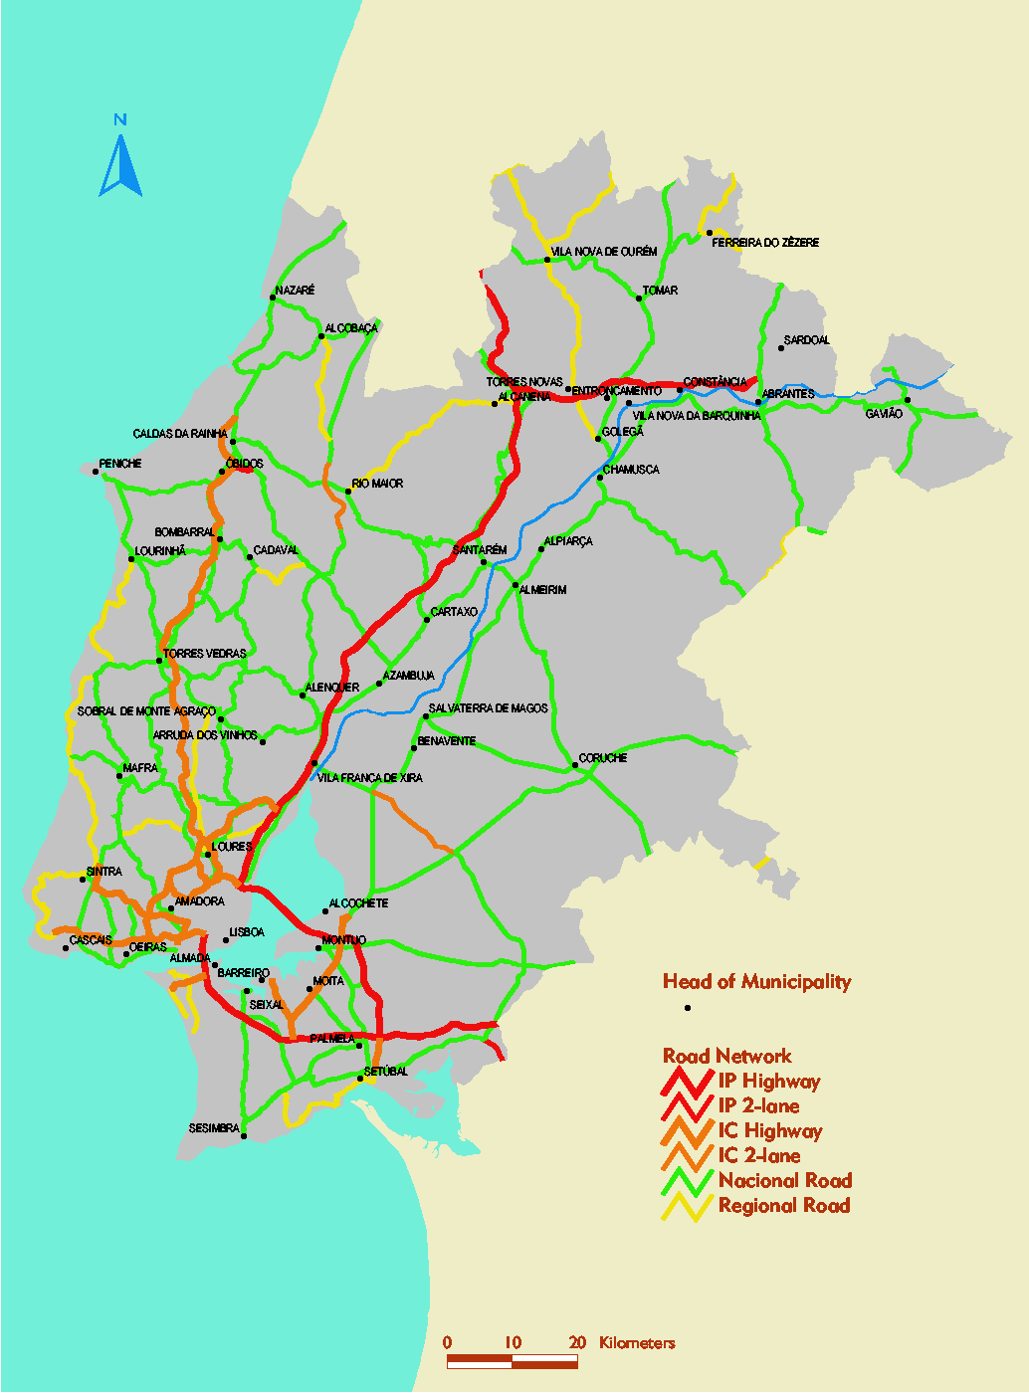
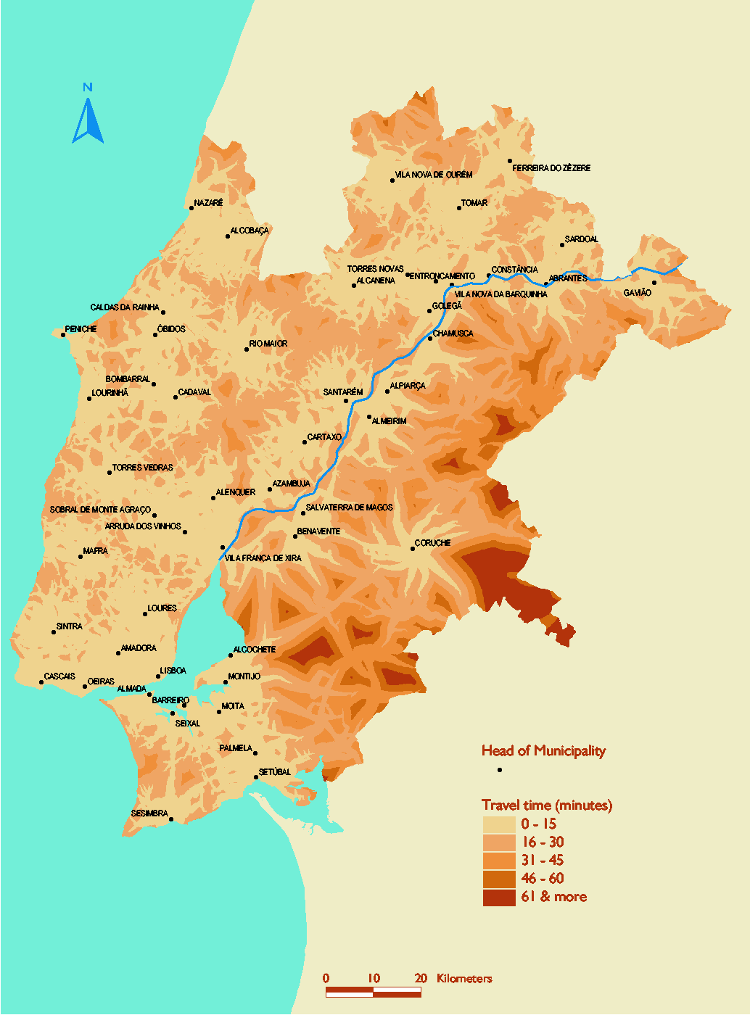
GIS-based approaches to measure physical accessibility to health care services
Catchment area
The area and population from which a city or individual service attracts visitors or customers. ¹
Based on survey data
Spider diagram
Can overlap
Using GIS-based approaches (model)
Distance based
Hybrid
Travel time based
Thiessen polygon
Buffer
Network
Surface
Can overlap
Can overlap
¹ www.wikipedia.org
Can overlap
18

Slide 19
GIS-based approaches to measure physical accessibility to health care services
Catchment area – Spider diagram
Need:
A survey to identify the point of origin and the health facility visited (household or patient exit survey)
Geographic location of the point of origin (e.g household)
Geographic location of the visited health facilities
Main advantage:
Gives an illustration of the extent of the “real” catchment area
Major limitation:
Requires an important field data collection exercise to get a representative picture
19

Slide 20
GIS-based approaches to measure physical accessibility to health care services
Catchment area – Thiessen Polygons
Not designed based on a maximum distance or travel time
Need:
Geographic location of the considered health facilities
a GIS software able to draw the Thiessen polygons (Voronoi diagrams)
Main advantage:
Indicates which facility is the closest in terms of distance from any point in the study area
Major limitation:
Does not take into account the environment crossed by patients, including barriers to movements
20

Slide 21
GIS-based approaches to measure physical accessibility to health care services
Catchment area – Buffer
Need:
Geographic location of the considered health facilities
Maximum travel time to reach the nearest health facility => distance (speed)
A GIS software to draw the buffers around each health facility
Main advantage:
Easy to implement once we have the location of the facilities
Major limitations:
Only realistic in flat areas and where everybody is traveling by foot ! Does not take barriers into account
21

Slide 22
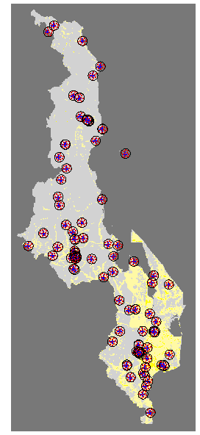
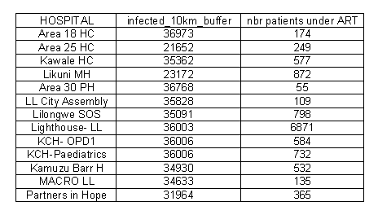
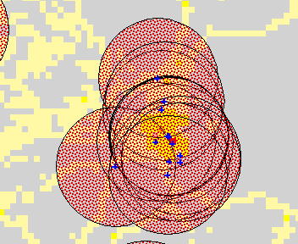
GIS-based approaches to measure physical accessibility to health care services
Catchment area – Buffer
Major limitations:
Managing the overlaps between buffers
Counting the same person several times !
22
22

Slide 23
GIS-based approaches to measure physical accessibility to health care services
Catchment area – Network
Need:
Geographic location of the considered health facilities
The road network
A travel scenario
A GIS software/tool able to perform network analysis
Main advantage:
Realistic in countries where most of the population use the roads to reach health care (bus, car, motorcycle,..)
Major limitation:
Does not cover areas not connected to the road network
Good for referral analysis
23

Slide 24
GIS-based approaches to measure physical accessibility to health care services
Catchment area – Surface
Need:
Geographic location of the health facilities
Digital Elevation Model (DEM)
Road network
Landcover distribution
A travel scenario
A GIS software/tool to generate the travel time distribution grid
Main advantage:
Allows covering the whole study area and any travel scenario that could be considered
Major limitation:
Data intensive approach
24

Slide 25
GIS-based approaches to measure physical accessibility to health care services
Catchment area – Surface
Two types of catchment areas that can be drawn from the travel time distribution grid
Time-based “Voronoi” diagram
Catchment area for any given facility and travel time
Closest facility in terms of distance from any point in the study area
Health facility specific catchment area
25

Slide 26
GIS-based approaches to measure physical accessibility to health care services
Combining different approaches allows to have a complete picture of the situation
Axis
X: travel time expressed in minutes
Y: percentage of total considered population
ART
patients
Curves
Example of spatial distribution of the prevalence population according to the travel time to the nearest ART site (model)
Prevalence
population
Example of spatial distribution of the ART patients according to the travel time they took in the reality (survey)
26

Slide 27
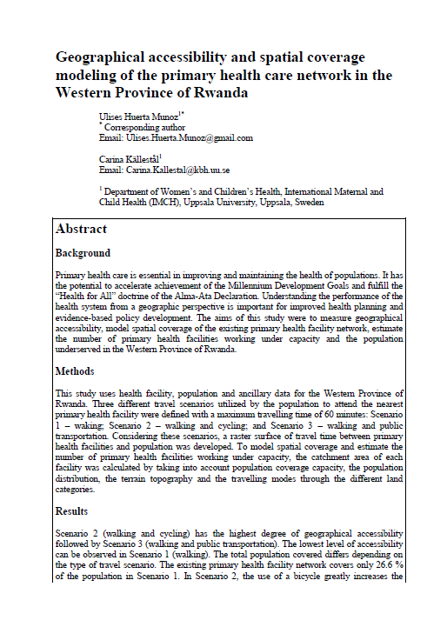
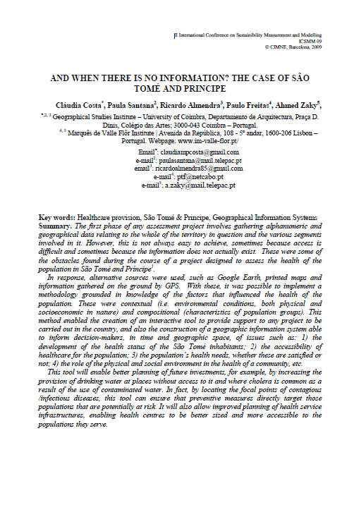


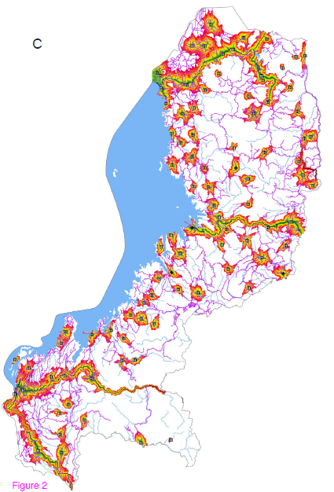
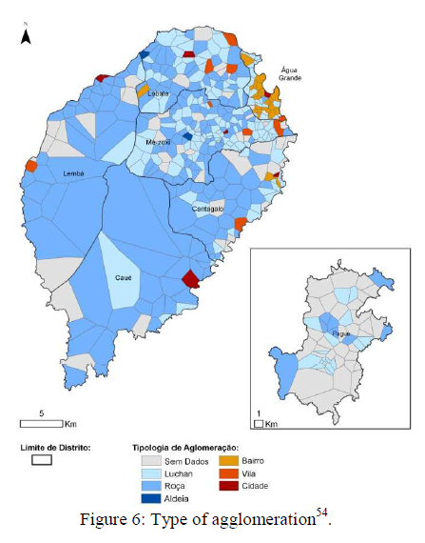
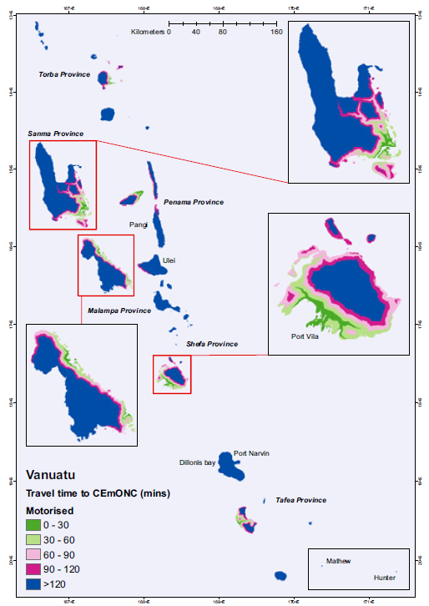
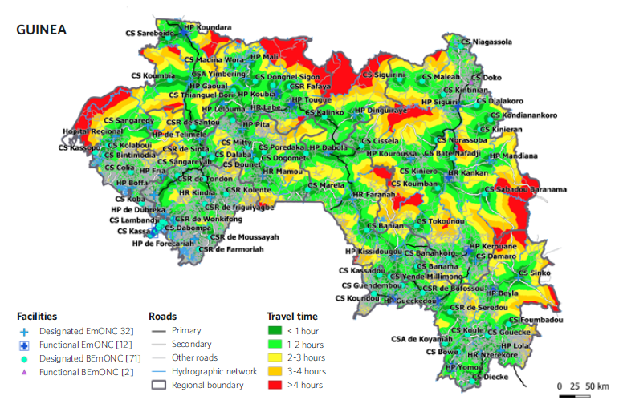
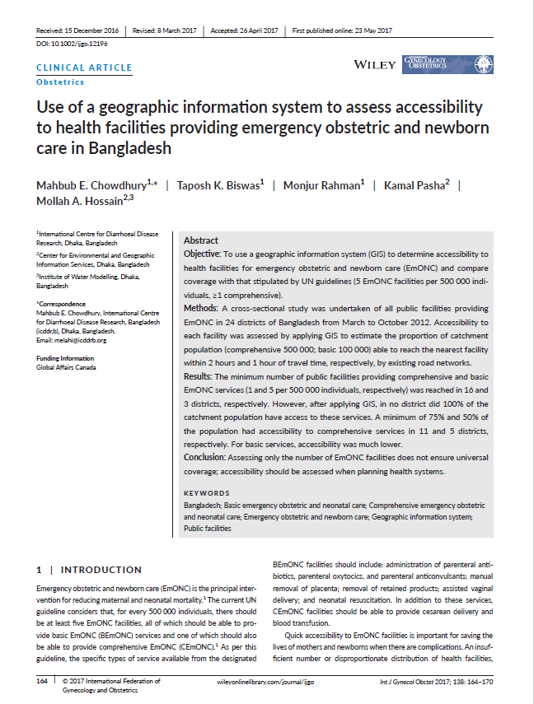
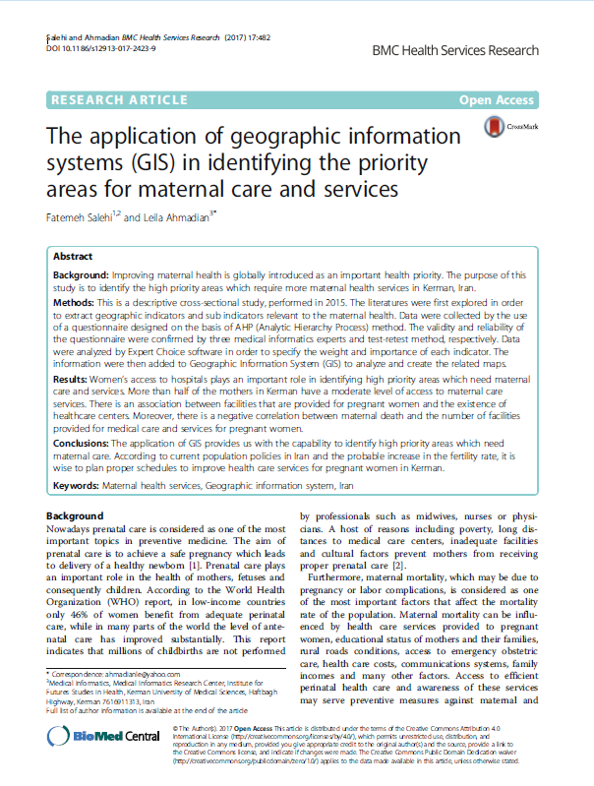
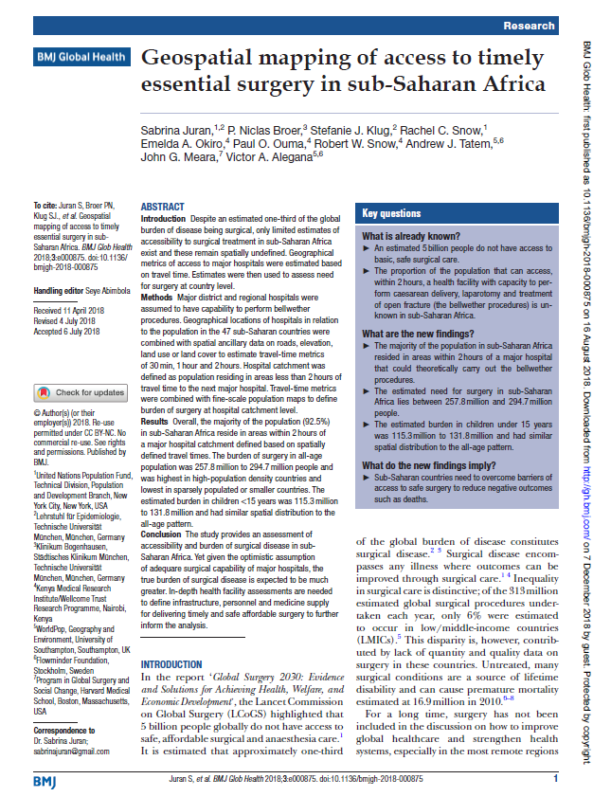
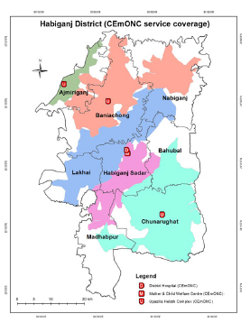
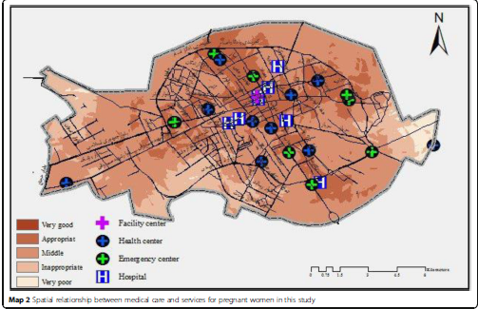
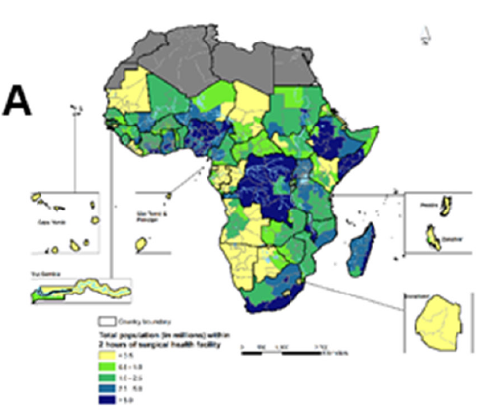
GIS-based approaches to measure physical accessibility to health care services
Increasing bibliography on this topic
27

Slide 28
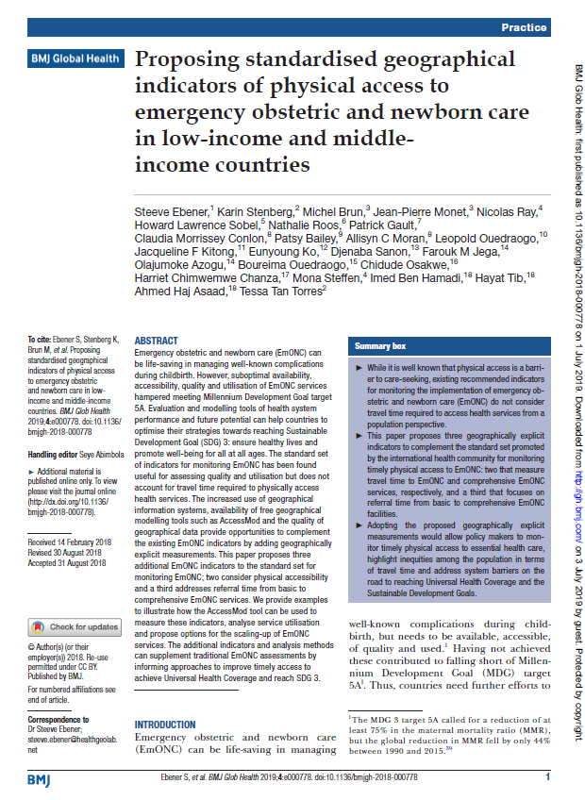
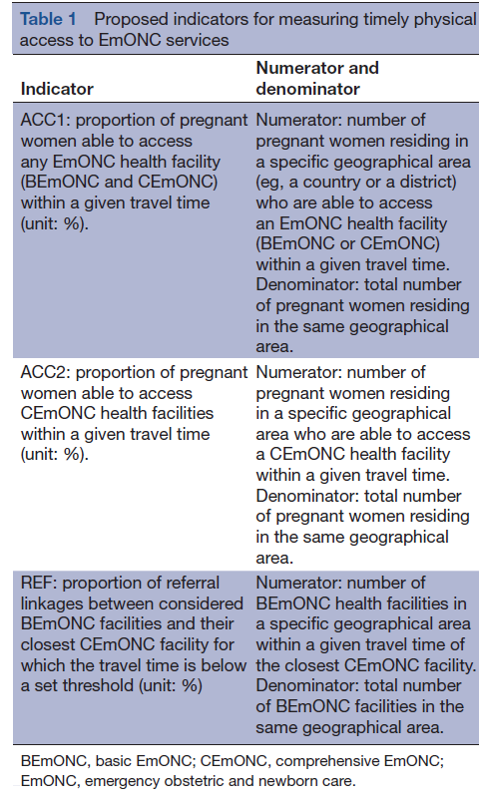
GIS-based approaches to measure physical accessibility to health care services
Increasing bibliography on this topic
Indicators similar to those
used in the present study here in Vanuatu
28

