Slide 1
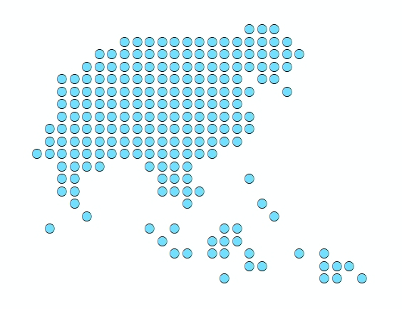


Recap of the third day
Port Vila, Vanuatu
5 December 2019

Slide 2
What did we do yesterday?
Prepare the parameters for the geographic coverage analysis
Run the geographic coverage analysis for the Health centres and Dispensaries and look at the results
Run the referral analysis between the Health centres and the nearest Hospital
??
Any questions?
2
Notes:
What is QGIS?

Slide 3
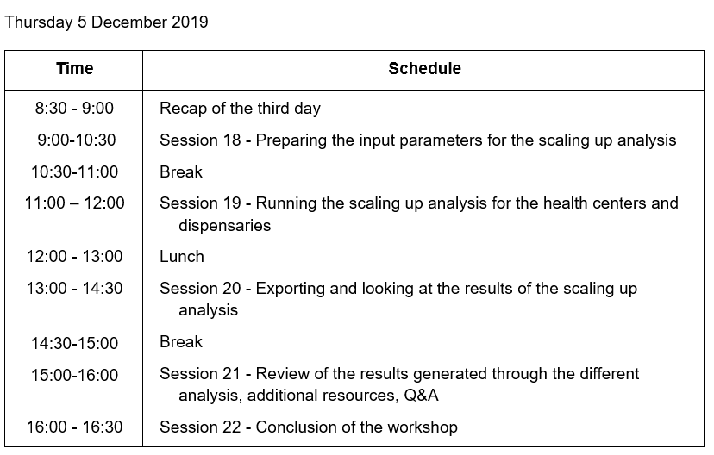
Agenda – Day 4
Scaling up analysis
3

Slide 4
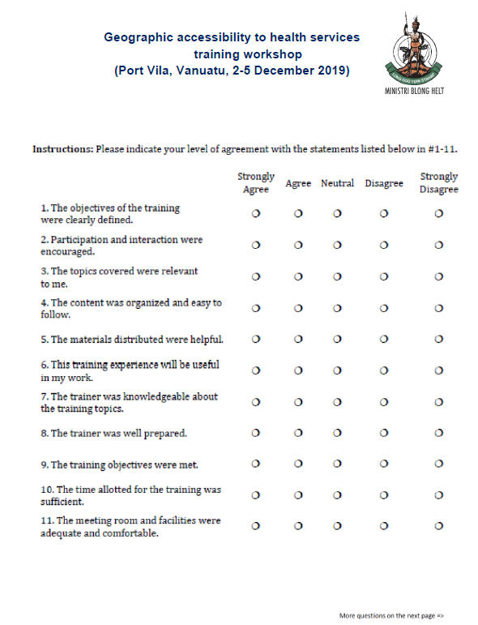
Evaluation form
2 pages
4

Slide 5
Session 18 – Preparing the input parameters for the scaling up analysis
Port Vila, Vanuatu
5 December 2019
5

Slide 6
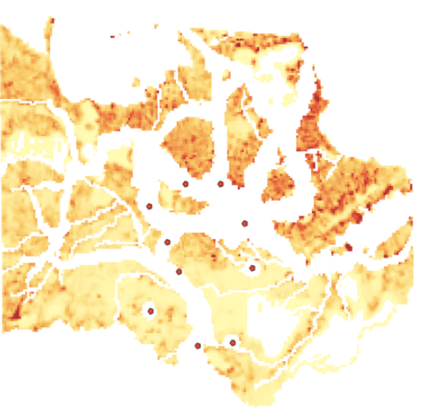


Scaling up analysis
47% of Coverage
??
What are the most suitable locations to build new health facilities to reach a given geographic coverage (80% for example)?
6

Slide 7


Geographic coverage analysis
Input parameters
Exclusion areas
Areas in which no new health facilities will be located
Can be defined in two ways in AccessMod, namely by using:
The vector or raster format layers imported as exclusion areas in the project (see Section 3.3.1.5 in the user guide).
The location of the health facilities, including the new ones being located at each iteration during the analysis.
What has been considered so far in the case of Vanuatu:
3 Km buffer from an active volcano crater
20 m from each island coastline
Anything else to be considered?
7
Notes:
What is QGIS?

Slide 8
Geographic coverage analysis
Input parameters
Suitability index
Used to determine which areas are the most suitable to locate new health facilities
Can be defined by combining the spatial distributions of the following suitability factors into a single suitability index layer:
Sum of population within a radius (in kilometers) | Euclidean distance from features (e.g., roads, existing facilities) | Travel time to/from features | Generic priority map
Allows to consider sites with the highest neighbouring population density as being the most suitable for locating a new facility | Allows, for example, to consider the sites close to roads as being the most suitable for locating a new facility | Allows, for example, to consider sites located far away from already-existing health facilities as being the most suitable for locating a new facility | Allows, for example, to consider that districts with a particular prevalence are the most suitable for locating a new facility
Possible to define if higher values in the factor distribution layer are to be considered as more or less suitable for locating a new facility
8
No criteria being defined for the moment for Vanuatu
Notes:
What is QGIS?

Slide 9
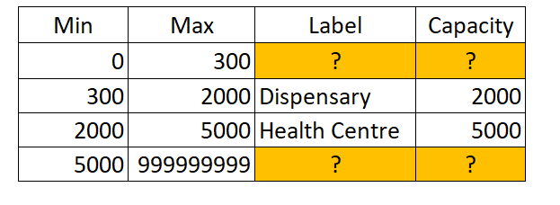
Scaling up analysis
Input parameters
New health facility information table
Table containing the following information about the different types of health facilities to be added during the analysis:
Min: minimum population that should be covered by the specific type of health facility in order to be cost-effective
Max: maximum population that should be covered by the specific type of health facility in order to be cost-effective.
Label: type of health facility considered for the specified range of population located in the catchment area (min and max fields)
Capacity: Maximum population coverage capacity attached to the health facility type
Current values for Dispensaries and Health centres (RDP):
How to fill the blanks?
9
Notes:
What is QGIS?

