Slide 1
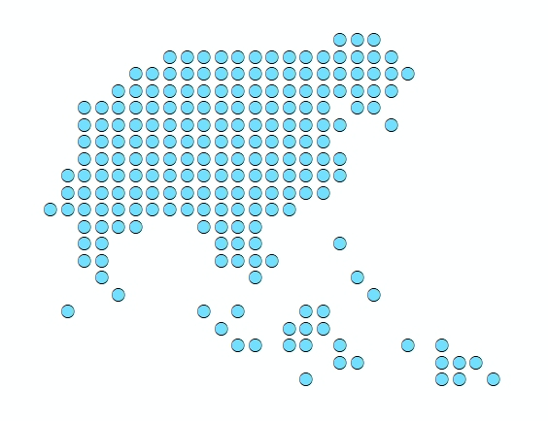


Session 16 – Running the referral analysis between the Health centres and the nearest Hospital
Port Vila, Vanuatu
4 December 2019
1

Slide 2



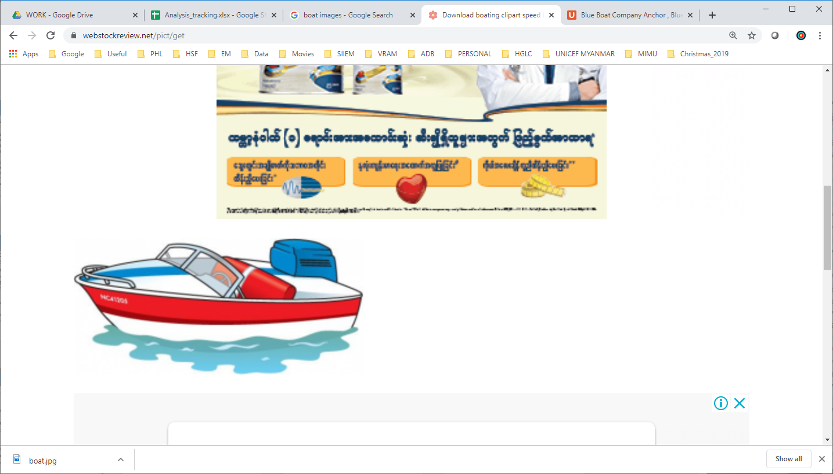
Referral analysis
A
B
C
??
Which option is the shortest by distance?
Which one is the shortest by time?
2
Notes:
What is QGIS?

Slide 3

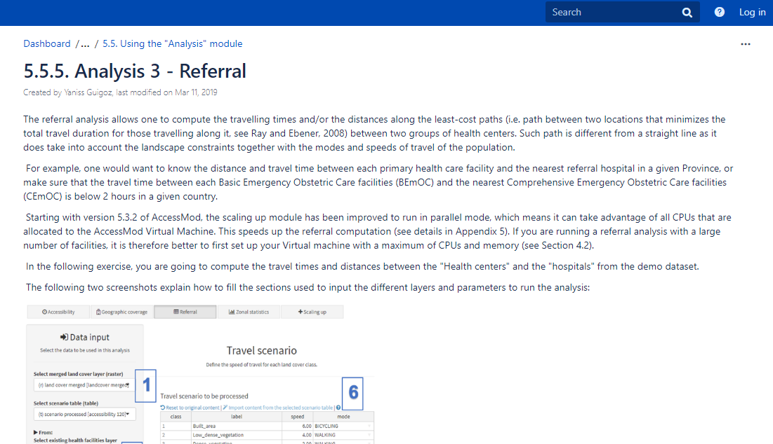
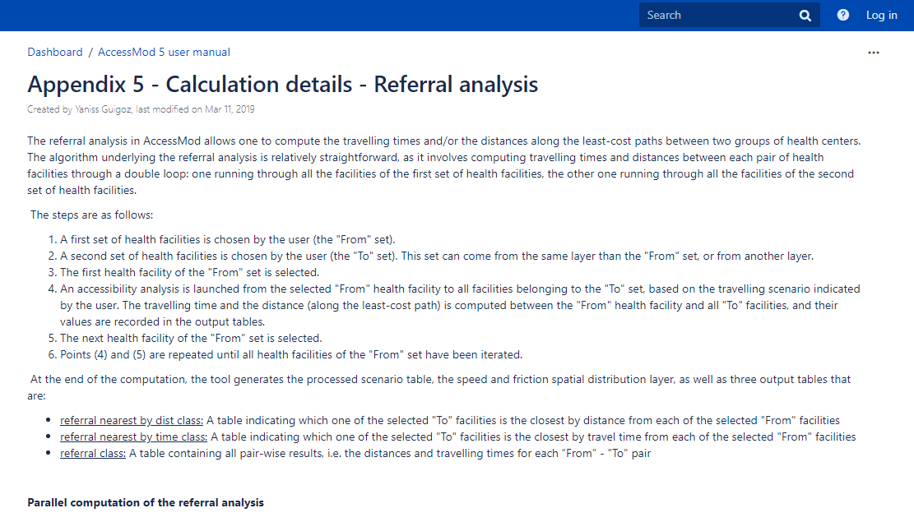
Referral analysis
Description of the analysis
Section 5.5.5 of the user guide
for the steps to follow
Appendix 5 for the calculation details
We will conduct the analysis together to see how long it takes to travel from each health centres and the nearest hospitals in Shefa Province
Let’s start by creating a RESULTS/REF folder on the computer
3
Notes:
What is QGIS?

