Slide 1
Session 5.2: Prepare the data to create a thematic map in a GIS software

Slide 2
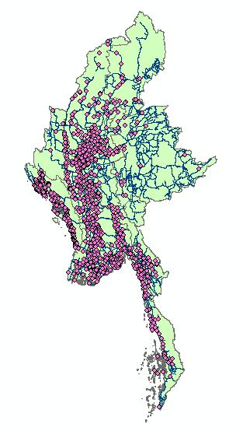
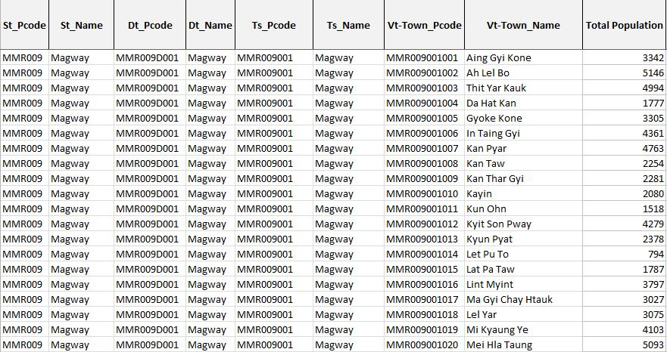
Preparing data to create a thematic map in a GIS
The two main types of data needed to create a thematic map:
Geospatial data
Attribute data
Additional data:
Other information to be included on the map (e.g., logo)
Basemap

Slide 3
What is needed?
The data to be prepared depends on the types of objects to appear on the map.
Fixed objects that can be represented by a point (health facility, village, school, …)
Fixed objects that can be represented by a line or polygons to which information/statistics can be linked (admin boundaries, road, river,…)
“Mobile” objects (patients, health workers, vehicle,…)
Continuous geospatial data (Digital Elevation Model (DEM), landcover,…)

Slide 4

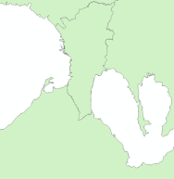
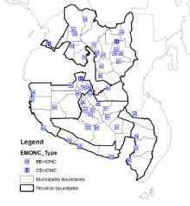
What is needed?
1. Fixed objects that can be represented by a point (health facility, village, school, …)
Master list with unique identifier, admin divisions and geographic coordinates
Unique identifier included in the statistics/information table
Coordinates used to create a GIS layer (points
Unique identifier allows joining the statistics/information with the map

Slide 5

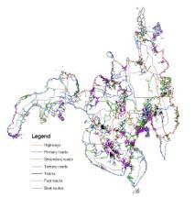
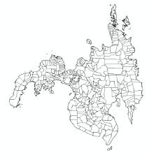
What is needed?
2. Objects that can be represented by a line or polygons to which information/statistics can be linked (admin boundaries, road, river,…)
Complete, up-to-date master list
with unique identifier
identifier included in the attribute table of the GIS layer
identifier included in the
Statistics/information table
GIS layer aligned with master list
Identifier allows joining the statistics/information with the GIS layer

Slide 6





What is needed?
3. “Mobile” objects (patients, health workers, vehicle,…)
Complete, up-to-date master list
with unique identifier and fields to capture the place of care, of residence,… through other fixed object’s respective unique identifier
Village
But you might want to track some of these objects…
...
174000001
12034
174000000

Slide 7
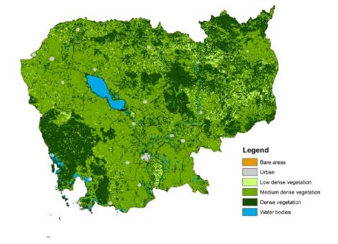
What is needed?
4. Continuous geospatial data (Digital Elevation Model (DEM), landcover,…)
The GIS Layer
The classification if not already included in the layer itself
5. Basemaps
Nothing needed except the access to the basemap layer which is most likely going to be through internet

Slide 8
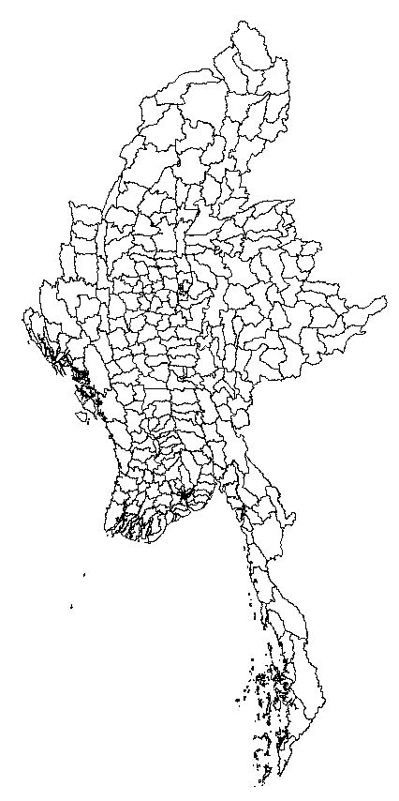
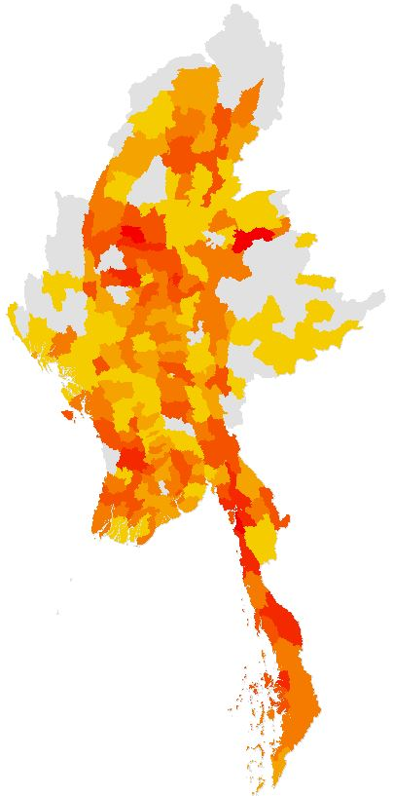
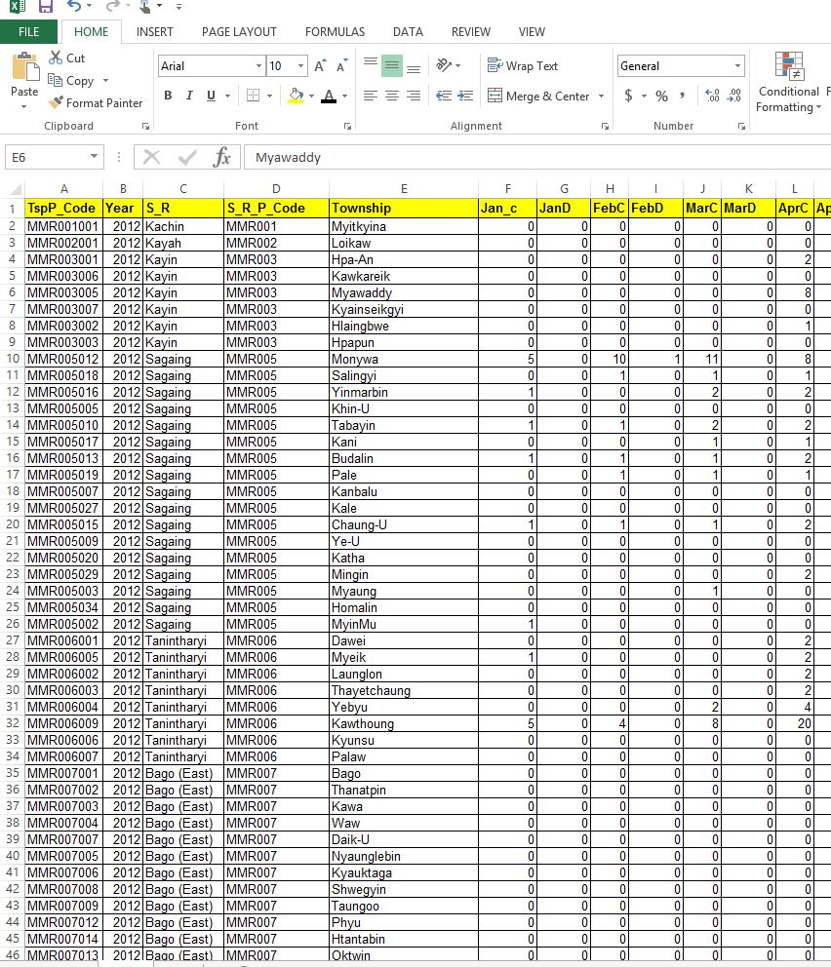
What is needed?
What you will mostly be doing is to link statistics/ information to a shapefile to create a thematic map
+
The unique identifier is key!
Notes:
.

Slide 9
Preparation of statistical data
Proper data structure
GIS software expects:
  Well-formatted data organized in rows and columns:
    One record (health establishment, village, etc.) per line
    One statistic per column
  Using the same unique identifier as in the GIS layer attribute table
    It is important to use the unique ID of the master list

Slide 10
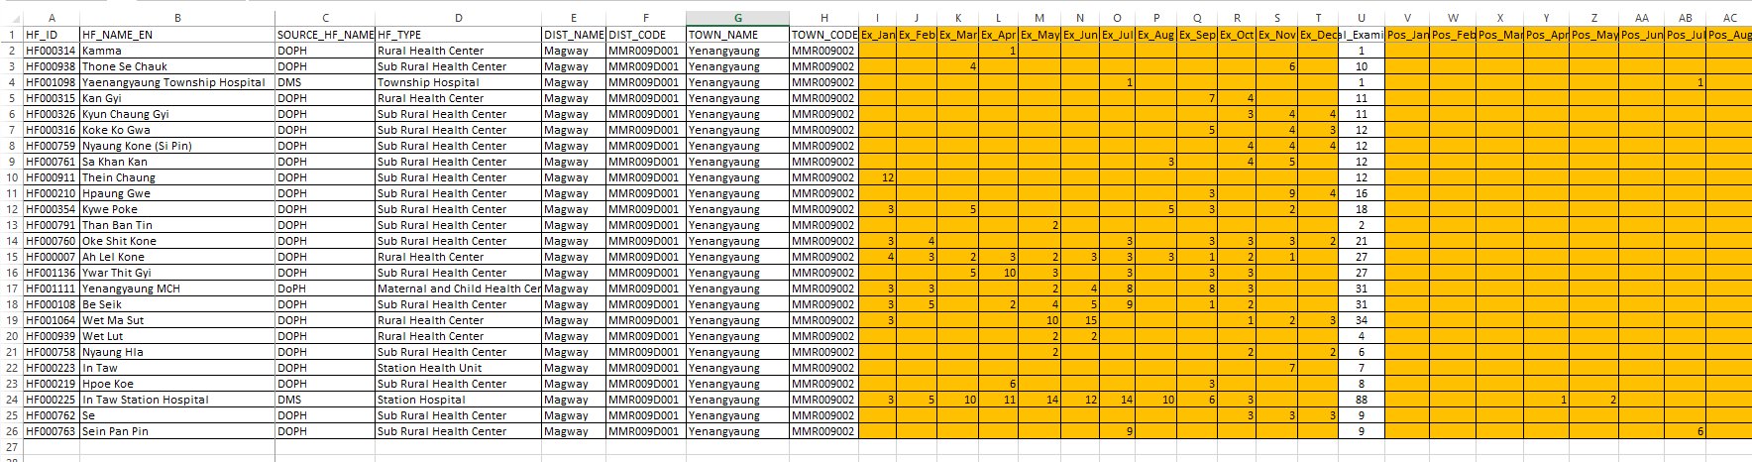
Preparation of statistical data
Proper data structure
Unique identifier from the master list
Other useful information from the master list
Statistics/information
One record (health facility) per line
One statistic/information per column
This will be practiced during Exercise 5.A

Slide 11
Preparation of statistical data
Things to avoid when preparing statistical data
Columns used for spacing - No empty (entire) columns between columns containing data
Merged Cells - No merged cells as they will not be accepted in GIS software.
Information stored at the top of the table - The top rows of the table must only contain the column headers. Avoid placing information such as title, date, etc. at the top of the table, then start with the actual data a few rows below.
Long headers - Limit headers to 10 characters maximum (this is what ArcMap allows). Use acronyms or short names for headings, then create a data catalog in a separate tab of the spreadsheet that will explain the meaning of each short heading
Duplicates – The table must not contain duplicates

Slide 12
Preparation of statistical data
Things to avoid when preparing statistical data
Numbers displayed as text - Make sure numbers are formatted and displayed as numbers. This will avoid errors, especially when joining with geospatial data.
Spaces, special characters, hyphens, or symbols in the header name - These characters will not be read or will be replaced by your GIS software.
Multiple information stored in a single column - Each column should only contain one type of information
Data inconsistency between records - For example, if the health facility type is supposed to be stated in full, no acronyms or abbreviations should be used (e.g., “RHU” instead of “rural health unit”).

Slide 13
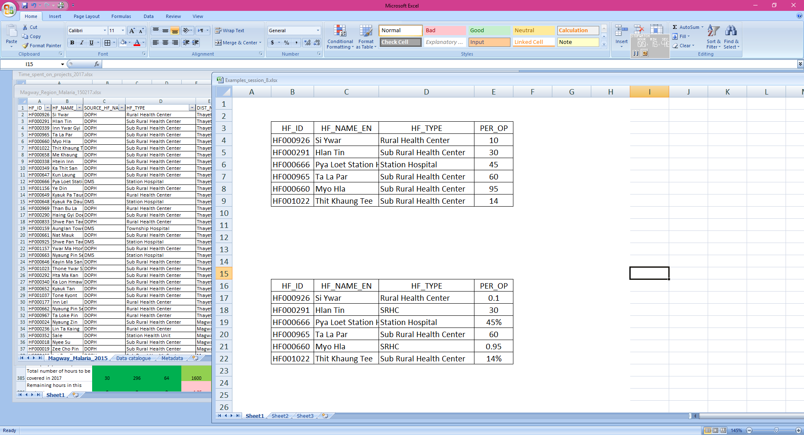


Preparation of statistical data
Data consistency between records
The way the statistics/information is captured should be consistent between records to allow proper representation on the map:
  Names should always spelled the same way
  Number should use the same format

Slide 14
Preparation of geospatial data
The preparation of geospatial data is expected to result in GIS layers that present:
  The same geographic coordinate system if more than one layer is to be included on the map (good practice to also use the same projected coordinate system).
  An attribute table that has the same structure and content (especially the unique identifier) as the corresponding master list.
  The geography of the GIS layer which corresponds to the geography of the statistical/informational data that you wish to represent on the map.
This will be practiced during Exercise 5.B

Slide 15

Data Confidentiality
Another important thing to consider is data confidentiality.
Some data may contain sensitive information that is not for public consumption.
It concerns both the statistical data/information and geospatial data.
The statistical data/information should be anonymized before being linked to geospatial data
Precisely locating certain information on a map might allow locating the person in question even without mentioning his/her name (sex, age, marital status, job,…)
Great attention should be put on this issue

Slide 16
…at the end
Creating a good map might require for you to spend:
70% of your available time to prepare good data
  Collecting, checking, cleaning, validating, formatting, linking with other data
20% to create the map
10% to check the resulting map, make potential adjustments
A good map is made of good data!
The better the data quality from the start, the more time you have to produce good maps and analyze them.

Slide 17

Let’s use GIS software!
Let’s proceed to the exercises of Module 5 to prepare your statistical and geospatial data and use them to create your thematic map.
Notes:
Let’s use GIS software!

