Slide 1
MODULE 5:
Creating good thematic maps
Session 5.1: Components of good thematic maps and the process to create them

Slide 2
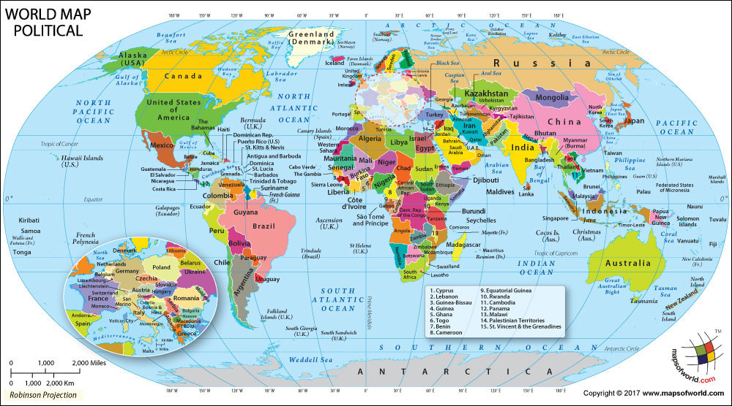
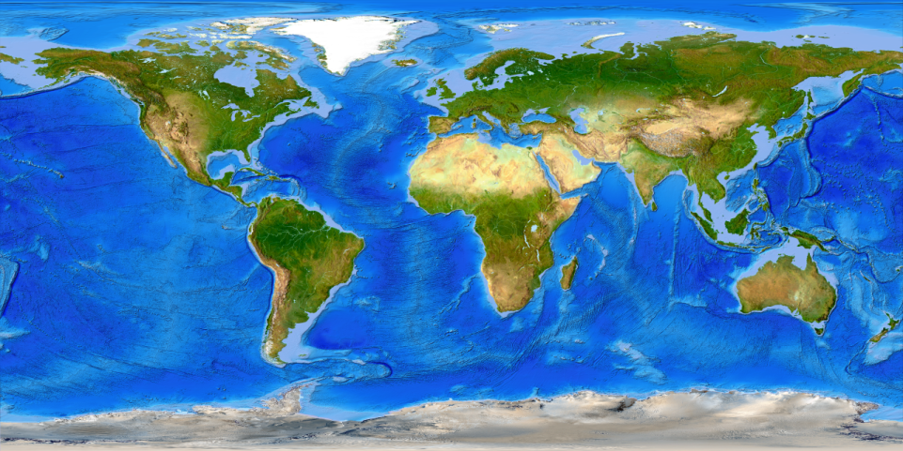
What is a map?
Drawing of the Earth's surface, or part of it, showing the shape and position of different countries, political boundaries, natural features such as rivers and mountains, and man-made features such as roads and the buildings.

Slide 3
Types of maps
Political maps
Physical maps
Topographic maps
Climate maps
Street maps
Geological maps
Navigation maps
Thematic maps
Topic of this session
https://www.healthgeolab.net/DOCUMENTS/Guide_HGLC_Part2_6_1.pdf

Slide 4
Thematic map
What is a thematic map?
A map designed to convey information about a single subject or theme, such as population density, geology, or health
What is a good thematic map?
A good thematic map easily and effectively conveys the information it contains to the reader without the need to contact the person who created the map.
Match the purpose for which it was created
Easy to understand by the intended audience
Contains all the information necessary to be usable

Slide 5
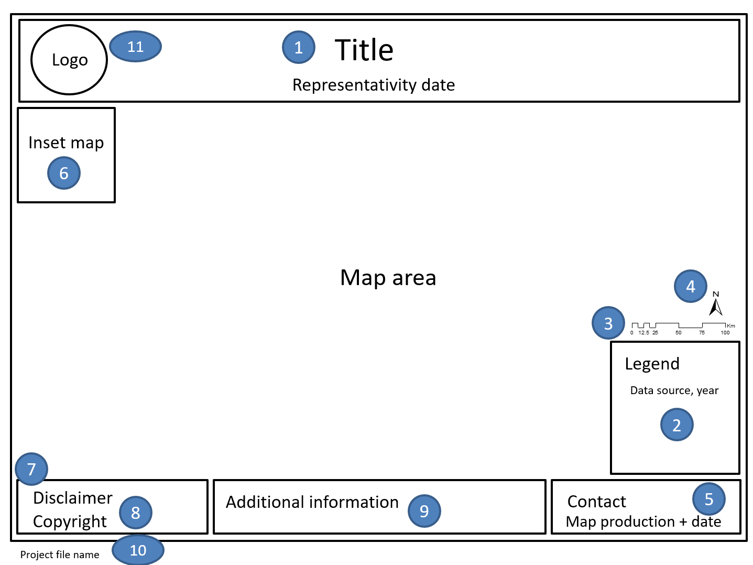
Components of a good thematic map
A good thematic map should at least always include the following elements:
Title with representativity date
Legend
Scale
North arrow
Map production information (author, contact, date)

Slide 6
Components of a good thematic map
The following items, although not mandatory, are also important and/or add value to the map:
Inset map
Disclaimer
Copyright
Additional information
Project file name
Logo
It is recommended that you create a portrait-oriented and a landscape-oriented layout template each that can be used each time you create a thematic map.

Slide 7
Components of a good thematic map – Main elements
Title – Description of the content of the map
A good practice, when it applies, is to also indicate in the title the date of validity of the information represented on the map.
Legend – Description of the different symbols used in the map. The legend can also contain the source of the data and the year of data collection.
The source and year associated with the data can also be mentioned in the additional information if the texts are too long.
Scale – A map element used to graphically represent the scale of a map. It can be a scale bar, representative fraction, or a verbal scale.
North Arrow – Map symbol that indicates the direction of north on the map, thereby showing the orientation of the map.
Map production information – indicates the person and/or organization that created the map and their contact details as well as the date the map was created.

Slide 8
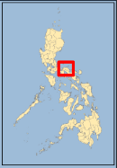
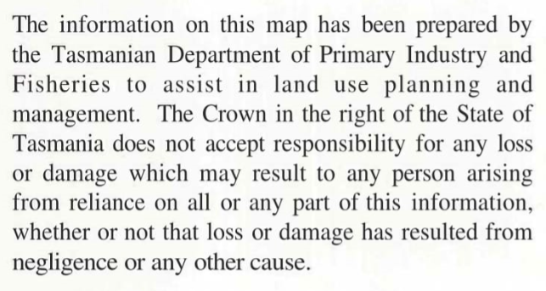
Components of a good thematic map – Other elements
Inset Map – shows a detailed part of the map at a larger scale, the location of the main map in the context of a larger area, or information for a related location that cannot easily be placed on the same map
Disclaimer – delineates the extent of the author's rights and liability with respect to the content of the map.
Copyright – detail information relating to the use and distribution of the map.

Slide 9
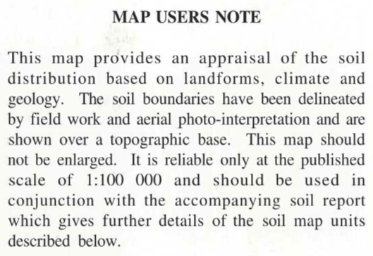
Components of a good thematic map
Optional components
Additional information – details that would provide further context to the map
Project file name – and its complete path to allow the GIS technician to easily find such project in case changes need to be made.
Logo – A personal or organization logo that will help make the map more recognizable as a property of and contribute to the image of the owner or organization

Slide 10
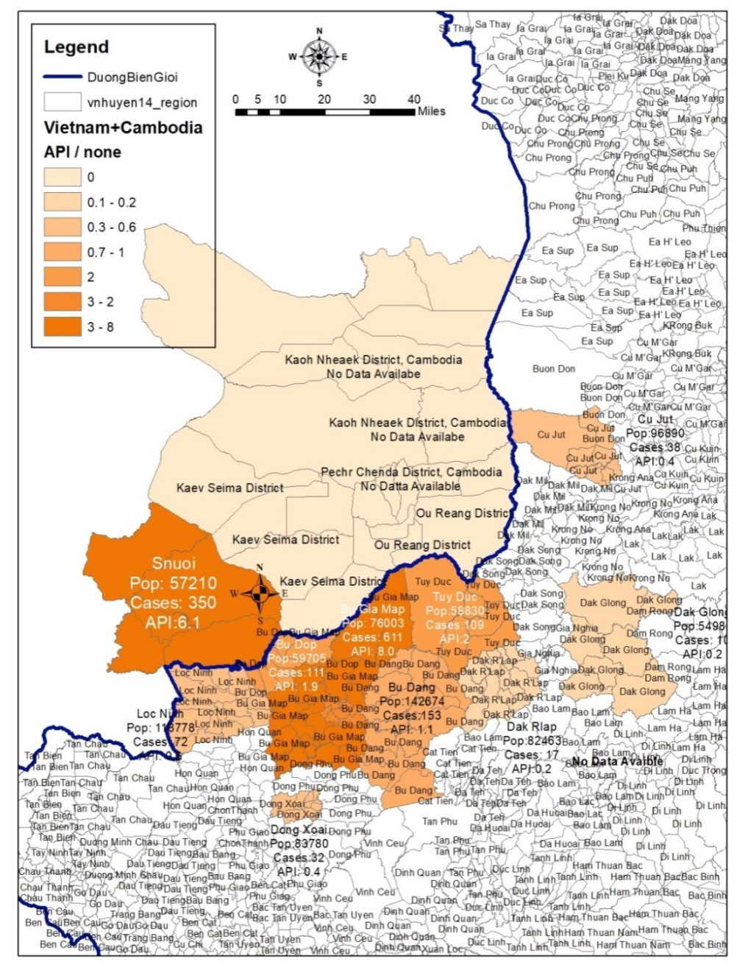
Is this a good thematic map?
Is this a good thematic map?
What is missing?
What should/could be improved?
Does it contain the right amount of information?
Is this map useful?

Slide 11
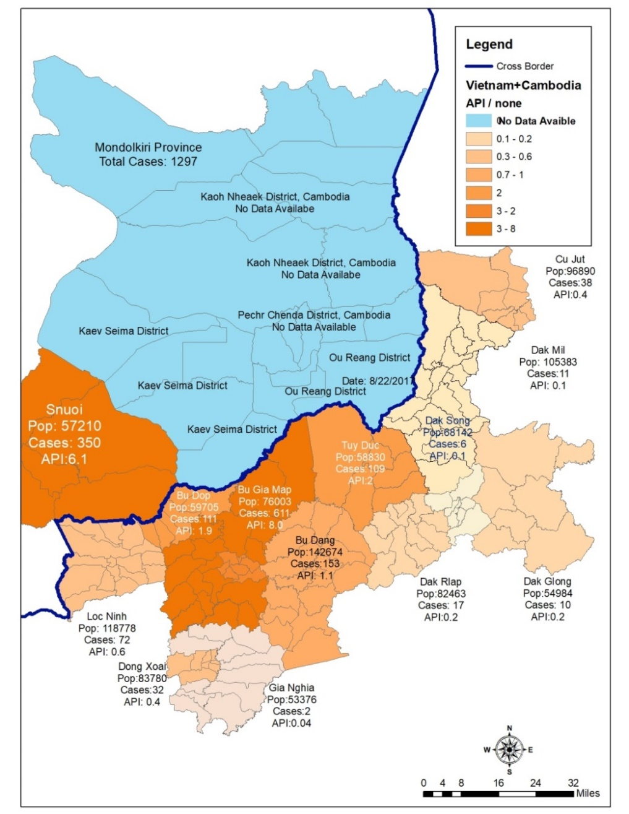
Is this a good thematic map?
Is this a good thematic map?
What is missing?
What should/could be improved?
Does it contain the right amount of information?
Is this map useful?

Slide 12
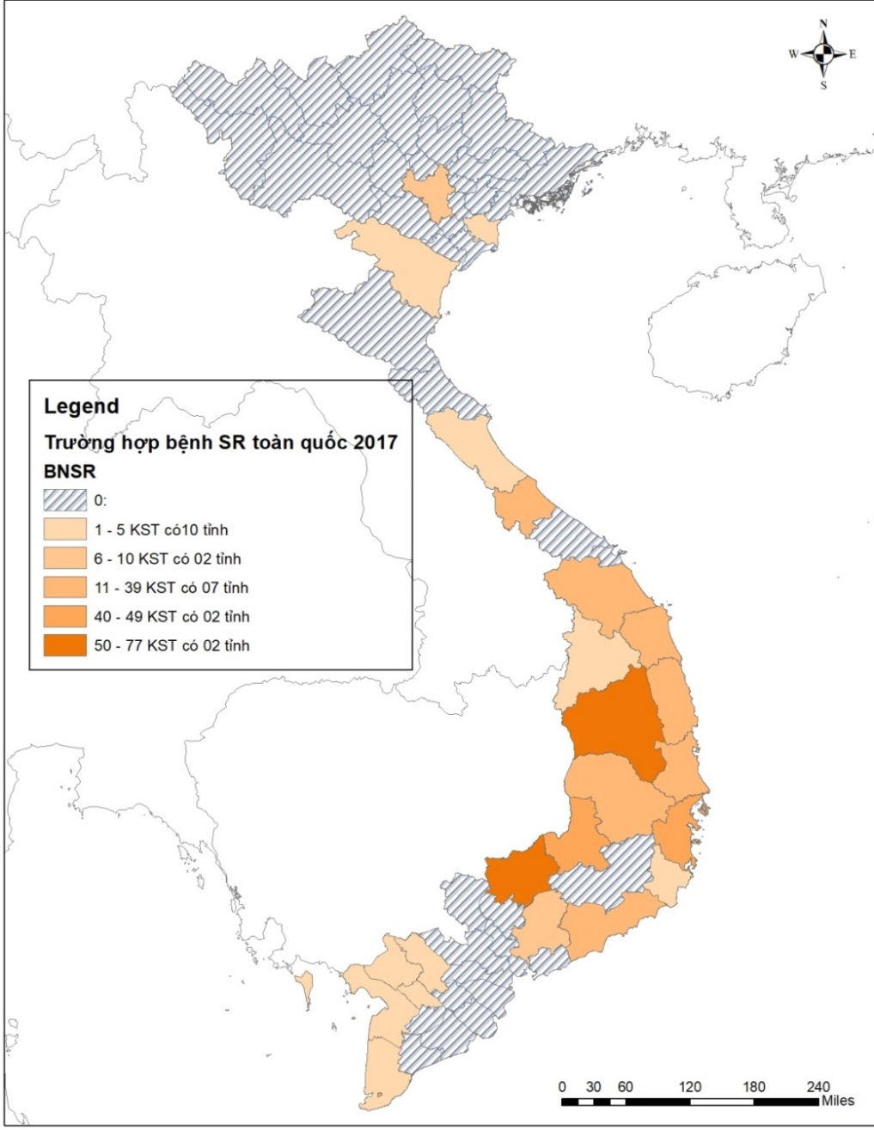
Is this a good thematic map?
Is this a good thematic map?
What is missing?
What should/could be improved?
Does it contain the right amount of information?
Is this map useful?

Slide 13
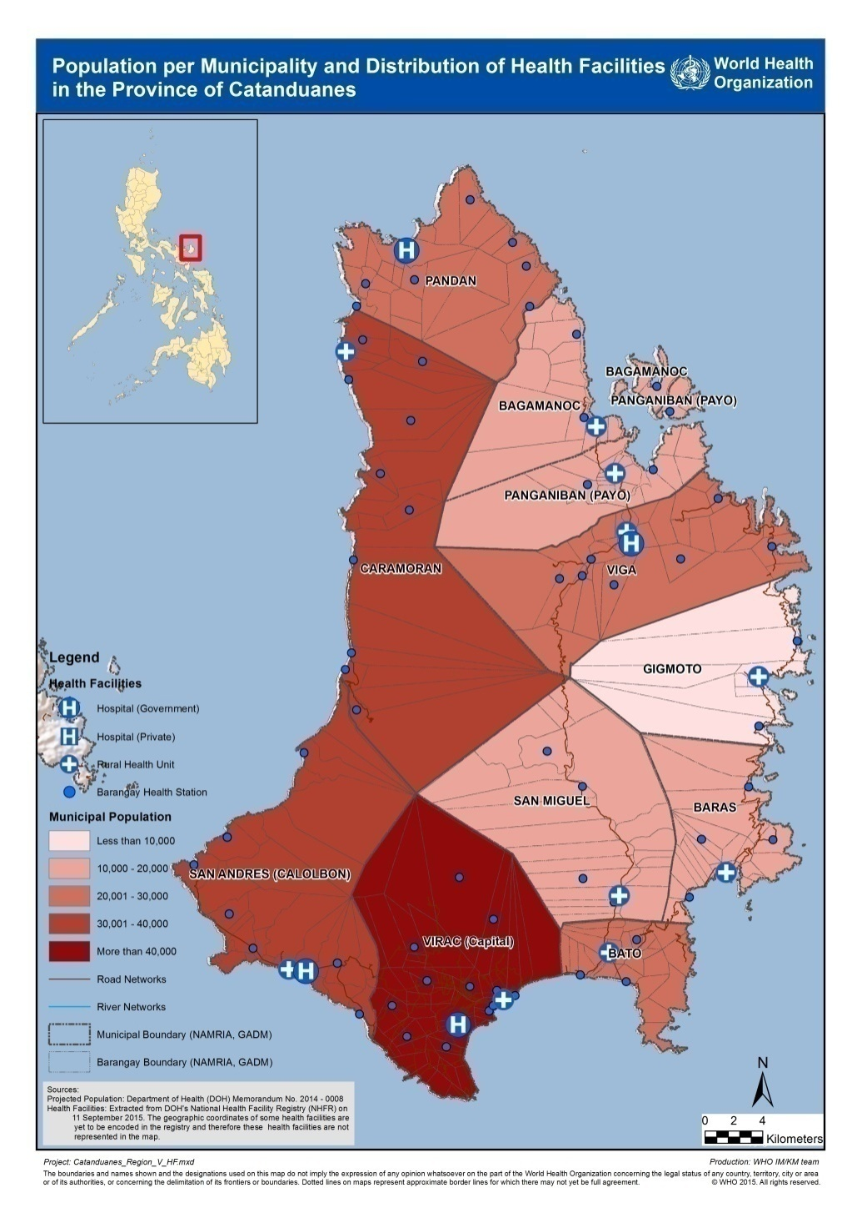
Is this a good thematic map?
Is this a good thematic map?
What is missing?
What should/could be improved?
Does it contain the right amount of information?
Is this map useful?

Slide 14
Example of good thematic map

Slide 15
The thematic mapping process
Three main parts of the process:
Understand the context of the map to be created
Collection and preparation of necessary data and information
Creation of the thematic map itself
Ask
Acquire
Examine
Create
Analyze
https://www.healthgeolab.net/DOCUMENTS/Guide_HGLC_Part2_6_1.pdf

Slide 16
The thematic mapping process
Understand the context of the map to be created
1. Understand the purpose
What will the map be used for? Is it for general information, decision-making?
What message(s) does the map intend to convey?
When and where will this map be used?
Who will present the map?

Slide 17
The thematic mapping process
Understand the context of the map to be created
2. Understanding the audience
Who will use the map?
Is this map intended only for the Ministry of Health or for the public?
Can we use technical terms/jargon or do we have to use only simple terms?
Is the audience familiar with the topic covered by the map?
Do your map readers know the area well?
Notes:
.

Slide 18
The thematic mapping process
Understand the context of the map to be created
3. Set the content
What information should be included on the map to achieve the intended objective and reach the target audience?
Is there a particular way to represent the information on the map?
What data and information should be collected to create the map?
Avoid including too much information in a single map!

Slide 19
The thematic mapping process
Understand the context of the map to be created
4. Identify the medium
Medium on which the map will be stored (printed on paper, saved as a PDF or PowerPoint file, shared online, etc.)
How will the map reach the public?
What is the appropriate size for the map?
Does the audience need to zoom in on the map?

Slide 20
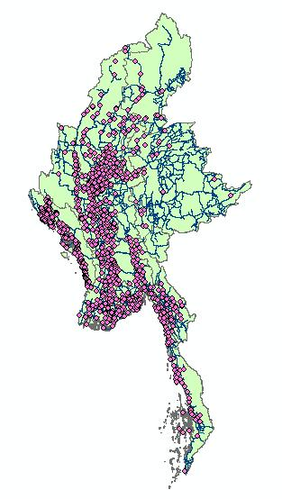
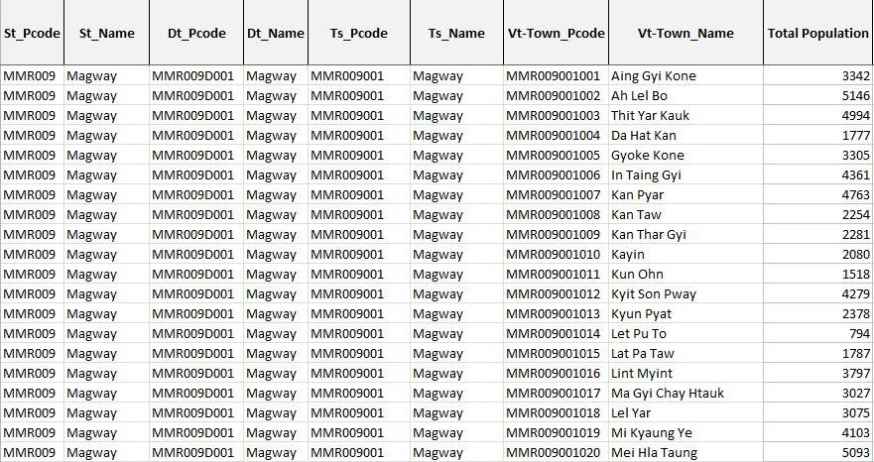
The thematic mapping process
Understand the context of the map to be created
The two main types of data needed to create a thematic map:
Geospatial data
Attribute data
Additional data:
Other information to be included on the card (e.g., logo)
Basemap

Slide 21
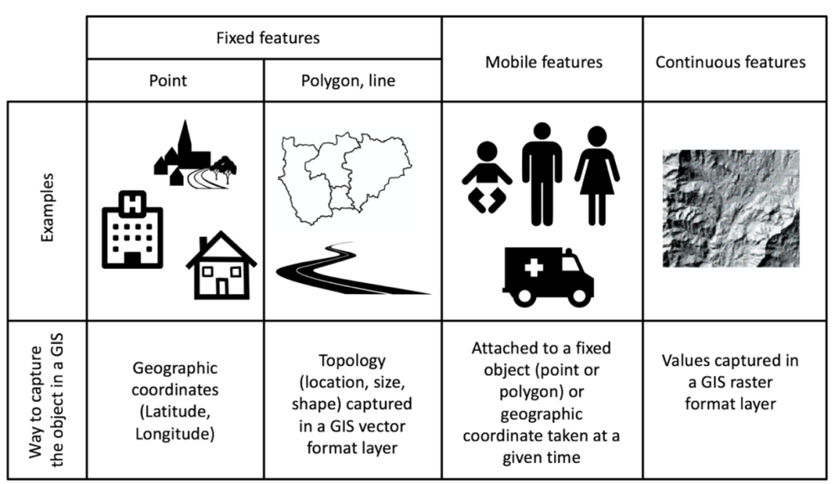
The thematic mapping process
Collection and preparation of necessary data
Geospatial data
Information about the location and shape of geographic features (object) and the relationships between them, usually stored as coordinates and topology (how points, lines and polygons share their geometry).
Guide_HGLC_Part2_1
https://www.healthgeolab.net/DOCUMENTS/Guide_HGLC_Part2_1.pdf

Slide 22
The thematic mapping process
Collection and preparation of necessary data
Attribute data
Statistical data and/or information that can be linked to specific geographic objects (geospatial data)
Usually stored in a table (Excel file for example)
A unique identifier allowing the link (join) with the corresponding object
Unique identifier

Slide 23
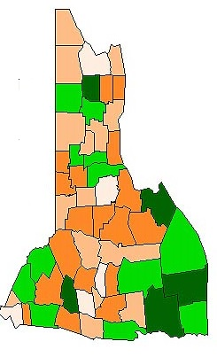
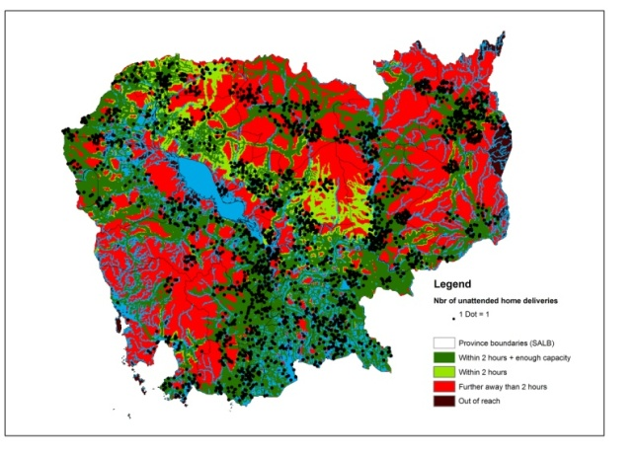
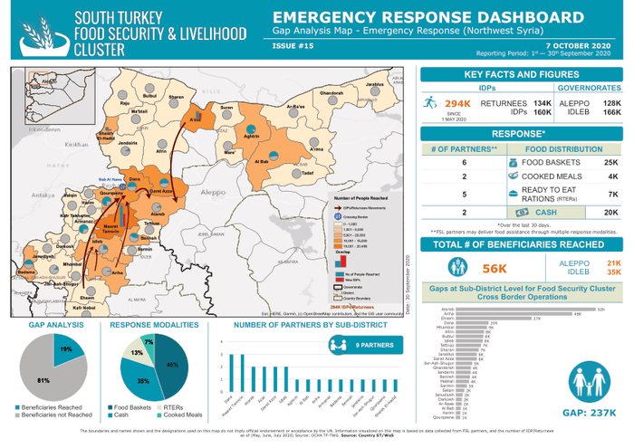
The thematic mapping process
Collection and preparation of necessary data
Data
Information
Data product
Text
According to the district report, the number of malaria cases has doubled in the last six months.
Geographic features/objects
Stat/Info
Unique identifier
Province
Unique identifier
Map
Stat/Info
District
Stat/Info
Unique identifier
Village
Stat/Info
Unique identifier
Health facility
Table/graph
Stat/Info
Unique identifier
Person
Programmatic data
Master List

Slide 24
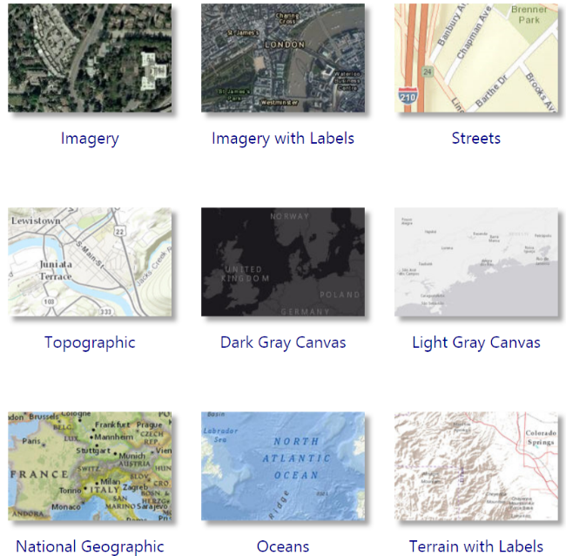
The thematic mapping process
Collection and preparation of necessary data
Basemap
Selection of layers of information combined into a single raster or vector file generally accessible via an online map service
Used as a background for a map
Examples
Google Maps
Images Esri via ArcGIS online
Open Street Map
For viewing purposes only

Slide 25
The thematic mapping process
Steps to create a thematic map
Import data into the GIS software
Create the geographic data that will be represented on the map
Choose the appropriate mode of representation
Fix the symbology
Add labels to the map
Choose map orientation
Fix other elements of the layout
Save the final map in the appropriate format
Possibly, adjust certain elements of the map outside the GIS software

Slide 26
The thematic mapping process
Creation of the thematic map
1. Import data into the GIS software
Geospatial data
Attribute data
+ Add basemap in background
2. Create the geographic data that will be represented on the map
Join attribute data to geospatial data using the unique identifier

Slide 27
The thematic mapping process
Creation of the thematic map
3. Choose the representation mode appropriate to the content of the map
Choropleth
Proportional symbols
Isarithmic or isopleth
Chorochromatic
Dot density
Dasymmetric or cartogram
Graduated colors
Most used
Proportional symbols
Combined
The most appropriate way to represent data on a thematic map depends on the type of data and the message you are trying to convey.

Slide 28
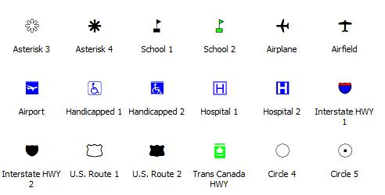
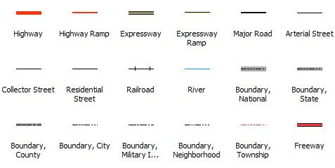
The thematic mapping process
Creation of the thematic map
4. Fix the symbology
A set of conventions, rules, or encoding systems that define how geographic features are represented by symbols on a map. A characteristic of a map element can influence the size, color, and shape of the symbol used.

Slide 29
The thematic mapping process
Creation of the thematic map
5. Add labels to the map
In cartography, a label is text placed on or near an element of the map that describes or identifies it.
Identify the intellectual hierarchy
The ranking of the importance of the different elements of the map
Determine visual hierarchy of map labels based on intellectual hierarchy
The way map labels are designed to help map readers organize geographic information.

Slide 30
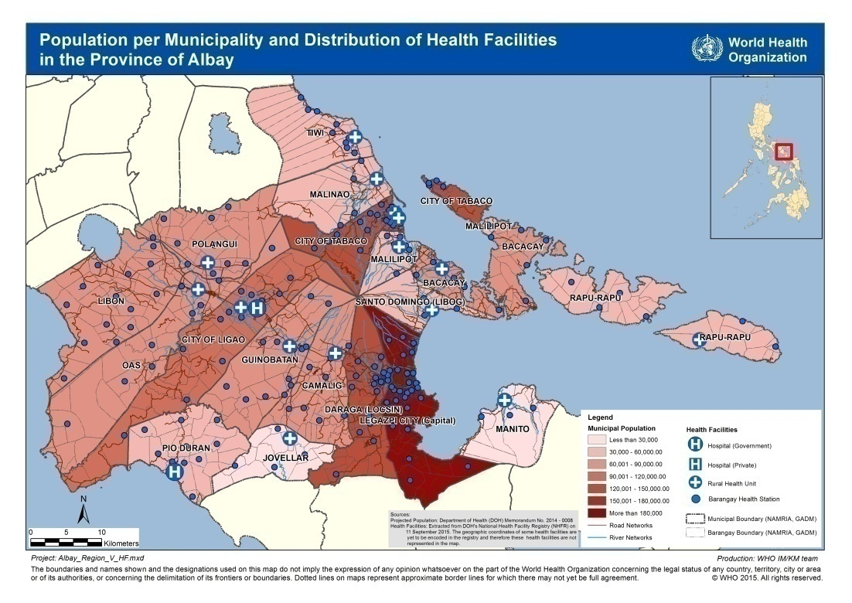
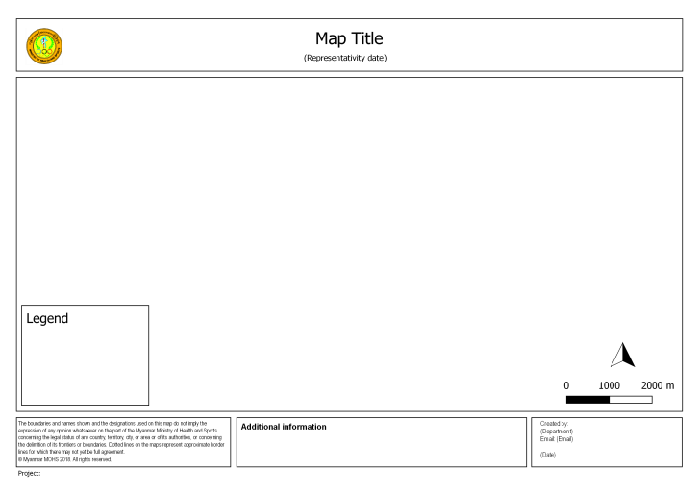
The thematic mapping process
Creation of the thematic map
6. Choose the map orientation (or map template)
Portrait
Landscape
Mainly depends on the shape of the geographic area being covered

Slide 31
The thematic mapping process
Creation of the thematic map
7. Fix other elements of the layout
Fix other elements of the layout.
If you use a layout template:
Provide the text for title, production date, project file name, etc.
Check that the legend and scale represent the current map
Check the overall look of your map
Make sure it looks clean and balanced

Slide 32
The thematic mapping process
Creation of the thematic map
8. Save the final map in the appropriate format
Save the map in a file format that is most suitable for the end use.
For use in electronic viewing where map readers do not need to zoom in, the map can be saved in JPEG, BMP, or PNG file format.
Otherwise, it is best to save as PDF
It is recommended to save the map with a resolution of at least 300 dots per inch (dpi).

Slide 33
The thematic mapping process
Creation of the thematic map
9. Correcting map elements outside of GIS software (after export)
Sometimes, it is necessary to make minor changes after the final map has been created:
Repositioning or adding labels
Adding text information
Removing unnecessary data and/or text
JPEG, BMP, and PNG MS Paint or Adobe Photoshop
PDF Adobe Photoshop or Adobe Illustrator

