Slide 1
Exercise 5.C: Creating a thematic maps using ArcMap
Notes:
MODULE 5: CREATING GOOD THEMATIC MAPS
Exercise 5.C: Creating a thematic maps using ArcMap

Slide 2
Objectives
The objectives of this exercise are to teach participants how to:
Apply the lessons learned from Session 5.1
Prepare geospatial data for use in GIS software (ArcMap)
Recommended background sessions
Although the modules in the HIS Geo-enabling Course can be taken separately, it is recommended for participants of Module 5 to go through Module 4, particularly Session 4.3 and Exercise 4.B beforehand.
These session and exercise will provide the necessary background and basic skills needed to be able to complete the present exercise.
Exercise Data
The data used in this exercise are fictitious and created only to facilitate the exercises in this course. The different geospatial objects are not related to any real location or infrastructure in the real world.

Slide 3
Recap
In Exercise 5.A, you prepared the statistical data
In Exercise 5.B, you prepared the geospatial data
In Exercise 5.C, you will join the statistical data with the geospatial data to create geographic data which you will represent in your maps.
Create thematic maps!

Slide 4

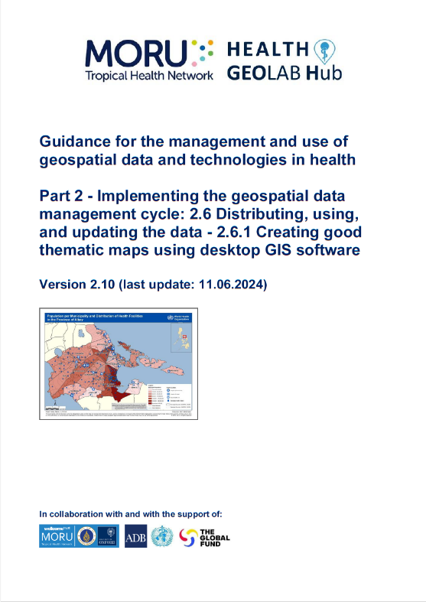
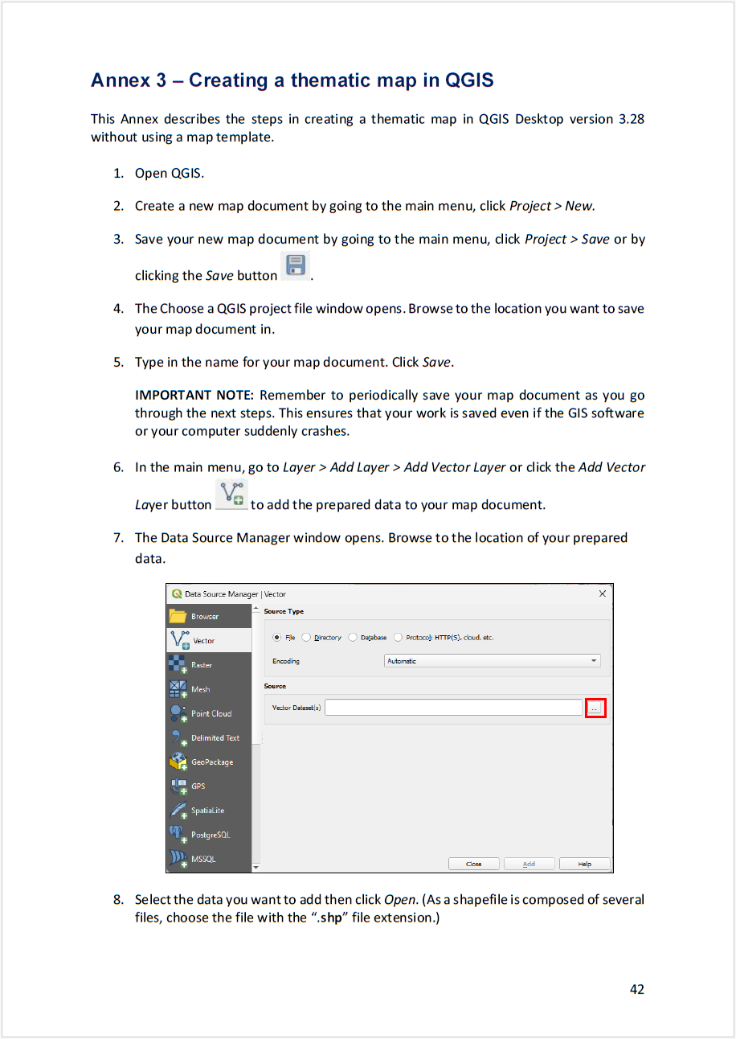
Quick reminder – The thematic mapping process
Creating the thematic map
Import the data into QGIS
Create the geographic data that will be represented on the map
Choose the appropriate mode of representation
Fix the symbology
Add labels to the map
Choose map orientation
Fix other elements of the layout
Save the final map in the appropriate format
https://www.healthgeolab.net/DOCUMENTS/Guide_HGLC_Part2_6_1.pdf

Slide 5
Request received for a map
Purpose: Assist on-going malaria control and elimination activities
Audience: Province-level Malaria Surveillance Officer
Content:
  Number of malaria cases:
    By place of reporting at the health facility level
    By place of reporting aggregated by Barangay
Medium: A4 size map stored as PDF
??
Need to find away to represent the information in a visually appealing way on top of each other

Slide 6
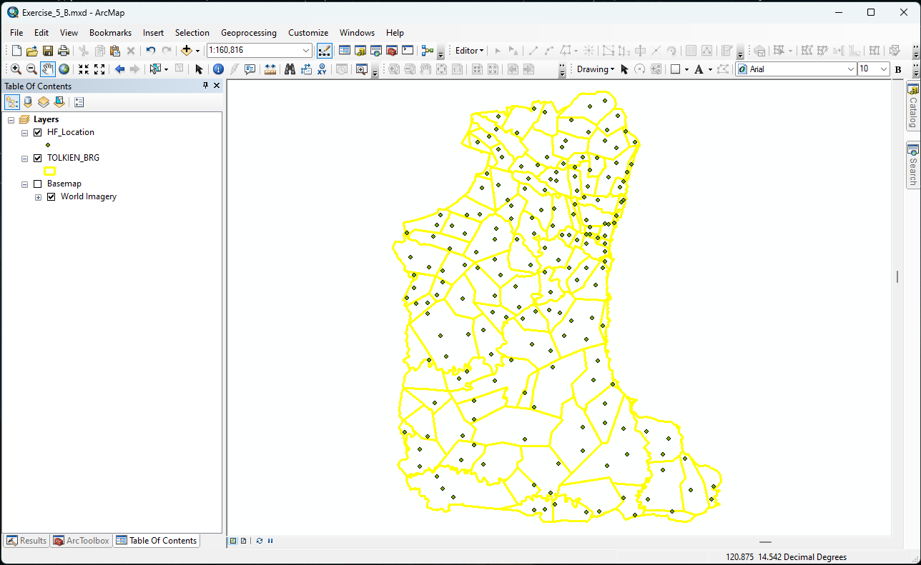
All the geospatial data already in ArcMap from Exercise 5.B
Re-open your project created during Exercise 5.B
Save your project as Exercise 5.C by clicking File > Save As… from the main menu. Go to the folder you want to save your project in and type in a file name.
We will now link the statistical data with the geospatial data to create geographic data

Slide 7
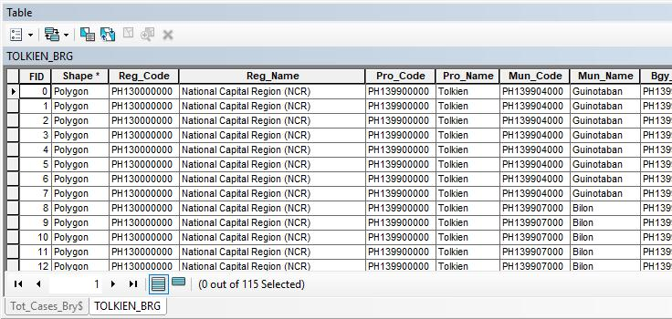
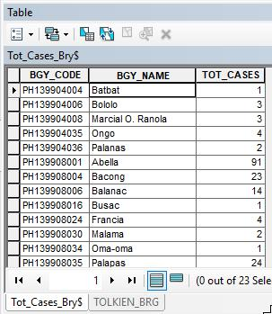
Creating geographic data for the map – Part 1
Barangay – Link with the number of malaria cases aggregated at barangay level
Click the Add Data button
You will use the Tot_Cases_Bgy_010425.xls file you created in Exercise 5.A. Browse to its location on your computer.
Double-click on the Tot_Cases_Bgy_010425.xls file. Select ‘Tot_Cases_Bgy$’ and click Add.
Open the attribute table of the Excel file you just added and the Barangay boundary shapefile and compare the two tables.
Do they contain the same list of Barangays?
Is there a unique identifier in common to both tables that could be used to join them together?

Slide 8
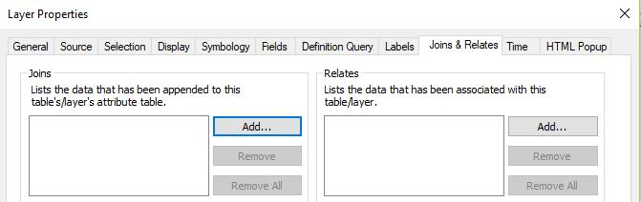
Creating geographic data for the map – Part 1
Barangay – Link with the number of malaria cases aggregated at barangay level
This means that we can join the content of the malaria cases table (Excel) to the attribute table of the shapefile
Right-click on the barangay shapefile name in the ToC and click on Properties…
Click the Joins & Relates tab in the dialog box that opens
Click the Add button in the Joins section
You can also right-click on the layer, select Joins & Relates > Join…

Slide 9
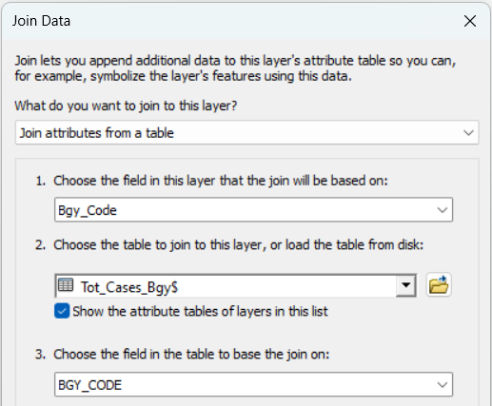
Creating geographic data for the map – Part 1
Barangay – Link with the number of malaria cases aggregated at barangay level
In the dialog box that opens, select:
  Bgy_Code as the field in the layer that the join will be based on (1)
  ‘Tot_Cases_Bgy$’ as the table to join to the layer (2)
  BGY_CODE as the field in the table to base the join on (3)
  Keep the other default settings.
  Click OK twice.

Slide 10
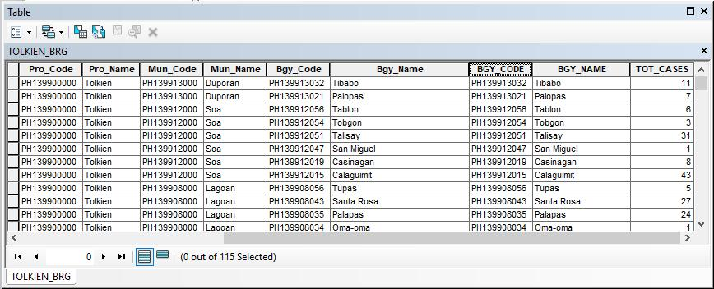
Creating geographic data for the map – Part 1
Barangay – Link with the number of malaria cases aggregated at barangay level
Re-open the attribute table of the Barangay boundaries shapefile
  Notice that the content of the malaria cases table from the Excel file is now included in the shapefile attribute table (last columns)
  Check that all the Barangays for which cases have been reported contain a value in the attribute table
Layer ready for thematic mapping!
Don’t forget to save your project!

Slide 11
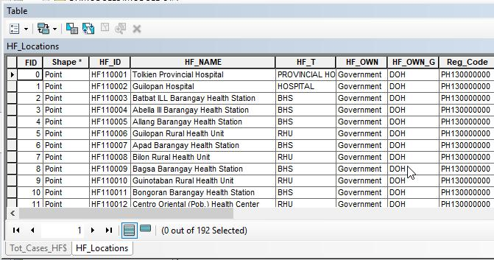
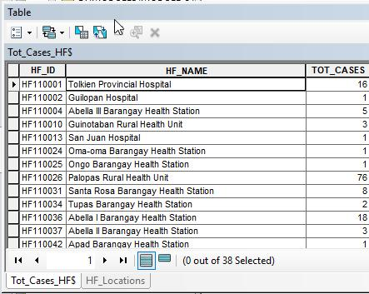
Creating geographic data for the map – Part 2
Health facility location – Link with the number of malaria cases by health facility
Click the Add Data button
You will use the Tot_Cases_HF_010425.xls file you created in Exercise 5.A. Browse to its location on your computer.
Double-click on the Tot_Cases_HF_010425.xls file. Select ‘Tot_Cases_HF$’ and click Add.
Open the attribute table of the Excel file you just added and Health facility shapefile and compare the two tables.
Do we have the unique identifier?
Is there a value in the TOT_CASES column for each health facility in the Excel file?

Slide 12
Creating geographic data for the map – Part 2
Health facility location – Link with the number of malaria cases by health facility
We can join the content of the malaria cases table (Excel) to the attribute table of the shapefile
Right-click on the health facility shapefile name in the ToC and click on Properties…
Click the Joins & Relates tab in the dialog box that opens
Click the Add button in the Joins section
You can also right-click on the layer, select Joins & Relates > Join…

Slide 13
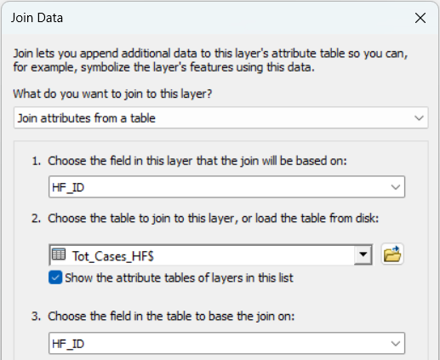
Creating geographic data for the map – Part 2
Health facility location – Link with the number of malaria cases by health facility
In the dialog box that opens select:
  HF_ID as the field in the layer that the join will be based on (1)
  ‘Tot_Cases_HF$’ as the table to join to the layer (2)
  HF_ID as the field in the table to base the join on (3)
  Keep the other default settings.
  Click OK twice.
Save the project!

Slide 14
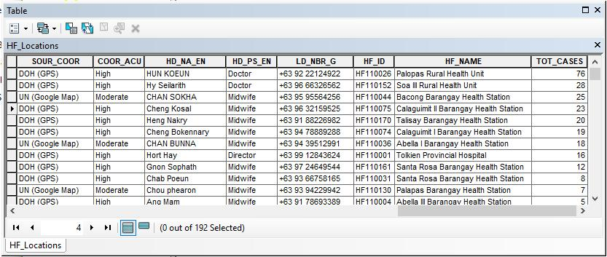
Creating geographic data for the map – Part 2
Health facility location – Link with the number of malaria cases by health facility
Re-open the attribute table of the health facility shapefile
  Notice that the content of the malaria cases table from the Excel file is now included in the shapefile attribute table (last columns)
  Notice that not all the health facilities have TOT_CASES value because health facilities with no reported cases (0 cases) were not included in the Excel file
Right-click on the header of the “TOT_CASES” column (last column) and select Sort Descending and scroll down to check that the join worked for all the 38 facilities
  Do all the health facilities for which we have malaria cases have a Latitude/Longitude?
Layer ready for thematic mapping

Slide 15
Creating thematic map – Mode of representation
You may now choose the mode of representation for your map.
As mentioned in Session 5.1, there are different ways to represent the data in your map.
For this exercise, graduated colors and proportional symbols are chosen as an example.
Let’s represent our data!

Slide 16
Creating thematic map – Mode of representation
Some complement to Annex 2:
Symbologies:
Single symbol symbology applies the same symbol to all features in a layer. This symbology is used for drawing a layer with only one category, such as county boundaries.
Graduated color symbology is used to show a quantitative difference between mapped features by varying the color of symbols. Data is classified into ranges that are each assigned a different color from a color scheme to represent the range.
Graduated symbols are used to show a quantitative difference between mapped features by varying the size of symbols. Data is classified into ranges that are each then assigned a symbol size to represent the range.
Data classification methods:
Equal interval: divides the range of attribute values into equal-sized subranges.
Natural breaks (Jenks): finds natural groupings of data. There would be maximum variance between individual classes and least variance within each class.
Standard deviation: calculates the mean of the data; creates class based on standard deviation from the mean
Manual interval: allows users to define own classes, to manually add class breaks, and to set class ranges that are appropriate for the data.

Slide 17
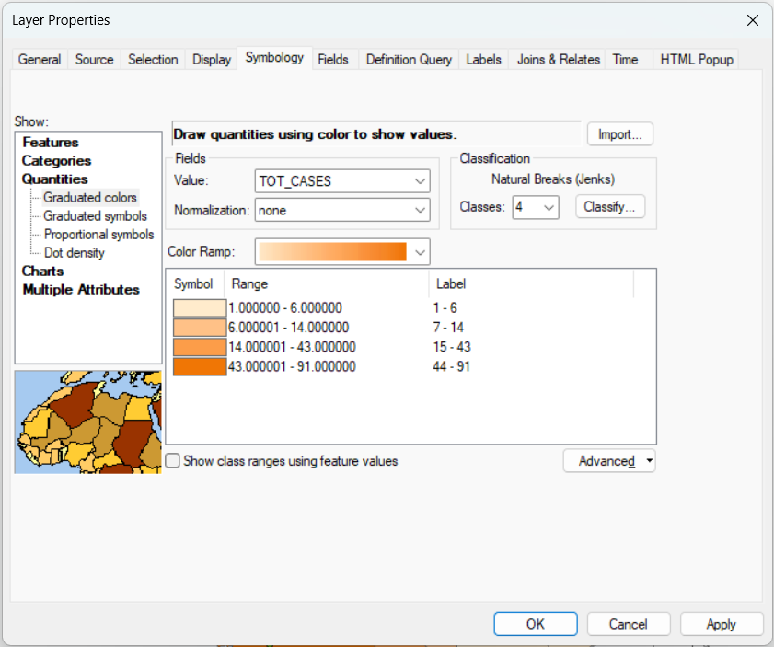
Creating thematic map – Mode of representation
To create Graduated Colors symbology:
Open the Layer Properties of the barangay layer.
Go to the Symbology tab and follow the settings in the image on the right.
  In the Show section, select Quantities then Graduated colors
  In the Fields section, select TOT_CASES as the Value to be represented
  In the Classification section, specify 4 classes.
  Choose a color from the Color ramp. (Select a color ramp that will show the sequential differences in the number of cases¹)
  Click on the Label header and select Format Labels… Set the Number of decimal places to 0.
  Click OK twice.
1 Chapter 4.3.4. Fix the symbology: http://www.healthgeolab.net/DOCUMENTS/Guide_HGLC_Part2_6_1.pdf

Slide 18
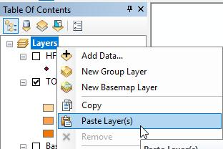
Creating thematic map – Mode of representation
The graduated colors settings in the previous slide does not allow the barangays with no value to be represented.
To have these barangays represented, do the following:
Right-click on the barangay layer in the ToC and select Copy
Right-click on Layers data frame in the ToC and select Paste Layer(s)
You will now have 2 barangay layers in the ToC. Right-click on the first barangay layer and select Properties…

Slide 19
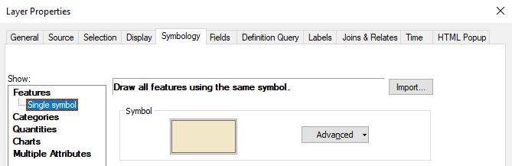
Creating thematic map – Mode of representation
Go to the Symbology tab. Select Features (Single symbol) in the Show section then click on the rectangle symbol.
Choose No Color as the fill color. (It will be transparent but will appear as white for our purpose.)
Click OK twice.

Slide 20
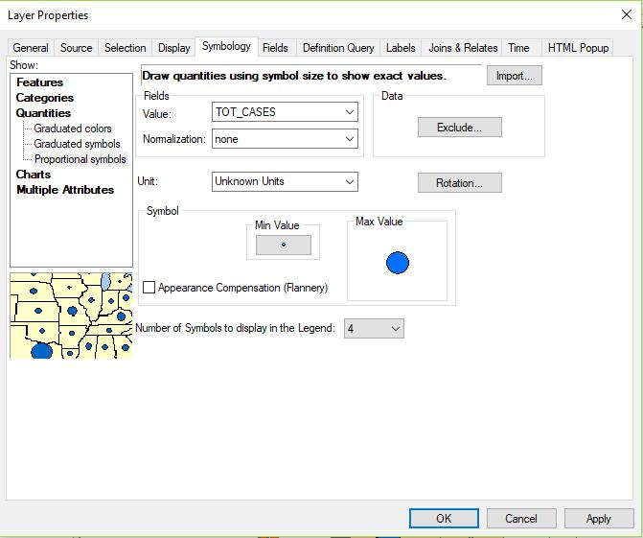
Creating thematic map – Mode of representation
To create proportional symbols:
Open the Layer Properties of the health facility layer.
Go to the Symbology tab and follow the settings in the image on the right.
  In the Show section, select Quantities then Proportional symbols
  In the Fields section, select TOT_CASES as the Value to be represented
  Click the Min Value to select the symbol and color you want to use for the proportional symbol.
  Set the Number of symbols to display in the Legend as 4.
  Click OK.

Slide 21
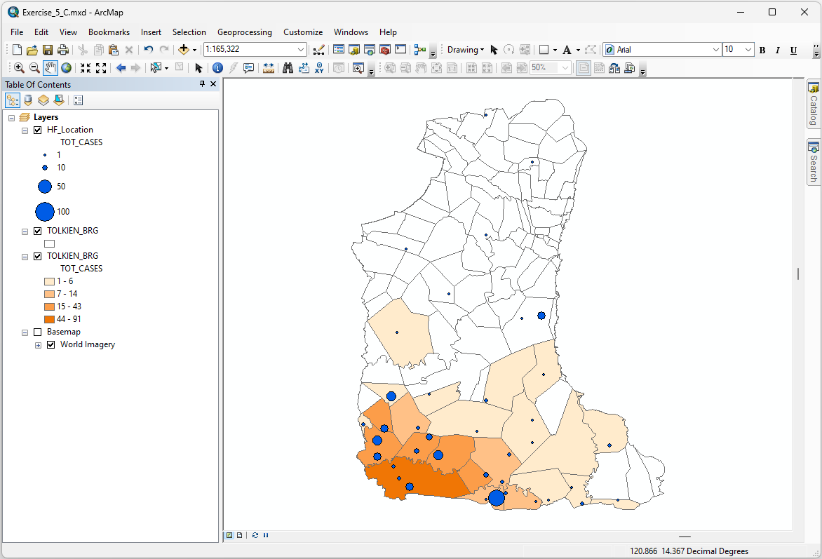
Creating thematic map – Mode of representation
Play around with the symbology of your layers until you are satisfied with how they look.
They can look as simple as the map on the right or you may experiment with more complex symbologies.
Ensure that the symbologies are visually appealing and the map conveys its message to the audience.
Save the project!

Slide 22
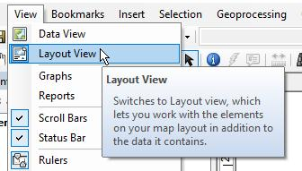

Creating the thematic map (Layout)
We will now be able to layout the thematic map!
We have prepared two layout templates that you can use for this part of the process (portrait, landscape)
To be downloaded from: MAP TEMPLATE and placed in the C:\ or D:\MODULE_5\EXERCISE_5_C subfolder
To start laying out your map, go to View > Layout View from the main menu or by clicking the Layout View button (second button) at the bottom beside the Table of Contents pane.
To use the pre-made template, click the Change Layout button on the Layout toolbar.
If the Layout toolbar is not visible, right-click anywhere on the Toolbar area and click Layout from the list of toolbars that appears.

Slide 23
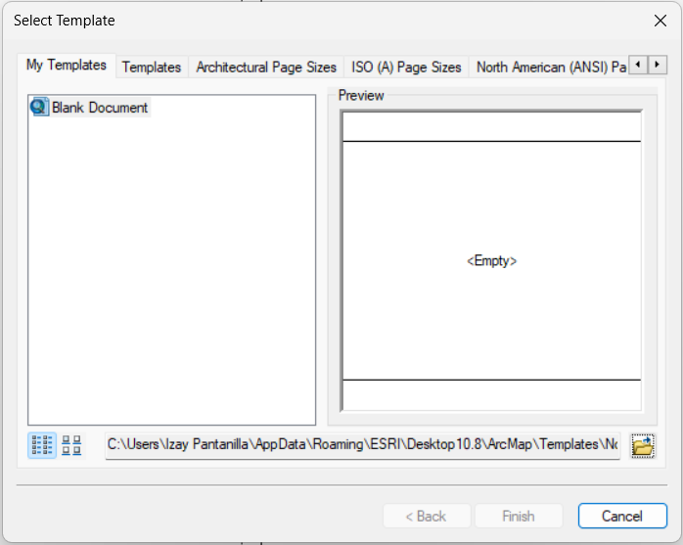
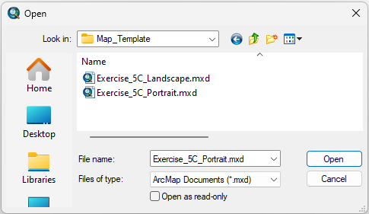
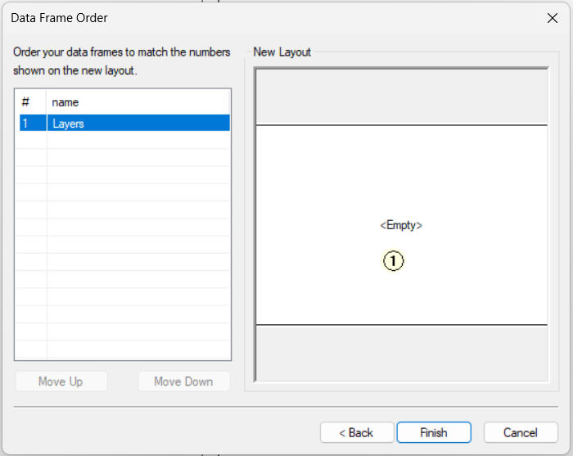
Creating the thematic map (Layout)
In the template selection dialog box that opens, click the browse button then navigate to the MODULE_5\EXERCISE_5_C\Map_Template folder. You will find two templates (landscape, portrait).
Click the template with the appropriate orientation for your map. Click Open.
In the Data Frame Order dialog box, click Finish.

Slide 24
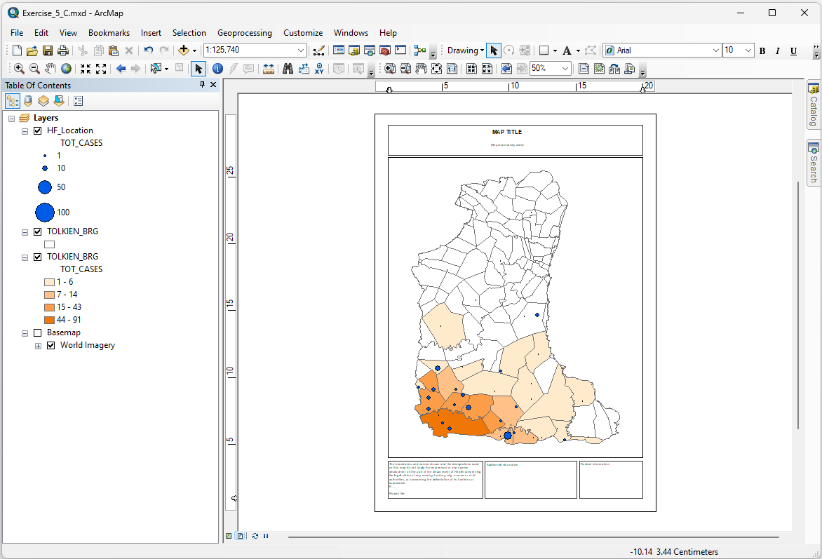
Creating the thematic map (Layout)
The layout template will open with your map symbolized.

Slide 25
Creating the thematic map (Layout)
Familiarize yourself with the functions and toolbars that you will use when creating your map layout.
Layout toolbar
Zoom In
Zoom Out
Pan
Zoom Whole Page
Zoom to 100%
Fixed Zoom In
Fixed Zoom Out
Go Back To Extent
Go Forward To Extent
Zoom To Percent
Toggle Draft Mode
Focus Data Frame
Change Layout
Data Driven Pages Toolbar
The highlighted functions are those you will use most commonly

Slide 26
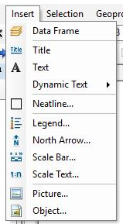
Creating the thematic map (Layout)
Tools toolbar
To move your map in the optimal position in the map area, use the Zoom In , Zoom Out , and Pan buttons from the toolbar.
To select the element that you need to interact with, use the Select Elements button.
Insert menu
To add the different map layout elements, use Insert from the main menu.

Slide 27
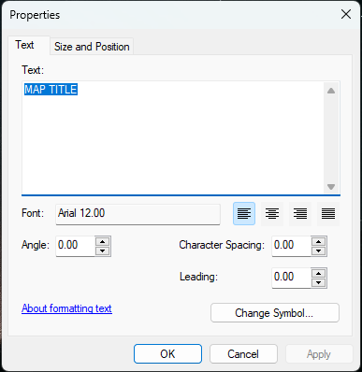
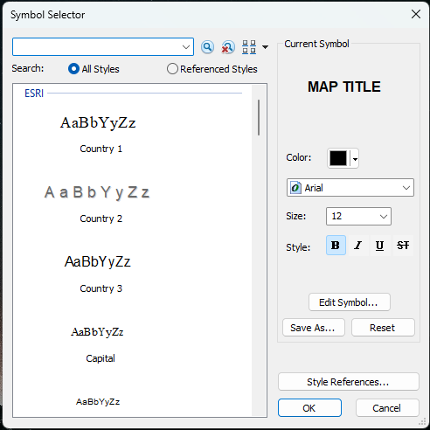
Creating the thematic map (Layout)
Adjust the map title or other text box
  Click the Select Elements button on the Tools toolbar.
  Double-click on the text you want to edit. The (Text) Properties dialog box opens.
  Enter the necessary text in the box under the Text tab.
  Click the Change Symbol… button. The Symbol Selector dialog box opens. Select the font, size, and type you want then click OK.
  Click OK in the (Text) Properties dialog box.
Save the project!

Slide 28

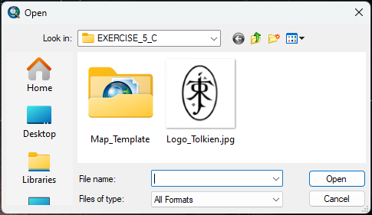
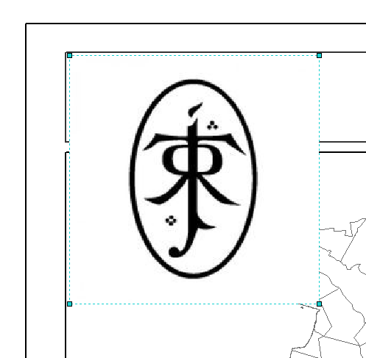
Creating the thematic map (Layout)
Add a logo
  Click Insert > Picture… from the main menu.
  In the dialog box that opens, navigate to the MODULE_5\EXERCISE_5_C folder.
  Double-click the image file containing the logo to add it to the map layout.
  To move the logo, click, hold, and drag it to the correct position. Or click it to select and use the arrow keys on your keyboard.
  If necessary, change the size of the logo by clicking and dragging the corners of the logo area.
  Refer to step 39 of Annex 4 of Health GeoLab Guide 2.6.1 to embed the logo in your map project in case you are not able to export your map at the end of class.
Save the project!
http://www.healthgeolab.net/DOCUMENTS/Guide_HGLC_Part2_6_1.pdf

Slide 29
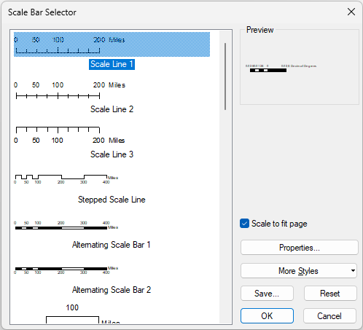
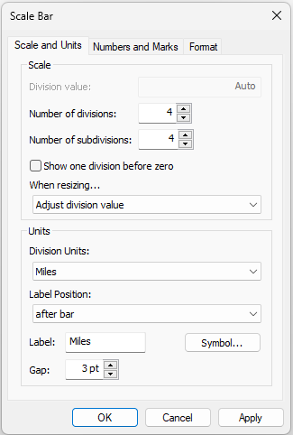
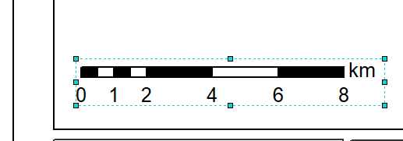
Creating the thematic map (Layout)
Add a scale bar
  Click Insert > Scale Bar… from the main menu.
  The Scale Bar Selector dialog box will open. Choose the scale bar type you want by clicking it.
  Click the Properties button. In the dialog box that opens, set the scale and units of the scale bar. You may also change the number and marks and the text format. Once set, click OK.
  Click OK on the Scale Bar Selector dialog box. The scale bar will appear on your map layout.
  To move the scale bar, click, hold, and drag it to the correct position. Or click it to select and use the arrow keys on your keyboard.
  If necessary, change the size of the scale bar by clicking and dragging its corners.

Slide 30
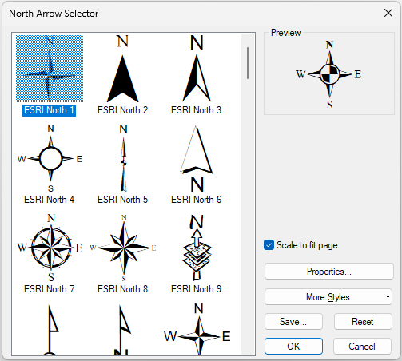
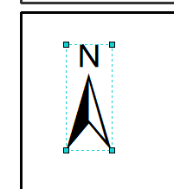
Creating the thematic map (Layout)
Add the north arrow
  Click Insert > North Arrow… from the main menu.
  The North Arrow Selector dialog box will open. Choose the north arrow style you want by clicking it. Click OK.
  To move the north arrow, click, hold, and drag it to the correct position. Or click it to select and use the arrow keys on your keyboard.
  If necessary, change the size of the north arrow by clicking and dragging its corners.
Save the project!

Slide 31
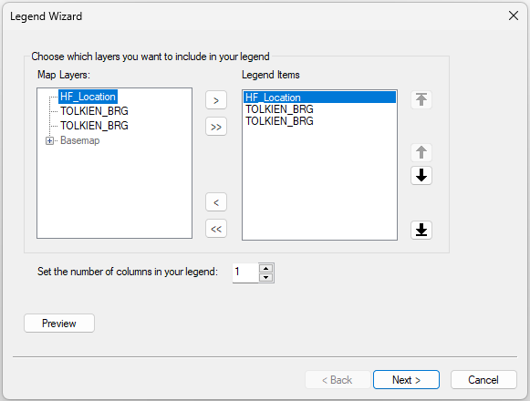

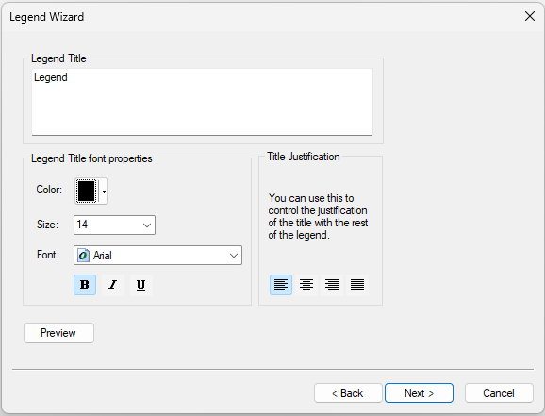
Creating the thematic map (Layout)
Add the legend
  Click Insert > Legend… from the main menu.
  The Legend Wizard dialog box will open. Choose the map layers you want to appear in the legend then click the forward arrow to add them to the Legend Items box. Click Next.
  Select the color, size, font, and justification of the legend title. Click Next.

Slide 32
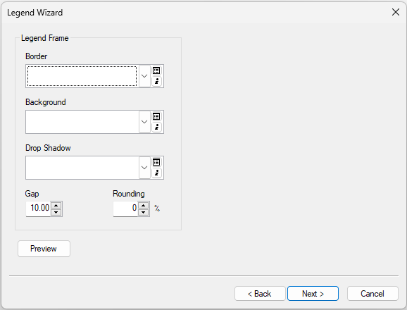
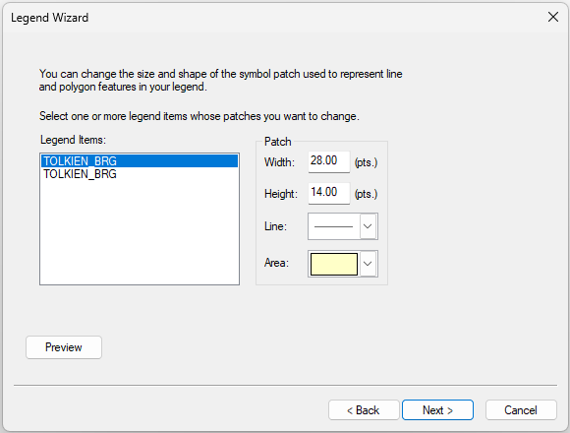
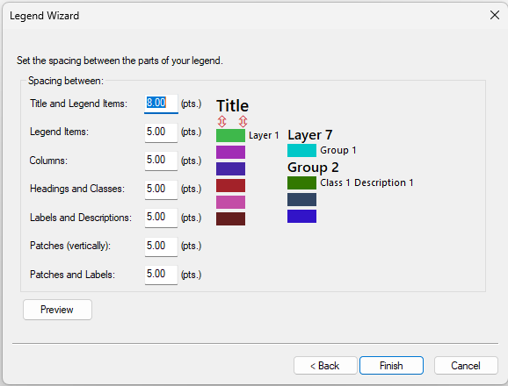
Creating the thematic map (Layout)
Add the legend
  Set the border, background, drop shadow, gap, and rounding of the legend frame (optional). Click Next.
  Change the size and shape of the symbol patch/es used to represent line and polygon features in your legend (optional). Click Next.
  Set the spacing between the patch/es of your legend (optional). Click Finish if you are done or click Back if you want to change the settings on the previous pages.
  To move the legend, click, hold, and drag it to the correct position. Or click it to select and use the arrow keys on your keyboard.
Save the
project!

Slide 33
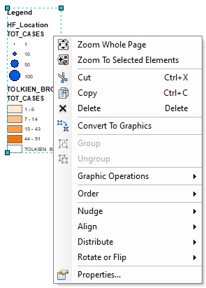
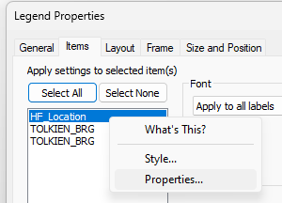
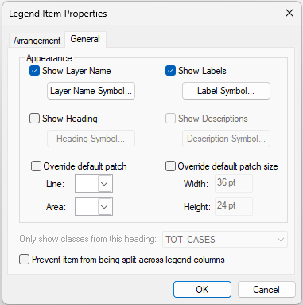
Creating the thematic map (Layout)
Edit the label of legend items
  To limit the text appearing in the legend, right-click on the legend and select Properties...
  In the Items tab of the Legend Properties dialog box, right-click on the HF_Location layer and select Properties...
  In the Legend Item Properties dialog box that opens, uncheck the Show Heading box. Click OK. (This removes the ‘TOT_CASES’ label in the legend.)

Slide 34
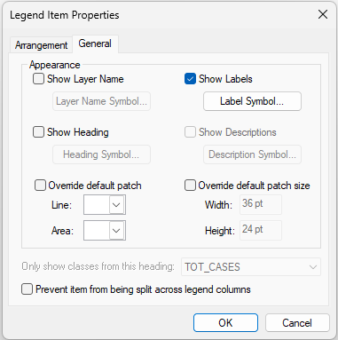
Creating the thematic map (Layout)
Edit the label of legend items
  Back in the Items tab of the Legend Properties dialog box, right-click on the first TOLKIEN_BRG layer and select Properties...
  In the Legend Item Properties dialog box that opens, check the Show Layer Name box. Click OK.
  Back in the Items tab of the Legend Properties dialog box, right-click on the second TOLKIEN_BRG layer and select Properties...
  In the Legend Item Properties dialog box that opens, uncheck both the Show Layer Name and the Show Heading boxes. Click OK.
  Click OK in the Legend Properties dialog box.

Slide 35
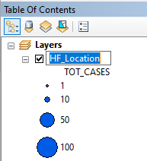
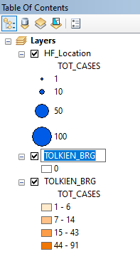

Creating the thematic map (Layout)
Edit the label of legend items
  In the ToC, click on the health facility layer and press F2 on your keyboard to be able to rename the layer. (Or do 2 slow clicks on the layer name.)
  Change the name of the layer as it should appear on the legend.
  Click on the first barangay layer and press F2 on your keyboard. Change the name of the layer as it should appear on the legend.
  Click the space beside the white rectangle of the first barangay layer and press F2 on your keyboard. Type “0” (to represent the barangays with zero cases).

Slide 36
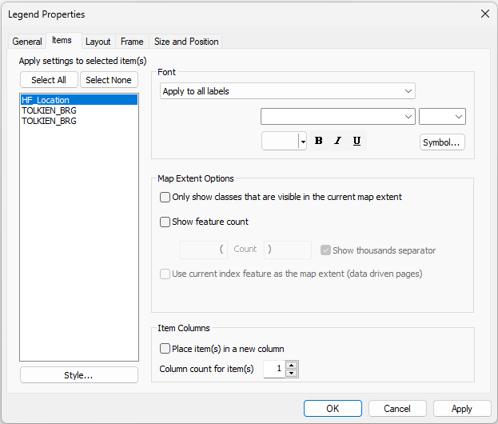
Creating the thematic map (Layout)
Edit the label of legend items
  You can play around with the different tabs in the Legend Properties to change the font settings, divide the legend into columns, adjust the symbology sizes, adjust the frame, etc.
Save the project!

Slide 37
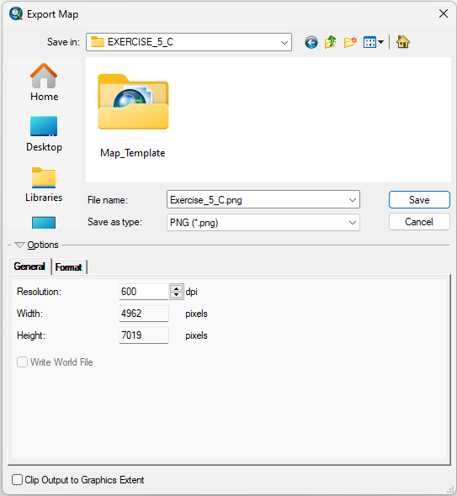
Creating the thematic map (Layout)
Export the map
Once you've finished laying out your map, you can export it as one of the various image files (.JPG, .PNG, .BMP, etc.), a scalable vector graphics (SVG) file, or a Portable Document Format (PDF) file.
  Click File > Export Map… from the main menu.
  In the Export Map dialog box that opens, go to the folder where you want to save your map.
  Type your file name and choose the file type.
  In the General tab at the bottom, set the resolution for your map.
  Click Save.
Have fun!
...and don't forget to save the project!

Slide 38
Criteria to judge the maps
Adapted to the purpose, audience, content and medium
Purpose: Assist on-going malaria control and elimination activities
Audience: Province-level Malaria Surveillance Officer
Content:
  Number of malaria cases:
    By place of reporting at the health facility level
    By place of reporting aggregated by Barangay
Medium: A4 size map stored as PDF
+
Include the key components that make a good map
Good luck !!!

