Slide 1
Exercise 5.B: Preparing and uploading the geospatial data in the GIS software (QGIS)
Notes:
MODULE 5: CREATING GOOD THEMATIC MAPS
Exercise 5.B: Preparing and uploading the geospatial data in the GIS software (QGIS)

Slide 2
Objectives
The objectives of this exercise are to teach participants how to:
Apply the lessons learned from Session 5.2
Prepare geospatial data for use in GIS software (QGIS)
Recommended background sessions
Although the modules in the HIS Geo-enabling Course can be taken separately, it is recommended for participants of Module 5 to go through Module 4, particularly Session 4.3 and Exercise 4.B beforehand.
These session and exercise will provide the necessary background and basic skills needed to be able to complete the present exercise.
Exercise Data
The data used in this exercise are fictitious and created only to facilitate the exercises in this course. The different geospatial objects are not related to any real location or infrastructure in the real world.

Slide 3
Request received for a map
Purpose: Assist on-going malaria control and elimination activities
Audience: Province-level Malaria Surveillance Officer
Content:
Number of malaria cases:
By place of reporting at the health facility level
By place of reporting aggregated by Barangay
Medium: A4 size map stored as PDF
What geospatial data do we need?

Slide 4
What geospatial data do we need?
For the Province of Tolkien, we need shapefiles containing the:
Boundaries of the Barangay with the unique identifiers from the master list included in the attribute table
Location of the health facilities with the unique identifier from the master list included in the attribute table
What geospatial data do we have?
Barangay boundaries shapefile (LMB)
Health facility master list that will be converted into the health facility location shapefile
Download the exercise data from: EXERCISE DATA
In the “MODULE_5” folder you created in the previous exercise, create a subfolder ”EXERCISE_5_B” and place the downloaded data there for easier access.
(i.e., C:\ or D:\MODULE_5\EXERCISE_5_B)

Slide 5
What geospatial data do we need?
Basemap
Satellite
images
Ground reference
Will be used to check the consistency, accuracy, and completeness of the geospatial data that we will be using

Slide 6
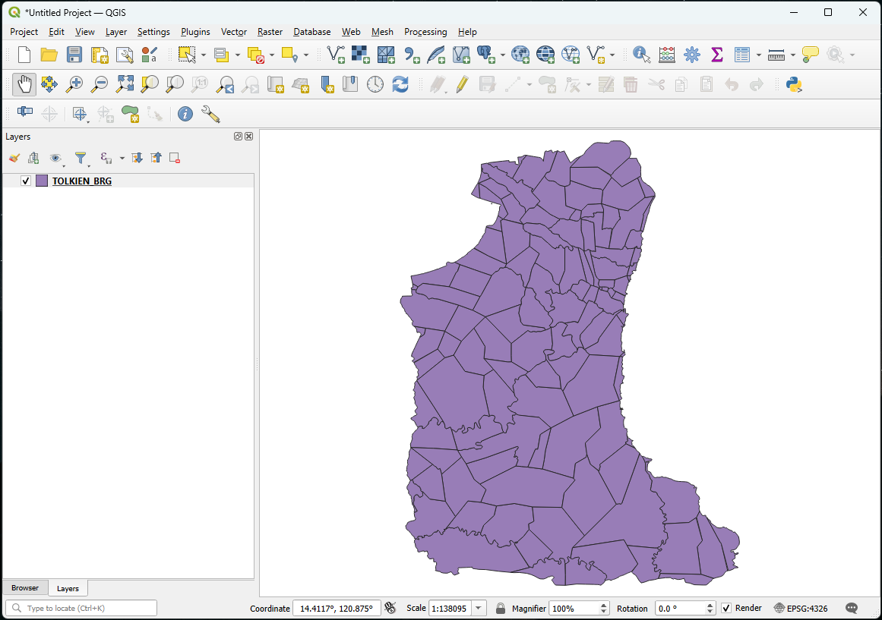
Exercise 5.B – Part 1
Barangay boundaries shapefile
Launch QGIS
Click on the Save button
Browse to the folder where you want to save your QGIS project
Enter a file name and click Save
Click the Add Vector Layer button
Browse to the location of the MODULE_5\EXERCISE_5_B\DATA\ BARANGAY_BOUNDARIES\LMB folder on your computer
Double-click on the TOLKIEN_BRG.shp file and click on the Add button
Close the Data Source Manager dialog box
The Barangay boundaries for the Province of Tolkien should appear in the map canvas of QGIS. (Random color is assigned.)

Slide 7
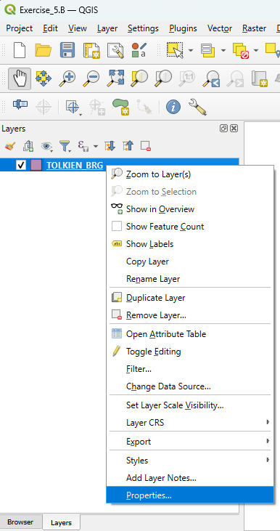
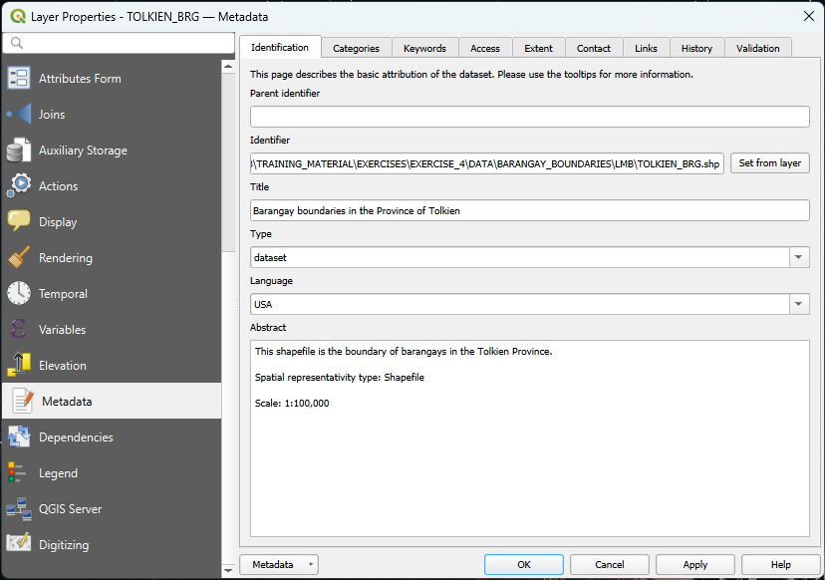
Exercise 5.B – Part 1
Barangay boundaries shapefile - Metadata
Right-click on the barangay boundaries layer and select Properties…
Select Metadata in the left-hand menu and have a look at information reported there
You can also have a look at the METADATA_LMB_BRG_BND.txt file stored in the MODULE_5\EXERCISE_5_B\DATA\BARANGAY_ BOUNDARIES\LMB folder to get information about this layer

Slide 8
Exercise 5.B – Part 1
Barangay boundaries shapefile - Projection
Still in the Layer Properties dialog box, click on Source.
The information about the geographic coordinate and projection system is stored under “Assigned Coordinate Reference System”
Layer not projected, only using a geographic coordinate system (WGS 84)
Close the Layer Properties dialog box.

Slide 9
Exercise 5.B – Part 1
Barangay boundaries shapefile – Attribute table
Right-click on the layer
Select Open Attribute Table in the menu
Take some time to look at how the attribute table is structured (rows, columns)
Does this remind you of another table we saw in the previous exercise?
Does the content of the shapefile match the content of the master list?

Slide 10
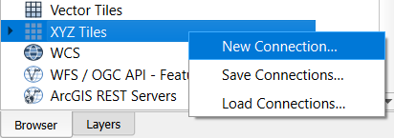
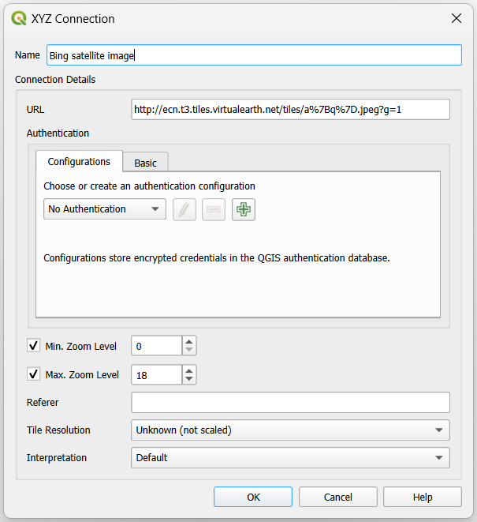
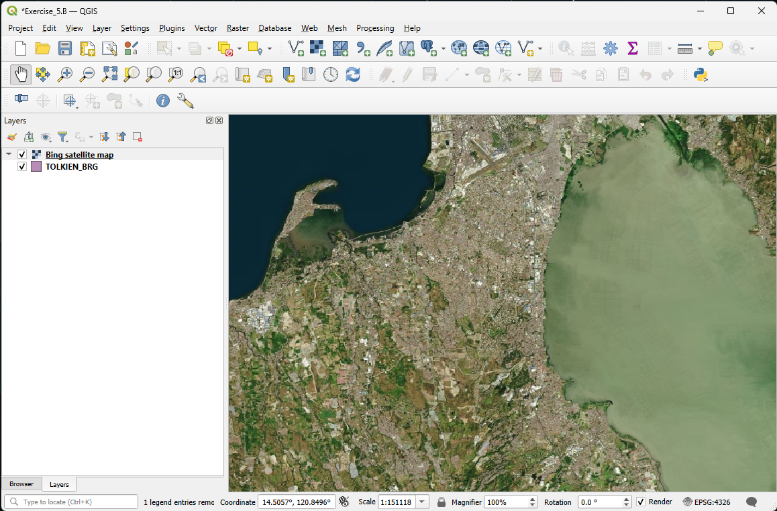
Exercise 5.B – Part 1
Barangay boundaries shapefile – Consistency with the satellite image used as ground reference
In the Browser Panel, expand XYZ Tiles. A Bing satellite image layer should already be there.
If this is not the case, right-click on XYZ Tiles then choose New Connection…
In the dialog box that opens:
Indicate the name under which you want to see this layer appear in the list (e.g., Bing satellite image)
Enter the URL of the WMS you want to use (LINK_BING_SATELLITE.txt file in the DATA folder)
Do not change the other settings in the dialog box. Click OK.
Double-click on the layer name under the XYZ Tiles
The satellite images should appear in the map canvas
Save the project!

Slide 11
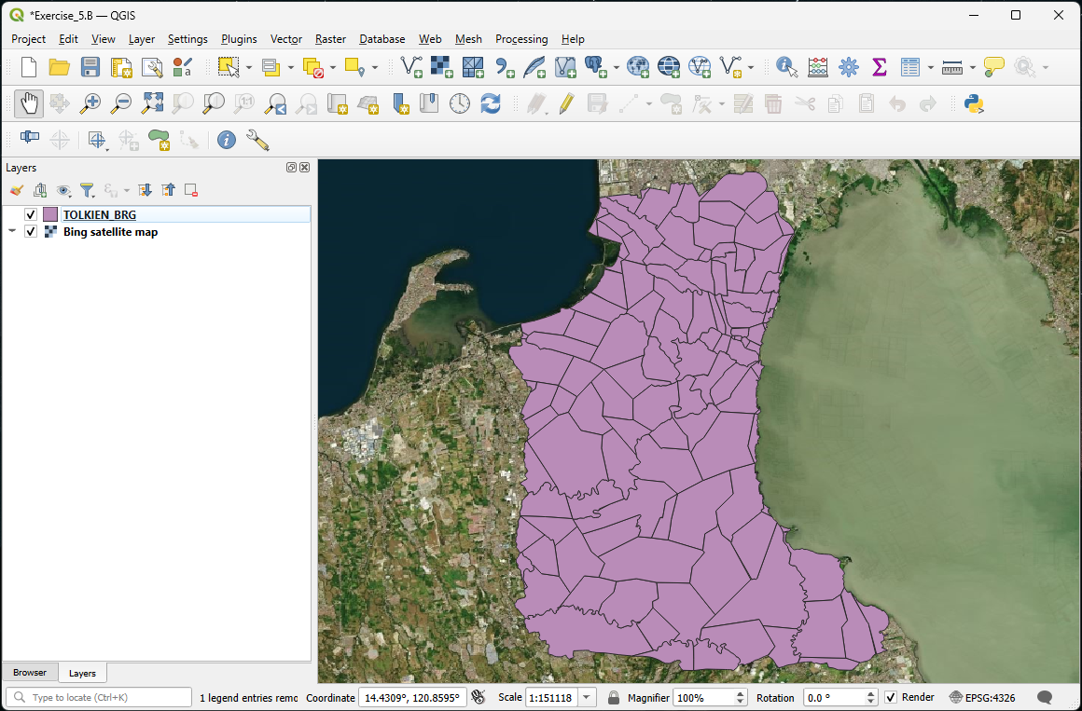
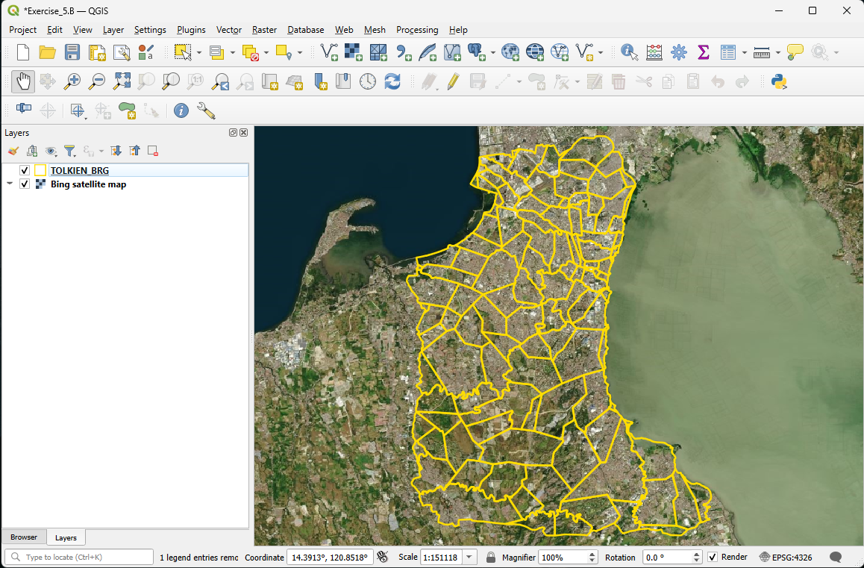
Exercise 5.B – Part 1
Barangay boundaries shapefile – Consistency with the satellite image used as ground reference
Move the satellite image basemap to the back of the Barangay boundaries
Change the symbology of the Barangay boundaries layer so that we can see the satellite images through it
Zoom on some areas to visually judge the accuracy of the Barangay boundaries
Uncheck the basemap and Barangay boundaries layer before moving to the next step
Save the project!

Slide 12
Exercise 5.B – Part 2
Health facilities location shapefile
Open the Health_Facilities_master_list_DOH_Jan2025.xls file in Excel (located inside MODULE_5\EXERCISE_5_B\DATA)
Look at the fields containing the information related to the geographic coordinates of the health facilities:
How many fields do you see?
What do these fields contain?
What is the level of accuracy of the geographic coordinates?

Slide 13
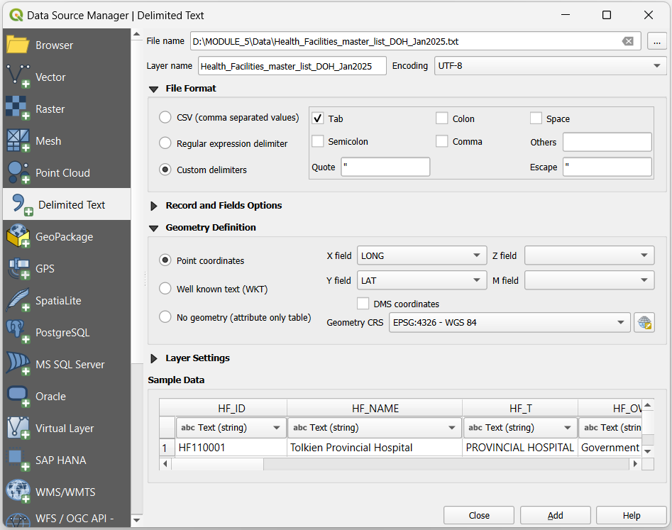
Exercise 5.B – Part 2
Health facilities location shapefile
We have to convert the content of the health facility master list into a shapefile
Save the Health_Facilities_master_list_DOH_Jan2025.xls as tab delimited (.txt) file
Close Excel
In QGIS:
Click on the Add Delimited Text Layer button
In the dialog box that opens:
Browse to the location of the .txt file
Select Custom delimiters under File format and check Tab
Indicate which fields contain the longitudes and latitudes and Project CRS; EPSG:4326 – WGS 84 under Geometry definition
Click Add then Close.

Slide 14
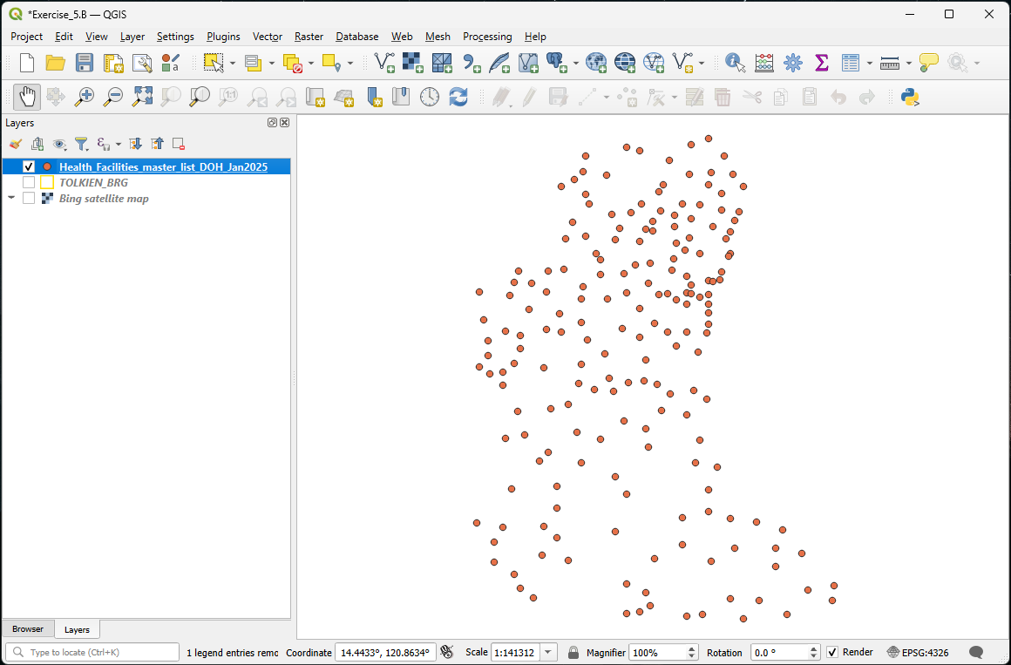
Exercise 5.B – Part 2
Health facilities location shapefile
The locations of the health facilities included in the master list should appear in the map canvas
Save the project!
The points are not yet saved in a shapefile!!!

Slide 15
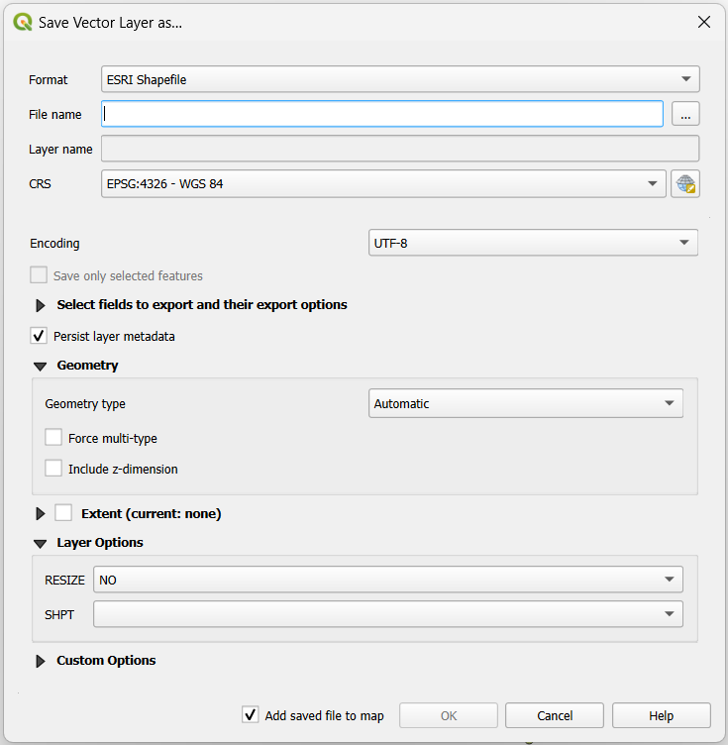
Exercise 5.B – Part 2
Health facilities location shapefile
To save the points as a shapefile:
Right-click on the layer containing the points in the layer panel and click on Export > Save Features As…
In the dialog box that opens:
Select Esri Shapefile as the Format
Browse to the folder where you want to save it and give it a name (HF_Location.shp)
Keep EPSG:4326 - WGS 84 as the CRS
Click OK

Slide 16
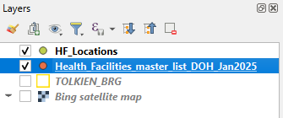
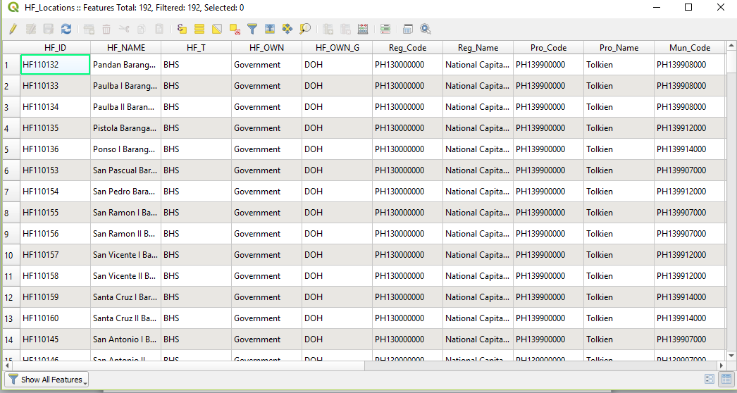
Exercise 5.B – Part 2
Health facilities location shapefile
The new shapefile is now added to the Layers panel
You can delete the temporary layer by right-clicking on it and then selecting Remove Layer.
Once done, save the project and:
Make sure that all the points are falling within the Tolkien Province (click on the Zoom Full button for that )
Open the attribute table and check that all the content from the master list is there (191 health facilities)
Check that the health facilities are falling within the correct City and Barangay
Save the project!

Slide 17
Exercise 5.B – Conclusion
Geospatial data can be stored in different ways (geographic coordinates in an excel file, shapefile, raster grid,…)
It is very important to remain very critical about the data you are using to make sure that it is of good quality and corresponds to your needs
Metadata
Ground reference
Always make sure that all the data you use have the same datum, or even better, the same geographic coordinate system and projection to avoid shifts between layers.

Slide 18
Exercise 5.B – Conclusion
Ready to make some maps!!

