Slide 1
Exercise 5.B: Preparing and uploading the geospatial data in the GIS software (ArcMap)
Notes:
MODULE 5: CREATING GOOD THEMATIC MAPS
Exercise 5.B: Preparing and uploading the geospatial data in the GIS software (ArcMap)

Slide 2
Objectives
The objectives of this exercise are to teach participants how to:
Apply the lessons learned from Session 5.2
Prepare geospatial data for use in GIS software (ArcMap)
Recommended background sessions
Although the modules in the HIS Geo-enabling Course can be taken separately, it is recommended for participants of Module 5 to go through Module 4, particularly Session 4.3 and Exercise 4.B beforehand.
These session and exercise will provide the necessary background and basic skills needed to be able to complete the present exercise.
Exercise Data
The data used in this exercise are fictitious and created only to facilitate the exercises in this course. The different geospatial objects are not related to any real location or infrastructure in the real world.

Slide 3
Request received for a map
Purpose: Assist on-going malaria control and elimination activities
Audience: Province-level Malaria Surveillance Officer
Content:
Number of malaria cases:
By place of reporting at the health facility level
By place of reporting aggregated by Barangay
Medium: A4 size map stored as PDF
What geospatial data do we need?

Slide 4
What geospatial data do we need?
For the Province of Tolkien, we need shapefiles containing the:
Boundaries of the Barangay with the unique identifiers from the master list included in the attribute table
Location of the health facilities with the unique identifier from the master list included in the attribute table
What geospatial data do we have?
Barangay boundaries shapefile (LMB)
Health facility master list that will be converted into the health facility location shapefile
Download the exercise data from: EXERCISE DATA
In the “MODULE_5” folder you created in the previous exercise, create a subfolder ”EXERCISE_5_B” and place the downloaded data there for easier access.
(i.e., C:\ or D:\MODULE_5\EXERCISE_5_B)

Slide 5
What geospatial data do we need?
Basemap
Satellite
images
Ground reference
Will be used to check the consistency, accuracy, and completeness of the geospatial data that we will be using

Slide 6
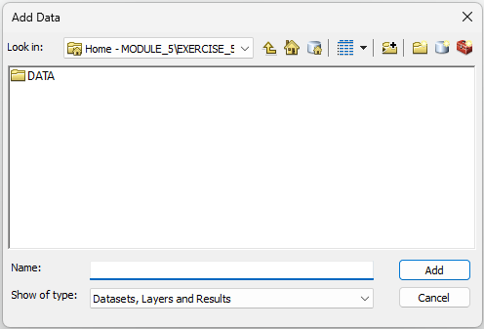
Exercise 5.B – Part 1
Barangay boundaries shapefile
Launch ArcMap
Click the Save button
Browse to the folder where you want to save your ArcMap project (Preferably inside the MODULE_5\EXERCISE_5_B folder to facilitate faster access to the exercise data)
Enter a file name (e.g., Exercise_5_B) and click Save.
Click the Add Data button
The ‘Home’ path should already be the MODULE_5\EXERCISE_5_B if you had saved the ArcMap project in the same folder. Go to the DATA\ BARANGAY_BOUNDARIES\LMB folder
Otherwise, you would first have to create a connection to the MODULE 5 folder by clicking the Connect To Folder button. In the dialog box that opens,
Browse to the location of the MODULE_5 \EXERCISE_5_B folder
Select the EXERCISE_5_B folder
Click OK.

Slide 7
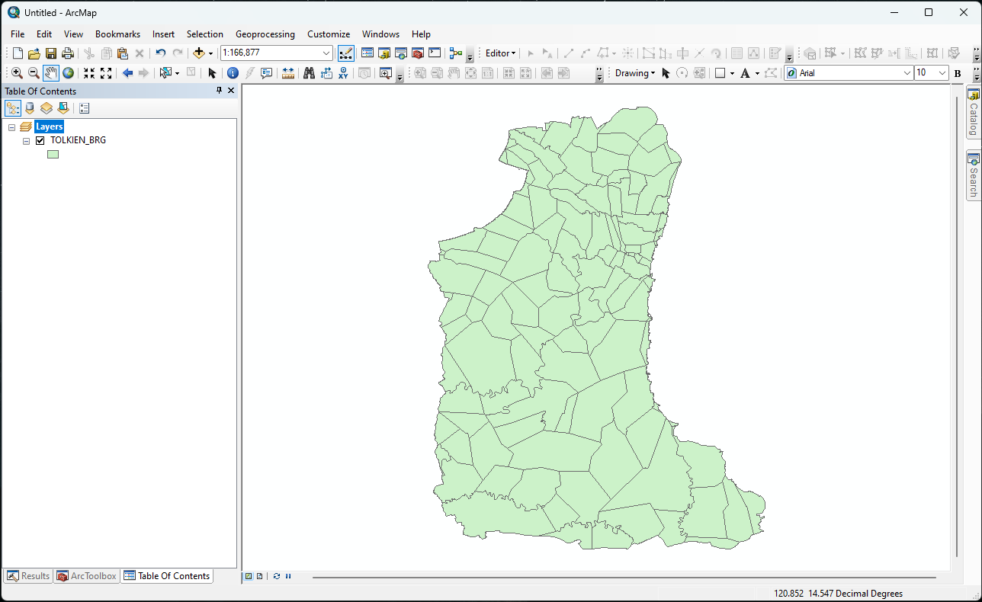
Exercise 5.B – Part 1
Barangay boundaries shapefile
Select the TOLKIEN_BRG.shp file and click the Add button
The Barangay boundaries for the Province of Tolkien should appear in the map display area of ArcMap. (Random color is assigned.)
Click on the Save button

Slide 8
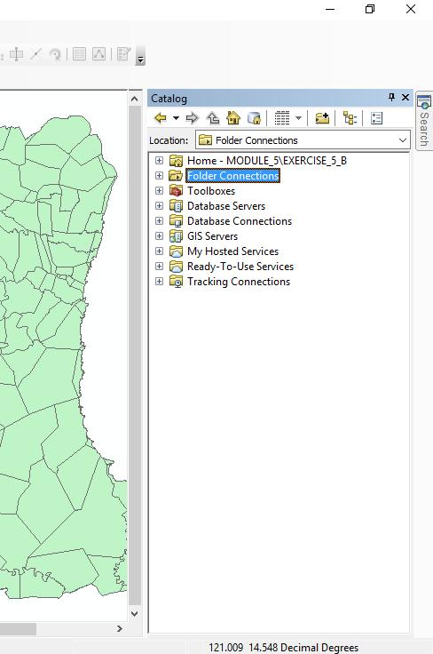
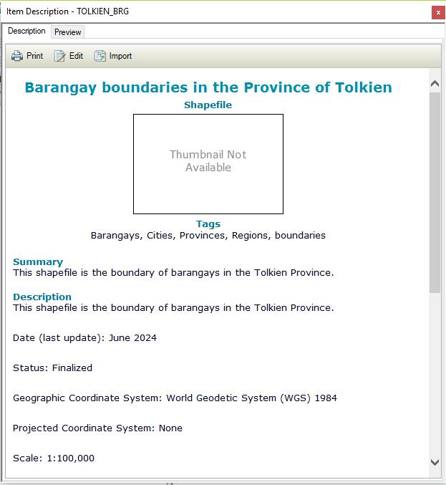
Exercise 5.B – Part 1
Barangay boundaries shapefile - Metadata
Click the Catalog button from the Toolbar. The Catalog pane will open on the right side of ArcMap.
From the Home location or Folder Connections, navigate to the location of the TOLKIEN_BRG.shp.
Right-click on the barangay boundaries shapefile and select Item Description…
The Item Description window will open. Have a look at information reported there.
You can also have a look at the METADATA_LMB_BRG_BND.txt file stored in the MODULE_5\Exercise_5_B\DATA\BARANGAY_BOUNDARIES\LMB folder to get information about this layer.

Slide 9
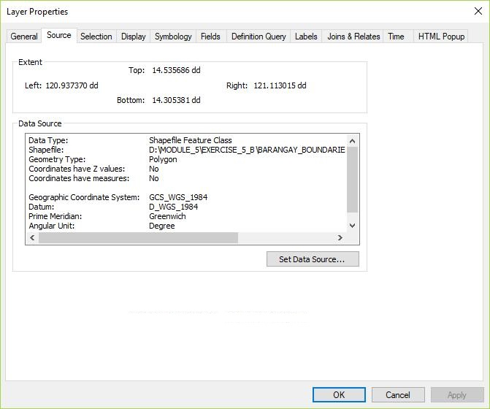
Exercise 5.B – Part 1
Barangay boundaries shapefile - Projection
Right-click on the barangay boundaries layer and select Properties…
In the Layer Properties dialog box, click on the Source tab.
The information about the geographic coordinate and projection system is stored under “Data Source”
Layer not projected, only using a geographic coordinate system (WGS 84)
Close the Layer Properties dialog box.

Slide 10
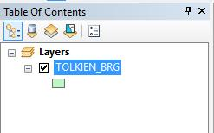
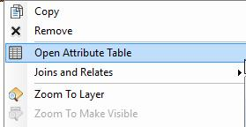
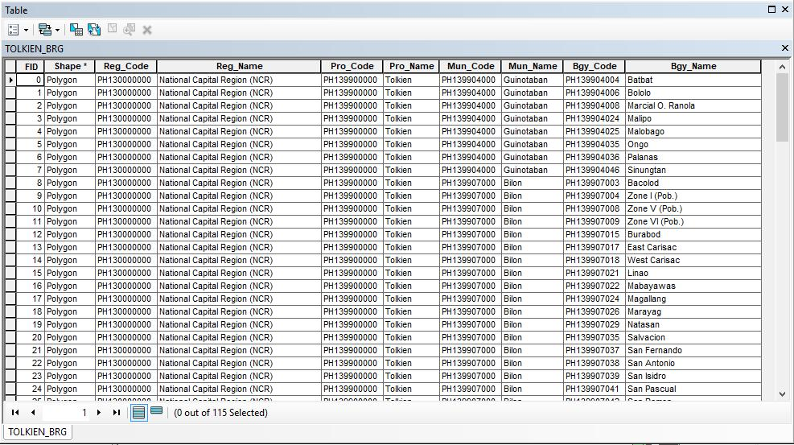
Exercise 5.B – Part 1
Barangay boundaries shapefile – Attribute table
Right-click on the layer
Select Open Attribute Table in the menu
Take some time to look at how the attribute table is structured (rows, columns)
Does this remind you of another table we saw in the previous exercise?
Does the content of the shapefile match the content of the master list?

Slide 11
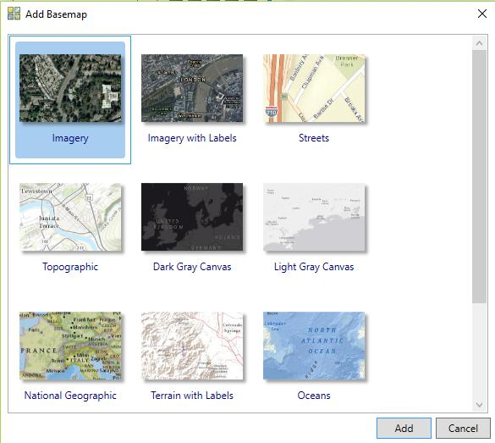
Exercise 5.B – Part 1
Barangay boundaries shapefile – Consistency with the satellite image used as ground reference
Click the dropdown arrow of the Add Data button and select Add Basemap…
Select Imagery then click Add.
Note: An internet connection is needed to add a basemap on ArcMap.
The satellite images should appear in the map display and in the Table of Contents (ToC) below the barangay layer.
Save the project!

Slide 12
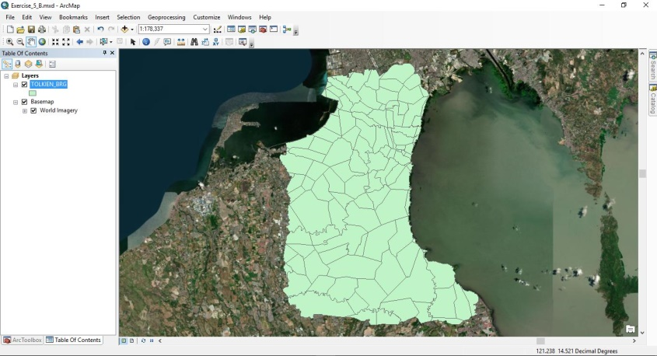
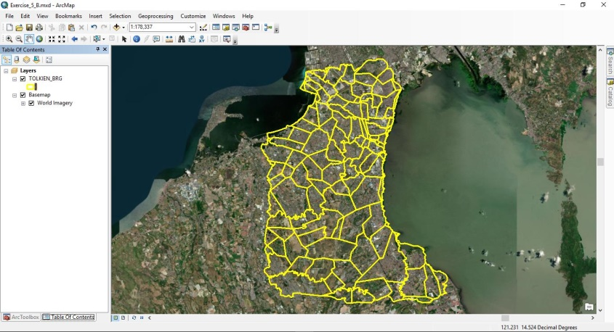
Exercise 5.B – Part 1
Barangay boundaries shapefile – Consistency with the satellite image used as ground reference
Change the symbology of the Barangay boundaries layer so that we can see the satellite images through it.
Zoom on some areas to visually judge the accuracy of the Barangay boundaries
Uncheck the basemap and Barangay boundaries layer before moving to the next step.
Save the project!

Slide 13
Exercise 5.B – Part 2
Health facilities location shapefile
Open the Health_Facilities_master_list_DOH_Jan2025.xls file in Excel (located inside MODULE_5\Exercise_5_B\DATA)
Look at the fields containing the information related to the geographic coordinates of the health facilities:
How many fields do you see?
What do these fields contain?
What is the level of precision of the geographic coordinates?

Slide 14
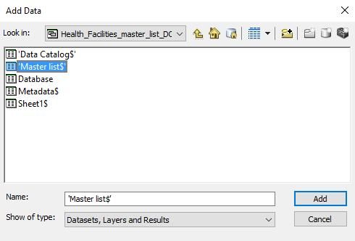
Exercise 5.B – Part 2
Health facilities location shapefile
We have to convert the content of the health facility master list into a shapefile
Click the Add Data button
Browse to the location of the Health_Facilities_master_list_DOH_Jan2025.xls
Double-click on the Excel file. This will show the different worksheets in the file.
Select the worksheet containing the needed data ('Master list$‘)
Click Add.

Slide 15
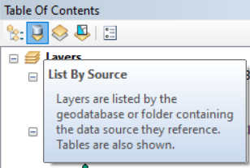
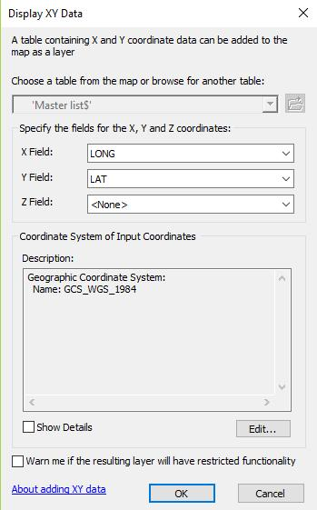
Exercise 5.B – Part 2
Health facilities location shapefile
Right-click on the added worksheet and select Display XY Data… (If you cannot see the worksheet, click the List By Source button for the Table of Contents.)
In the dialog box that opens,
Choose the corresponding fields for the X and Y Fields (if not already chosen by default)
Keep the default geographic coordinate system
Click OK.
(You may get a warning message that the table does not have Object-ID field. Click OK.)

Slide 16
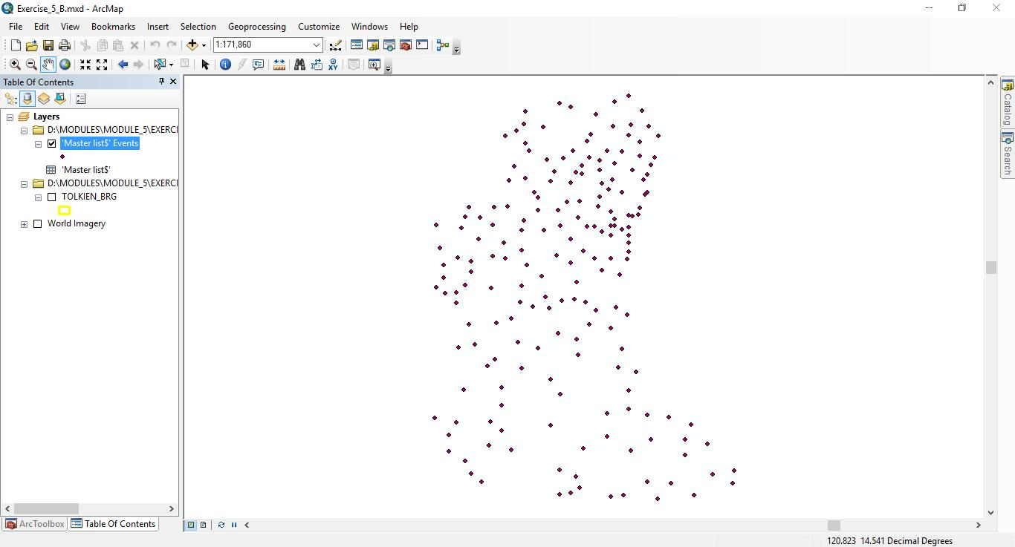
Exercise 5.B – Part 2
Health facilities location shapefile
The locations of the health facilities included in the master list should appear in the map display.
Save the project!
The points are not yet saved in a shapefile!!!

Slide 17
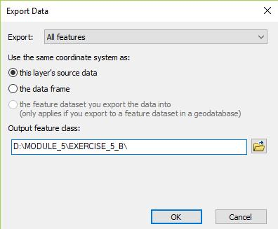
Exercise 5.B – Part 2
Health facilities location shapefile
To save the points as a shapefile:
Right-click on the layer containing the points in the ToC and click on Data > Export Data…
In the dialog box that opens:
Browse to the location where you want to save the shapefile (e.g., MODULE_5\EXERCISE _5_B\DATA)
Give it a name (HF_Location.shp) and click Save.
Click OK.
When prompted if you want to add the exported data to the map, choose Yes.

Slide 18
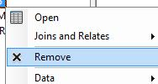
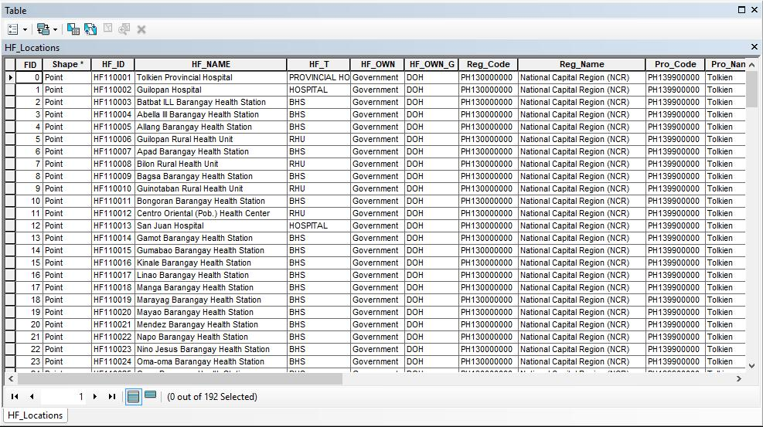
Exercise 5.B – Part 2
Health facilities location shapefile
The new shapefile is now added to the Table of Contents
You can delete the worksheet and temporary layer by right-clicking on each and then choosing on Remove.
Once done, save the project and:
Make sure that all the points are falling within the Tolkien Province (Right-click on the HF_Location layer and choose Zoom To Layer)
Open the attribute table and check that all the content from the master list is there (191 health facilities)
Check that the health facilities are falling within the correct City and Barangay
Save the project!

Slide 19
Exercise 5.B – Conclusion
Geospatial data can be stored in different ways (geographic coordinates in an excel file, shapefile, raster grid,…)
It is very important to remain very critical about the data you are using to make sure that it is of good quality and corresponds to your needs
Metadata
Ground reference
Always make sure that all the data you use have the same datum, or even better, the same geographic coordinate system and projection to avoid shifts between layers.

Slide 20
Exercise 5.B – Conclusion
Ready to make some maps!!

