Slide 1
Session 4.4: Introduction to the concepts of registry and Common Geo-Registry (CGR)
Notes:
MODULE 4: HANDS-ON GEOSPATIAL TECHNOLOGIES
Session 4.4: Introduction to the concepts of registry and Common Geo-Registry (CGR)

Slide 2
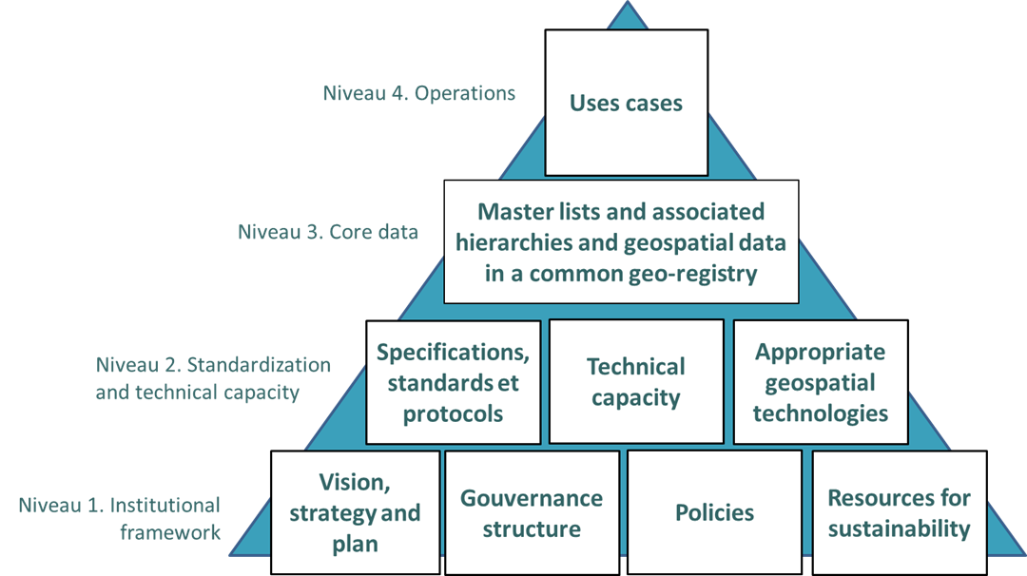
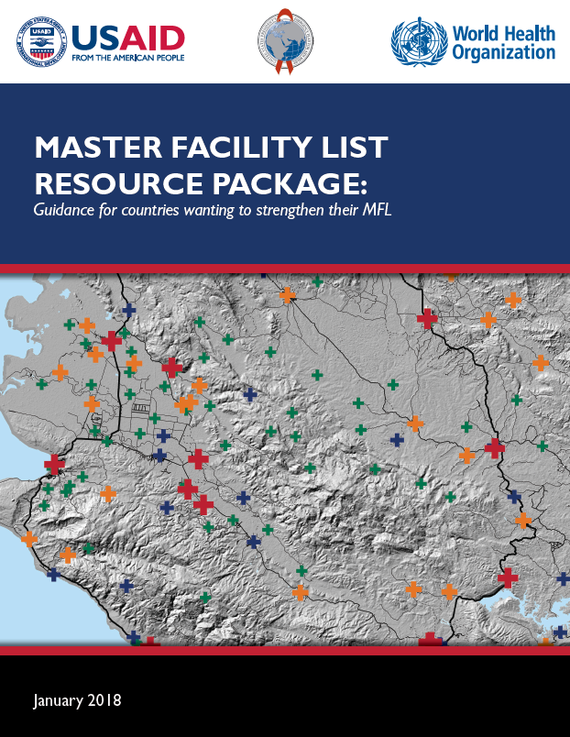
The importance of the registry concept in the HIS geo-enabling framework
Master lists are pivotal to the framework and the operationalization of strong use cases supporting planning and decision making
As the information contained in these master lists, as well as the associated geospatial data, evolves through time, there is a need for an IT solution that would store, manage, regularly update, and share them
Registry or common geo-registry
Ideally deployed/developed and maintained as part of the geo-enablement of the HIS

Slide 3
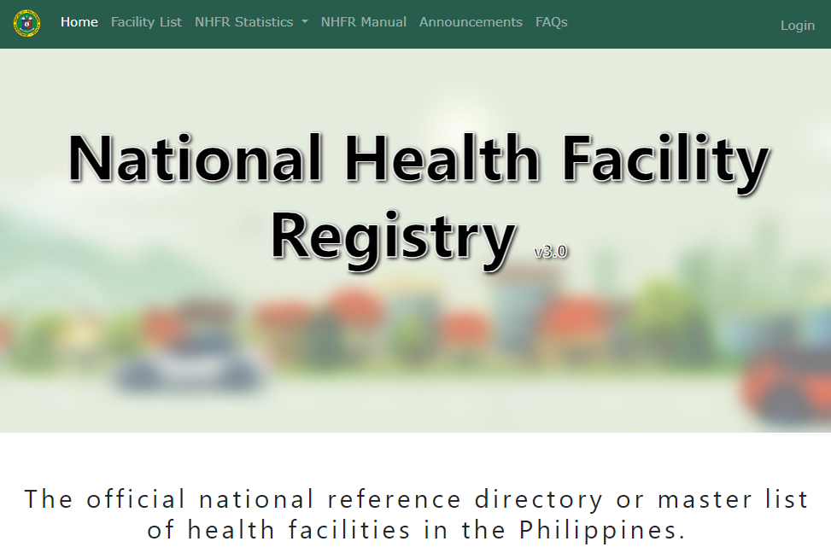
The concept of registry
An IT solution that allows storing, managing, validating, updating and sharing of the master list for a specific geographic object. It is the “container” for the master list.
Example of the National Registry of Health Facilities from the Department of Health of the Philippines: https://nhfr.doh.gov.ph/Home
Container that manages a single master list…
…but Public Health requires considering several types of geographic features/objects at the same time (health facilities, administrative units, villages, etc.) and these features/objects are connected to each other through different types of relationships (geographic, administrative, referral,…) and all of these changes through time….
https://drive.google.com/file/d/1jj779zww4herWOESAd9mXqVE1YfQehtH/view

Slide 4
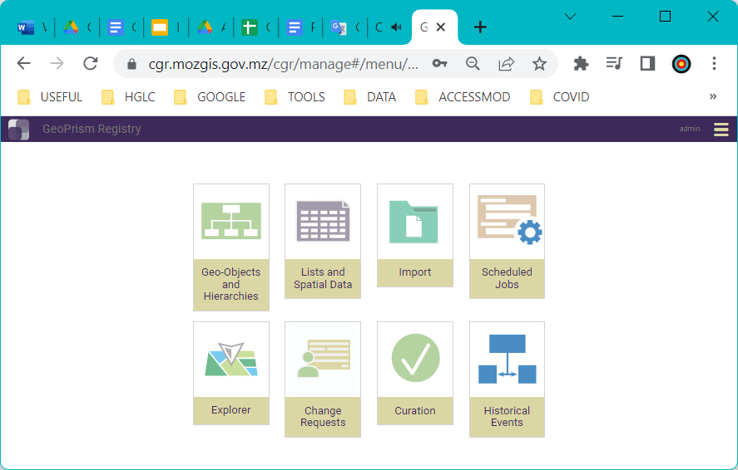
The Concept of Common Geo-Registry (CGR)
IT solution that allows the simultaneous hosting, management, regular update, and sharing of the master lists as well as associated hierarchies and geospatial data for the geographic objects core to development in general and public health in particular.
Container that simultaneously manages, regularly updates, and hosts multiple master lists and their associated hierarchies and geospatial data:
Unlimited number of geographic objects (facilities, administrative divisions, reporting divisions, villages,…) and hierarchies
Multiple organizations and different types of users
Handles changes over time down to the data element level
Accessible by any information system part of, or outside, the HIS
Supports the National Spatial Data Infrastructure (NSDI)
GeoPrism Registry
https://geoprismregistry.com/
4
https://healthgeolab.net/DOCUMENTS/Guidance_Common_Geo-registry_Ve2.pdf

Slide 5
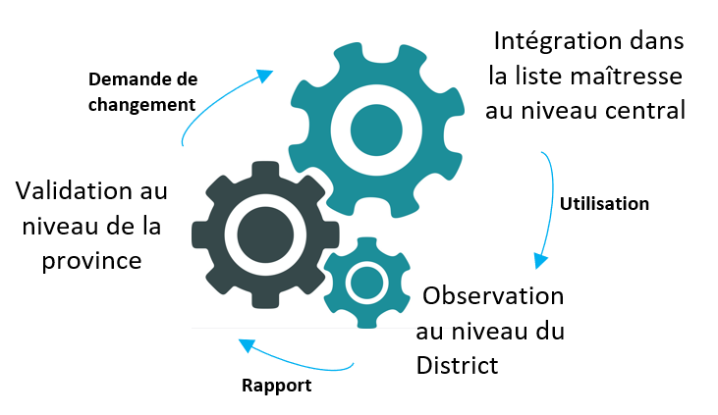
The Concept of Common Geo-Registry (CGR)
1. Contextualize data from different sources in space and time
5. “Geo-enabled” applications»
1. Mandated government institutions
National Mapping Agency
Ministry of Health
Ministry of Health
2. Use geographic features as a common link between data sources
Ministry of the Interior
Ministry of Education
Ministry of Education
ID | Name
910 | Thantoxaly
920 | Pientiaver
Common Geographic registry (RGC)
Master lists
Operational lists
Ministry of the Interior
3 Facilitate trend analysis
Hierarchies
3. Common and official geography over time
Geospatial data
Bureau of Statistics
2. Hosting, management, updating, sharing
4. Aggregate data according to different hierarchies
4. Users
5
5. Use GIS to create thematic maps, perform spatial analyses, or apply spatially distributed models

Slide 6
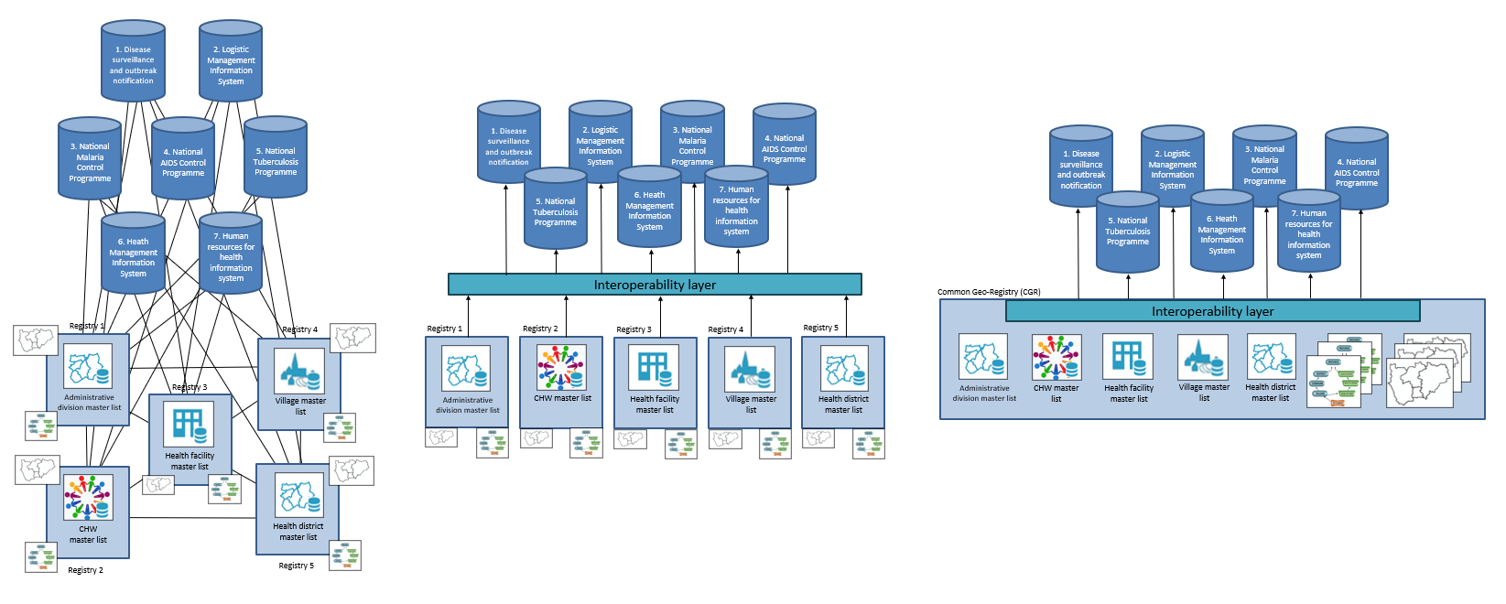
From separated registries to a Common Geo-Registry (CGR)
1. One registry per geographic feature, no interoperability layer
2. One registry per geographic feature with a separated interoperability layer
3. One common geo-registry with an integrated interoperability layer
Only one registry to maintain
Exchange only needed between the common geo-registry and each information system
Easier to scale up
Large number of registries to maintain
Still a significant volume of exchange between registries to ensure data quality, including consistency between them
Difficult to scale up
Large number of registries to maintain
Important volume of exchange to ensure data quality between registries and information systems
Very difficult to scale up
Model promoted by the HIS geo-enabling framework

Slide 7
How to select and operationalize the appropriate IT solution to serve
as registry or common geo-registry?
1
Establish a technical working group
Document the use cases justifying the deployment of a registry or common geo-registry and define the business requirements
Assess the current enabling environment
Define what the registry needs to do
Identify the appropriate IT solution to serve as registry
Develop the implementation, monitoring, evaluation, and communication plans
Deploy or develop the selected IT solution to serve as a registry (planning, implementation, configuration (e.g.: language, roles), quality assurance)
Upload the current version of the list(s) or master list(s) with associated hierarchies and geospatial data into the registry
Test, and if necessary, adjust the registry’s functionalities
Operationalize the registry (training of the manager and users, operational support, continuous monitoring, content updating mechanism, maintenance, etc.)
2
3
+ one toolkit under finalization by UNICEF and WHO to support the identification and deployment of a health facility registry service in countries
Key steps also applicable to other geospatial technologies but very often bypassed
1 https://www.unicef.org/documents/implementation-support-guide-development-national-georeferenced-community-health-worker
2 https://healthgeolab.net/KNOW_REP/MFL_Resource_Package_Jan2018.pdf
3 https://healthgeolab.net/DOCUMENTS/Guidance_Common_Geo-registry_Ve2.pdf

Slide 8
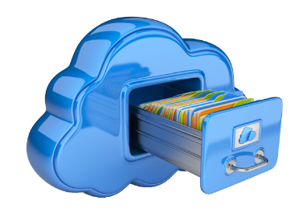
Document use cases and define business requirements –
Example for the Health Facility Registry Service (HFRS)
A platform for storing, managing, and sharing the health facility master list and associated data and information
The business requirements of a HFRS are directly found in its definition:
Store: Provide the necessary functionalities to ensure the storage, security, and scalability of the registry’s content in a usable, reliable, cost-effective, and performing environment.
Manage: Provide the necessary functionalities for the authorized users to effectively manage the content of the registry and ensure its quality and integrity.
Share: Provide the necessary functionalities to ensure proper access to the registry’s content as well as its exchange with other systems and applications as articulated by the national digital health enterprise architecture.

Slide 9
Document use cases and define business requirements –
Example for the Health Facility Registry Service (HFRS)
Non-exhaustive list of benefits (use cases) considering that the HFRS, together with the HFML and other data it contains, is meant to serve as a backbone of the digital health system:
Data standardization and quality: A health facility registry enforces data standardization and, as such, the quality of the information collected and stored in the master list.
Interoperability: A health facility registry enables data interoperability and sharing between information systems collecting, managing, and/or analyzing facility level data and information.
Online access: A standardized health facility registry facilitates online use of information contained in the master list including, when appropriate, the creation of a public-facing portal for users to access basic information about nearby health facilities.
Data-driven decision making: A well-maintained health facility master list accessible through a registry empowers policymakers, healthcare administrators, and stakeholders with accurate, ideally real-time data and reports. This facilitates evidence-based decision-making, allowing for informed policy formulation, strategic planning, and resource allocation.
Efficient resource management: By centralizing information about health facilities, the registry first reduces duplication of efforts through the centralized management and regular update of the master list. It then enables efficient resource allocation for better health care access and delivery. It aids in identifying gaps in services, redistributing resources, and strategically planning infrastructure development.

Slide 10
Define use cases for a registry
(example: registry for the master list of health facilities)
Document use cases and define business requirements –
Example for the Health Facility Registry Service (HFRS)
Optimized public health interventions: Timely access to health facility master list of quality through a registry enables authorities to design and implement targeted public health interventions efficiently.
Enhanced coordination and collaboration: The sharing and accessibility of up-to-date information across various stakeholders within the healthcare system foster collaboration and coordination not only at the national but also regional and global level. This proves invaluable during emergencies, public health crises, and routine healthcare delivery.
Transparency and accountability: The transparency offered by a comprehensive health facility master list hosted in a registry fosters accountability among healthcare providers and institutions. It allows for monitoring quality standards, compliance with regulations, and assessing the performance of facilities.
Innovation and research: Researchers and analysts benefit from the data contained in the registry to conduct studies, analyzing trends, and identifying areas for improvement. This aids in fostering innovation and driving advancements in healthcare practices.
Programmatic use cases are not included here because a HFRS is meant to support any program or intervention in view of the nature of its content

Slide 11
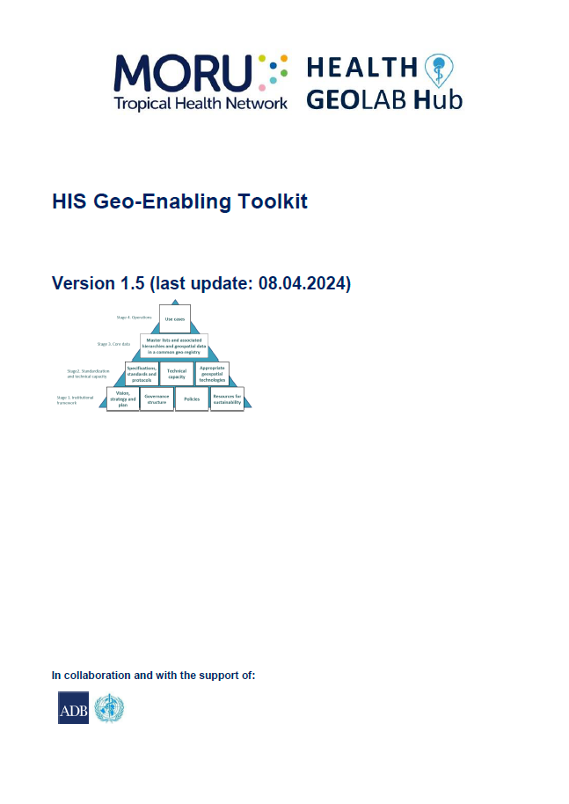
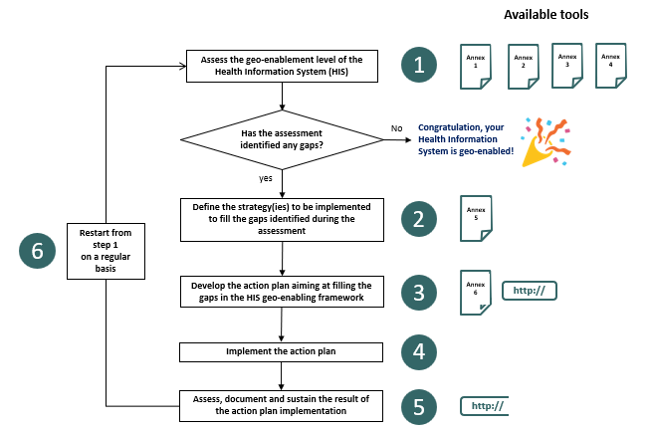
Assess the enabling environment
1
Correspond to the first two levels of the HIS geo-enabling framework.
Directly linked to the assessment step of the HIS geo-enabling process (Session 2.2)
2
1 https://healthgeolab.net/KNOW_REP/MFL_Resource_Package_Jan2018.pdf
2 https://www.healthgeolab.net/DOCUMENTS/HIS_geo-enabling_toolkit.pdf

Slide 12
Define the business requirements (what, why) of a registry
(example: registry for the master list of health facilities)
Define what the registry needs to do – Example for the
Health Facility Registry Service (HFRS)
Having a clearly documented picture of what the HFRS needs to do is a critical step towards not only being in the position to identify the appropriate IT solution but also to communicate with vendors, and when applicable developers, as well as contract them.
A great level of attention should be given to this step to avoid misunderstandings between parties, frustrations, delays, cost overruns, and even failure.
In the case of a HFRS, this picture can be obtained by identifying and documenting the following:
The data ecosystem to be covered by the HFRS (geographic features, hierarchies, data dictionary, and associated classification tables, data source)
The task flows and user roles to be supported by the HFRS.
The functional and non-functional requirements that the HFRS should fulfill.
The expected user experience.
Master list(s) and associated data/information managed by the registry
Covered now

Slide 13
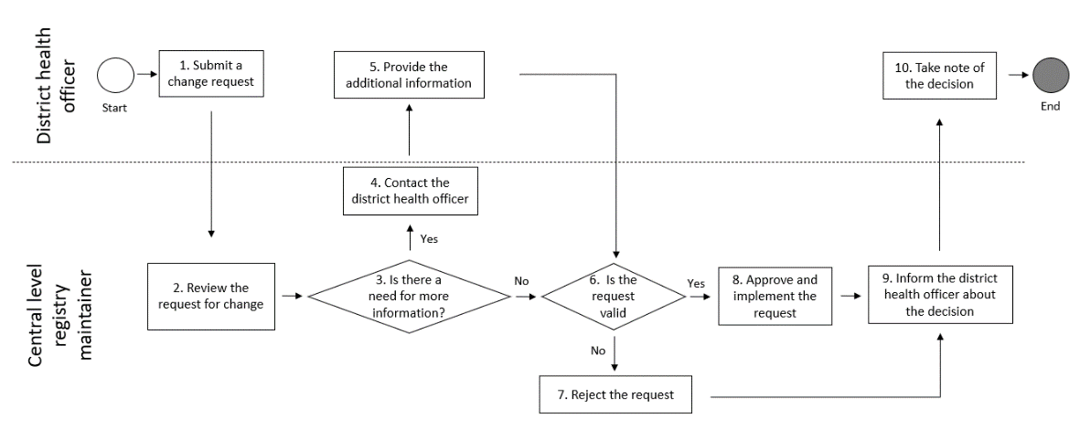
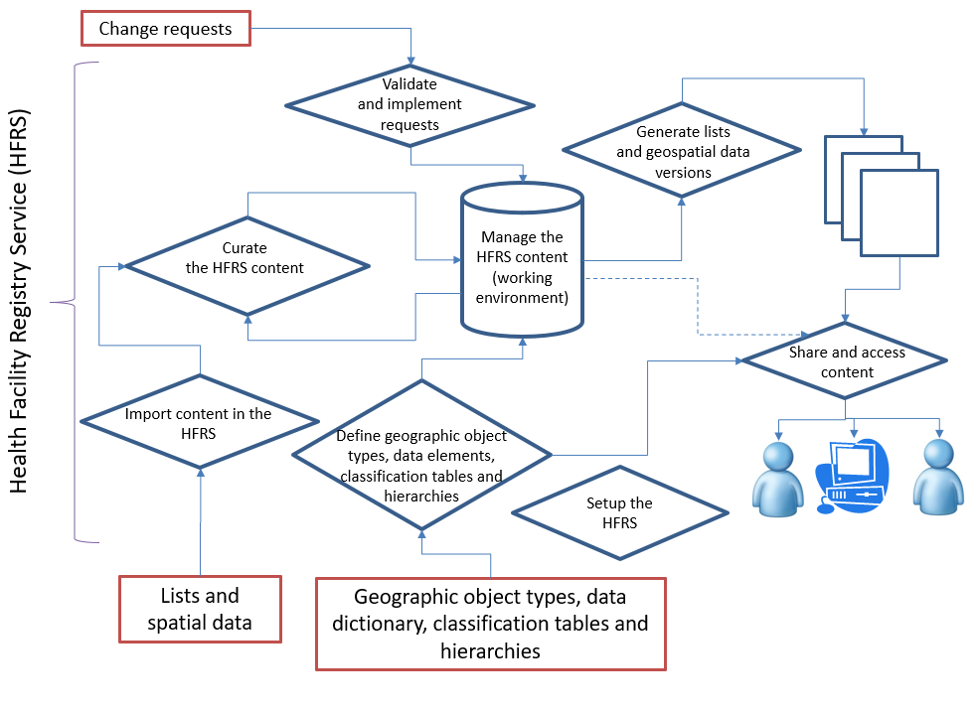
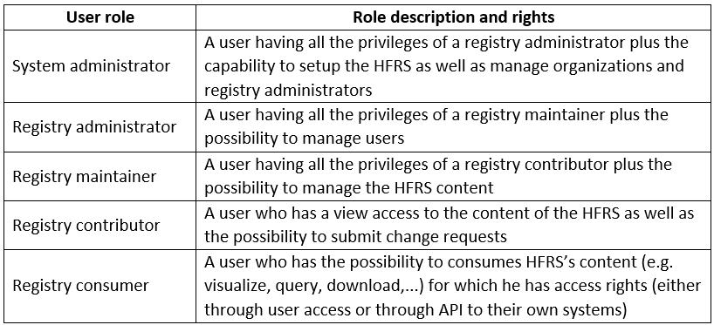
Define the functional requirements (how) of a registry
(example: registry for the master list of health facilities)
Define what the registry needs to do – Example for the
Health Facility Registry Service (HFRS)
Task flows and user roles
Example of task flow for the submission and treatment of a change request
Organization of business processed in a HFRS
Example of user roles

Slide 14
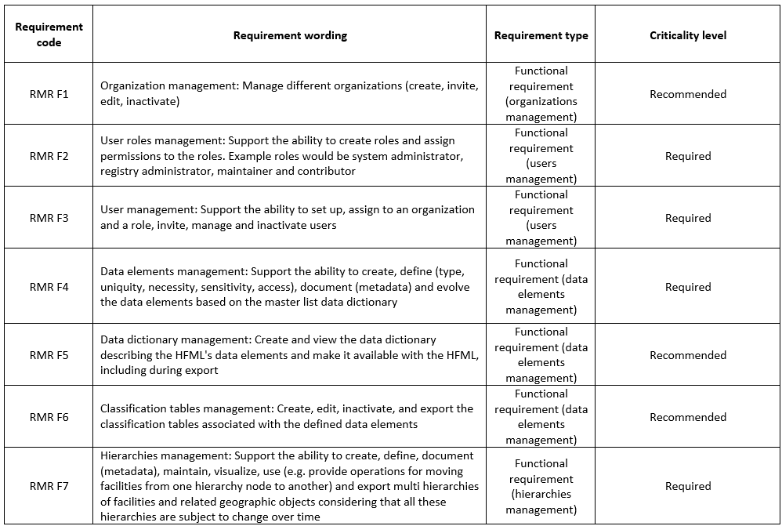
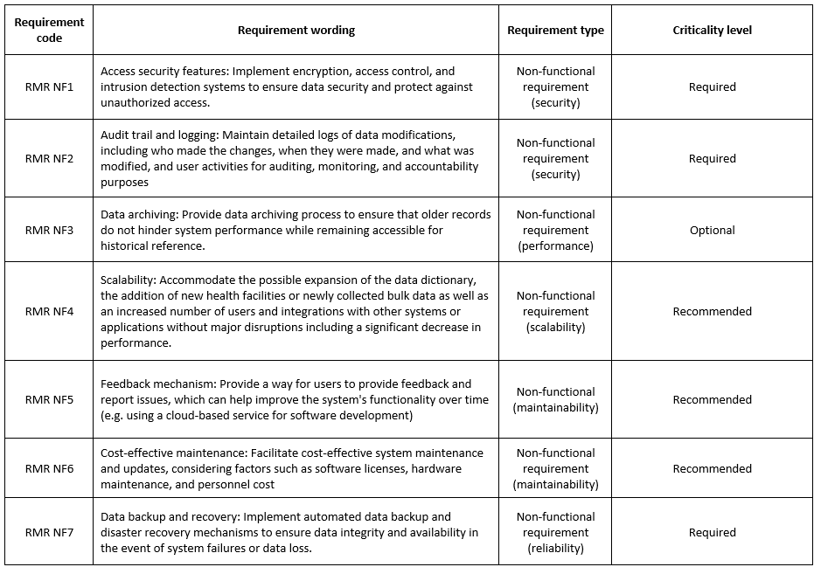
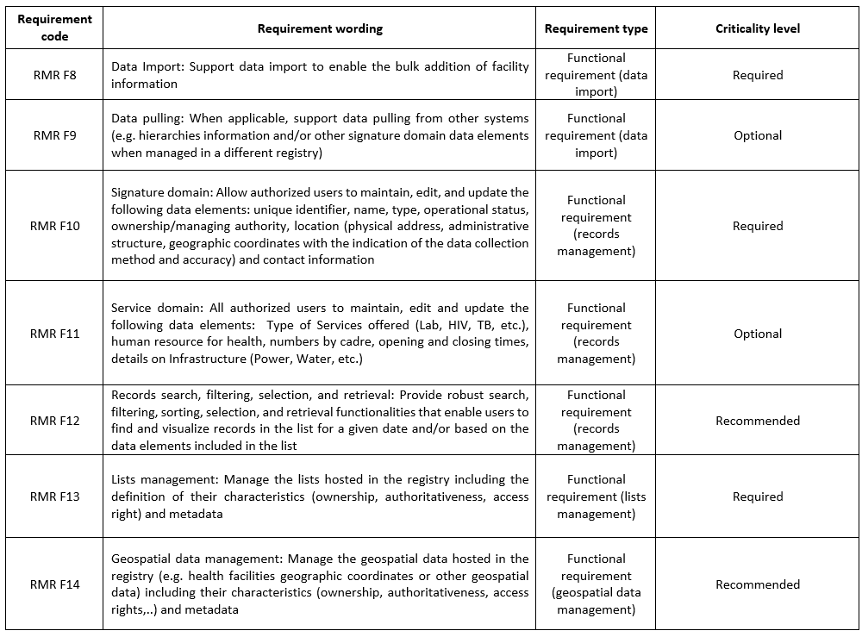
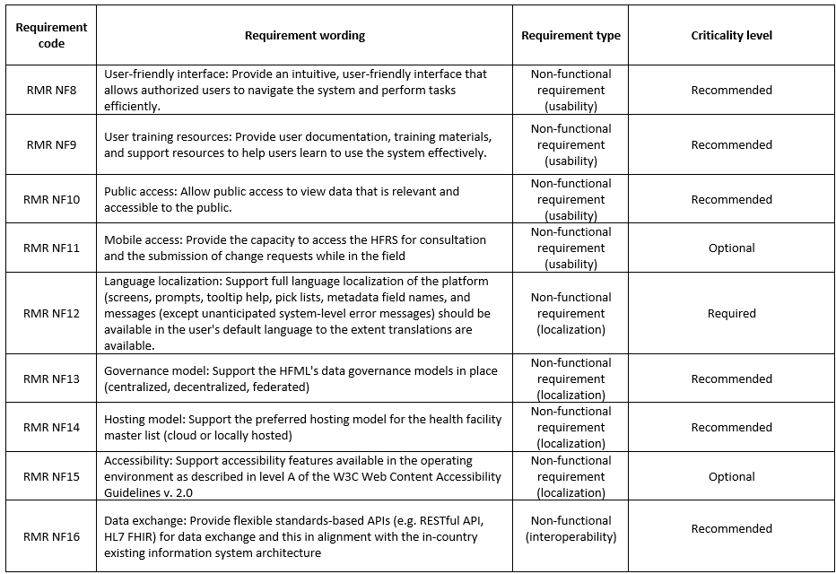
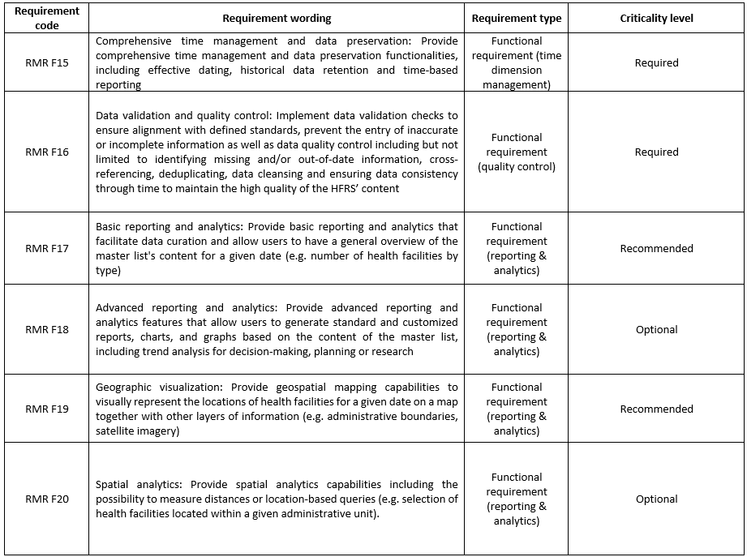
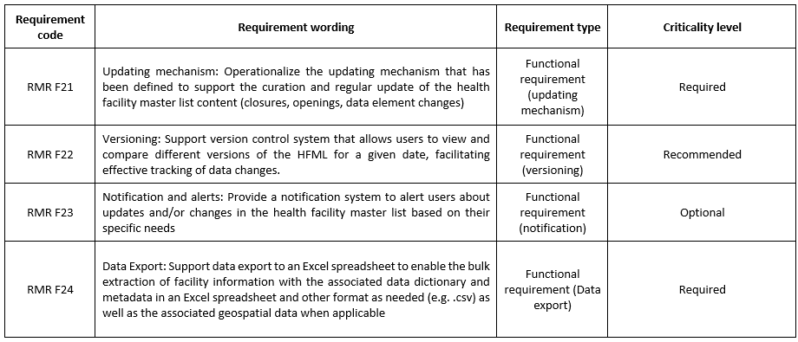
Define the functional requirements (how) of a registry
(example: registry for the master list of health facilities)
Define what the registry needs to do – Example for the
Health Facility Registry Service (HFRS)
Functional requirements: Product features or functions that developers must implement to enable users to accomplish their tasks
Non-functional requirements: Requirements describing how a system should perform
24 functional and 16 non-functional requirements with criticality level grouped by type

Slide 15
Define the functional requirements (how) of a registry
(example: registry for the master list of health facilities)
Define what the registry needs to do – Example for the
Health Facility Registry Service (HFRS)
Approach proposed to obtain a comprehensive list of functional and non-functional requirements:
Use the list of 24 functional and 16 non-functional requirements as the starting point for the process.
Organize a survey and/or workshop to get feedback on this initial list based on the potential limiting factors identified during the enabling environment assessment, the data ecosystem, task flows, and user roles that have been defined and documented earlier in the present step. More specifically, identifying if:
The criticality level currently included in the list for each requirement should be adjusted. The recommendation is not to change the level for the requirements that are labeled as required as they are core to the concept of HFRS but only to potentially upgrade the level of those that are currently labeled as recommended to required or those labeled as optional to recommended depending on the local context.
The spelling of some of the requirements should be adjusted to facilitate their understanding or be better aligned with the local context (data governance model for example).
Requirements should be added to the list. If this is the case, their description and criticality level should be defined at the same time.

Slide 16
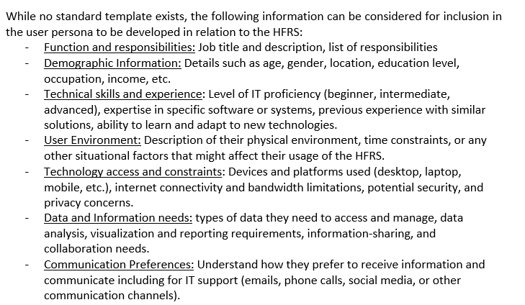
Define the functional requirements (how) of a registry
(example: registry for the master list of health facilities)
Define what the registry needs to do – Example for the
Health Facility Registry Service (HFRS)
Expected user experience
Defining the expected user experience at this stage in the process consists of:
Defining a user persona for each user role that the HFRS should support
Documenting user stories specific to each requirement from the point of view of a specific user persona.
These stories describe what exactly the user wants the system to do and is usually phrased as follows: “As a [user role] I want to [insert need] so that I can/all the users can [insert why].”
Some examples:
As a system administrator, I want to have access to an audit trail so that I can control that all the changes operated in the HFRS have been made by authorized users.
As a registry maintainer, I want to be able to add a newly opened health facility so that all the users can have access to a complete HFML.

Slide 17
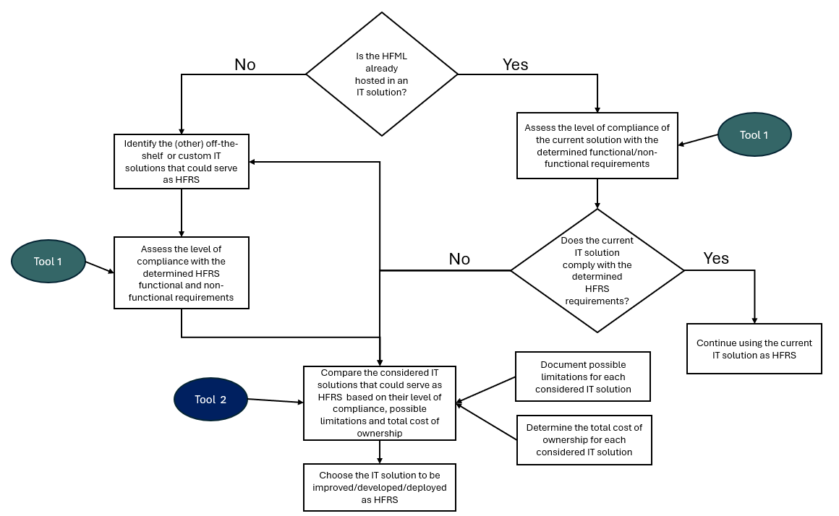
Define the functional requirements (how) of a registry
(example: registry for the master list of health facilities)
Identify the appropriate IT solution to serve as registry – Example for the Health Facility Registry Service (HFRS)
The choice of this solution depends on three main factors:
Possible limitations identified during the assessment of the enabling environment.
The level of compliance against the requirements that have been determined
The total cost of ownership (TCO)
Process during which it is important to first consider the IT solution in which the HFML is currently hosted when applicable

