Slide 1
Session 4.4: Available resources to explore geospatial technologies further
Notes:
MODULE 4: HANDS-ON GEOSPATIAL TECHNOLOGIES
Session 4.4: Available resources to explore geospatial technologies further
This session presents some of the available resources for GNSS and GIS (QGIS and ArcMap) that users can explore to learn more about these geospatial technologies.

Slide 2
Available Resources
This session presents some of the available resources for GNSS and GIS (QGIS and ArcMap) that users can explore to learn more about these geospatial technologies.
While definitely not exhaustive, these resources will already give a good start on further lessons and exercises on these geospatial technologies.
Notes:
Available Resources
This session presents some of the available resources for GNSS and GIS (QGIS and ArcMap) that users can explore to learn more about these geospatial technologies.
While not exhaustive, these resources will already give a good start on further lessons and exercises on these geospatial technologies.

Slide 3
GNSS Resources
Website
European Global Navigation Satellite Systems Agency (GSA) has a dedicated page for European GNSS: https://www.gsa.europa.eu/european-gnss/what-gnss
Lecture
Unit 1: GPS/GNSS Fundamentals of the Geodesy Tools for Societal Issues (GETSI) module on High Precision Positioning with Static and Kinematic GPS/GNSS: https://serc.carleton.edu/getsi/teaching_materials/high-precision/unit1.html
Video
GPS: An Introduction to Satellite Navigation https://www.youtube.com/playlist?list=PLGvhNIiu1ubyEOJga50LJMzVXtbUq6CPo
Notes:
GNSS Resources

Slide 4
QGIS Website
The QGIS website provides learning resources for their users.
A Gentle Introduction to GIS
Version 3.4
https://docs.qgis.org/3.4/en/docs/gentle_gis_introduction/index.html#
QGIS User Guide
Online:
https://docs.qgis.org/3.4/en/docs/user_manual/index.html
PDF:
https://docs.qgis.org/3.4/pdf/
QGIS Training Manual
Online:
https://docs.qgis.org/3.
4/en/docs/training_manual/index.html
PDF:
https://docs.qgis.org/3.4/pdf/
Notes:
QGIS Resources
QGIS Website
While the resources mentioned in this slide are for the current long-term release of QGIS (version 3.4), the QGIS website also contains the documentation for its older and newer versions: https://qgis.org/en/docs/index.html#

Slide 5
Other QGIS Reference Materials
Aside from their own materials, QGIS also lists other FREE training material:
https://www.qgis.org/en/site/forusers/trainingmaterial/index.html
NOTE: If you have free QGIS training material/s, you can have it listed in the QGIS website.
QGIS Tutorials and Tips website: http://www.qgistutorials.com/en/
QGIS Video Tutorials: http://qgis-tutorials.mangomap.com/
YouTube has a lot of video tutorials for different QGIS topics:
www.youtube.com
Notes:
QGIS Resources
Other QGIS Reference Materials

Slide 6
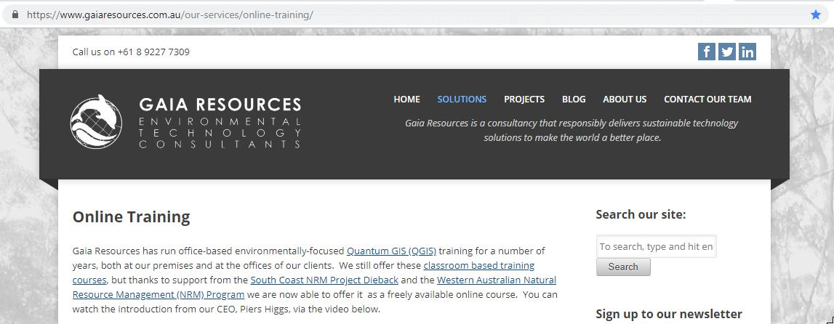
QGIS Online Course
There are different QGIS courses you can find online such as:
Environmental QGIS Training from Gaia Resources:
https://www.gaiaresources.com.au/our-services/online-training/
It is a self-paced course you can follow on YouTube:
https://www.youtube.com/playlist?list=PLfInsSYJw1lQ_vii1wxePr7aKqBOziKVQ
Notes:
QGIS Resources
QGIS Online Course

Slide 7
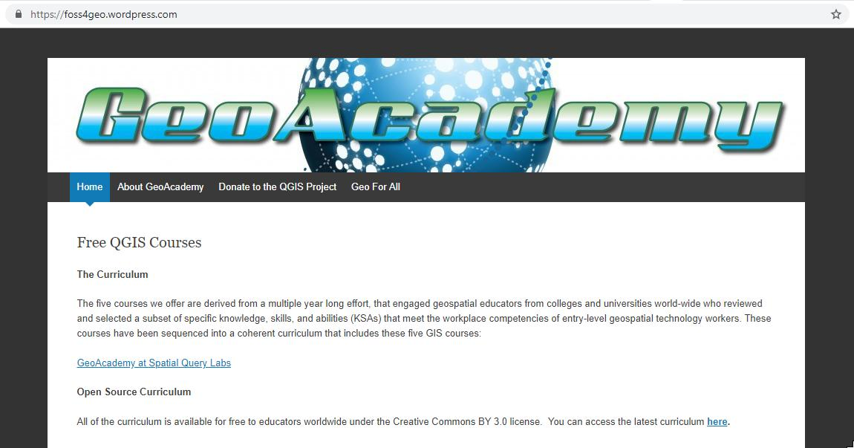
QGIS Online Course
Free QGIS courses from GeoAcademy:
https://foss4geo.wordpress.com/
Notes:
QGIS Resources
QGIS Online Course

Slide 8
ArcMap Resources
The ArcMap page on the ArcGIS for Desktop website http://desktop.arcgis.com/en/arcmap/
HGLC ArcMap starter kit: http://www.healthgeolab.net/DOCUMENTS/HGLC_ArcMap_10-5_code_starter_kit.pdf
Exercises on Learn ArcGIS page on Esri’s website
Get Started with ArcMap page: https://learn.arcgis.com/en/projects/get-started-with-arcmap/
Lessons Gallery page (choose ArcMap as the product in the filter): https://learn.arcgis.com/en/gallery/
Training materials from Esri’s e-Learning website:
https://www.esri.com/training/
HGLC Esri e-Learning starter kit: http://www.healthgeolab.net/DOCUMENTS/HGLC_Esri_e-Learning_Starter_Kit.pdf
Notes:
ArcMap Resources
The first one is from Esri itself,the creator of ArcMap.
The second one is the ArcMap starter kit developed by Health GeoLab Collaborative.
The third and fourth links are for exercised from the Esri website.
The fifth link is for the Esri e-Learning, Esri’s dedicated training website where you can access different trainings on GIS and ArcMap in particular that are professionally developed and curated, have contents suitable for different roles and skill levels, and available in multiple options and formats.
The last link is for the starter kit developed by HGLC on how you can access Esri’s e-Learning.

Slide 9
ArcMap Resources
Videos:
SabberFoundation: Introduction to Basic GIS using ArcGIS 10: https://www.youtube.com/playlist?list=PLfpC92A6_hGMxot13_jO8jbq6Fh7vEsRJ
Iris Cornell: https://www.youtube.com/channel/UC_6MA8DKRO9XfAc49-vpWMg
ArcGIS 10 Basics
1: https://www.youtube.com/watch?v=ekmyWkAP4eI
2: https://www.youtube.com/watch?v=OmFKLTqQhkY
3a: https://www.youtube.com/watch?v=uWYY0h-9g4M
3b: https://www.youtube.com/watch?v=DkGmRv5cHlQ
4a: https://www.youtube.com/watch?v=XGiVChKdQjM
4b: https://www.youtube.com/watch?v=VRa0xnPP87M
Notes:
ArcMap Resources
These are some videos on YouTube on introduction to GIS and some exercises on ArcMap.

