Slide 1
Session 4.3: Introduction to Geographic Information System (GIS)
Notes:
MODULE 4: HANDS-ON GEOSPATIAL TECHNOLOGIES
Session 4.3: Introduction to Geographic Information System (GIS)

Slide 2
Geographic Information Systems (GIS)
Two groups of definitions
“A computer system that analyzes and displays geographically referenced information”
“Computer tool for representing and analyzing all the things that exist on earth as well as all the events that occur there“
GIS as a geospatial technology – software
“Information system designed to collect, store, process, analyze, manage, and present all types of spatial and geographic data”
“Information system set up by an organization to describe the spatial objects, phenomena, and processes that are necessary for its action “
GIS as an information system
Often a source of confusion

Slide 3
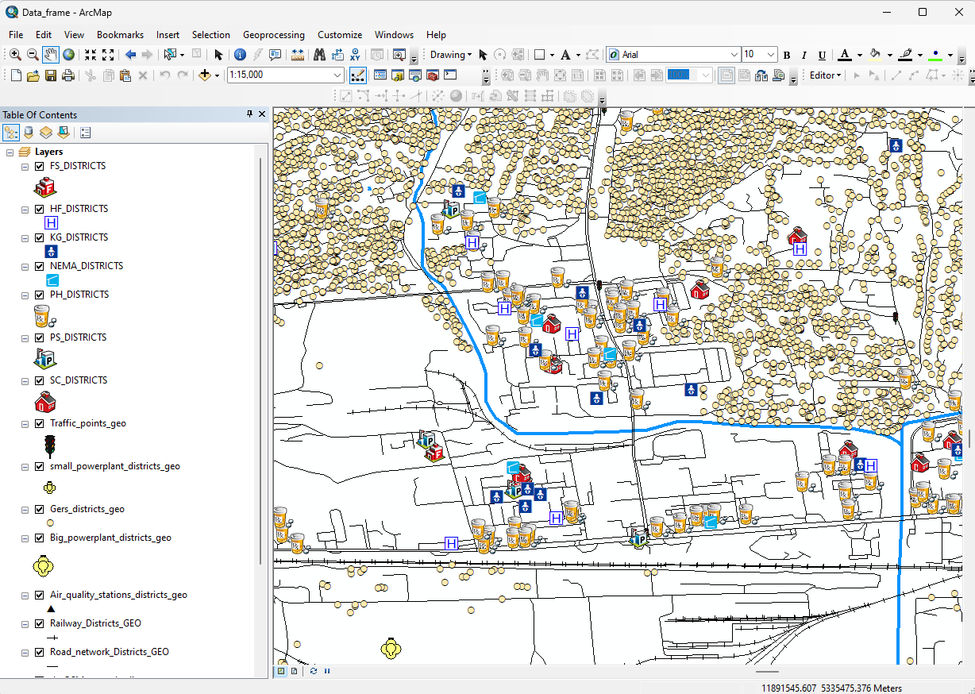
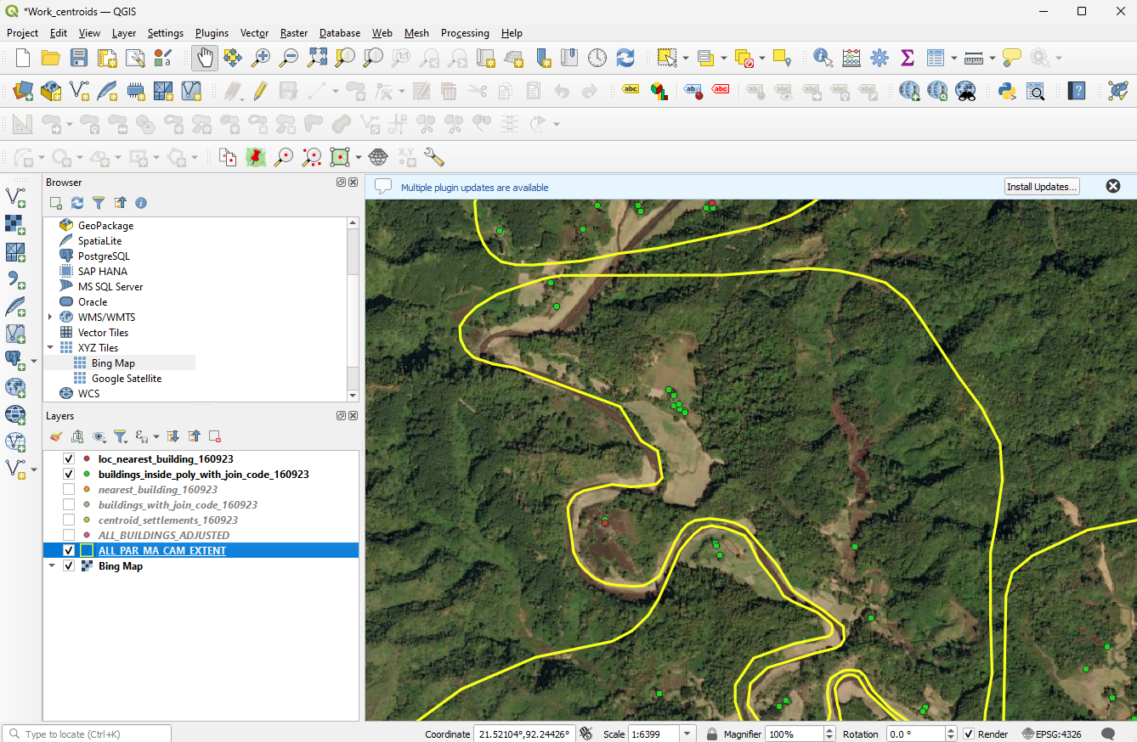
GIS as a software
Desktop GIS software:
Most used type of tool and providing the widest number of features. The most used being QGIS and ArcMap/ArcGIS Pro
Online GIS application:
Not as fast nor offering as many features as desktop GIS programs but still providing much of the same functionality (examples: ArcGIS Online (proprietary) or GeoNode (open source))
Can provide a convenient bridge between desktop work and a mobile work environment
Deployed either on the cloud or on a local server, each of which has a cost
GIS extensions:
Additional tools that are required to operationalize certain applications and/or not available by default in desktop or online GIS software
Available as extensions (example: ArcGIS Spatial Analyst Extension)

Slide 4
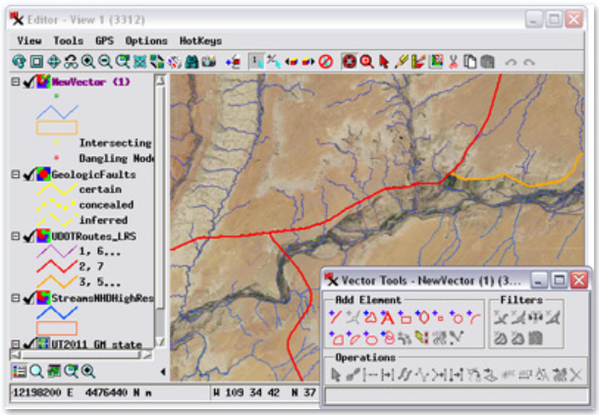
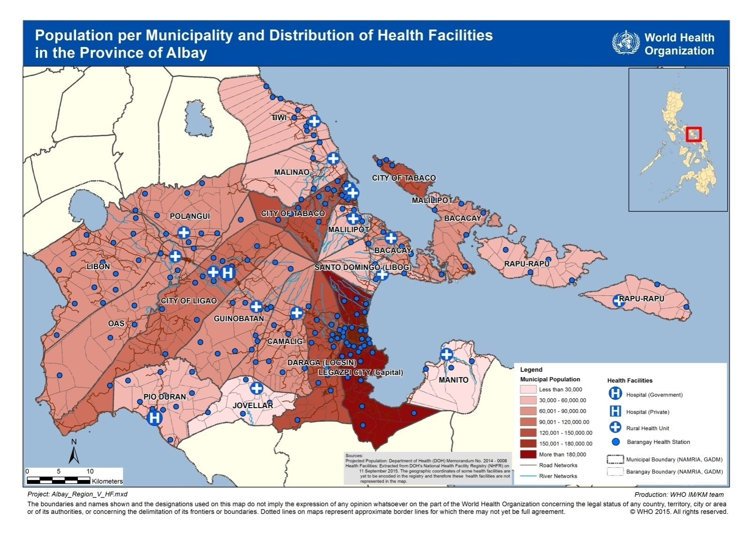
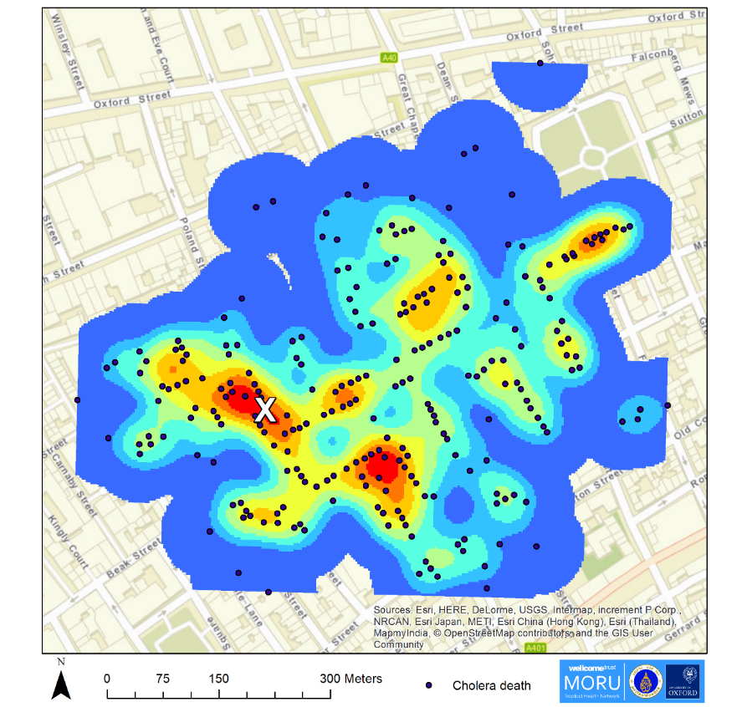
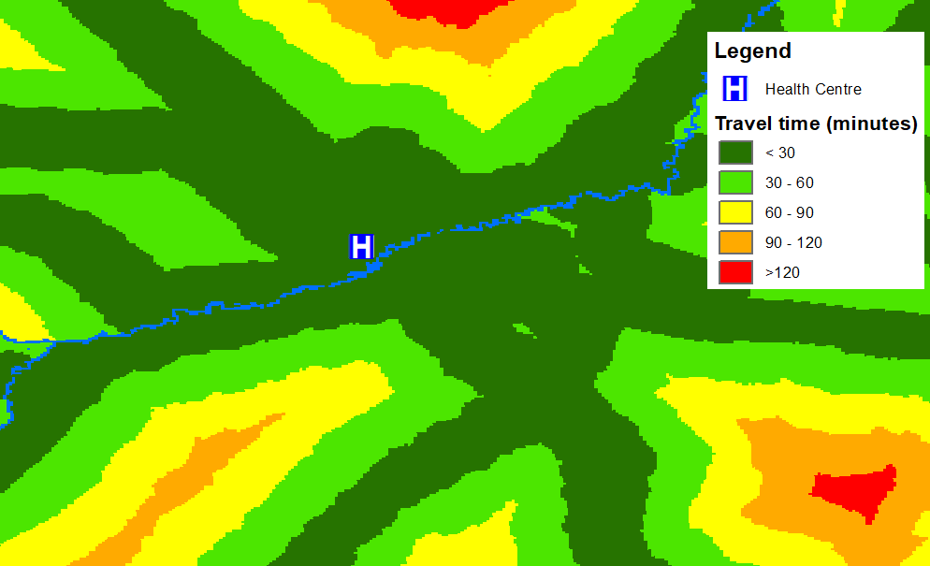
GIS as a software
A real GIS software allows you to perform:
Geospatial data management: All the disciplines related to managing geospatial data as a valuable resource (creating, editing,…)
Thematic mapping: the process of creating thematic maps to convey information about a single topic or theme, such as population density or health.
Spatial analysis: The process of examining the locations, attributes, patterns, and relationships of features in spatial data in order to address a question or gain useful knowledge
Spatial modeling: A methodology or set of analytical procedures used to derive information about spatial relationships between geographic phenomena
Software and applications not performing the above should not be considered a GIS software

Slide 5
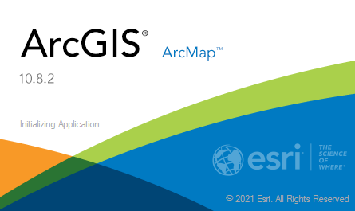
Not everything is GIS software!
Database managers with a thematic mapping interface
«Bridges» with GIS software that are existing or under development
Online mapping platforms
« Real » GIS software
ArcGIS www.esri.com
The most complete and versatile
Complete GIS ecosystem
Technical support
Proprietary (free/reduced cost licenses for the healthcare sector)
QGIS www.qgis.org
Very good for thematic mapping, sometimes limited for other functionalities but constantly being improved
Open Source, limited technical support
Free

Slide 6
GIS – Open Source vs. Proprietary
The choice between the two must be based on the context, needs, and resources available.
Some examples:
Use | Open source | Proprietary
Creation of thematic maps occasionally | X
Creation and management of quality geospatial data | X | X
Mapping support in an emergency operations center |  | X
Need to be able to move directly from field data collection to an online and desktop solution |  | X
Very often the solution is a combination of the two options
The most important thing is to have access to quality data and qualified personnel and to ensure that the work carried out is based on solid and documented processes.

Slide 7
GIS software to use for the exercises
The two GIS software mentioned in the previous slide will be used for Exercise 4.B and the exercises in Module 5.
QGIS: (formerly known as Quantum GIS) is a free and open-source cross platform desktop GIS application that supports viewing, editing, and analysis of geospatial data.
It is a widely, if not the most widely, used free GIS software at the moment.
ArcMap: the central application in the ArcGIS suite of products from Esri.
ArcMap is where you display and explore GIS datasets for your study area, where you assign symbols, create and edit datasets, perform spatial analyses, and where you create map layouts for printing or publication.
The software to be used by the participants will depend on its availability.

Slide 8
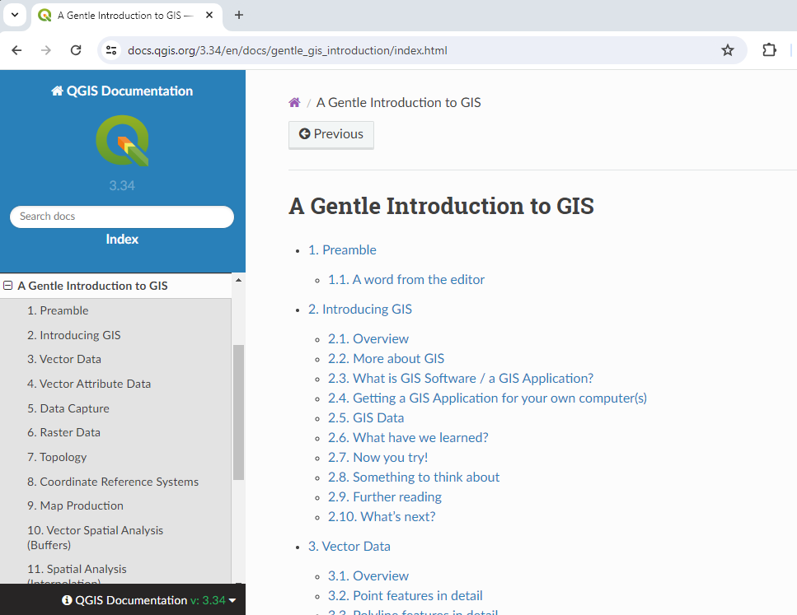
GIS Resources – QGIS
The QGIS website provides resources for their users:
A Gentle Introduction to GIS
https://docs.qgis.org/3.34/en/docs/gentle_gis_introduction/index.html
QGIS User Manual
Online: https://docs.qgis.org/3.34/en/docs/user_manual/index.html
PDF: https://docs.qgis.org/3.34/pdf/en/QGIS-3.34-DesktopUserGuide-en.pdf
QGIS Training Manual
Online: https://docs.qgis.org/3.34/en/docs/training_manual/index.html
PDF: https://docs.qgis.org/3.34/pdf/en/QGIS-3.34-TrainingManual-en.pdf

Slide 9
GIS Resources – QGIS
There are different QGIS courses you can find online such as:
YouTube offers many video tutorials on different QGIS topics: www.youtube.com
Environmental QGIS Training from Gaia Resources:
https://www.gaiaresources.com.au/our-services/online-training/
It is a self-paced course you can follow on YouTube:
https://www.youtube.com/playlist?list=PLfInsSYJw1lQ_vii1wxePr7aKqBOziKVQ

Slide 10
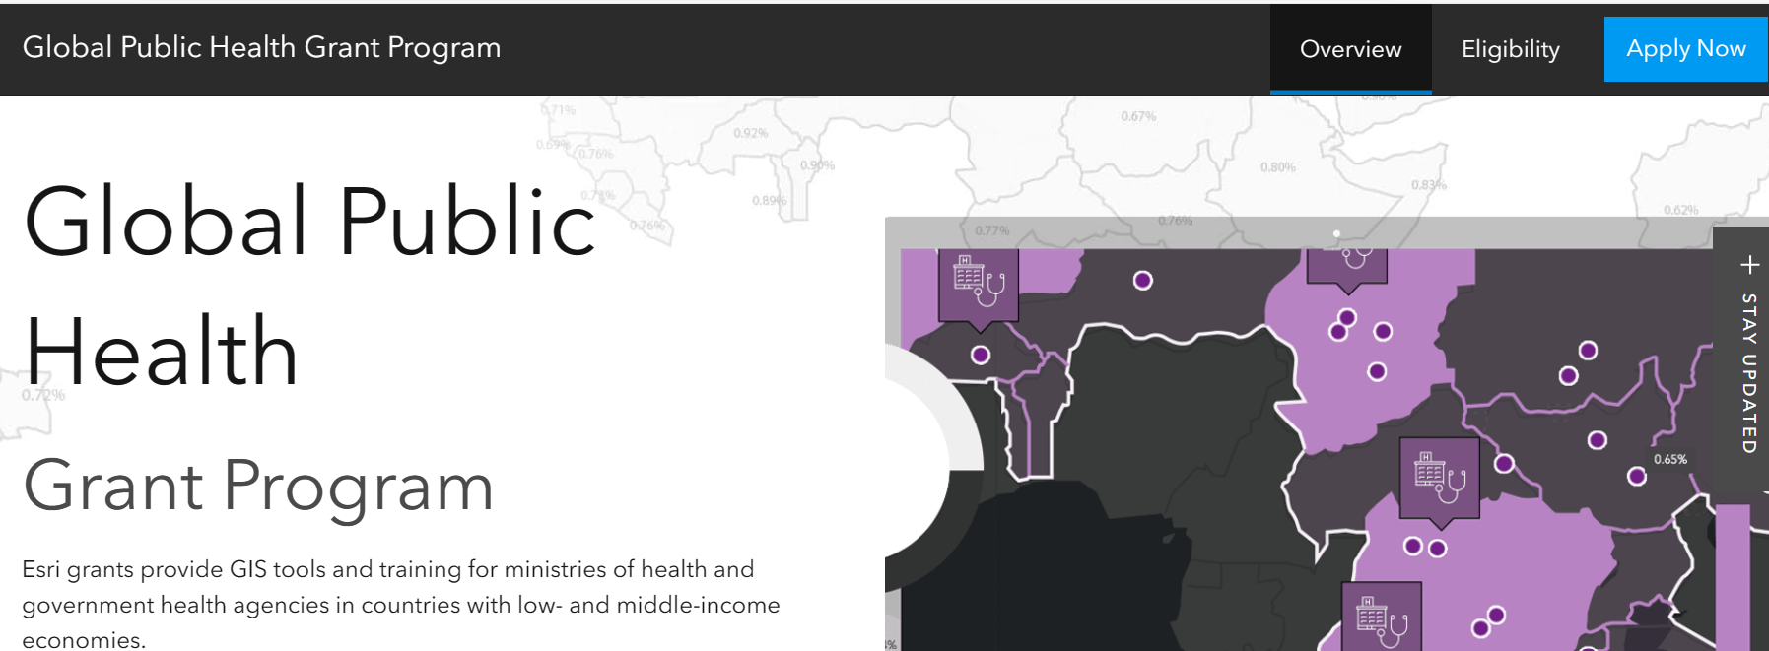
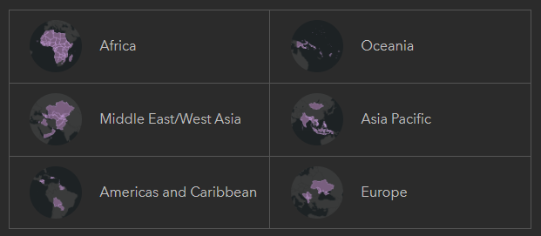
GIS Resources – Esri
Esri Health and Human Services Grant Program: https://bit.ly/2PjysU1
Free for 2 years then very reduced cost after that
Visit the website to see if your country is eligible for the grant

Slide 11
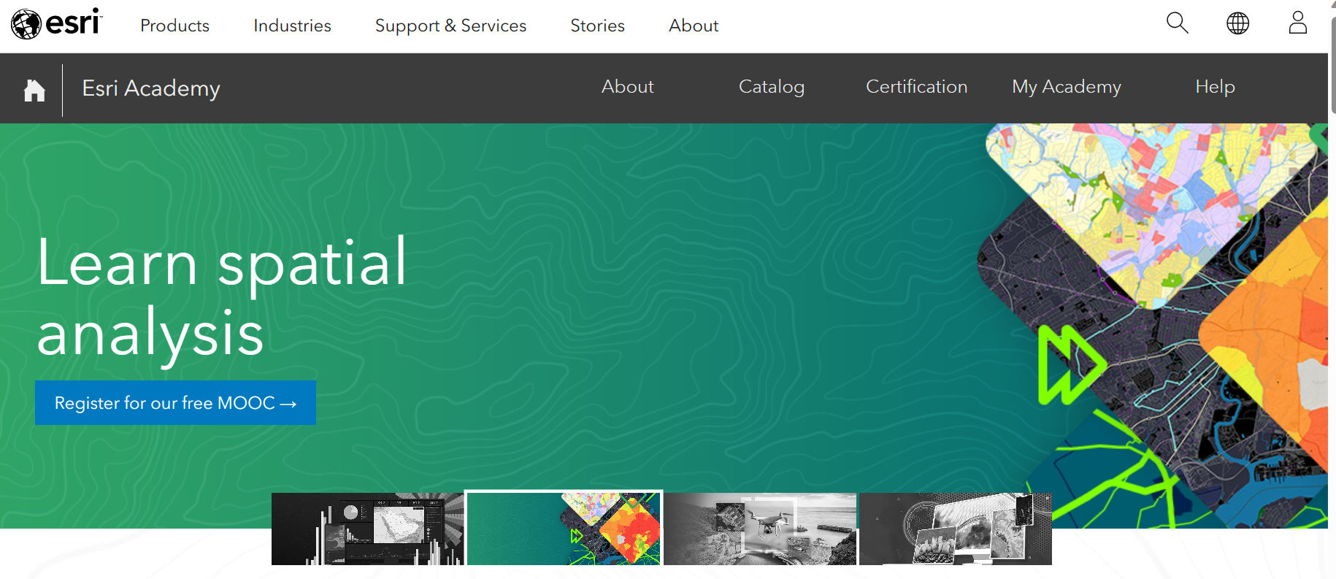
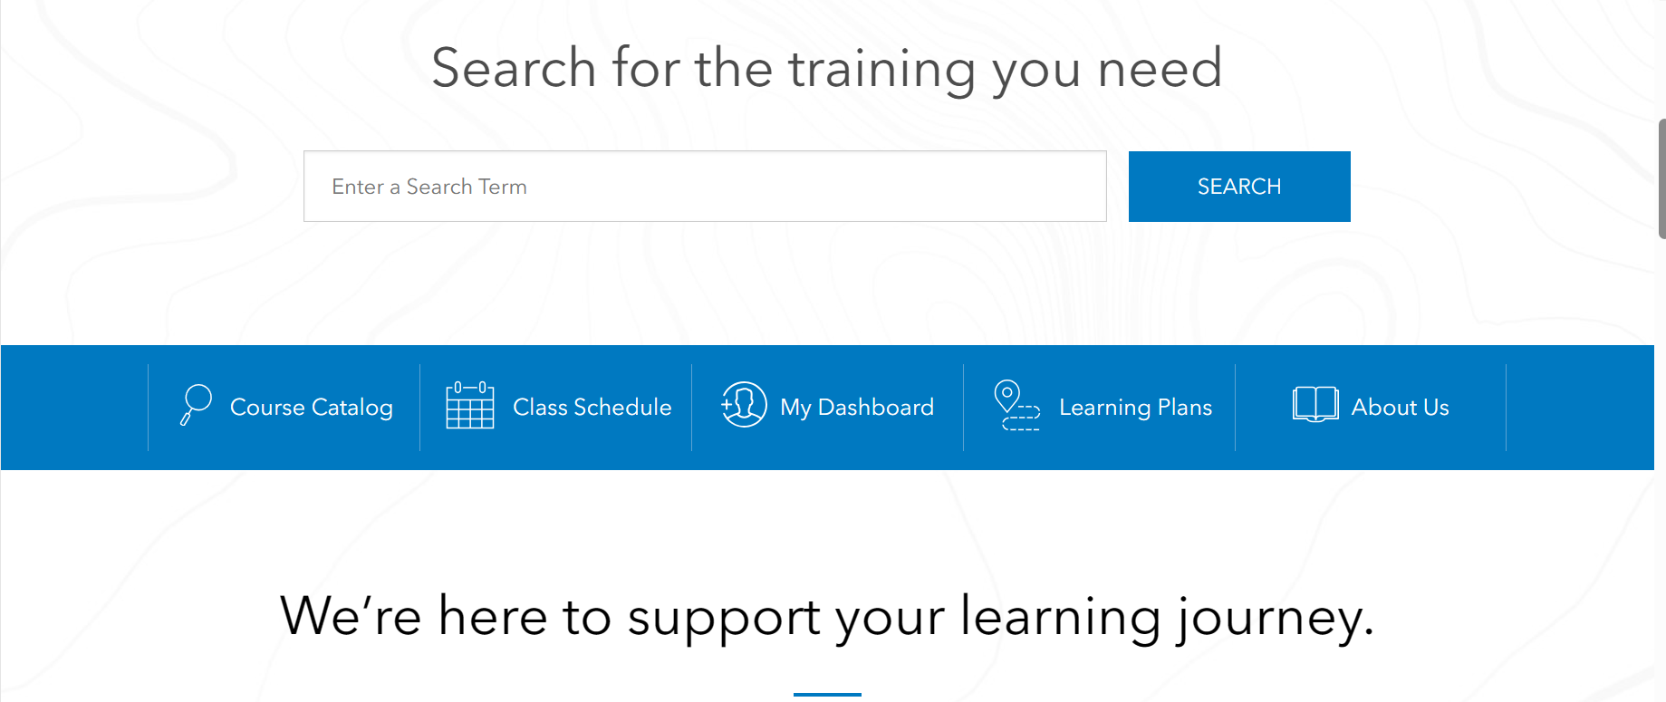
GIS Resources – Esri
https://www.esri.com/training/
https://healthgeolab.net/resources/reference-materials/

Slide 12
GIS as information system
“Information system set up by an organization to describe the spatial objects, phenomena, and processes that are necessary for its action“
Combines and articulates data, equipment, software, organizational structures (including personnel), and methods to represent and analyze geographic objects necessary for project implementation
GIS is not just about software!
Translated from: https://www.univ-st-etienne.fr/wikimastersig/doku.php/glossaire:systeme_d_information_geographique_sig

Slide 13
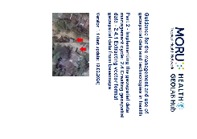
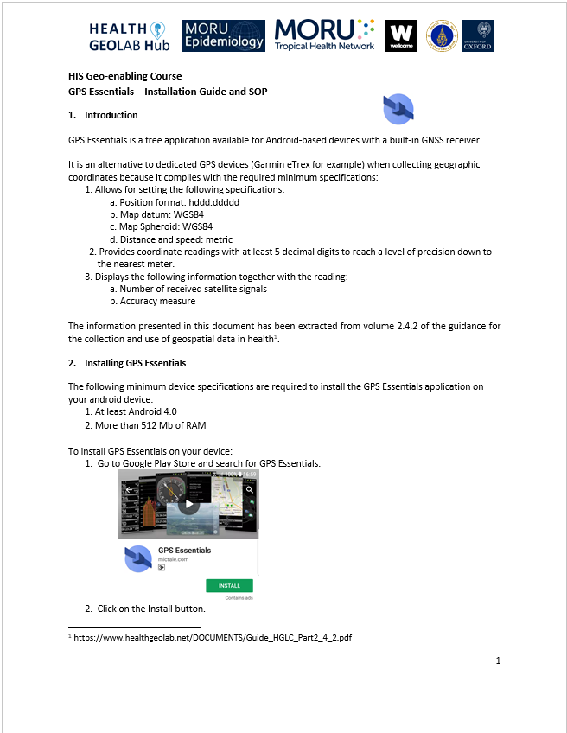
Essential elements of a GIS as an information system
5
Data
Software
Equipment
People
Methods
2
1
4
Data at the center of the system
5
3
Part of a geo-enabled information system
5
13

Slide 14
Let’s use GIS software!
Let’s proceed to Exercise 4.B where you will learn the basic functionalities of your chosen GIS software.
Notes:
Let’s use GIS software!

