Slide 1
Session 4.2: Introduction to Global Navigation Satellite Systems (GNSS)
Notes:
MODULE 4: HANDS-ON GEOSPATIAL TECHNOLOGIES
Session 4.2: Introduction to Global Navigation Satellite Systems (GNSS)

Slide 2
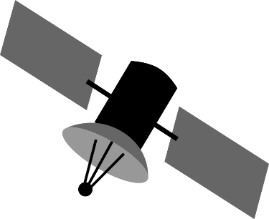


Global Navigation Satellite Systems (GNSS)
Constellation of satellites providing signals from space that transmit positioning and timing data to GNSS receivers. The receivers then use this data to determine the location.

Slide 3




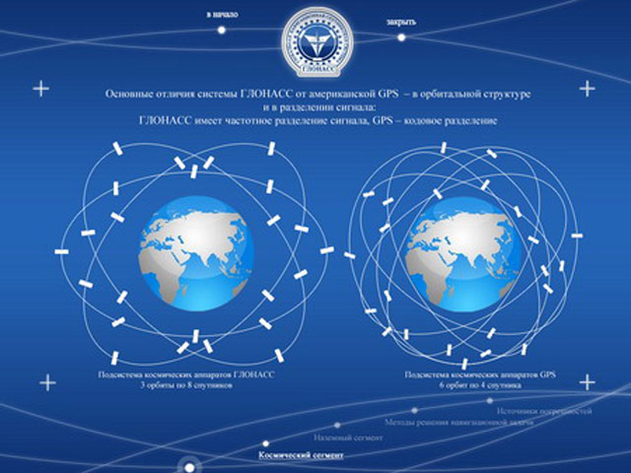
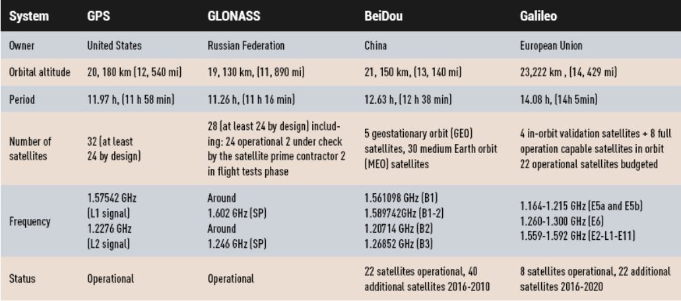
Global Navigation Satellite Systems (GNSS)
There are currently four different satellite navigation systems providing autonomous geospatial positioning:
GPS (USA), GLONASS (Russia), BeiDou (China), and Galileo (EU).

Slide 4
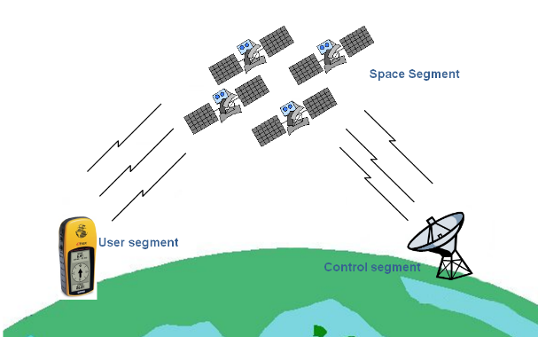
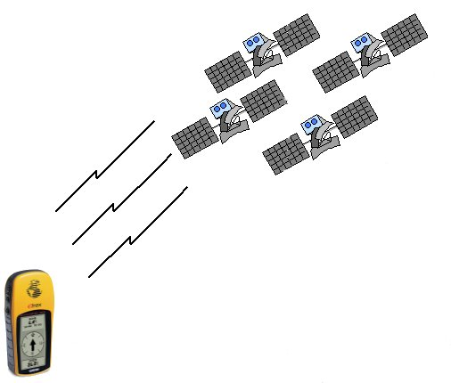
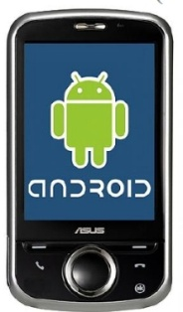
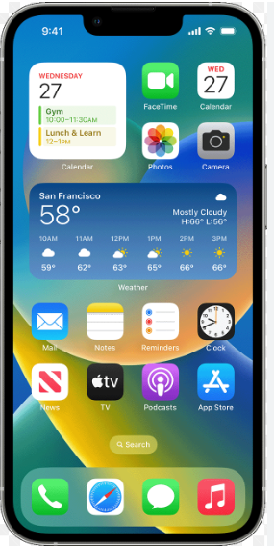
How it works?
1. Unique identifier
2. Almanac data
(state and orbital information to calculate which satellites are visible)
No need for internet!!!
3. Ephemeral data
(precise orbital information to calculate satellite location)

Slide 5

How it works?
When receiving the signal from only one satellite
?
?
?
?
?
?
?

Slide 6
How it works?
When receiving the signal from only two satellites
The device can be anywhere along the circle generated by the intersection of the sphere of each satellite
?
?
?
?
?
?
?
?
Satellite 2: 20,000 km
Satellite 1: 17,000 km

Slide 7
How it works?
As soon as you receive the signal from 3 satellites...
Intersection between the circle and one more sphere => 2 points
… and with 4 signals
Only 1 point possible
Reason why you need at least 4 satellite signals to get a good reading
Facilitated by the existence of the 4 constellations (if your device can receive their signal)

Slide 8
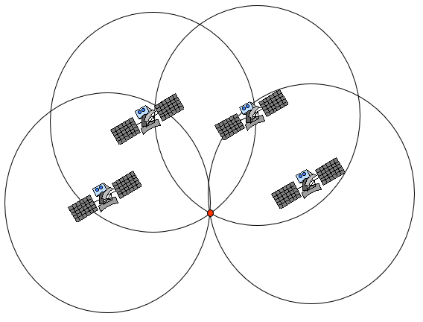
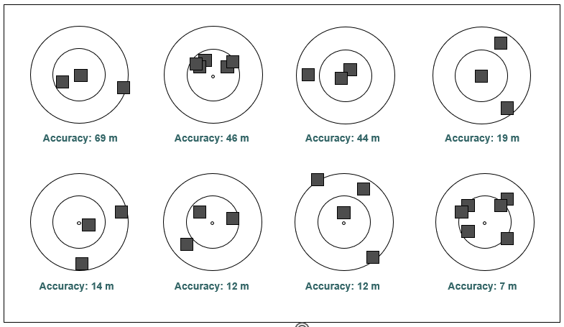
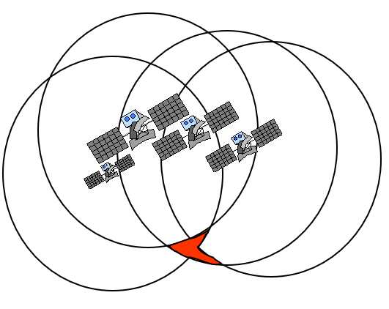
Sources of signal errors
Another thing which is facilitated by the existence of the 4 constellations
Positional Dilution of Precision (PDOP)
Good PDOP
It is preferable to have a good dispersion and to look at the accuracy measurement given by the device
Poor PDOP

Slide 9


Sources of signal errors
Natural or artificial barriers
Important to be in the most open space possible when collecting geographic coordinates

Slide 10


Sources of signal errors
Signal multipath
1
2
1
2
Important to be in the most open space possible when collecting geographic coordinates

Slide 11


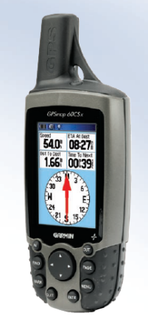
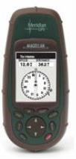
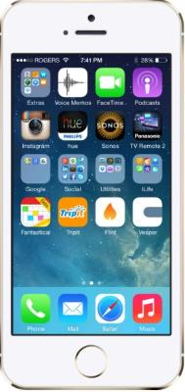

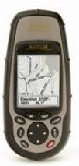
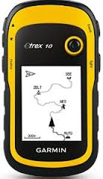
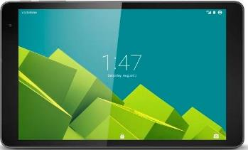
Which device to use?
Large selection / Different prices!
Minimum requirements:
1. Allow to be configured as follows:
  a. Position format: Decimal degrees (hddd.ddddd)
  b. Map datum/Cartographic reference system: WGS84
  c. Map spheroid: WGS84
  d. Distance and speed: Meter
2. Provide a reading with at least 5 decimal places to reach a level of precision down to the meter
3. Display the following information:
  a. Number of satellite signals received
  b. Accuracy measure
4. Have access to GPS and GLONASS constellations (Also
having access to Galileo and Bei Dou is a big plus)
A smart phone with a good GNSS receiver and an app is the option being used the most frequently nowadays

Slide 12

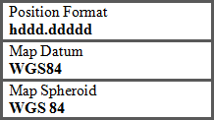
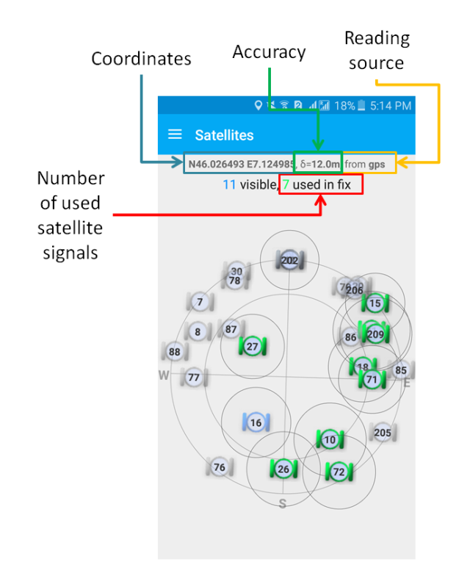
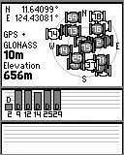
Unit setting
Must match the data specifications
Take a reading
Coordinates
GPS and GLONASS activated
Accuracy value
Position of
satellites
Number of satellite signals received
Mobile phone + app
GNSS device

Slide 13
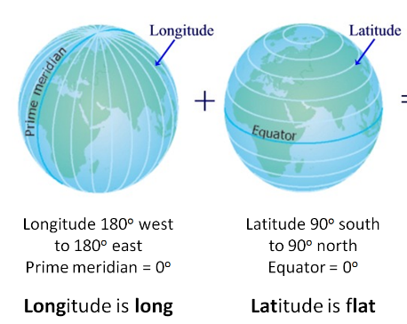
Why use latitude and longitude (decimal degrees)?
Easiest georeferencing method to use
  Standardized, stable, unique, infinitely fine resolution
Uses a well-defined and fixed frame of reference
  Based on the Greenwich (Prime) Meridian and the Equator
Most used in geospatial technologies
  Can be easily projected if needed

Slide 14
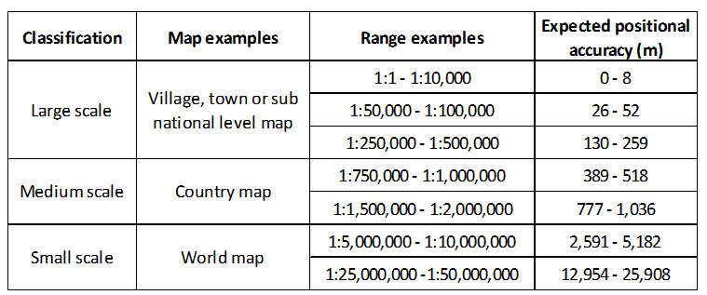
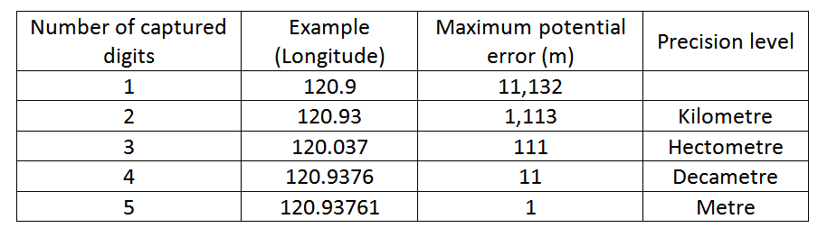
Scale, accuracy, and precision
15 m
Recommended

Slide 15
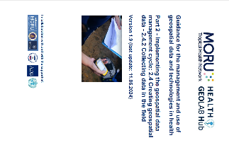
Data collection methods
Method used during Exercise 4.A
Without GNSS-enabled device
With GNSS-enabled device
https://www.healthgeolab.net/DOCUMENTS/Guide_HGLC_Part2_4_2.pdf

Slide 16
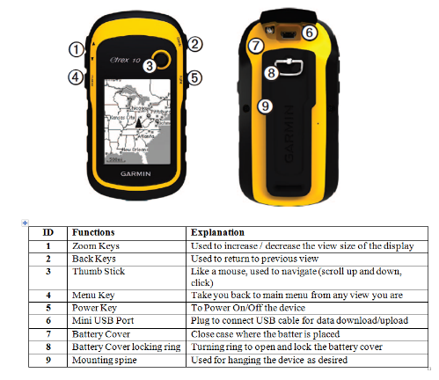
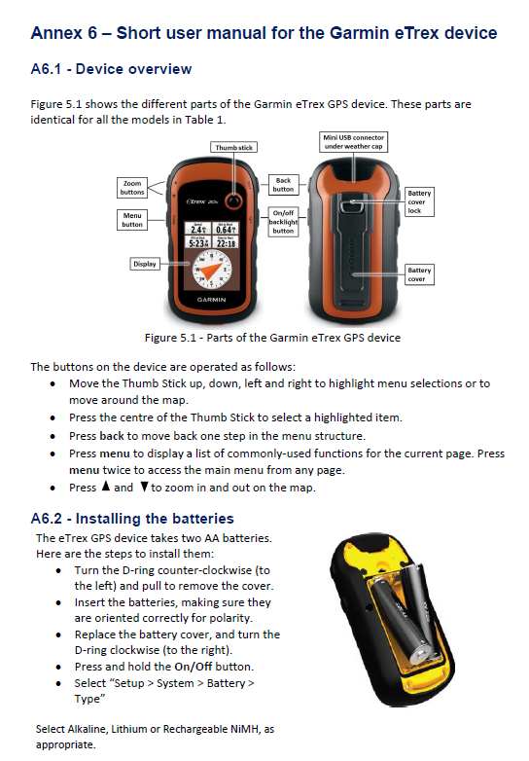
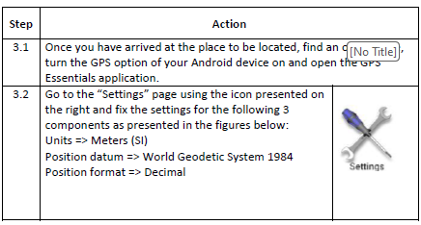
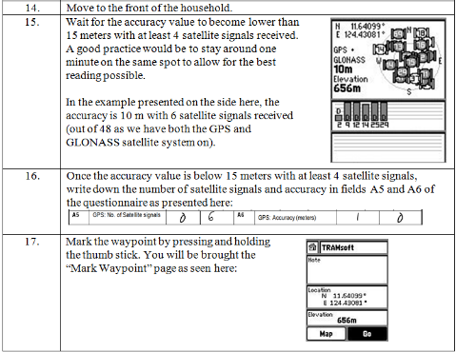
Standard Operating Procedure (SOP)
It is important to have and follow a Standard Operating Procedure (SOP).
The SOP should at least cover:
Description of the device being used
Device user manual (buttons, functions, etc.)
How to configure the device
Material/s to use in addition to the device (e.g., form, other documents)
Step-by-step process for data collectors
https://www.healthgeolab.net/DOCUMENTS/Guide_HGLC_Part2_4_2.pdf

Slide 17
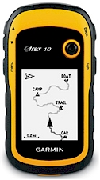

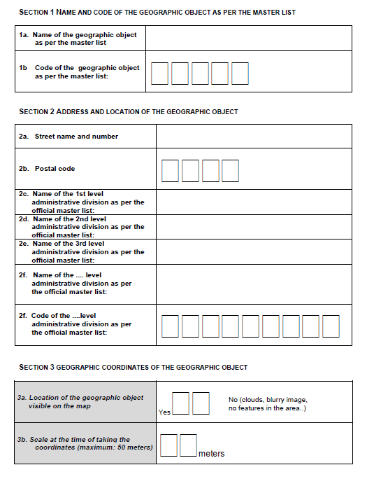
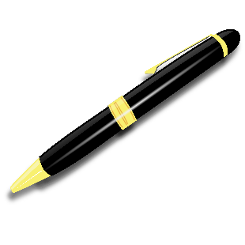

GNSS – Before data collection
This phase is critical to preparing the data collectors to be independent in the field and able to collect high quality geographic coordinates with minimal supervision.
Two primary actions:
Preparing the material needed to implement the selected data collection method
Selection and training of the data collectors and their supervisor(s)

Slide 18
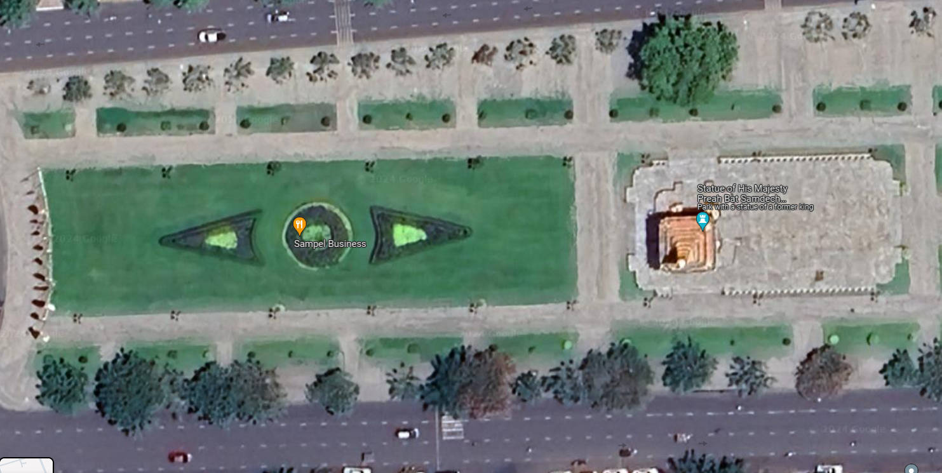
GNSS – Before data collection (material preparation)
Landmark visible on satellite images
The preparation of the material must cover the:
Selection of the collection method that will be implemented
Adjustment of the data collection form to match the selected method
Creation of the electronic form, if required
Preparation of the associated documents and materials
Development of the SOP to be implemented in the field
Installation of the applications on the devices, if required
Configuration of the devices and/or app and verification that the GNSS receiver is working correctly
Preparation of the training material
Device
readings
GNSS receiver working correctly
Potential issues with the GNSS receiver

Slide 19
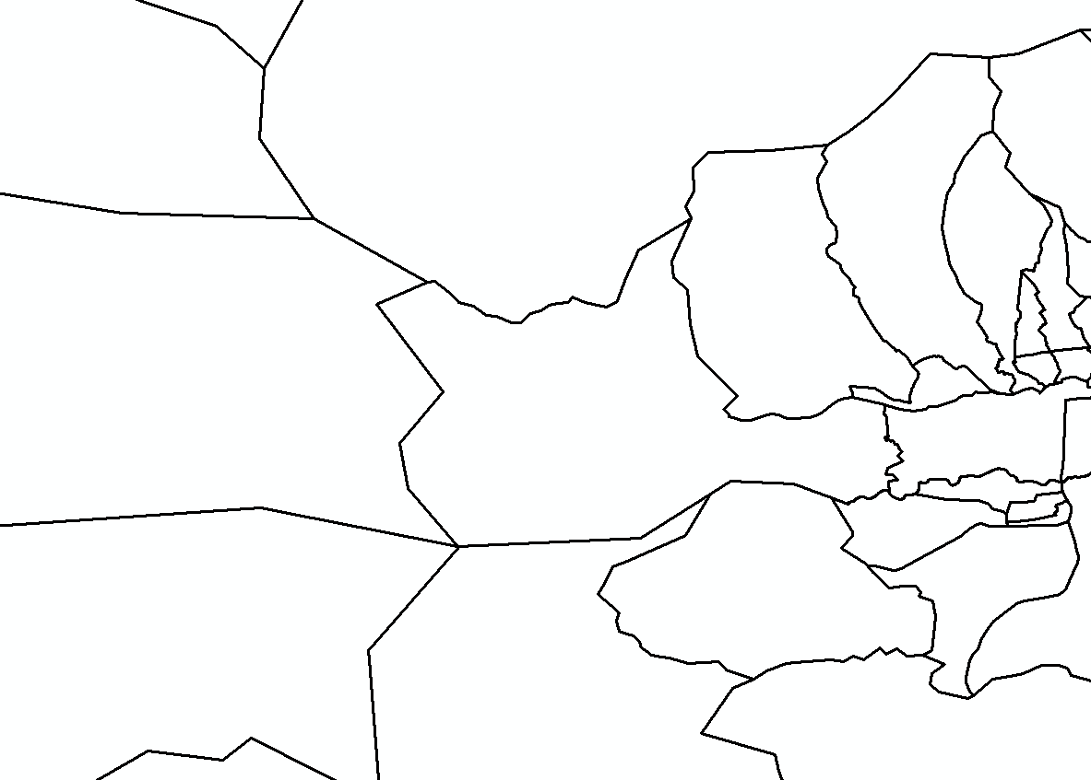
GNSS – Before data collection (selection and training of collectors)
Knowledge and experience in using GNSS-enabled devices should be considered when selecting data collectors and their supervisor(s).
In addition to selecting qualified data collectors, training data collectors and their supervisor(s) is one of the, if not the most, important steps in the pre-survey process.
This is what will make the difference between…
…this… ..and this

Slide 20
GNSS – Before data collection (training)
The training should aim to provide a good understanding and proper use of the different documents, the data collection equipment, and SOPs. The training should also cover appropriate troubleshooting methods regarding commonly encountered issues while in the field.
To achieve these goals, the training should at least cover the following topics:
Overview of existing GNSS and use of the chosen GNSS-enabled device
Introduction to the GNSS-enabled device
SOP to complete the data collection instrument
Hands-on practice session
It is important to:
Allocate enough time for the above-mentioned session.
Ensure that the participants can ask questions.
Give copies of the different documents to all the participants.
Ensure every participant has the opportunity for hands-on practice of using a GNSS-enabled device.
Check all the GNSS-enabled devices to be used in the field, if not already done

Slide 21
GNSS – During data collection
During the field data collection exercise, the data collectors should follow the SOP using the associated documents that will have been provided to them.
Despite a high-quality training session, it remains important to verify the methods used to collect the geographic location information and address any unexpected issues while the data collectors are in the field.
The following verification steps should be followed depending on available resources and the extent of the surveyed area:
On-site spot checks of data accuracy and completeness conducted by the data collection supervisor. Part of the check for accuracy can be performed using Survey123 for ArcGIS, Maps.Me, or Google Maps as way to ensure that the point is falling in the expected area.
Verification of the data remotely through periodic submissions of the collected data in a spreadsheet, either using Google Sheets online or emailing a Microsoft Excel spreadsheet to the data collection supervisor. For certain applications, a purpose-designed online database system may be used as well. However, these solutions usually require a regular access to the internet.

Slide 22
GNSS – After data collection
Ensure that the collected data is organized in a structured table that can be saved as a spreadsheet (e.g., in Microsoft Excel) and should contain all the fields that are on the data collection form
Don’t forget about the data catalogue and metadata worksheet covered during Session 3.4

Slide 23
GNSS – Summary
Choose the appropriate GNSS-enabled device (check the quality of the GNSS receiver) and data collection method
Use a pre-established Standard Operating Procedure (SOP) which includes all the necessary information for the data collectors to properly collect coordinates in the field (e.g., source of error signals)
Collect high accuracy (instrumental accuracy below 15 meters) and high precision (5 digits after the decimal point) coordinates
Invest in a good training for data collectors and supervisors
Establish a good monitoring process during data collection
Properly store and document the geographic coordinates resulting from the data collection exercise
Note: Pay attention to potential ethical issues when locating or tracking individuals with a high accuracy !!!

Slide 24
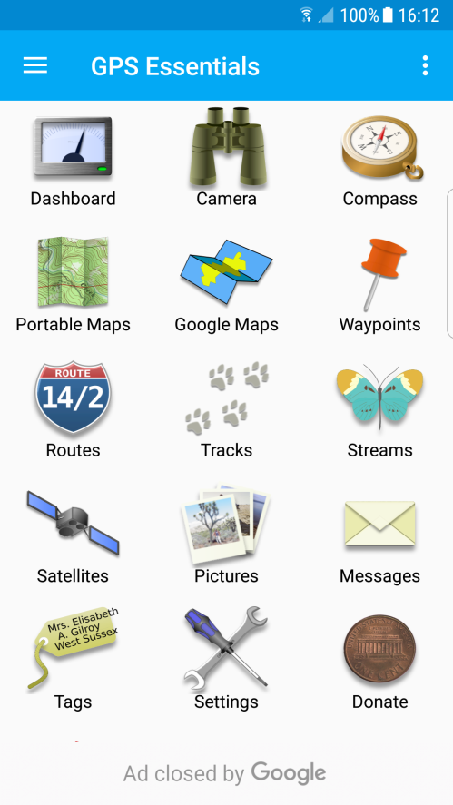
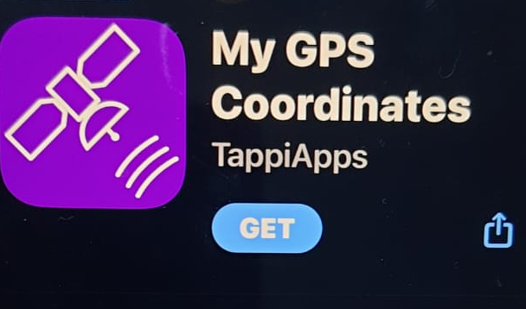
GNSS Apps for smart phones (Android, iPhone)
Android
GPS Essentials is a free app available for Android devices with a built-in GNSS receiver that complies with all the recommended requirements
iPhone
“My GPS Coordinates” is a free app available for Apple devices (iPhone/iPad)
These apps can be used as an alternative to dedicated GNSS-enabled devices when collecting geographic coordinates as they comply with the specifications discussed in previous slides.

Slide 25
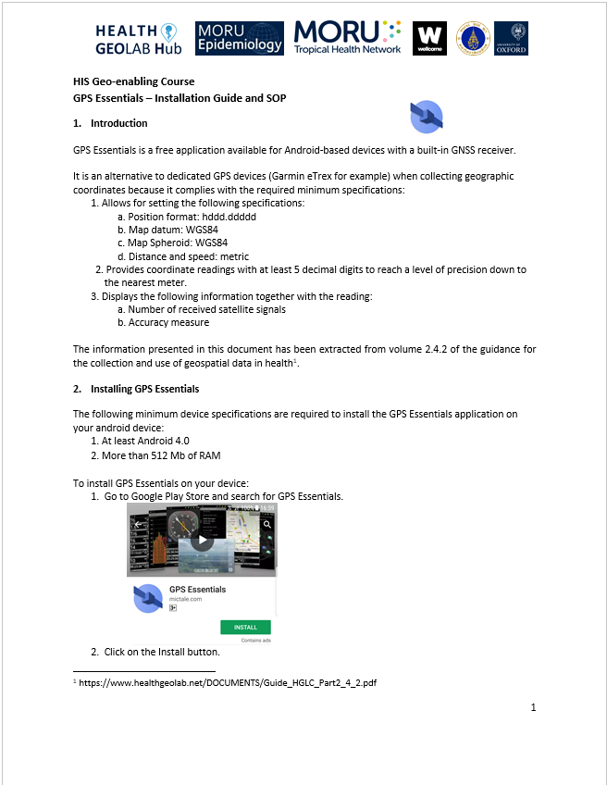
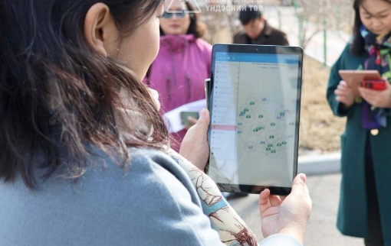
Preparation for Exercise 4.A
  Separate document
  GPS Essentials Installation Guide
  SOP to follow and data collection form to use when collecting geographic coordinates using an Android phone and GPS Essentials
Proceed to Exercise 4.A

