Slide 1
Session 4.1: Introduction to geospatial technologies
Notes:
MODULE 4: HANDS-ON GEOSPATIAL TECHNOLOGIES
Session 4.1: Introduction to geospatial technologies

Slide 2
Geospatial Technologies – Definition
Set of technological approaches such as Geographic Information Systems (GIS), Global Navigation Satellite Systems (GNSS), photogrammetry, and remote sensing (RS), used in the acquiring and manipulating geographical data.¹
This also includes new technologies that are starting to be deployed (e.g., Common Geo-Registry (CGR))
¹ Modified from: https://support.esri.com/en-us/gis-dictionary/geospatial-technology

Slide 3
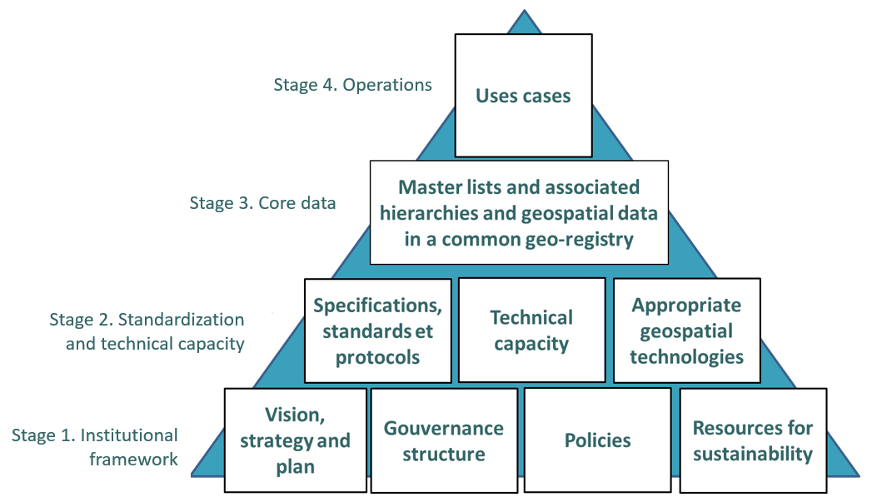
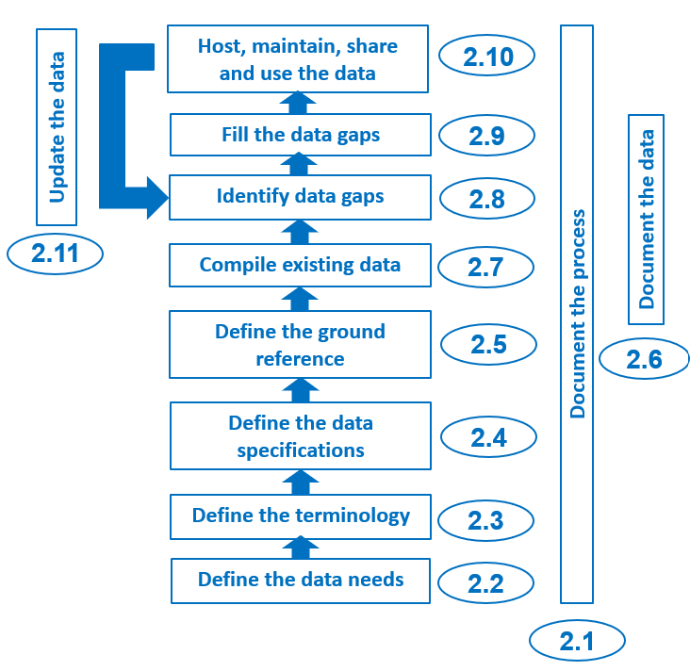
Place of Geospatial Technologies in the HIS geo-enabling framework and geospatial data management cycle
Technology supporting content and use cases, not driving them!
Notes:
It must be emphasized that the role of geospatial technologies in the HIS geo-enabling framework and geospatial data management cycle is to support the content and use cases and not drive them.
As such, choosing the geospatial technologies to use comes at the later stages of the HIS geo-enabling framework and geospatial data management cycle. And the chosen geospatial technologies should be able to help produce the data, information, and information products according to the defined data specifications, standards, and protocols.

Slide 4
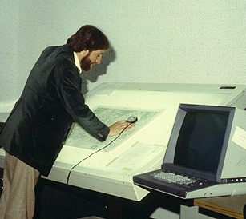
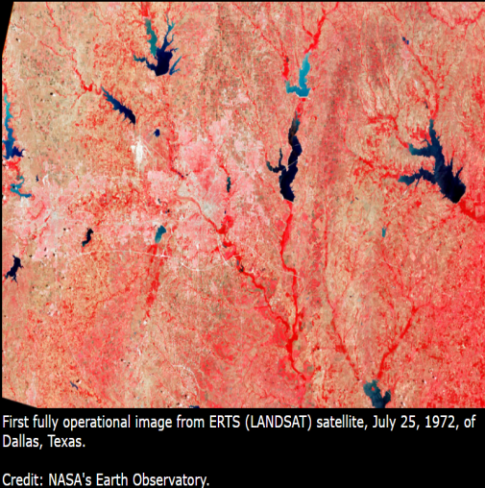
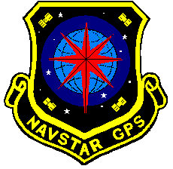
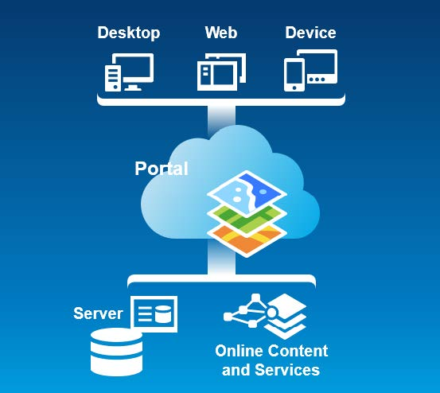

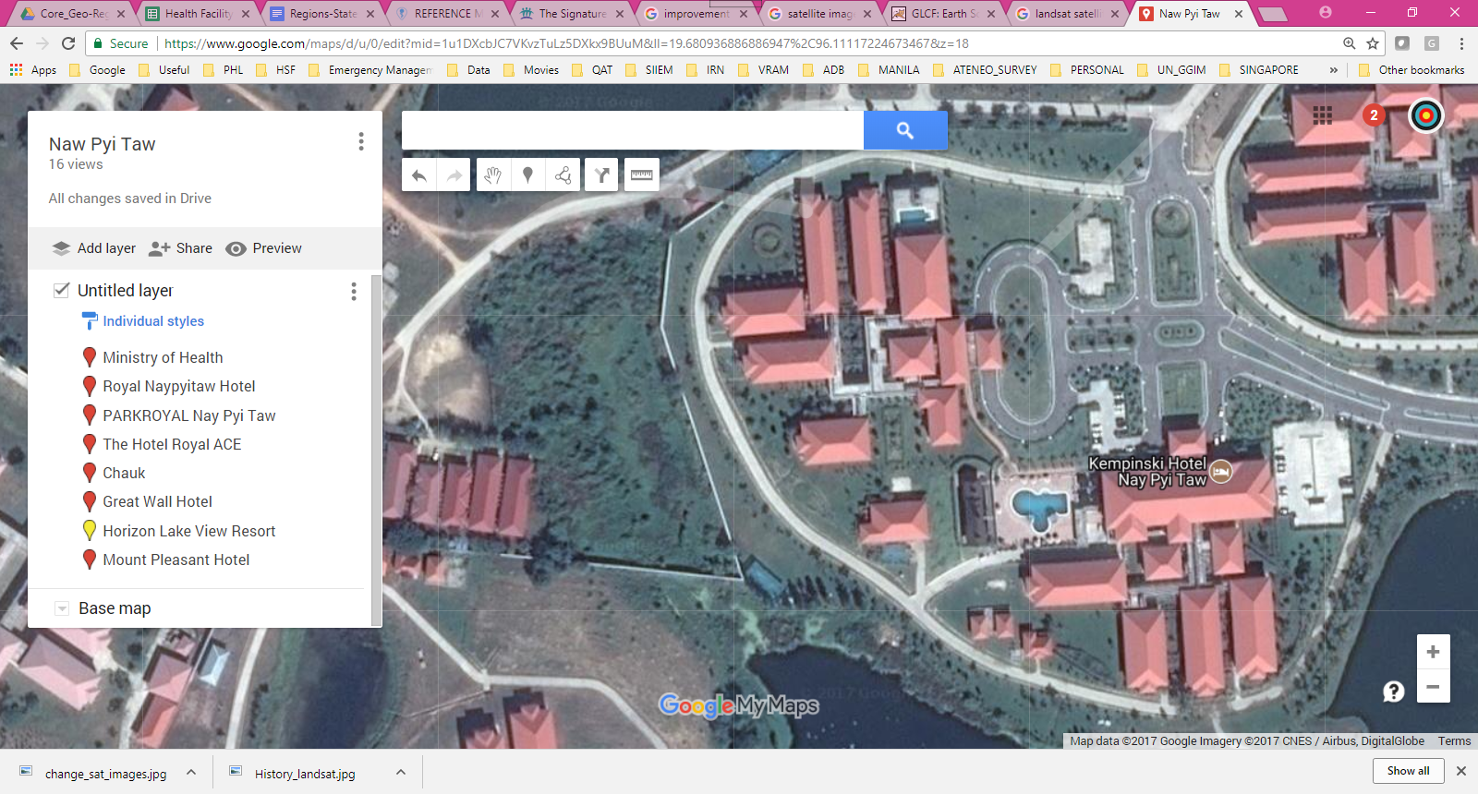

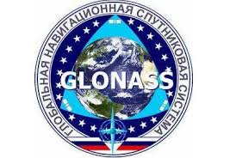
Evolution of Geospatial Technologies
These technologies have evolved enormously over the last 50 years.
GIS
GNSS
Remote sensing
1970s
2023

Slide 5
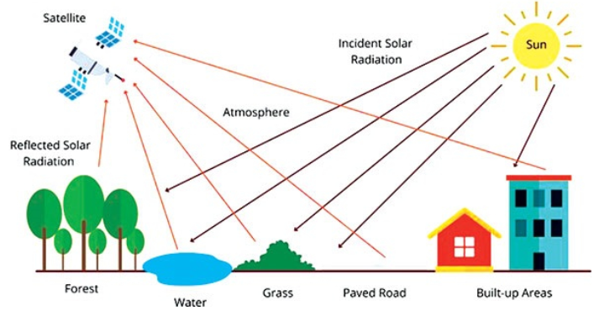
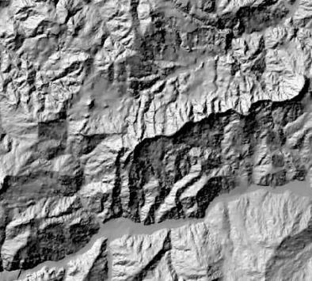
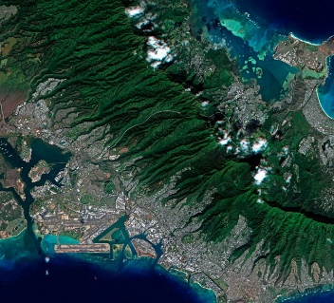
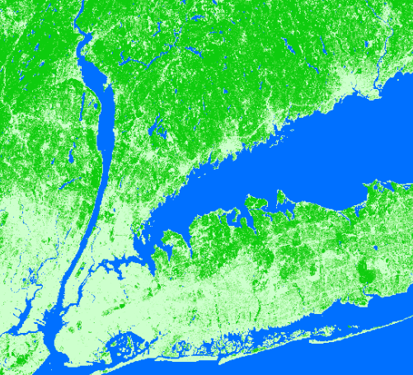
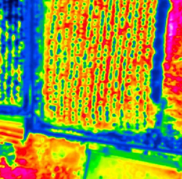
Geospatial Technologies – Remote Sensing (RS) and Photogrammetry
Remote sensing: The process of detecting and monitoring the physical characteristics of an area by measuring its reflected and emitted radiation remotely (usually from a satellite or aircraft)
A censor attached to a flying object (satellite, plane, drone) captures the radiation in question
Examples of derived data
Altitude Images Land cover Temperature

Slide 6
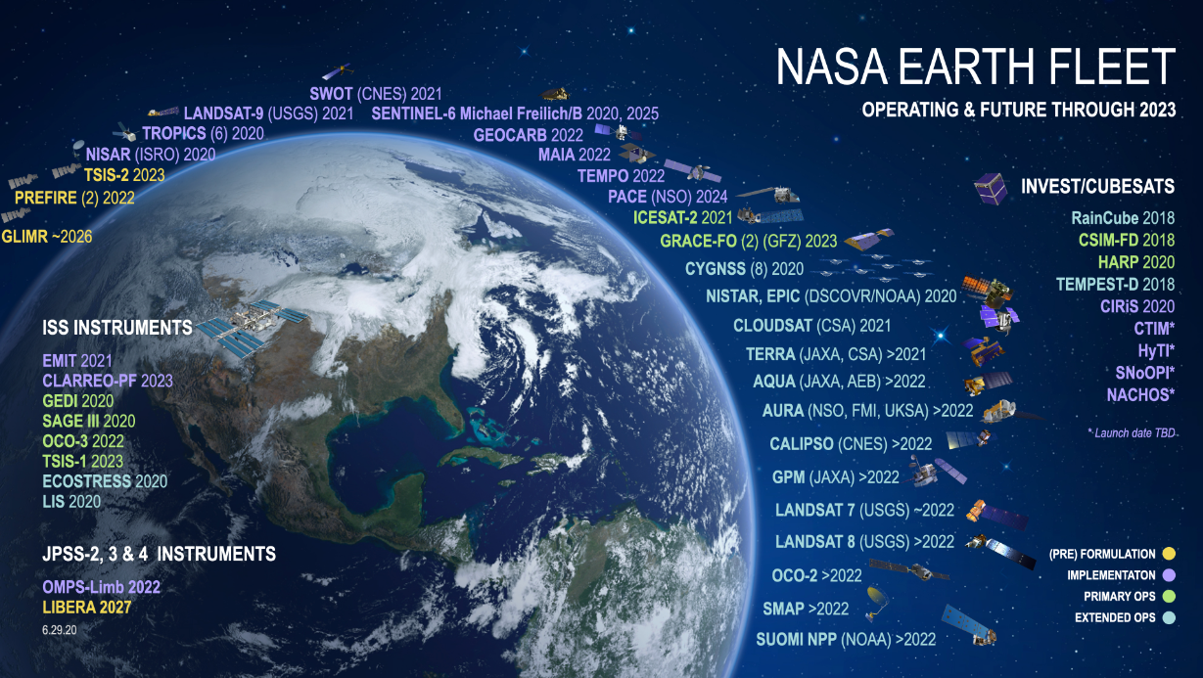
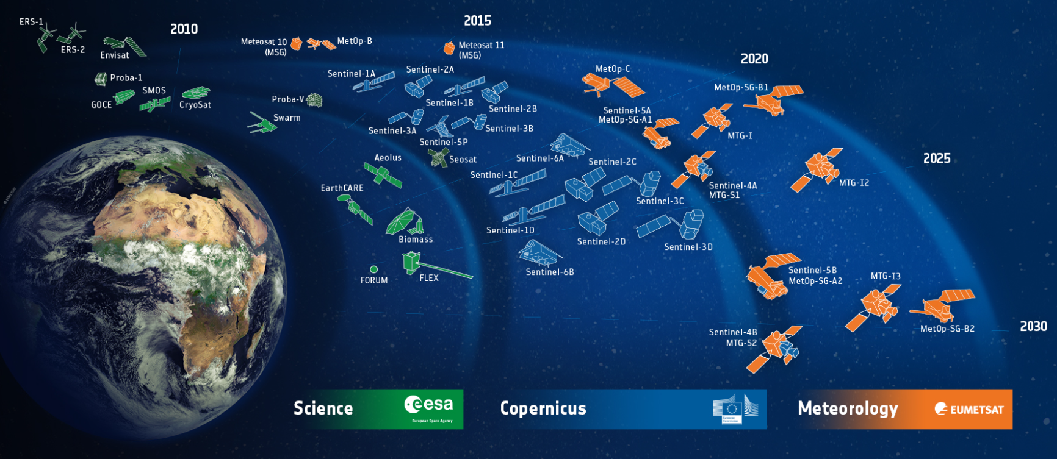

Geospatial Technologies – Remote Sensing (RS) and Photogrammetry
…. and there are plenty of satellites!
Only those from NASA and ESA shown here

Slide 7
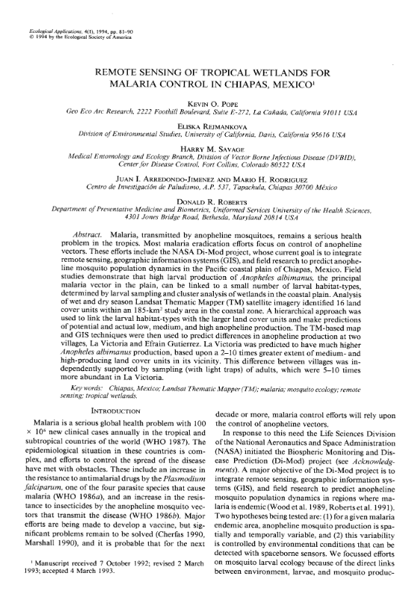
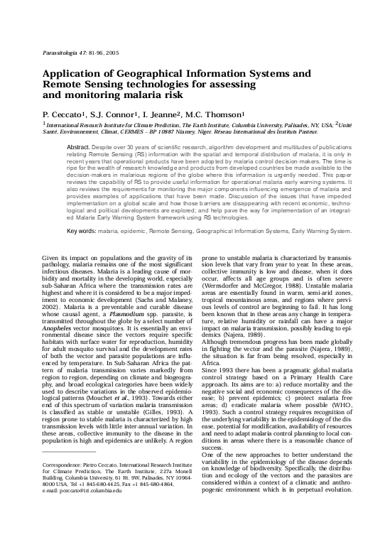
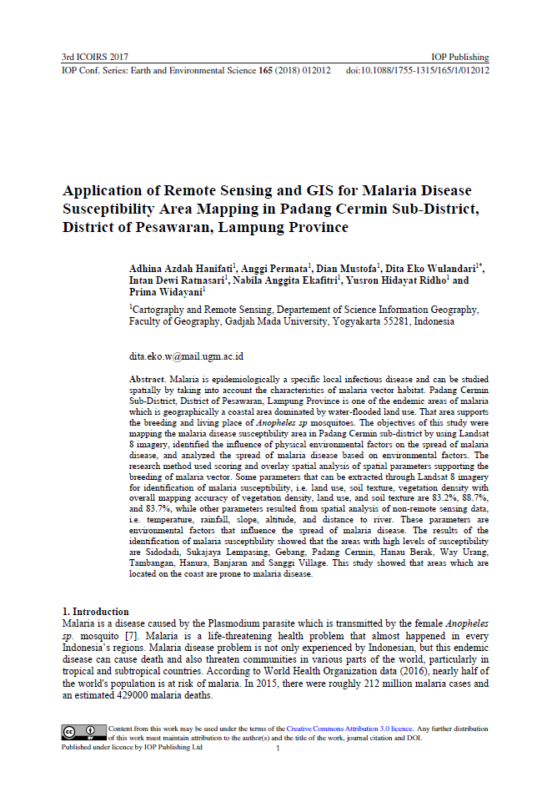

Use of remote sensing to combat malaria
A use which began a long time ago and which continues to support programs to combat vector-borne diseases in particular (example for Malaria presented here)
1994
2005
2017
2021

Slide 8
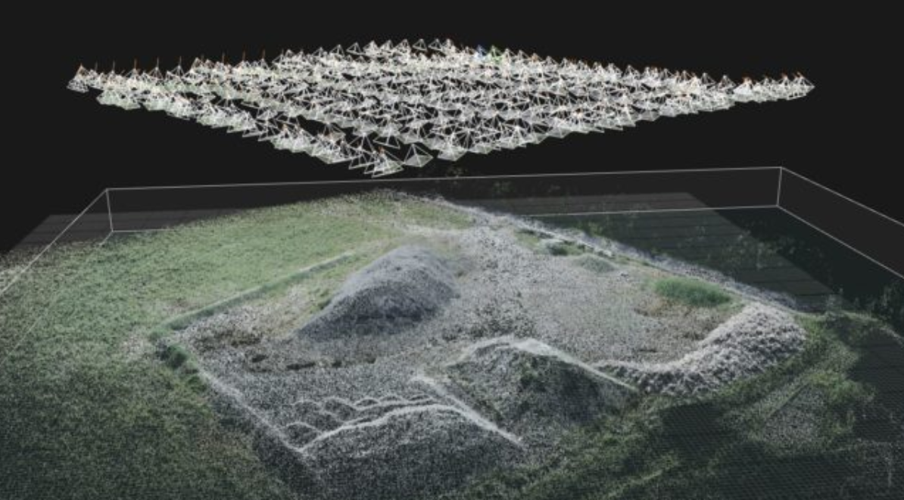
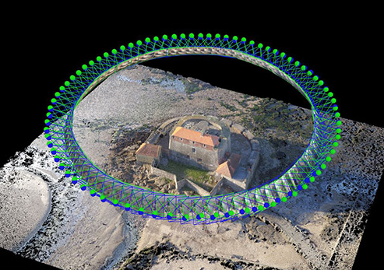
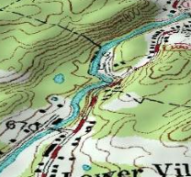
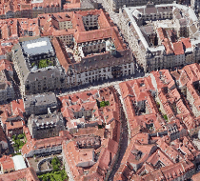
Geospatial Technologies – Remote Sensing (RS) and Photogrammetry
Photogrammetry: Determination of the dimension of objects by means of measurements made on photographic perspectives of these objects.
A camera is attached to a flying object or to the ground
Examples of derived data
Topography 3D views

Slide 9
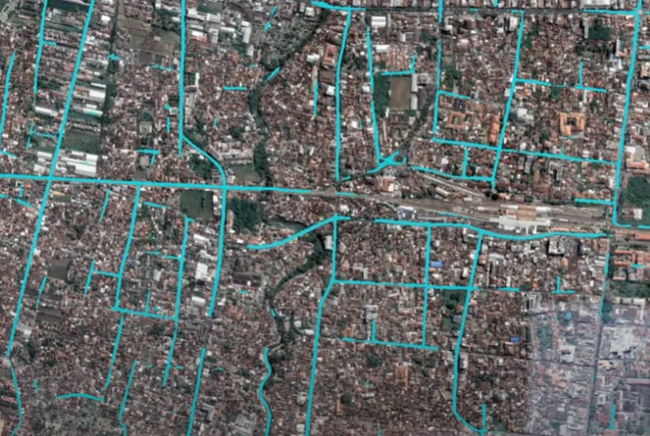
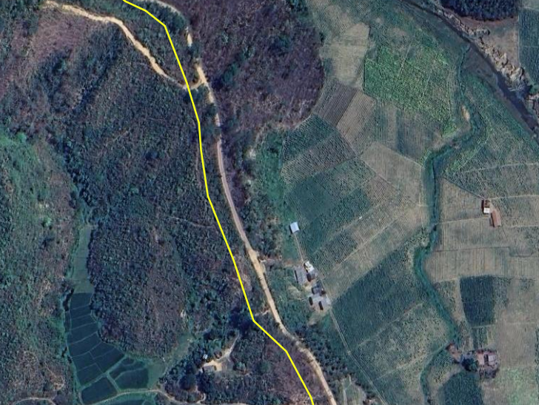
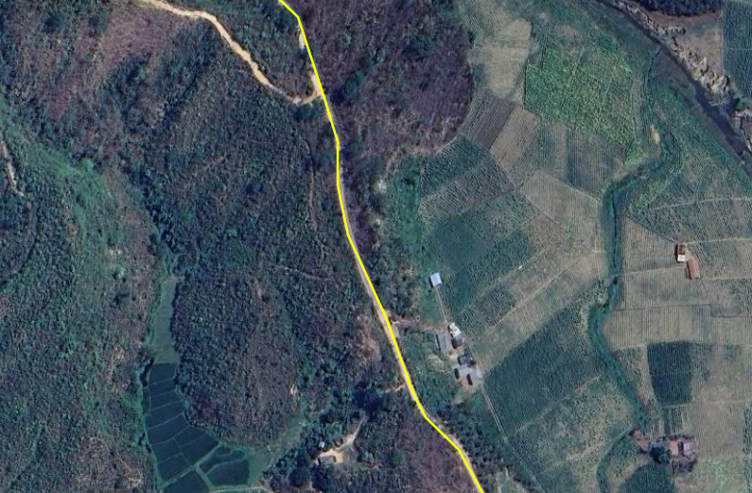


Use of remote sensing and photogrammetry for other applications
Automatic, or semi-automatic, extraction of geographic features visible on satellite (or other) imagery including building footprints which are core to population estimation and spatial distribution (Sessions 3.5 and 3.6)
Using satellite (or other) imagery as a ground reference to assess and improve the quality of geospatial data (Session 3.3)
Use of the digital elevation model and land cover to analyze accessibility to care
Remote sensing and photogrammetry generates key geospatial data needed to operationalize several of the applications of geospatial data and technologies

Slide 10
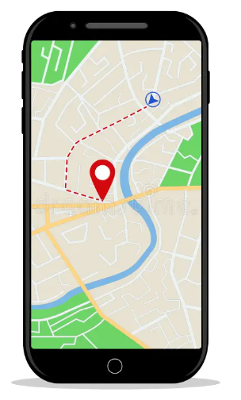
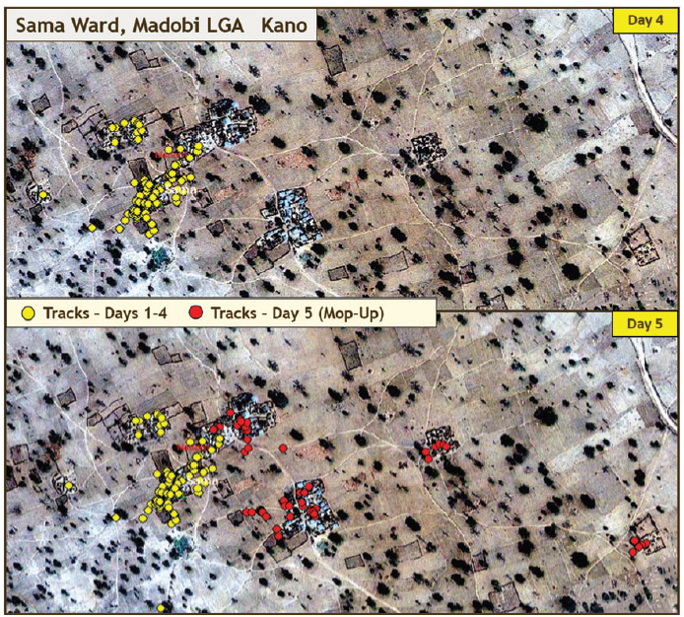
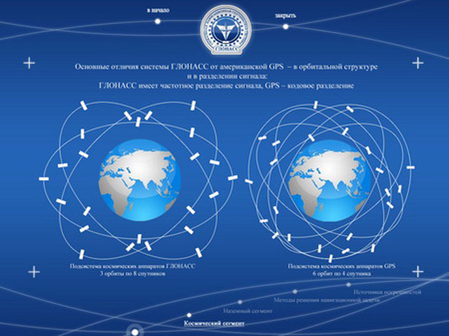
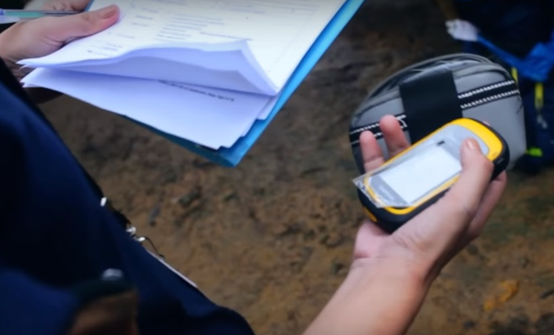
Geospatial Technologies – Global Navigation Satellite Systems (GNSS)
Use of a Global Navigation Satellite System (GNSS) enabled device to get to a particular location (navigate), track , or collect geographic coordinates (latitude, longitudes) in the field
Tracking to support Polio eradication in Nigeria
Navigation
Collection of geographic coordinates in the field
Global Navigation Satellite System (GNSS)
Covered in more detail in Session 4.2

Slide 11
Geospatial Technologies – Geographic Information Systems (GIS)
Two groups of definitions
“Integrated hardware and software that store, manage, analyze, edit, produce, and visualize geographic data”
“Computer tool for representing and analyzing all the things that exist on earth as well as all the events that occur there“
GIS as geospatial technologies - software (this session)
“Information system designed to collect, store, process, analyze, manage, and present all types of spatial and geographic data”
“Information system set up by an organization to describe the spatial objects, phenomena, and processes that are necessary for its action “
GIS as an information system
Often a source of confusion
Both covered in more detail in Session 4.3

Slide 12
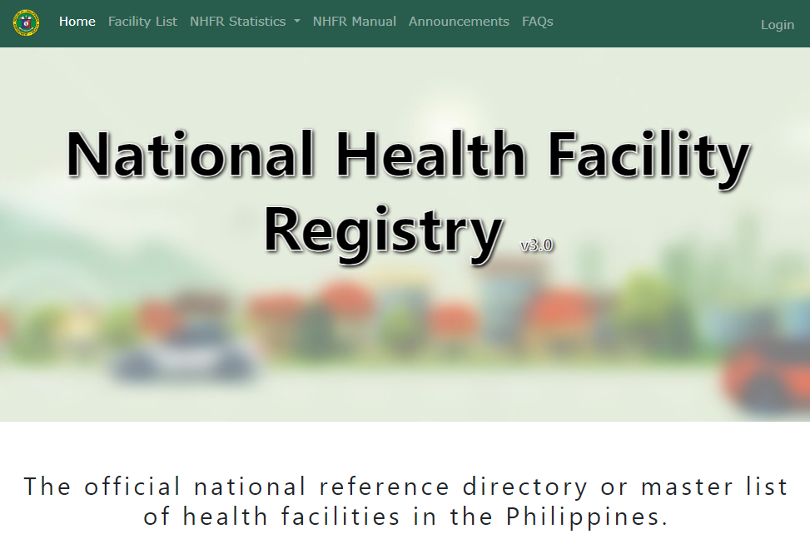
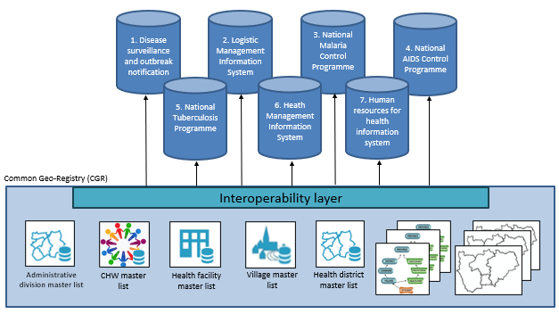
Geospatial Technologies – Registries and Common Geo-Registry (CGR)
Registry: IT solution to store, maintain, validate, update, and share a master list.
Container that manages only one master lists and potentially its associated hierarchies and geospatial data
Common Geo-Registry: IT solution that allows the simultaneous hosting, management, regular update, and sharing of master lists as well as associated hierarchies and geospatial data for the geographical objects core to development in general and public health in particular.
Container that simultaneously manages multiple master lists and their associated hierarchies and geospatial data
Both covered in more detail in Session 4.4

Slide 13
…and in the end
Remember that:
Technology is not supposed to guide the process but support it
The choice of technology(ies) must be based on clearly defined needs taking the local context into account (e.g., financial resources)
And above all: Garbage in – Garbage out!
Choosing the technology(ies) is not the starting point of the process

