Slide 1
Session 4.1: Introduction to geospatial technologies
Notes:
MODULE 4: HANDS-ON GEOSPATIAL TECHNOLOGIES
Session 4.1: Introduction to geospatial technologies

Slide 2
Key terms used in this session
Geospatial technology: Equipment used to measure and analyze Earth's land and features; A set of technological approaches, such as GIS, photogrammetry, and remote sensing, for acquiring and manipulating geographic data.
Geographic Information System (GIS): An integrated collection of computer software and data used to view and manage information about geographic places, analyze spatial relationships, and model spatial processes
GNSS: Acronym for Global Navigation Satellite System, and is the standard generic term for satellite navigation systems that provide autonomous geo-spatial positioning with global coverage. This term includes e.g. the GPS, GLONASS, Galileo, Beidou and other regional systems.
Notes:
Key terms used in this session

Slide 3
Geospatial Technology
What is geospatial technology?
It refers to equipment used to measure and analyze Earth's land and features.¹
A set of technological approaches, such as GIS, photogrammetry, and remote sensing, for acquiring and manipulating geographic data. ²
¹ https://articles.extension.org/pages/72985/what-is-geospatial-technology
² http://wiki.gis.com/wiki/index.php/GIS_Glossary/G
Notes:
Geospatial Technology
What is geospatial technology?
It refers to equipment used to measure and analyze Earth's land and features.
A set of technological approaches, such as GIS, photogrammetry, and remote sensing, for acquiring and manipulating geographic data.

Slide 4
Importance of Geospatial Technology
Why is geospatial technology important?
As mentioned in Session 2.1, “everything happens somewhere at a given time.” Geography is a fundamental aspect of all human activity.
Geospatial technologies help us understand the world we live in by helping us build a digital representation of the real-world which we can analyze depending on our needs.
Notes:
Importance of Geospatial Technology
Why is geospatial technology important?
As mentioned in Session 2.1, “everything happens somewhere at a given time.” Geography is a fundamental aspect of all human activity.
Geospatial technologies help us understand the world we live in by helping us build a digital representation of the real-world which we can analyze depending on our needs.

Slide 5
Types of Geospatial Technology
There are different geospatial technology available today such as:
Geographic Information System (GIS)
Global Navigation Satellite System (GNSS)
Remote sensing
Photogrammetry
Internet mapping technologies
GIS and GNSS are the focus of this module
Notes:
Types of Geospatial Technology
There are different geospatial technology available today such as:
Geographic Information System (GIS): An integrated collection of computer software and data used to view and manage information about geographic places, analyze spatial relationships, and model spatial processes
Global Navigation Satellite System (GNSS): Acronym for Global Navigation Satellite System, and is the standard generic term for satellite navigation systems that provide autonomous geo-spatial positioning with global coverage. This term includes e.g. the GPS, GLONASS, Galileo, Beidou and other regional systems.
Remote sensing: Collecting and interpreting information about the environment and the surface of the earth from a distance, primarily by sensing radiation that is naturally emitted or reflected by the earth's surface or from the atmosphere, or by sensing signals transmitted from a device and reflected back to it. Examples of remote-sensing methods include aerial photography, radar, and satellite imaging.
Photogrammetry: The science of making reliable measurements of physical objects and the environment by measuring and plotting electromagnetic radiation data from aerial photographs and remote-sensing systems against land features identified in ground control surveys, generally in order to produce planimetric, topographic, and contour maps.
Internet mapping technologies: software programs like Google Earth and web features like Microsoft Virtual Earth.

Slide 6
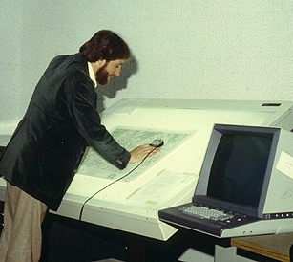
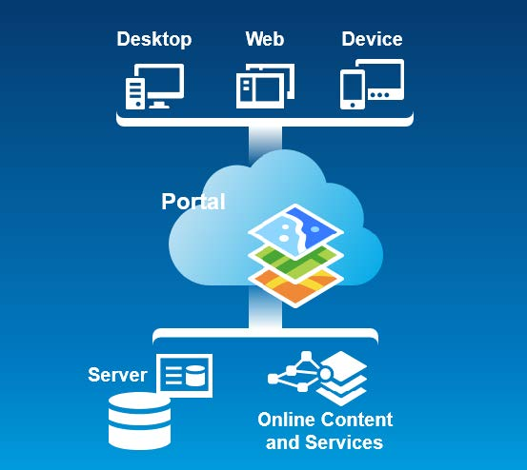
Evolution of Geospatial Technology
These technologies have been evolving through time and are getting more and more sophisticated.
GIS
GNSS
Remote sensing
1970s
2019
Notes:
Evolution of Geospatial Technology
These technologies have been evolving through time and are getting more and more sophisticated.
A few decades ago, only a few of these technologies were available. But today, not only are there more for each type, they are also more advanced.

Slide 7
Accessibity of Geospatial Technology
In the past, the technology to develop these tools were expensive and not largely accessible. As a result, most of these technologies were available only to the military, specialists, or institutions with sufficient funding.
With the advancement in technology, they are now easier and relatively less costly to develop making them accessible to the general public.
Notes:
Accessibity of Geospatial Technology
In the past, the technology to develop these tools were expensive and not largely accessible. As a result, most of these technologies were available only to the military, specialists, or institutions with sufficient funding.
With the advancement in technology, they are now easier and relatively less costly to develop making them accessible to the general public.

Slide 8
Application of Geospatial Technology
Geospatial technology can be applied and is useful to all agencies of government such as:
Agriculture
Defense
Education
Energy
Environment
Health
Notes:
Application of Geospatial Technology
Geospatial technology can be applied and is useful to all agencies of government such as for these applications:
Agriculture – surveying and mapping of plantation crops
Defense – monitoring, predicting and countering threats, helping to strategize and support field operations
Education – distribution of schools and population
Energy – integral in all phases of geothermal resources development: exploration, resource appraisal, drilling, exploitation and management of steam/hot water fields
Environment – an essential component of the Environmental Impact Assessment (EIA) process, as environmental resources are directly affected by changes in the shape and extent of the proposed disturbance.
Health – solving public health problems

Slide 9
Going further with Geospatial Technology
This module will discuss more about 2 particular geospatial technology:
GNSS
Session 4.2 gives an introduction to GNSS and Exercise 4.A. teaches how tocCollect data in the field using GNSS-enabled devices
GIS
Session 4.3 gives an introduction to GIS and Exercise 4.B teaches how to use the basic functionalities of GIS software (ArcMap or QGIS)
The available resources to further explore GNSS and GIS is presented in Session 4.4.
Notes:
Going further with Geospatial Technology
This module will discuss more about 2 particular geospatial technology:
GNSS
Session 4.2 gives an introduction to GNSS and Exercise 4.A. teaches how tocCollect data in the field using GNSS-enabled devices
GIS
Session 4.3 gives an introduction to GIS and Exercise 4.B teaches how to use the basic functionalities of GIS software (ArcMap or QGIS)
The available resources to further explore GNSS and GIS is presented in Session 4.4.

