Slide 1
Exercise 4.B: Using the basic functionalities of GIS software (QGIS)
Notes:
MODULE 4: HANDS-ON GEOSPATIAL TECHNOLOGIES
Exercise 4.B: Using the basic functionalities of GIS software (QGIS)

Slide 2
Objectives
The objectives of this exercise are to:
Familiarize the participants with the user interface of QGIS
Guide the participants in the use of the basic functionalities of QGIS
Exercise Data
The data used in this exercise are fictitious and created only to facilitate the exercises in this course. The different geospatial objects are not related to any real location or infrastructure in the real world.
Download the exercise data from: EXERCISE DATA
Preferably, create a “MODULE_4” folder in the C: or D: drive on your computer and place the downloaded data there for easier access.
(i.e., C:\ or D:\MODULE_4\DATA)

Slide 3
Download and Install QGIS 3.34
QGIS version 3.34 is used for the exercises in this course as it is the most stable version of QGIS at the time of update of this course which means that it has fewer bugs and less likely to crash.
Caveat: QGIS is continuously being improved and new versions of the software are constantly being released. It could be that newer version/s has/have already been released in the meantime. However, it is best to install version 3.34 as there may be major changes in the functionalities and user interface between versions and therefore, it would be easier to follow the exercises using the same version advised here.
You may download QGIS version 3.34 from these links:
For Windows: https://qgis.org/downloads/QGIS-OSGeo4W-3.34.6-1.msi
For macOS: https://qgis.org/downloads/macos/qgis-macos-ltr.dmg

Slide 4
Download and Install QGIS 3.34
For Windows:
Once downloaded, double-click on the installer file and follow the Setup Wizard to install QGIS.
For macOS:
Once downloaded, double-click on the .dmg file.
A new window will open with the QGIS app and the Applications folder shortcut. Drag the QGIS app into the Applications folder to install QGIS.
Warning for macOS users:
After installing QGIS, the first launch attempt may fail due to security protections. To enable QGIS, control-click on its icon in your Applications folder and select Open in the context menu. A confirmation dialog will display where you need to click the Open button again. This only has to be done once.

Slide 5
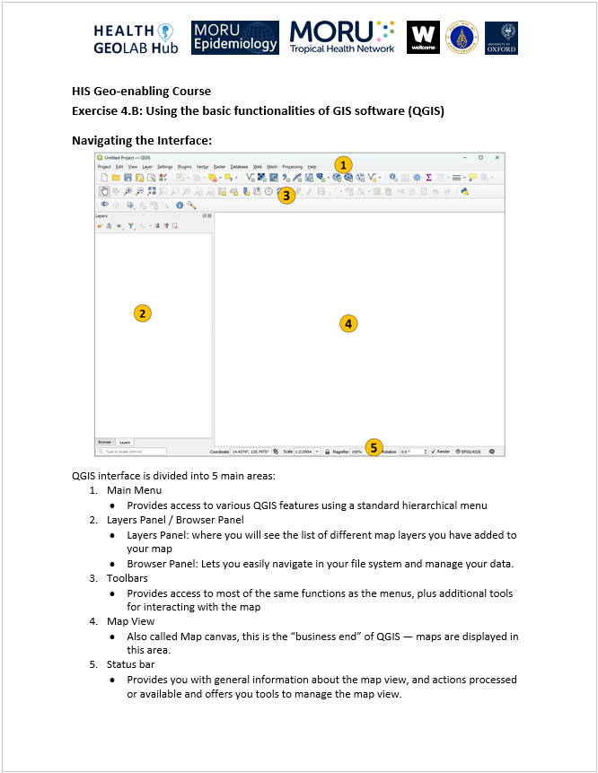
Using basic functionalities of QGIS 3.34
To help you in this exercise, you may refer to:
QGIS_Interface_Menu_Tools.pdf
that can be downloaded from: https://bit.ly/2lUDCww

Slide 6
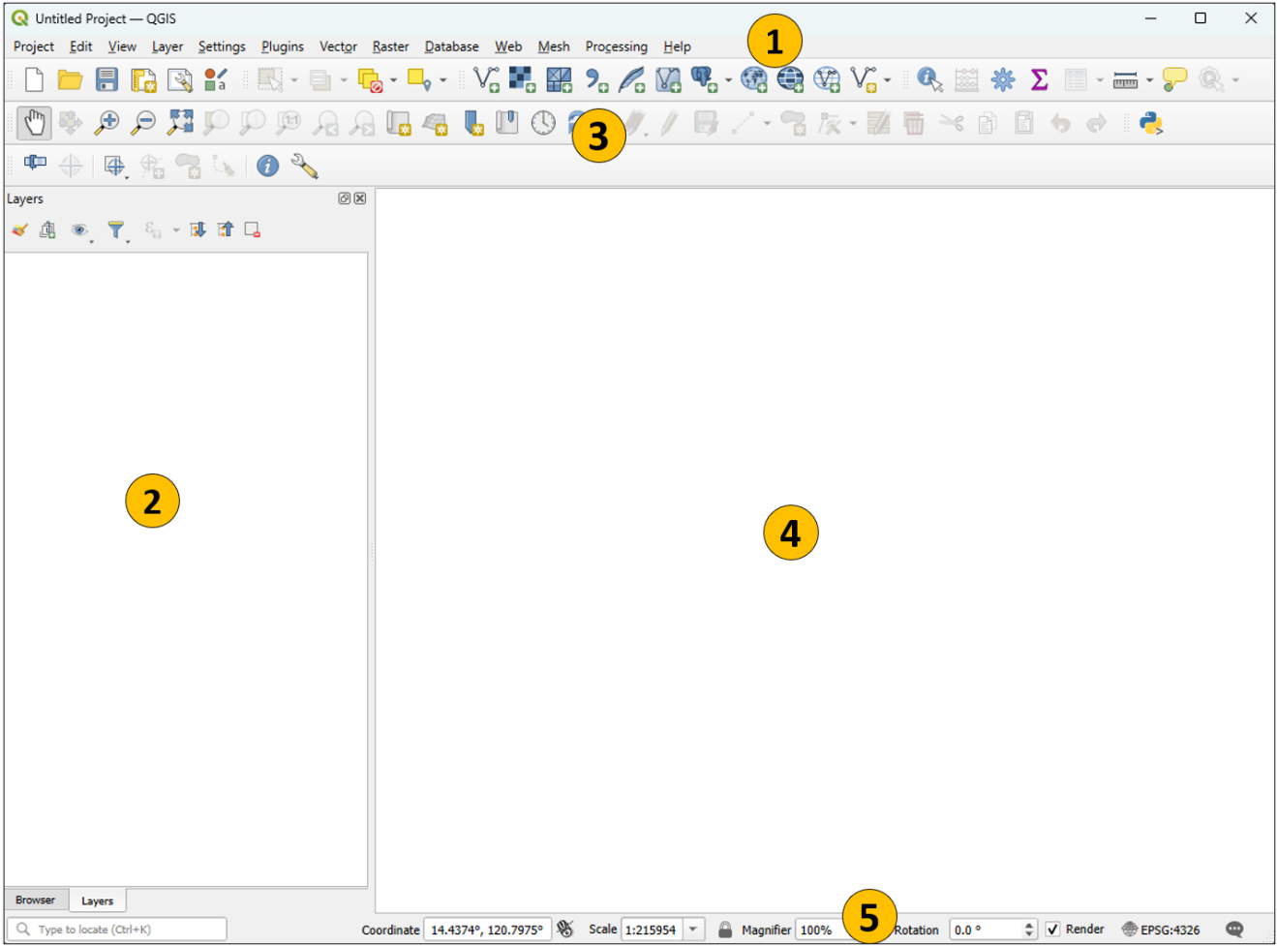
Navigating the Interface
When you launch QGIS, you will see an interface like this:
QGIS interface is divided into 5 main areas:
Main Menu:
Provides access to various QGIS features using a standard hierarchical menu.
Layers Panel / Browser Panel
Layers Panel: where you will see the list of different map layers you have added to your map
Browser Panel: lets you easily navigate in your file system and manage your data.
Toolbars
Provides access to most of the same functions as the menus, plus additional tools for interacting with the map
Map View
Also called Map canvas, this is the “business end” of QGIS — maps are displayed in this area.
Status bar
Provides you with general information about the map view, and actions processed or available and offers you tools to manage the map view.

Slide 7
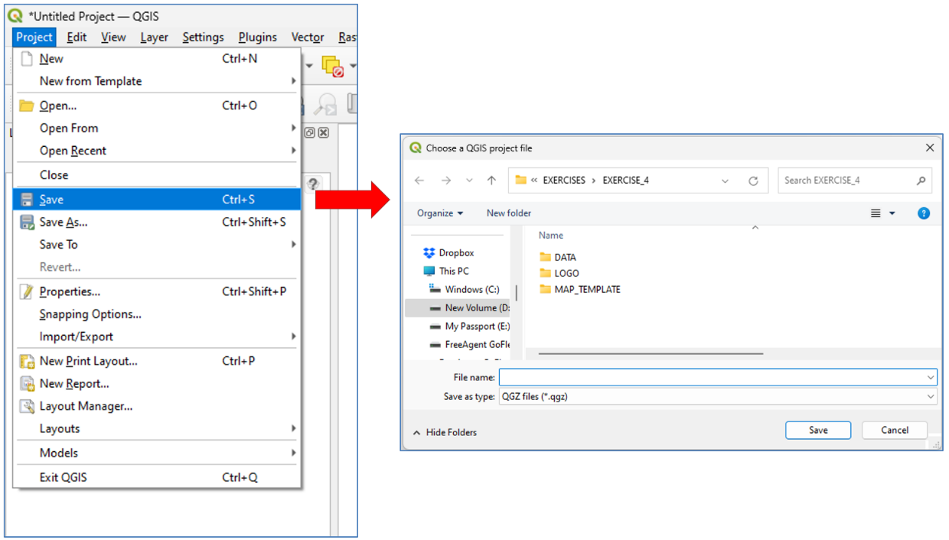
Saving Project Files
It can be a good habit to develop to save your QGIS project files even before adding any layers. This way, from that moment on, you will just have to regularly press CTRL+S on your keyboard to save you file.
QGIS can save user sessions. (A QGIS file is called a project.)
From the Main Menu, click Project > Save
Browse to the location of your created folder (C:\ or D:\MODULE_4)
Type in a file name and save your project as a QGZ file (.qgz)

Slide 8
Manage Layers Toolbar
The Manage Layers toolbar looks like this:
Add Vector Layer
Add Raster Layer
Add Mesh Layer
Add Delimited Text Layer
Add SpatiaLite Layer
Add/Edit Virtual Layer
Add PostGIS Layers
Add WMS/WMTS Layer
Add WCS Layer
Add WFS Layer
New Shapefile Layer
The 3 highlighted functions are the ones you will most commonly use

Slide 9
Add Vector Layer
Let’s add the Tolkien Barangay Boundary vector layer to the map:
Click the Add Vector Layer button
Click the Browse button and go to the location of the Exercise 4 data (C:\ or D:\MODULE_4\DATA)
Go to the BARANGAY_BOUNDARIES\LMB folder. Select TOLKIEN_BRG.shp and click Open.
Click Add then click Close to close the Data Source Manager dialog box.

Slide 10
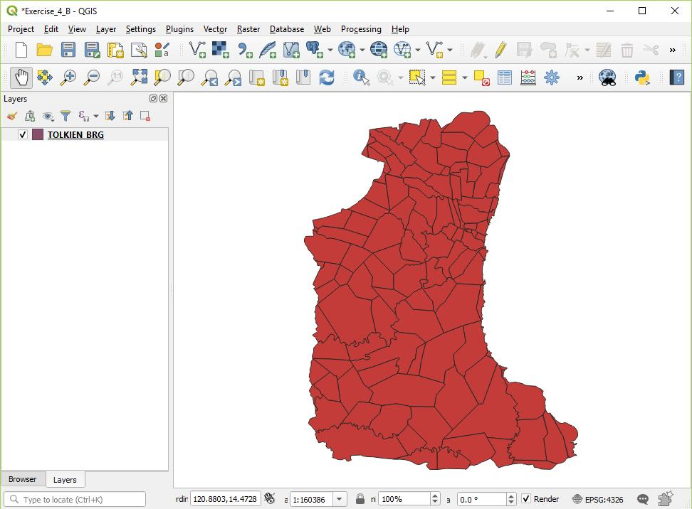
Add Vector Layer
You will now see the Tolkien Barangay Boundary vector layer listed on the Layers Panel and represented on the Map Canvas. (Random color is assigned.)

Slide 11
Add Raster Layer
Let’s add the Digital Elevation Model (DEM) raster layer to the map:
Click the Add Raster Layer button
Click the Browse button and go to the location of the Exercise 4 data (C:\ or D:\MODULE_4\DATA)
Go to the DEM\SRTM_30M folder. Select srtm_61_10.tif and click Open.
Click Add then click Close to close the Data Source Manager dialog box.

Slide 12
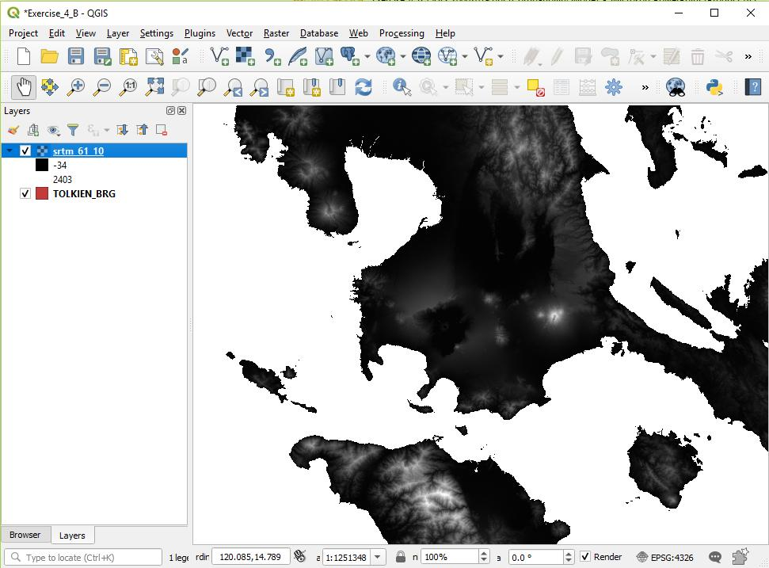
Add Raster Layer
You will now see the DEM raster layer listed on the Layers Panel and represented on the Map Canvas.

Slide 13
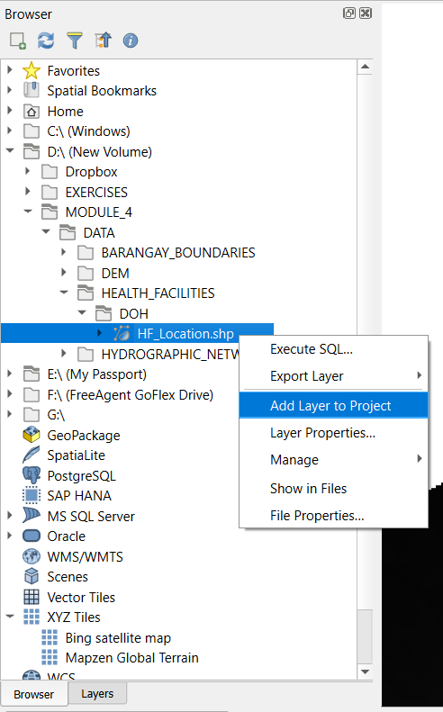
Other Ways to Add Layers
Another way to add a vector or raster layer to your map is to use the Browser Panel.
Go to the Browser Panel.
Go to the C:\ or D:\MODULE_4\DATA\HEALTH_FACILITIES\DOH
Right-click on HF_Location.shp and select Add Layer to Project
You may also double-click on the layer or drag and drop it onto the canvas to add it.

Slide 14
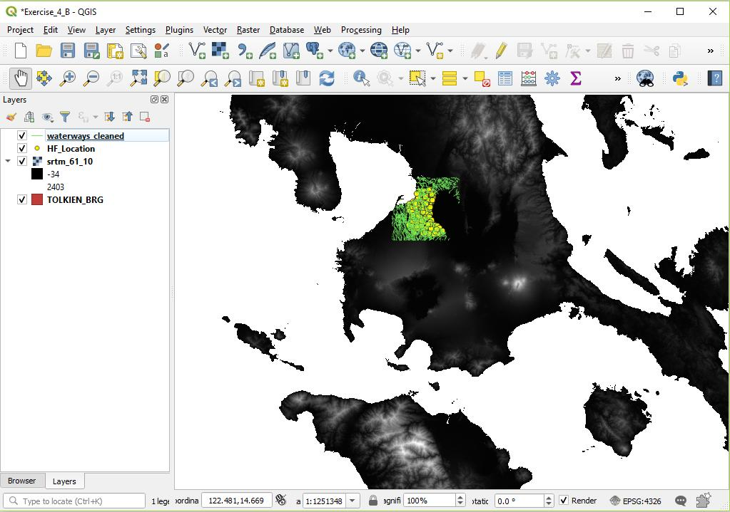
Add Layer
Try adding the waterways_cleaned.shp vector layer from the MODULE_4\DATA\HYDROGRAPHIC_NETWORK\WATERWAYS\OSM_CLEANED folder.
Your map should now look similar to this.

Slide 15
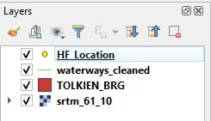
Managing the Layers in the Layers Panel
The map layers appear in the Layers Panel based on the way they are added to the map.
The layers are drawn on the Map Canvas based on the way they are arranged in the Layers Panel which means point layers can be covered by polygon layers if they are at the bottom in the Layers Panel.
The layers should usually be arranged with the point layers on top, followed by line layers, then polygon layers and raster layers. (This may change depending on your need.)
The layers can be re-arranged by clicking on the layer name and dragging the layer above or below the other layers in the list.
Arrange your layers according to the image on the right.

Slide 16
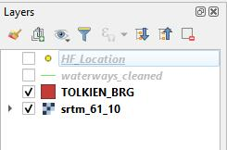
Managing the Layers in the Layers Panel
You can make the map layers visible or not in the Map Canvas by turning the layer on or off in the Layers Panel.
You can do this by clicking the box beside the layer: a check in the box means the layer is visible, no check means it is not visible.

Slide 17
Map Navigation Toolbar
The Map Navigation toolbar looks like this:
Pan Map
Pan Map to Selection
Zoom In
Zoom Out
Zoom Full
Zoom to Selection
Zoom to Layer
Zoom to Native Resolution
Zoom Last
Zoom Next
New Map View
New 3D Map View
New Spatial Bookmark
Show Spatial Bookmarks
Temporal Control Panel
Refresh
The highlighted functions are the ones you will most commonly use

Slide 18
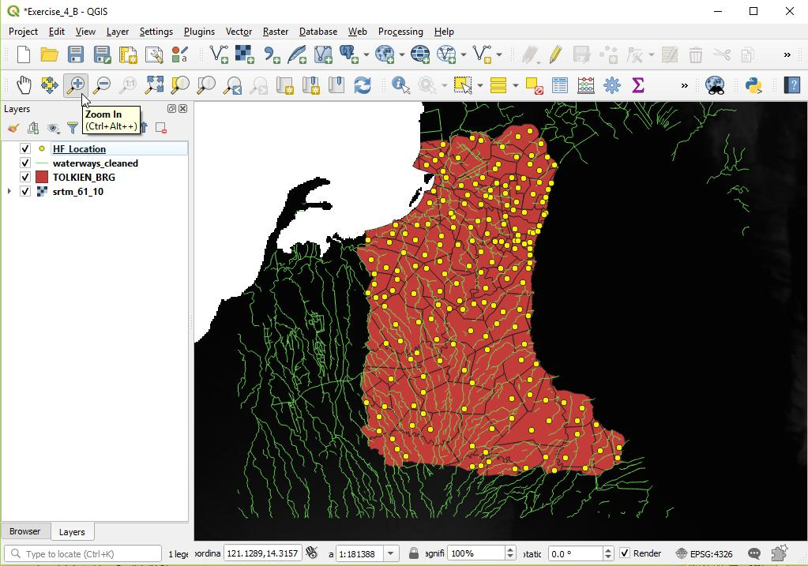
Map Navigation Toolbar
Play around with your map using the different tools in the Map Navigation toolbar.

Slide 19
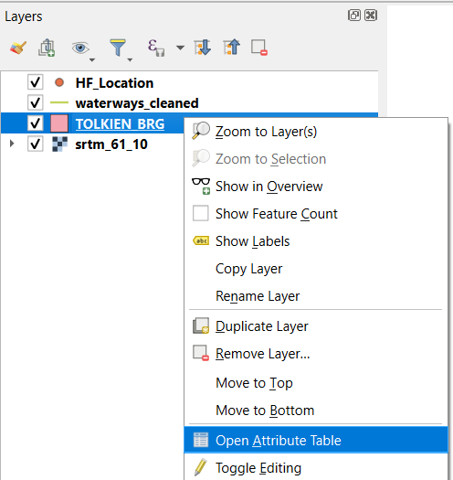
Attributes Toolbar
The Attributes toolbar looks like this:
The Open Attribute Table tool is the one you will most commonly use
You can also do the same by right-clicking on a layer and selecting Open Attribute Table

Slide 20
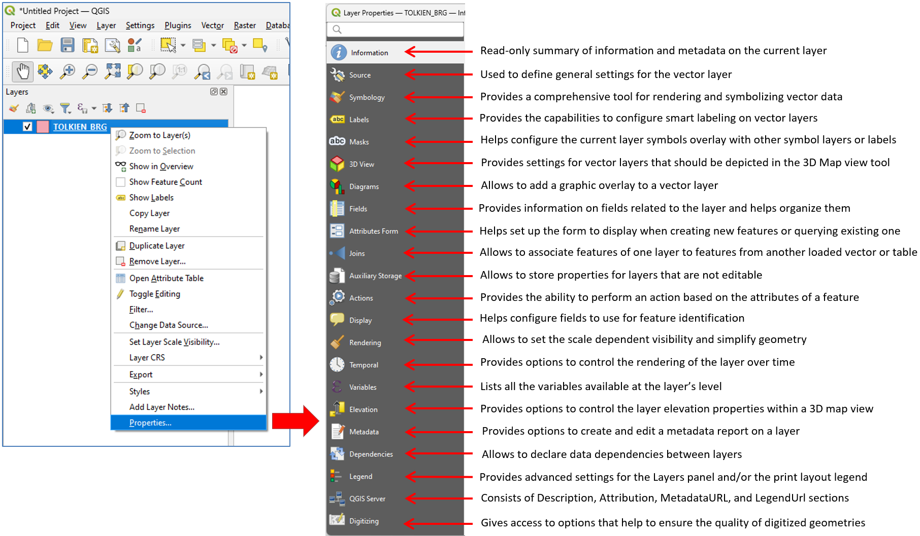
Vector Layer Properties
The (Vector) Layer Properties can be accessed by right-clicking on the layer and selecting Properties… or by double-clicking on the layer.
The (Vector) Layer Properties dialog box provides information about the vector layer and provides general settings to manage appearance of layer features in the map (symbology, labeling, diagrams) and interaction with the mouse (actions, map tips, form design).

Slide 21
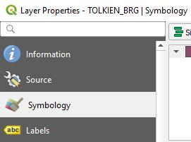
Vector Layer Properties
Let’s try to use one of settings you will mostly use in the Layer Properties: Symbology
Open the Layers Properties of the Tolkien Barangay Boundary vector layer.
Click Symbology tab from the left menu.
Click on Simple Fill.

Slide 22
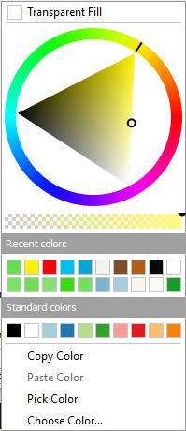
Vector Layer Properties
Click the dropdown button of the Fill color field.
Choose a color you want by clicking on a color in the wheel, recent colors, or standard color.
You can click on Choose Color… to be able to enter a specific RGB or HTML notation.
You can also choose to have a Transparent Fill by checking the box at the top.

Slide 23
Vector Layer Properties
Click the dropdown button of the Stroke color field. This is for the outline color of the barangay boundaries.
Choose a color you want by clicking on a color in the wheel, recent colors, or standard color.
You can also click on Choose Color… to be able to enter a specific RGB or HTML notation.
Click on Apply then OK to close the Layer Properties dialog box.

Slide 24
Vector Layer Properties
Change the symbology of the other vector layers in your map.
Play around with the Symbology settings. You may also change the Fill style, Stroke width, and Stroke style among others.
Familiarize yourself with the information about the layers in the Layer Properties dialog box.

Slide 25
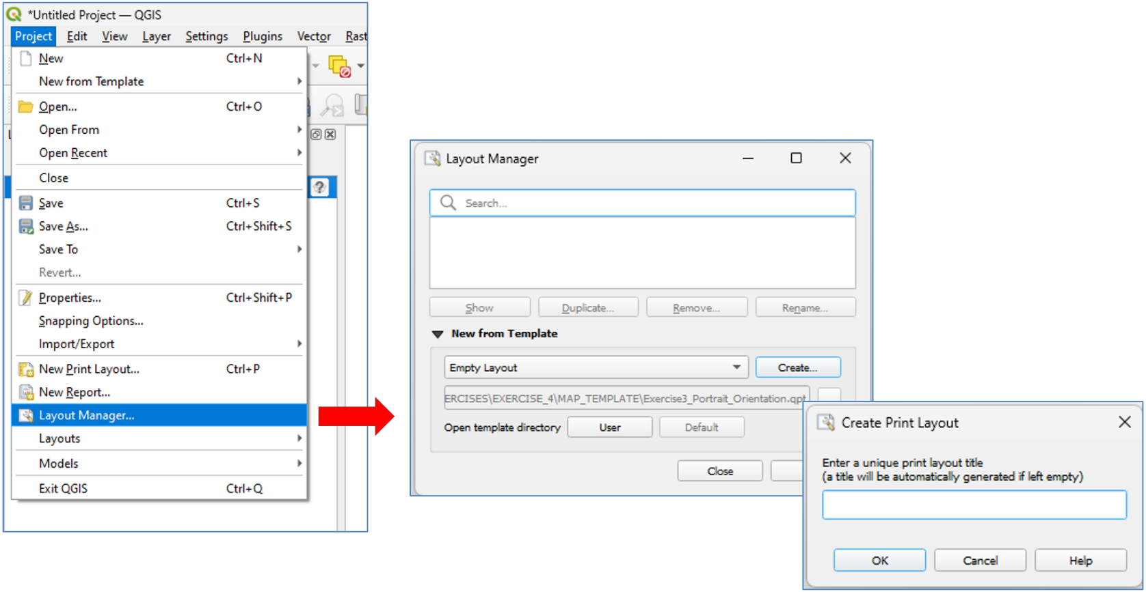
Layout Manager
The Layout Manager allows you to create a new map layout either from an empty layout or a template.
It can be accessed from the Project menu (Project > Layout Manager…) or in the Print Layout dialog box (Layout > Layout Manager…).

Slide 26
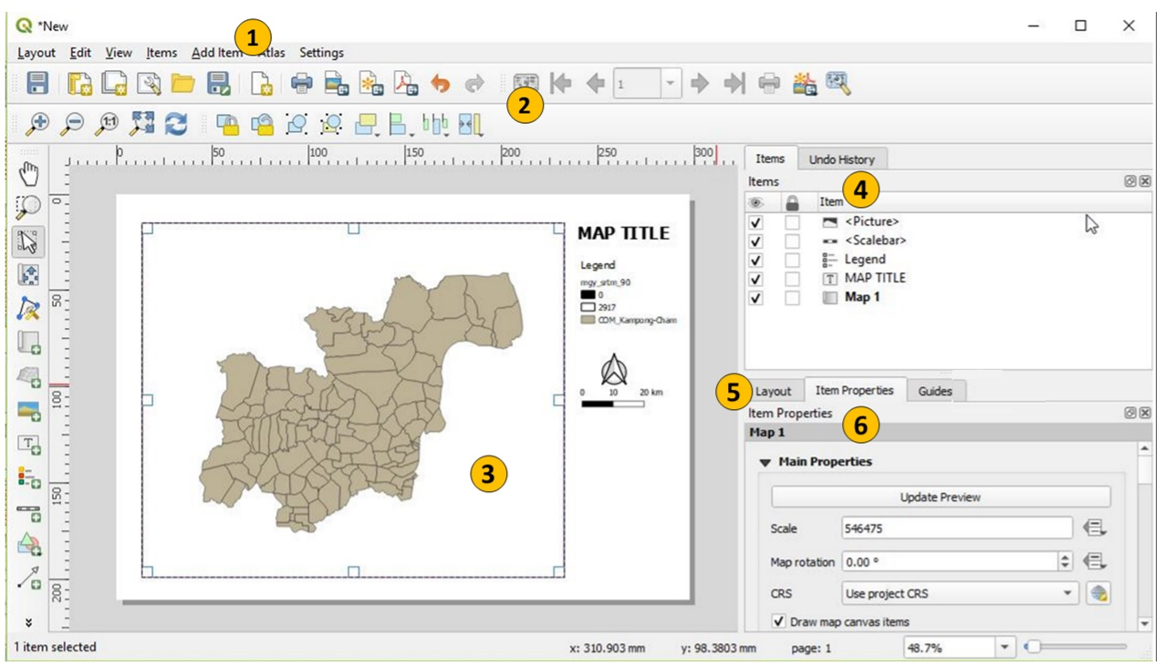
Print Layout
The Print Layout window looks like to this:

Slide 27
Print Layout
The different areas of the Print Layout window are:
Main Menu
Provides access to various QGIS Layout features using a standard hierarchical menu.
Toolbars
Provides access to most of the same functions as the menus, plus additional tools for interacting with the map layout
Map Layout Area
This where your map layout is displayed
Items/Undo History
Items: Provides a list of items/elements in your map
Undo History: Keeps track of the changes made to your layout and allows you to undo changes as needed
Layout tab
Contains the settings for the whole map layout
Item Properties tab
Contains the settings for the different items in the map layout (depending on the item selected in the Items list)

Slide 28
Layout Toolbar
The Layout toolbar looks like this:
Save project
New layout
Duplicate layout
Layout manager
Add items from template
Save as template
Add Pages…
Print Layout
Export as image
Export as SVG…
Export as PDF…
Undo
Redo
The highlighted functions are the ones you will most commonly use

Slide 29
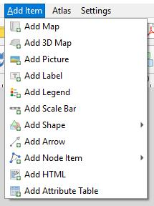
Add Layout Elements
You can add the different map layout elements by the Add Item main menu or the Toolbox.
Try adding and editing the different elements in your map layout.

Slide 30
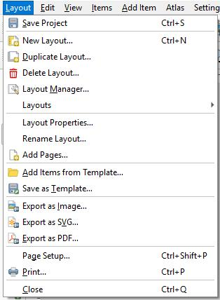
Exporting the map layout
Once you are done with your map layout, you can export it as an image file, a scalable vector graphics (SVG) file, or Portable Document Format (PDF) file.
You can do this by going to the Layout main menu and choosing Export as Image, SVG, or PDF.
Or by choosing the appropriate button in the Layout toolbar.

