Slide 1
Exercise 4.B: Using the basic functionalities of GIS software (ArcMap)
Notes:
MODULE 4: HANDS-ON GEOSPATIAL TECHNOLOGIES
Exercise 4.B: Using the basic functionalities of GIS software (ArcMap)

Slide 2
Objectives
The objectives of this exercise are to:
Familiarize the participants with the user interface of ArcMap
Guide the participants in the use of the basic functionalities of ArcMap
Exercise Data
The data used in this exercise are fictitious and created only to facilitate the exercises in this course. The different geospatial objects are not related to any real location or infrastructure in the real world.
Download the exercise data from: EXERCISE DATA
Preferably, create a “MODULE_4” folder in the C: or D: drive on your computer and place the downloaded data there for easier access.
(i.e., C:\ or D:\MODULE_4\DATA)

Slide 3
Install ArcMap 10.8
ArcMap version 10.8 is used for the exercises in this course. Other versions may also be used although there may be differences in the functionalities.
Make sure that you have installed ArcMap in your computer to be able to follow this exercise.
As mentioned in Session 4.3, Esri offers a Health and Human Services Grant Program that provides access to Esri product licenses to Ministries of Health of eligible countries. Learn more about it here: https://bit.ly/2PjysU1
Caveat for macOS users: ArcMap is designed to run on Windows OS and does not run natively on a Mac. You may try to install ArcMap using the steps here: https://guides.library.jhu.edu/gis/software-access/mac
Please note that Health GeoLab is not liable for any damages this may cause to your computer.

Slide 4
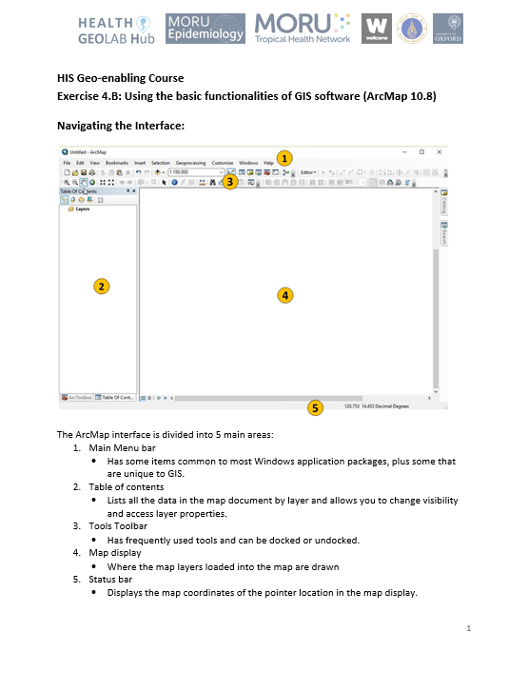
Using basic functionalities of ArcMap 10.8
To help you in this exercise, you may refer to:
ArcMap_Interface_Menu_Tools.pdf
that can be downloaded from: https://bit.ly/2mhtluK

Slide 5
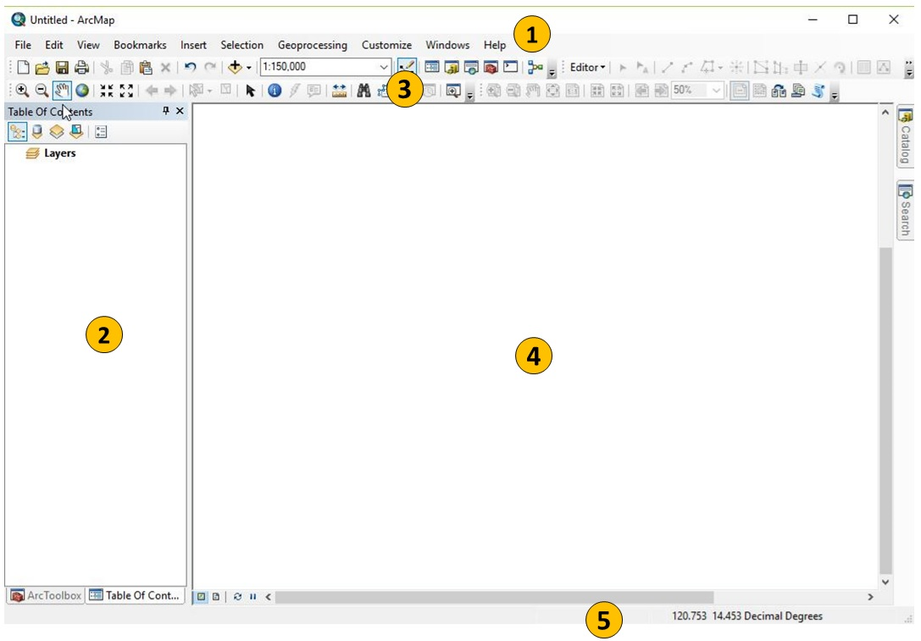
Navigating the Interface
When you launch ArcMap, you will see an interface like this:
ArcMap interface is divided into 5 main areas:
Main Menu
Has some items common to most Windows application packages, plus some that are unique to GIS
Table Of Contents (ToC)
Lists all the data in the map document by layer and allows you to change visibility and access layer properties
Tools toolbar
Has frequently used tools and can be docked or undocked
Map display
Where the map layers loaded into the map are drawn
Status bar
Displays the map coordinates of the pointer location in the map display

Slide 6
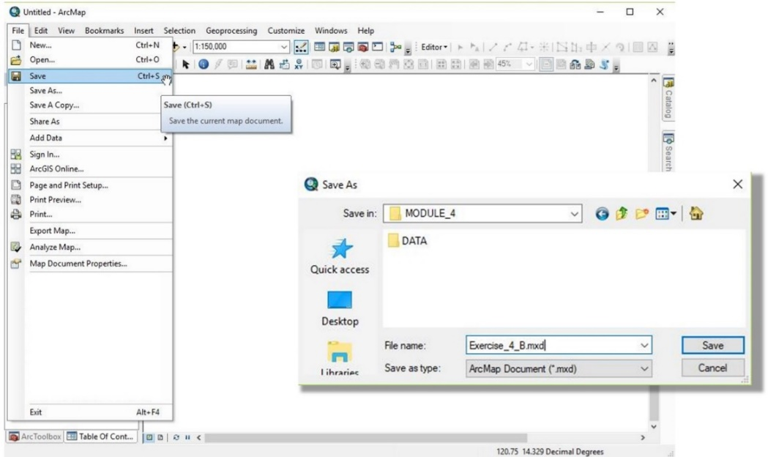
Saving Map Documents
It can be a good habit to develop to save your ArcMap document even before adding any layers. This way, from that moment on, you will just have to regularly press CTRL+S on your keyboard to save your file.
ArcMap can save user sessions. An ArcMap document is called a map document or mxd since the file name extension (.mxd) is automatically appended to your map document name.
From the Main Menu, click File > Save
Browse to the location of your created folder (C:\ or D:\MODULE_4)
Type in a file name and save your map document.
Note: The folder where you saved your map document becomes the ‘Home’ folder for the same map document and can then be accessed by the Home folder button . If your data is stored in the same folder, the Home folder button makes access to the data easier.

Slide 7
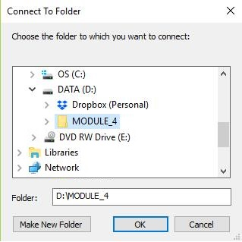
Add Vector Layer
Let’s add the Tolkien Barangay Boundary vector layer to the map:
Click the Add Data button
In the Add Data dialog box, click the Connect to Folder button. (This is in case the data is in a different folder than the map document. Otherwise, click the Home folder button and proceed to step 5.)
Go to the location of the Exercise 4 data (C:\ or D:\MODULE_4)
Select the MODULE_4 folder and click OK.
Note: You need to connect to a folder only once. ArcMap retains the connection even in succeeding map documents.
Back to the Add Data dialog box, go to the BARANGAY_BOUNDARIES\LMB folder. Select TOLKIEN_BRG.shp and click Add.

Slide 8
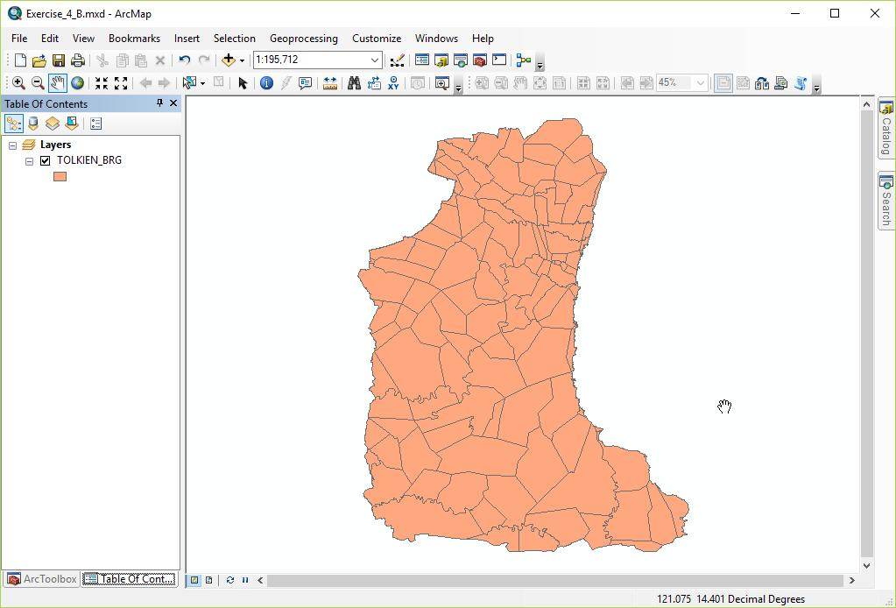
Add Vector Layer
You will now see the Tolkien Barangay Boundary vector layer listed in the Table Of Contents and represented on the Map display. (Random color is assigned.)

Slide 9
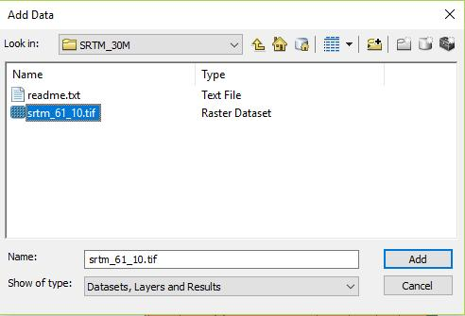
Add Raster Layer
Let’s add the Digital Elevation Model (DEM) raster layer to the map:
Click the Add Data button
Go to the location of the DEM raster data (MODULE_4\DATA\ DEM\SRTM_30M)
Select srtm_61_10.tif and click Add.
When asked if you would like to create pyramids, click Yes.

Slide 10
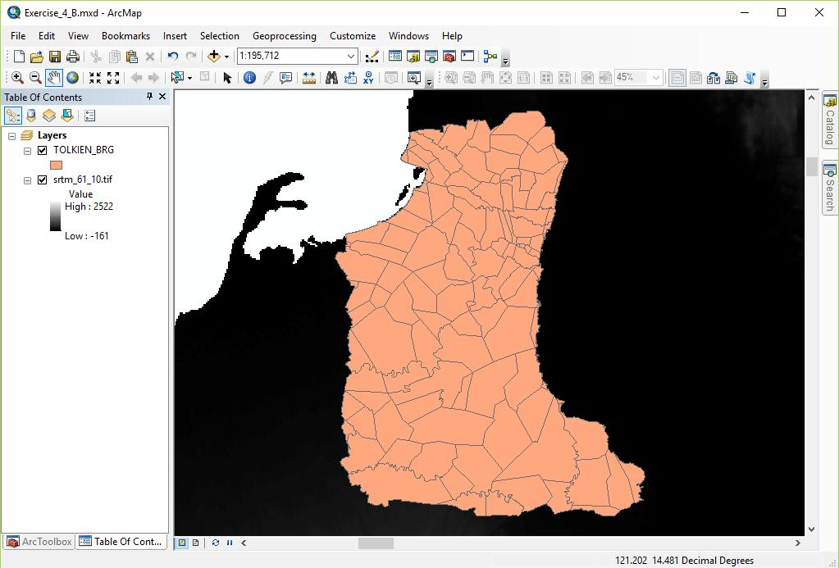
Add Raster Layer
You will now see the DEM raster layer listed in the Table Of Contents and represented on the Map display.

Slide 11
Other Ways to Add Layers
Another way to add a vector or raster layer to your map is to use the Catalog window.
Open the Catalog window by clicking the Catalog button from the Standard toolbar or clicking the Catalog tab on the right side.
Go to the MODULE_4\DATA\HEALTH_ FACILITIES\DOH
(through HOME – MODULE_4 or Folder Connections)

Slide 12
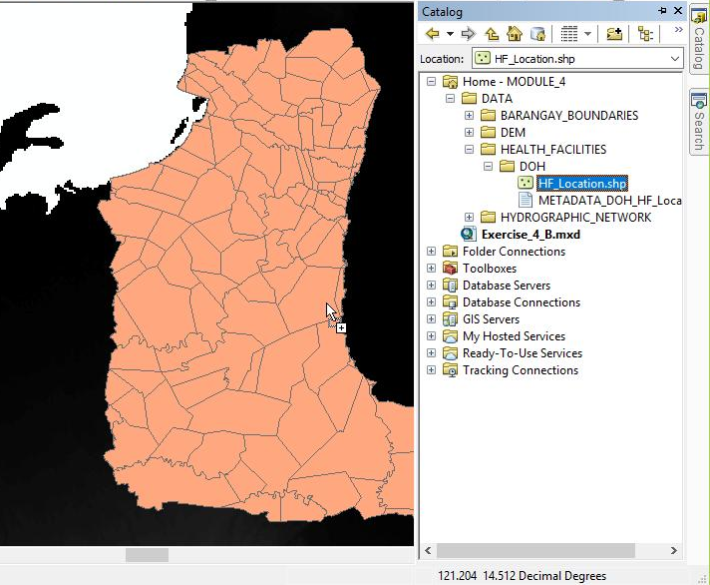
Other Ways to Add Layers
Expand the DOH folder by clicking the “+” button beside it.
Select HF_Location.shp
Drag and drop HF_Location.shp to the map display or Table Of Contents

Slide 13
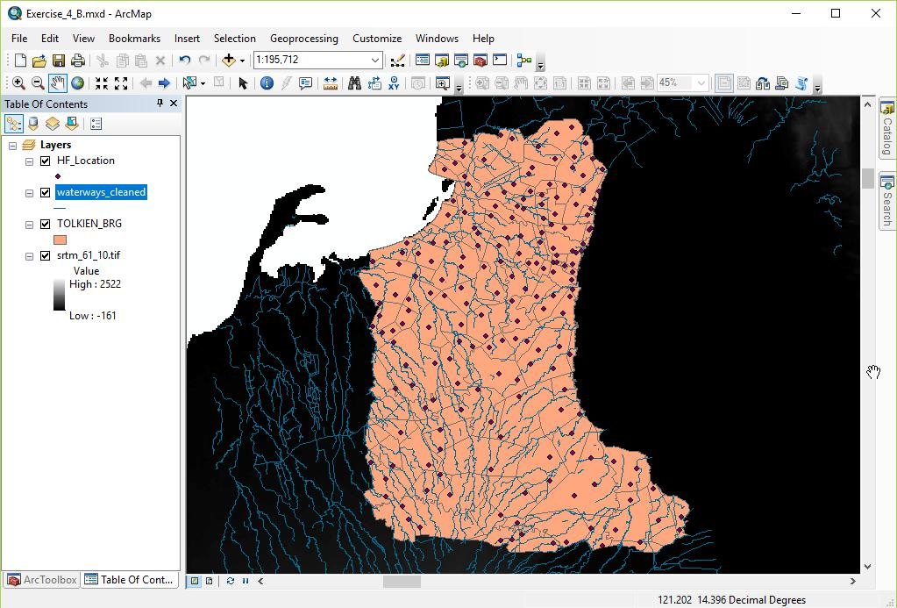
Add Layer
Try adding the waterways_cleaned.shp vector layer from the MODULE_4\DATA\HYDROGRAPHIC_NETWORK\WATERWAYS\OSM_CLEANED folder.
Your map should now look similar to this.

Slide 14
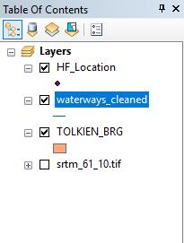
Managing the Layers in the Table of Content
The layers are drawn on the Map display based on the way they are arranged in the Table Of Contents (ToC) by default (when the List by Drawing Order button is active).
ArcMap arranges the map layers in the ToC with the point layers on top, followed by line layers, then polygon layers and raster layers.
However, the layers can be re-arranged by clicking and dragging the layer above or below the other layers in the list based on your needs.
Try re-arranging the layers in the ToC and see how it reflects on the layers in the Map display.
You can change the visibility of the map layers in the Map display by turning the layer on or off in the ToC.
You can do this by clicking the box beside the layer: a check in the box means the layer is visible, no check means it is not visible.

Slide 15
Tools Toolbar
The Tools toolbar looks like this:
Zoom In
Zoom Out
Pan
Zoom to Full Extent
Fixed Zoom In
Fixed Zoom Out
Go Back To Previous Extent
Go To Next Extent
Select Features
Clear Selected Features
Select Elements
Identify
Hyperlink
HTML Popup
Measure
Find
Find Route
Go To XY
Time Slider
Create Viewer Window
The highlighted functions are the ones you will most commonly use

Slide 16
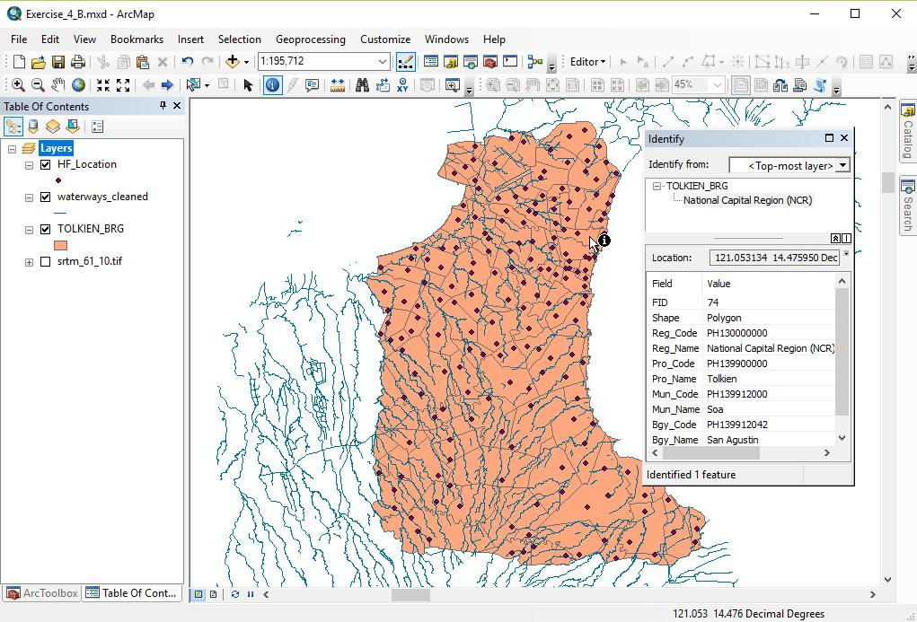
Tools Toolbar
The Tools toolbar allows you to move around your map as well as select and identify different map features.
Play around with your map using the different tools in the Tools toolbar.

Slide 17
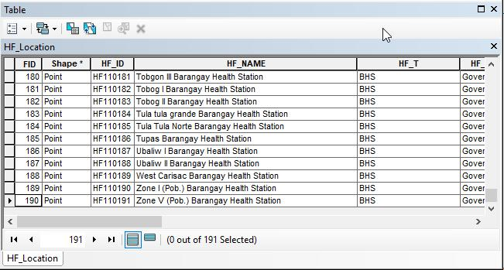
Attributes Table
The Attributes Table contains the information about the different features in a map layer.
To access the Attribute Table of a map layer, right-click on the layer and select Open Attribute Table.

Slide 18
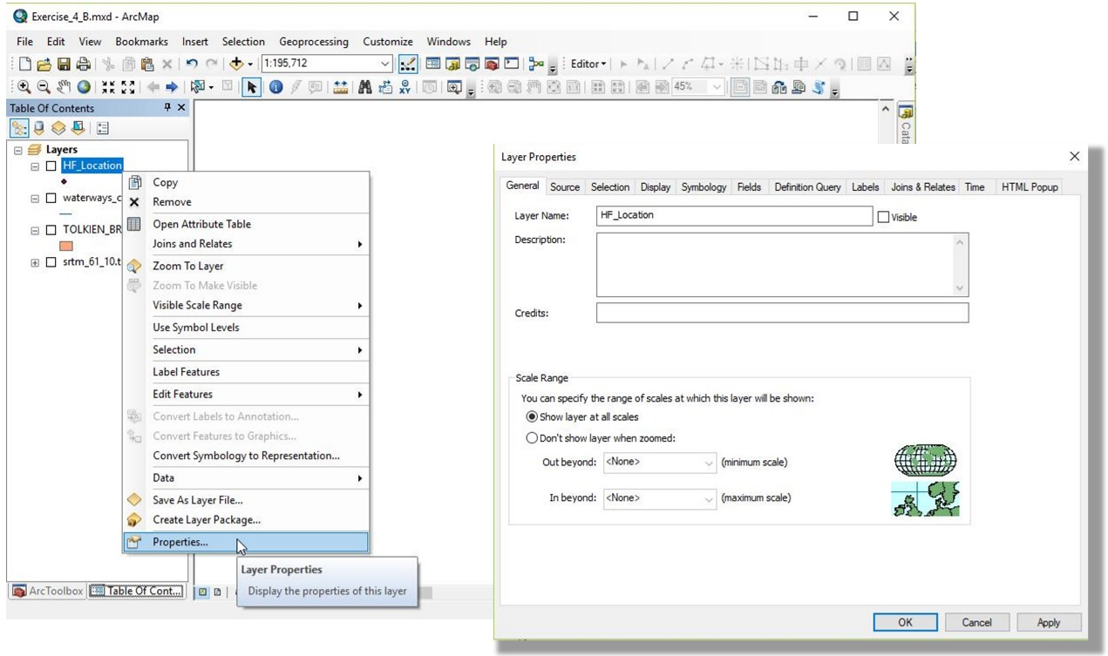
Vector Layer Properties
The (Vector) Layer Properties can be accessed by right-clicking on the layer and selecting Properties… or by double-clicking on the layer.
The (Vector) Layer Properties dialog box provides information about the vector layer and provides general settings to manage appearance of layer features in the map (display, symbology, labeling) and selection of fields or features to appear (fields, definition query).
Learn more about the different layer properties from the ArcMap Tools and Interface document mentioned at the start of this exercise.

Slide 19
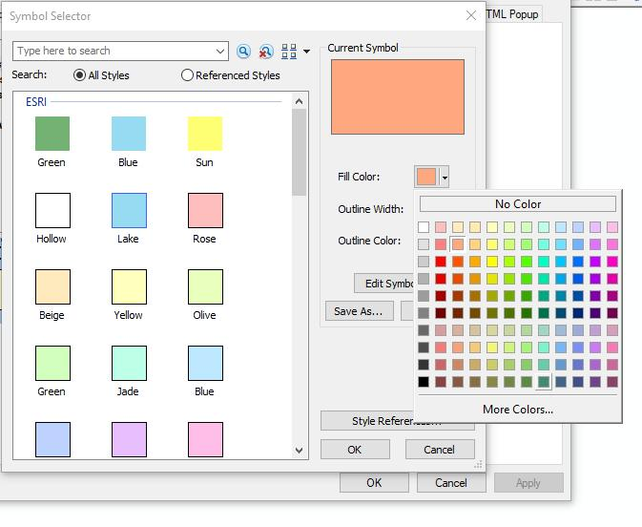
Vector Layer Properties
Let’s try to use one of settings you will mostly use in the Layer Properties: Symbology
Open the Layers Properties of the Tolkien Barangay Boundary vector layer.
Click Symbology tab.
Click on the symbol for the layer.
In the Symbol Selector dialog box, click the dropdown menu of the Fill Color field.
Choose a color you want by clicking on one of the preset colors.
You may click on More Colors… to be able to enter a specific RGB, HSV, or CMYK.
You may also choose your layer to have No Color fill (transparent fill).

Slide 20
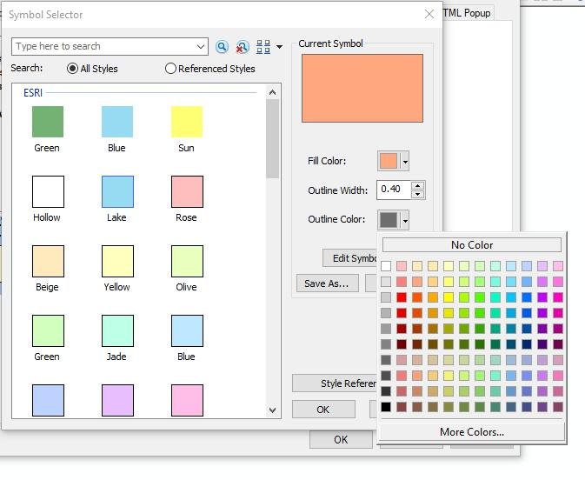
Vector Layer Properties
Click the dropdown menu of the Outline Color field.
Choose a color you want by clicking on one of the preset colors.
You may click on More Colors… to be able to enter a specific RGB, HSV, or CMYK.
You may also choose your layer to have No Color (transparent) outline.
Click OK.
Click Apply then OK in the Layer Properties dialog box.

Slide 21
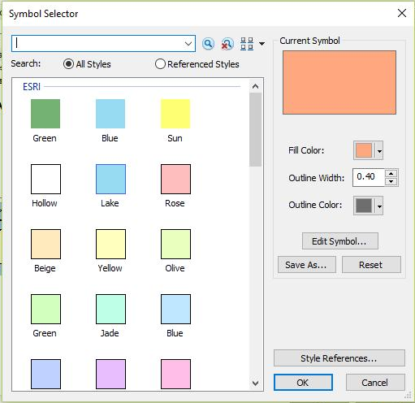
Vector Layer Properties
Change the symbology of the other vector layers in your map.
Play around with the Symbology settings. You may also choose from one of the preset symbologies.
Familiarize yourself with the information about the layers in the Layer Properties dialog box.

Slide 22
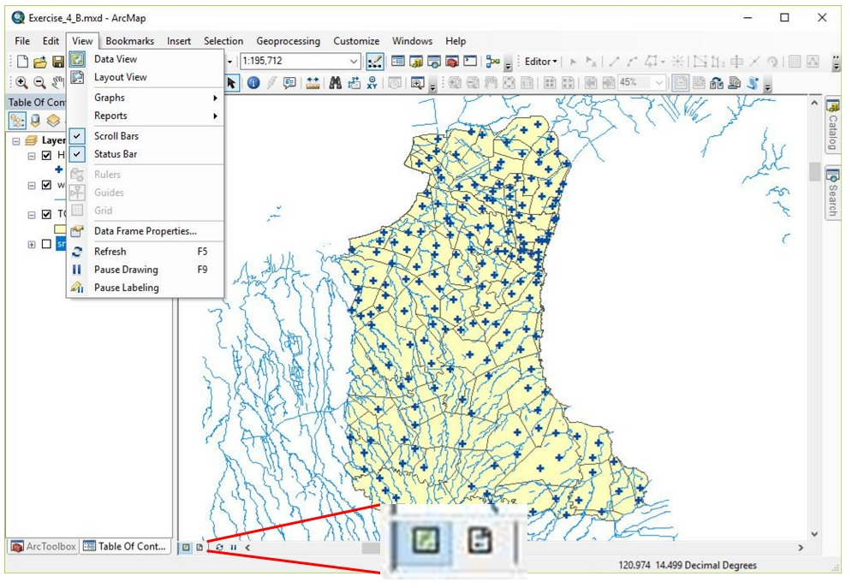
Layout View
ArcMap has two available views: Data View and Layout View
Data view: an all-purpose view for exploring, displaying, and querying the data on your map. This view hides all the map elements on the layout, such as titles, north arrows, and scale bars, and lets you focus on the data in a single data frame, for instance, editing or analysis.
Layout view: a virtual page on which you can place and arrange map elements, and you can do almost everything you can in data view, plus design your map.
You can access either view from the View main menu or the view button at the bottom of the map display.

Slide 23
Layout Toolbar
The Layout toolbar looks like this:
Zoom In
Zoom Out
Pan
Zoom Whole Page
Zoom to 100%
Fixed Zoom In
Fixed Zoom Out
Go Back To Extent
Go Forward To Extent
Zoom To Percent
Toggle Draft Mode
Focus Data Frame
Change Layout
Data Driven Pages Toolbar
The highlighted functions are the ones you will most commonly use

Slide 24
Add Layout Elements
You can add the different map layout elements through the Insert main menu.
Try adding and editing the different elements in your map layout.

Slide 25
Exporting the map layout
Once you are done with your map layout, you can export it by going to the File main menu and choosing Export Map…
You can save your map layout as BMP, TIFF, JPEG, GIF, PNG, EMF, EPS, PDF, AI, or SVG file.

