Slide 1
Session 3.6: Implementing the geospatial data management cycle (Part 5): Fill data gaps
Notes:
MODULE 3: GEOSPATIAL DATA MANAGEMENT
Session 3.6: Implementing the geospatial data management cycle (Part 5): Fill data gaps

Slide 2
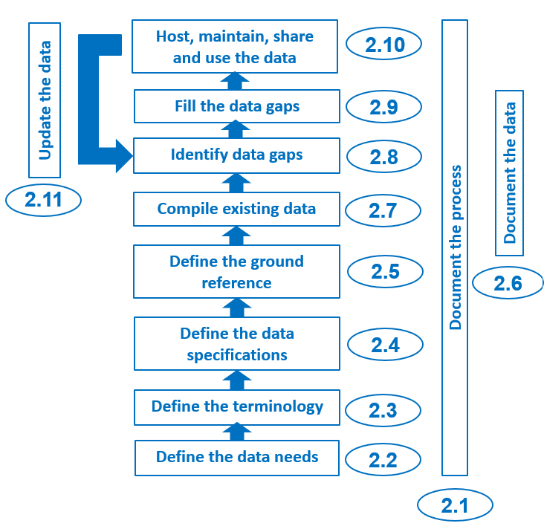
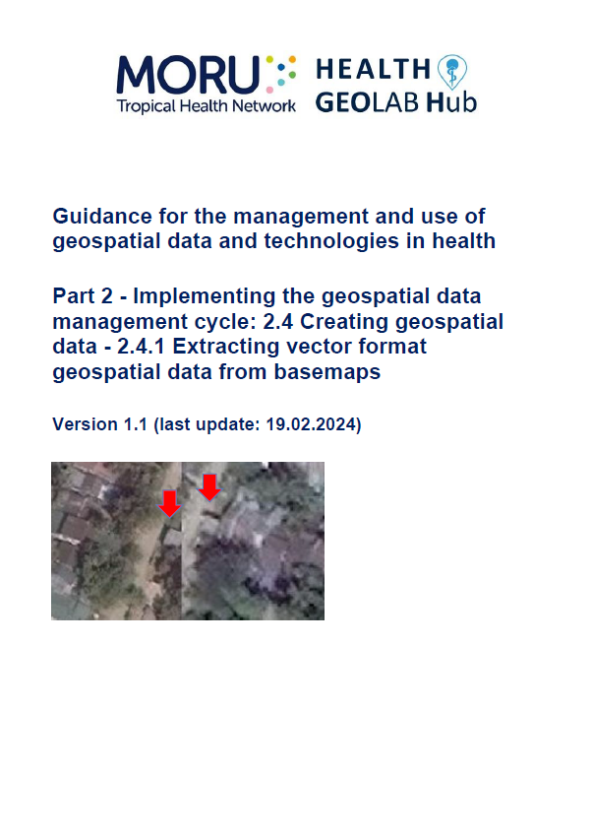
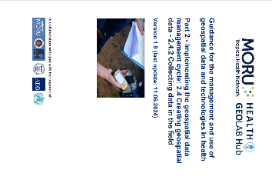
Fill data gaps
The data gaps that have been identified in the previous step do not need to be filled at this stage, but it is important to estimate if and how this can be done in preparation for the development of the action plan.
1
Topics of two other
HGL guidance document
(2.4.1 and 2.4.2)
2
1 https://healthgeolab.net/DOCUMENTS/Guide_HGLC_Part2_4_1.pdf
2 https://healthgeolab.net/DOCUMENTS/Guide_HGLC_Part2_4_2.pdf

Slide 3
Fill data gaps
Filling data gaps (master lists, geospatial and statistical data) can be done in following main ways:
By improving existing data (geospatial data)
By collecting or extracting additional data (lists, geospatial data)
Modelling or projecting values (statistical data)
Independently from the method, the data in question should be validated to ensure the highest possible quality
It is important to start by filling the gaps in the master lists because they serve as a ground reference for geospatial and statistical data.

Slide 4
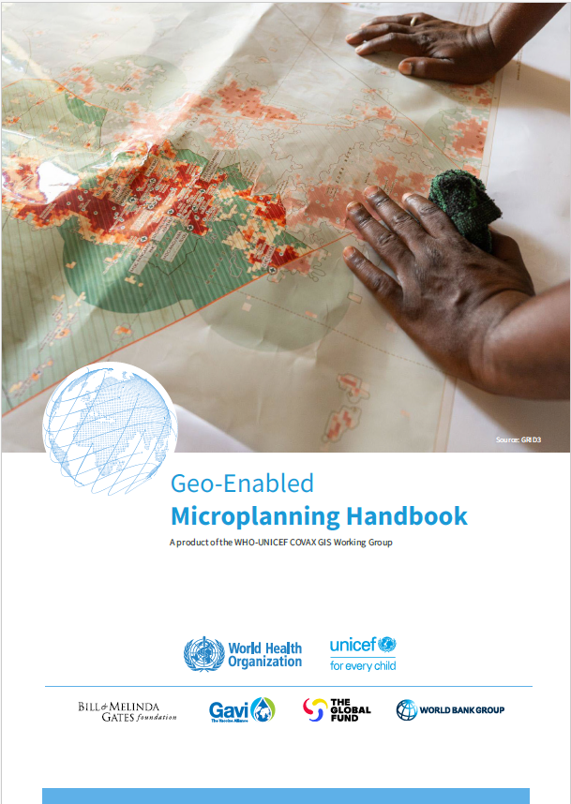
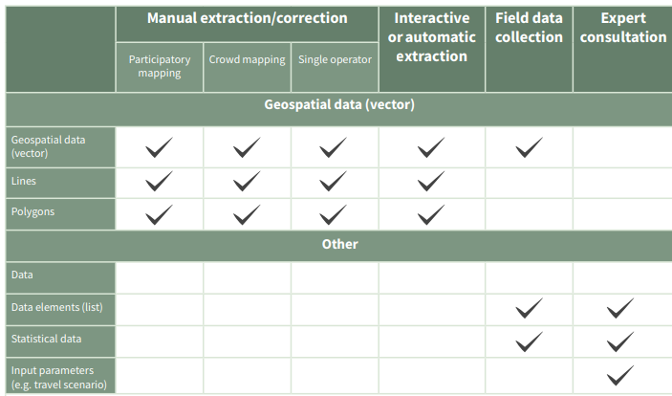


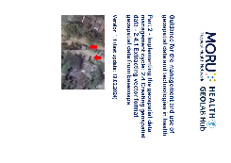

Fill data gaps
Possible approaches to fill data or information gaps
HGL guides covering part of these methods (2.4.1 and 2.4.2)

Slide 5
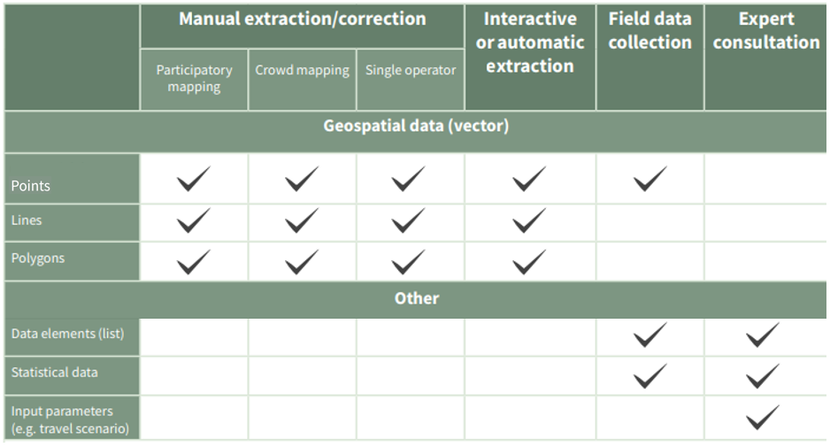
Fill data gaps – Master list
Before collecting data to fill the gaps identified in the first draft of a master list, it is important to validate the list in question with the government entity in charge of curating this list to ensure that the list:
Contains all currently active geographic features – Record-level completeness
Contains the indication of the administrative unit (from the highest to the lowest level in the hierarchy) in which each geographic feature is currently located
Does not contain duplicates that might have been missed during the cleaning and homogenization step
It is important to identify at what level of disaggregation the validation should take place to involve people with situational awareness on the ground.
Depending on the situation, and the type of geographic feature concerned, validation can constitute the first step in collecting data in the field

Slide 6
Fill data gaps – Master list
Once the completeness of the records of the 1st draft of the master list is validated by the curating government authority, and this applies to any geographic feature (infrastructure, health personnel, etc.), the collection of missing, uncertain, or outdated data can take place.
Two types of data can be distinguished at this level because they may require a different collection method:
Geographic coordinates
Other data elements contained in the list
In both cases, a Standard Operating Procedure (SOP), including the validation step, should be defined and documented and the data collectors trained accordingly to ensure the effectiveness of the exercise and the quality of the data collected.
Important note: the unique identifier of each geographic feature must be included in the instrument used for the 2nd type of data to make the link with the master list
This course focuses on the first type of data

Slide 7

Fill data gaps – Collecting geographic coordinates
Twelve (12) methods for collecting geographic coordinates have been identified and documented by the Health GeoLab:
This table can be used to determine the most appropriate method based on the need for scalability and accuracy.
https://healthgeolab.net/DOCUMENTS/Guide_HGLC_Part2_4_2.pdf

Slide 8

Fill data gaps – Collecting geographic coordinates
When selecting an option from the table, it is important to remember that:
These options consider that there is no pre-existing electronic system in place for data collection in the country. If such system is already in place then using it might be more scalable than implementing a new one.
The use of an electronic form, with predefined content when applicable, can considerably reduce data collection time as well as data entry errors. The use of such form should therefore be preferred over paper ones.
The higher the accuracy and precision of the collected coordinates, the greater the number of use cases. It is therefore recommended to always aim to achieve the highest possible level of accuracy and precision.
Collecting geographic coordinates through the sole use of offline map applications (options 1-3) requires that data collectors know how to navigate on a map and be able to identify where they are and the geography of the area from an aerial view.

Slide 9
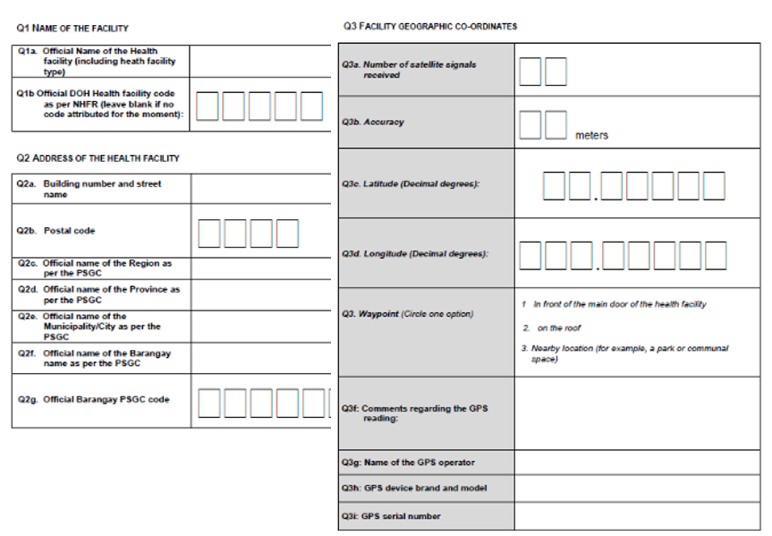
Fill data gaps – Collecting geographic coordinates
The following items are required for each of these options:
  Data collection form
  A standard operating procedure (SOP)
  Master list of the geographic feature for which geographic coordinates are collected
Data collection form
A proper collection form should include:
  The official name and unique identifier of the geographic feature taken from the official master list;
  The address and location in the administrative structure (official name and unique identifier of the administrative unit in which the geographic feature is located) of the feature
  The geographic coordinates of the geographic feature as well as the fields used to evaluate the quality of these coordinates (number of signals, instrumental accuracy
Practiced during Exercise 4.A

Slide 10
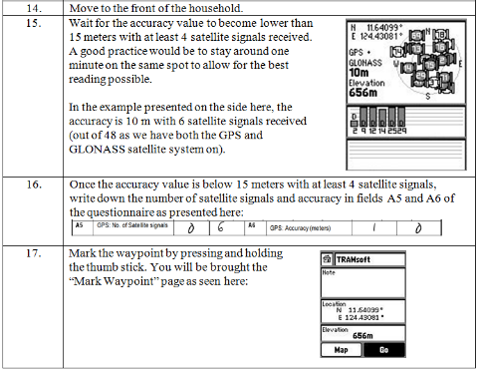
Fill data gaps – Collecting geographic coordinates
Standard Operating Procedure (SOP)
An SOP is a document that:
Contains the checklist of steps to follow to collect and verify the quality of geographic coordinates
Should be used during the training of data collectors and supervisors as well as during the data collection exercise.
Focuses on providing only essential information, being as clear and simple as possible, covering all the fields in the form, and including illustrations that will help the data collector complete each step.

Slide 11
Fill data gaps – Collecting geographic coordinates
Master Lists
The data collection exercise is based on the use of the master list of:
  Geographic features that need to be located: typically, infrastructure (e.g., health facility, school, household).
  Administrative units: For the area covered by data collection exercise (total or part of the country).
The following items are also required to implement some of the options:
  Geospatial data containing the boundaries of administrative units
  Geographic Information System (GIS)
  GNSS-enabled device
  Offline map application
  Anticipated minimum/ maximum values for geographic coordinates
  Purpose-designed data collection application

Slide 12

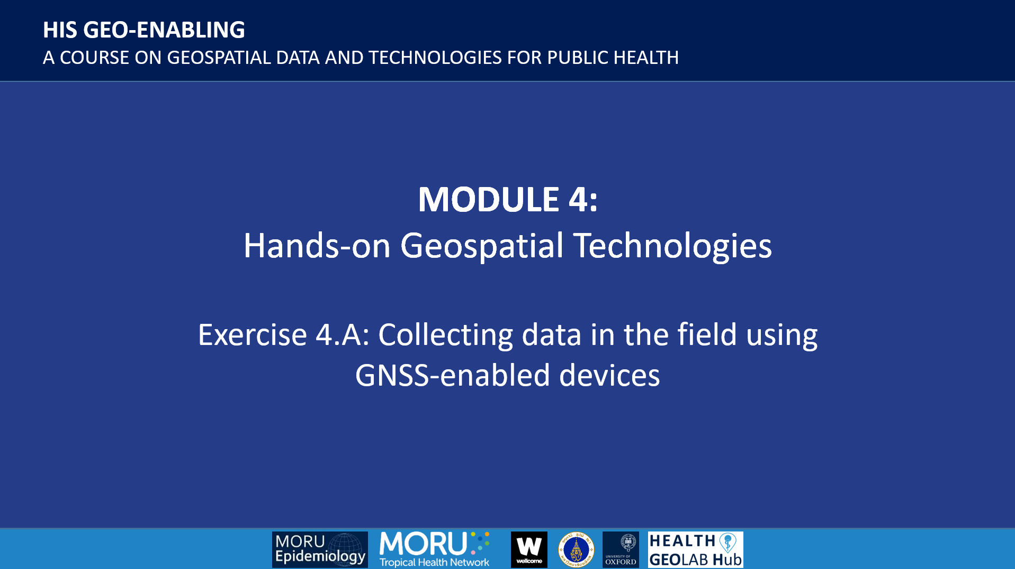

Fill data gaps – Collecting geographic coordinates
Several important steps must be implemented before, during, and after data collection.
Before data collection:
Prepare the materials needed to implement the selected option and train data collectors and supervisors.
Select the people responsible for data collection and their supervisor(s)
Train data collectors and supervisors so that they can be as independent as possible once in the field.
A good training is key!
This will be practiced during Exercise 4.A

Slide 13
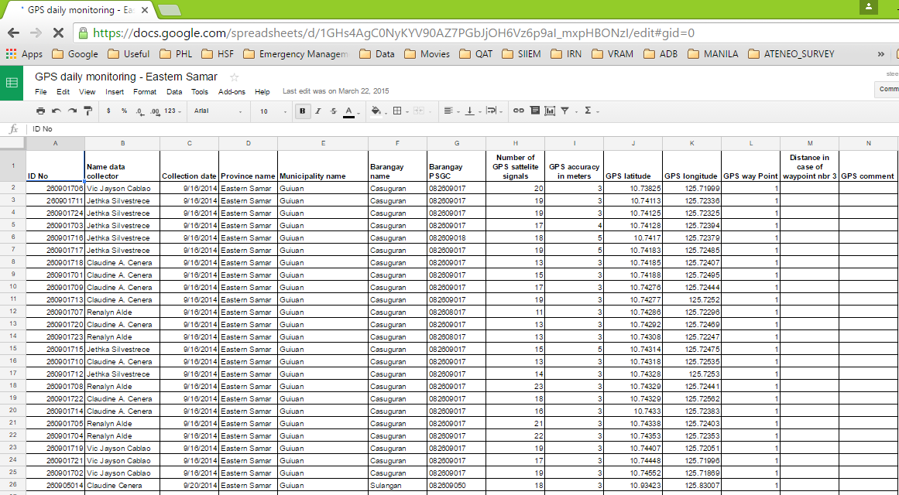
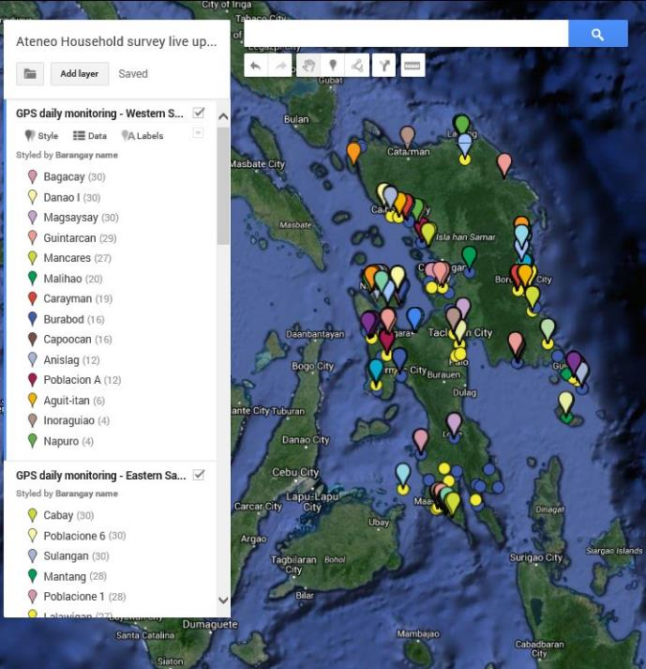
Fill data gaps – Collecting geographic coordinates
During data collection:
The most important thing is to ensure that those responsible for data collection follow the standard operating procedure using the associated documents provided to them.
It is also important to be able to resolve any unexpected issues while the data collectors are in the field.
The following measures should be implemented depending on available resources and the geographic extent of the area being covered:
On-site spot checks of data accuracy and completeness conducted by the data collection supervisor.
Verification of the data remotely through periodic submissions of the collected data in a spreadsheet.

Slide 14
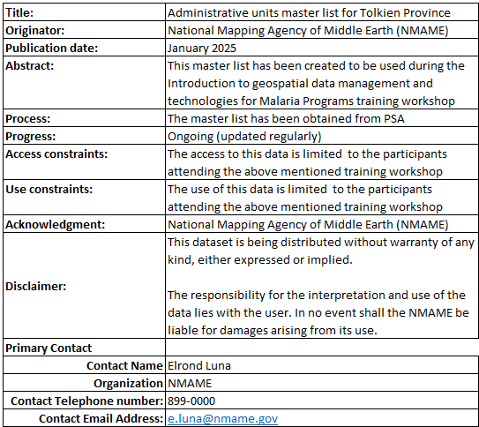
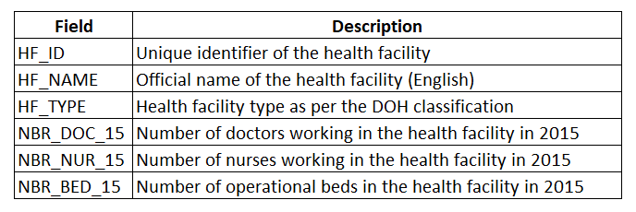
Fill data gaps – Collecting geographic coordinates
After data collection:
If this has not already been done as part of the data verification process implemented during the data collection, it is important to ensure that the data collected is organized into a structured table that can be saved or exported under the form of a spreadsheet (for example, in Microsoft Excel).
If the data is collected in electronic form, it must be able to be exported in a similar structure. This dataset must contain all fields included in the data collection form.
It is important that the worksheet containing the data is accompanied by the following two additional worksheets:
The data catalogue
The metadata

Slide 15

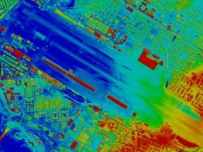

Fill data gaps – Geospatial data
Filling gaps in geospatial data can be done in different ways depending on the expected format:
  Raster format:
    Use of remote sensors placed on a satellite, airplane or drone (remote sensing)
  Raster or vector format:
    Processing images from remote sensing (image processing)
  Vector format:
    Adjust, create, or extract point, line, or polygon type geographic features from a basemap
The method you are most likely going to use
15

Slide 16
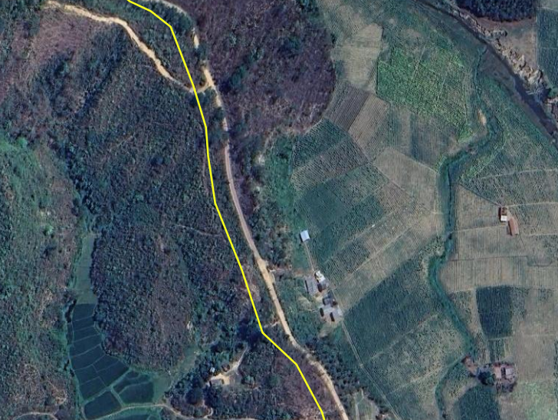
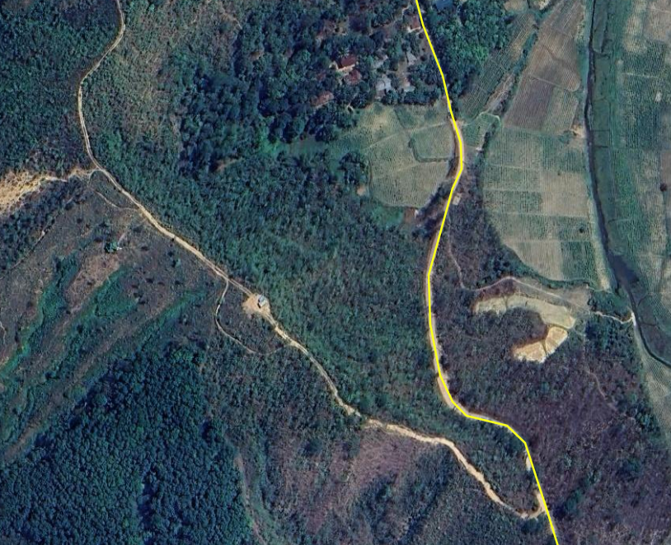
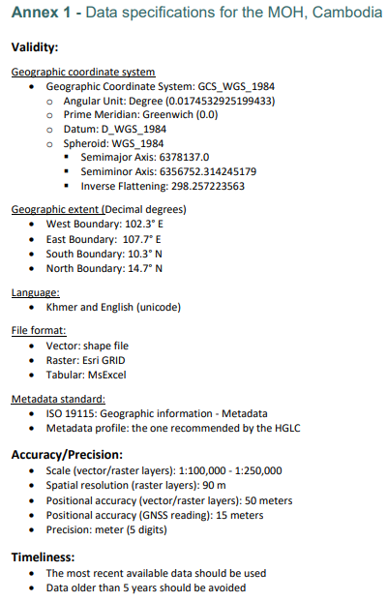
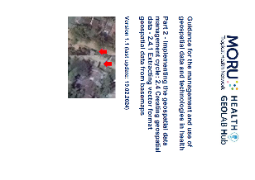
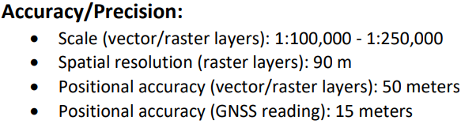
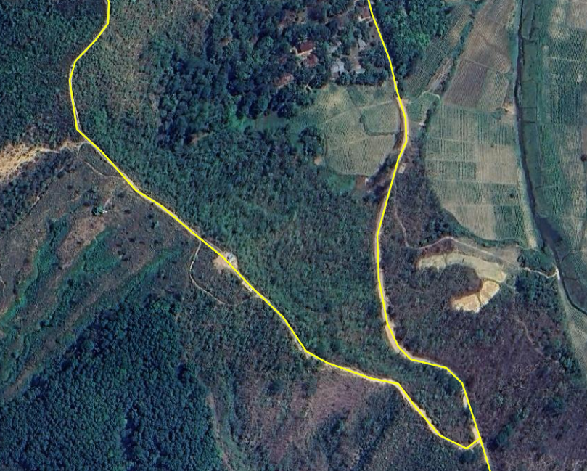
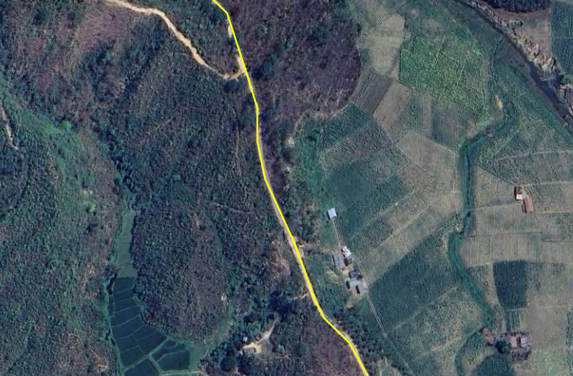
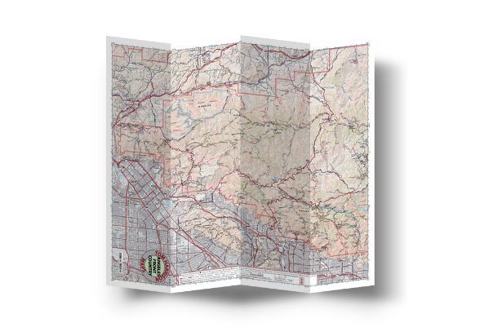
Fill data gaps – Adjust, create, or extract point, line, or polygon type geographic features from a basemap
Adjust GIS data in vector format (editing)
Extract data in vector format (digitizing)
Data specifications
300 m!!
16

Slide 17
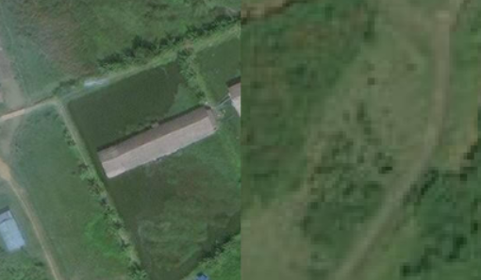
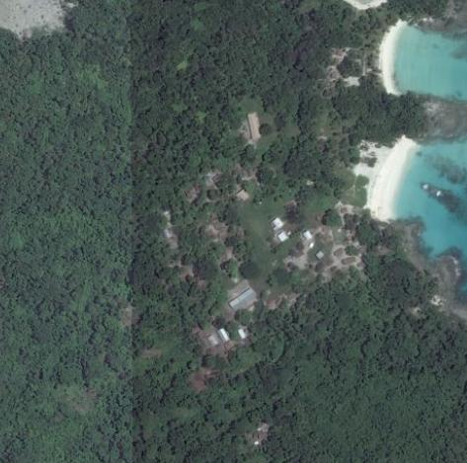
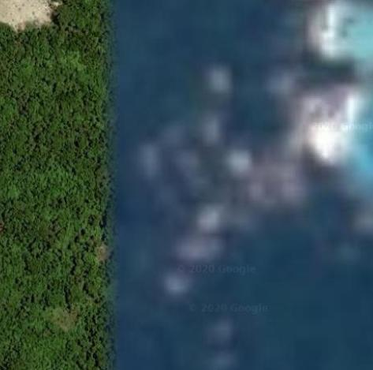
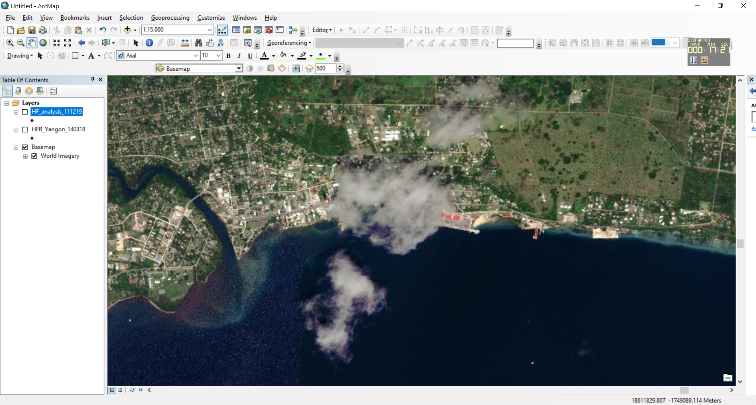
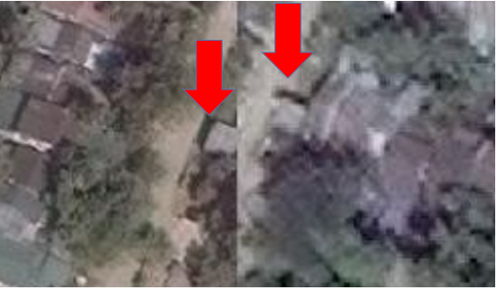
Fill data gaps – Adjust, create or extract point, line, or polygon type geographic features from a basemap
When editing and/or extracting vector data from a basemap, it is important to choose:
  The appropriate basemap
  Respect the data specifications that have been defined:
    Imagery: temporal validity, resolution, accuracy
    Scanned map: temporal validity, scale, digitization resolution
  Images should be free of clouds wherever possible to ensure completeness.
  The images must be well orthorectified to avoid "duplicates" at the border between two scenes.
17

Slide 18
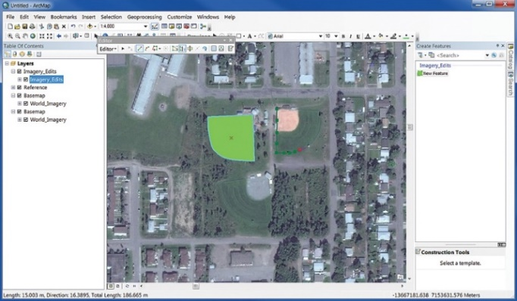
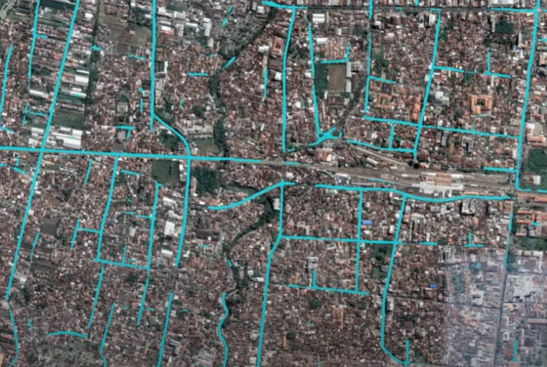
Fill data gaps – Adjust, create or extract point, line, or polygon type geographic features from a basemap
When editing and/or extracting vector data from a basemap, it is important to choose:
  2. The most appropriate method
  Manual extraction: human-guided digitizing of geographic features from a basemap (usually done on-screen these days).
  Interactive extraction: manual extraction of features assisted by the automatic snapping to raster cells functionalities provided by the GIS software or application being used
  Automatic extraction: An automatic, computer-guided method that converts raster data into vector data using image processing software that uses pattern recognition technology.
18

Slide 19
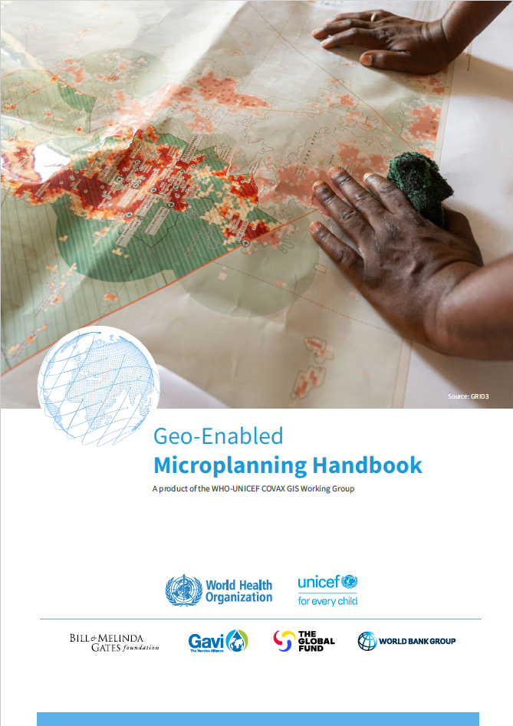
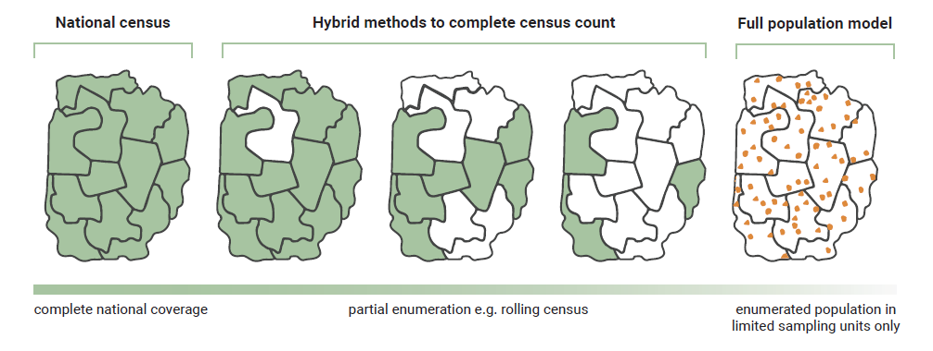
Fill data gaps – Population estimates and spatial distribution
Different types of gaps might have to be filled:
Need to expand the geographic extent of the available population estimates to obtain full coverage. The method being used will depend on the available data:
Bottom-up estimation to fill gaps
2. Need to increase the resolution of the population estimate (disaggregate)
Top-down estimation to fill gaps
3. Project the population estimates to be representative of the correct point in time for which it is needed
2015 2020 2024
19

Slide 20
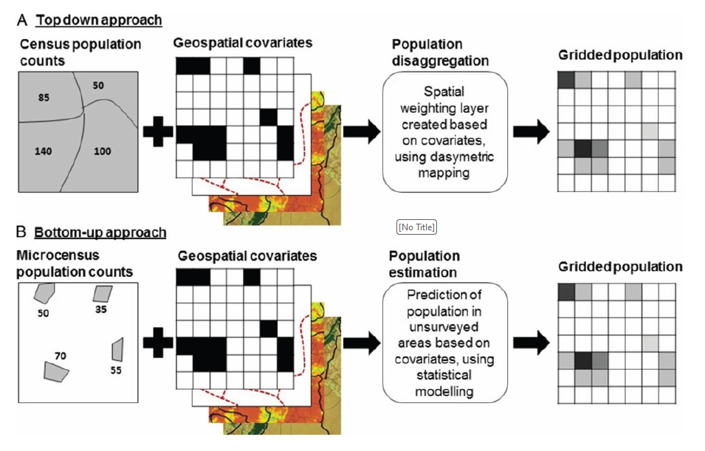
Fill data gaps – Population estimates and spatial distribution
This approach uses specific spatially distributed model to disaggregate the census data to a higher resolution (i.e., grids).
This methodology is more recent and relies on geospatial data such as land cover, building footprints, roads, and other geospatial features as covariates for Bayesian statistical models. This approach can also be used when no population data are available
Considerations included in the geo-enabled microplanning handbook
20

Slide 21
Fill data gaps – …and in the end…
It may well be that some of the gaps could not be filled due to lack of time and/or resources.
If this is the case, a decision will have to be taken regarding the implementation of the current iteration of the HIS geo-enabling process:
Option 1: The quality of the data is sufficient for the implementation of the project (Be careful of the impact this could have on decision-making!). In this case, it is necessary to precisely document the limitations that this implies, including on the information products that will be created.
Option 2: The quality is insufficient, and this is a major limitation. In this case, the project may need to be postponed until the necessary time and/or resources are available.
Option 3: The quality is insufficient, but the gaps could be addressed as part of the operationalization of the updating mechanism
Something that will have to be addressed at the time of developing the action plan
21

