Slide 1
Session 3.5: Implementing the geospatial data management cycle (Part 4): Compile the data and identify data gaps
Notes:
MODULE 3: GEOSPATIAL DATA MANAGEMENT
Session 3.5: Implementing the geospatial data management cycle (Part 4): Compile the data and identify data gaps

Slide 2
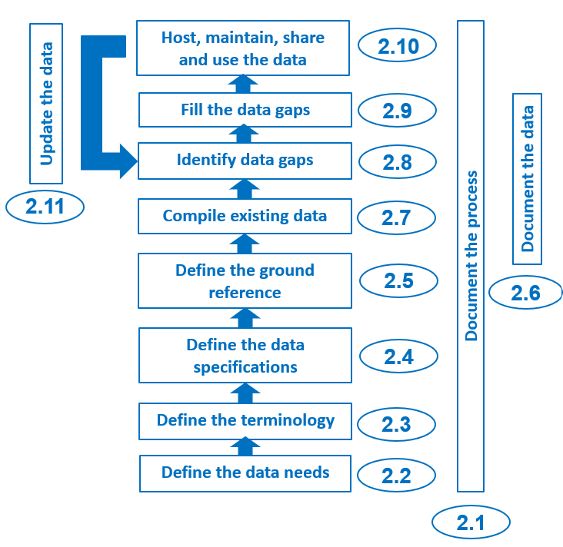
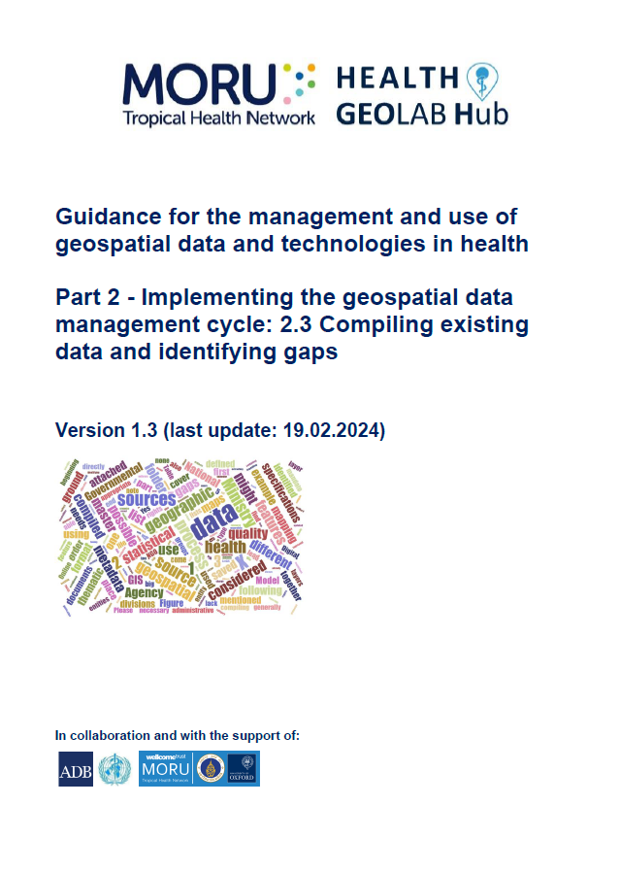
Compile existing data and identify data gaps
The next steps consist of compiling existing data and identifying potential gaps against the needs that have been defined at the beginning of the process
1
Topics of one of the HGL’s guidance document (2.3)
1 https://www.healthgeolab.net/DOCUMENTS/Guide_HGLC_Part2_3.pdf

Slide 3
Compile existing data
What to compile?
All data identified during the step aiming at defining the data needs
Depending on the applications of geospatial data and technologies considered, this may include:
All data and information that could be used to establish one or more master lists
If they already exist, the master list for all the geographic features included in the data model that has been documented
The geospatial data containing the location (point) or extension (polygons, lines) of these same geographic features
Statistical data that will either be represented on thematic maps or used during geospatial analyses or modeling
The parameters that will be used during certain analyses (example: travel scenario)
It is critical to obtain, and to keep, the metadata for this data and information

Slide 4
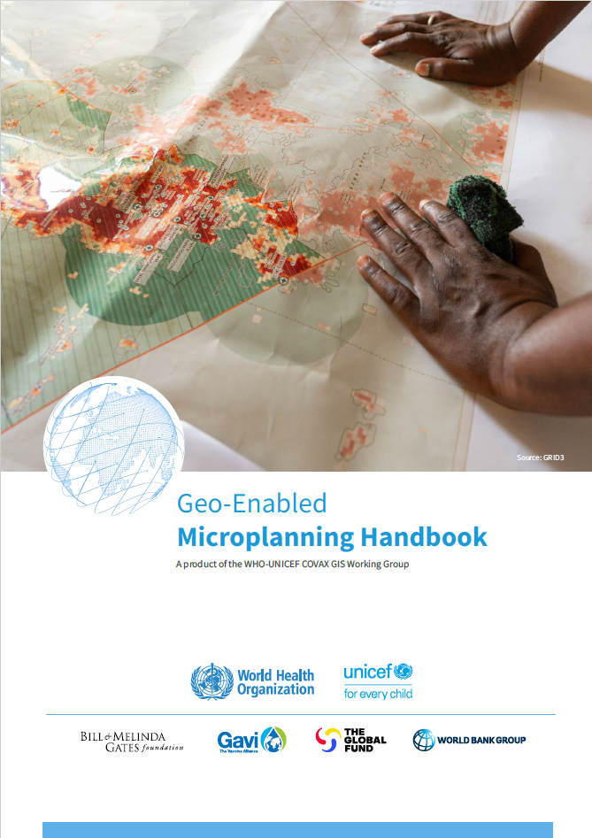
Compile existing data
1
Source of the data to be compiled – Master lists and geospatial data
Master lists should only come from the government entities having the official mandate over each considered geographic feature.
This table provides the list of the governmental entities generally in charge of the master list and associated geospatial data for the geographic features core to public health.
Geographic feature | Master list | Geospatial data | Governmental entity
Health facilities | ✔ | ✔ | Ministry of Health, NGO (WHO)
Health districts or other reporting divisions | ✔ | ✔ | Ministry of Health, NGO (WHO)
Administrative divisions and villages | ✔ | ✔ | Ministry of Interior, National Statistical Agency, National Mapping Agency
Transportation network | Not necessary | ✔ | Ministry of Public Works, Ministry of Transportation
Hydrographic network | Not necessary | ✔ | Ministry of Environment/Agriculture
Climate data (temperature, precipitation, etc.) | Not applicable | ✔ | Ministry of Meteorology, Meteorological agency
Digital Elevation Model (DEM) | Not applicable | ✔ | National Mapping Agency
Land cover | Not applicable | ✔ | National Mapping Agency, Ministry of Environment/Agriculture
A master list is not required for certain geographic features
1 https://drive.google.com/file/d/1jj779zww4herWOESAd9mXqVE1YfQehtH/view

Slide 5
Compile existing data
Other potential sources of data to compile
Non -governmental sources of geospatial data can also be considered according to the availability, quality, and accessibility of the governmental data
For example:
NGOs (UN, etc.) and voluntary groups (e.g., SALB, OSM): administrative boundaries, road network, hydrographic network, populated places, etc.
Research groups/universities: Population distribution grids, land cover, DEM
The quality and usability (e.g., use and/or redistribution rights) of this data must first be identified

Slide 6
Compile existing data
Other potential sources of data to compile – Example of global data
Geographic feature | Database name | Temporal validity/ last update | Format | Website | Access rights | Use restrictions | Redistribution restrictions
Digital elevation model | SRTM90 | 2000 | Raster | https://cmr.earthdata.nasa.gov/search/concepts/C1214622194-SCIOPS | Open access | Commercial use | Commercial use
Land cover | Copernicus Global Land Cover Layers | 2015 - 2019 | Raster | https://land.copernicus.eu/global/products/lc | Open access | None | None
Distribution of the population | WorldPop | 2020 | Raster | https://hub.worldpop.org/geodata/summary?id=50236 | Open access | None | None
Hydrographic network | OpenStreetMap (OSM) | 2024 | Vector | http://download.geofabrik.de/ | Open access | None | None
Transport network | OpenStreetMap (OSM)
Building footprint | Google Open building | 2021 | Vector | https://sites.research.google/open-buildings/ | Open access | None | None

Slide 7
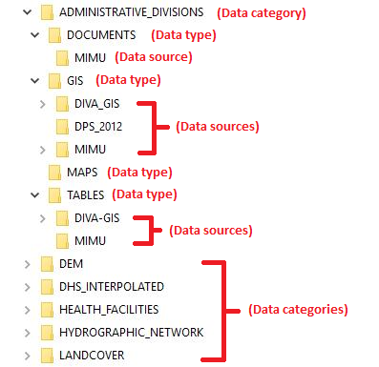
Compile existing data
Organization of the compiled data
It is important to organize the data compiled so that it can be easily found, including by other users in the event of sharing it within a group.
Example using 3 levels of folders:
Data category corresponding to geographic characteristics (for example, administrative divisions)
Data type
Four types to consider:
Documents: reports, publication, and other narrative documents
GIS: for geospatial data
Maps: for maps saved in PDF, MS Word, or other formats
Tables: data recorded in the form of a table (Excel, CSV, DBF, etc.)
3. Data source with a file by source, including metadata
Category
Type
Source
Type
Source
Type
Type
Source
The compiled data file is then placed in the corresponding subfolder

Slide 8
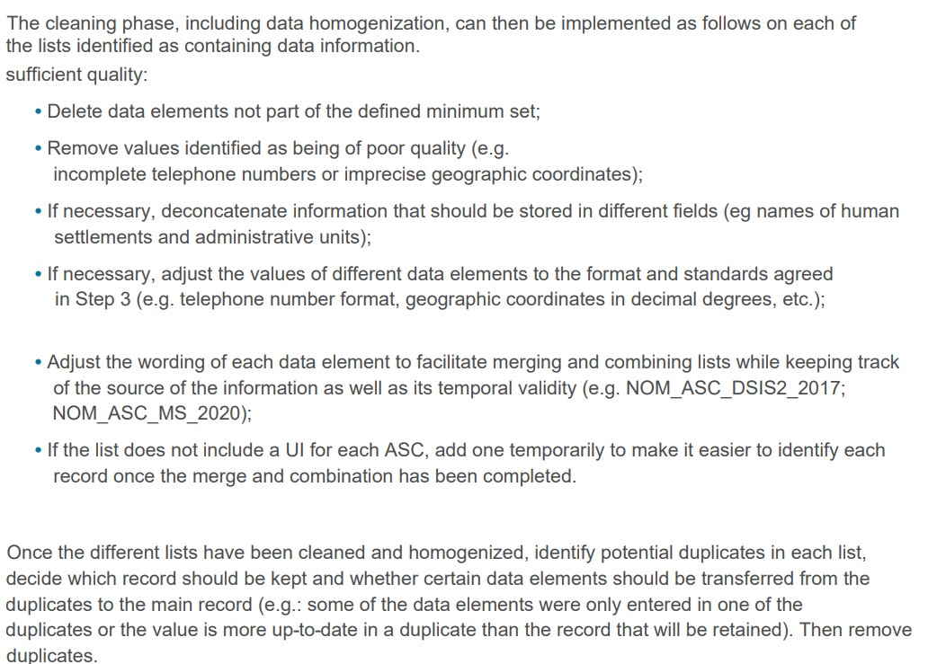
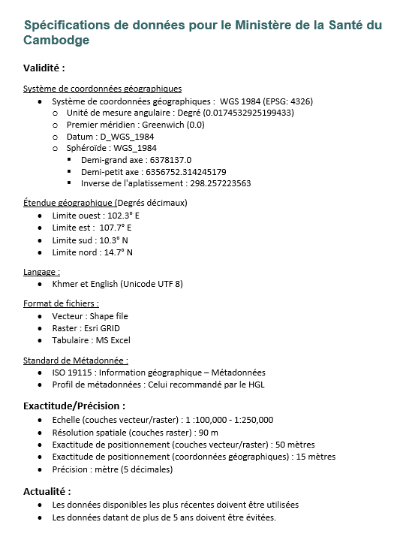
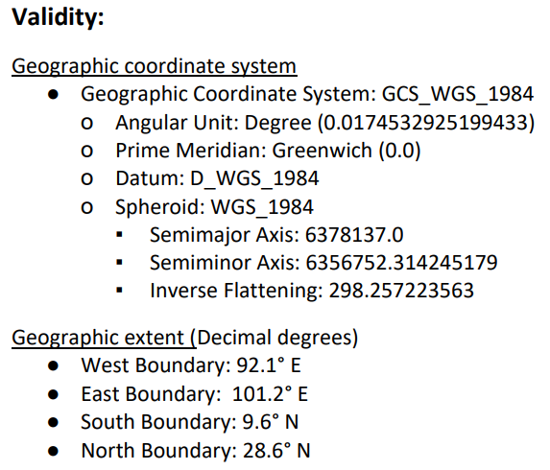
Clean and homogenize compiled data
Lists and geospatial data
Once organized the data will have to be cleaned and homogenized in terms of validity (format, structure) and uniqueness (duplicate)
Lists
Geospatial data
Data specifications
The lists (if more than one) can then be merged (rows) and/or combined (columns)
+ Where applicable, align the geospatial data attribute table with the contents of the corresponding master list
First draft of master list for which gaps can be identified
Geospatial data for which gaps can be identified

Slide 9
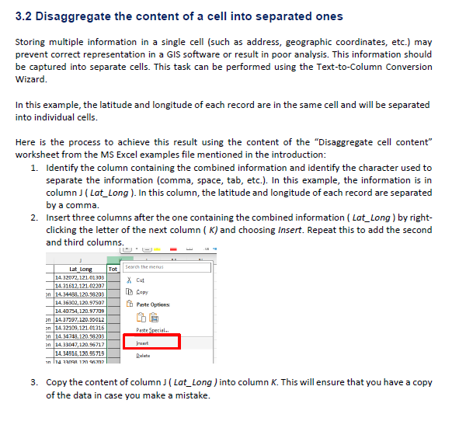
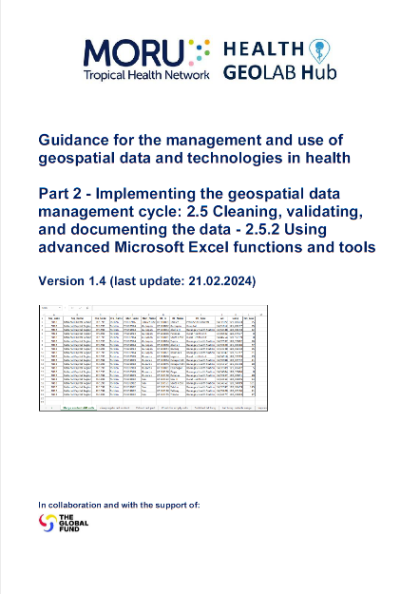
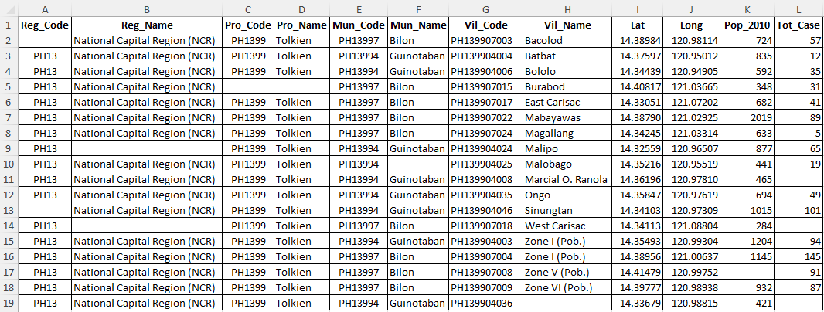
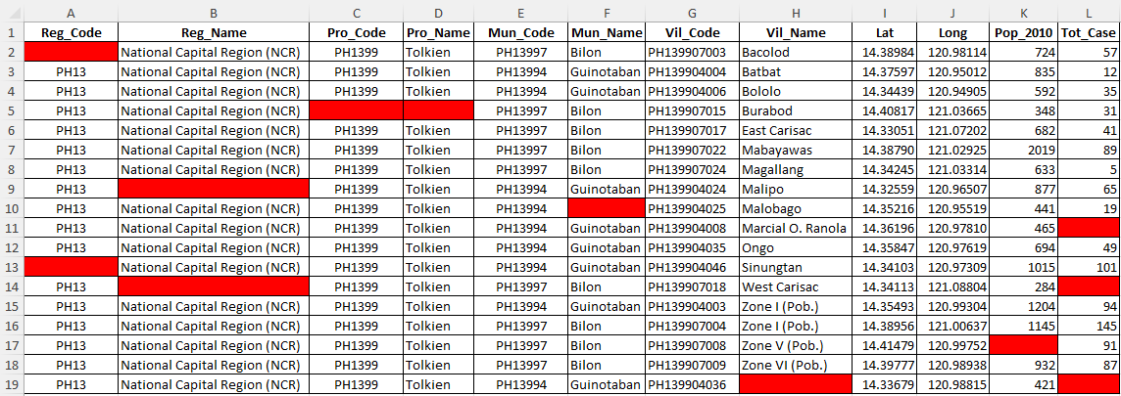
Clean and homogenize compiled data
Using MS Excel
Step-by-step
Much of the work of cleaning and standardizing the compiled lists happens in MS Excel before the first version of the master list is managed in a registry or common geo-registry.
It is important to know how to use the functions and tools provided by MS Excel
Exercise file
Subject of one of the guides prepared by the Health GeoLab (2.5.2)
Result file
https://healthgeolab.net/DOCUMENTS/Guide_HGLC_Part2_5_2.pdf

Slide 10
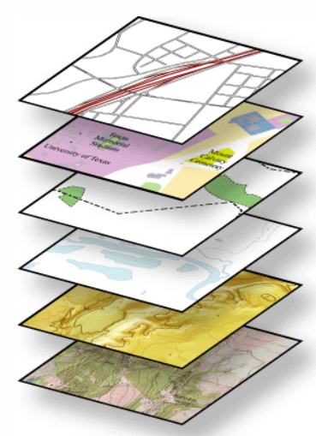
Clean and homogenize compiled data
Identify temporal disparities
Data collected at, or representative of, different points in time
Roads (2023)
Land cover (2000)
Administrative boundaries (2015)
Hydrographic network (2020)
Population (2009)
Satellite imagery (2022)
The GIS software will not report this problem
This should be identified as part of the cleaning and homogenization process
Importance of metadata

Slide 11
Clean and homogenize compiled data
Identify data gaps
Data gaps can be of two types:
No source is available, accessible, and/or usable (e.g., restriction of use)
There are gaps in the required quality across the six dimensions.
For example:
1st draft of the master list
Geospatial data
Lack of value/information for certain data elements
Uncertainty about values/information entered (including geographic coordinates)
Outdated information
Geographic features not captured or missing
Tracing of geographic features not aligned with satellite imagery (example: roads)
Inconsistencies between databases (administrative boundaries not aligned with the hydrographic network)

Slide 12
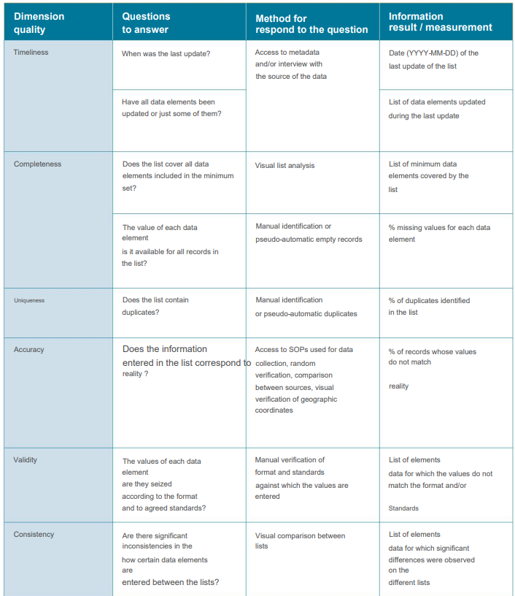
Assess the quality of compiled data
Lists and Master lists
Questions to assess the quality of the master list, or lists to be combined, across the 6 dimensions of data quality
Several cases may arise after answering these questions:
None of the lists contains information considered to be of sufficient quality (too old, too much gaps, many duplicates, etc.).
Create the master list from scratch
Only one of the lists contains information considered to be of sufficient quality.
Process based solely on this list (no fusion is necessary).
Several lists contain information considered to be sufficient quality.
Merge the different lists together

Slide 13
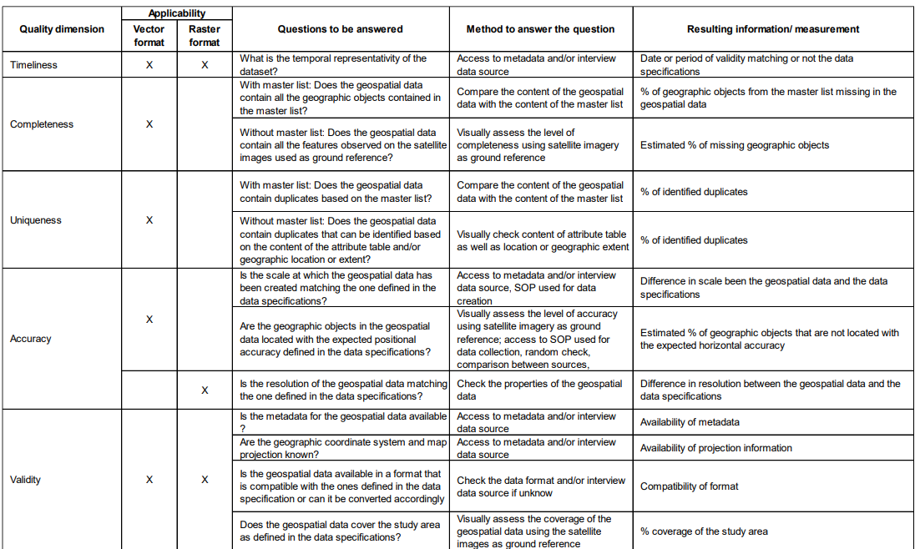
Assess the quality of compiled data
Geospatial data
Questions to assess the quality of compiled geospatial data
Consistency is itself reached once the reference criteria set for other dimensions are reached

Slide 14
Assess the quality of compiled data
Statistical data
When it comes to statistical data, the questions to answer are mainly the following from the point of view of their use in a geospatial application:
Timeliness:
What is the temporal validity of the statistical data?
Does it correspond to the temporal validity defined in data specifications?
Completeness:
Is a value available for each of the recorded records in the corresponding master list?
Uniqueness:
Does the data set contain duplicates?
Validity:
Is the data set accompanied by a data and metadata dictionary containing all the information necessary to use it correctly?
Is the data set available in a format that allows its use or could be converted to such a format?

Slide 15
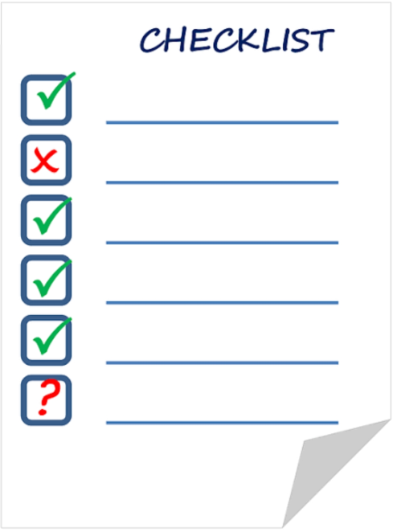
Assess the quality of compiled data
Identified data gaps
These are gaps that should be documented and ideally filled as part of the action plan implementation.
Start by looking for additional sources of data that may have been missed during the first round of data compilation.
If there are none, the gaps need to be filled either of extracting data from other sources or collecting data in the field

