Slide 1
Session 3.4: Implementing the geospatial data management cycle (Part 3): Document the data
Notes:
MODULE 3: GEOSPATIAL DATA MANAGEMENT
Session 3.4: Implementing the geospatial data management cycle (Part 3): Document the data

Slide 2
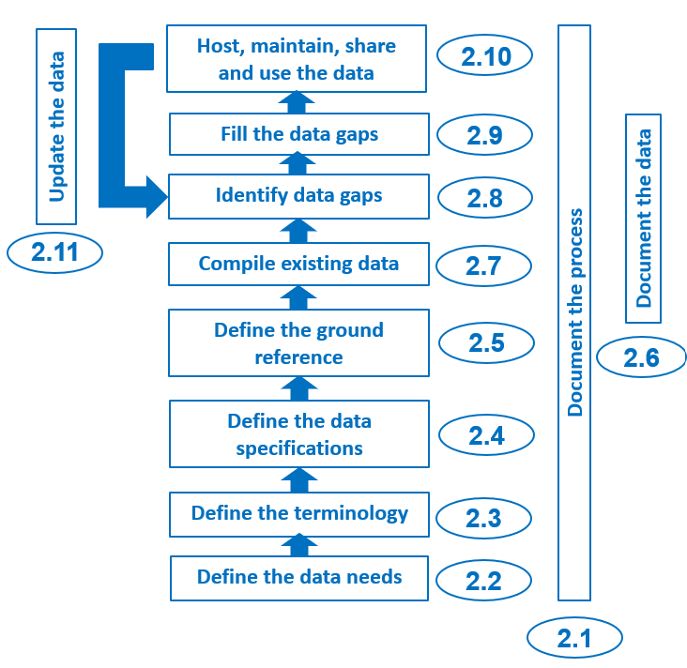
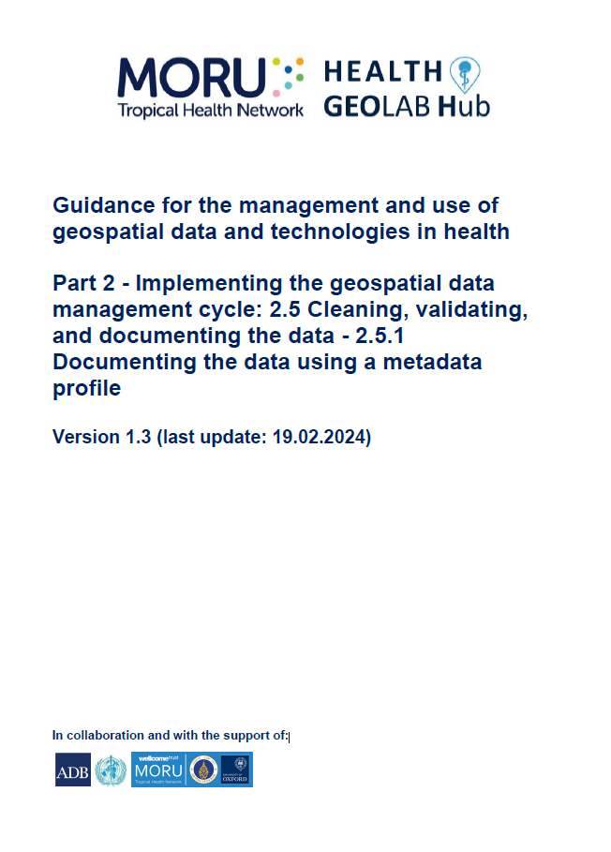
Document the data – Metadata
Documentation is a key activity in the geospatial data management cycle. It applies not only to processes (Step 2.1), but also to individual data that has been compiled and/or created.
Georeferenced master lists, geospatial and statistical data must be properly documented using what we call metadata.
Topics of one of the HGL’s guidance document (2.5.1)
https://www.healthgeolab.net/DOCUMENTS/Guide_HGLC_Part2_5_1.pdf

Slide 3
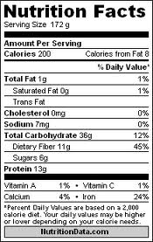
Document the data – Metadata
Information that describes the content, quality, condition, origin, and other characteristics of data or other pieces of information.
Data about the data
Allows user to find out if the data is appropriate for its intended purpose
Applies to master lists, geospatial and statistical data
The information captured in the metadata profile should be captured as much as possible during data collection and completed before data dissemination.
Begin as soon as the data specifications are defined

Slide 4
Document the data – Metadata
Good metadata must at least make it possible to answer the following questions:
What is the data about?
Who created the data?
When was the data last created, collected, or updated?
How was the data created?
What are the data specifications associated with the data (geographic coordinate system/projection system, scale, accuracy, precision, language, etc.)
Is the data subject to any restrictions on use or redistribution?
Who can I contact if I have questions about the data?

Slide 5
Document the data – Metadata
Information is entered into a metadata record based on a metadata profile (modification of an existing metadata standard to suit the data type and local context).¹
A metadata standard is a requirement to establish a common understanding of the meaning or semantics of data, and to ensure correct and adequate use and interpretation of data by its owners and users.²
The most widely used metadata standards are those produced by:
The International Organization for Standardization (ISO)
The Federal Geographic Data Committee (FGDC)
The ISO standard is obtained by international consensus which promotes a wider use.
1 http://wiki.gis.com/wiki/index.php/GIS_Glossary/M (Metadata profile)
2 https://en.wikipedia.org/wiki/Metadata_standard

Slide 6
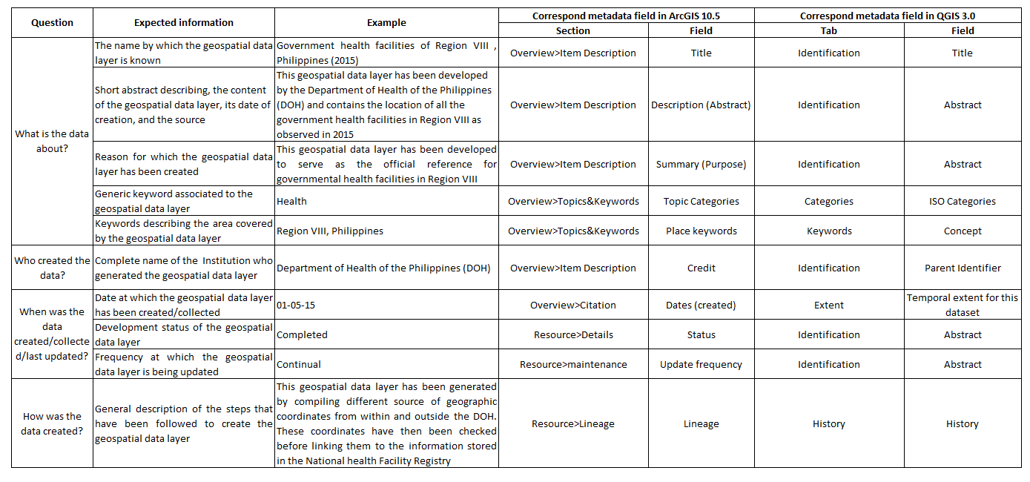
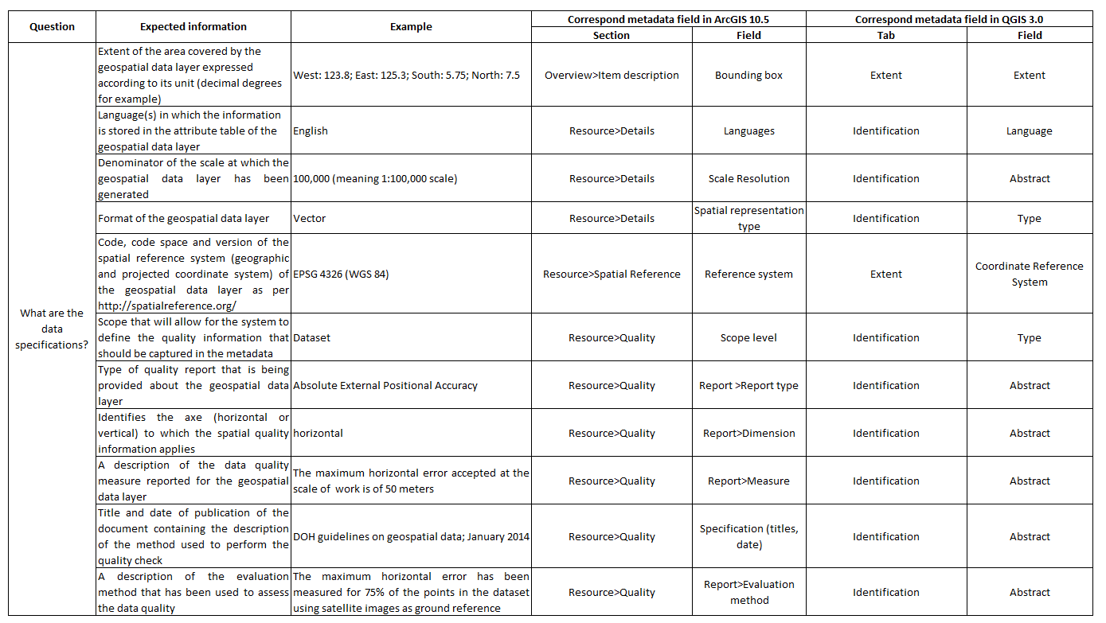
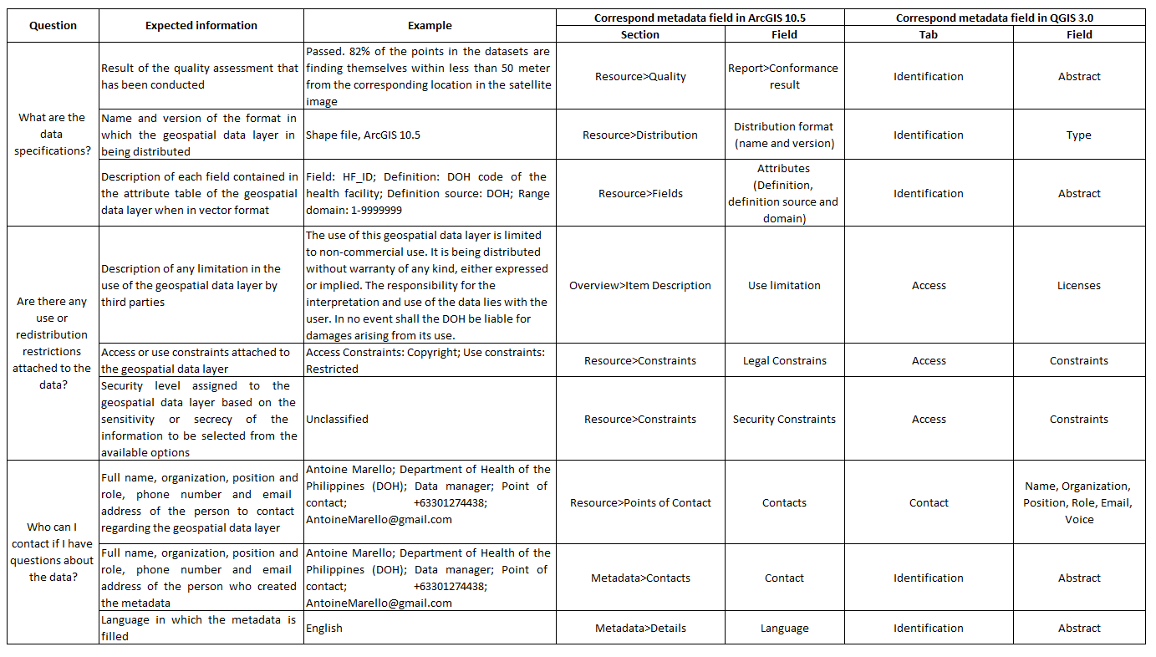
Document the data – Metadata for geospatial data
The minimum metadata profile for geospatial data recommended by the HGL is based on the ISO 19115 metadata standard.
30 fields to fill in to answer the key questions mentioned earlier
https://www.healthgeolab.net/DOCUMENTS/Guide_HGLC_Part2_5_1.pdf

Slide 7
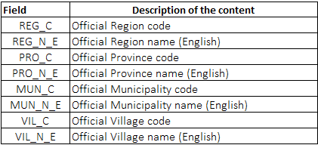
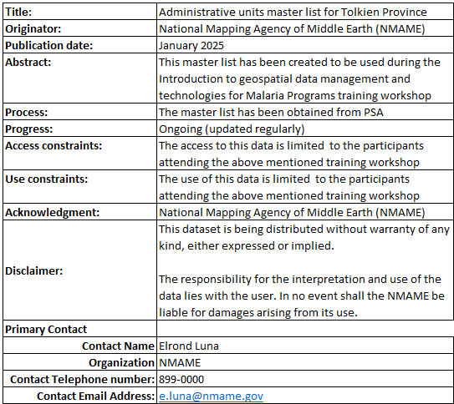
Document the data – Metadata for georeferenced master list
There are no specific metadata standards for georeferenced master lists.
A simple and effective way is to add a “data catalogue” and “metadata” worksheets into the Excel file containing the georeferenced master list when sharing it.
Data catalogue
Metadata

Slide 8
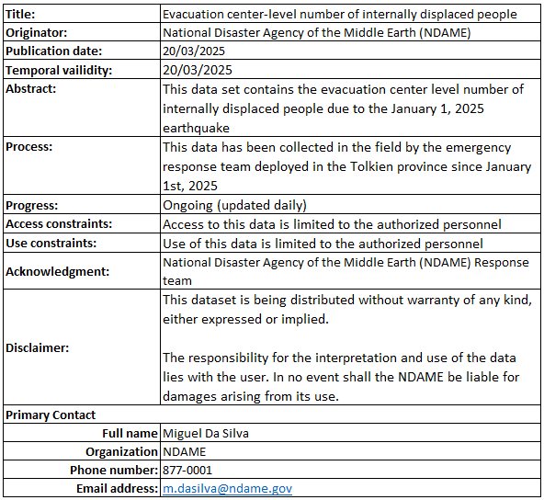
Document the data – Metadata for statistical data
There are different metadata standards for statistical data, including the EDSM (Exchange of Statistical Data and Metadata) initiative. However, these standards tend to be difficult for non-IT professionals to understand and focus more on how data and metadata are exchanged.
The same approach as the one used for georeferenced master list can also be applied for files containing statistical data
“Data catalogue” and “metadata” worksheet included into the Excel file containing the statistical data .

Slide 9
Document the data – Metadata for georeferenced master list and statistical data
The “Metadata” worksheet then captures the essential information allowing the user to answer the questions that minimal metadata should cover.
Name by which the statistical dataset is known
-------------
Full name of the institution that generated the dataset-
-----------
Date the data was collected
------------
Brief description of the contents of the statistical dataset-
-----------
General description of the steps taken to create the dataset-
------------
Dataset development status
------------
Access constraints related to the dataset
------------
Use dataset constraints
------------
Responsibility statement for the dataset
------------
Full name, organization, position and role, phone number, and email address of the person to contact about the dataset.
Title: | Master list of health facilities in the Province Tolkien
Originator: | Department of Health (DOH)
Publication date : | January 2025
Summary | This master list was created for use during the workshop
Process: | The list was generated by combining different sources of information validated by the health department. Geographic coordinates have different levels of precision depending on the data collection method used
Progress | In progress (regularly updated))
Access constraints: | Access to this data is limited to participants attending the workshop
Usage constraints | Use of this data is limited to workshop participants
Disclaimer: | This dataset is distributed without warranty of any kind, express or implied. Responsibility for the interpretation and use of Health cannot be held arising from its use
Point-of-contact
Contact name | Ariela Antonio
Organization | DOH
Contact phone number | 877-0000
Contact fax number | NA
Contact email address: | a.antonio@doh.gov

Slide 10
Document the data – Metadata for georeferenced master list and statistical data
Microsoft Excel is the recommended format for exchanging statistical data because:
It is widely used in countries
It allows the storage of data and information in multiple worksheets within the same file, which is not the case with other file formats such as .csv files.
This allows the georeferenced master list or statistical dataset as well as the data catalogue and metadata to be stored in a single file, ensuring that none of this information is lost when shared.

