Slide 1
Session 3.3: Implementing the geospatial data management cycle (Part 2): Define the terminology, data set specifications, and ground reference
Notes:
MODULE 3: GEOSPATIAL DATA MANAGEMENT
Session 3.3: Implementing the geospatial data management cycle (Part 2): Define the terminology, data set specifications, and ground reference

Slide 2
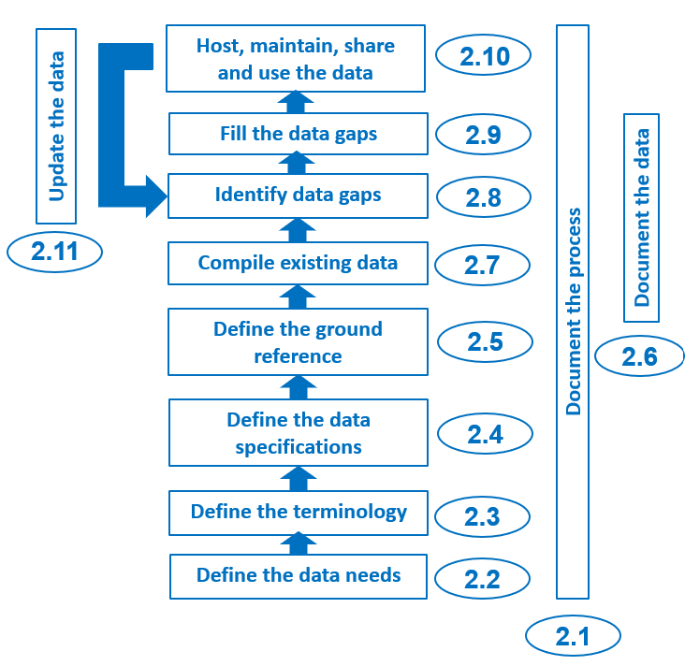
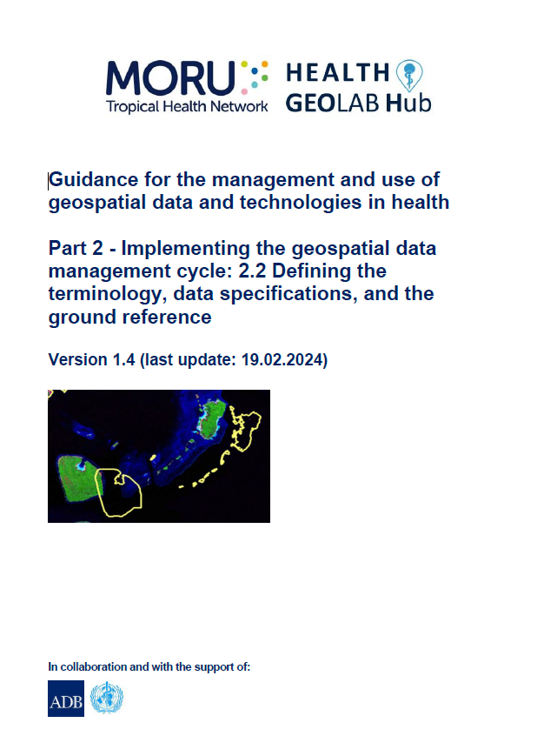
Define the terminology, data specifications, and ground reference
Once the data needs have been defined, the next three steps in the geospatial data management cycle (define the terminology, the data specifications, and the ground reference) provide the foundation that will ensure the quality of the data being used during the rest of the process.
Topics of one of the HGL’s guidance document (2.2)
1
1 http://www.healthgeolab.net/DOCUMENTS/Guide_HGLC_Part2_2.pdf

Slide 3
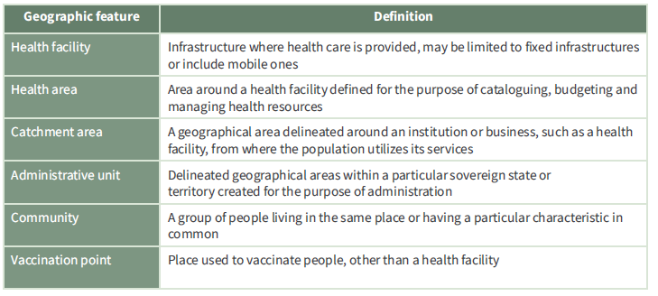
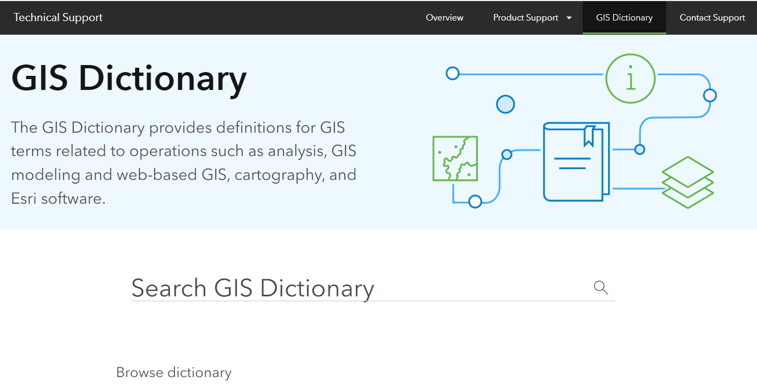
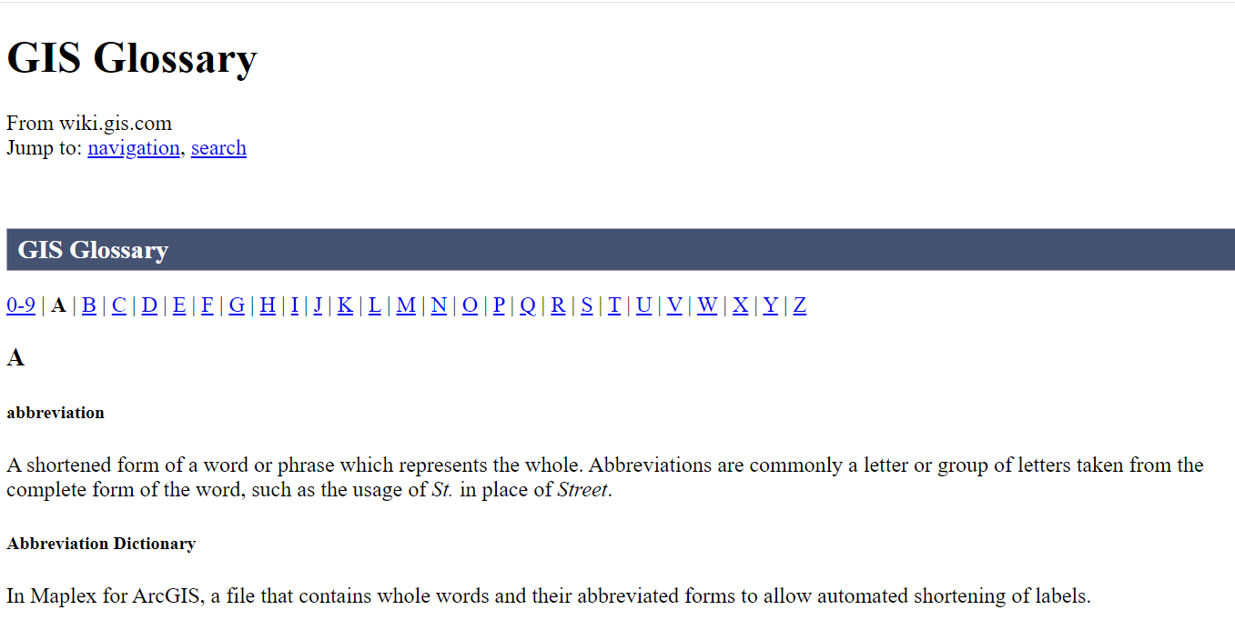
Define the terminology
Agreeing on a common terminology ensures that all actors involve speak the same language!
2 main glossaries to have:
Definition of each geographic feature
Geospatial data and technologies terminology. Examples:
Esri GIS Dictionary: https://support.esri.com/en-us/gis-dictionary
Wiki GIS Glossary: https://wiki.gis.com/wiki/index.php/GIS_Glossary
It is also important to have a dictionary/glossary covering the relevant thematic area (Malaria, tuberculosis,…)
https://drive.google.com/file/d/1jj779zww4herWOESAd9mXqVE1YfQehtH/view?usp=sharing; https://healthgeolab.net/DOCUMENTS/Guidance_Common_Geo-registry_Ve2.pdf

Slide 4

Define the data specifications and ground reference
Addressing public health issues requires data to be of quality and this across the six (6) dimensions of data quality:
Completeness: No data gap
Uniqueness: No duplicates
Timeliness: Up-to-date
Validity: Conform to the defined format, type, range,...
Accuracy: Correctness
Consistency: No difference across sources
1
Data quality is being assessed and improved based on measurable criteria captured in the data specifications and using remote sensing images and the master lists as ground reference
These specifications are measurable criteria defined to ensure the same minimum level of quality for the data used by an organization.
1 http://www.healthgeolab.net/DOCUMENTS/Guide_HGLC_Part2_2.pdf

Slide 5
Define the data specifications – Geospatial data
When it comes to geospatial data for example, these criteria should at least cover:
Validity:
  V.1 Geographic coordinate system and map projection
  V.2 Geographic extent of the area being covered
  V.3 Language(s) included in the data
  V.4 File format(s) for sharing data
  V.5 Metadata standard used to document the data
Accuracy:
  A.1 Scale (vector layers)
  A.2 Spatial resolution (raster layers)
  A.3 Positional accuracy (vector layers)
  A.4 Positional accuracy (GNSS reading)
  A.5 Positional precision (GNSS reading)
Timeliness:
  T.1 Period for which the data is being considered as relevant
Consistency

Slide 6
Define the data specifications – Geospatial data
If criteria for the completeness and uniqueness dimensions are to be included in the specifications, these would be expressed in relation to the corresponding master list as follows for vector format geospatial data (not applicable to raster format geospatial data):
Completeness:
  a. Records: When applicable, the layer contains all the active records included in the corresponding master list
  b. Data elements: When applicable, a value is available for all the data elements as included in the corresponding master list
Uniqueness:
a. No duplicate records using the corresponding master list as ground reference.

Slide 7

Define the data specifications – Geospatial data
V.1 Geographic Coordinate System
System in which geospatial data is defined by a 3-D surface and measured in latitude and longitude.
Different models exists, each of them trying to reproduce the earth’s shape based on:
Angular units: The unit of measure on the spherical reference system.
Prime meridian: The longitude origin of the spherical reference system.
Datum: Defines the relationship of the reference spheroid to the Earth's surface.
Spheroid: The reference spheroid for the coordinate transformation.
Earth’s shape is not a perfect sphere (21,385 m difference between the two axis)

Slide 8
Define the data specifications – Geospatial data
V.1 Geographic Coordinate System
IMPORTANT: All the datasets combined on a map must present the same Geographic Coordinate System
Impact of using different datum
Correct Datum
Up to 36 metres difference

Slide 9
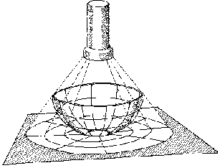
Define the data specifications – Geospatial data
V.2 Projected Coordinate System
System in which geospatial data is defined by a flat 2-D surface and can be measured in units of meters and feet.
Map projection
A method by which the curved surface of the earth is portrayed on a flat surface
The systematic transformation of points on the Earth’s surface to corresponding points on a plane (flat) surface
The earth is 3-D but maps need to be flat!
This requires distortion of some parts of the map.
Note: When displaying data that's using a geographic coordinate system, GIS uses a projected coordinate system. Basically, we just treat the coordinate values as if they are linear and just display the data.

Slide 10
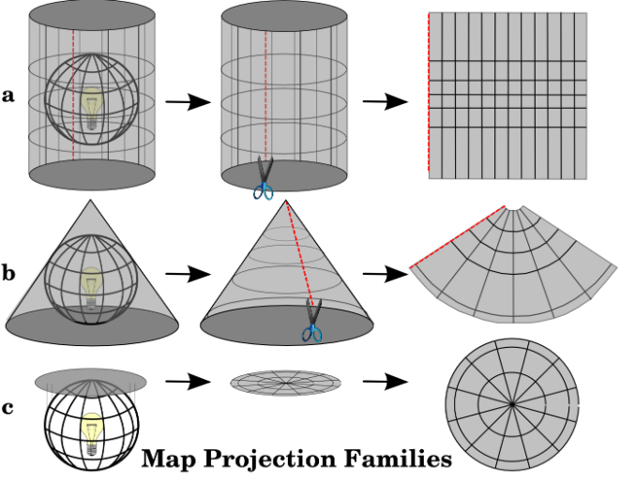
Define the data specifications – Geospatial data
V.2 Map Projection – Basic projection techniques
Cylindrical
Conical
Azimuthal
http://www.icsm.gov.au/mapping/about_projections.html#types
Notes:
A map can be projected in different ways using different techniques.

Slide 11
Define the data specifications – Geospatial data
V.2 Map Projection – Basic Projection Types
Each projection preserves a particular relationship or characteristic​:
Equal-Area — correctly shows the size of a feature
Conformal — correctly shows the shape of features
Equidistant — correctly shows the distance between two features
True Direction — correctly shows the compass direction between two features
A map cannot be at the same time equal-area or conformal – it can only be one or the other, or neither.
A map projection is to be chosen based on the needs

Slide 12
Define the data specifications – Geospatial data
V.2 Map Projection – Examples
Projection | Technical | Type
Equirectangular | Cylindrical | Equidistant | Simplest geometry; distances along meridians are conserved. Plate carrée: special case having the equator as the standard parallel.
Lambert cylindrical equal-area | Cylindrical | Equal-area
Universal Transverse Mercator (UTM) | Cylindrical | Conformal | Divides the Earth into sixty zones, each being a six-degree band of longitude
Robinson | Pseudocylindrical | Compromise (neither equal-area nor conformal) | Used to create global maps
https://en.wikipedia.org/wiki/List_of_map_projections
Notes:
Define the data specifications
V.2 Projected Coordinate System
Having known the different map projection types and techniques, each map projection can then be described as a combination of these two classifications. For example, an equirectangular projection uses cylindrical technique and an equidistant type map.
The map projection recommended by HGL is the Universal Transverse Mercator (UTM).

Slide 13
Define the data specifications – Geospatial data
V.3 Language
National and international language (e.g., English)
V.4 Geospatial and attribute data format (most used)
Vector
  Shapefiles (actually composed of the 3 to 8 files)
  GeoJSON (QGIS)
Raster
  Georeferenced: Geotiff or GRID
  Not georeferenced: .jpeg, .png, etc.
Tabular
  Spreadsheets: .xls, .dbf
Combined vector/raster/tabular
  Geodatabases
Recommended
Notes:
Define the data specifications
V.3

Slide 14
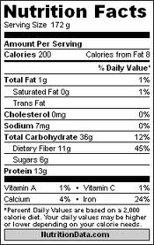
Define the data specifications – Geospatial data
V.5 Metadata
Information that describes the content, quality, condition, origin, and other characteristics of data or other pieces of information.
Data about the data
Allows user to find out if the data is appropriate for its intended purpose
Applies to master lists, geospatial and statistical data
Different standards exists (FGDC, ISO) but they first need to be converted into a metadata profile (selection of fields) before being used.
Will be covered in more details during Session 3.4

Slide 15
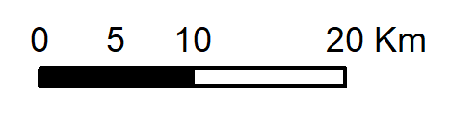
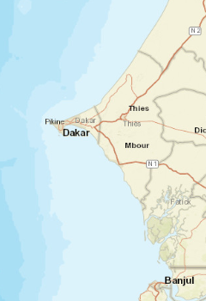
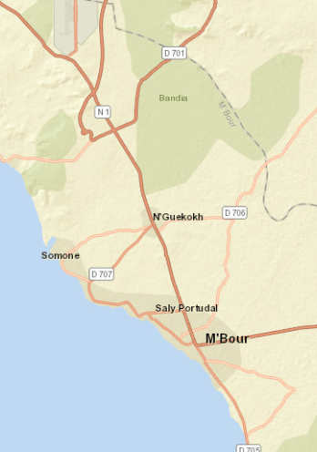
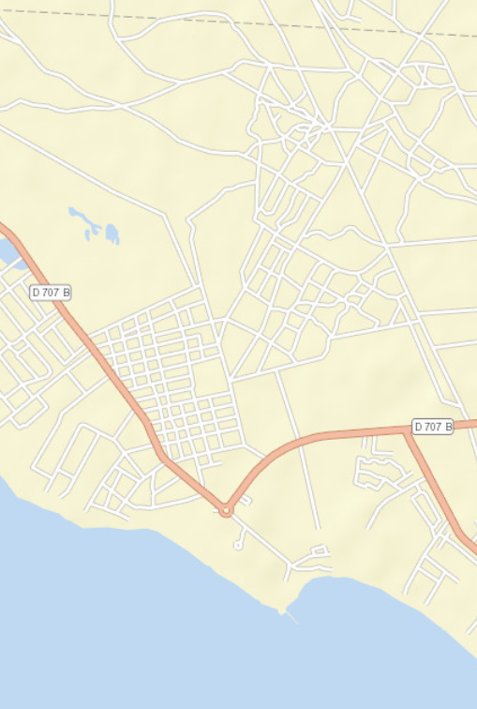
Define the data specifications – Geospatial data
A.1 Scale
The ratio or relationship between a distance or area on a map and the corresponding distance or area on the ground, commonly expressed as a fraction or ratio
A map scale of 1/100,000 or 1:100,000 means that one unit of measure on the map equals 100,000 of the same unit on the earth surface.
Large scale map versus small scale map
A large-scale map has a smaller ratio (1:10,000 or 1:25,000) and would contain more details such as streets and building footprints.
Small scale Medium scale Large scale

Slide 16
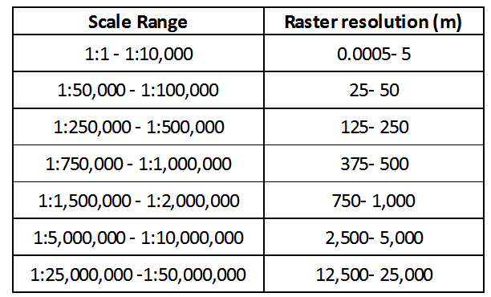
Define the data specifications – Geospatial data
A.2 Resolution
The dimensions represented by each cell or pixel in a raster format geospatial dataset.
100 m
100 m
Relation between scale and resolution
Tobler W. (1987): Measuring Spatial Resolution, Proceedings, Land Resources Information Systems Conference, Beijing, pp. 12-16

Slide 17
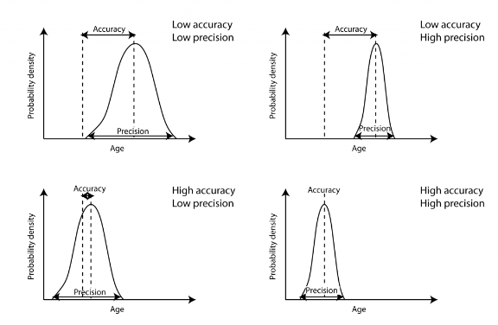
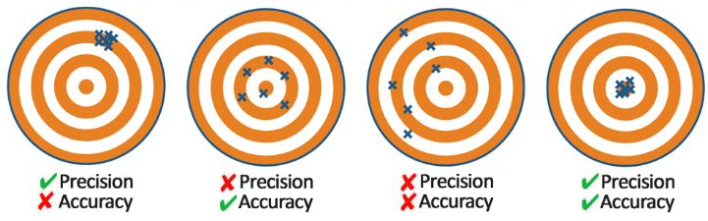
Define the data specifications – Geospatial data
A.3 & A.4 Accuracy, and A.5 Precision
Accuracy: The degree to which a measured value conforms to true or accepted values (proximity of measurements to a specific value)
Precision: The number of significant digits used to store numbers, particularly coordinate values (proximity of measurements to each other, dispersion)
= real value, reality
Indicator Geographic coordinates

Slide 18
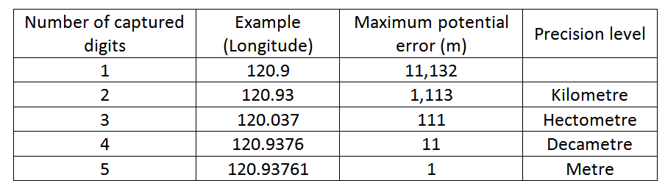
Define the data specifications – Geospatial data
Precision (A.5)
At the equator: 360 º
40’075 km
1 º
͌
111’320 m
Recommended
During data collection in the field (GNSS enabled devices)
When generating or extracting vector format geospatial data (precision level of vertices)

Slide 19
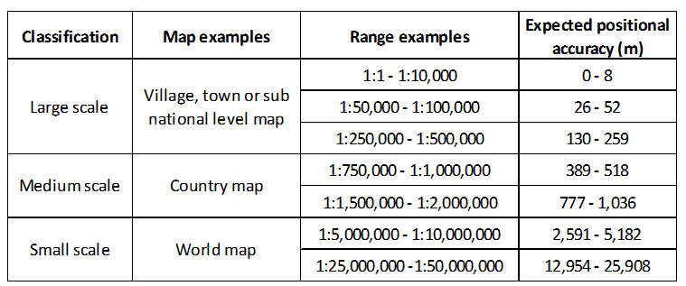
Define the data specifications – Geospatial data
Scale and positional accuracy (A.1, A.3, and A.4)
United States Geological Survey mapping standards: "requirements for meeting horizontal accuracy as 90 per cent of all measurable points must be within 1/30th of an inch for maps at a scale of 1:20,000 or larger, and 1/50th of an inch for maps at scales smaller than 1:20,000."
Similar relationship than between scale and resolution
http://www.colorado.edu/geography/gcraft/notes/error/error_f.html

Slide 20
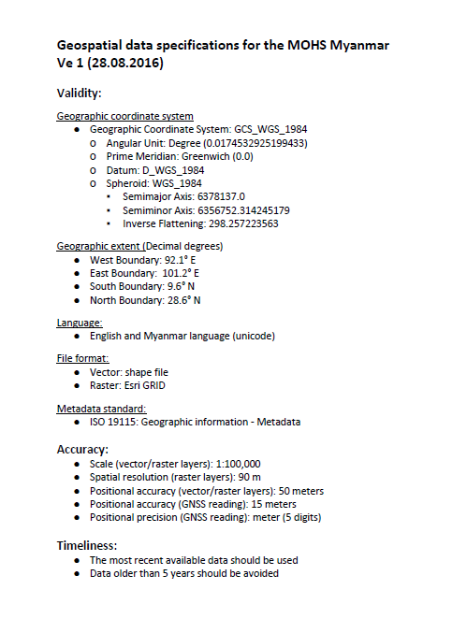
Define the data specifications – Geospatial data
Summary
The purpose behind the use of geospatial data will guide the choice of a specific scale of work.
This scale will directly influence the positional accuracy and spatial resolution that should be used when compiling, collecting, or extracting geospatial data.
The highest accuracy and precision possible should be sought when using GNSS-enabled devices to allow for the largest use possible of the resulting data;
A precision level down to the meter (5 digits in decimal degrees) is being recommended.
Geospatial data set specifications for Myanmar

Slide 21
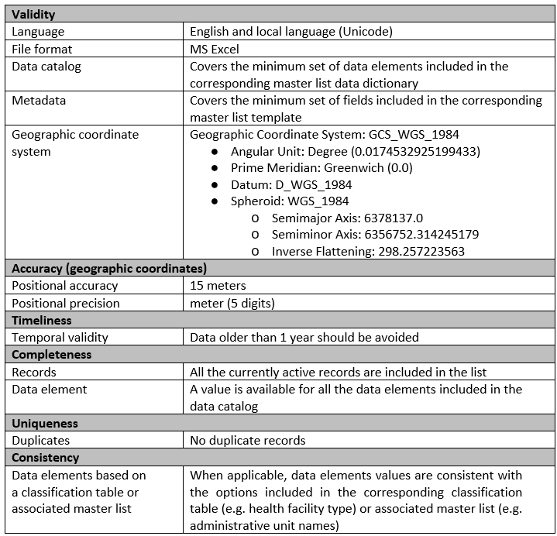
Define the data specifications – Georeferenced Master List
Data dictionary
Master list template
Same criteria as with the geospatial data
Classification tables
Other master lists
Fake example

Slide 22
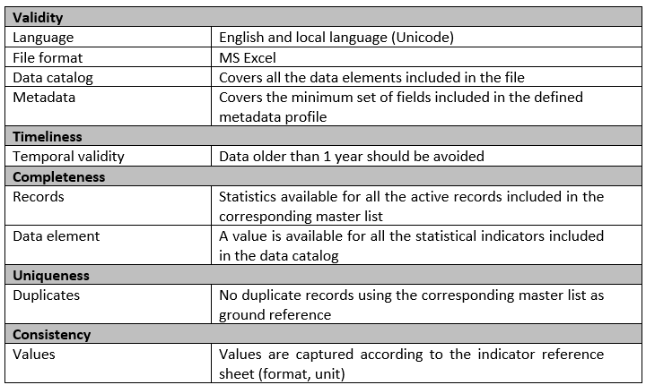
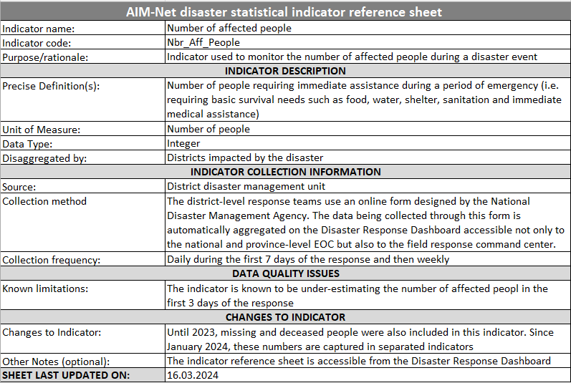
Define the data specifications – Statistical data
Metadata profile
Indicator reference sheet
Fake example

Slide 23
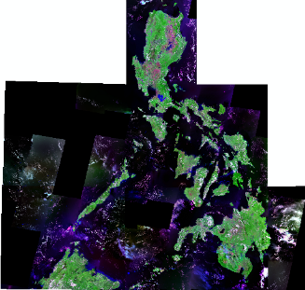
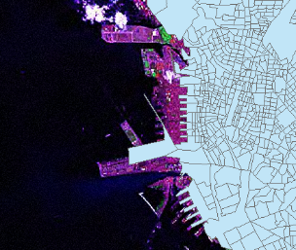

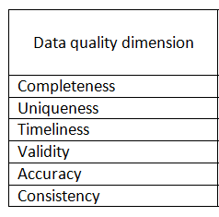
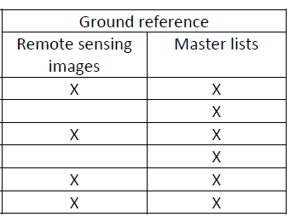
Define the ground reference
The closest reference to the reality against which data quality can be measured
In the context of the HGL guidance, the ground reference is provided by the following :
High resolution orthorectified remote sensing imagery (applies to geospatial data)
Georeferenced master lists (applies to geospatial and statistical data)
The image has its own accuracy
890 m

Slide 24
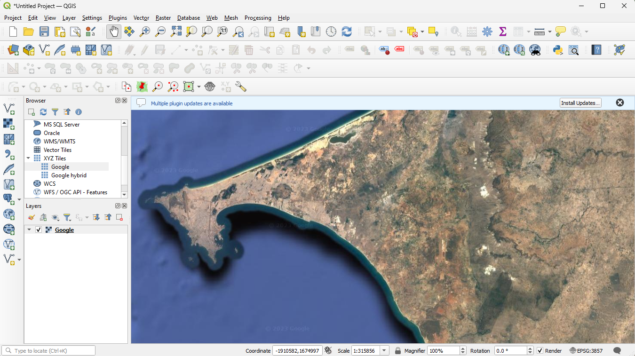
Define the ground reference – Remote sensing imagery
Imagery collected by a satellite, an aircraft, or a drone
Medium to high resolution images are now available for free through online applications such as Google Map or Bing Map or directly in GIS software through what we call a web mapping service.
This will be discussed in more detail when talking about data quality assessment

Slide 25
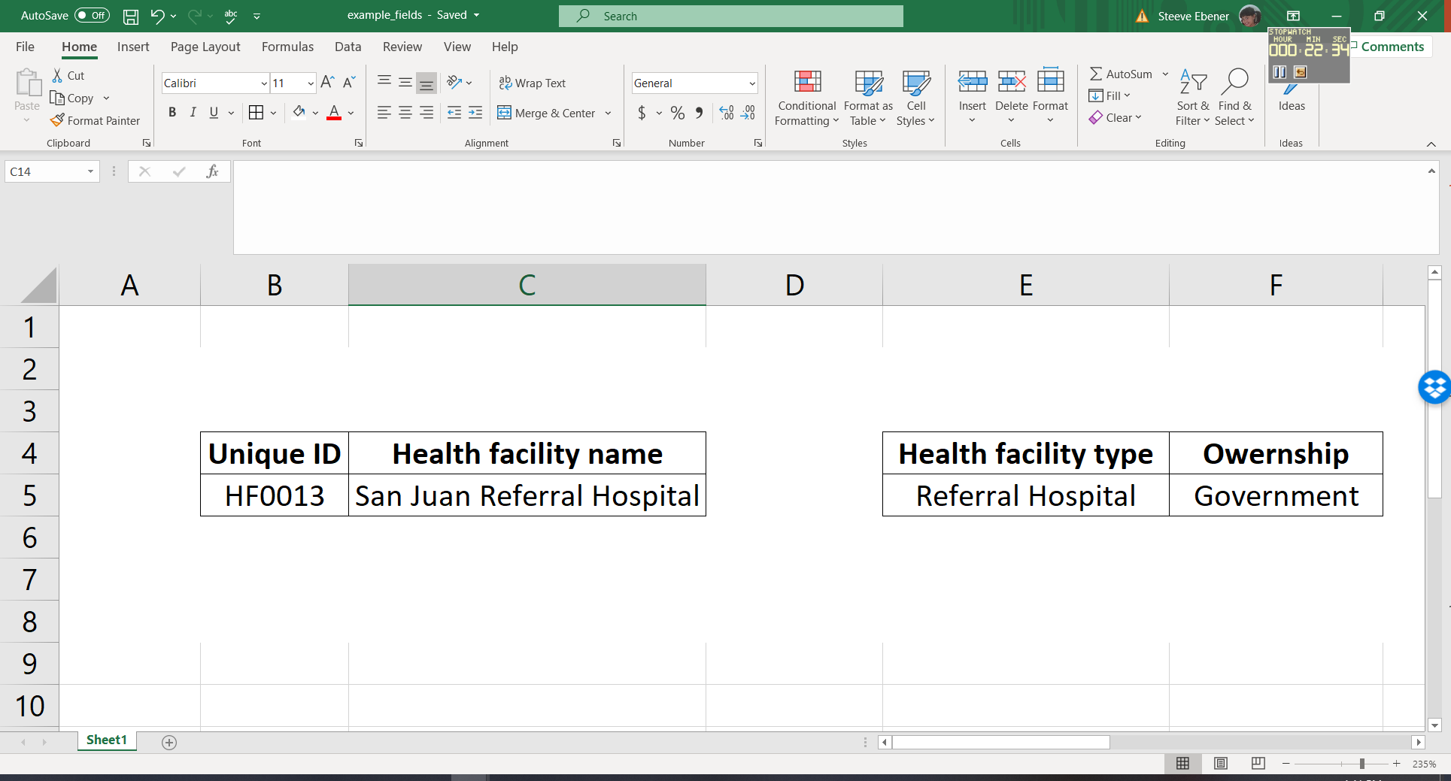
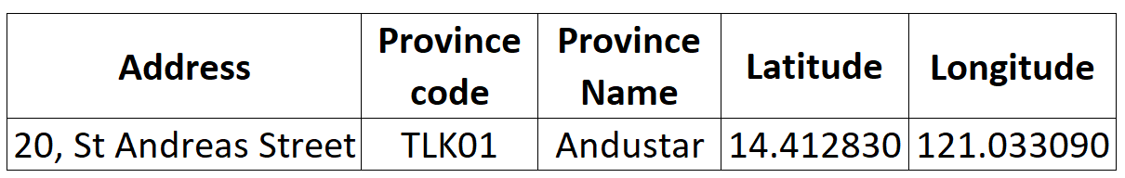
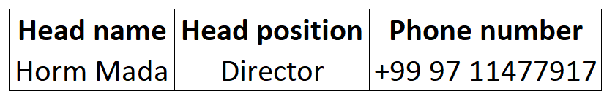
Define the ground reference – Georeferenced Master Lists
Unique, authoritative, officially curated by the mandated agency, complete, up-to-date, and uniquely coded list of all the active (and past active) records for a given type of geographic feature/object (e.g. health facilities, administrative units, villages)
The information that allows to do the following for each of the records in the master list:
Uniquely identify (unique identifier, name)
Classify (type, ownership,…)
Locate (address, administrative division, geographic coordinates)
When it applies, contact (head name, phone number, email address,…)
Example for health facilities

Slide 26
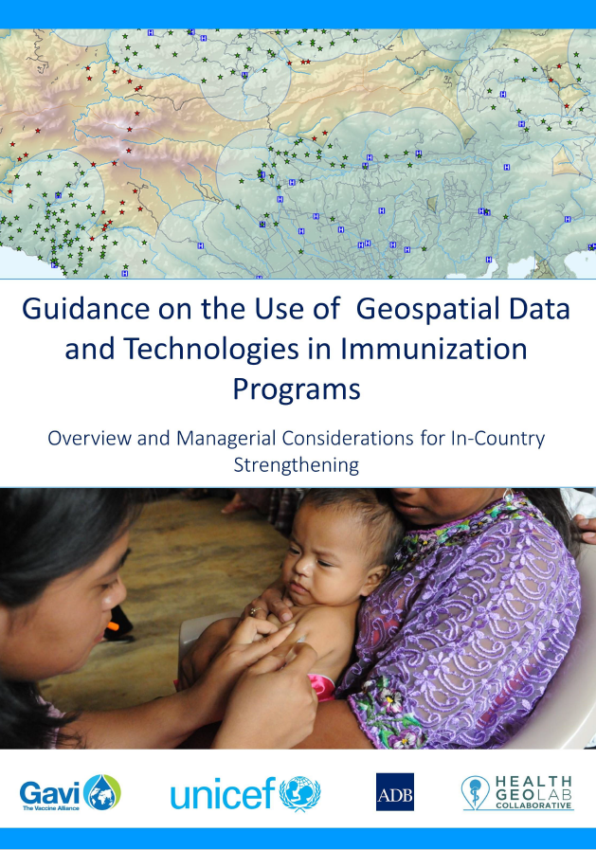


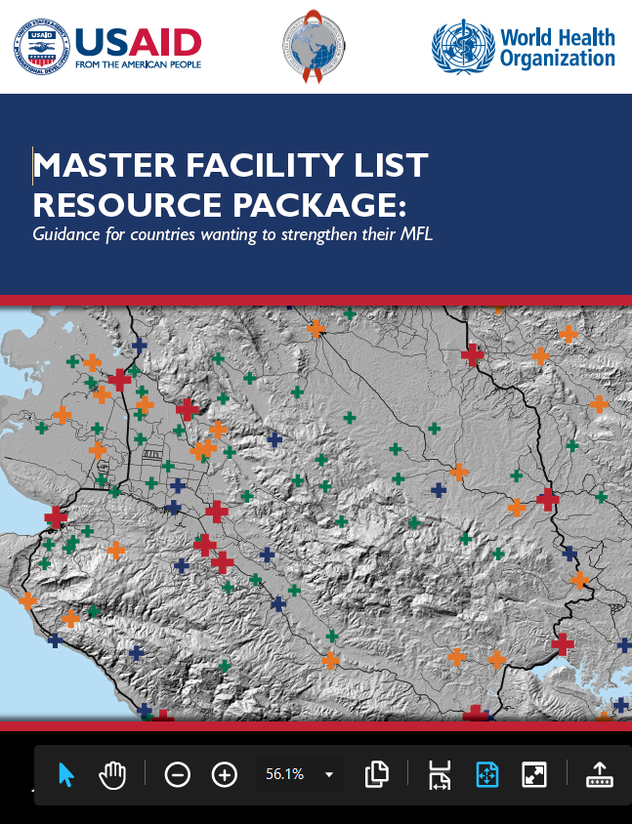

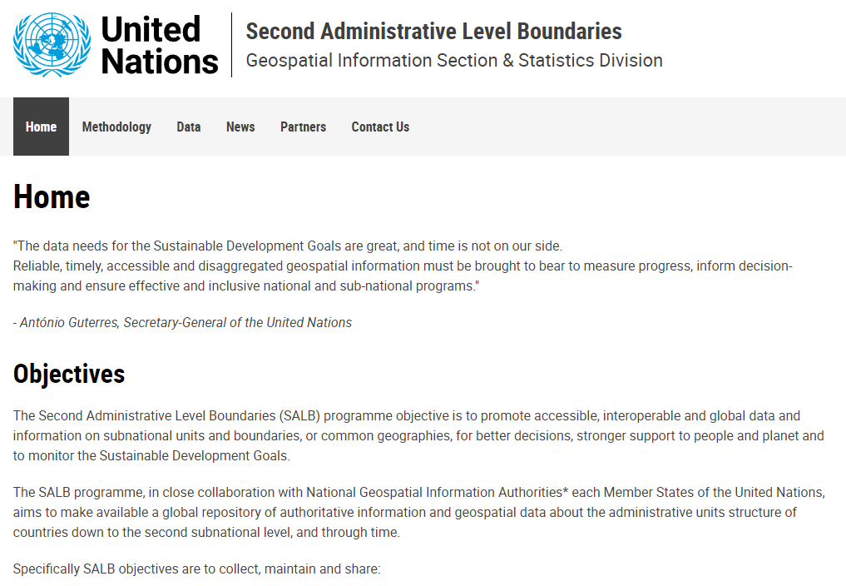
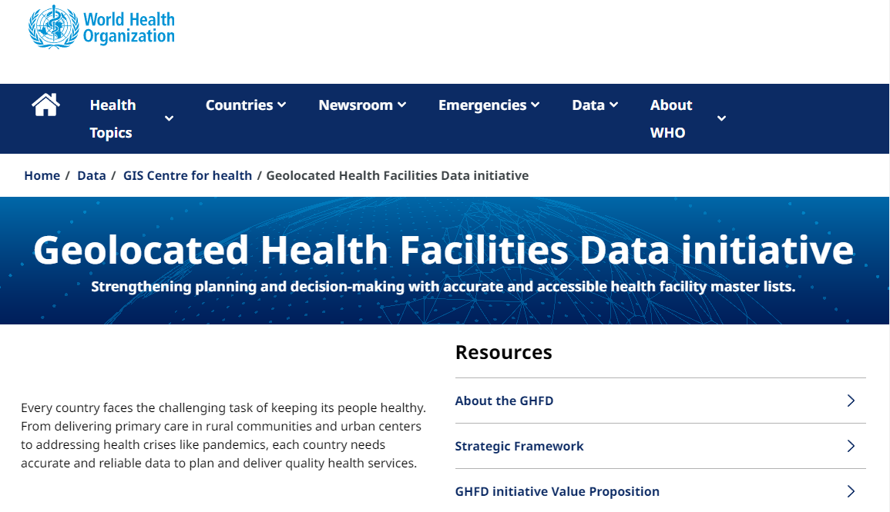
Define the ground reference – Georeferenced Master Lists
Key elements mentioned in several health program guidelines
…the main subject of a growing number of master list-specific documents
Administrative units
Healthcare facilities
…and at the origin of global level initiatives
https://salb.un.org/en
https://www.who.int/data/GIS/GHFD

Slide 27
Define the ground reference – Georeferenced Master Lists
Key elements of a master list
Definition
Content
  Data elements and dictionary
  Coding scheme
  Naming convention
  Classifications (types, owner)
  Locations (addresses, administrative divisions, geographic coordinates)
  Contact information (establishment manager, telephone number, etc.)
Registry or Common Geo-Registry (CGR)
Process
27

Slide 28

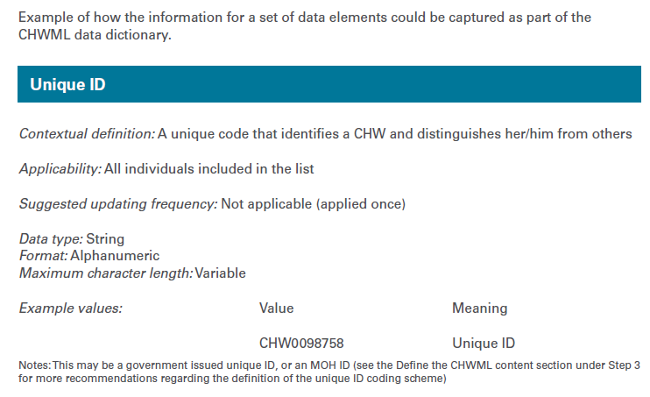
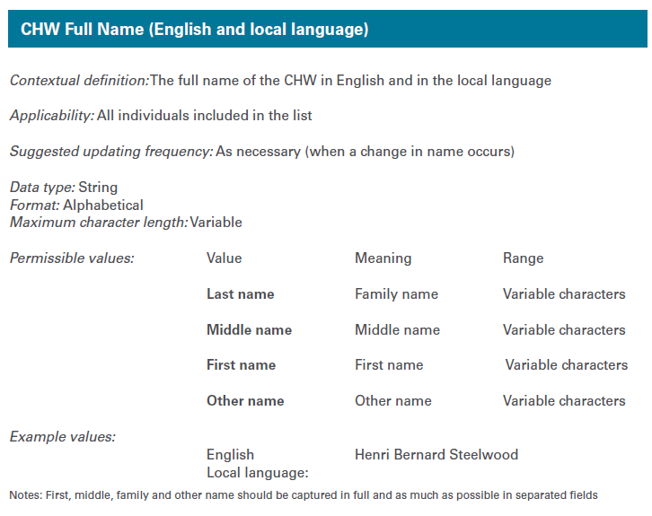
Georeferenced Master Lists – Data dictionary
1
A collection of names, description, and attributes about the data elements that are being used or captured in a database or information system
A clear contextual definition
Its applicability (applied to all individuals in the list or only some of them)
Its format (alphanumeric, numeric, date, other)
Its maximum character length
The values that the data element can take, especially when these are bound to a limited number of options (classification tables)
Whether the data element should be considered as mandatory when a new CHW is being added to the master list (all the core data elements should be considered as mandatory by default).
Such a dictionary needs to be developed for each master list and must contain the description of the minimum data elements to be included in each of them
The list of data elements to be included is developed through the implementation of a consultative and collaborative involving the concerned stakeholders
28
1 https://www.unicef.org/documents/implementation-support-guide-development-national-georeferenced-community-health-worker

Slide 29
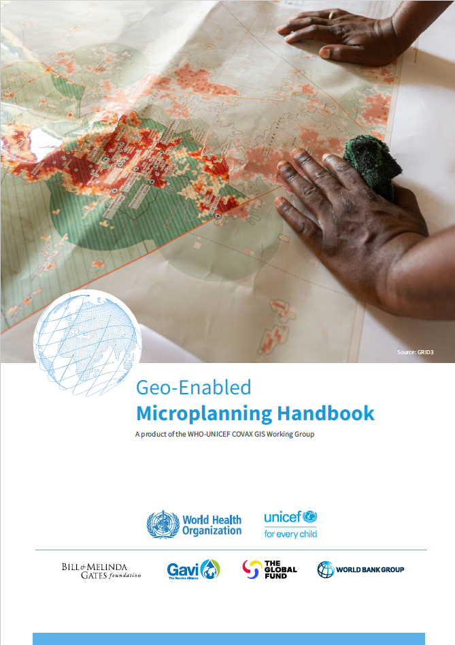
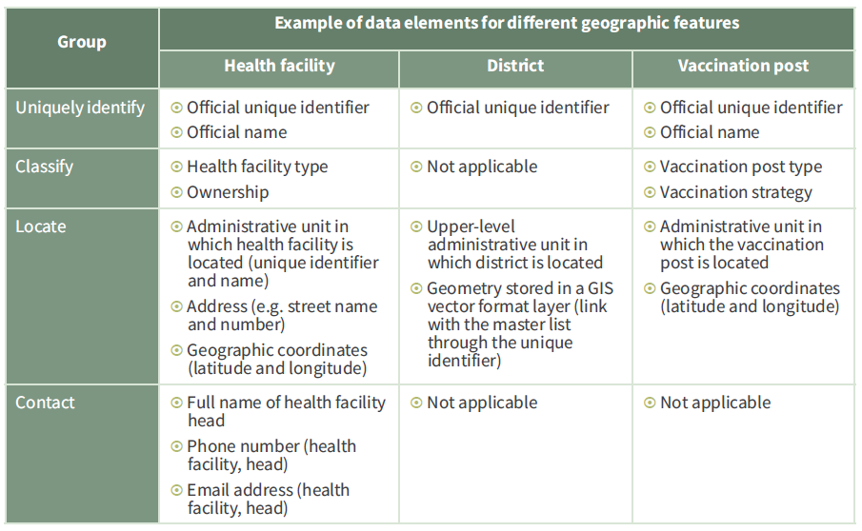
Georeferenced Master Lists – Data elements
Examples of core data elements for different types of geographic features
1
1 https://drive.google.com/file/d/1jj779zww4herWOESAd9mXqVE1YfQehtH/view

Slide 30
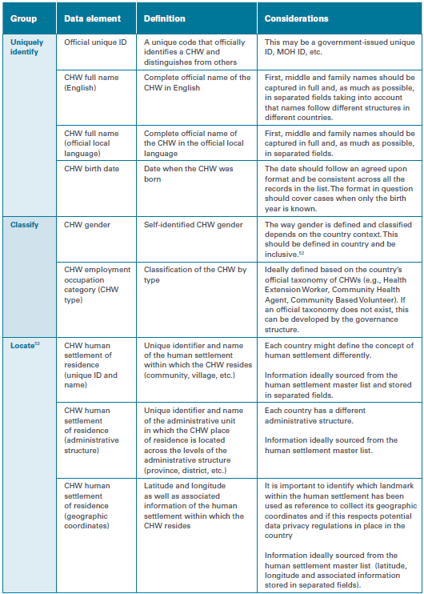
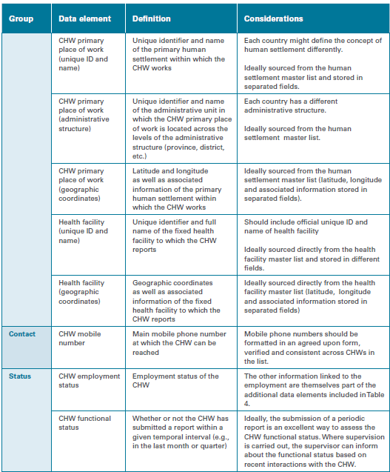
Georeferenced Master Lists – Data elements
Core data elements for establishing a community health worker master list
1
Core data elements necessary to uniquely identify, classify, locate and contact each Community Health Worker in the country as well as know their current contractual and reporting status.
1 https://www.unicef.org/documents/implementation-support-guide-development-national-georeferenced-community-health-worker

Slide 31
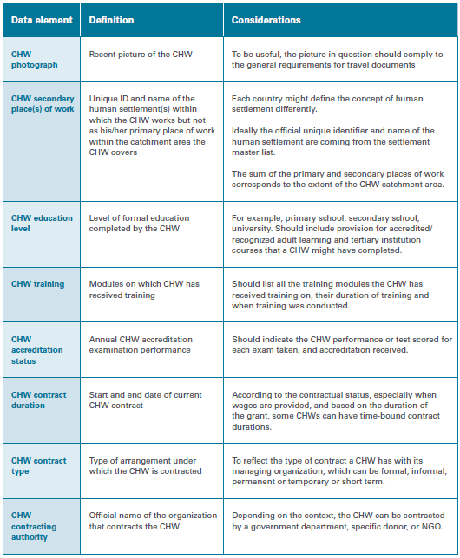
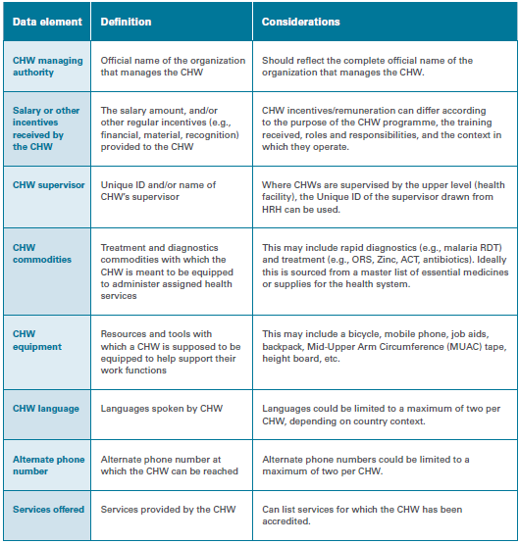
Georeferenced Master Lists – Data elements
Additional data elements for establishing a community health worker master list
1
Example of additional data elements to be prioritized in order to define which ones to be included in the minimum set for the master list
Note: the more data elements you include the more difficult it is to maintain the quality of the master list
1 https://www.unicef.org/documents/implementation-support-guide-development-national-georeferenced-community-health-worker

Slide 32
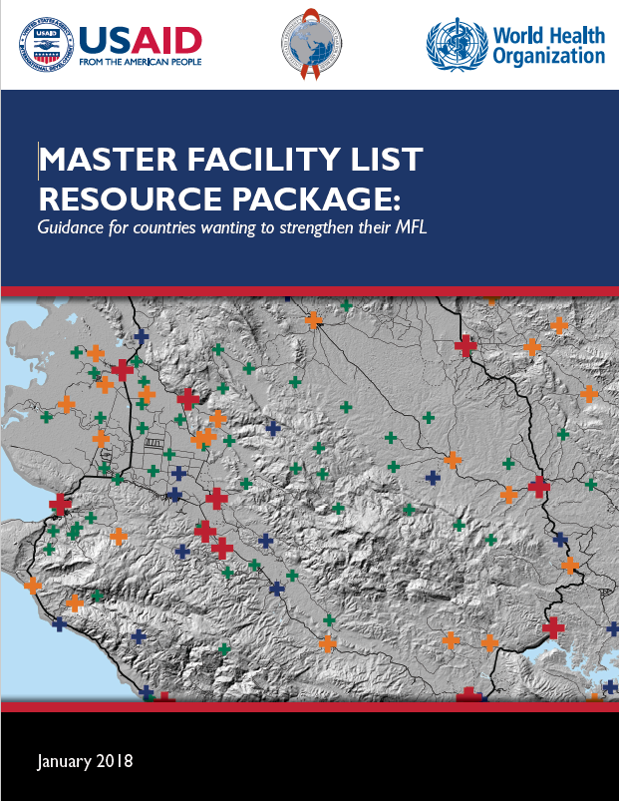
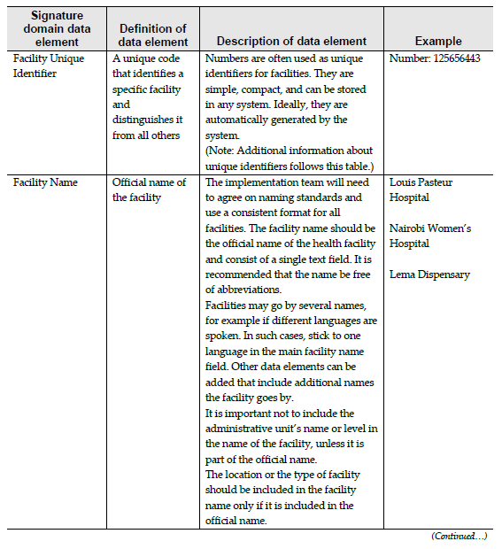
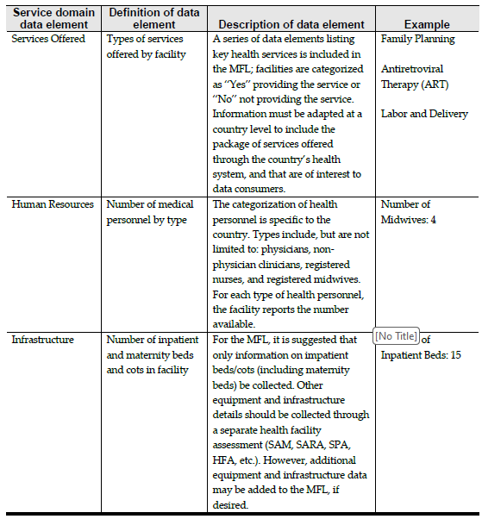
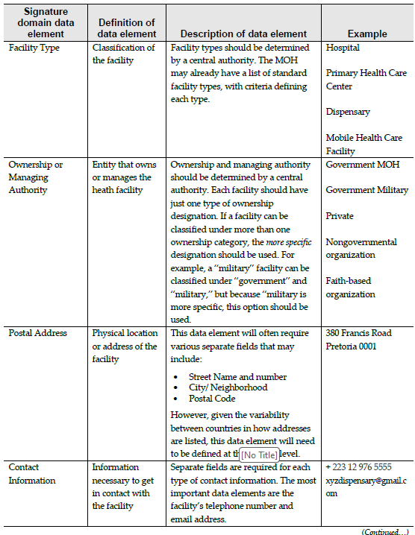
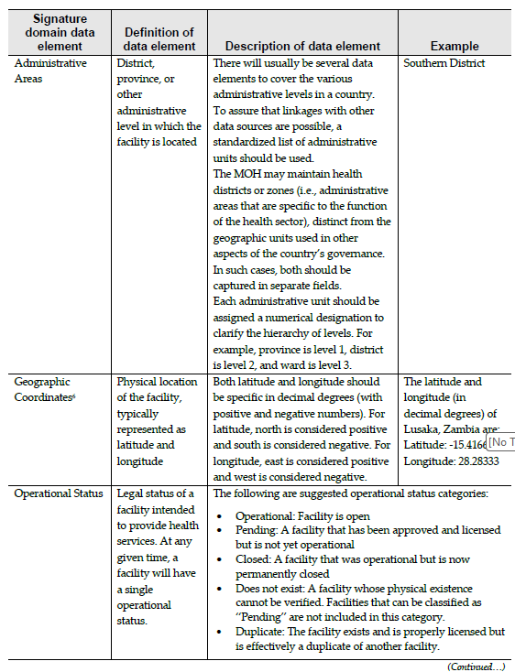
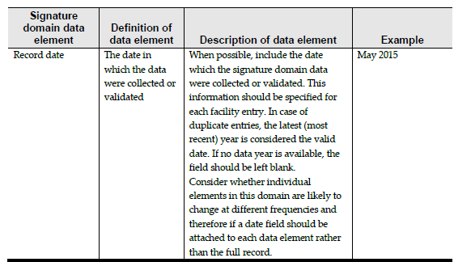
Georeferenced Master Lists – Data elements
Health facility master list (HFML) vs Master Facility List (MFL)
1
Service domain data elements
Signature domain data elements
1 https://www.who.int/publications/i/item/-9789241513302

Slide 33
Georeferenced Master Lists – Data elements
Health facility master list (HFML) vs Master Facility List (MFL)
Covering the 4 types of information considered as being core to master lists (uniquely identify, classify, locate, and contact) can already result in a long list of data elements to include in the data dictionary and therefore the master list.
Example: Master list of health facilities – Mongolia (33 data elements)

Slide 34

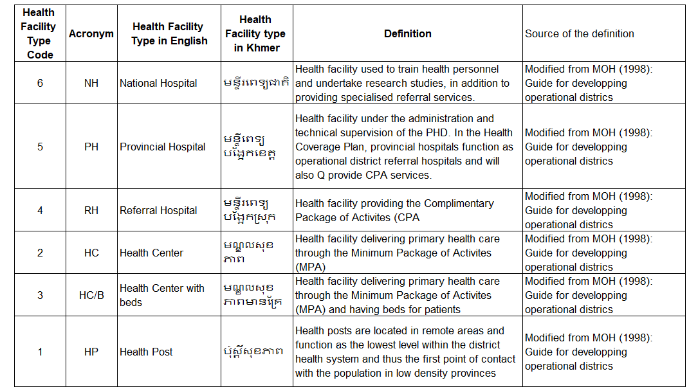
Georeferenced Master Lists – Classification tables
Table organizing and categorizing the values for a data element according to predefined criteria
1
To be defined for each of the data elements where the values are limited to a set of options (example: type, ownership, accuracy, etc.)
Ensures consistency across records
1 https://healthgeolab.net/DOCUMENTS/Guidance_Common_Geo-registry_Ve2.pdf

Slide 35
Georeferenced Master Lists – Coding scheme
Core rules to choose an appropriate coding scheme to uniquely identify each record in the master list:
Ensure for the code schemes to be meaningless => never include information that could change through time in an identifier (e.g., admin division code, health facility type, etc.).
2. Use a sequence as short as possible but taking into account the number of changes that could take place over the coming decades (function of the current number of health facilities observed in the country)
3. Use a specific set of characters at the beginning of the sequence (e.g., “HF”) to avoid the problems linked to having a “0” in front of it
Province | OD | Health facility
09 | 01 | 10
148337353801198976
08365222

Slide 36
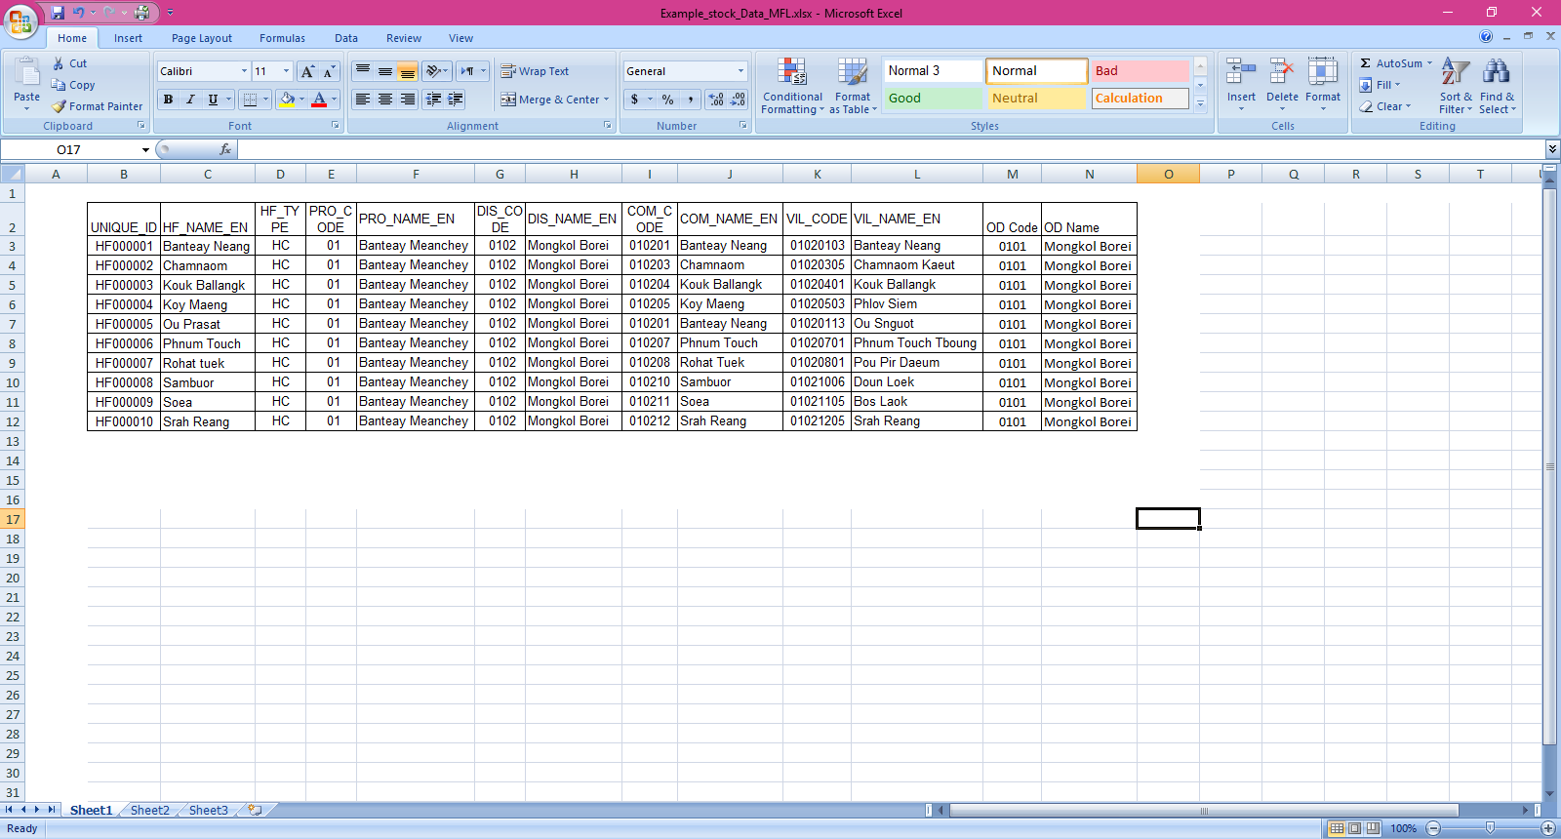
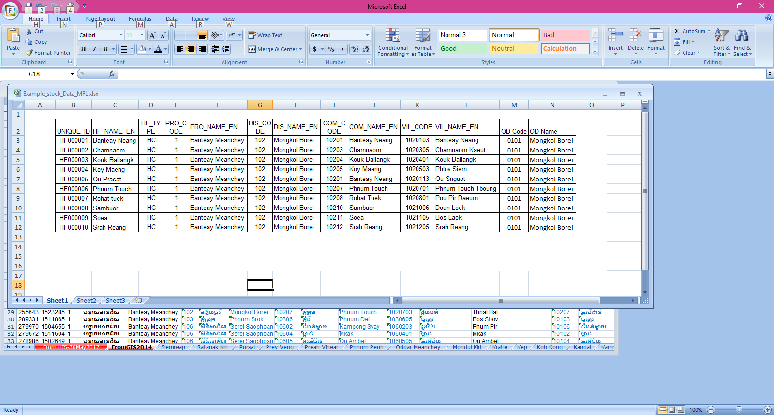
Georeferenced Master Lists – Coding scheme
Ensures that the unique identifier remains the same from the start until the end of existence of each geo-object (example: opening until the closing of the facility and this even if its name, type (upgrade), or location changes (because of a flood for example))
2017
2010
2010
Example for Cambodia
2005
2005
All the other information are stored in the master list and past values are kept in the platform serving as health facility registry
Allows following the changes occurring through time for a given health facility

Slide 37
Georeferenced Master Lists – Coding scheme
“Geo-tag”
If users want to be able to quickly identify which administrative unit a health facility is located in, they can always use what we call a «geolocation».
Concatenate the unique identifier of the administrative unit with that of the health facility on the fly based on the contents of the health facility master list at a given time.
1020113 + HF000005
= Geo-tag 1020113HF000005
This should not be used as a unique identifier as this “tag” contains meaning and it will change over time!
37

Slide 38


Georeferenced Master Lists – Naming convention
Good practices:
In local language and English
Include the name of the facility in full
Include the health facility type to avoid names duplicates
    Some time also requires to include more information to avoid duplicates (example Soum name)
Examples for
Myanmar

Slide 39


Georeferenced Master Lists – Location
Address
Street number and name (if applicable)
Possibly the postal code if useful
Location in the administrative structure
Official code and name of the administrative unit of 1st, 2nd, 3rd,… level in which the geographic feature is located
The administrative structure of the country also evolves over time
Requires a regularly updated master list of administrative units and villages
Such master list should come from the governmental entity having the curation mandate over this information

Slide 40







Georeferenced Master Lists – Location
Geographic coordinates
Example:
Latitude and longitude of the health facility expressed in decimal degrees as well as the indication of the source, method, and level of accuracy attached to the coordinates (a separate data element for each information)
COOR_SO: Source
COOR_MU: Method used
COOR_AC: Qualitative assessment of accuracy
Thematic mapping
Examples for Cambodia
Spatial analysis
Spatial modeling

Slide 41




Georeferenced Master Lists – Contact information
Information needed to contact the healthcare facility through various media, including:
The full name and position of the head of the health facility
Telephone numbers (mobile, landline)
E-mail address
Not applicable to all the geographic features

Slide 42
Georeferenced Master Lists – Process
Assess the current state
Establish the governance structure
Define the target state
Generate the first version of master list
Establish the registry (or common geo-registry) to host, manage and regularly update the master list
Share and use the master list
Maintain the master list and registry
1
1 https://www.unicef.org/documents/implementation-support-guide-development-national-georeferenced-community-health-worker

