Slide 1
Session 3.2: Implementing the geospatial data management cycle (Part 1): Document the process and define the data needs
Notes:
MODULE 3: GEOSPATIAL DATA MANAGEMENT
Session 3.2: Implementing the geospatial data management cycle (Part 1): Document the process and define the data needs

Slide 2
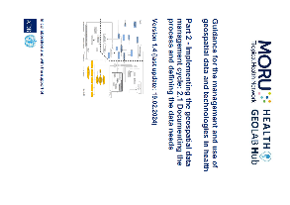
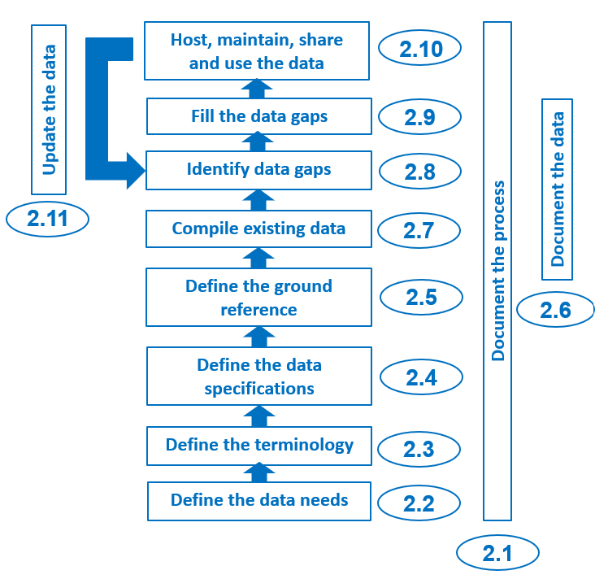
Document the process
The geospatial data management cycle comprises several steps, and implementing these steps takes a long time, involves different people and/or needs to be repeated in the future.
Documenting each step from the beginning as precisely as possible ensures that the process can be replicated
Some steps may require simple documentation such as just describing the choices made and why. Other steps may require a lengthier description of the processes and other elements involved (for example, modifying data).
https://www.healthgeolab.net/DOCUMENTS/Guide_HGLC_Part2_1.pdf

Slide 3

Document the process
The report of the study on physical accessibility to health services carried out for the Vanuatu Ministry of Health is a good example of this type of documentation.
All the elements and processes involved (indicators, targets, assumptions, tools, analyses, data, and norms) are fully documented in the report.
A good document such as this will allow someone else to obtain the same results
This level of detail is also useful when it comes to scientifically publishing the work carried out
https://healthgeolab.net/KNOW_REP/Acc_Analysis_VUT_050224_FINAL.pdf

Slide 4
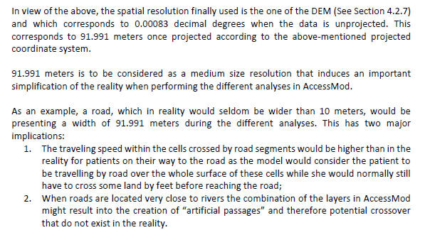
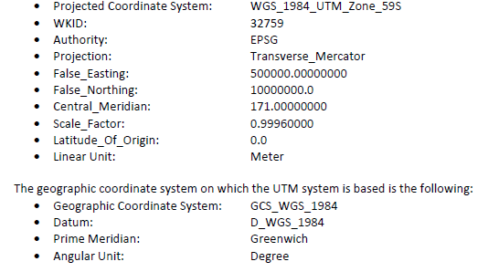
Document the process
Elements included in this report ¹ - Specifications and data limitations
1 https://healthgeolab.net/KNOW_REP/Acc_Analysis_VUT_050224_FINAL.pdf

Slide 5
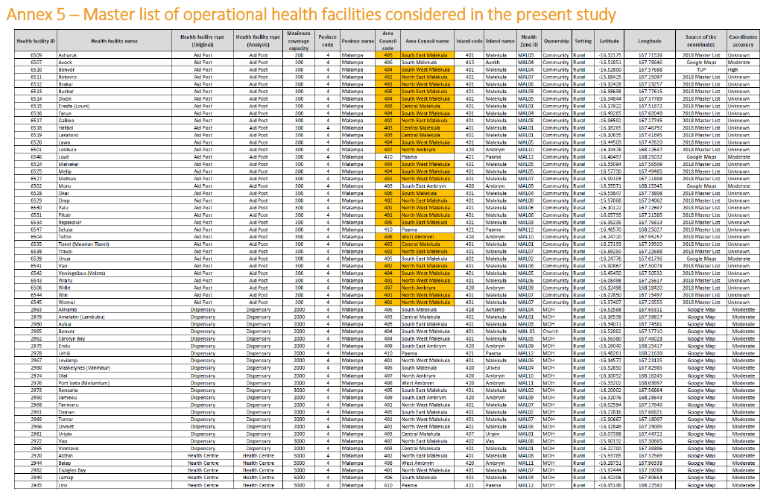
Document the process
Elements included in this report ¹ - Master lists of geographic objects considered in the analysis, including the unique identifier.
1 https://healthgeolab.net/KNOW_REP/Acc_Analysis_VUT_050224_FINAL.pdf

Slide 6
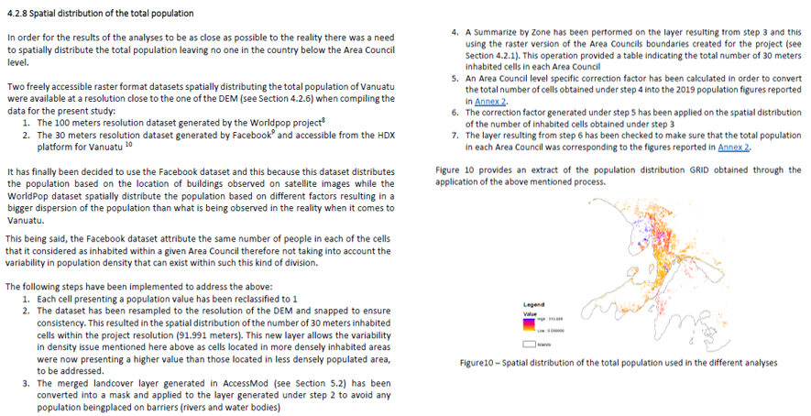
Document the process
Elements included in this report ¹ - Detailed description of each geospatial dataset used and changes made.
1 https://healthgeolab.net/KNOW_REP/Acc_Analysis_VUT_050224_FINAL.pdf

Slide 7
Define the data needs
Two scenarios are possible when reaching this step:
The geo-enablement is being performed for a specific program or intervention. In this case:
  The geography of the program or intervention as well as the products to be generated have already been defined during step B of the HIS geo-enabling process (see Session 2.2)
The geo-enablement happens at the HIS level. In this case:
This step consists of identifying the geospatial, statistical, and other data and information needed to generate these products
  This step consists of defining the geography of the health sector (geographic features with definition and their relationships) as done during step B
https://www.healthgeolab.net/DOCUMENTS/Guide_HGLC_Part2_1.pdf

Slide 8
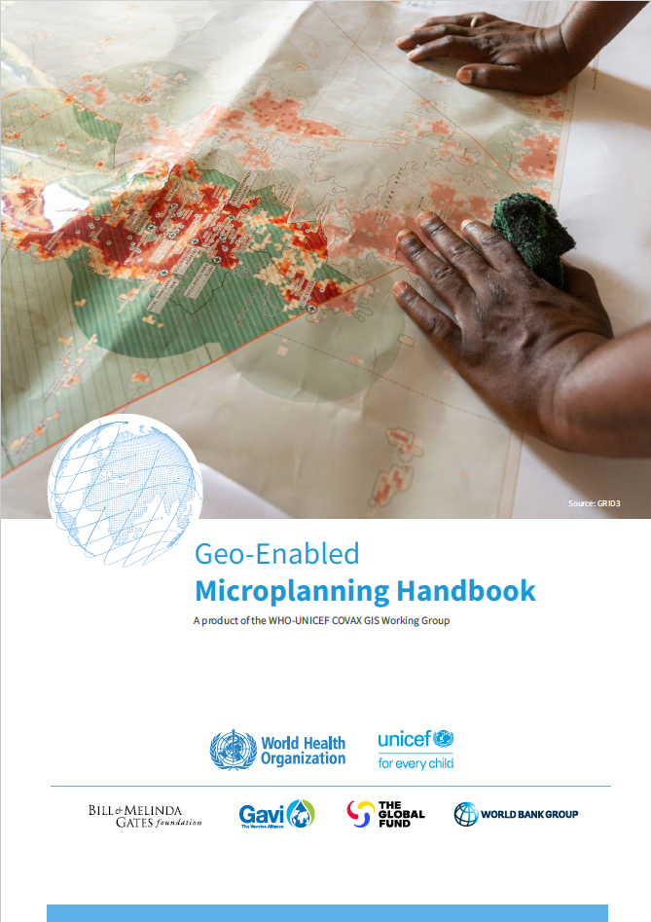
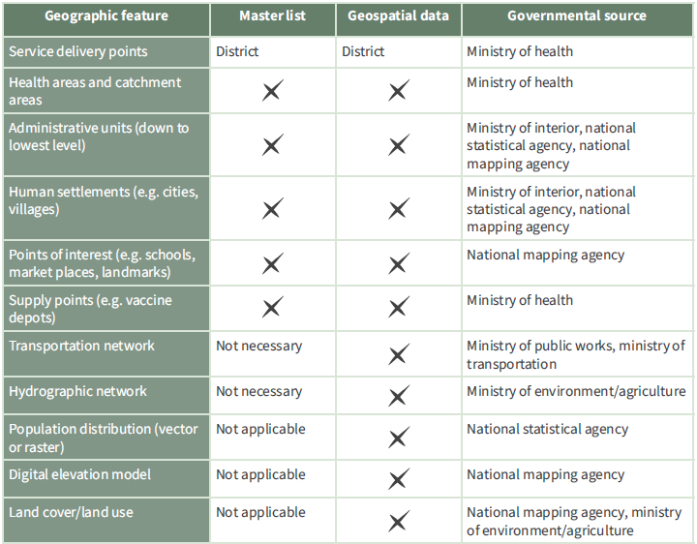
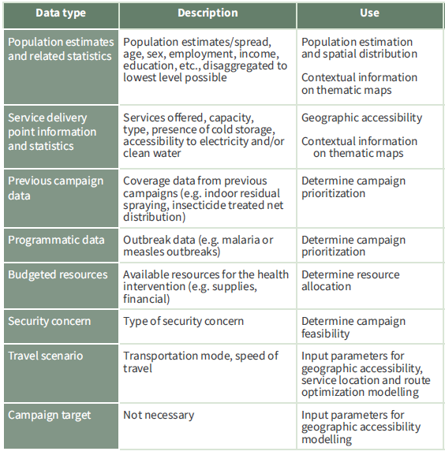
Define the data needs – Program or intervention implementation
The content of the products identified during step B of the HIS geo-enabling process define the data that are needed
Example for microplanning
Master lists
Geospatial data
Statistical data
Input parameters
Will depend on the application of geospatial data and technologies and of the local context.
Examples on the right for microplanning
https://drive.google.com/file/d/1jj779zww4herWOESAd9mXqVE1YfQehtH/view

Slide 9
Define the data needs – HIS level implementation
Identifying and documenting the geography of the health sector will provide the list of geographic features to be considered as well as the relationships that exist between them.
Master lists which must be established to serve as a reference on the ground to guarantee the quality of the data
Geospatial data that will need to be compiled, collected, and/or extracted for use in GIS software
Information to include in the master list and in geospatial data to recreate existing relationships between geographic features
Additional data and information must also be captured to operationalize the relevant application of geospatial data and technologies (georeferenced master list, population estimation and spatial distribution, geographic accessibility, service location and route optimization modeling, thematic mapping, navigation and collection of geographic coordinates using GNSS).

