Slide 1
Session 3.1: Introduction to the geospatial data management cycle
Notes:
Session 3.1: Introduction to the geospatial data management cycle

Slide 2
The importance of data and information in Public health
Solving problems related to public health priorities requires making important decisions supported by data, information, and information products.
Terms | Definition
Data | Raw, unorganised facts and statistics collected for reference or analysis
Information | Data processed, organised, structured, or presented in a given context so as to make it useful
Information products | Product derived from one or more sources of data and information to meet a specific objective

Slide 3


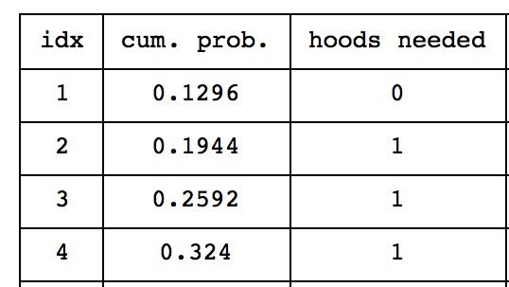
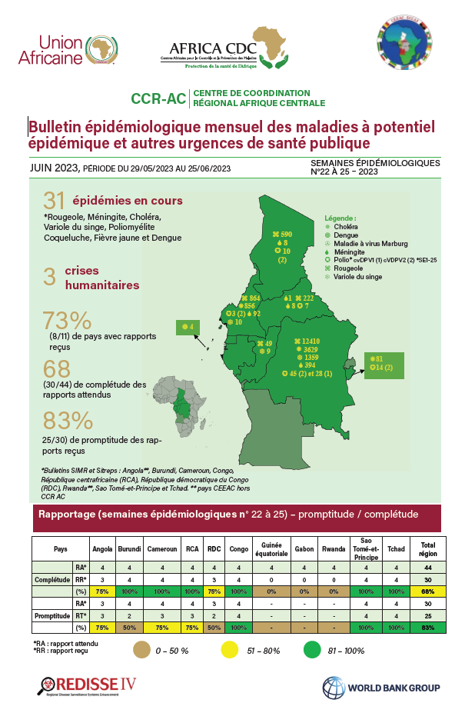

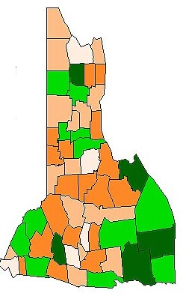
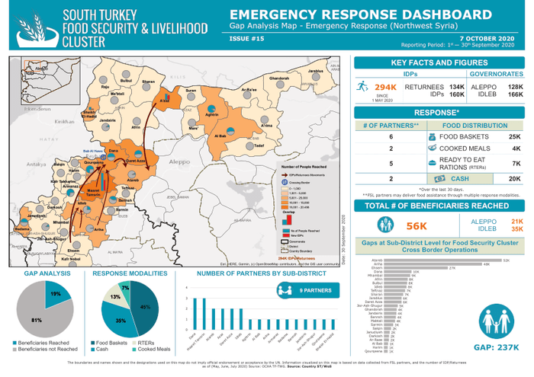
From data to information products
Data
Information
Information products
Example: Total district population
According to the district report, the number of malaria cases has doubled in the last six months.
Documents containing text, tables, graphics, maps (e.g. newsletters, reports, bulletins, updates, etc.)
Process, organise, structure,...
Text
700
667
854
Table
920
Infographics
Individual or statistical facts :
Graphic
Quantitative (statistical) data is provided in numerical form, such as an item's weight, volume or cost.
Qualitative (factual) data is descriptive, but not numerical, such as a person's name, gender, or eye color.
Dashboards/maps with additional data and/or information
Thematic map

Slide 4

The importance of data and information in Public health
However, the data and information needed to solve public health problems cannot be just any data, they must be of good quality to generate good quality information and information products.
Garbage in –
Garbage out !
How_to_lie_with_maps
“Whatever the degree of advancement of GIS technologies, the results of their use will only be valid to the extent that the quality of the primary data used is sufficient. The results of their use will only be as good as the quality of the primary data used.” ¹
Underlines the need for good data management practices
¹ Mendis K. (2009) Spatial technology & malaria control. Indian J Med Res 130, November 2009, pp 498-500

Slide 5
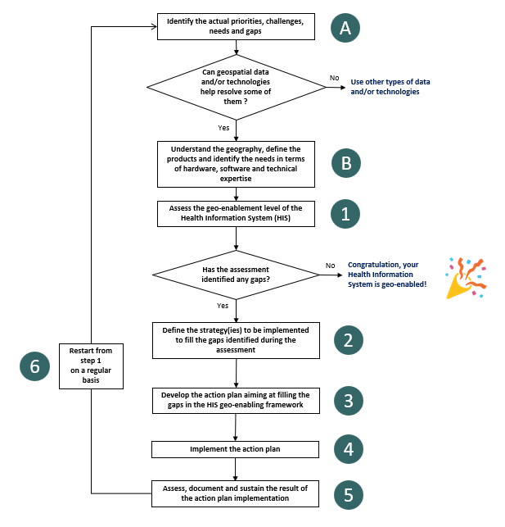
HIS Geo-enabling framework implementation process
Step 1 : Assess the availability, quality, and accessibility of data and information
When geo-enabling the HIS, this step in the process only look at where the master list for a set of geographic features core to public health find themselves along a predefined continuum
Geo-enabling a program or intervention requires for a more in-depth assessment of the availability, quality, and accessibility of the data needed to generate the information products defined during step B
Such an assessment is to take place during Step 1 and meant to identify currently existing gaps and how to fill them
Also an entry point for the geospatial data management cycle

Slide 6

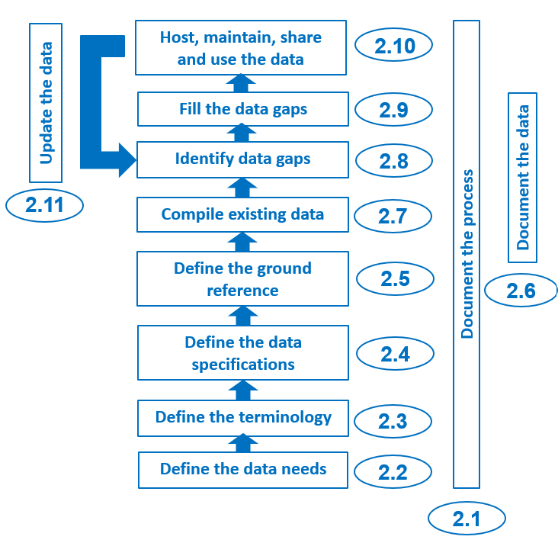
The geospatial data management cycle
1
Generating and maintaining good quality data (geospatial, statistical) and generating information and information products require proper data management standards, processes, and protocols to be defined and implemented.
The geospatial data management cycle provides the steps needed to ensure that proper data management standards, processes, and protocols are defined and implemented
Ensures data quality and therefore the quality of the information and information products to be generated out of it
Applicable to any type of data (geospatial, statistical)
1 http://www.healthgeolab.net/DOCUMENTS/Guide_HGLC_Part1.pdf

Slide 7
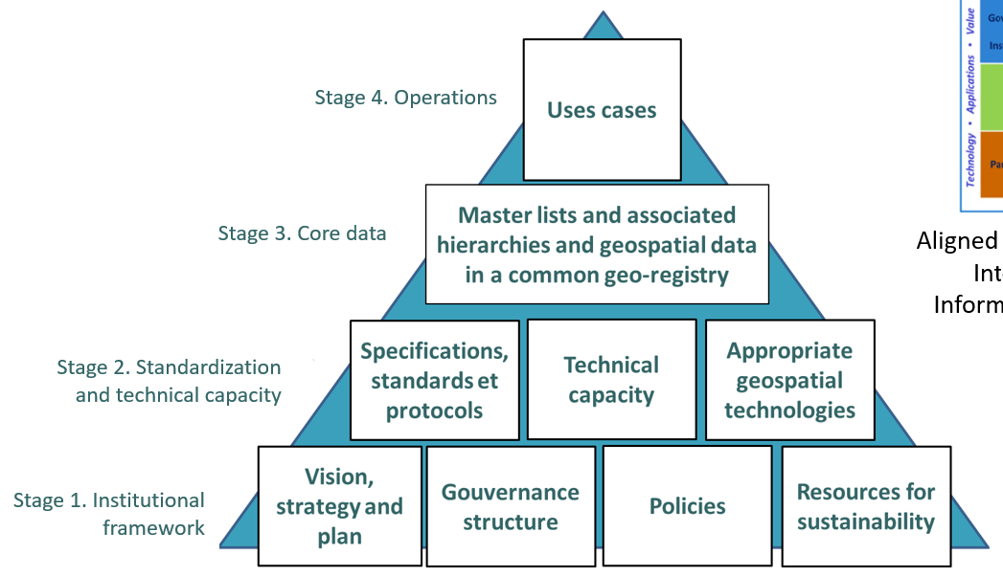
The geospatial data management cycle
The technical process of the HIS geo-enabling framework
Strategic framework Technical process

Slide 8
The geospatial data management cycle
2.9
2.10
2.11

Slide 9
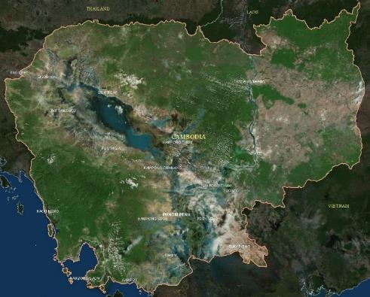
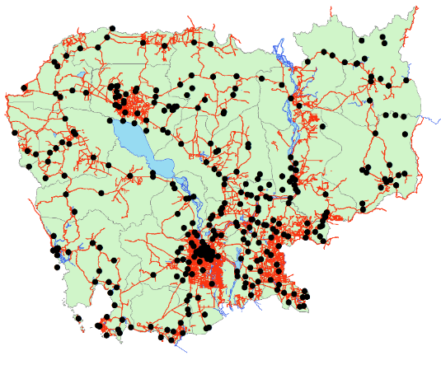
Geospatial data
Also referred to as spatial data; information about the locations and shapes of geographic features and the relationships between them, usually stored as coordinates and topology.
Digital representation of geography

Slide 10
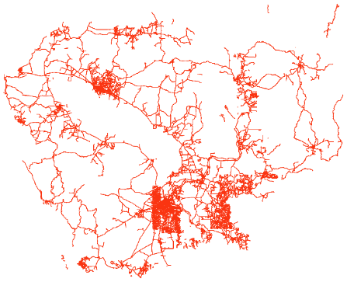
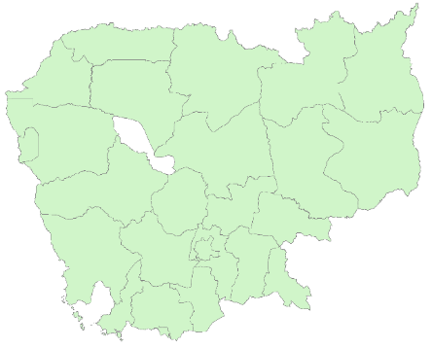
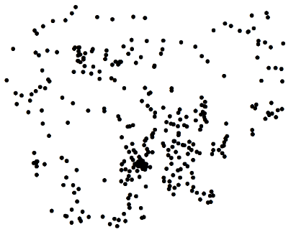
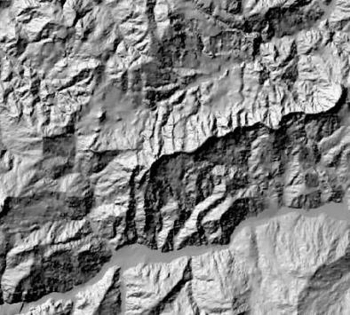
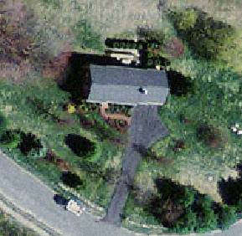

Geospatial data types
Vector format (shapefile)
Point Line Polygon
Raster format (Geotiff, GRID)

Slide 11

Document the process
Documenting each step from the beginning as precisely as possible ensures that the process can be replicated
Applies to the entire geospatial data management cycle
A critical activity often forgotten or considered to be acquired
1
Good example of project implementation documentation
  1 https://healthgeolab.net/KNOW_REP/Acc_Analysis_VUT_050224_FINAL.pdf
Notes:
.

Slide 12
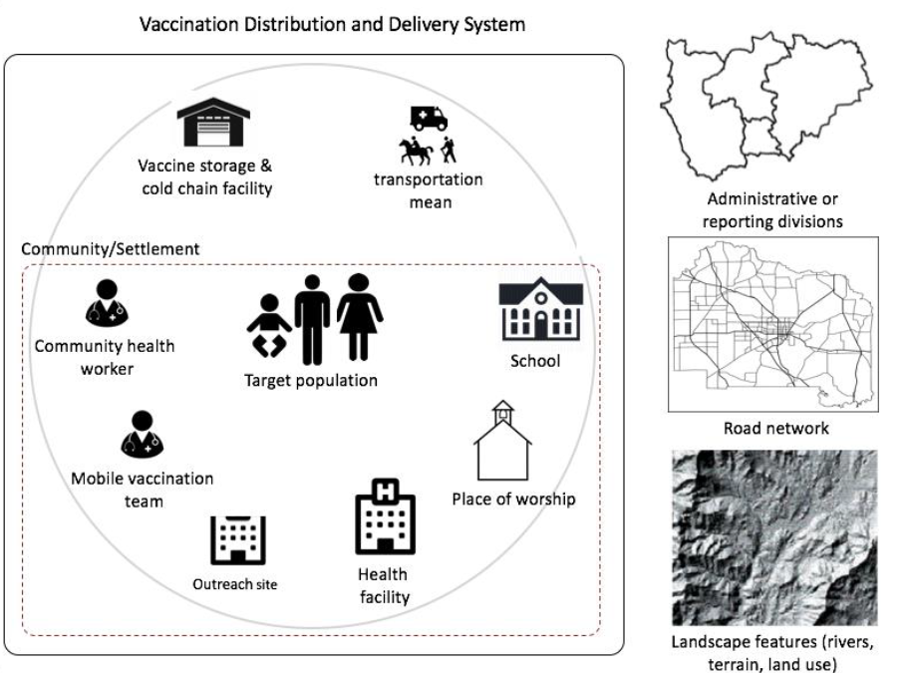
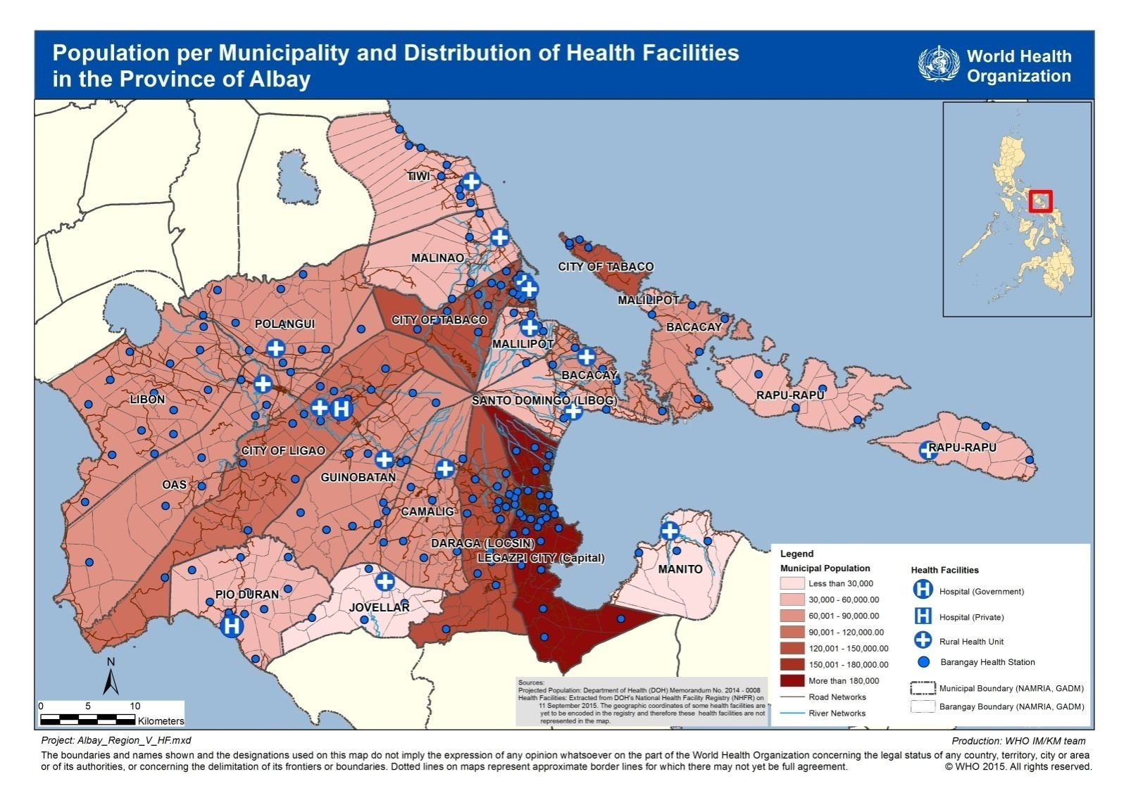
Define the data needs
Three important activities must be completed during this step:
Understand and document the geographic context
Characterize data and information specific to geospatial data and technology applications
Identify the data needed to generate the information products
Notes:
.

Slide 13
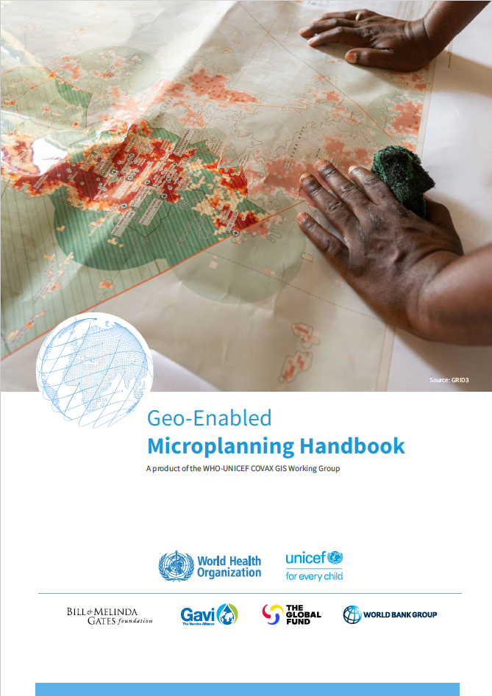
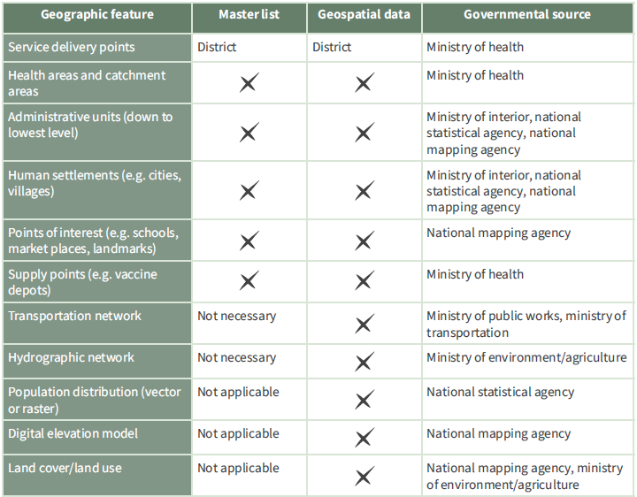
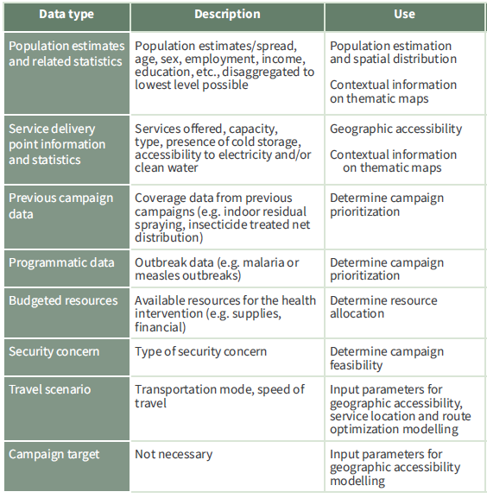
Define the data needs
The content of the products identified during step B of the HIS geo-enabling process define the data that are needed
Example for microplanning
Master lists
Geospatial data
Statistical data
Input parameters
Will depend on the application of geospatial data and technologies and of the local context.
Examples on the right for microplanning
Notes:
.

Slide 14
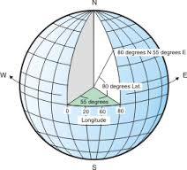

Define terminology, data specifications, and ground references
The definition of terminology makes it possible to ensure that all the actors involved speak the same language.
Data specifications and ground references (satellite imaging, master lists) provide the measurable criteria to assess and improve the quality of geospatial data across the 6 dimensions of data quality (completeness, uniqueness, timeliness, accuracy, validity and consistency).
890 m
Notes:
.

Slide 15
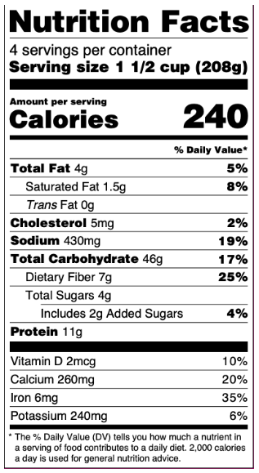
Document the data
All geospatial and statistical data used or generated as part of the implementation of the cycle must be properly documented.
This documentation provides the information needed to guarantee the quality of the data and should be started as soon as possible throughout the cycle.
The information is entered in a metadata record based on a standardized metadata profile.

Slide 16
Compile existing data and identify gaps
The compilation and organization of existing data make it possible to reduce the duplication of efforts, and therefore save time and money.
The quality of the existing data that has been compiled must be evaluated in relation to the specifications of data and references on the ground to identify the potential gaps that will have to be filled.
Restrictions in the use and/or sharing of compiled data can also cause the need to collect new or additional data.
Notes:
.

Slide 17
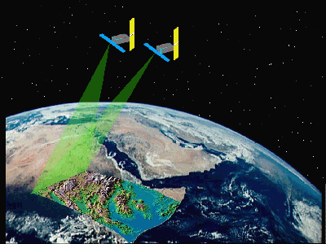
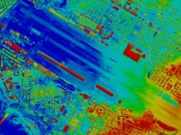


Fill the gaps in the data
Gaps in the data identified during the previous step should ideally be filled.
Different approaches can be used, including the improvement of existing data, the extraction of new data using different methods such as digitization, or the collection of geographic coordinates in the field.
The data in question must also be validated before being used.

Slide 18
Host, manage, share, and use data
Once the geospatial data has reached the appropriate quality level, it can be used to generate information and/or or the information product(s) defined at the beginning of the process.
They must also be properly hosted and maintained.
Depending on the restrictions attached to it, the data can be distributed to the targeted and/or interested parties. The same goes for information and/or information products which are then generated based on this data.
Notes:
.

Slide 19
Update data
Like any other type of data, geospatial data must be updated regularly to reflect the changes that occur over time.
Such an update must be done by following an established update mechanism.
This may require the collection or extraction of additional data as well as updating information and information products that result from it.
Generates a loop
Note: The identification of new data needs may require taking up the entire process from step 1.

Slide 20



Health GeoLab guidelines
The Health Geolab has created a series of guidances that describe the geospatial data management cycle and provide advice on how to implement each of the step in the cycle.
Used as a reference in the context of this course
Freely accessible:
https://healthgeolab.net/resources/reference-materials/

