Slide 1
Session 2.3: The Health GeoLab Hub: A regional resources to support HIS geo-enabling across Asia and Pacific

Slide 2
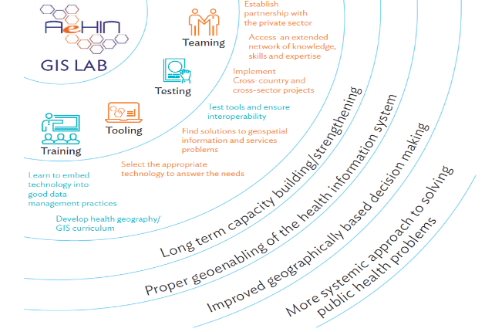
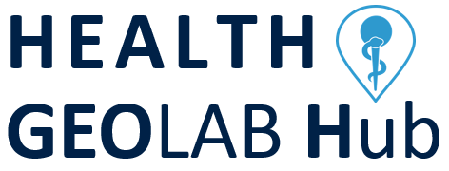
The Health GeoLab Hub to help fill the gaps
Vision: For low- and middle-income countries in Asia and the Pacific to fully benefit from the power of geography, geospatial data, and technologies to achieve SDG 3
Mission: Support the implementation of the HIS geo-enabling framework in countries across Asia and the Pacific

Slide 3
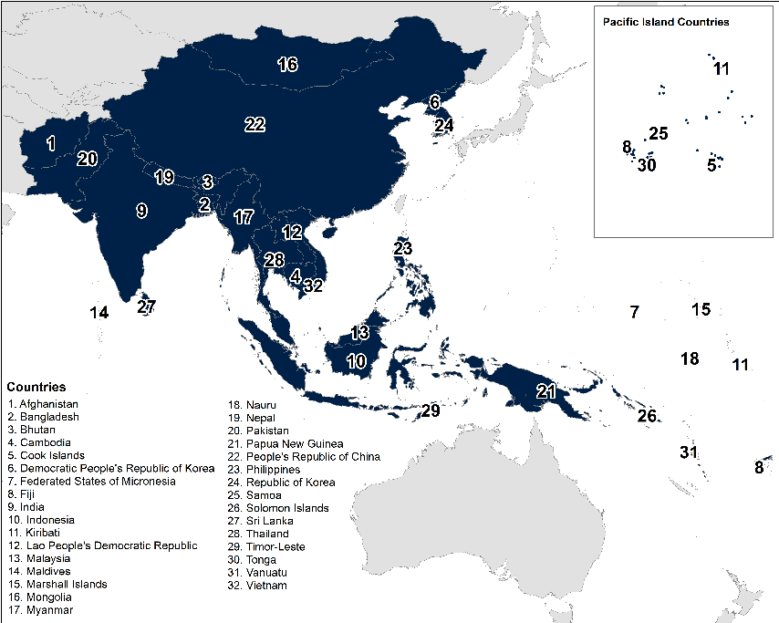

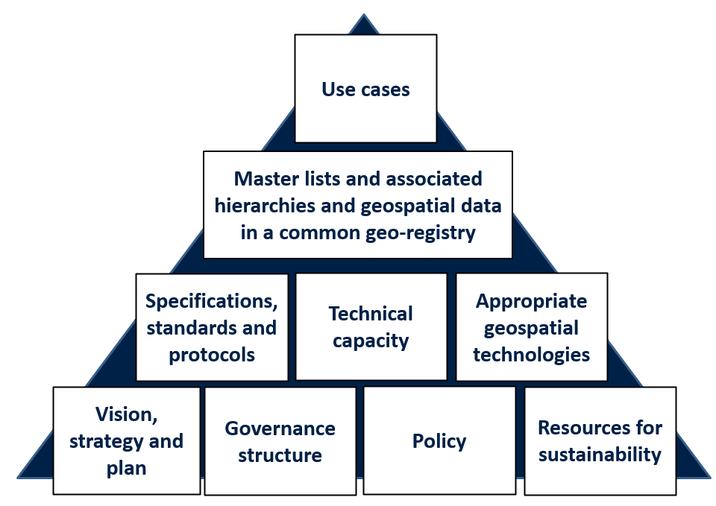

Regional resource supporting countries in Asia and the Pacific with the geo-enablement of their Health Information Systems (HIS)
More effective management and use of geospatial data and technologies to support decision making for health
Research
Technical assistance
Training
Hub activities are aligned with these 9 elements
richard@tropmedres.ac
healthgeolab.net/hub
Support for collection, management and analysis of geospatial data
Develop, validate and apply robust methods and tools
HIS Geo-Enabling Framework

Slide 4
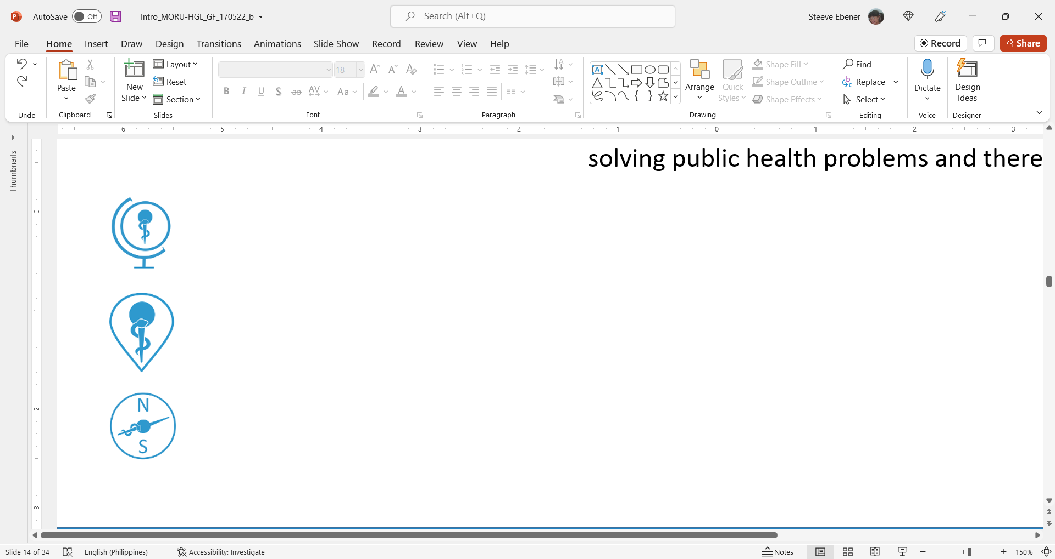
Health GeoLab Hub areas of work
Country technical support
Provide technical assistance to the health sector regarding the geo-enablement of its HIS
Maintenance of a roster of in-country experts working closely with the Ministry of Health
Engagement, knowledge sharing and transfer
Strengthen the link between the academic and health sector as well as partners in countries regarding the importance of the geographic dimension in public health.
Establish and maintain an innovative community of Practice to address the geographic dimension of SDG3.
Management of the Health GeoLab Hub for the development and sharing of resources supporting the geo-enablement of the health sector in countries
Organization of regional events to address countries’ needs and challenges
Teaching and research
Train current and future public health professionals and researchers on how to effectively manage and use geospatial data and technologies building on already existing HGL and MORU material
Assess the impact of suboptimal geospatial data on public health decision making.
Develop, test, implement and transfer new methods for geospatial data collection and/or cleaning to improve data quality.
Conduct, or provide support for, geospatial analysis and modelling to address public health questions

Slide 5
How we work
Prioritize one-on-one in-country capacity strengthening activities adjusted to the country’s specific needs and capacities.
Provide long term “coaching” as part of pilot projects instead of one-off training events.
Use regional gathering mainly to cover concepts and processes and allow countries to share their experience and knowledge as well as identify common needs and challenges.
Facilitate the organization of software specific training with professionals when needed.
Develop and maintain freely accessible reference and training material through its knowledge repository.
Establish partnership aiming at facilitating access and use of geospatial technologies.
Develop a network of professionals dealing with the management and use geospatial data and technologies across the Region.
Through the assistance being provided, the health sector benefits from a more effective management and use of geospatial data and technologies to support geographically based decision making across health programs and reach a more systemic approach to solving public health problems and therefore the health SDG
For more information: https://healthgeolab.net/hub/

Slide 6
What we do – Advanced analysis and modeling
Healthcare accessibility analysis (COVID-19, PHC, EmONC,…)
Supporting the establishments of master lists of health facilities (GHFD) and villages
Estimating population density and travel patterns from social media data and field surveys
Malaria risk mapping
Spatial transmission modelling of malaria elimination interventions
Dengue breeding site and risk mapping in urban environment
COVID-19 country stratification
Mapping and geospatial analysis for rabies vaccination programme
Mapping soil transmitted helminth survey data for the eradication programme
Geospatial analysis of trends in routine malaria incidence and intervention data
Spatial analysis of association between climate and malaria/dengue
Fine scale mapping of antimalarial drug resistance from genetic markers
Mapping forest goer travel and forest camps
Vulnerability and Risk Analysis and Mapping 3
All of this supported by good data management practices

Slide 7

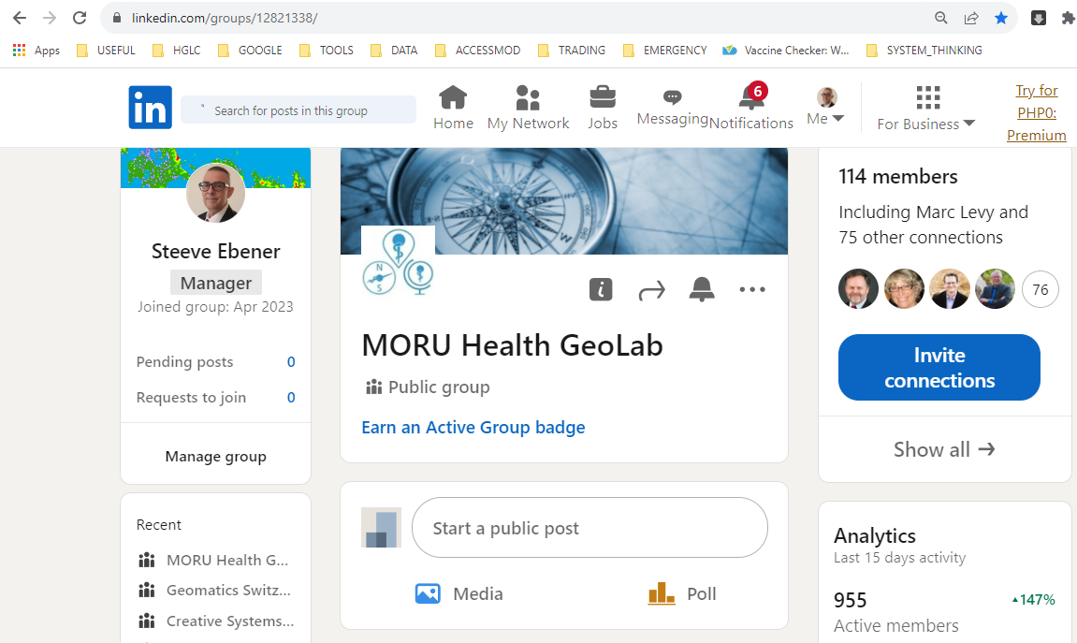














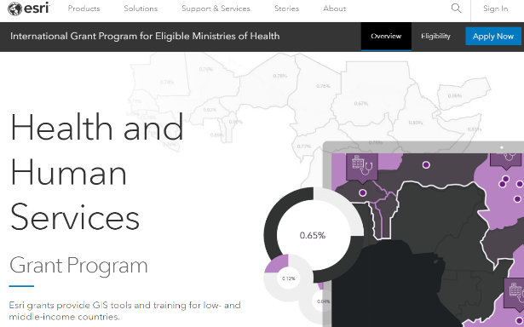
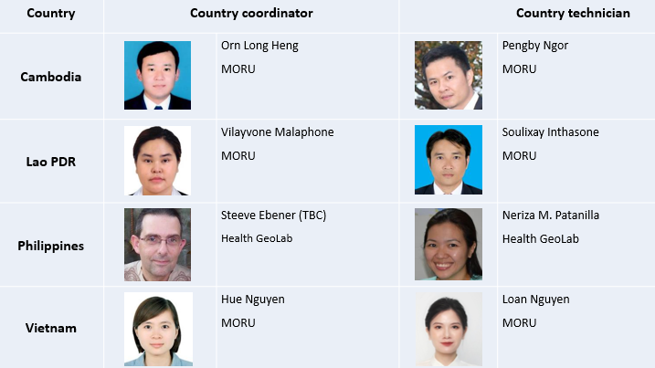
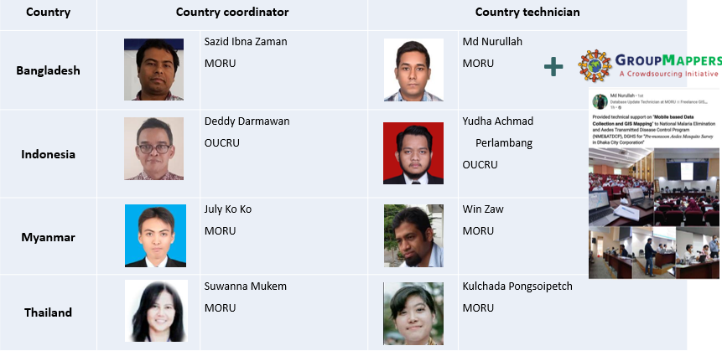
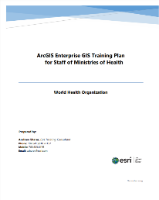
What we do – Teaming/Networking
Partners and working relationships - Governmental agencies, development partners, academic institutions, private sector, volunteer organizations
LinkedIn group
(114 members)
https://www.linkedin.com/groups/12821338/
Thai GIS Network
(241 members)
Public-Private Partnership (PPP) with Esri
In country teams
Additional staff brought on board to cover larger projects if needed

Slide 8

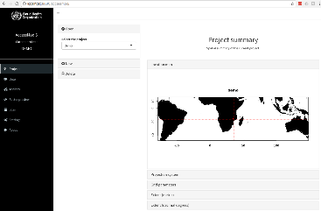
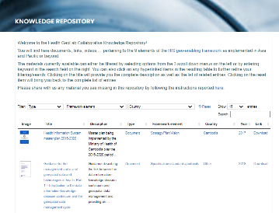
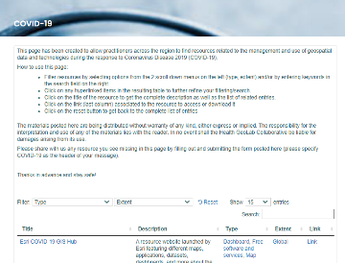

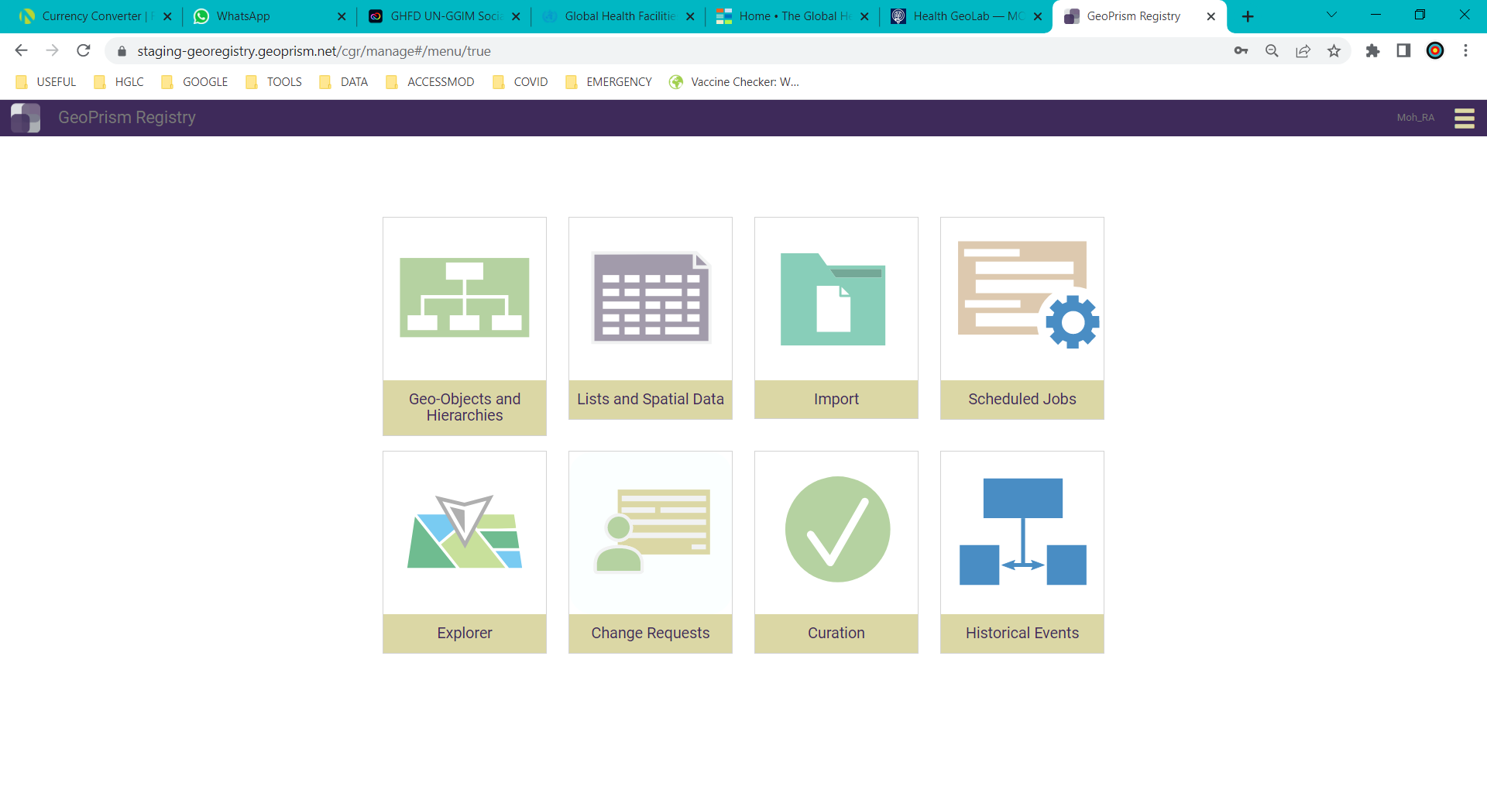
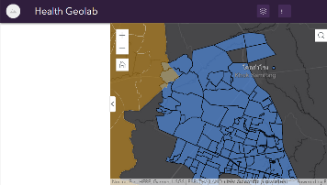

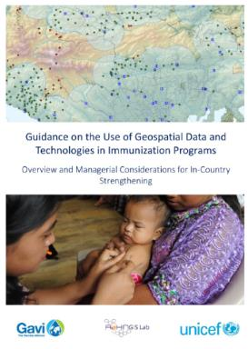
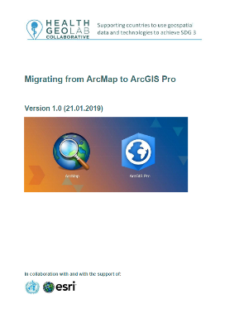
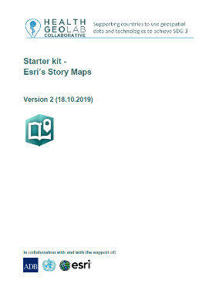

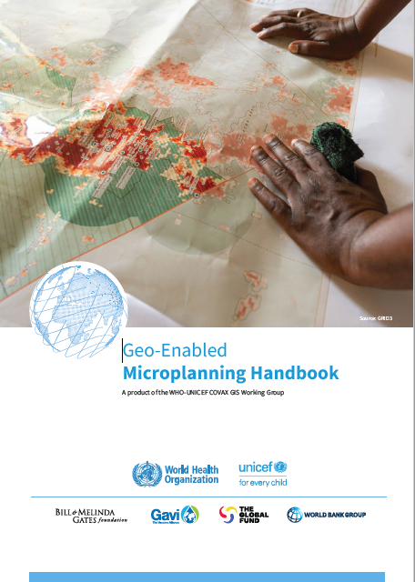
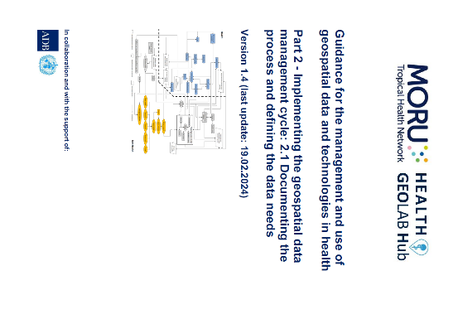
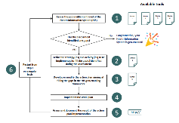
What we do – Tooling and knowledge sharing
Developing, testing and using tools
Exchanging knowledge and experiences
AccessMod
Common Geo-Registry (CGR)
Knowledge repository (126)
COVID-19 resources (184)
Boundaries widget
https://healthgeolab.net/hub/resources/knowledge-repositories/
Develop and share reference material
HIS geo-enabling toolkit
Guidance
Starter kits
https://healthgeolab.net/resources/reference-materials/
Free resources

Slide 9
What we do – AccessMod
2002: Start of the activity in the context of cost-effectiveness analysis (WHO)
2003: Need to develop an automated module. First results obtained through the application of the extension developed for ArcView
2004: Decision on the name for the extension: AccessMod. Release of the first set of versions (ArcView 3.2) and first publication (ESRI health user conference)
2005: Release of version 2.1 (isotropic version, ArcView 3.2)
2008: Release of version 3.0 (anisotropic version, ArcView 3.2)
2012: Release of version 4.0 (extension to ArcGIS)
2017: Release of version 5.0 (stand alone version)
2023: Version 5.8.1 (current version)
21 years of development and use!

Slide 10
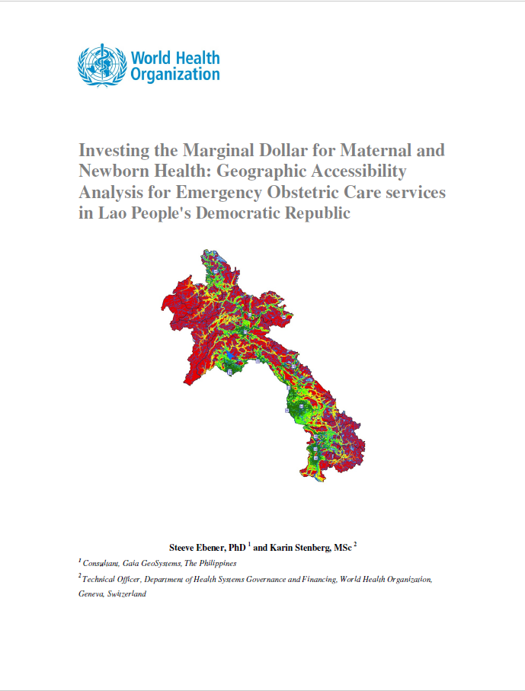
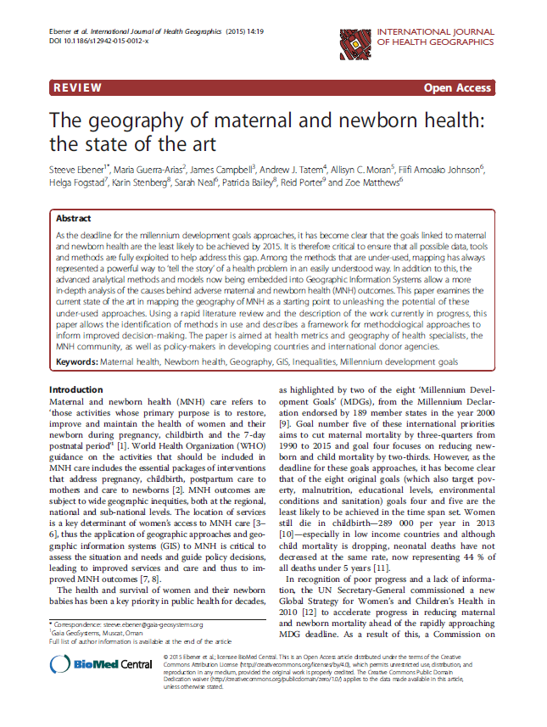
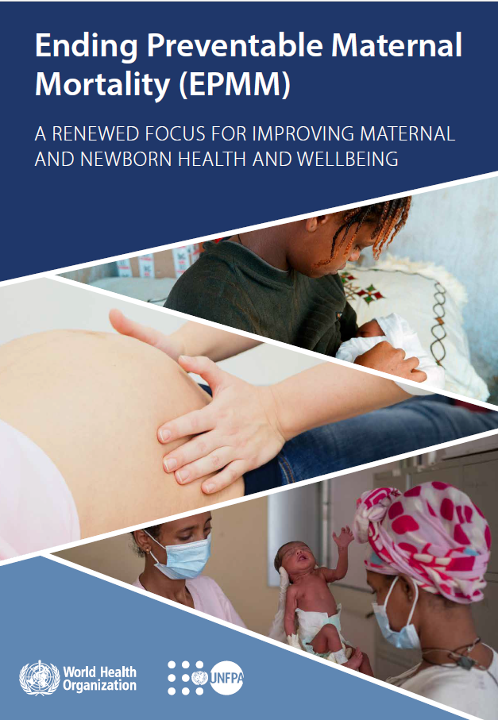
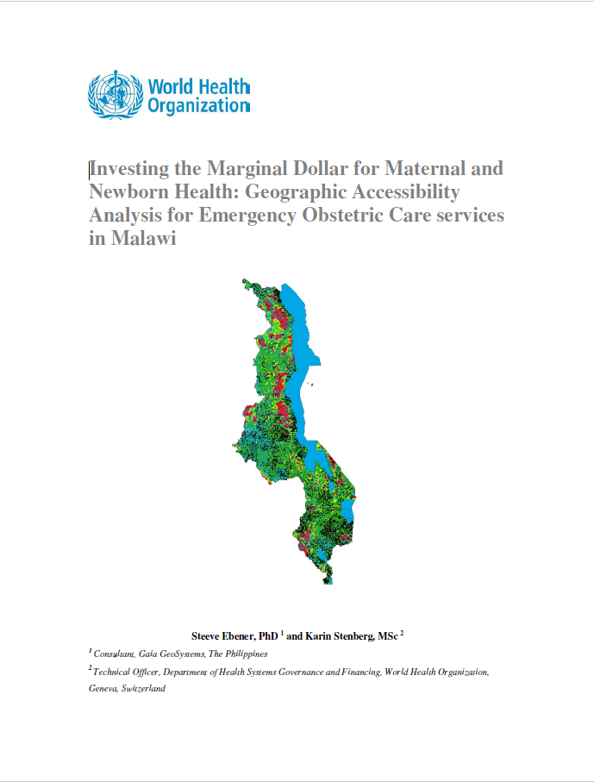

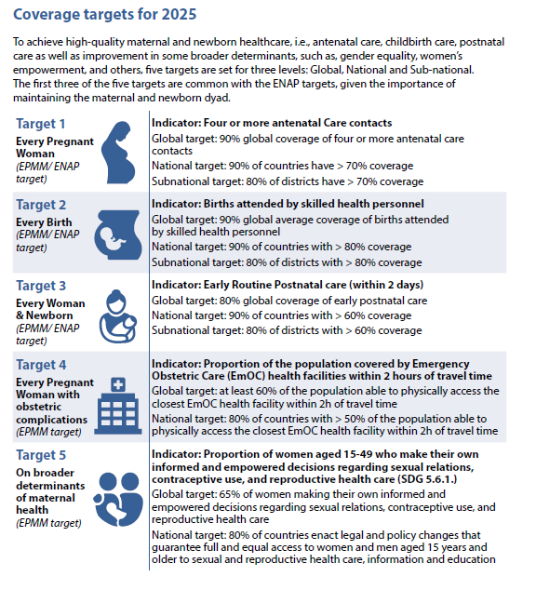
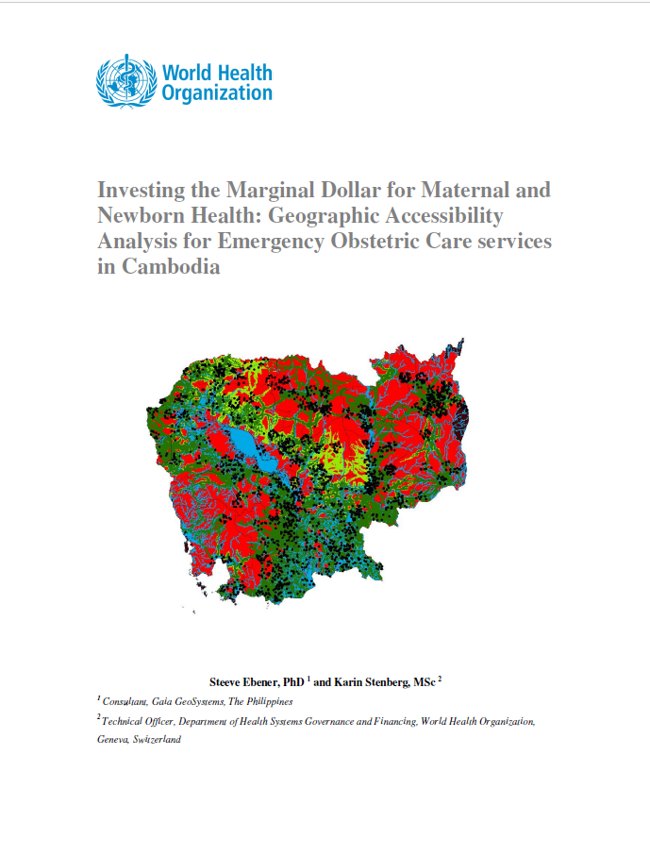
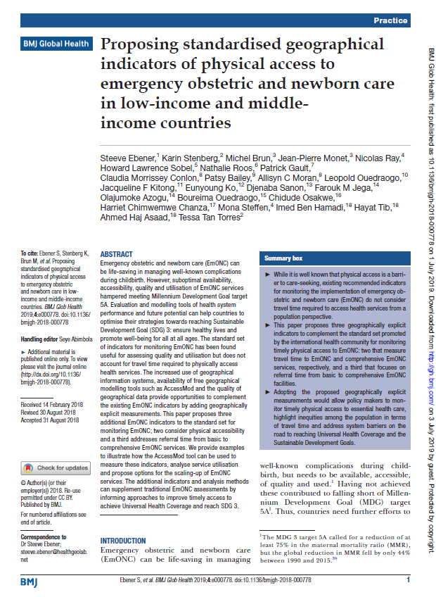
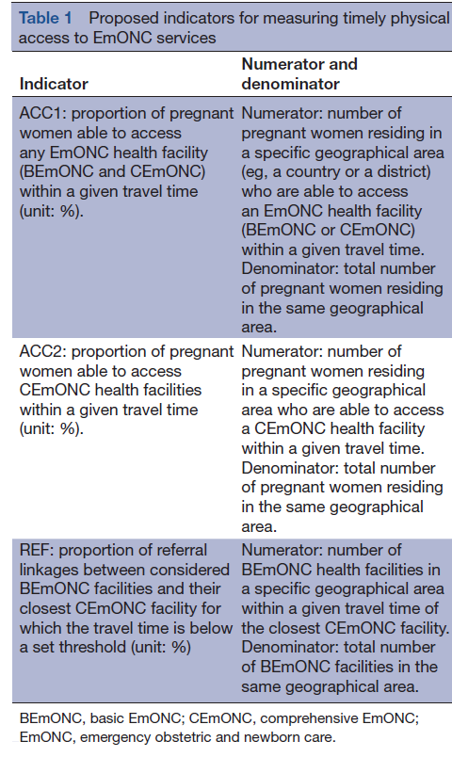
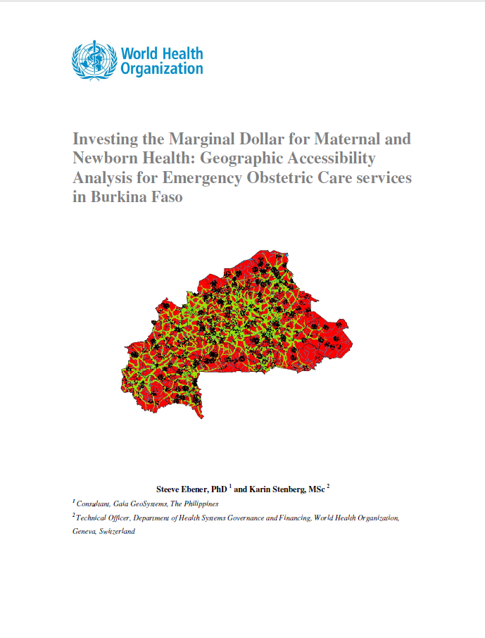
What we do – AccessMod
2015
1
2019
2
2021
5
2020
4
2019
3
Proportion of population within 2 hours' commute time of the nearest SONU functional health facility
Geospatial analysis in support of policy formulation
https://www.accessmod.org/
https://ij-healthgeographics.biomedcentral.com/articles/10.1186/s12942-015-0012-x
https://gh.bmj.com/content/4/Suppl_5/e000778.info
https://www.unfpa.org/featured-publication/implementation-manual-developing-national-network-maternity-units
https://www.who.int/publications/i/item/9789240040519

Slide 11
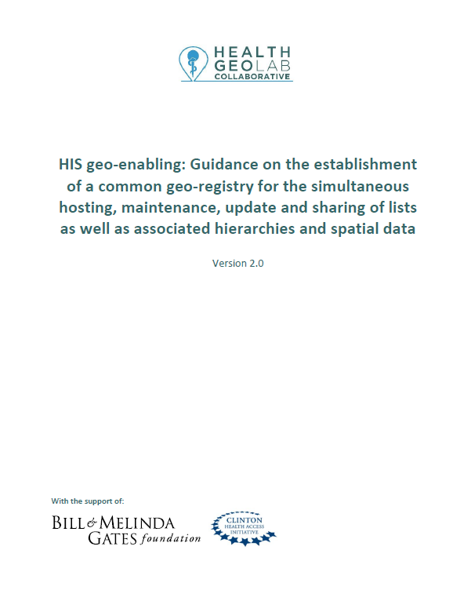
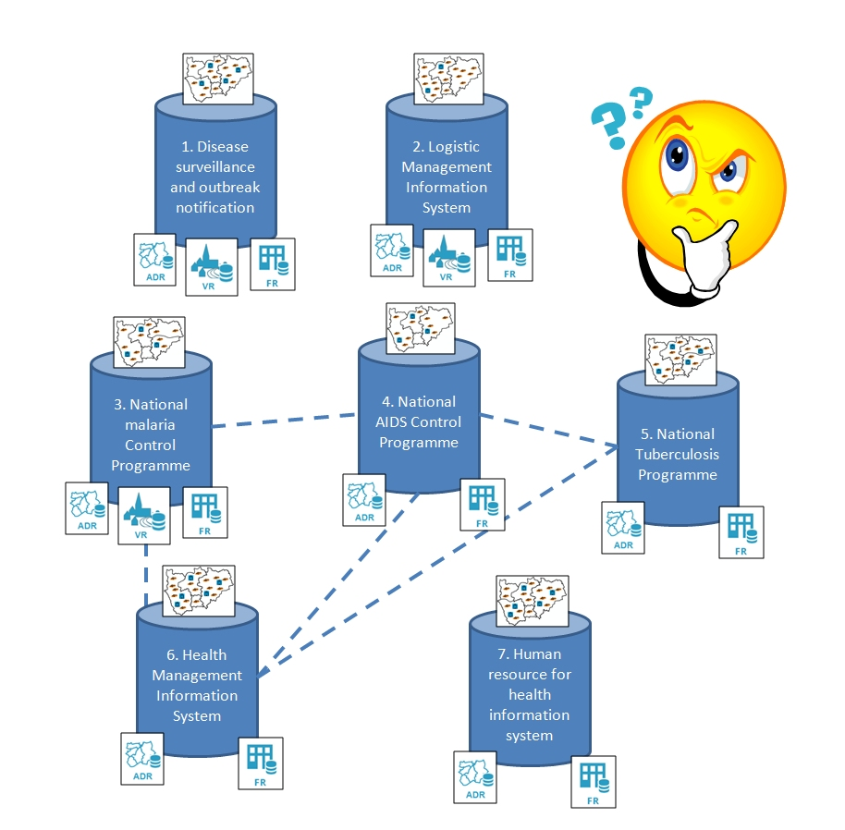
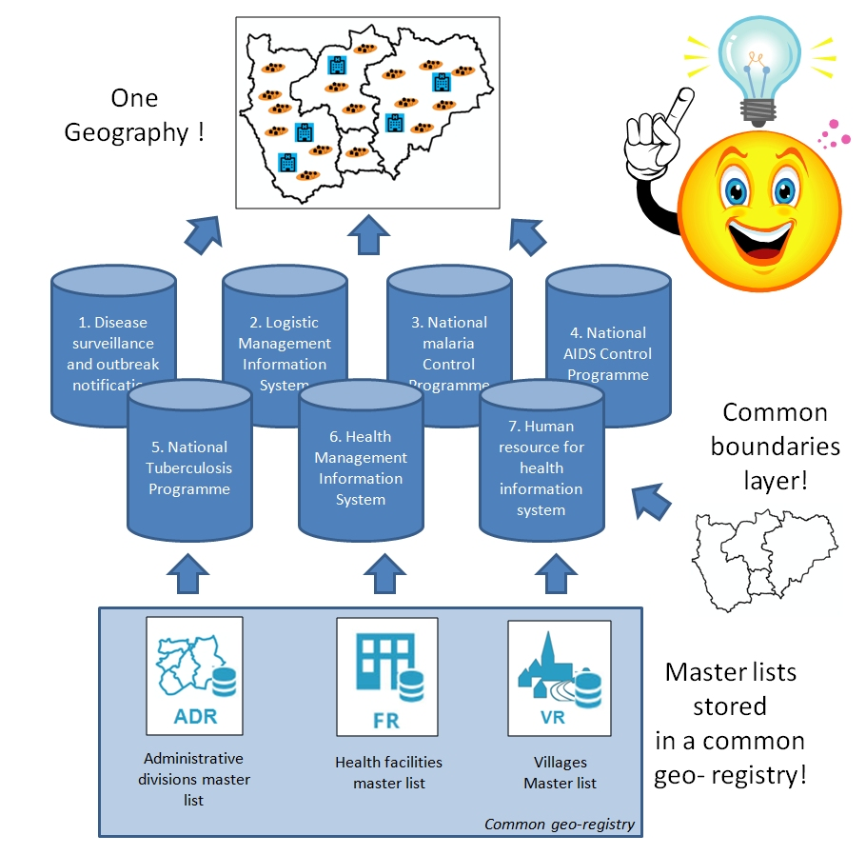
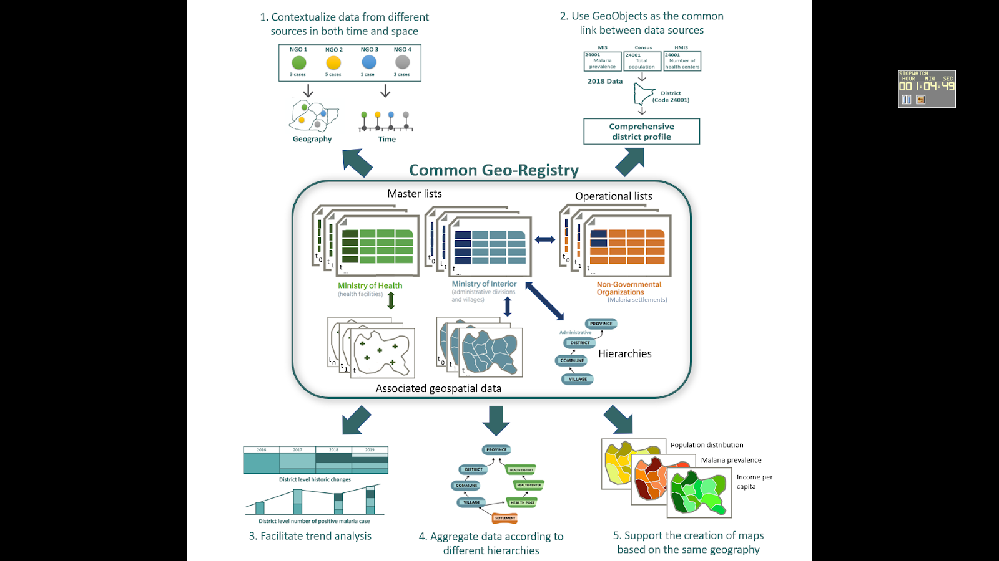
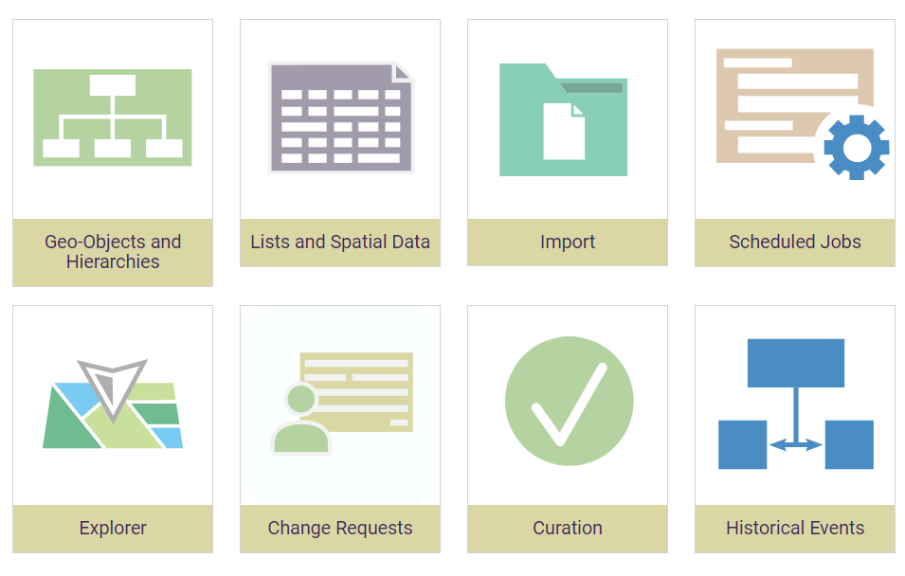
Common Geo-registry Concept/GeoPrism Registry platform
Passing from this…
…to this
https://healthgeolab.net/DOCUMENTS/Guidance_Common_Geo-registry_Ve2.pdf
Common Geo-Registry
Hierarchy
Geospatial data
Each information system is using a different geography, maintaining each geography separately is not cost-effective and this situation does not allow benefiting from the power of geography, geospatial data and geospatial technologies
All the information systems use the same geography which does not only reduce duplication of efforts and cost but also allows to fully benefit from the power of geography, geospatial data and geospatial technologies
GeoPrism Registry
https://demo-georegistry.geoprism.net/cgr/manage#/login
11

Slide 12

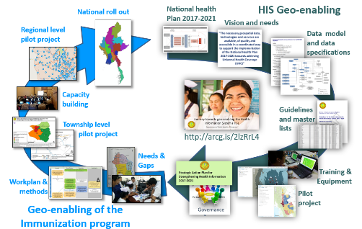





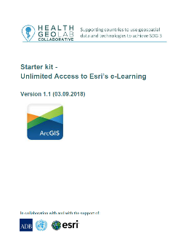
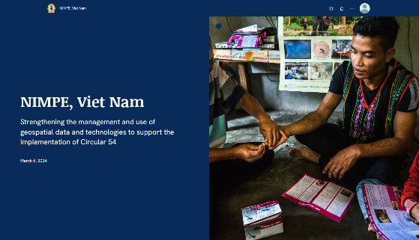
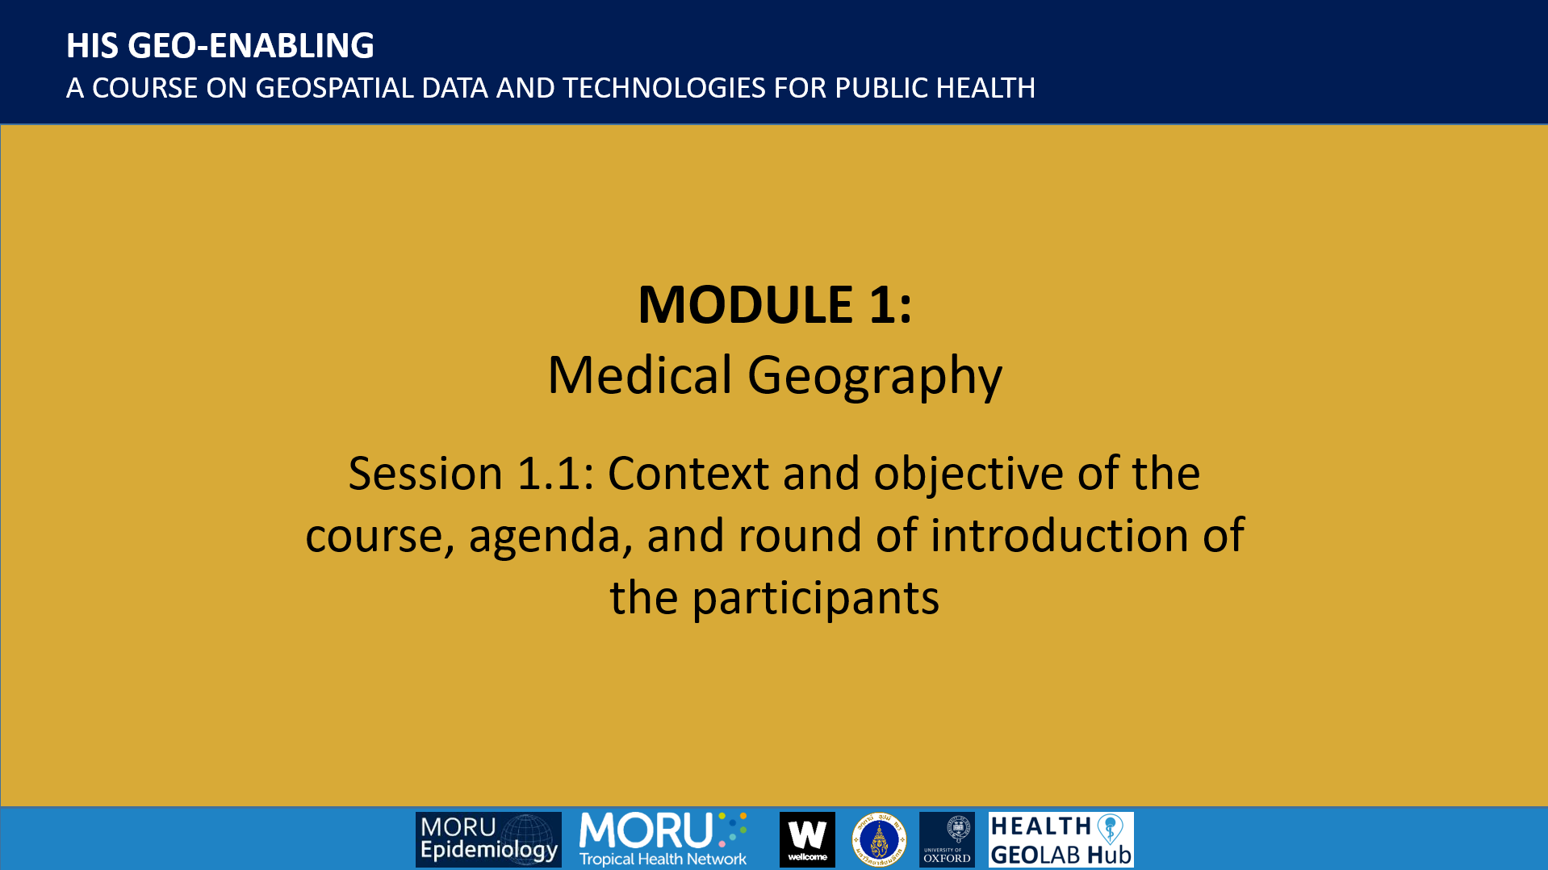
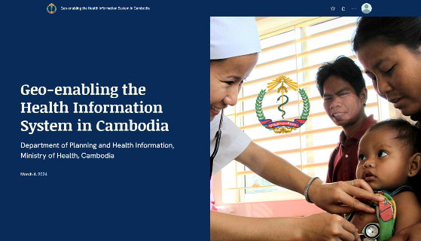
What we do – Technical capacity strengthening
Training countries on how to implement the whole process, not only on how to use the technology
Country level training
Cambodia
Myanmar
https://arcg.is/OCHOz
Vietnam
Philippines
https://healthgeolab.net/resources/workshops_trainings/
Esri e-learning resources
Documented implementations
Schools of public health
https://arcg.is/1XmLjy
Vietnam
https://arcg.is/0uviGj
Cambodia
https://healthgeolab.net/resources/reference-materials/
https://healthgeolab.net/resources/his-geo-enabling-course/
Free resources

Slide 13
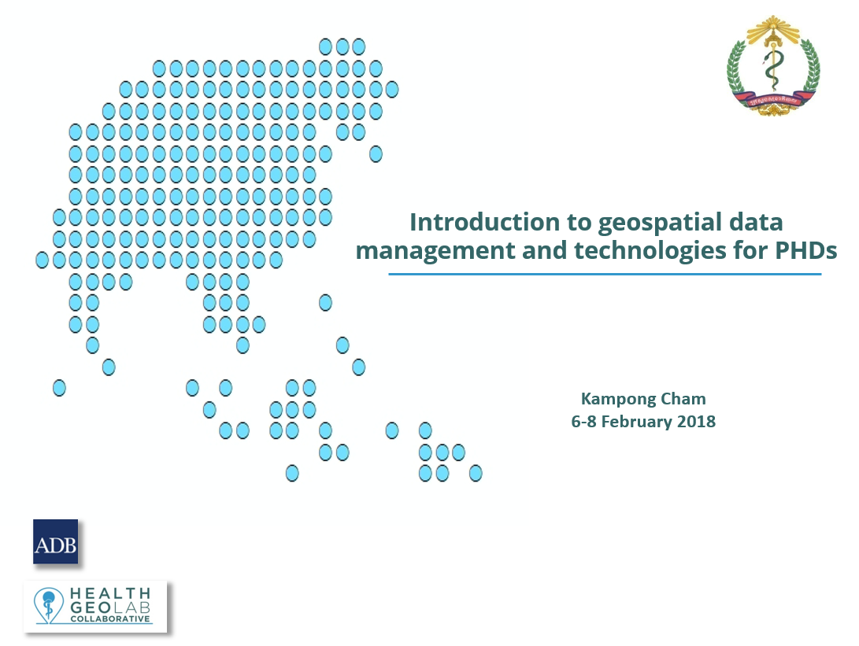

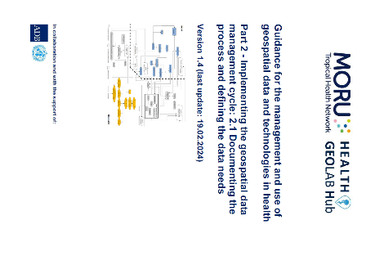
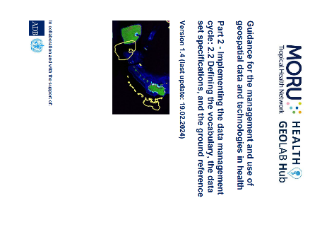

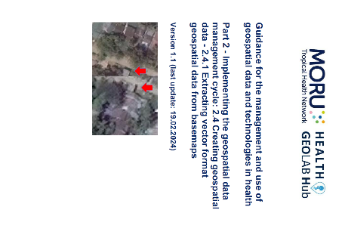
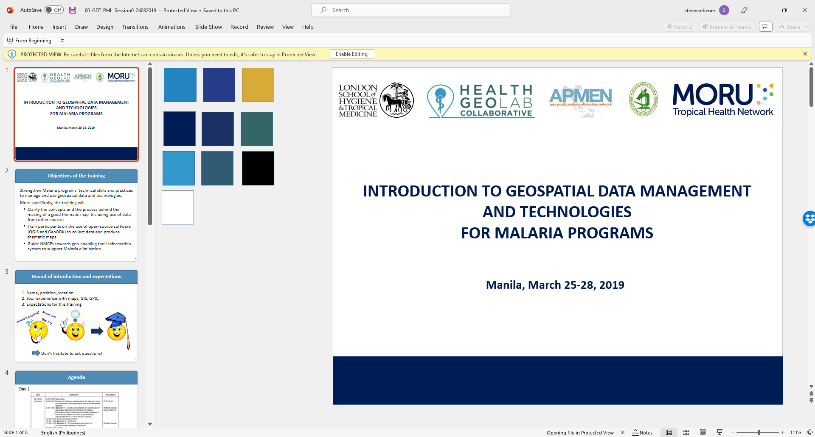
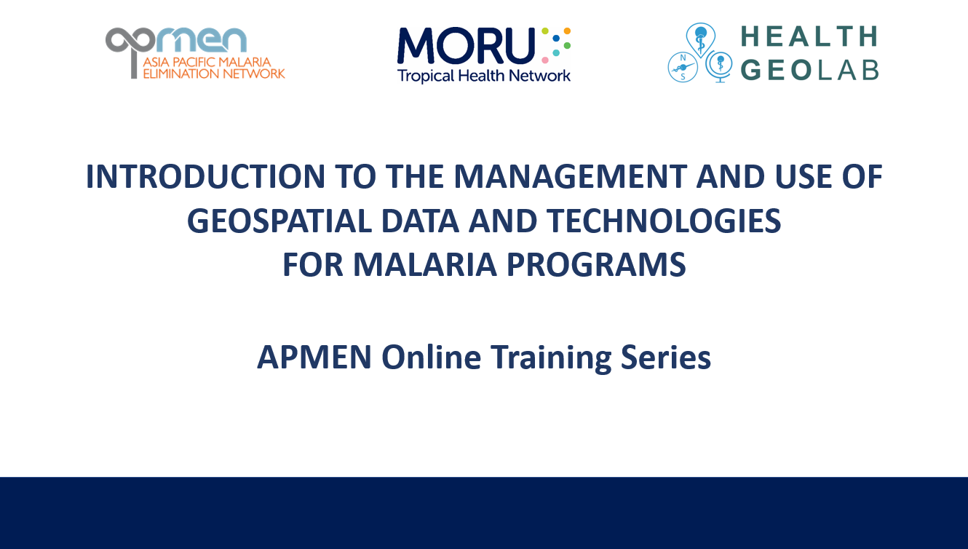
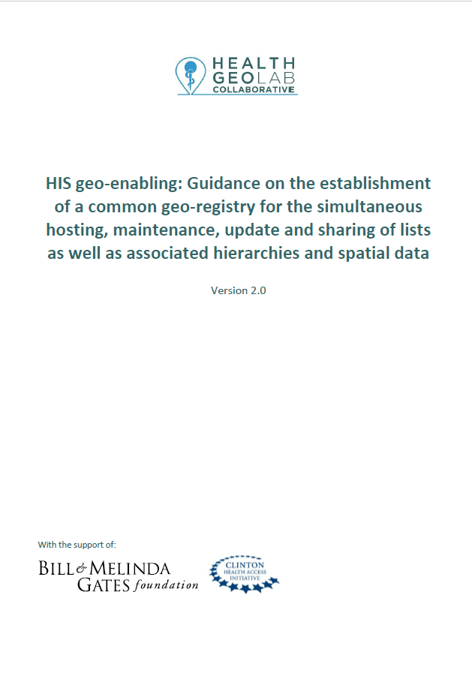
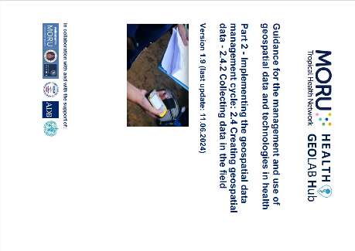

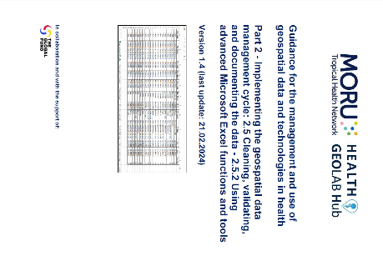
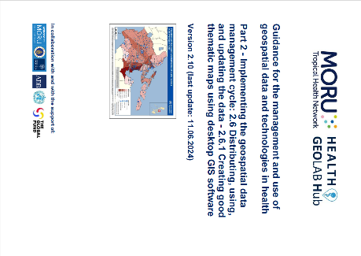


Additional useful tools – Reference to Health GeoLab’s free resources
Guidance material
Training material
https://healthgeolab.net/resources/reference-materials/
https://healthgeolab.net/hub/resources/training-materials/

Slide 14






Management and use of geospatial data and technologies
for Malaria Programs
An Online Training Series conducted in collaboration with the Asia Pacific Malaria Elimination Network (APMEN) to strengthen countries’ Malaria programs’ technical skills and practices to manage and use geospatial data and technologies
An APMEN TechTalks webinar episode discussing the concepts and the process behind the use of geo-spatial data and technologies for improving physical accessibility to malaria services.

Slide 15





HIS geo-enabling technical support to French-speaking African countries
Activity supported by the Global Fund and implemented in collaboration with the University of Geneva and the University Amadou Mahtar MBOW (UAM) of Dakar to help countries geo-enable their Health Information System (HIS)
Pre-workshop survey to assess the current level of geo-enablement across Malaria, TB and HIV programs as well as the unit in charge of the Health Information System (HIS)
Workshop (Saly – Senegal, 6-10 November 2023) attended by 55 participants from 11 countries to take them through the HIS geo-enabling concept and process, finalize the assessment and strengthen their technical capacity
Post-workshop technical support provided to 10 countries to help them develop an action plan aiming at filling the gaps identified during the assessment

Slide 16







Mongolia - HIS Geo-enabling
Pilot project supported by UNICEF and implemented locally by the Center for Policy Research and Analysis (CPRA) of Ulaanbaatar City with the objectives to:
  Illustrate the benefits of the geo-enablement
  Continue strengthening the technical capacity of the health sector when it comes to the management and use of geospatial data and technologies
  Establish the necessary institutional framework to sustain the geo-enablement beyond the pilot project
Governance: Proposed Technical Working Group TORs
Data specifications, standards, SOPs: Geospatial data management guidelines
Core datasets: Health Facility Master List (HFML) Core components (definition, data dictionary, classification tables,…)
Technical capacity: Training at the central and subnational level
Use cases: Pilot project to demonstrate the benefits of the geo-enablement
Sustainability: Engagement with the Mongolian National University of Medical Sciences (MNMUS)
“A building or physical structure providing health care”
  Immunization: Conversion of the current immunization sketch map into a GIS-based one
  Environmental health: A
    Air pollution and respiratory diseases
    Ground water quality and impact on child health
  Planning: Physical accessibility to a specific type of health service (service still to be defined)
  Emergency management: Exposure to seismic hazard (population, health facilities and schools)

