Slide 1
Session 2.3: The HIS Geo-enabling Framework: Implementation
Notes:
MODULE 2: GEO-ENABLING THE HEALTH INFORMATION SYSTEM (HIS)
Session 2.3: The HIS Geo-enabling Framework: Implementation
The nine elements of the HIS geo-enabling framework and the benchmarks that need to reached for each of the elements have been described and discussed in the previous session.
In this session, we will discuss how to implement the HIS geo-enabling framework.
To better understand this session, you are encouraged to read the HIS Geo-enabling Toolkit: http://www.healthgeolab.net/DOCUMENTS/HIS_geo-enabling_toolkit.pdf

Slide 2
Key terms used in this session
Action plan: Document describing in great detail exactly how strategies will be implemented to accomplish the objectives that have been set
After action review (AAR): A knowledge management tool that is being applied during or after the implementation of a project to assess what happened and learn from this
Geo-enable: Apply geospatial capabilities to a business process in order to establish the authoritative spatial location of business data, and enable contextual spatial analysis
Geo-enabled HIS: An Information System that fully benefits from the power of geography, geospatial data and technologies through the proper integration of geography and time across its business processes
Notes:
Here are some key terms that are used in this session.

Slide 3
Key terms used in this session
Health Information Systems: A system that integrates data collection, processing, reporting, and use of the information necessary for improving health service effectiveness and efficiency through better management at all levels of health services. HIS is a much broader term than HMIS and includes HMIS, Patient Management Registration System (PMRS), Logistics Management Information System (LMIS), Human Resources Information System (HRIS), Financial Management System (FMS), etc.
Strategy: Approach that will be used to reach the objectives that have been defined
Vision: Vivid picture of where you want to be in the future
Notes:
Here are some key terms that are used in this session.

Slide 4
HIS Geo-enabling - Implementation
Reaching the HIS geo-enabling framework benchmarks is done by following a simple 6-step process:
Step 1: Assess the level of geo-enablement of the health information system
Step 2: Define the strategy(ies) and activity(ies) to be implemented to fill the gap(s) identified during the assessment
Step 3: Develop or modify the action plan aiming at geo-enabling the HIS
Step 4: Implement the action plan
Step 5: Assess and document the result of the action plan implementation
Step 6: Restart from step 1 on a regular basis
http://www.healthgeolab.net/DOCUMENTS/HIS_geo-enabling_toolkit.pdf
Notes:
The implementation of the HIS geo-enabling framework is done by follwing a simple 6-step process.
What are these steps?
(Refer to slide)
These steps are explained in detail in the Health GeoLab Collaborative document: HIS Geo-enabling toolkit: http://www.healthgeolab.net/DOCUMENTS/HIS_geo-enabling_toolkit.pdf

Slide 5
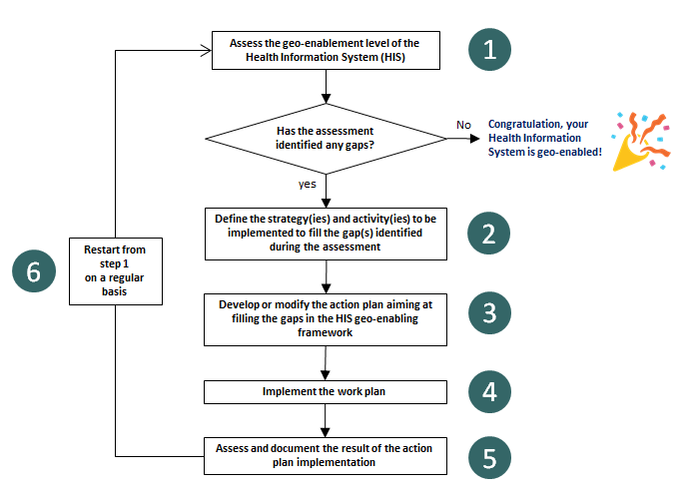
HIS Geo-enabling - Implementation
In-country HIS geo-enabling framework implementation process
Notes:
This workflow represents the 6 steps (shown in the previous slide) of the in-country HIS geo-enabling framework implementation process.
Note that the implementation is a cycle with the need to re-start from step 1 done every once in a while to ensure that the HIS is still geo-enabled. This is to take into account the changes that may have happened after the first full assessment cycle has been done.

Slide 6
HIS Geo-enabling - Implementation
Step 1: Assess the level of geo-enablement of the health information system
Notes:
Step 1: Assess the level of geo-enablement of the health information system

Slide 7
HIS Geo-enabling - Implementation
Step 1: Assess the level of geo-enablement of the health information system
Objective: Identify potential gaps across the 9 elements of the HIS geo-enabling framework
Expected deliverable: A report giving the picture of the current situation with the list of the gaps
Estimated duration of implementation: 1 week
Amount of resources needed: Limited
Person to be involved: Head of the geospatial data management and technology unit if any, representatives from key health programs (health information system, communicable diseases, planning, emergency management, and immunization), development partners, external facilitator
Notes:
Step 1: Assess the level of geo-enablement of the health information system
Quick overview
(Refer to slide)

Slide 8
HIS Geo-enabling - Implementation
Step 1: Assess the level of geo-enablement of the health information system
Supporting tools:
a. HIS geo-enabling benchmarks
b. Quick assessment questionnaire
c. Additional information and documents to be collected in complement to the quick assessment questionnaire
d. Resources illustrating the first 7 elements of the HIS geo-enabling framework
Notes:
Step 1: Assess the level of geo-enablement of the health information system
Quick overview
(Refer to slide)

Slide 9
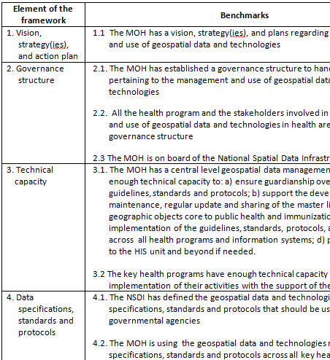
HIS Geo-enabling - Implementation
Step 1: Assess the level of geo-enablement of the health information system
This step is done to assess the level of geo-enablement of the HIS to have a clear picture of the gaps that exist against the benchmarks to be reached for the HIS to be considered as geo-enabled.
The quick geo-enabling assessment questionnaire is used to facilitate this exercise.
If the result of the assessment shows that no gap exists, it means that the HIS is already geo-enabled!
Notes:
Step 1: Assess the level of geo-enablement of the health information system
The HIS geo-enabling benchmarks is Annex 1 of the HIS Geo-enabling toolkit.
Assessing the level of geo-enablement of the HIS is the foundation of the overall HIS geo-enabling process. This should be done with the utmost care and level of details, especially if it is being conducted for the first time.
If the HIS geo-enablement is implemented without first doing the assessment, it may result in wrong assumptions and therefore loss of time and resources.

Slide 10
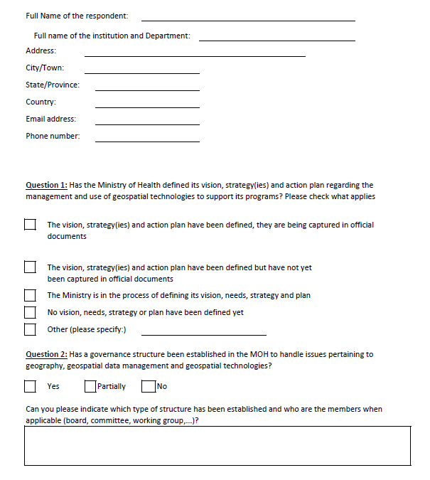
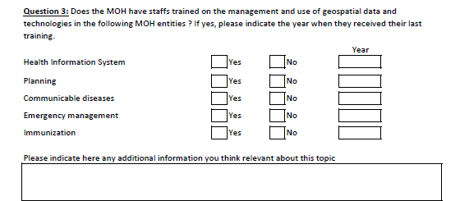
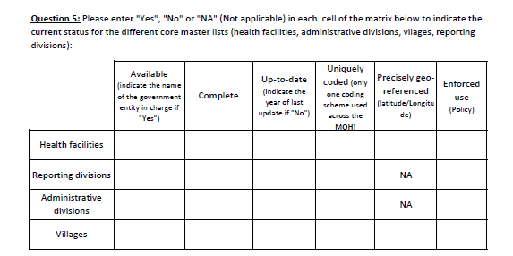
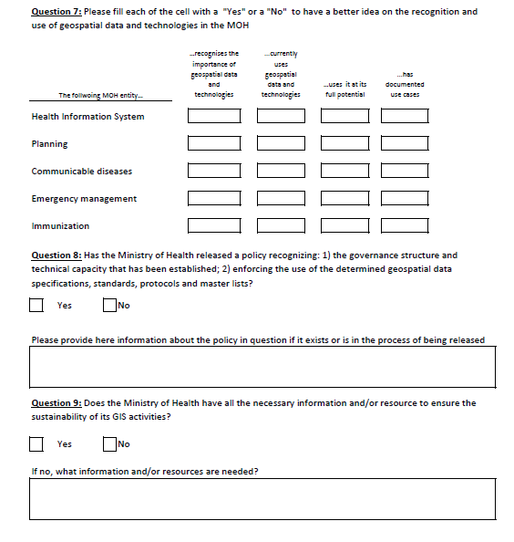
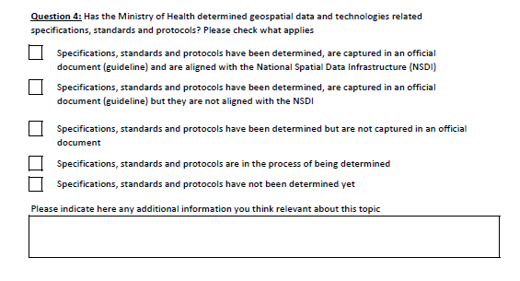
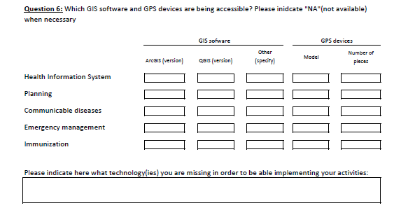
HIS Geo-enabling - Implementation
Step 1: Assess the level of geo-enablement of the health information system
HIS geo-enabling quick assessment tool
The questionnaire is organized according to the 9 elements of the HIS geo-enabling framework
Notes:
Step 1: Assess the level of geo-enablement of the health information system
The HIS geo-enabling quick assessment tool is Annex 2 of the HIS Geo-enabling toolkit.
The quick geo-enabling assessment tool has been developed to help in the assessment of level of geo-enablement of the HIS. It is a modified checklist of the 9 elements of the HIS geo-enabling framework.

Slide 11
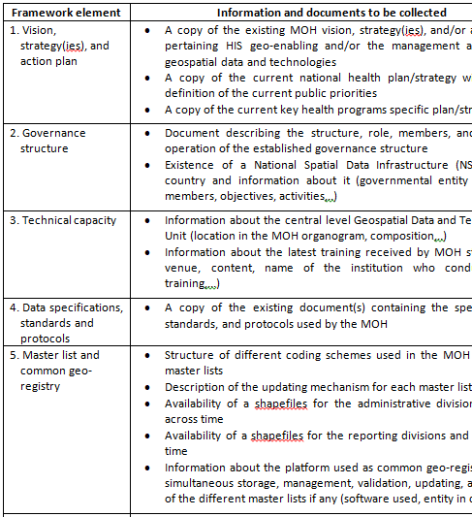
HIS Geo-enabling - Implementation
Step 1: Assess the level of geo-enablement of the health information system
The information and documents listed in Annex 3 of the HIS Geo-enabling Toolkit should be collected to have a complete picture of the situation.
Notes:
Step 1: Assess the level of geo-enablement of the health information system
What information and documents should be collected when conducting the assessment?
The information and documents are listed in Annex 3 of the HIS Geo-enabling Toolkit.
All the listed information and documents should be collected as completely as possible to support the result of the assessment.

Slide 12
HIS Geo-enabling - Implementation
Step 1: Assess the level of geo-enablement of the health information system
The assessment should at least cover the following Key Health Programs (KHPs) as being the main providers and potential users of geospatial data and technologies:
Health Information System (HIS): Natural guardian of the national level geospatial data management and technologies unit.
Planning: Physical accessibility to health care is an important component of Universal Health Coverage (UHC) which depends on the spatial distribution of the population in need, the spatial distribution of services that are being provided, and the environment that the patients have to cross to reach them.
Notes:
Step 1: Assess the level of geo-enablement of the health information system
The Key Health Programs (KHPs) that should at least be covered by the assessment:
Health Information System (HIS)
Planning
(Continued on next slide)

Slide 13
HIS Geo-enabling - Implementation
Step 1: Assess the level of geo-enablement of the health information system
Communicable diseases: Being able to contextualize cases in both time and space is key to surveillance, monitoring, and elimination of communicable diseases.
Immunization: Base microplanning maps are essential to ensure that all the targeted population is covered during an immunization campaign.
Emergency management: Geospatial data and technologies are critical instruments across the whole emergency management cycle (mitigation/preparedness, response, recovery).
Notes:
Step 1: Assess the level of geo-enablement of the health information system
The Key Health Programs (KHPs) that should at least be covered by the assessment:
Communicable diseases
Immunization
Emergency management

Slide 14
HIS Geo-enabling - Implementation
Step 1: Assess the level of geo-enablement of the health information system
The assessment can be done by either:
The MOHS itself (self-assessment) or
Outside facilitator
The person facilitating the assessment should have already conducted an internet search to collect as many information as possible prior to the on-site visit
Saves time and provides background information that can be used during interviews
Notes:
Step 1: Assess the level of geo-enablement of the health information system
Who should conduct the assessment?

Slide 15
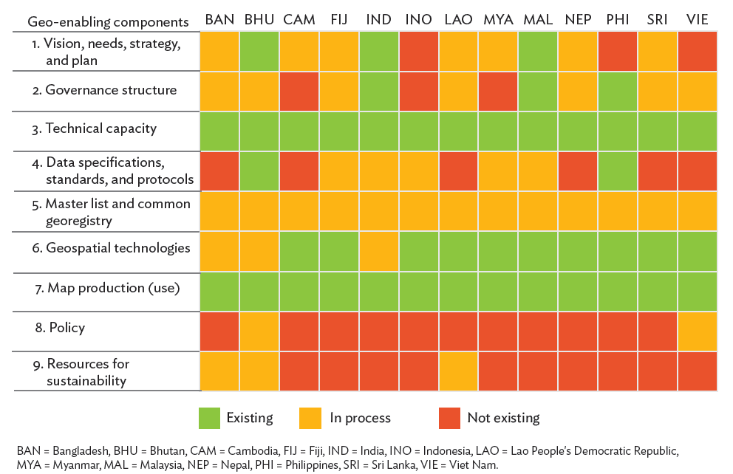
HIS Geo-enabling - Implementation
Step 1: Assess the level of geo-enablement of the health information system
The product resulting from the assessment will be a report describing the current strengths, gaps, and opportunities for each of the 9 elements of the HIS geo-enabling framework.
Can be complemented by a visual that is useful when comparing the result of the assessment between different health programs or countries (example below)
Notes:
Step 1: Assess the level of geo-enablement of the health information system
How should the resulting product of the assessment be presented?

Slide 16
HIS Geo-enabling - Implementation
Step 2: Define the strategies and activities to be implemented to fill the gap(s) identified during the assessment
Notes:
Step 2: Define the strategies and activities to be implemented to fill the gap(s) identified during the assessment

Slide 17
HIS Geo-enabling - Implementation
Step 2: Define the strategies and activities to be implemented to fill the gap(s) identified during the assessment
Objective: Define a strategy and activities for each of the gaps identified during the assessment
Expected deliverable: A document defining the strategies to be followed and associated activities to be conducted in order to address the gap(s) identified during the assessment
Estimated duration of implementation: up to 1 week
Amount of resources needed: Limited
Notes:
Step 2: Define the strategies and activities to be implemented to fill the gap(s) identified during the assessment
Quick overview
(Refer to slide)

Slide 18
HIS Geo-enabling - Implementation
Step 2: Define the strategies and activities to be implemented to fill the gap(s) identified during the assessment
Person to be involved: Head of the geospatial data management and technology unit if any, representatives from key health programs (health information system, communicable diseases, planning, emergency management, and immunization), development partners, external facilitator
Supporting tools:
a. Non exhaustive list of strategies, recommended stakeholders to be involved, and level of implementation for activities aiming at filling the identified gap(s)
Notes:
Step 2: Define the strategies and activities to be implemented to fill the gap(s) identified during the assessment
Quick overview
(Refer to slide)

Slide 19
HIS Geo-enabling - Implementation
Step 2: Define the strategies and activities to be implemented to fill the gap(s) identified during the assessment
This step consists of identifying a strategy and associated activities to fill each of the gaps identified as a result of the assessment conducted in the previous step.
At the end of this second step, the Ministry of Health should have clear strategies and activities to be able to develop a plan of action (Step 3).
Notes:
Step 2: Define the strategies and activities to be implemented to fill the gap(s) identified during the assessment
What does Step 2 entail?
What should the MOH have after they finish this step?

Slide 20
HIS Geo-enabling - Implementation
Step 2: Define the strategies and activities to be implemented to fill the gap(s) identified during the assessment
Annex 5 of the HIS Geo-enabling Toolkit has been designed to support this exercise and is organized as follows:
A list of potential gaps identified during the assessment are provided for each of the framework element
A strategy, or set of strategies, are proposed for each of the identified gap
The minimum list of stakeholders to be involved as well as the level of implementation for the activities to be conducted are then recommended
The list is non-exhaustive but should contain the major gaps that could be expected.
Notes:
Step 2: Define the strategies and activities to be implemented to fill the gap(s) identified during the assessment
(Present Annex 5 of the HIS Geo-enabling Toolkit)
How can this document help in this step of the process?

Slide 21
HIS Geo-enabling - Implementation
Step 2: Define the strategies and activities to be implemented to fill the gap(s) identified during the assessment
The details of the activities to be conducted in order to implement the strategies depend on the context in which they are being implemented.
The list on the right provides the common types of capacity building activities.
Notes:
Step 2: Define the strategies and activities to be implemented to fill the gap(s) identified during the assessment
The details of the activities to be conducted in order to implement the strategy(ies) are not provided in Annex 5 due to the different forms these activities can take depending on the context in which they are being implemented.
As a reference, the table on the right gives a list of common types of capacity building activities to be considered. Such activities will therefore have to be defined.

Slide 22
HIS Geo-enabling - Implementation
Step 2: Define the strategies and activities to be implemented to fill the gap(s) identified during the assessment
The HIS Geo-enabling Toolkit considers two levels of implementation:
National: Implemented national wide, starting with the central before the sub-national level for the former to serve as trainers for the latter
Pilot: Implemented on a limited part of the country's territory
Notes:
Step 2: Define the strategies and activities to be implemented to fill the gap(s) identified during the assessment
There are two levels of implementation considered in the HIS Geo-enabling Toolkit.
National: Implemented national wide, starting with the central before the sub-national level for the former to serve as trainers for the latter
Pilot: Implemented on a limited part of the country's territory

Slide 23
HIS Geo-enabling - Implementation
Step 2: Define the strategies and activities to be implemented to fill the gap(s) identified during the assessment
The level of implementation chosen will greatly depend on country-specific context and on the size of the gap versus the availability of resources (financial, human, and physical) and organizational support to fill such gap.
Notes:
Step 2: Define the strategies and activities to be implemented to fill the gap(s) identified during the assessment
How is the level of implementation chosen?

Slide 24
HIS Geo-enabling - Implementation
Step 2: Define the strategies and activities to be implemented to fill the gap(s) identified during the assessment
The product resulting from this step will be a report or a table providing a strategy together with a list of associated activities, including the list of involved stakeholders and level of implementation, for each of the gaps identified during the assessment (Step 1).
Notes:
Step 2: Define the strategies and activities to be implemented to fill the gap(s) identified during the assessment
What is the resulting product for this step?

Slide 25
HIS Geo-enabling - Implementation
Step 3: Develop or modify the action plan aiming at geo-enabling the HIS
Notes:
Step 3: Develop or modify the action plan aiming at geo-enabling the HIS

Slide 26
HIS Geo-enabling - Implementation
Step 3: Develop or modify the action plan aiming at geo-enabling the HIS
Objective: Develop or modify the action plan for the activities identified during step 2
Expected deliverable: HIS geo-enabling action plan
Estimated duration of implementation: 1 week
Amount of resources needed: Limited
Notes:
Step 3: Develop or modify the action plan aiming at geo-enabling the HIS
Quick overview
(Refer to slide)

Slide 27
HIS Geo-enabling - Implementation
Step 3: Develop or modify the action plan aiming at geo-enabling the HIS
Person to be involved: Head of the geospatial data management and technology unit if any, representatives from key health programs (health information system, communicable diseases, planning, emergency management, and immunization), development partners, external facilitator
Supporting tools:
a. Example of action plan
Notes:
Step 3: Develop or modify the action plan aiming at geo-enabling the HIS
Quick overview
(Refer to slide)

Slide 28
HIS Geo-enabling - Implementation
Step 3: Develop or modify the action plan aiming at geo-enabling the HIS
This step consists of organizing the strategies and activities identified during the previous step into an action plan in order to be implemented. Such action should at least contain:
The long term vision
The objectives
The gap(s), strategies, and activities defined during the previous steps of the HIS geo-enabling process
Notes:
Step 3: Develop or modify the action plan aiming at geo-enabling the HIS
What does Step 3 entail?

Slide 29
HIS Geo-enabling - Implementation
Step 3: Develop or modify the action plan aiming at geo-enabling the HIS
Such action should at least contain: (cont’d)
A timeline covering all the activities with the mention of:
The target group
The person/entity in charge of the activity
A detailed budget broken down by activity
An Evaluation and Monitoring plan schedule
At the end of this third step, the Ministry of Health should have a clear action plan containing all the information it needs for a successful implementation.
Notes:
Step 3: Develop or modify the action plan aiming at geo-enabling the HIS
What does Step 3 entail?
What should the MOH have after they finish this step?

Slide 30
HIS Geo-enabling - Implementation
Step 3: Develop or modify the action plan aiming at geo-enabling the HIS
The following should be taken into account when developing the action plan to ensure successful implementation and long-term sustainability:
Make sure that the action plan in general and the use cases in particular address public health priorities included in the National Health plan.
Build on already existing action plan(s) taking the results of the HIS geo-enabling assessment into account.
Think about the sustainability of the technical capacity or common assets developed during the implementation of the action plan.
Notes:
Step 3: Develop or modify the action plan aiming at geo-enabling the HIS
Things that should be taken into account when developing an action plan.

Slide 31
HIS Geo-enabling - Implementation
Step 3: Develop or modify the action plan aiming at geo-enabling the HIS
Be as inclusive as possible by engaging in the process not only the key health programs identified during the assessment but also development partners who might currently be supporting project with a geo-enabling component or interested in doing so.
Leverage local MOH champions who have understood the value of the geo-enablement and have a clear view on their needs for geospatial data and technologies.
Have at least one focal point officially nominated for each MOH entity and the partners involved in the implementation of the action plan.
Notes:
Step 3: Develop or modify the action plan aiming at geo-enabling the HIS
Things that should be taken into account when developing an action plan

Slide 32
HIS Geo-enabling - Implementation
Step 3: Develop or modify the action plan aiming at geo-enabling the HIS
Use local capacity (national consultant, universities, private companies,...) as much as possible, not only because this reduces costs but allows also a more close follow up on the implementation as well as helps in addressing potential language issues.
Prefer long term coaching to one-off training sessions.
Start by strengthening the central level before the sub national level in order for the central level to then serve as trainers and point of contact for the sub-national level.
Notes:
Step 3: Develop or modify the action plan aiming at geo-enabling the HIS
Things that should be taken into account when developing an action plan

Slide 33
HIS Geo-enabling - Implementation
Step 3: Develop or modify the action plan aiming at geo-enabling the HIS
Use the implementation of the use cases as the context to strengthen the technical capacity of the MOH.
Get the MOH Staff to do as much of the work as possible with the support of the national and international consultants. This will contribute to the strengthening of their technical capacity and to experience first-hand potential data and process related issues.
Notes:
Step 3: Develop or modify the action plan aiming at geo-enabling the HIS
Things that should be taken into account when developing an action plan

Slide 34
HIS Geo-enabling - Implementation
Step 3: Develop or modify the action plan aiming at geo-enabling the HIS
Don't be too ambitious at first even if the resources are available. Better cut the action plan into few phases if needed and go for a full scale implementation only once enough local capacity has been established at the central level. The implementation of a pilot project also has the advantage of giving a clearer picture on the activities, resources, time, etc. needed to expand the implementation to the whole country.
Don't implement action plan spanning further than 12 months (8 to 9 for a pilot project) in order to have the opportunity to regularly assess and adjust the plan if needed.
Notes:
Step 3: Develop or modify the action plan aiming at geo-enabling the HIS
Things that should be taken into account when developing an action plan

Slide 35
HIS Geo-enabling - Implementation
Step 3: Develop or modify the action plan aiming at geo-enabling the HIS
Anticipate unexpected delays in the implementation of the activities and try to come up with a timeline that would be flexible enough to absorb them as much as possible.
Notes:
Step 3: Develop or modify the action plan aiming at geo-enabling the HIS
Things that should be taken into account when developing an action plan

Slide 36
HIS Geo-enabling - Implementation
Step 3: Develop or modify the action plan aiming at geo-enabling the HIS
The product resulting from this step will be an action plan.
Consider presenting the final action plan in a tabular form which might make it easier to digest as opposed to a narrative report.
Notes:
Step 3: Develop or modify the action plan aiming at geo-enabling the HIS
What is the resulting product for this step?
An action plan in a tabular form presents the activities, timeline, responsible entity, budget, etc. in such a way that one can easily understand which columns contain what information.

Slide 37
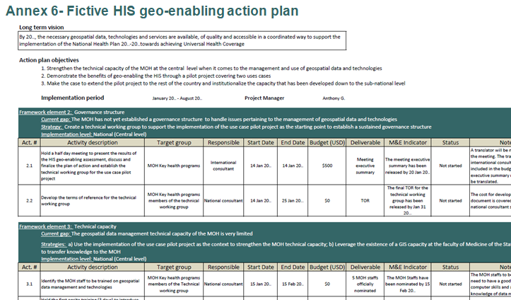
HIS Geo-enabling - Implementation
Step 3: Develop or modify the action plan aiming at geo-enabling the HIS
Take for example the fictive action plan in Annex 6 which was created for a fictitious country at the earliest stage of its HIS geo-enabling journey wherein important gaps have been identified during the assessment the need to demonstrate the benefits of the geo-enablement remains.
Still lacks a complete budget
Notes:
Step 3: Develop or modify the action plan aiming at geo-enabling the HIS
The example in Annex 6 of the toolkit presents such example of an action plan in tabular form.
Note that a complete budget is still missing from this fictive action plan.

Slide 38
HIS Geo-enabling - Implementation
Step 3: Develop or modify the action plan aiming at geo-enabling the HIS
The budget should cover the cost of activities reported in the action plan and other items such as:
Salary for the national and international consultants as well as field data collectors when it applies
Travel for the international, and in some cases, national consultant(s)
Allowance for the MOH staffs attending the meeting, workshops, and training if not located in the same city as well as for field data collectors when it applies
Required hardware and software and a good internet bandwidth at the MOH
Online common drive (Dropbox for example) for the sharing of data among the members of the technical working group
Notes:
Step 3: Develop or modify the action plan aiming at geo-enabling the HIS
When creating a budget for the action plan, these items should be taken into account.

Slide 39
HIS Geo-enabling - Implementation
Step 4: Implement the action plan
Notes:
Step 4: Implement the action plan

Slide 40
HIS Geo-enabling - Implementation
Step 4: Implement the action plan
Objective: Complete the activities defined in the action plan
Expected deliverable: Those listed in the action plan
Estimated duration of implementation: 9-12 months
Amount of resources needed: Limited to significant depending on the activities included in the action plan
Person to be involved: All the parties involved in the implementation of the action plan
Supporting tools: None for this step
Notes:
Step 4: Implement the action plan
Quick overview
(Refer to slide)

Slide 41
HIS Geo-enabling - Implementation
Step 4: Implement the action plan
This step consists of implementing the activities included in the action plan as long as the necessary resources are available.
If this is not the case, this step will first have to leverage the resources in question.
Notes:
Step 4: Implement the action plan
What does Step 4 entail?
One thing to consider once the action plan has been developed is whether resources are available for its implementation.
If this is not the case, the necessary resources will have to be leveraged first.
If the resources are already available, the action plan can already be implemented.

Slide 42
HIS Geo-enabling - Implementation
Step 4: Implement the action plan
The following are the important issues to be addressed before the implementation of the HIS geo-enabling action plan:
Make sure that all parties involved have a clear understanding of the action plan in general and of each of the activities it contains in particular.
Get a focal point to be officially nominated for each of the parties involved in the action plan implementation.
Develop and give access to a shared contact database for the focal and other key person from the ministry to facilitate communication.
Notes:
Step 4: Implement the action plan
These are the important issues to be addressed before the implementation of the HIS geo-enabling action plan

Slide 43
HIS Geo-enabling - Implementation
Step 4: Implement the action plan
Clearly define the roles and responsibilities of each involved parties (focal points, consultants, development partners,..). Develop terms of reference when necessary and ensure that someone is in charge of the specific activities to take place during the action plan implementation (see next set of bullet points).
Define the mode of communication between parties taking potential language issues into account. This is particularly important when parties are in different locations during the course of the implementation (international consultant for example).
Notes:
Step 4: Implement the action plan
These are the important issues to be addressed before the implementation of the HIS geo-enabling action plan

Slide 44
HIS Geo-enabling - Implementation
Step 4: Implement the action plan
Establish an online common working space (using Dropbox for example) to facilitate the sharing of files among the MOH staffs and the consultants.
Notes:
Step 4: Implement the action plan
These are the important issues to be addressed before the implementation of the HIS geo-enabling action plan

Slide 45
HIS Geo-enabling - Implementation
Step 4: Implement the action plan
During implementation itself, it is important to:
Keep track of the action plan implementation
Manage the financial resources
Manage potential risks
Ensure a proper flow of communication among the involved parties
Notes:
Step 4: Implement the action plan
During the implementation itself, it is important to:
• Keep track of the action plan implementation: This is to ensure that the implementation remains on track based on the establish timeline and that the activities do not go outside the approved scope of the action plan.
• Manage the financial resources: Independently from specific actions required by the development agencies funding the implementation of the action plan, it is crucial for someone to keep track of the overall flow of financial resources.
• Manage potential risks: Internal or external events may occur during the implementation of the action plan and could threaten its success. It is therefore important to be able to identify risks as early as possible. Once identified, the risks need to be qualified according to their probability of occurrence and their impact on action plan objectives and action being taken to mitigate them.
• Ensure proper flow of communication among the involved parties. Regular on-site visits and teleconference in between these visits are important to keep all parties informed and address the previous items listed here.

Slide 46
HIS Geo-enabling - Implementation
Step 5: Document and assess the result of the action plan implementation
Notes:
Step 5: Document and assess the result of the action plan implementation

Slide 47
HIS Geo-enabling - Implementation
Step 5: Document and assess the result of the action plan implementation
Objective: Evaluate and showcase the result of the action plan implementation
Expected deliverable: Implementation report, marketing material, after action review
Estimated duration of implementation: 1 month
Amount of resources needed: Moderate
Person to be involved: All the parties involved in the implementation of the action plan
Notes:
Step 5: Document and assess the result of the action plan implementation
Quick overview
(Refer to slide)

Slide 48
HIS Geo-enabling - Implementation
Step 5: Document and assess the result of the action plan implementation
Supporting tools:
a. Example of story maps
b. After Action Review guides
Notes:
Step 5: Document and assess the result of the action plan implementation
Quick overview
(Refer to slide)

Slide 49
HIS Geo-enabling - Implementation
Step 5: Document and assess the result of the action plan implementation
This step consists of documenting and assessing the result of the action plan implementation.
Documenting the result of the action plan implementation serves as a justification of the work that has been accomplished and also as a marketing material to:
Demonstrate the benefit of the geo-enablement, especially in the context where the organization was not convinced in the first place.
Leverage resources to either ensure the sustainability of what has been established, support the extension of the pilot project to the whole country, or finance the next round of HIS geo-enabling activities.
Notes:
Step 5: Document and assess the result of the action plan implementation
What does Step 5 entail?
Why document the result of the action plan implementation?

Slide 50
HIS Geo-enabling - Implementation
Step 5: Document and assess the result of the action plan implementation
Donors or development agencies each have their own reporting requirement but it can be useful to complement such reports with visually appealing presentations.
One such option are story maps which offers dynamic maps and are accessible from any device with internet connection.
Story maps were used to document the HIS geo-enabling process in Myanmar and Cambodia.
Their story maps will be shown at the end of the session.
Notes:
Step 5: Document and assess the result of the action plan implementation
It is important to follow the requirement of each donor or development agencies when creating reports but one can also supplement such reports with visually appealing presentations that may also make it easier to understand the content of the report in one glance.
One such option are story maps which offers dynamic maps and are accessible from any device with internet connection.
Story maps have already been used in documenting the HIS geo-enabling process in Myanmar, Cambodia, and Vietnam. The story map of Myanmar has actually already been presented in a number of international conferences.
This story maps will be shown at the end of the session.

Slide 51
HIS Geo-enabling - Implementation
Step 5: Document and assess the result of the action plan implementation
Conducting an after action review is another activity that should take place after the implementation of the action plan.
All the parties involved in the implementation meet to answer a set of questions that allows discussing the successes and failures in an open way.
Notes:
Step 5: Document and assess the result of the action plan implementation
An after action review (AAR) is a knowledge management tool that is being applied during or after the implementation of a project to assess what happened and learn from this.

Slide 52
HIS Geo-enabling - Implementation
Step 5: Document and assess the result of the action plan implementation
Some short documents describing what an ARR is about and how to conduct one:
https://www.adb.org/sites/default/files/publication/27570/conducting-after-action-reviews.pdf
https://www.unicef.org/knowledge-exchange/files/After_Action_Review_production.pdf
https://www.cebma.org/wp-content/uploads/Guide-to-the-after_action_review.pdf
Notes:
Step 5: Document and assess the result of the action plan implementation
Some short documents describing what an ARR is about and how to conduct one.

Slide 53
HIS Geo-enabling - Implementation
Step 6: Restart from step 1 on a regular basis
Notes:
Step 6: Restart from step 1 on a regular basis

Slide 54
HIS Geo-enabling - Implementation
Step 6: Restart from step 1 on a regular basis
Objective: Ensure that the process to be implemented on a regular basis until the HIS has been geo-enabled
Expected deliverable: Start of a new cycle of the HIS geo-enabling process
Estimated duration of implementation: 1 day
Amount of resources needed: Limited
Person to be involved: Head of the geospatial data management and technology unit if any, representatives from key health programs (health information system, communicable diseases, planning, emergency management, and immunization), development partners
Supporting tools: None for this step
Notes:
Step 6: Restart from step 1 on a regular basis
Quick overview
(Refer to slide)

Slide 55
HIS Geo-enabling - Implementation
Step 6: Restart from step 1 on a regular basis
This step consists of repeatedly conducting the activities from step 1 to step 5 until the Health Information System is geo-enabled in a sustainable manner.
This step also takes into account that several elements are meant to change over time including public health priorities, geospatial technologies, or even the strategy that the government follows regarding information management.
It is important to regularly update the previous version of the assessment in order to have an updated picture of the geo-enablement level of the HIS and identify the gaps that remains.
Notes:
Step 6: Restart from step 1 on a regular basis
What does Step 6 entail?
As mentioned at the start, HIS geo-enabling framework implementation process is a cycle.
When the process is first implemented, it may take several rounds before the HIS is considered geo-enabled. After some time, the process will have to be re-started again to ensure that the HIS is still geo-enabled.
Why is it is important to regularly update the previous version of the assessment?

Slide 56
HIS Geo-enabling - Implementation
To date, this implementation of the HIS geo-enabling framework has been done in Myanmar, Cambodia, and partially in Vietnam.
Here are the links to their stories:
Myanmar: https://arcg.is/1KL18X0
Cambodia: https://arcg.is/1CmSeL
Vietnam: https://arcg.is/1L01Kq
Let’s have a look at them!
Notes:
Let’s have a look at the story maps!

