Slide 1
Session 2.2: Implementation of the
HIS Geo-enabling Framework

Slide 2
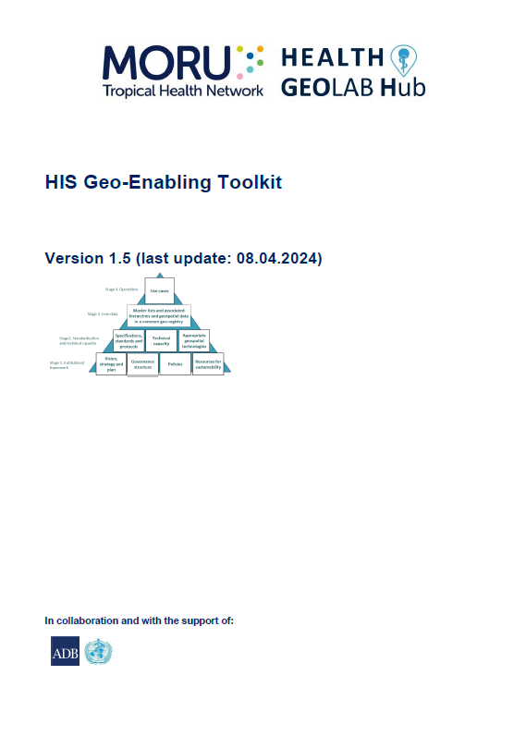
HIS Geo-enabling framework implementation process
To achieve the benchmarks of the HIS geo-enabling framework, it is necessary to follow a six-step process described in the HIS Geo-enabling Toolkit:
Step 1 : Assess the level of geo-enablement of the health information system
Step 2 : Define the strategy(ies) to be implemented to fill the gaps identified
during the assessment
Step 3 : Develop the action plan aiming at geo-enabling the HIS
Step 4 : Implement the action plan
Step 5 : Assess and document the result of the action plan implementation
Step 6 : Restart from step 1 on a regular basis
http://www.healthgeolab.net/DOCUMENTS/HIS_geo-enabling_toolkit.pdf

Slide 3
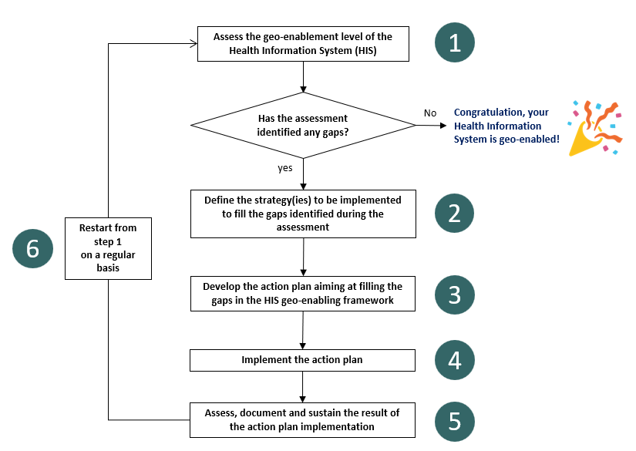
HIS Geo-enabling framework implementation process

Slide 4
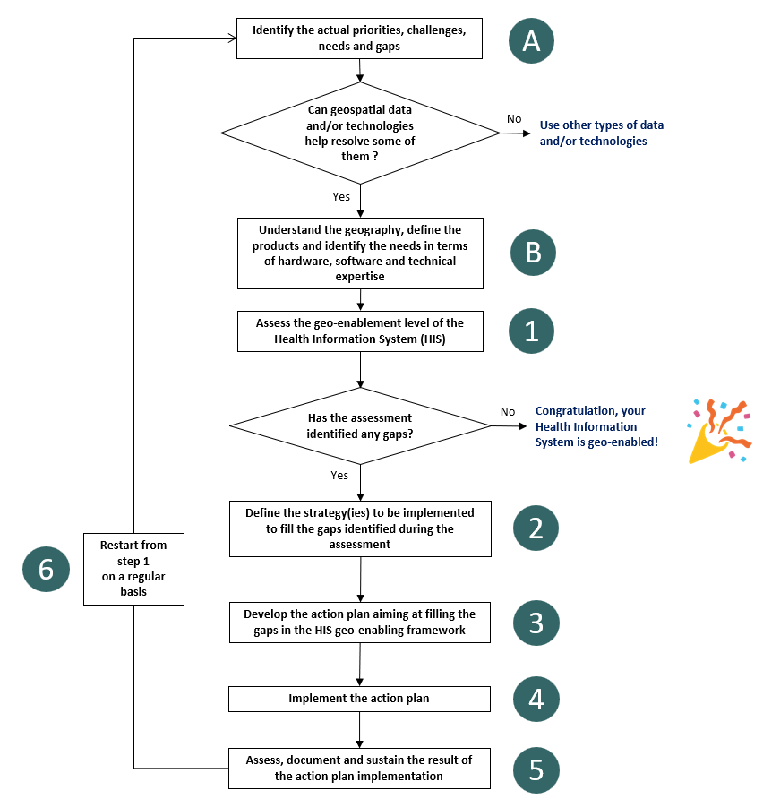
HIS Geo-enabling framework implementation process
When geo-enabling is specific to a health program or intervention
Additional preliminary steps specific to the program or intervention
Pre-workshop survey + Workshop sessions
The loop returns to the stage of determining priorities, needs, and gaps

Slide 5
HIS Geo-enabling framework implementation process
Step A : Identify the actual priorities, challenges, needs, and gaps

Slide 6



HIS Geo-enabling framework implementation process
Step A : Identify the actual priorities, challenges, needs, and gaps
Objective: Identify and document the actual priorities, challenges, and gaps that could be addressed using geospatial data and technologies
Expected deliverable: A list of priorities, challenges, needs and gaps that could be addressed using geospatial data and technologies
Estimated duration of implementation: 1-2 weeks depending on the approach being used
Volume of resources needed: Limited
Person to be involved: Representatives from the key health program(s) to benefit from the geo-enablement (communicable diseases, planning, emergency management, and immunization)
Supporting tool:
  First part of the quick HIS geo-enabling assessment questionnaire (Annex 2 in the HIS Geo-enabling Toolkit)
  Figure C and Table 1 of the geo-enabled microplanning handbook
  Figure 3 of GAVI’s rapid guidance for investment planning on leveraging geospatial technologies
  and data to strengthen immunization programmes
  Section 2.2.1 of UNICEF’s guidance on the use of geospatial data and technologies in
  immunization programs

Slide 7
Health system challenges
Health system challenges
(WHO classification)
1
2
3 Quality
1 Information
3.6 Inadequate supportive supervision
1.1 Lack of population denominator
5 Utilization
Applications of geospatial data and technologies
1.2 Late reporting of events
5.1 Low demand for services
1.3 Lack of quality/reliable data
Georeferenced Master Lists
5.2 Geographic inaccessibility
1.5 Lack of access to information or data
6 Efficiency
Population estimation and spatial distribution
6.2 Lack of or inappropriate referrals
1.6 Insufficient utilization of data and information
6.3 Poor planning and coordination
1.7 Lack of a unique identifier
6.4 Delayed provision of care
Geographic accessibility, service localization, and route optimization modeling
2 Availability
6.5 Inadequate access to transportation
2.1 Insufficient supply of commodities
7 Costs
Thematic mapping
7.2 Lack of effective resource allocation
2.2 Insufficient supply of services
8 Accountability
2.3 Insufficient supply of equipment
8.3 Absence of a Community feedback mechanism
Navigation, tracking and geographic coordinate collection using a GNSS
2.4 Insufficient supply of qualified health workers
8.5 Poor accountability between the levels of the health sector
1 https://drive.google.com/file/d/1jj779zww4herWOESAd9mXqVE1YfQehtH/view?usp=sharing
2 https://www.gavi.org/news/document-library/leveraging-geospatial-technologies-and-data-strengthen-immunisation
8.6 Inadequate understanding of the beneficiary population

Slide 8

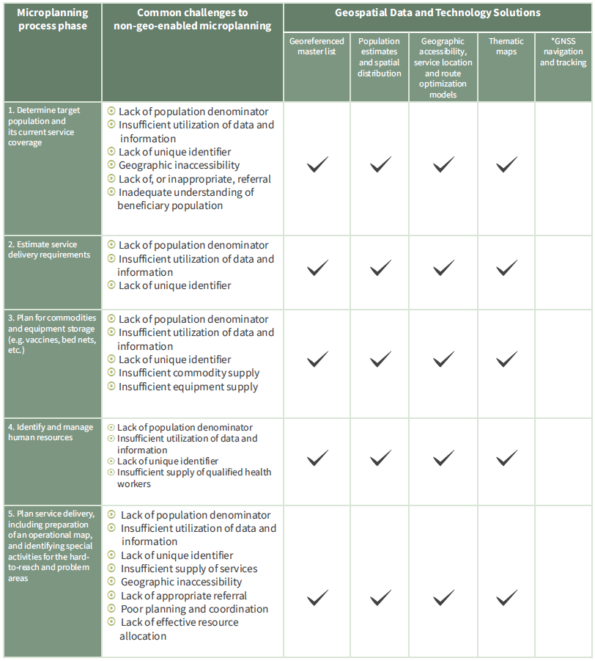
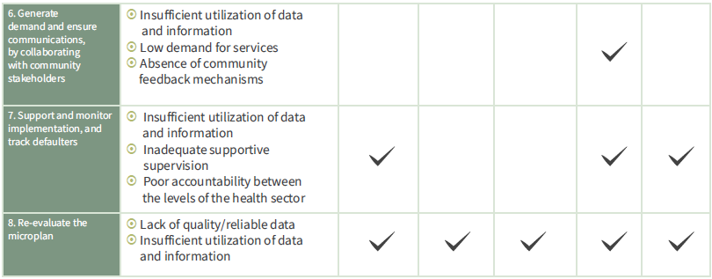
Microplanning challenges

Slide 9
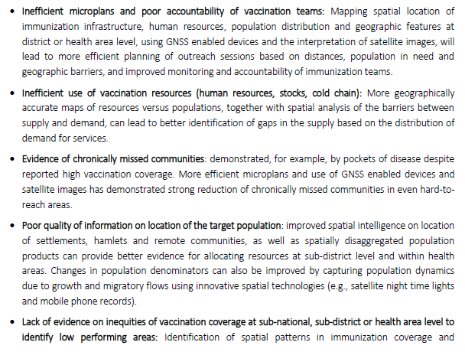
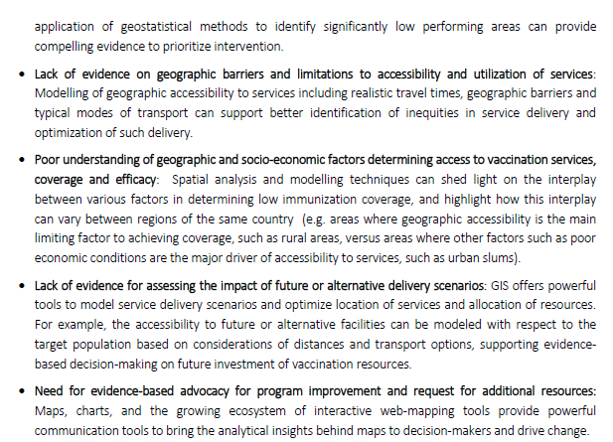
Immunization needs and gaps
Allow identifying if geospatial data and/or technologies can help in addressing some of these challenges

Slide 10
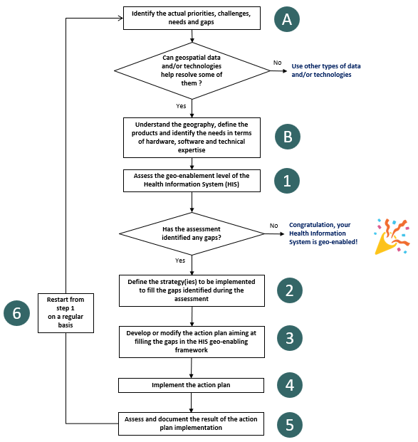
HIS Geo-enabling framework implementation process
Step B : Understand the geography, define the products, and identify the needs

Slide 11

HIS Geo-enabling framework implementation process
Step B : Understand the geography, define the products, and identify the equipment and technical capacity needs
Objective:
Identify and document the geographic features that define the program or intervention’s geography
Define and document the products to be generated to support the programs or the intervention
Identify and document the needs in terms of equipment and technical capacity to generate the products
Expected deliverable: Report documenting the geography, products, and needs
Estimated duration of implementation: 1-2 weeks
Volume of resources needed: limited
Person to be involved: Head of the geospatial data management and technology unit if any, representatives from the health information system unit and key health program(s) to benefit from the geo-enablement (communicable diseases, planning, emergency management, and immunization)
Supporting tool:
  Volume 2.1 of the Health GeoLab guidance for the management and use of geospatial data and technologies in health
  Section 1.2.1 of UNICEF’s guidance on the use of geospatial data and technologies in
  immunization programs
  Sections 6.2 to 6.5 of the geo-enabled microplanning handbook

Slide 12
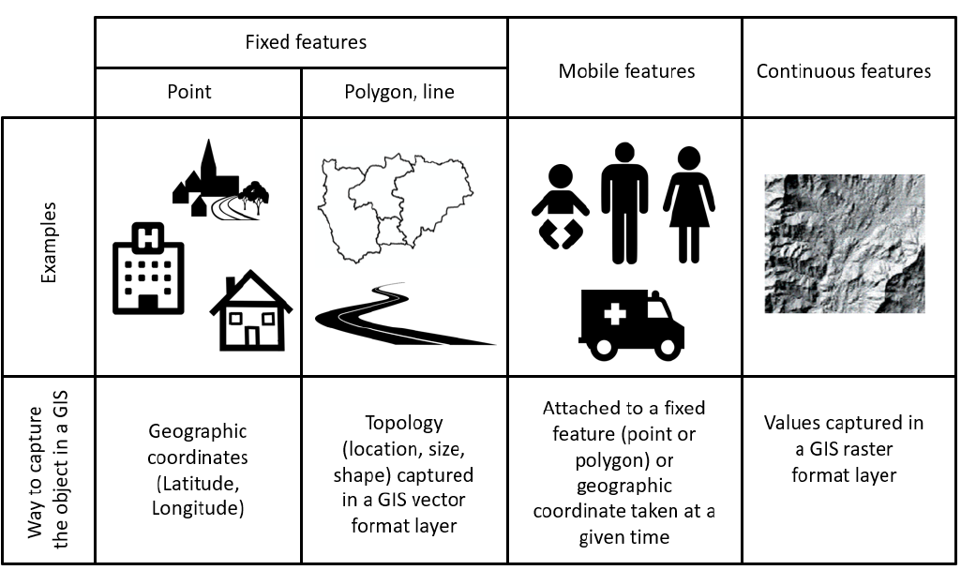
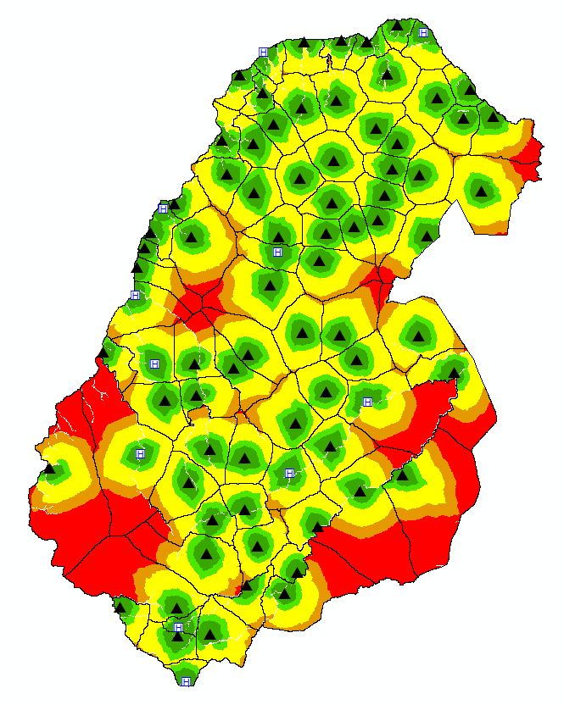
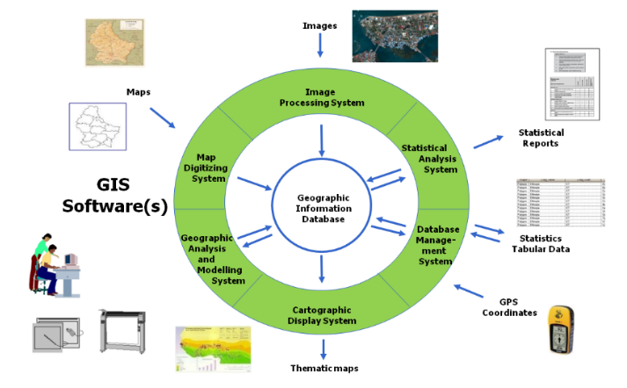
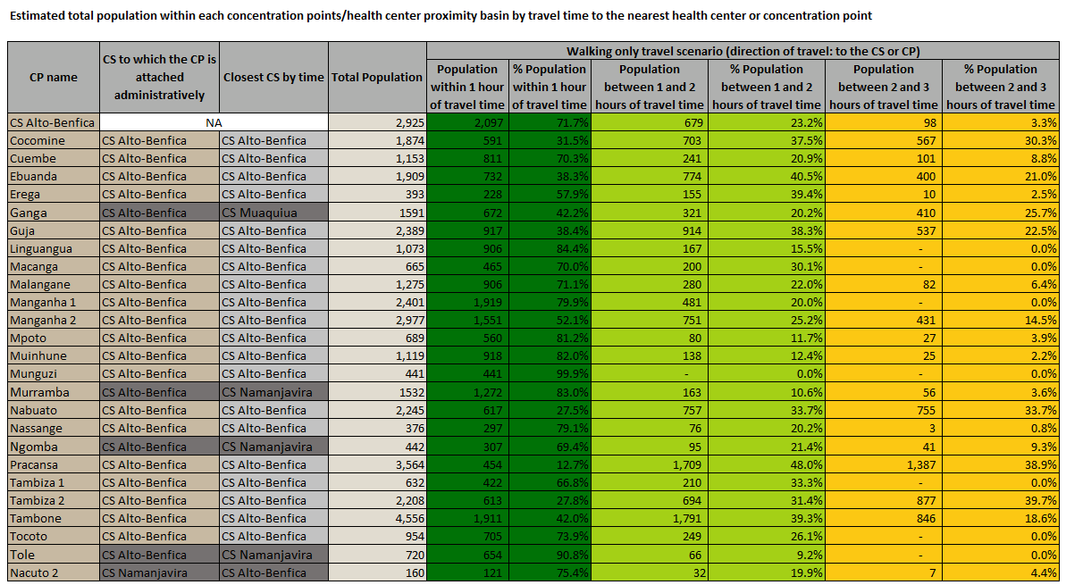
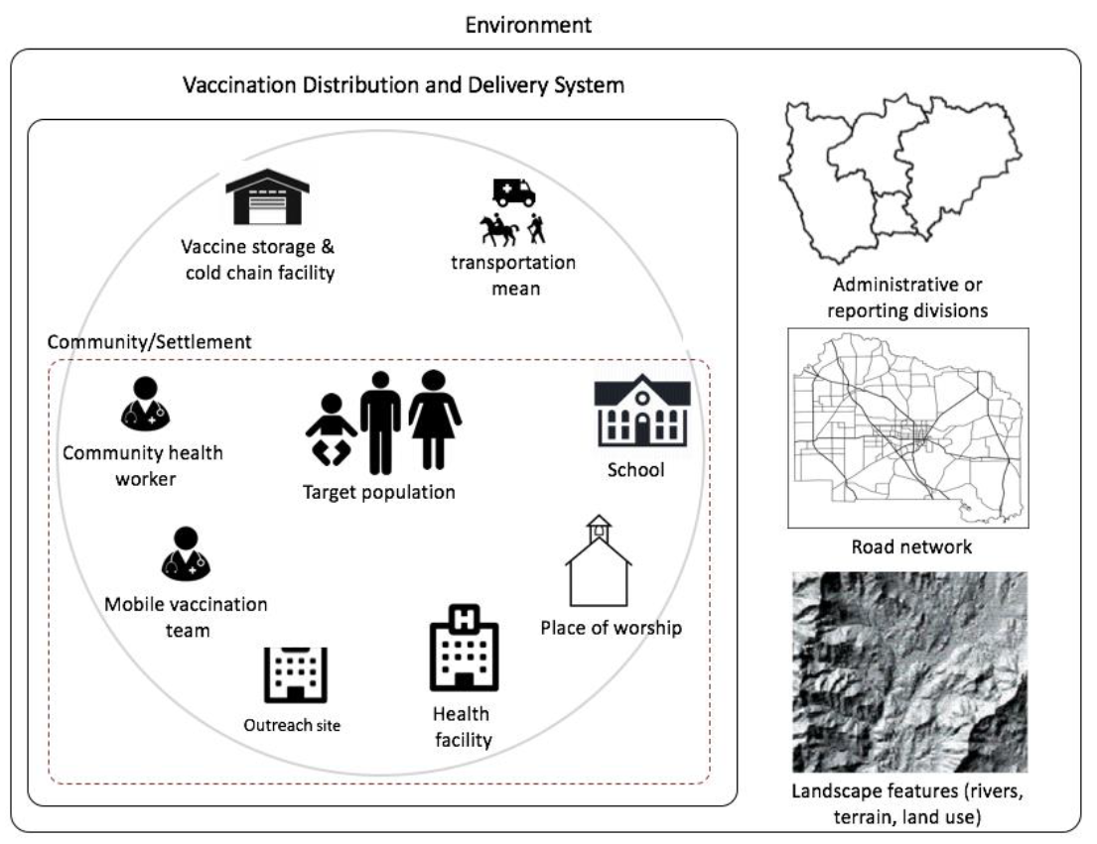
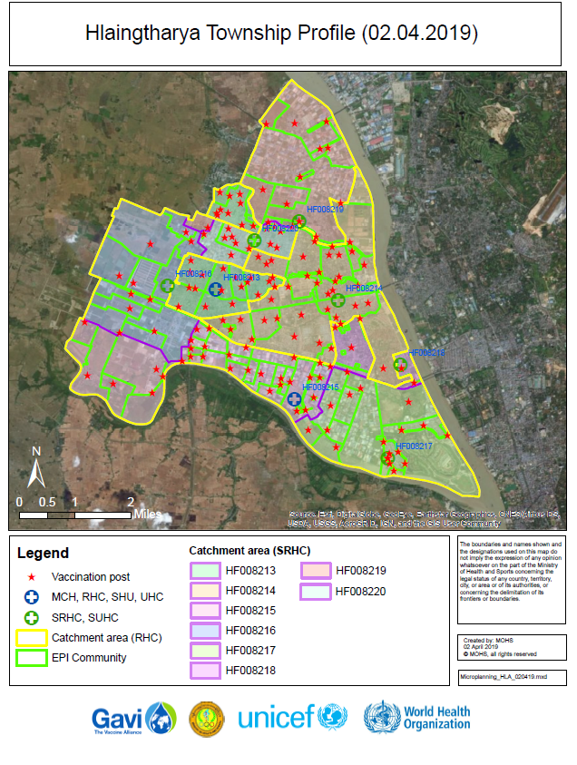
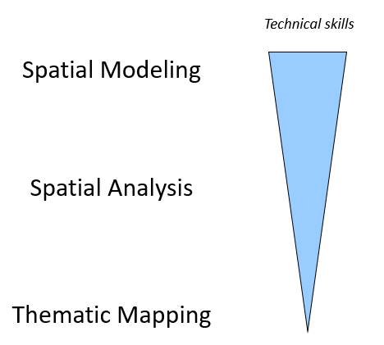
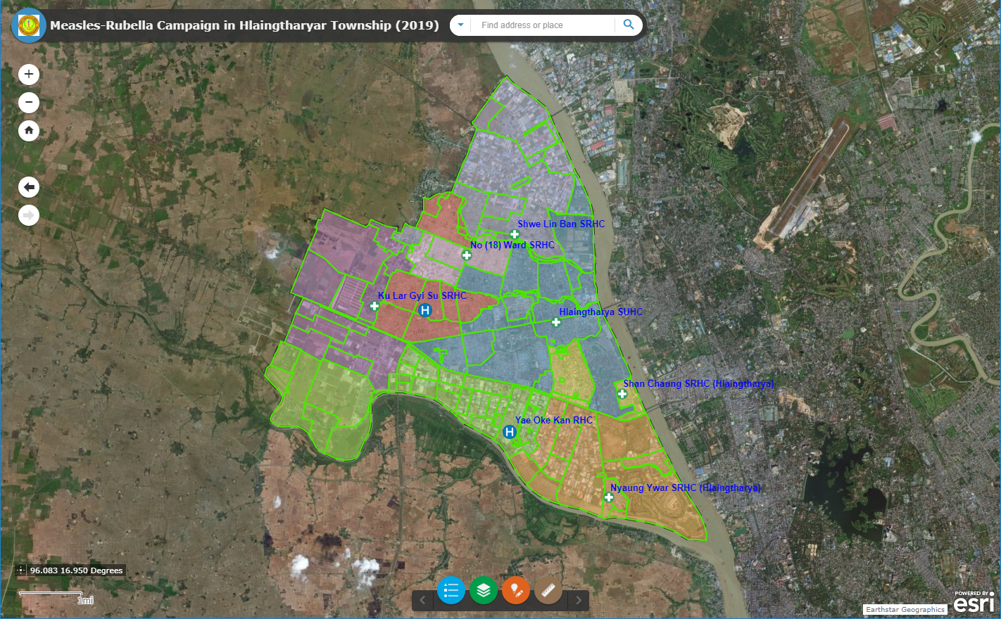
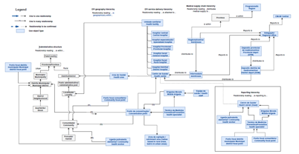
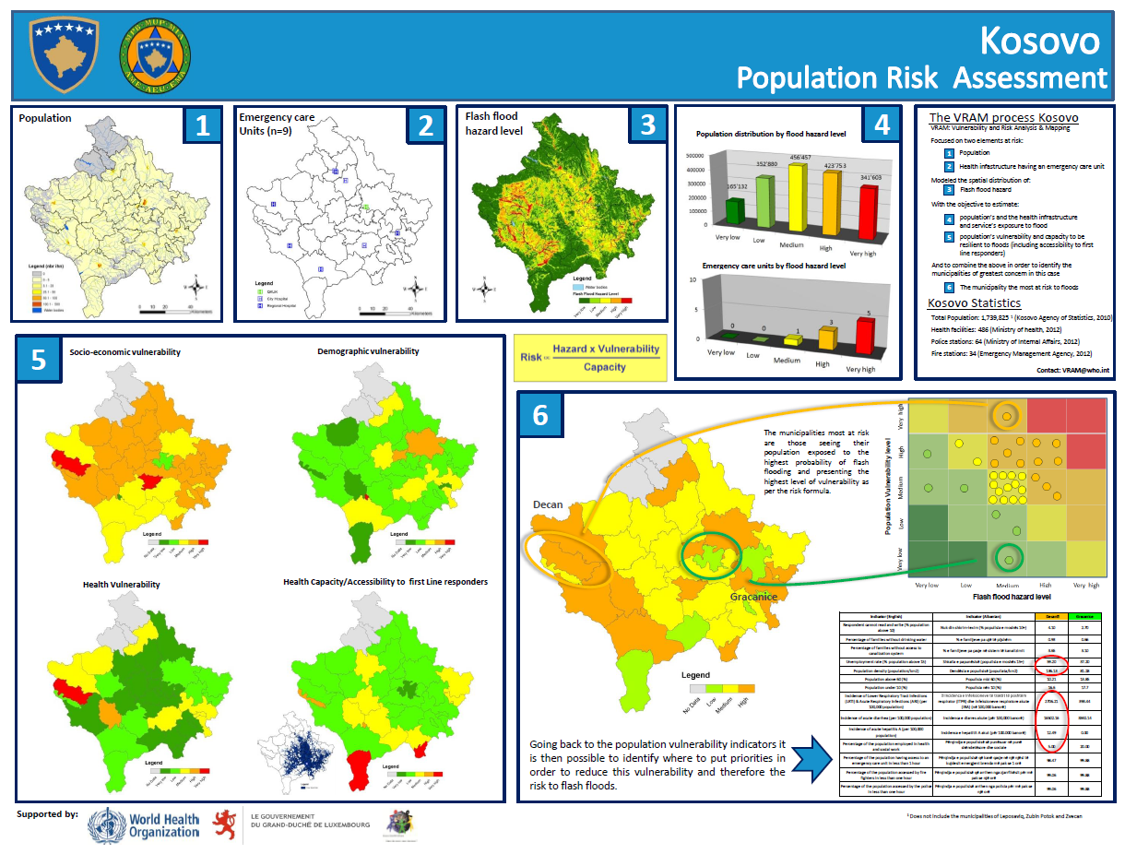
HIS Geo-enabling framework implementation process
Step B : Understand the geography, define the products, and identify the equipment and technical capacity needs
Understand the geography
Define the products
Identify the equipment and technical capacity needs

Slide 13
HIS Geo-enabling framework implementation process
Step B : Understand the geography
This understanding is achieved by identifying and documenting:
The program or implementation strategy (e.g., home vaccination) if the geo-enablement is happening at that level
Context
The geographic features that are central to the implementation of the program (list of these features with their definition)
Eco-system
Data model
The relationships that exists between these geographic features
Hierarchies
Important to include all stakeholders in the planning and implementation of the intervention(s) covered by geo-enabling
This will directly influence the data that is needed to generate products

Slide 14

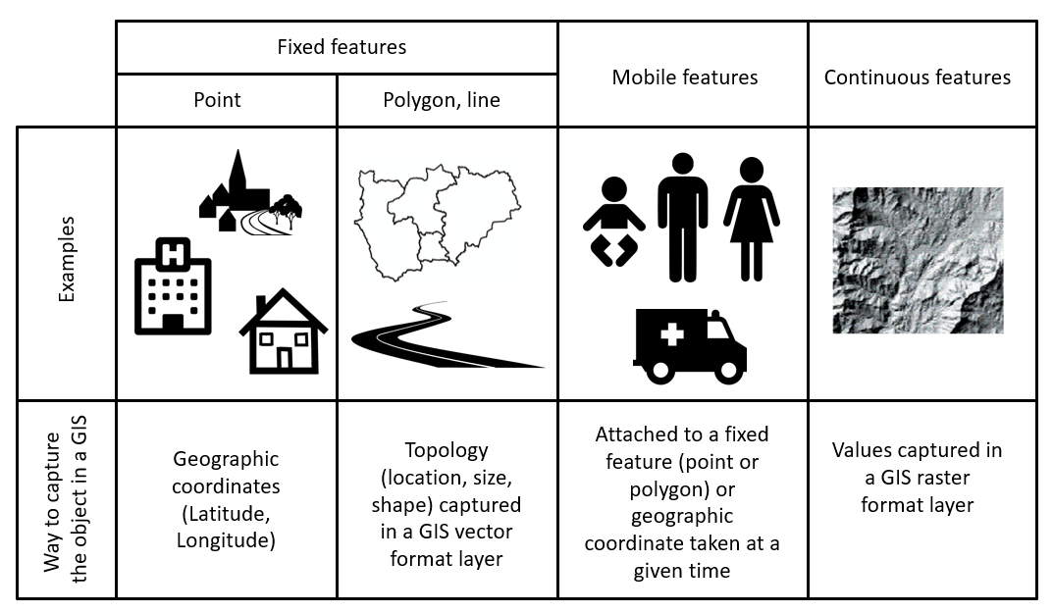

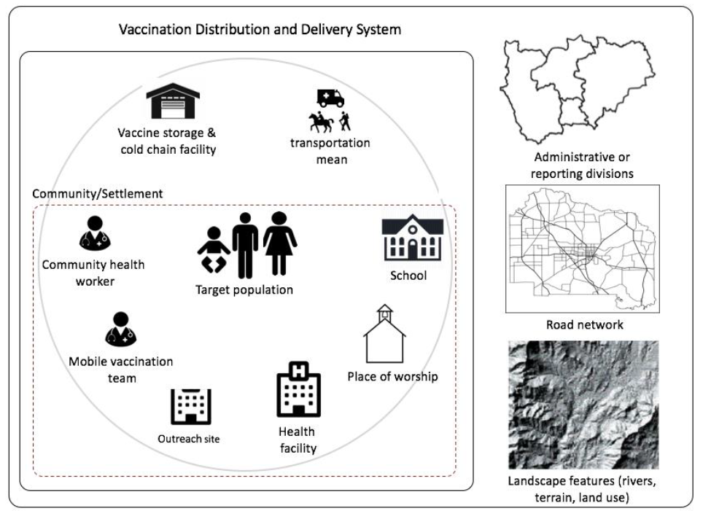
Understanding the geography – Geographic features
1
2
Geographic feature = Naturally and artificially-created features on the earth (e.g. house, road, health facility, river, etc.)
Geographic object = Also called a geo-object, computer representation of a geographic feature (e.g. point, line, polygon)
http://www.healthgeolab.net/DOCUMENTS/Guide_HGLC_Part2_1.pdf
https://www.unicef.org/media/58181/file

Slide 15
Understanding the geography – Geographic features
Example: What is a health facility?
Medline Plus: Places that provide health care. They include hospitals, clinics, outpatient care centers, and specialized care centers, such as birthing centers and psychiatric care centers.
Health authority Abu Dhabi: Standalone building with inpatient services for 24 hours use or longer by patients in the treatment of diseases, injuries, deformities, abnormal physical or mental status, maternity cases, nurseries and dispensaries.
Free dictionary: Building where medicine is practiced.
DOH Philippines: A building or physical structure that has amenities, equipment and staffing for the
delivery of health care services.
Wikipedia: in general, any location at which medicine is practiced regularly.
A building or a place/location are two different things
Might need to define additional concepts (health care, medicine, service)
The final definition will impact the next steps of the geo-enablement process

Slide 16

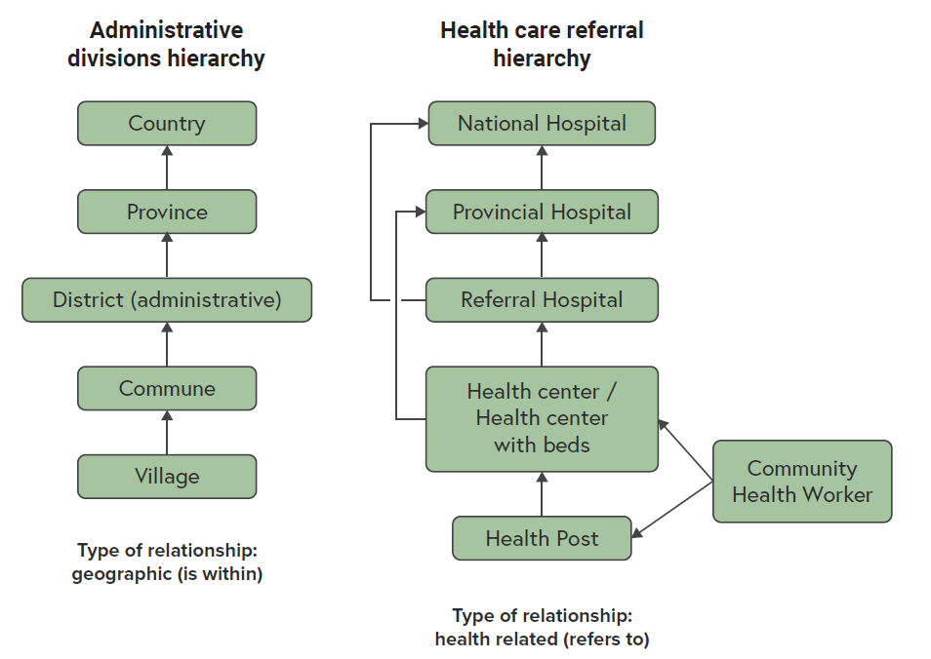
Understanding the geography – Hierarchies
1
The relationship between geographic features can be of different types. For example:
Geographic (…is geographically located within..)
Health (…refers patients to…)
Administrative (…is administered by…)
Associative (…part of…)
2
Identifying and capturing these relationships in the form of hierarchies will influence the information that must be attached to each geographic feature to be in the position to recreate these hierarchies
1 https://drive.google.com/file/d/1jj779zww4herWOESAd9mXqVE1YfQehtH/view?usp=sharing
2 https://healthgeolab.net/DOCUMENTS/Guidance_Common_Geo-registry_Ve2.pdf

Slide 17
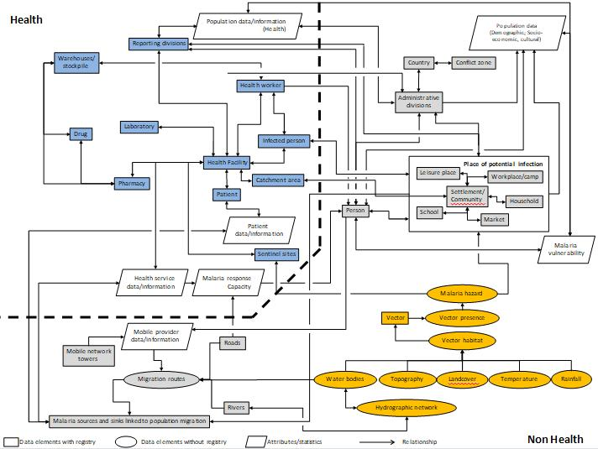
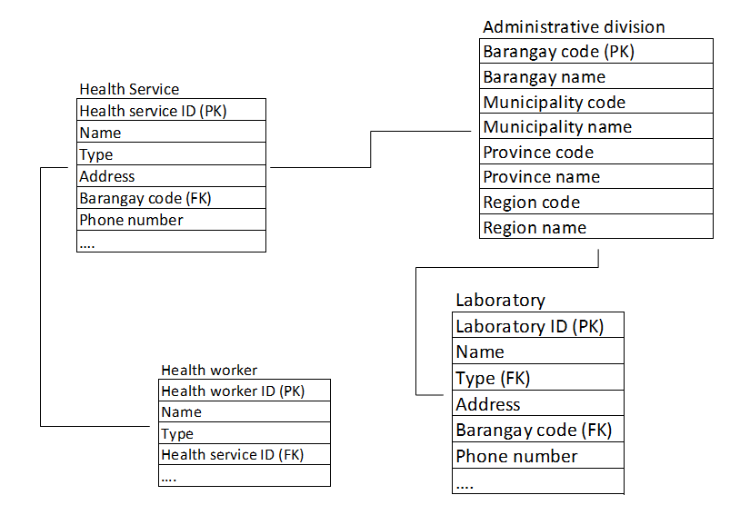
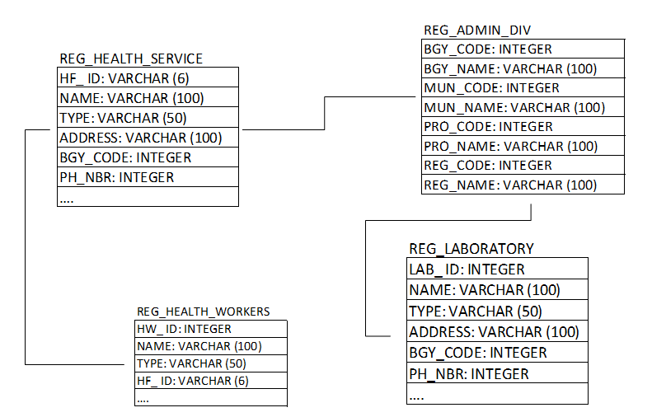
Understanding the geography – Data model
1
A data model is an abstract model that organizes and document the relationships that exists between geographic features and the data elements attached to each of them
Three (3) main levels of data model can be differentiated:
Conceptual data model
Conceptual data model which captures all the identified geographic features and the relationships between all of them
Logical data model which also captures the data elements associated to each geographic feature, without regard to how they will be physically implemented in the database
Physical data model which captures how the model is being implemented in the information system
Logical data model
Physical data model
1 http://www.healthgeolab.net/DOCUMENTS/Guide_HGLC_Part2_1.pdf

Slide 18
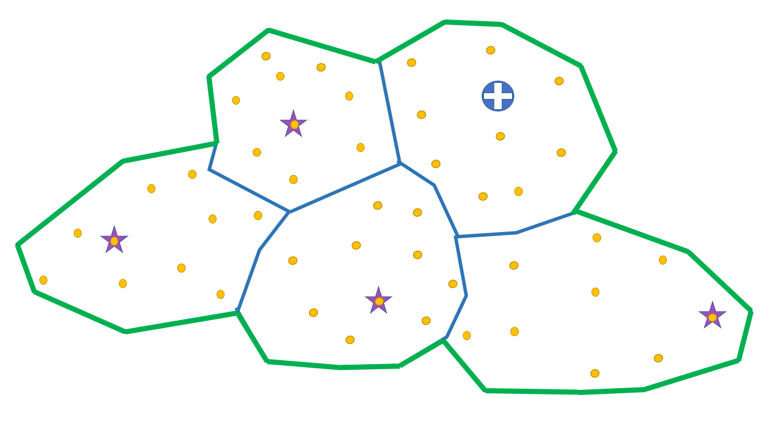
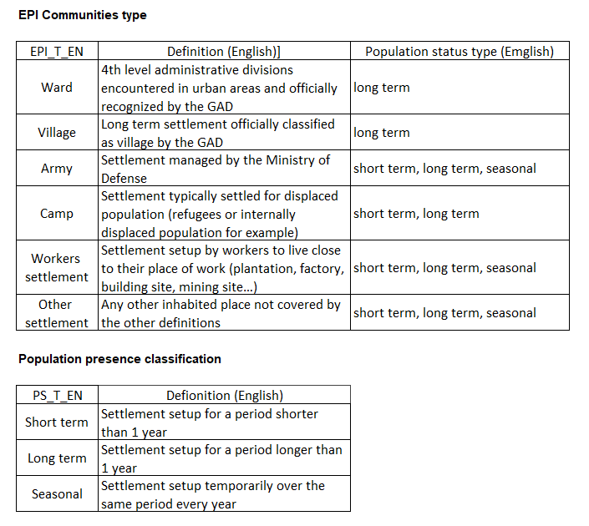
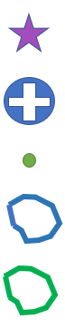
Understanding the geography – Example (Myanmar)
Challenge: Microplanning not covering the whole target population
Immunization ecosystem
EPI community?
Definition: Place where people live in community
Required to define different types of EPI communities and population presence
Legend
Vaccination post
Health centre
Village
EPI community
Health area
Helped identify communities that were not yet covered by vaccination campaigns

Slide 19
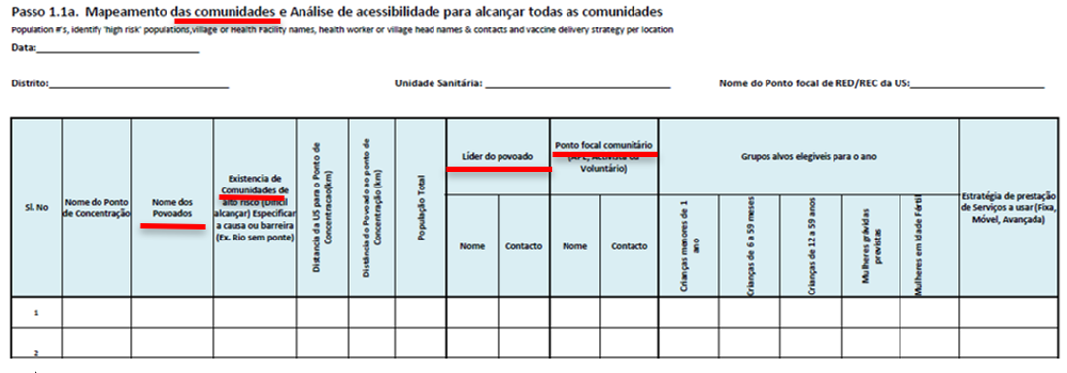
Understanding the geography – Example (Mozambique)
Challenge: Microplanning form combining different types of geographic features that were not clearly defined (povoados, community)
Needed to get a clear definition for both geographic features and understand how they related to each other

Slide 20
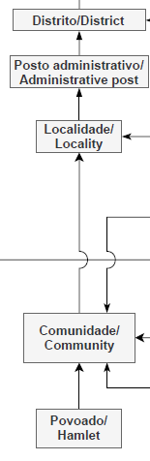
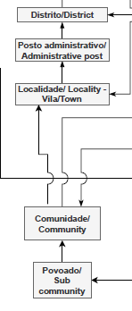
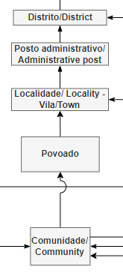
Understanding the geography – Example (Mozambique)
Challenge: Microplanning form combining different types of geographic features that were not clearly defined (povoados, community)
24 Aug 2021 21 Sep 2021 14 Oct 2021
Conclusion:
Geographic feature without administrative role (only for statistical purpose)
Unofficial geographic feature (no regulation in place)
Recommendation made to the Ministry of Health to define and manage the micro-plan at the concentration point (vaccination posts) level

Slide 21
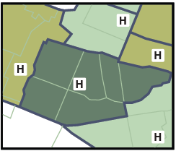
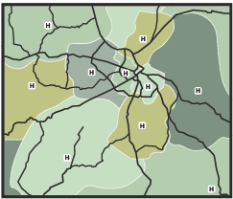
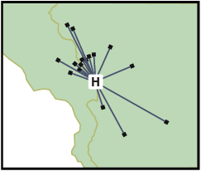
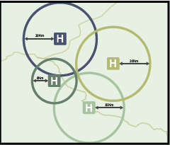
Understanding the geography – Example (zone types)
Challenge: Different understanding and use of the concept of catchment area
1
Needed to come up with a common terminology
Type | Definition
Health area | Area around a health facility defined for purposes of cataloging, budgeting and health resource management
Proximity basin | An area around a service delivery point defined such that any location within this area is closer to that service delivery point than to any other service delivery point.
Catchment area | A geographical area delineated around an institution or business, such as a health facility, from where the population utilizes its services
Actual catchment area | Area around a service delivery point based on the location of the patient who received care at that service delivery point
Modeled catchment area | Catchment area modeled based on distance (buffer), travel time, population or a combination of these factors
Health areas
Proximity basin (travel time)
Actual catchment area
Modeled catchment area (distance)
1 https://drive.google.com/file/d/1jj779zww4herWOESAd9mXqVE1YfQehtH/view?usp=sharing

Slide 22
Understanding the geography – Process
1
Three (3) exercises:
Identify the geographic features specific to the program or intervention
Agree upon a definition for each of the geographic features identified during exercise 1
Capture the relationships between the geographic features identified during exercise 1 and defined during exercise 2
Exercises ideally conducted (at least started) during a workshop attended by key representative from:
The program or intervention being geo-enabled
The main producers/consumers of geospatial data (HIS unit, communicable diseases, planning, immunization and emergency management) if the geo-enablement of the HIS is being performed
1 http://www.healthgeolab.net/DOCUMENTS/Guide_HGLC_Part2_1.pdf
22

Slide 23


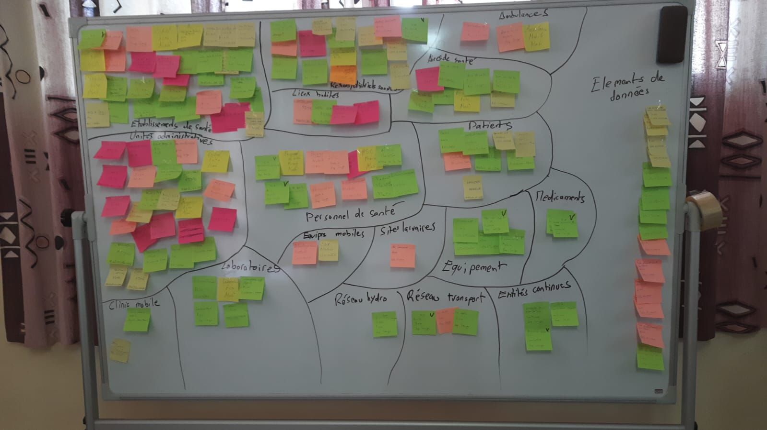
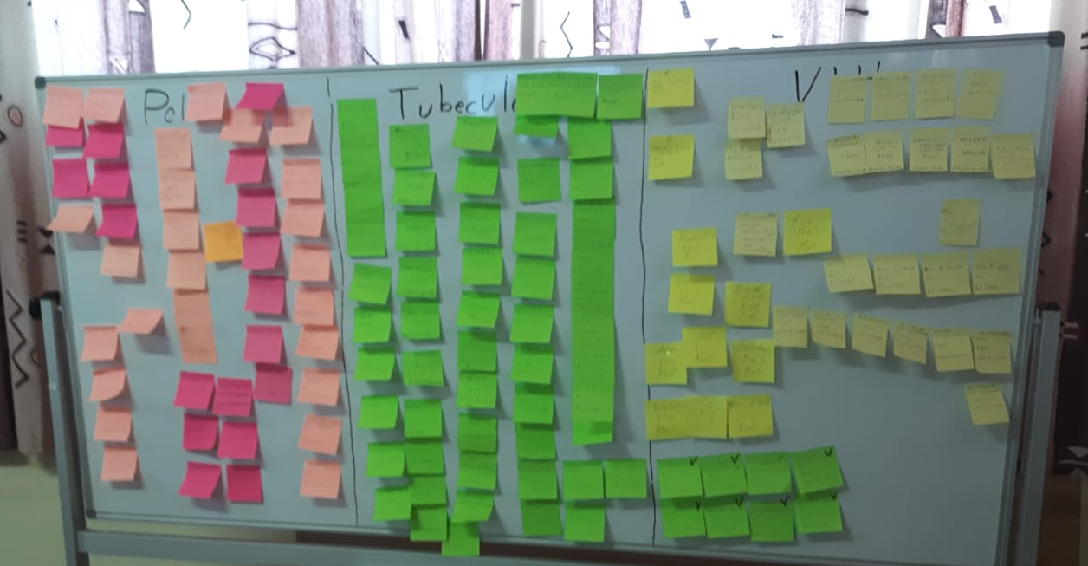
Understanding the geography – Exercise 1 (cross-program)
1. Participants identifying geographic features (1 feature per post-it, one color per program)
2. Participants placing the post-its on a board (one color per program)
4. Post it re-arranged by type of geographic feature
3. All the post-it submitted by the participants
Defines the ecosystem and demonstrates that most geographic features are in common to all programs
23

Slide 24
Understanding the geography – Exercise 1 (cross-program)
Health facilities
Laboratories
Settlements
Administrative units
Health districts
Health areas
Hydrographic network
Transportation network
Patients
Health personnel
Mobile clinics
Ambulances
Equipment
Medicines
Altitude
Land cover
Often also provide the opportunity to clarify certain concepts or misunderstanding (e.g. data elements versus geographic features)
24

Slide 25



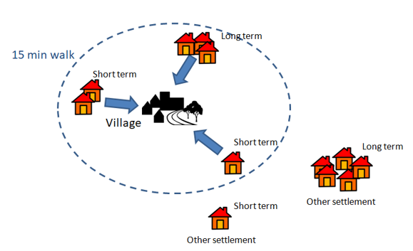




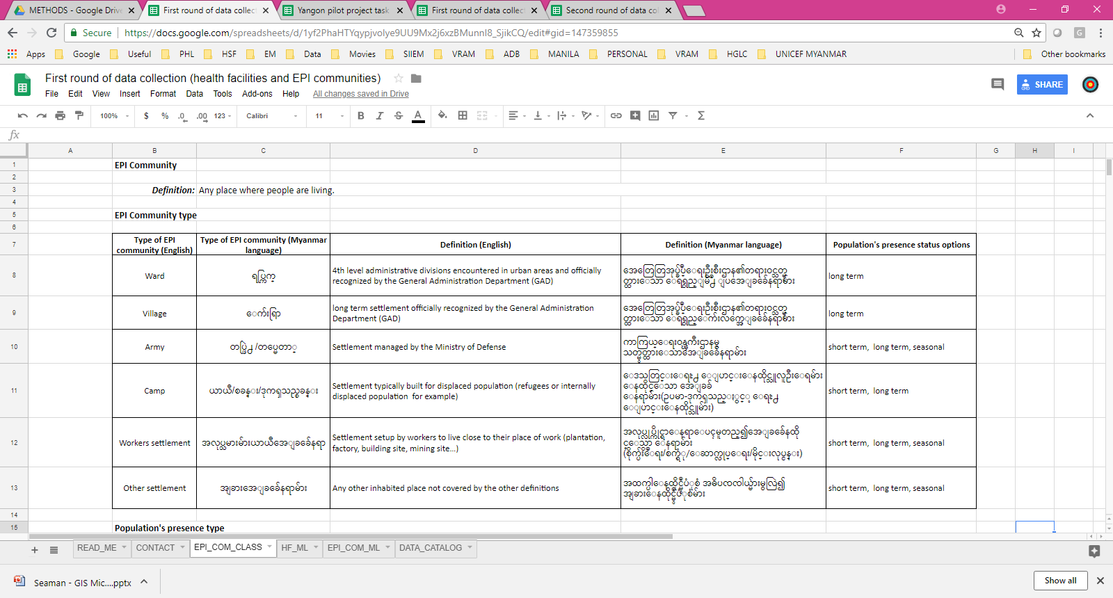


Understanding the geography – Exercise 2 (cross-program)
Term | Definition | Consensus
First set of definitions
First round during which each participant provide their own definition for the types of geographic features that are not already officially defined
Additional rounds to address the geographic features for which there is no consensus
Full consensus
Final agreed upon definitions
25

Slide 26
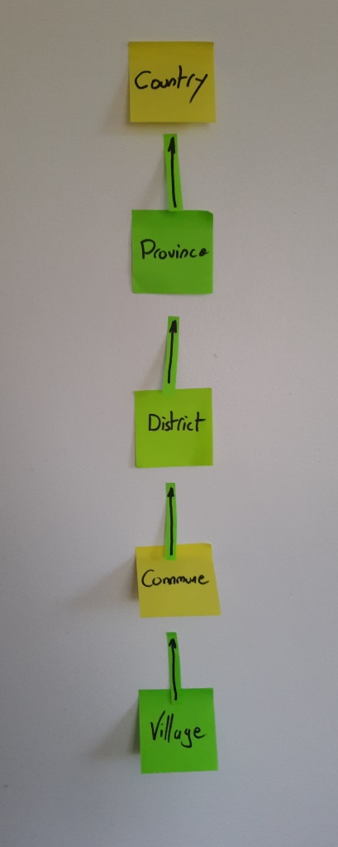
Understanding the geography – Exercise 3 (cross-program)
Use the post its from exercise 1 to get the participants to organize them under the form of hierarchies
Capture the agreed upon hierarchies in an electronic format
26

Slide 27
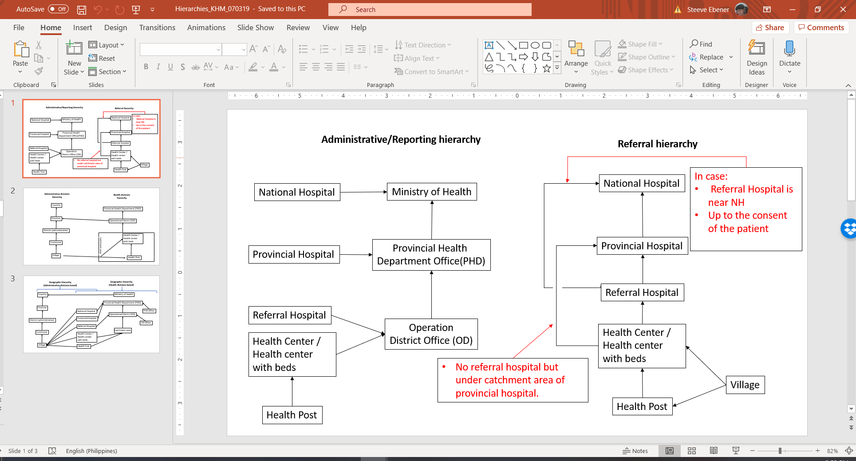
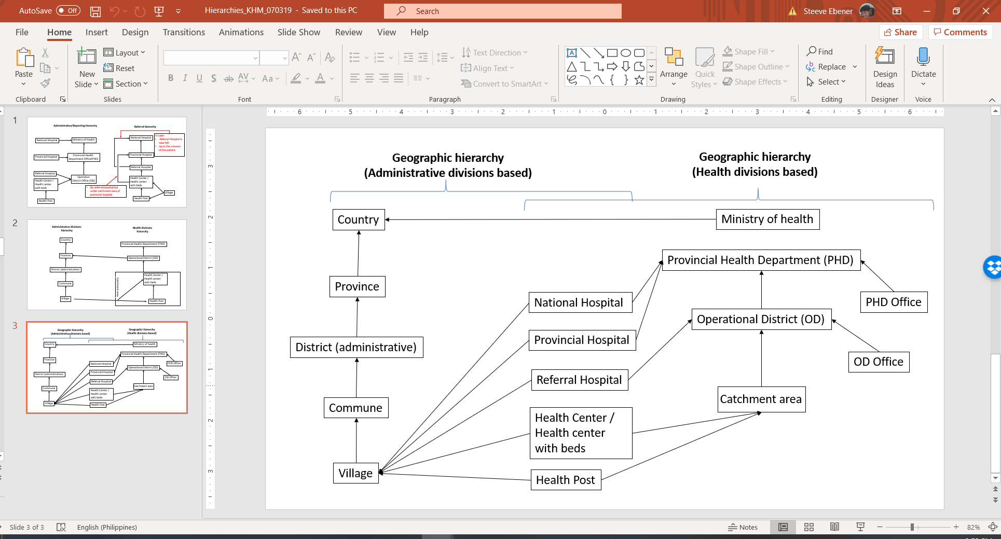
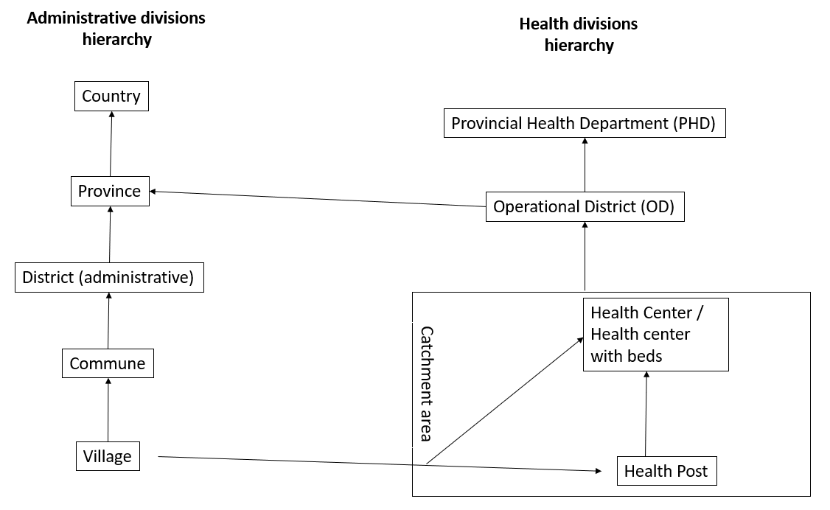
Understanding the geography – Exercise 3 (cross-program)
Several hierarchies can contain the same geographic feature
Example: Cambodia
27

Slide 28
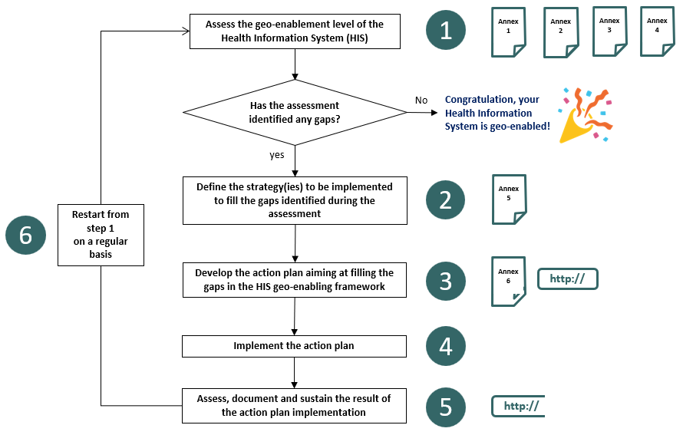
HIS Geo-enabling framework implementation process
Step 1 : Assess the level of geo-enablement of the health information system

Slide 29
HIS Geo-enabling framework implementation process
Step 1 : Assess the level of geo-enablement of the health information system
Objective: Identify and document the current situation and indirectly potential gaps across the nine (9) elements of the HIS geo-enabling framework
Expected deliverable: A report documenting the current situation
Estimated duration of implementation: 1-2 weeks
Volume of resources needed: Limited
Person to be involved: Head of the geospatial data management and technology unit if any, representatives from key health programs (health information system, communicable diseases, planning, emergency management, and immunization), development partners, external facilitator.
Supporting tool:
  HIS geo-enabling benchmarks (Annex 1 in the HIS Geo-enabling Toolkit)
  Quick HIS geo-enabling assessment questionnaire (Annex 2)
  Additional information and documents to be collected in complement to the quick assessment questionnaire (Annex 3)
  Resources illustrating the first 7 elements of the HIS geo-enabling framework (Annex 4)
  HIS geo-enablement assessment matrix template
Note: When implemented in the context of a program or intervention, this step of the HIS geo-enabling framework process does also involve assessing the availability, quality, and accessibility of additional data needed to generate the products that have been defined during step B.

Slide 30
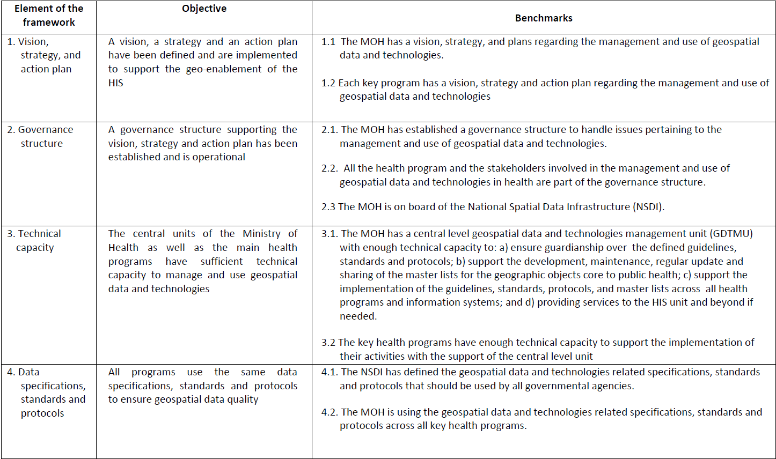
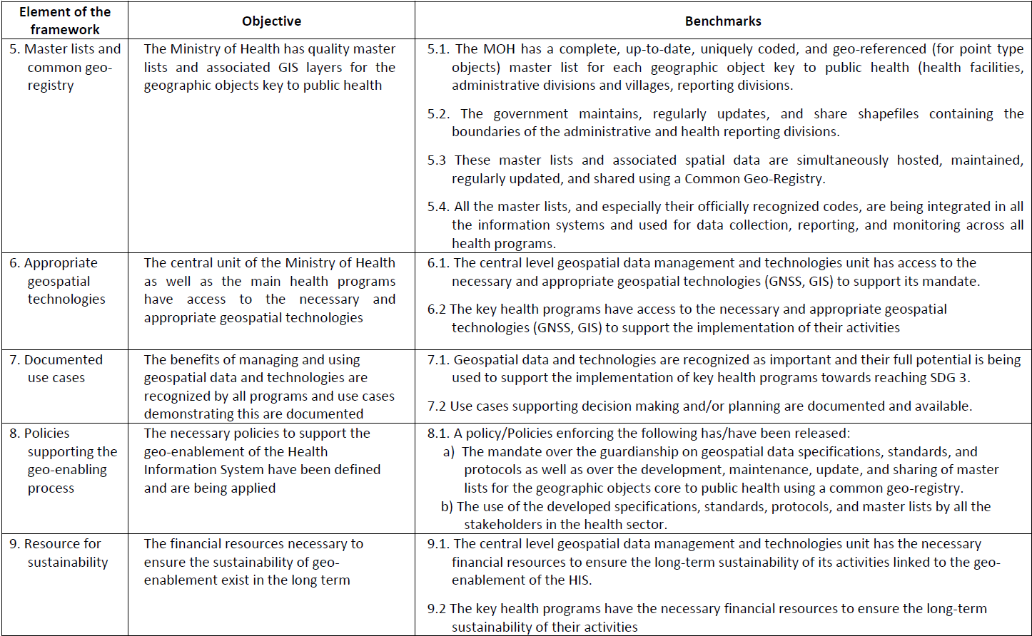
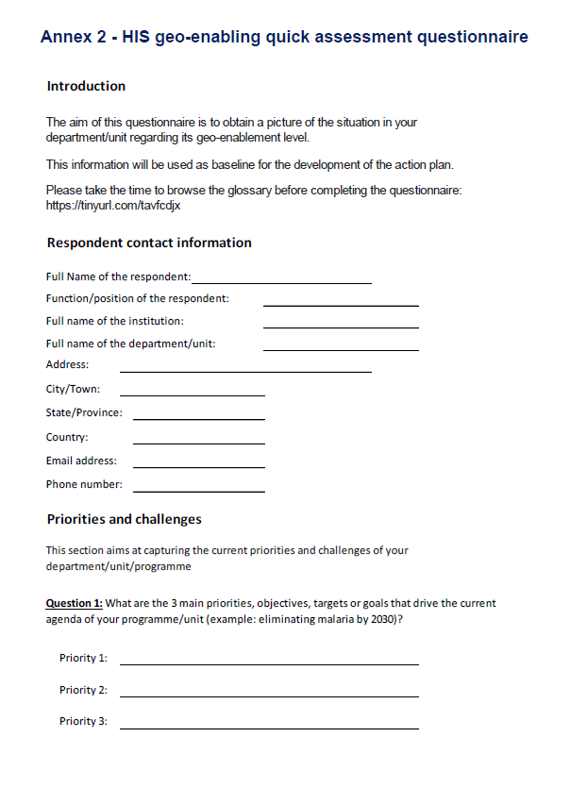
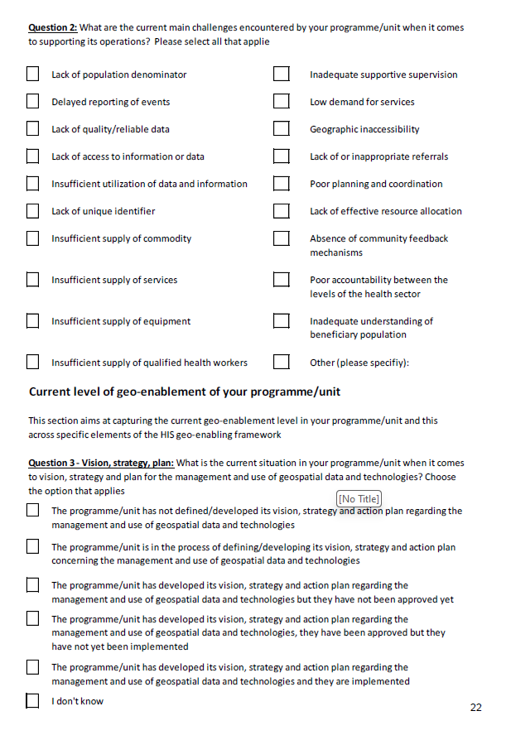
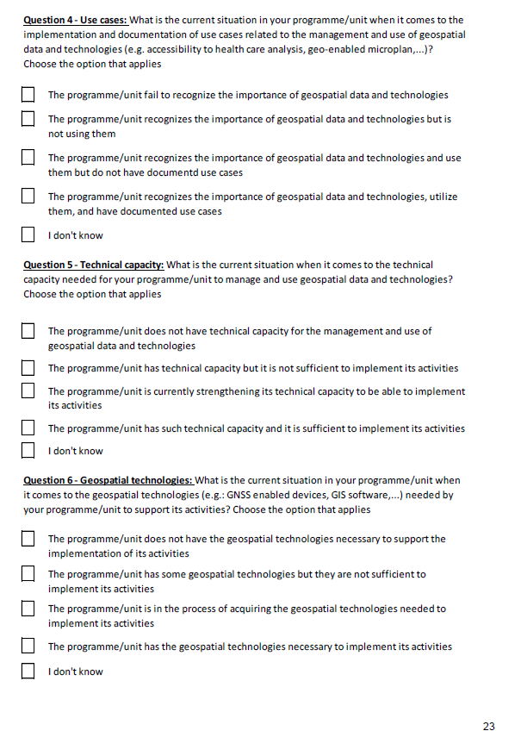
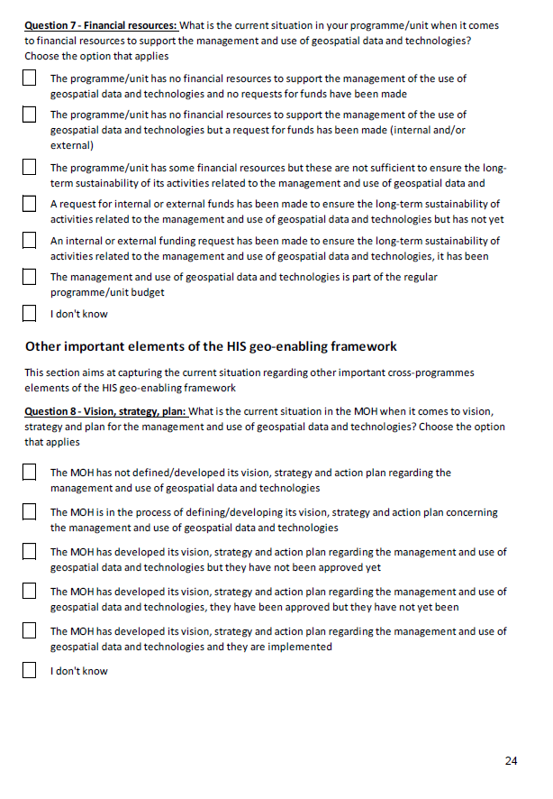
HIS Geo-enabling framework implementation process
Step 1 : Assess the level of geo-enablement of the health information system
This step allows to assess the current level of geo-enablement of the HIS to have a clear view of the gaps that exist in relation to the criteria that must be met for the HIS to be considered geo-enabled.
The rapid geo-enabling assessment questionnaire (Annex 2 of the HIS Geo-enabling Toolkit) is used to facilitate this exercise. It is organized according to the 9 elements of the HIS geo-enabling framework.
The information and documents listed in Annex 3 of the HIS Geo-enabling Toolkit should also be collected to obtain a complete picture of the situation.

Slide 31
HIS Geo-enabling framework implementation process
Step 1 : Assess the level of geo-enablement of the health information system
Ideally, the assessment should cover at least the following Key Health Programs (KHPs) as being the main providers and potential users of geospatial data and technologies:
Health Information System (HIS): Natural guardian of the national level geospatial data management and technologies unit.
Planning: Physical accessibility to health care is an important component of UHC which depends on the spatial distribution of the population in need, the spatial distribution of services that are being provided, and the environment that the patients has to cross to reach them.
Communicable diseases: Being able to contextualize cases in both time and space is key to surveillance, monitoring, and elimination of communicable diseases.
Immunization: Base microplanning maps are essential to ensure that all the targeted population is covered during an immunization campaign.
Emergency management: Geospatial data and technologies are critical instruments across the whole emergency management cycle (mitigation/preparedness, response, recovery

Slide 32
HIS Geo-enabling framework implementation process
Step 1 : Assess the level of geo-enablement of the health information system
The assessment can be conducted in different ways depending on the context and resources at disposal, among which we can mention:
By the Ministry of Health (self-assessment). It is recommended to then organize a workshop grouping all the concerned programs/units to validate the result of the assessment.
Facilitated on site by an external party through separate one-on-one interviews with each program/unit. This approach might require a cross-validation exercise to take place depending on the answers provided for the cross-cutting elements of the framework.
Facilitated on-site during a workshop grouping all the programs/units. This approach presents the advantage of allowing to directly clarify and cross-validate information during the workshop.
Independently of the approach being used, an internet search to collect as much information as possible should be performed prior to the assessment as this might provide some important background information including identifying some potential MOH programs/units to be involved in the exercise.
The assessment also represents an opportunity to inform the Ministry of Health and its partners about recent developments in the field of geospatial data and technologies and to illustrate how they are being used to support public health programs.

Slide 33
HIS Geo-enabling framework implementation process
Step 1 : Assess the availability, quality, and accessibility of data and information
When geo-enabling the HIS, this step in the process only look at where the master list for a set of geographic features core to public health find themselves along a predefined continuum
Geo-enabling a program or intervention requires a more in-depth assessment of the availability, quality, and accessibility of the data needed to generate the information products defined during step B
Such an assessment is to also take place during Step 1 of the process and meant to identify currently existing gaps and how to fill them
Entry point for the geospatial data management cycle

Slide 34


The geospatial data management cycle
1
Generating and maintaining good quality data (geospatial, statistical) and products require proper data management standards, processes, and protocols to be defined and implemented.
The geospatial data management cycle provides the steps needed to ensure that proper data management standards, processes, and protocols are defined and implemented.
Ensure data quality and therefore the quality of the product to be generated out of it
Applicable to all the data needed to generate these products
Will be covered in detail in Module 3
1 http://www.healthgeolab.net/DOCUMENTS/Guide_HGLC_Part1.pdf

Slide 35
HIS Geo-enabling framework implementation process
Step 2: Define the strategy(ies) to be implemented to fill the gaps identified during the assessment

Slide 36
HIS Geo-enabling framework implementation process
Step 2: Define the strategy(ies) to be implemented to fill the gaps identified during the assessment
Objective: Define the strategy(ies) to be implemented to fill each of the gaps identified during the assessment
Expected deliverable: Document documenting the strategy(ies) to be implemented to address the gaps identified during the assessment.
Estimated duration of implementation: up to 1 week
Volume of resources needed: Limited
Person to be involved: Head of the geospatial data management and technology unit if any, representatives from key health programs (health information system, communicable diseases, planning, emergency management, and immunization), development partners, external facilitator.
Supporting tools:
a. Non exhaustive list of strategy(ies), recommended stakeholders to be involved, and implementation level aiming at filling the identified gaps (Annex 5 in the HIS Geo-enabling Toolkit)
At the end of this second step, the Ministry of Health should have clear strategies to develop an action plan (Step 3).

Slide 37




HIS Geo-enabling framework implementation process
Step 2: Define the strategy(ies) to be implemented to fill the gaps identified during the assessment
Annex 5 of the HIS Geo-enabling Toolkit has been designed to support this exercise and is organized as follows:
A list of potential gaps identified during the assessment are provided for each of the framework elements.
Possible strategies to fill each of the identified gap.
The minimum list of stakeholders to be involved as well as the level of implementation for the strategies to be conducted are then recommended.
The list is non-exhaustive but should contain the major gaps that could be expected.

Slide 38

HIS Geo-enabling framework implementation process
Step 2: Define the strategy(ies) to be implemented to fill the gaps identified during the assessment
The HIS Geo-enabling Toolkit, and other guidance documents, consider two levels of implementation:
National: Implemented nationwide, starting with the central before the sub-national level for the former to serve as trainers for the latter
Pilot: Implemented on a limited part of the country's territory
The level of implementation chosen will greatly depend on country-specific context and on the size of the gap versus the availability of resources (financial, human, and physical) and organizational support to fill such gap.
The product resulting from this step will be a report or a table providing a strategy together with a list of associated activities, including the list of involved stakeholders and level of implementation, for each of the gaps identified during the assessment (Step 1).

Slide 39
HIS Geo-enabling framework implementation process
Step 3: Develop the action plan aiming at filling the gaps in the HIS geo-enabling framework

Slide 40

HIS Geo-enabling framework implementation process
Step 3: Develop the action plan aiming at filling the gaps in the HIS geo-enabling framework
Objective: Obtain a budgeted action plan to implement the strategies identified during step 2.
Expected deliverable: HIS geo-enabling action plan
Estimated duration of implementation: 1 month
Volume of resources needed: Limited
Person to be involved: Head of the geospatial data management and technology unit if any, representatives from key health programs (health information system, communicable diseases, planning, emergency management, and immunization), development partners, external facilitator.
Supporting tools:
Non-exhaustive list of activities to be considered for implementation across the 9 elements of the HIS geo-enabling framework (URL in the HIS Geo-enabling Toolkit)
Action plan template (URL in the HIS Geo-enabling Toolkit)
Example of action plan (Annex 6 of the HIS Geo-enabling Toolkit)
Cost and timeline drivers for activities aimed at strengthening the geo-enabling environment (GAVI’s Leveraging Geospatial Technologies and Data to Strengthen Immunization Programmes: Rapid guidance for investment planning)

Slide 41









HIS Geo-enabling framework implementation process
Step 3: Develop the action plan aiming at filling the gaps in the HIS geo-enabling framework – Origin of its content
Priorities, challenges, needs
Products purpose, audience, content and format
Equipment and expertise needs
Program/intervention geography
Data needs and gaps
Current HIS geo-enablement level and gaps
Action plan to fill the identified gaps

Slide 42
HIS Geo-enabling framework implementation process
Step 3: Develop the action plan aiming at filling the gaps in the HIS geo-enabling framework – Content
Such action plan should at least contain:
  The vision (short and/or long-term)
  The objectives to be achieved
  The timeline (start and end date) and full name of the implementation manager
  The date of last update of the plan
  For each element of the HIS geo-enabling framework:
  The current situation/gaps as identified during the assessment (a comments field to provide additional information can also added)
  The strategy(ies) to fill the identified gaps
  The level of implementation of the strategy(ies)
  The activities associated to each strategy with the mention of the following for each of them:
    The entity, individuals to involved in the activity (target group)
    Person/entity in charge of the activity (responsible)
    Timeline (start and end date)
    Budget
    Anticipated deliverable(s)
    Monitoring and evaluation indicators
At the end of this third step, the Ministry of Health should have a clear action plan containing all the information needed for successful implementation.

Slide 43


HIS Geo-enabling framework implementation process
Step 3: Develop the action plan aiming at filling the gaps in the HIS geo-enabling framework – Template
To help this process, the Health GeoLab has developed an MS Excel template accessible from the HIS Geo-enabling Toolkit.
https://bit.ly/3vHhOIA
To be defined through a consultative process involving the concerned stakeholders
Information coming from the HIS geo-enablement level and the identification of strategy(ies) to fill gaps

Slide 44
HIS Geo-enabling framework implementation process
Step 3: Develop the action plan aiming at filling the gaps in the HIS geo-enabling framework – Process to fill the template
Decide on the approach that will be used to fill the template and on the stakeholders to be involved. For example:
  In-person or remote workshop involving all relevant stakeholders
  Small group developing a draft action plan to be reviewed and approved by all relevant stakeholders
Implement the selected approach:
  Define the short and/or long term vision
  Define the objectives of the action plan
  Transfer the information from HIS geo-enabling level assessment matrix to the action plan template
  Transfer the strategy(ies) and corresponding implementation level that have been defined during the previous step to the action plan
  Define the activities that must be implemented for each element of the geo-activation framework together with the indication of the target group, responsible, timeline, deliverable(s), M&E indicator and possible notes
  Cost the action plan and nominate an implementation manager if not already done

Slide 45
HIS Geo-enabling framework implementation process
Step 3: Develop the action plan aiming at filling the gaps in the HIS geo-enabling framework
Experience shows that it is important to take the following into account when developing the action plan to ensure not only a successful implementation but also long-term sustainability:
Be as inclusive as possible from the start of the process by engaging in the process not only the key health programs identified during the assessment but also development partners who might currently be supporting projects with a geo-enabling component or interested in doing so.
Have at least one focal point officially nominated for each MOH entity and the partners involved in the implementation of the action plan.
Make sure that the action plan in general and the use cases (applications) in particular address public health priorities included in the National Health Plan.
Build on already existing action plan(s), taking the results of the HIS geo-enabling assessment into account.
Leverage local MOH champions who have understood the value of the geo-enablement and have a clear view on their needs for geospatial data and technologies.
Use local capacities (national consultant, universities, private companies, etc.) as much as possible, not only because this reduces costs but also allows a closer follow-up on the implementation as well as helps in addressing potential language issues.
Prefer long term coaching to one-off training sessions.

Slide 46
HIS Geo-enabling framework implementation process
Step 3: Develop the action plan aiming at filling the gaps in the HIS geo-enabling framework
Start by strengthening the central level before the subnational level for the central level to then serve as trainers and point of contact for the sub-national level.
Use the implementation of the use cases (applications) as the driver to strengthen the technical capacity of the MOH.
Get the MOH staff to do as much of the work as possible with the support of the national and international consultants. This will contribute to the strengthening of their technical capacity and to experience firsthand potential data and process related issues.
Even if the resources are available for a full-scale implementation, it might be better to implement the action plan in phases and to only go for a full-scale implementation only once sufficient capacity has been established at the central level. The implementation of a pilot project also presents the advantage of giving a clearer picture of the activities, resources, time, etc. needed to expand the implementation to the whole country.
Do not implement an action plan spanning further than 12 months (8 to 9 for a pilot project) to have the opportunity to regularly assess and adjust the plan if needed.
Anticipate unexpected delays in the implementation of the activities and try to come up with a timeline that would be flexible enough to absorb these delays as much as possible.
Anticipate the need to sustain the technical capacity and other common assets established during the implementation of the action plan.

Slide 47


HIS Geo-enabling framework implementation process
Step 3: Develop the action plan aiming at filling the gaps in the HIS geo-enabling framework
The budget should cover the cost of activities reported in the action plan and other items such as :
Salary for the national and/or international consultant(s) as well as field data collectors when it applies.
Travel for the international, and in some cases, national consultant(s).
Allowance for the MOH staff attending the meeting, workshops, and training if not located in the same city as well as for field data collectors when it applies.
A good internet bandwidth at the MOH.
Online common drive (Dropbox for example) for the sharing of data among the members of the technical working group.
Costs and deadlines for activities to strengthen the geo-enabling environment
https://www.gavi.org/news/document-library/leveraging-geospatial-technologies-and-data-strengthen-immunisation

Slide 48
HIS Geo-enabling framework implementation process
Step 4: Implement the action plan

Slide 49
HIS Geo-enabling framework implementation process
Step 4: Implement the action plan
Objective: Complete the activities defined in the action plan
Expected deliverable: Those listed in the action plan
Estimated duration of implementation: 9-12 months
Volume of resources needed: Limited to significant depending on the activities included in the action plan
Person to be involved: All the parties involved in the implementation of the action plan
Supporting tools: None for this step
This step consists of implementing the activities included in the action plan as long as the necessary resources are available.
If this is not the case, this step will first have to leverage the resources in question.

Slide 50
HIS Geo-enabling framework implementation process
Step 4: Implement the action plan
The following are the important issues to be addressed before the implementation of the HIS geo-enabling action plan:
Make sure that all parties involved have a clear understanding of the action plan in general and of each of the activities it contains in particular.
Get a focal point to be officially nominated for each of the parties involved in the action plan implementation.
Develop and give access to a shared contact database for the focal and other key person from the ministry to facilitate communication.
Clearly define the roles and responsibilities of each involved party (focal points, consultants, development partners, etc.). Develop terms of reference when necessary and ensure that someone oversees the specific activities to take place during the action plan implementation (see next set of bullet points).
Define the mode of communication between parties taking potential language issues into account. This is particularly important when parties are in different locations during the implementation (international consultant for example).
Establish an online common working space (using Dropbox for example) to facilitate the sharing of files among the MOH staff and the consultants.

Slide 51
HIS Geo-enabling framework implementation process
Step 4: Implement the action plan
It is important to do the following during the implementation of the HIS geo-enabling action plan:
Keep track of the action plan implementation to ensure that the implementation remains on track based on the establish timeline and that the activities do not go outside the approved scope of the action plan.
Ensure that someone is managing the overall flow of financial resources
Manage potential risks that could threaten the success of the implementation of the action plan
Ensure proper flow of communication among the involved parties through regular on-site visits and teleconferences

Slide 52

HIS Geo-enabling framework implementation process
Step 4: Implement the action plan – Address input data availability and quality issues
Steps to ensure that the highest quality data or information is collected and produced:
Develop and implement clear and easy to understand standard operating procedures (SOPs) detailing each step of the process for data collectors and supervisors. Conducting a test run of the SOP with people who are not familiar with it could help to validate the procedures, especially for approaches that have never been implemented before
Define monitoring, quality control, and/or validation measures that can be implemented on site or remotely, depending on the approach
Select operators or field data collectors with the appropriate technical skills
For field data collection, check that mobile devices are functioning properly
Develop training materials adapted to participants and make sure participants understand and adhere to the SOP by conducting practical exercises during training
Provide operators and data collectors with printed copies of SOPs, as well as contact details of support staff, in case they encounter technical problems during field data collection
Implement monitoring and quality control measures as soon as implementation starts and throughout the entire process, making sure to address potential quality issues as soon as possible.
If possible, conduct a validation exercise. While the exercise's main objective is to build trust in the quality of the data that has been collected, it may also help identify issues to address before using data, (e.g. data entry errors, location data error, inconsistencies with other geospatial datasets)

Slide 53
HIS Geo-enabling framework implementation process
Step 4: Implement the action plan – Operationalize the four applications and generate products
The operationalization of the applications of geospatial data and technologies can start once data availability and quality issues have been sufficiently addressed to generate the products defined at the beginning of the process.
Operationalizing the applications is often done in the following order, due to the interdependencies that exist between the applications and to avoid implementation in silos:
Finalize georeferenced master lists, as the content of these lists, together with the associated geospatial data, are key to operationalizing the other applications
Generate spatial distribution and estimates for the target population next, as this data and information are needed to conduct geographic accessibility analysis and route optimization analysis
Conduct geographic accessibility, service location and route optimization modelling, using geometry stored or associated with master lists and population distributions as key input datasets
Generate thematic maps based on results from the other three applications
In some cases, especially for emergencies or time-constrained cases, the creation of thematic maps can take place earlier.

Slide 54
HIS Geo-enabling framework implementation process
Step 4: Implement the action plan – Operationalize the four applications and generate products
It is important to answer the following question for each product once generated:
Do the products help address the challenges identified at the beginning of the process?
Do they meet the purpose, content, and format that have been defined, and are they presented in such a way that they can be understood by the intended audience?
Are there any limitations and/or gaps that could affect intake or decision-making when using the product and that are not documented on the product?
Answering these questions could be part of a product evaluation and validation workshop, facilitated by those who generated the products, and that brings together representatives from different stakeholder groups meant to use the products in planning or implementing the program or intervention.
During this workshop, participants should first be instructed how to read and interpret the content of the different products and understand their relation to the overall program/ intervention objectives and process

Slide 55
HIS Geo-enabling framework implementation process
Step 4: Implement the action plan – Integrate the products in a program and/or intervention
The primary products and associated information to be integrated include:
The result of the conceptual data model exercise (e.g., definition and classification tables for the types of geographic objects used as the smaller implementation units)
The master lists for the geographic objects core to the program and/or intervention.
Tables and graphs presenting statistics and information resulting from population measurement and spatial distribution (e.g., target population distribution by subnational unit or health area) or geographic accessibility analysis (e.g., percentage of the target population with access within a given travel time)
Thematic maps presenting the geographic location or extent of various geographic objects stored in the master list and/or the geospatial data that has been generated (e.g., population and travel time distribution)

Slide 56
HIS Geo-enabling framework implementation process
Step 4: Implement the action plan - Integrate the products in a program and/or intervention
The actions required to ensure integration of the products and associated information can be broadly summarized as follows:
Alignment between the definitions and hierarchies defined during the geo-enabling process, and the equivalent information contained in other information products utilized by the program and/or intervention (e.g., microplanning forms)
Use the content of the master lists as denominator for the implementation of the program and/or intervention
Inclusion of additional tasks arising from the geo-enablement in the official program and/or intervention SOPs and guidance distributed by the relevant authority overseeing the process (e.g., collect of the geographic coordinates of new vaccination points)
Delivery of the maps, charts and tables produced by the geo-enabling process to the right user at the appropriate stage of the program/intervention process and with adequate training

Slide 57
HIS Geo-enabling framework implementation process
Step 5: Assess, document, and sustain the result of the action plan implementation

Slide 58
HIS Geo-enabling framework implementation process
Step 5: Assess, document, and sustain the result of the action plan implementation
Objective: Evaluate, document, showcase, and sustain the result of the action plan implementation
Expected deliverable: After action review, implementation report, marketing material and sustainability plan
Estimated duration of implementation: 1 month
Volume of resources needed: Moderate
Person to be involved: All the parties involved in the implementation of the action plan
Supporting tools:
a. After Action Review guides (URLs in the HIS geo-enabling toolkit)
b. Section 6.8.4 of the geo-enabled microplanning handbook
c. Example of story maps (URLs in the HIS geo-enabling toolkit)
All these activities are important to ensure that what has been established during the implementation of the action plan continue beyond such implementation

Slide 59
HIS Geo-enabling framework implementation process
Step 5: Assess the result of the action plan implementation
The following challenges and lessons learned should be assessed and documented:
Difference in budget and timeline compared to what has been defined in the workplan.
Adequacy of technical capacity, and workload of personnel involved to operationalize
the chosen applications.
Gaps in the standards, protocols, and guidelines that have been used.
Insufficient or inadequate technology being used during data management, including data collection, and/or the generation of the products.
Issues in data availability, quality, and accessibility that could not be resolved.
Difficulties by the intended users in reading, understanding, trusting, and/or using the products that have been generated despite the documentation provided.
Inadequacy of the products that have been generate.
Insufficient support (hotline) during the use of the products.
Adequacy of channels or avenues of communication and coordination between the personnel involved in various stages of the geo-enablement.
This exercise should be complemented by the measurement of the key performance indicators (KPIs) defined at the time of developing the action plan.

Slide 60

HIS Geo-enabling framework implementation process
Step 5: Assess the result of the action plan implementation
A process should also be initiated to understand if and how the products generated through the geo-enablement have been used and, if yes, the impact this had on the program or intervention
This could take place in the form of a survey, or interviews aimed at those who were meant to use these products
Document the impact of the geo-enablement
Children who received the full suite of recommended vaccines by one year of age increased from 43.8% in 2007-2008 to 69.8% by 2015-2016.
Reduced delivery time for vaccines and supplies to sites, and reduced travel time for 45 nurses who had been seconded as field vaccinators.
Might lead to the need to adjust some of these products, or to generate new ones, based on the feedback that have been received

Slide 61

HIS Geo-enabling framework implementation process
Step 5: Document the result of the action plan implementation
Documenting processes and lessons learned during the geo-enablement as well as its impact is a crucial step towards either scaling it up (pilot implementation) and/or institutionalizing it.
It is recommended to develop the following set of documents:
Overall process that led to the development of the geo-enabling workplan, starting from identification of the microplanning challenges to be addressed through the geo-enablement. This kind of report is important for those who invested in the geo-enablement.
Details of technical processes followed including challenges and lessons learned when addressing data availability and quality issues; identification of the geographic dimension of the program or intervention and definition of the conceptual data model; and generating the products resulting from the operationalization of the applications of geospatial data and technologies. If data specifications and/or standards have been defined as part of the geo-enablement, these should be documented at the same time.
Processes, feedback, challenges, and lessons learned during the integration and use of the products in the microplanning process.
Useful from a reporting and auditing perspective and serve as reference material to be used by other countries

Slide 62







HIS Geo-enabling framework implementation process
Step 5: Document the result of the action plan implementation
It is also important to document the work that has been accomplished in a format that can be easily shared to :
Demonstrate the benefit of the geo-enablement, especially in the context where some entities were not convinced in the first place.
Leverage resources to either ensure the sustainability of what has been established, support the extension of the pilot project to the whole country, or finance the next round of HIS geo-enabling activities.
Story maps, or similar media, provide an interesting option in this regard as they allow to include dynamic maps among other types of media

Slide 63



HIS Geo-enabling framework implementation process
Step 5: Sustain the result of the action plan implementation
Once the action plan implemented it is also important to look into:
Storing, maintaining, improving, and updating the data and products generated during the geo-enablement
Scaling up the geo-enablement process if the implementation has only been at the pilot project level until now
Ensuring the long-term sustainability of what has been established during the geo-enablement
Planning for the next iteration of the HIS, program, or intervention geo-enabling process

Slide 64
HIS Geo-enabling framework implementation process
Step 5: Sustain the result of the action plan implementation
Storing, maintaining, improving, and updating the data generated during the geo-enablement
The storage, maintenance, and regular update of the core data compiled and/or generated during the geo-enablement should ideally be included in the action plan.
If this is not the case, it is important to look into this once towards the end of the action plan implementation because this data:
Provides a picture of the situation at the time of geo-enabling the HIS, the program, or the intervention
Could be re-used by another program or intervention (e.g., routine immunization or subsequent public health campaigns) possibly outside the public health sector (e.g., education or nutrition programs).
If re-used they might need updating, which will be facilitated by proper storage and maintenance as well as the definition, documentation, and operationalization of the corresponding updating mechanism
Bring us back to the need for the proper set of registries or a common geo-registry to be deployed and sustained and the importance of the National Spatial Data Infrastructure (NSDI)

Slide 65
HIS Geo-enabling framework implementation process
Step 5: Sustain the result of the action plan implementation
Storing, maintaining, improving, and updating the data generated during the geo-enablement
The products that have been generated, such as the results of an accessibility analysis or a thematic map, should be stored in an organized way, ideally in the same backed-up repository as the one containing the data, together with associated key files (e.g., GIS projects used to create thematic maps) and metadata, enabling people to easily find, use, and edit them as needed.
Emphasizes the importance of documenting the details of the process used to generate or improve any given product, including the model(s) that have been implemented (Session 3.2). This documentation should be easily accessible and referred to in the metadata of the given products.
Any significant change in the data (improvement, update) used to generate these products, as well as errors or need for adjustment identified during the use of the current version of these products, should ideally trigger their update.

Slide 66
HIS Geo-enabling framework implementation process
Step 5: Sustain the result of the action plan implementation
Treating requests for modifications
Independently from the mechanism that has been established, the feedback and requests received should be treated according to their nature. More specifically:
Requests related to information captured in one of the georeferenced master lists should be channelled through the updating mechanism associated to these lists, ideally through the deployed registry or common geo-registry. This type of request includes, for example, new geographic coordinates collected in the field; identification of health facilities missing on the map and therefore in the master list, or that are not operational anymore.
Feedback or requests related to the usability of the thematic maps (e.g., change of colors in the legend, or errors noticed outside of the map content itself e.g., typo in the title of the map) could be directly communicated to the technician in charge of updating the map in question, once the change has been approved for implementation.
Feedback or requests related to the products on population estimate or spatial distribution or the results of the accessibility analysis might be more difficult to implement due to the complexity of the models and processes used to generate them. The pertinence and possibility to implement them should be assessed before implementation.

Slide 67
HIS Geo-enabling framework implementation process
Step 5: Sustain the result of the action plan implementation
Scaling the action plan
If the geo-enablement has taken place under the form of a pilot project covering only part of the country for some or all of its components as decided at the time of developing the action plan and it has been successful, the possibility to scale it up should be considered.
Such scaling up should take place based on a new action plan that builds on the results of the initial one and will be developed using the same guidance and considerations as those described in this course.
At this stage, care should be taken that any new knowledge arising from the pilot project is integrated into the new action plan, and that the technical capacities that have been established or strengthened during that same pilot are leveraged.
Depending on the geographic extent of the pilot project, the size of the country and/or the resources at disposal, the scaling up might either take place in phases or all at once to reach national coverage.
2 Districts 36 Districts all Districts

Slide 68

HIS Geo-enabling framework implementation process
Step 5: Sustain the result of the action plan implementation
Ensure long-term sustainability of what has been established
Institutionalization at both the program/intervention and health information system levels should be viewed holistically in the context of the first three stages of the HIS geo-enabling framework pyramid:
Supports the operationalization of any future use cases
The institutionalization should take place at the health system level and be aligned with the NSDI effort.
More cost-effective and facilitates coordination, collaboration, data quality among all partners
The program or intervention that has been geo-enabled may also need to institutionalize the investments made in some specific technological solutions and technical capacities.

Slide 69

HIS Geo-enabling framework implementation process
Step 6: Restart from step 1 or A on a regular basis
Planning for the next iteration of the HIS, program, or intervention geo-enabling process
Geo-enabling the HIS
Geo-enabling a program or intervention
Loop that should be repeated on a regular basis to identify and address new challenges and/or priorities or finalize the geo-enablement

Slide 70
HIS Geo-enabling framework implementation process
Step 6: Restart from step 1 or A on a regular basis
Objective: Ensure for the process to be implemented on a regular basis until the HIS has been geo-enabled and/or the program/intervention geo-enabled
Expected deliverable: Start of a new cycle of the HIS geo-enabling process
Estimated duration of implementation: 1 day
Volume of resources needed: Limited
Person to be involved: Head of the geospatial data management and technology unit if any, representatives from key health programs (health information system, communicable diseases, planning, emergency management, and immunization), development partners
Supporting tools: None for this step
This step consists of repeatedly conducting the activities from step 1 to step 5 until the Health Information System is geo-enabled in a sustainable manner.
This step also considers that several elements are meant to change over time including public health priorities, geospatial technologies, or even the strategy that the government follows regarding information management.
It is important to regularly update the previous version of the assessment to have an updated picture of the geo-enablement level of the HIS and identify the gaps that remains.

