Slide 1
Session 2.2: The HIS Geo-enabling Framework: Description
Notes:
MODULE 2: GEO-ENABLING THE HEALTH INFORMATION SYSTEM (HIS)
Session 2.2: The HIS Geo-enabling Framework: Description

Slide 2
Key terms used in this session
Action plan: Document describing in great detail exactly how strategies will be implemented to accomplish the objectives that have been set
Business process: Also business method; A collection of related structured activities or tasks that in a specific sequence produces a service or product (serves a particular business goal) for a particular customer or customers
Common geo-registry: IT solution that allows the simultaneous hosting, management, regular update, and sharing of the authoritative lists for the geographic objects core to public health
Notes:
Here are some key terms that are used in this session.

Slide 3
Key terms used in this session
Geo-enable: To apply geospatial capabilities to a business process in order to establish the authoritative spatial location of business data and enable contextual spatial analysis
Geo-enabled HIS: An Information System that fully benefits from the power of geography, geospatial data and technologies through the proper integration of geography and time across its business processes
Geographic Information System (GIS): An integrated collection of computer software and data used to view and manage information about geographic places, analyze spatial relationships, and model spatial processes. A GIS provides a framework for gathering and organizing spatial data and related information so that it can be displayed and analyzed.
Notes:
Here are some key terms that are used in this session.

Slide 4
Key terms used in this session
Geography: The study of places and the relationships between people and their environments
Geospatial data: Also referred to as spatial data, information about the locations and shapes of geographic features and the relationships between them, usually stored as coordinates and topology
Geospatial technologies: Refers to equipment used in visualization, measurement, and analysis of earth's features, typically involving such systems as Global Navigation Satellite System (GNSS), Geographical Information Systems (GIS), and remote sensing (RS)
Global Navigation Satellite System (GNSS): A satellite navigation system with global coverage
Notes:
Here are some key terms that are used in this session.

Slide 5
Key terms used in this session
Health Information Systems: A system that integrates data collection, processing, reporting, and use of the information necessary for improving health service effectiveness and efficiency through better management at all levels of health services. HIS is a much broader term than HMIS and includes HMIS, Patient Management Registration System (PMRS), Logistics Management Information System (LMIS), Human Resources Information System (HRIS), Financial Management System (FMS), etc.
Information System: Organized system for the collection, organization, storage, and communication of information
Notes:
Here are some key terms that are used in this session.

Slide 6
Key terms used in this session
National Spatial Data Infrastructure: A system of policies, human resources, databases, standards, and protocols dedicated to acquire, process, store, distribute, and improve utilization of core geospatial datasets of importance to society
Remote Sensing (RS): Collecting and interpreting information about the environment and the surface of the earth from a distance, primarily by sensing radiation that is naturally emitted or reflected by the earth's surface or from the atmosphere, or by sensing signals transmitted from a device and reflected back to it. Examples of remote-sensing methods include aerial photography, radar, and satellite imaging.
Strategy: Approach that will be used to reach the objectives that have been defined
Vision: Vivid picture of where you want to be in the future
Notes:
Here are some key terms that are used in this session.

Slide 7
Integrating geography and time in the HIS
Properly integrating geography and time in the HIS improves geographically-based decision making and therefore provides a more systemic approach to solving public health problems.
How do you properly integrate geography and time in the HIS?
Geo-enable the HIS
Notes:
As discussed in the preceding session, every piece of data or information in the HIS has a geographic and time dimension. It is therefore important to properly integrate geography and time in the HIS to improve geographically-based decision making and to provide a more systemic approach to solving public health problems.
How do you then properly integrate geography and time in the HIS?
The answer is to geo-enable the HIS.
This session discusses what a geo-enabled HIS is: description, elements, benchmarks.
To better understand this session, you are encouraged to read the HIS Geo-enabling Toolkit: http://www.healthgeolab.net/DOCUMENTS/HIS_geo-enabling_toolkit.pdf

Slide 8
A Geo-enabled HIS
An Information System that fully benefits from the power of geography, geospatial data and technologies through the proper integration of geography and time across its business processes
Notes:
What is a geo-enabled HIS?
A geo-enabled HIS is an Information System that fully benefits from the power of geography, geospatial data and technologies through the proper integration of geography and time across its business processes
What should be done to properly integrate geography and time in the HIS?

Slide 9
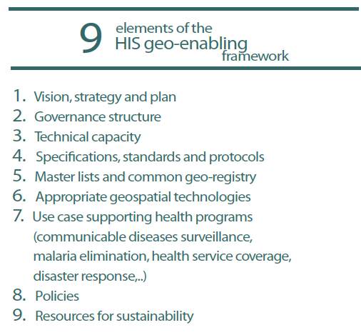
The HIS geo-enabling framework
Properly integrating geography and time across the HIS business processes requires the following 9 elements to be in place
These nine elements compose the HIS geo-enabling framework.
Core assets in common to all health programs!
Notes:
There are nine (9) elements that need to be in place to properly integrate geography and time across the HIS business processes:
Vision, strategy, and plan
Governance structure
Technical capacity
Specifications, standards, and protocols
Master lists and common geo-registry
Appropriate geospatial technologies
Use cases supporting health programs (communicable diseases surveillance, malaria elimination, health service coverage, disaster response, etc.)
Policies
Resources for sustainability
These nine elements compose the HIS geo-enabling framework. This framework has been developed and implemented by Health GeoLab Collaborative.
All these elements are core common assets in all health programs.

Slide 10
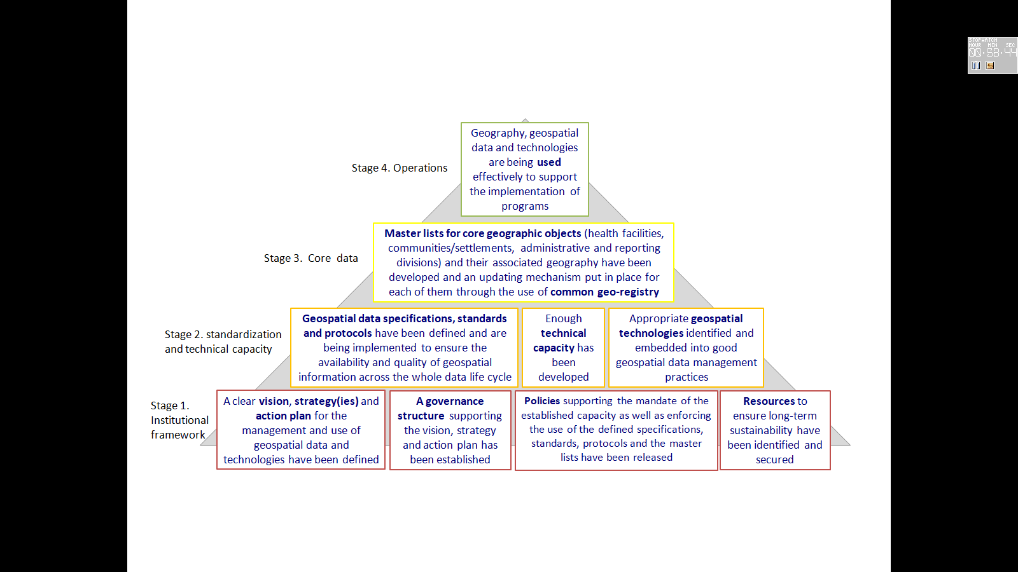
The HIS geo-enabling framework
These common assets cover four key stages of the HIS business process.
Each stage support the next one towards an operational use of geography, geospatial data and technologies to support the implementation of health programs.
Notes:
And these core common assets cover four key stages of the HIS business process:
Stage 1: Institutional framework
Stage 2: Standardization and technical capacity
Stage 3: Core data
Stage 4: Operations
Each stage supports the next one towards an operational use of geography, geospatial data and technologies to support the implementation of health programs.
In the succeeding slides, each of the elements of the HIS geo-enabling framework is described along with the benchmark/s needed to be reached to ensure that the element is in place.

Slide 11
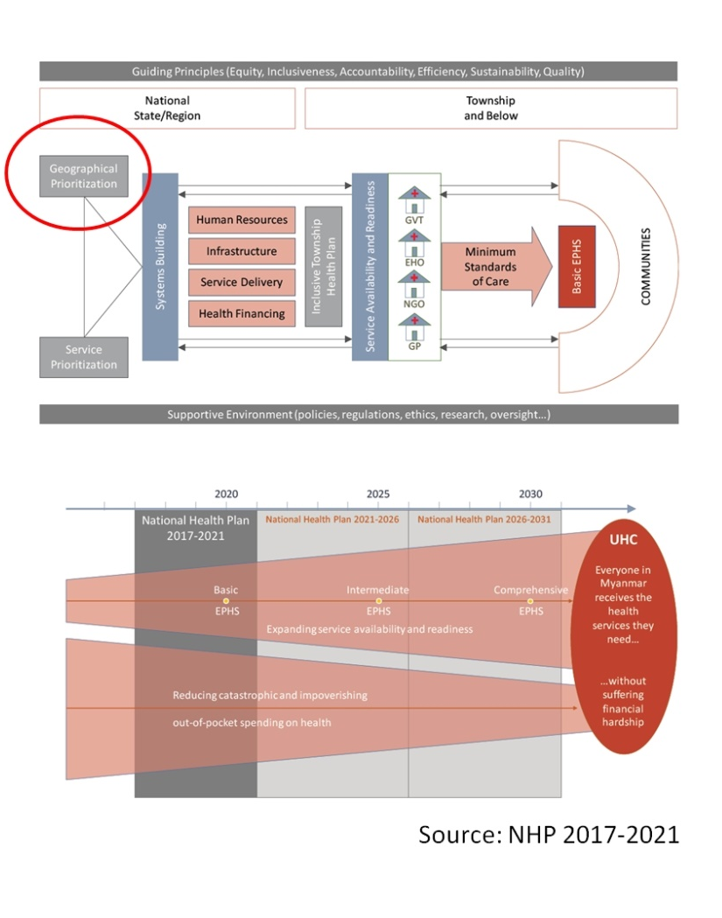
Framework element – Description and Benchmark
1. Vision, strategy(ies), and action plan
Description: A clear vision, strategy(ies), and action plan have been defined on the basis of an assessment.
Benchmark 1.1: The MOH has a vision, strategy(ies), and plans regarding the management and use of geospatial data and technologies.
Notes:
The element that needs to be in place is a clear vision, strategy(ies), and action plan.
The clear vision, strategy(ies), and action plan is defined based on the assessment of the current level of HIS geo-enablement (to be discussed in the next session) that has been conducted.
What is the benchmark for this element?
This element is deemed in place when the MOH has such vision, strategy(ies), and action plan.
The formulation of the vision is usually done through the consultation of the decision makers from the MOH, program managers, development partners, and national and local NGOs. This is so the different concerns and needs of these stakeholders are taken into account.
The strategy(ies) and action plan to be defined are meant to fill the gaps in HIS geo-enablement identified during the assessment.
Examples of such plan are the Myanmar National Health Plan 2017-2021 and the Cambodia Health Information System master plan 2016-2020.

Slide 12
Framework element – Description and Benchmark
2. Governance structure
Description: A governance structure supporting the vision, strategy(ies), and action plan has been established
Benchmark 2.1: The MOH has established a governance structure to handle issues pertaining to the management and use of geospatial data and technologies
Benchmark 2.2: All the health programs and the stakeholders involved in the management and use of geospatial data and technologies in health are part of the governance structure
Benchmark 2.3: The MOH is on board of the National Spatial Data Infrastructure (NSDI)
Notes:
2. The element that needs to be in place is a governance structure to support the vision, strategy(ies), and action plan that have been established as discussed in the previous slide.
What are the benchmarks for this element?
(Refer to slide)
The governance structure is meant to ensure that vision is kept in sight and that the strategy(ies) and action plan are being implemented accordingly.
The National Spatial Data Infrastructure (NSDI) in simple terms is the concept of one country, one geography. All government programs should be using the same geospatial data for the whole country. The MOH should be part of the NSDI both as data manager (for health related object) and users (for other data such as administrative boundaries).

Slide 13
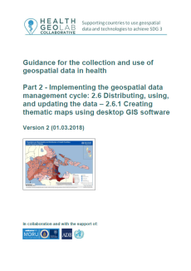
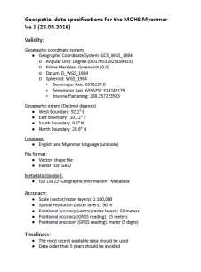
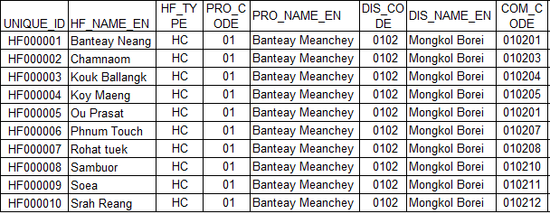

Framework element – Description and Benchmark
3. Technical capacity
Central level Geospatial Data Management Unit
Description: Sufficient technical capacity has been developed.
Master lists
Benchmark 3.1: The MOH has a central level geospatial data management unit with enough technical capacity to: a) ensure guardianship over the defined guidelines, standards, and protocols;
Guidelines,
standards,
protocols
Health program 1
Health program 2
Notes:
3. The element that needs to be in place is technical capacity.
Sufficient technical capacity should be developed among the staff of the MOH engaged in the HIS geo-enablement.
What are the benchmarks for this element?
(Refer to slide)
(Continued on next slide)

Slide 14
Framework element – Description and Benchmark
3. Technical capacity
Benchmark 3.1: (cont’d) b) support the development, maintenance, regular update, and sharing of the master lists for the geographic objects core to public health and immunization ; c) support the implementation of the guidelines, standards, protocols, and master lists across all health programs and information systems; and d) provide services to the HIS unit and beyond if needed.
Benchmark 3.2: The key health programs have enough technical capacity to support the implementation of their activities with the support of the central level unit
Notes:
(Continued from previous slide)
What are the benchmarks for this element?
(Refer to slide)
A central-level geospatial data management unit should be established and its capacity built first. It would serve as the guardian and main implementors of the defined guidelines, standards and protocols. And in building the central-level capacity first, the central-level staff would then act as the trainers and support for the sub-national level as well as the key health programs.

Slide 15
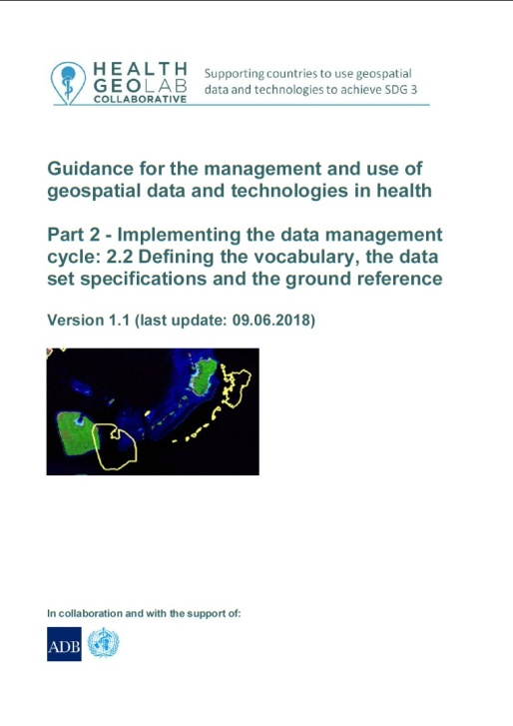

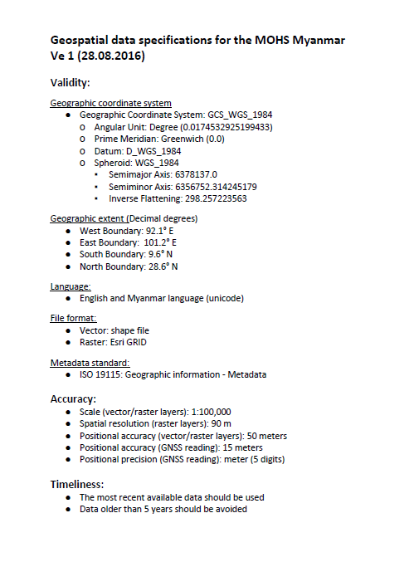
Framework element – Description and Benchmark
4. Data specifications, standards, and protocols
Description: Geospatial data specifications, standards, and protocols have been defined and are being implemented to ensure the availability and quality (completeness, uniqueness, timeliness, validity, accuracy, and consistency) of geographic information across the whole data life cycle.
Notes:
4. The element that needs to be in place is the data specifications, standards, and protocols.
Producing quality data products needs quality geographic data. In order to have this, geospatial data specifications, standards, and protocols need to be defined and implemented.
(The dimensions of geospatial data quality, geospatial data standards, and protocols are discussed in more detail in Module 3.)

Slide 16
Framework element – Description and Benchmark
4. Data specifications, standard, and protocols
Benchmark 4.1: The NSDI has defined the geospatial data and technologies related specifications, standards, and protocols that should be used by all governmental agencies.
Benchmark 4.2: The MOH is using the geospatial data and technologies related specifications, standards and protocols across all key health programs.
Notes:
What are the benchmarks for this element?
(Refer to slide)
Ideally, the NSDI should define the data specifications, standards, and protocols and all the government agencies should use them.
Examples of this are the Geospatial data management guideline for the Ministry of Health of Cambodia: http://www.healthgeolab.net/KNOW_REP/KHM_MOH_Guidelines_2018.pdf and the Health GeoLab Collaborative guidance documents: https://healthgeolab.net/resources/reference-materials/

Slide 17
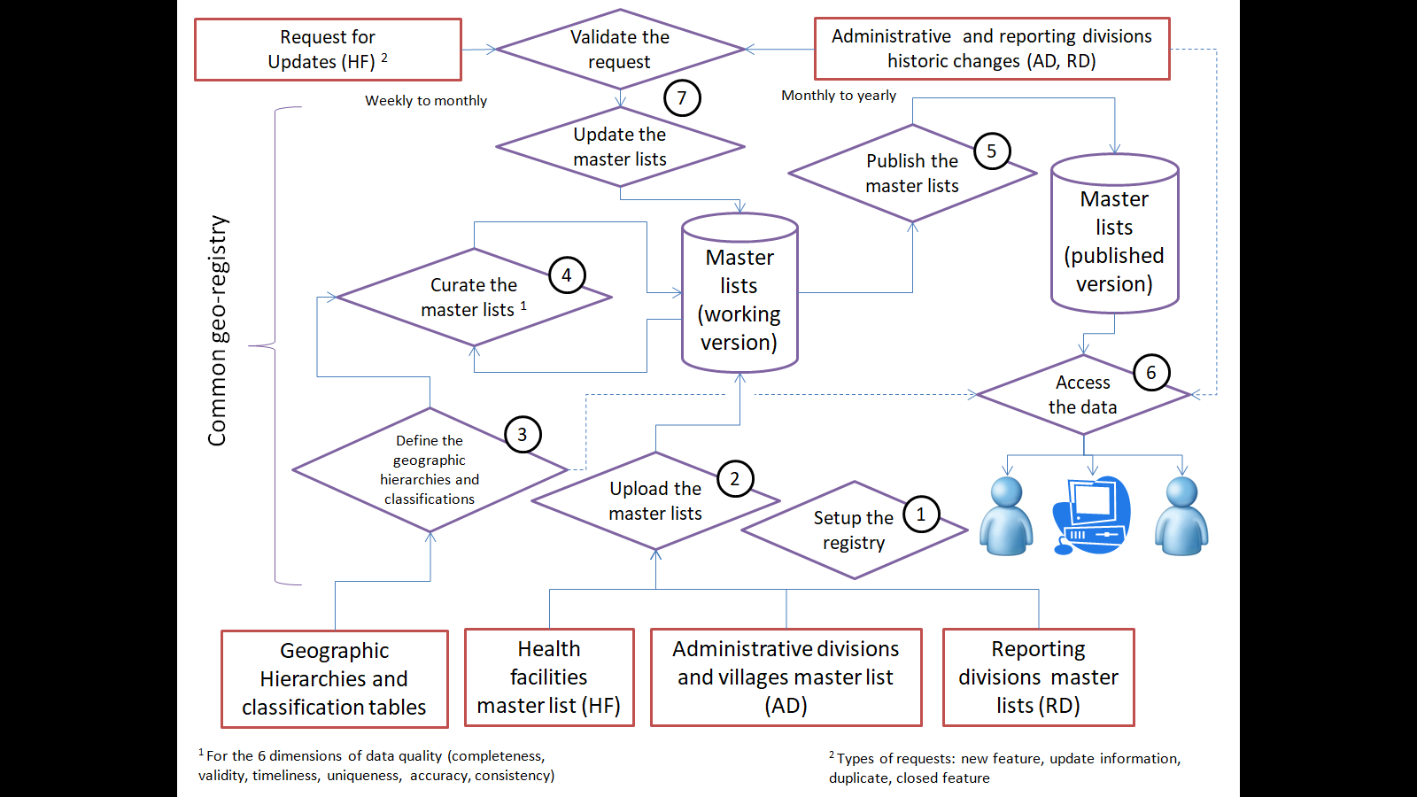
Framework element – Description and Benchmark
5. Master lists and common geo-registry
Description: The master lists for the core geographic objects (health facilities, administrative divisions and villages, and reporting divisions) and their associated geography have been developed, made accessible, and an updating mechanism put in place for each of them through the use of a common geo-registry.
Common geo-registry implementation
Notes:
5. The element that needs to be in place is the master list and common geo-registry.
A master list is an authoritative, officially curated by the mandated agency, complete, up-to-date, and uniquely coded list of all the active (and past active) records for a given geographic object (e.g. health facilities, administrative divisions, villages).
The master list for the core geographic objects and the associated geography particularly those related to health need to be developed, made accessible, and an updating mechanism put in place for each of them through the use of a common geo-registry.
The master list facilitates the object-oriented approach mentioned in Session 2.1 by allowing the statistical data to be linked to the corresponding geographic object through the unique codes/ID.

Slide 18
Framework element – Description and Benchmark
5. Master lists and common geo-registry
Benchmark 5.1: The MOH has a complete, up-to-date, uniquely coded, and geo-referenced (for point type objects) master list for each of the geographic objects key to public health (health facilities, administrative divisions and villages, reporting divisions).
Benchmark 5.2: These master lists are simultaneously hosted, maintained, regularly updated, and shared through a common geo-registry.
Notes:
What are the benchmarks for this element?
(Refer to slide)
To understand more about common geo-registry, the guidance document on the establishment of common geo-registry is available from this link: https://bit.ly/2FJxeRn
(Continued on next slide)

Slide 19
Framework element – Description and Benchmark
5. Master lists and common geo-registry
Benchmark 5.3: The government maintains, regularly updates, and share shapefiles containing the boundaries of the administrative and health reporting divisions.
Benchmark 5.4: All the above master lists, and especially their officially recognized codes, are being integrated in all the information systems and used for data collection, reporting, and monitoring across all health programs.
Notes:
What are the benchmarks for this element?
(Refer to slide)
The government should be the one to maintain, regularly updates, and share shapefiles of different geographic object (such as administrative divisions, health facilities, schools, reporting divisions, etc.) as it is the most authoritative entity when it comes to these objects.
All the health programs should then use and integrate the information from the master list particularly the officially recognized unique codes in their data collection, reporting, and monitoring. (As mentioned in Session 2.1).

Slide 20

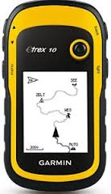

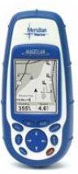
Framework element – Description and Benchmark
6. Appropriate geospatial technologies
Description: The appropriate geospatial technologies have been identified and are being used in accordance to good geospatial data management practices.
Central level Geospatial Data Management Unit
Benchmark 6.1: The central level geospatial data management and technologies unit has access to the necessary geospatial technologies (GNSS, GIS) to support its mandate.
Health program 1
Health program 2
Notes:
6. The element that needs to be in place is the appropriate geospatial technologies.
There are numerous geospatial technologies available nowadays with the range of functions going from collecting geographic coordinates to simple visualization to complex spatial analyses. Choosing the appropriate geospatial technologies and using them in accordance to good geospatial data management practices are important elements of the HIS geo-enabling framework.
What are the benchmarks for this element?
(Refer to slide)
The choice of geospatial technology depends on the context. For the central level, the appropriate geospatial technology may be those that can perform sophisticated analyses and modelling.
(Continued on next slide)

Slide 21
Framework element – Description and Benchmark
6. Appropriate geospatial technologies
Benchmark 6.2: The key health programs have access to the appropriate geospatial technologies (GNSS, GIS) to support the implementation of their activities.
Notes:
(Continued from previous slide)
What are the benchmarks for this element?
(Refer to slide)
The key health programs should have the appropriate geospatial technologies to support the implementation of their activities. This can sometimes be geospatial technologies that perform simpler analyses than what the central-level needs.

Slide 22
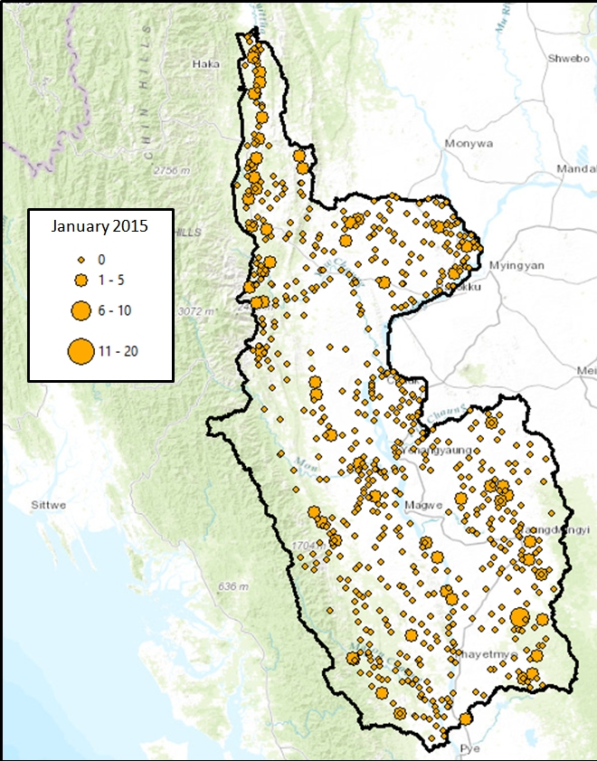
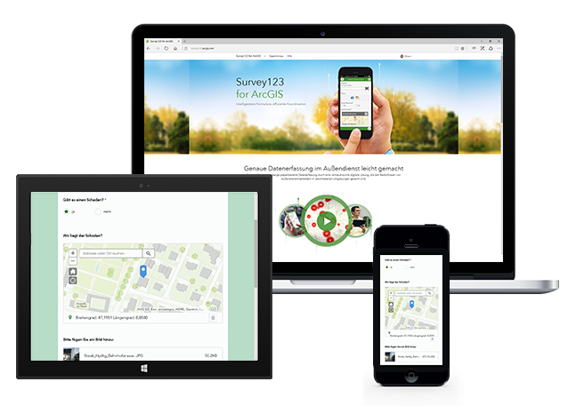
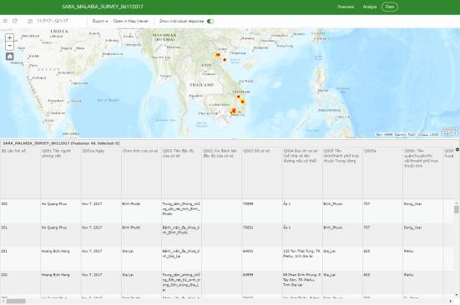
Framework element – Description and Benchmark
7. Use cases supporting health programs
Description: Use cases supporting health programs (communicable diseases surveillance, health service coverage, disaster management, etc.) towards reaching SDG 3 are being implemented and documented
Disease monitoring and control (Malaria)
Field data collection
(SARA Malaria)
Notes:
7. The element that needs to be in place is the use cases supporting health programs.
Use cases supporting health programs (communicable diseases surveillance, health service coverage, disaster management, etc.) towards reaching SDG 3 are being implemented and documented.
This is what the other eight (8) elements (from the other three key stages) are reaching towards – for the geography, geospatial data and technologies to be used to support the implementation of health programs.

Slide 23
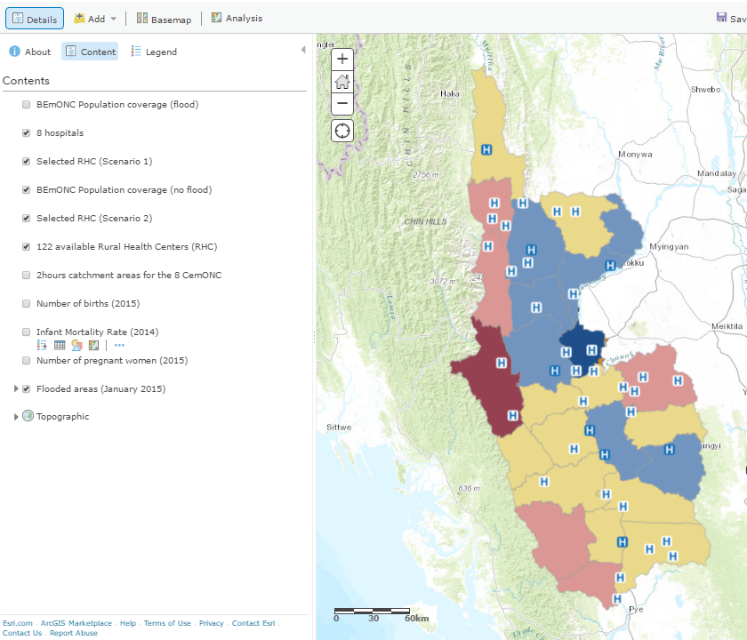
Framework element – Description and Benchmark
7. Use cases supporting health programs
Benchmark 7.1: Geospatial data and technologies are recognized as being important and their full potential is being used to support the implementation of key health programs towards reaching SDG 3.
EmONC Planning
Notes:
What is the benchmark for this element?
(Refer to slide)
Some examples for this are malaria monitoring and control in Myanmar, field data collection for SARA Malaria in Vietnam, and EmONC planning in Myanmar.

Slide 24
Framework element – Description and Benchmark
8. Policies
Description: Policies supporting and enforcing all of the above as well as geospatial data accessibility have been released.
Benchmark 8.1: A policy/policies enforcing the following has/have been released:
a) The mandate over the guardianship on geospatial data specifications, standards, and protocols as well as over the development, maintenance, update, and sharing of master lists for the geographic objects core to public health through the use of a common geo-registry.
Notes:
8. The element that needs to be in place is policies.
The policies supporting and enforcing all of the other elements as well as geospatial data accessibility need to be released.
It has been noted that even if the other elements of the HIS geo-enabling framework have been defined, actually using or implementing them is not guaranteed unless there is a policy enforcing this.
What is the benchmark for this element?
(Refer to slide)
(Continued on next slide)

Slide 25
Framework element – Description and Benchmark
8. Policies
Benchmark 8.1: A policy/policies enforcing the following has/have been released: (cont’d)
b) The use of the developed specifications, standards, protocols, and master lists by all the stakeholders in the health sector
Notes:
(Continued from previous slide)
What is the benchmark for this element?
(Refer to slide)
Having the policies in place guarantees that all the other elements that have to be in place are enforced.

Slide 26



HIS Geo-enabling Benchmarks
9. Resource for sustainability
Description: The necessary resources to ensure long-term sustainability have been identified and secured.
Benchmark 9.1: The MOH have the necessary human and financial resources to ensure the long term sustainability of their geospatial data and technologies-related activities
MOH
Reaching all these benchmarks means that the HIS is geo-enabled!
Notes:
9. The element that needs to be in place is the resource for sustainability.
The necessary resources to ensure long-term sustainability need to be identified and secured.
What is the benchmark for this element?
(Refer to slide)
To keep the HIS is geo-enabled, resources are needed such as for the following: geospatial data needs to updated, geospatial technologies being used need to upgraded or changed, staff need to be re-trained or new staff need to be hired, etc.
Once all these benchmarks have been reached, it means the HIS is geo-enabled!

