Slide 1
Session 2.1: Introduction to the Health Information System (HIS) geo-enabling framework

Slide 2
A geo-enabled health information system
An Information System that fully benefits from the power of geography, geospatial data and geospatial technologies through the proper integration of the geographic and time dimensions across its business processes
Can you think about one piece of data or information within an HIS that has neither a geographic nor a time dimension?
" everything happens somewhere
at a given time"
Properly integrating geography and time in the HIS actually improves geographically-based decision making and therefore provides a more systemic approach to solving public health problems.
2
Directly applicable to any program or intervention
2

Slide 3
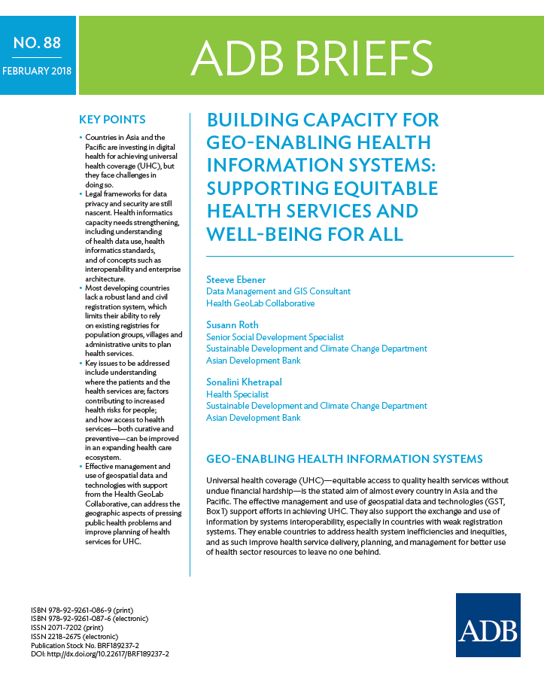
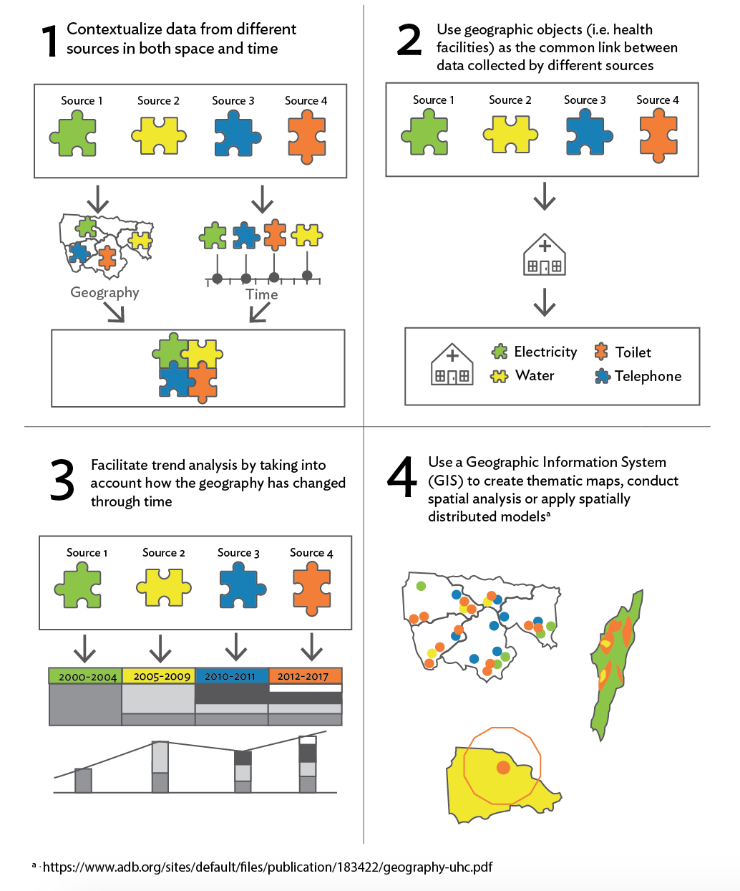
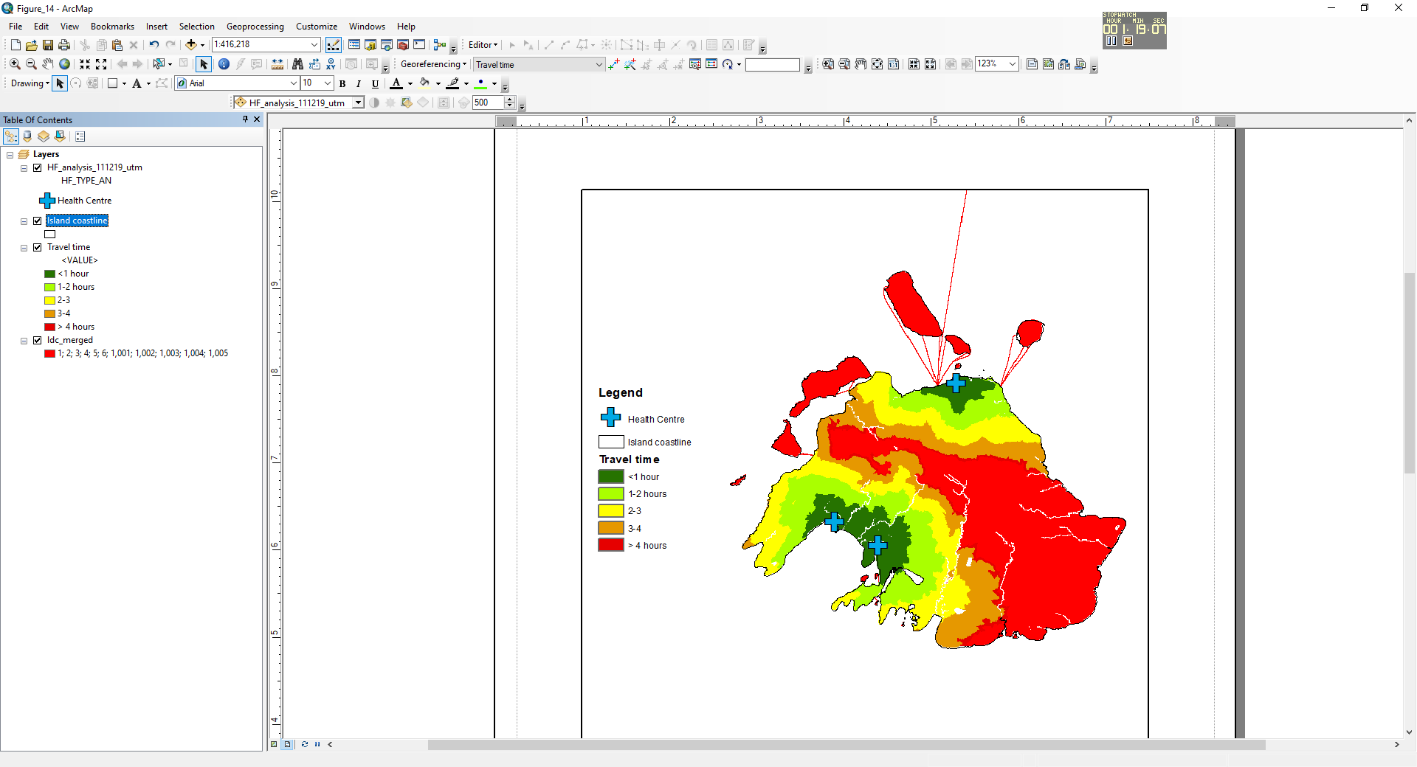
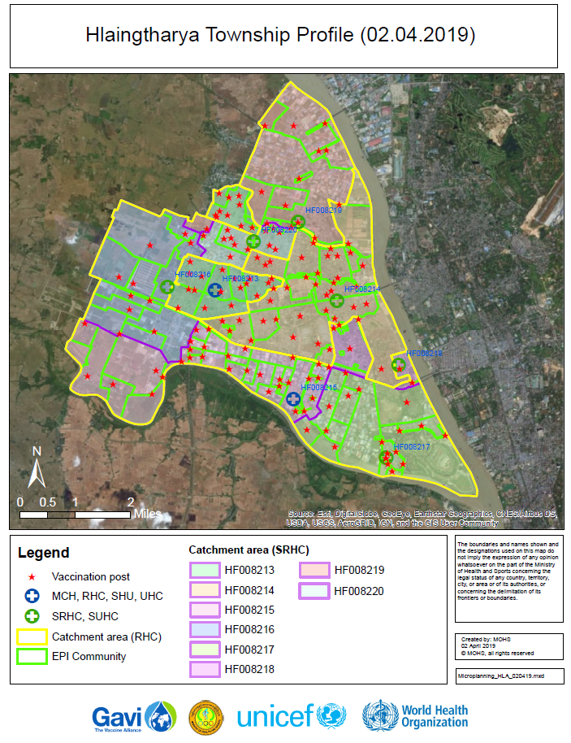
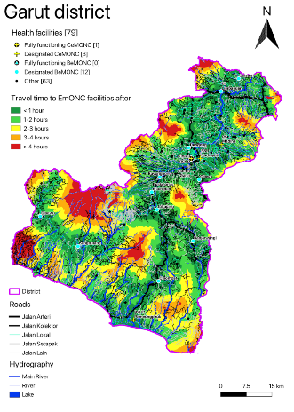
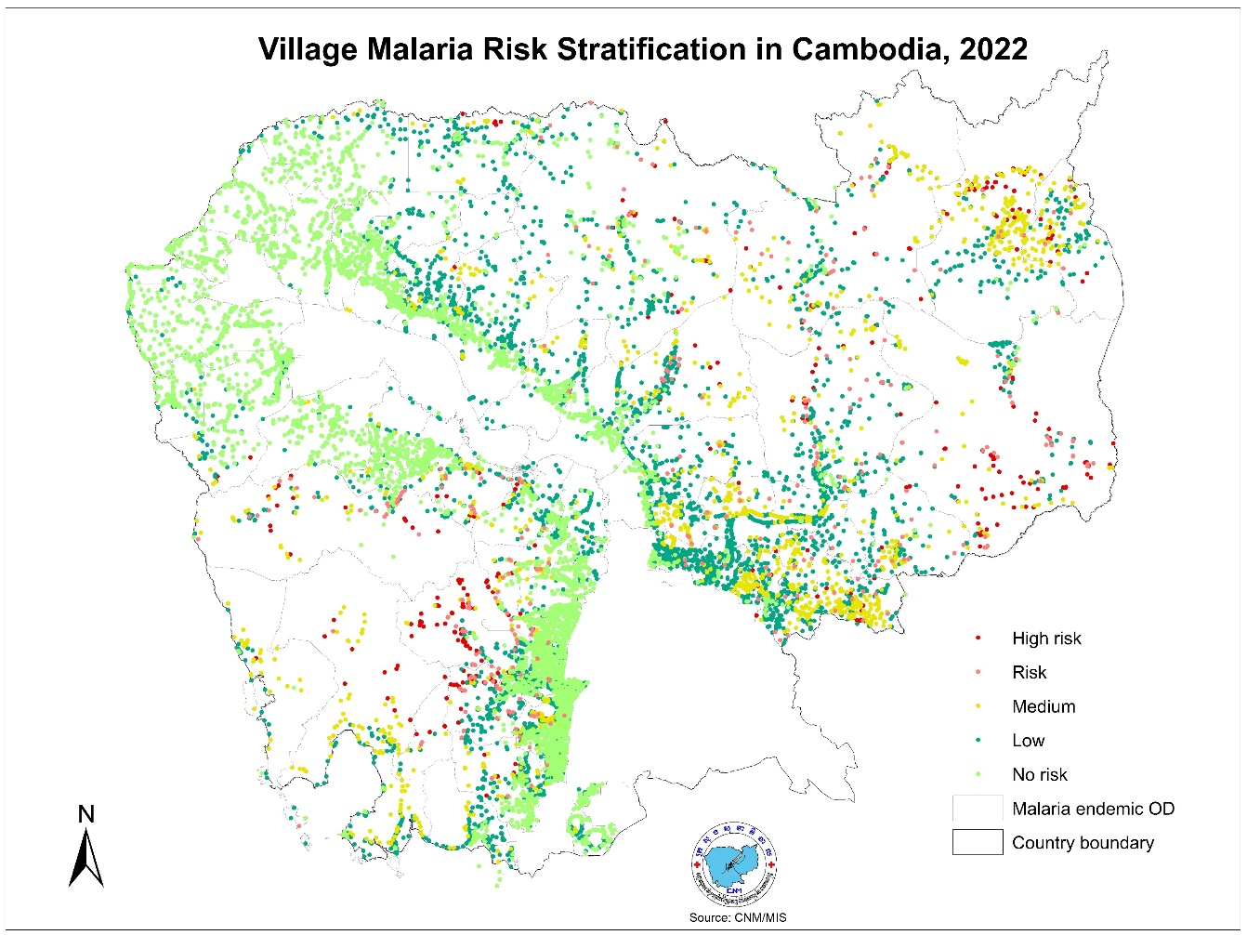
Other advantages of good integration of geographical and temporal dimensions in the HIS
1
Contextualize data from different sources in both space and time
Use geographic entities (i.e. health facilities) as the common link between data collected by different sources
Facilitate trend analysis by taking into account how the geography has changed through time
Use a geographic information system (GIS) to create thematic maps, conduct spatial analyses, or apply spatially distributed models
How do you benefit from this in a sustainable way?
By geo-enabling the health information system, programs or interventions
1 https://www.adb.org/publications/building-capacity-geo-enabling-health-information-systems
3

Slide 4
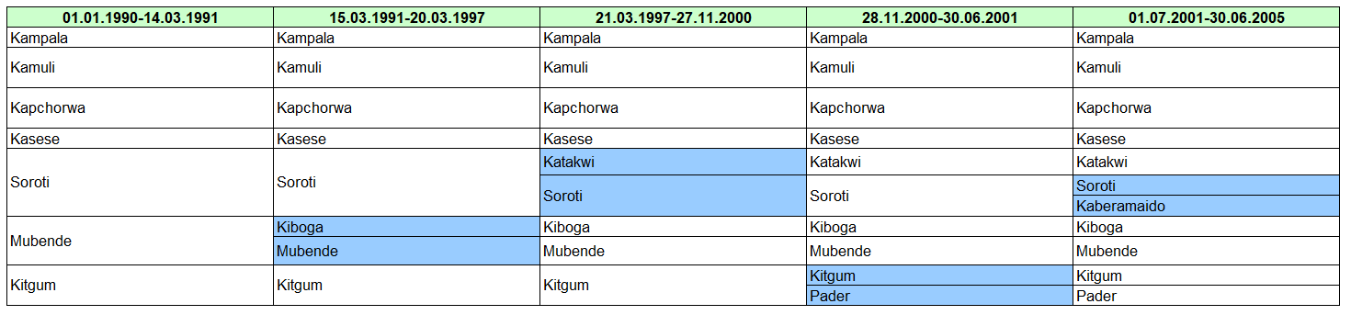
A geo-enabled health information system
  Importance of simultaneously managing the geographic and temporal dimensions
Uganda
Geography changes continuously over time and at a different “speed” depending on the geographical feature being considered.
4
https://salb.un.org/en
4

Slide 5
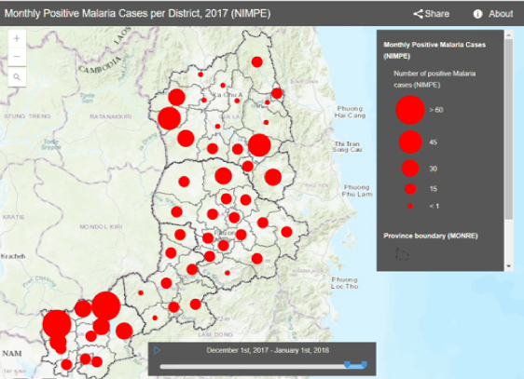
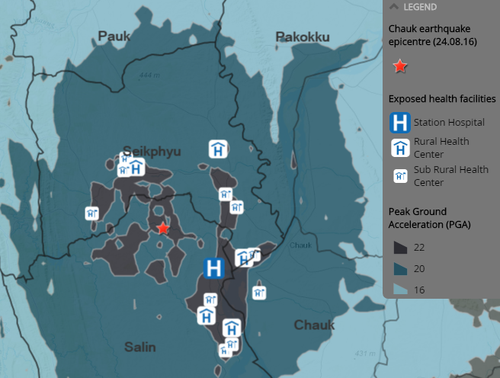
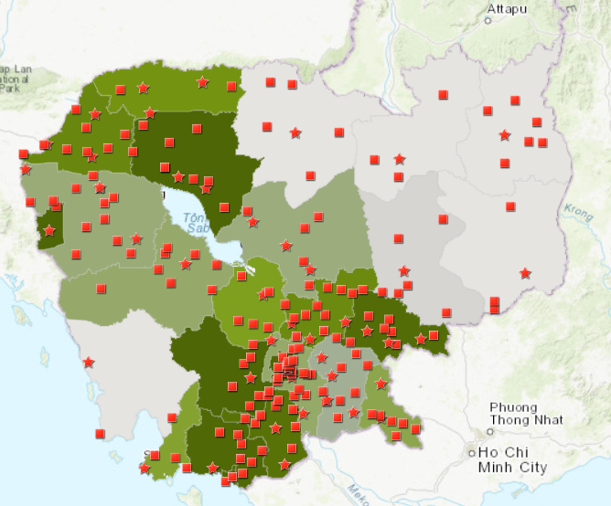
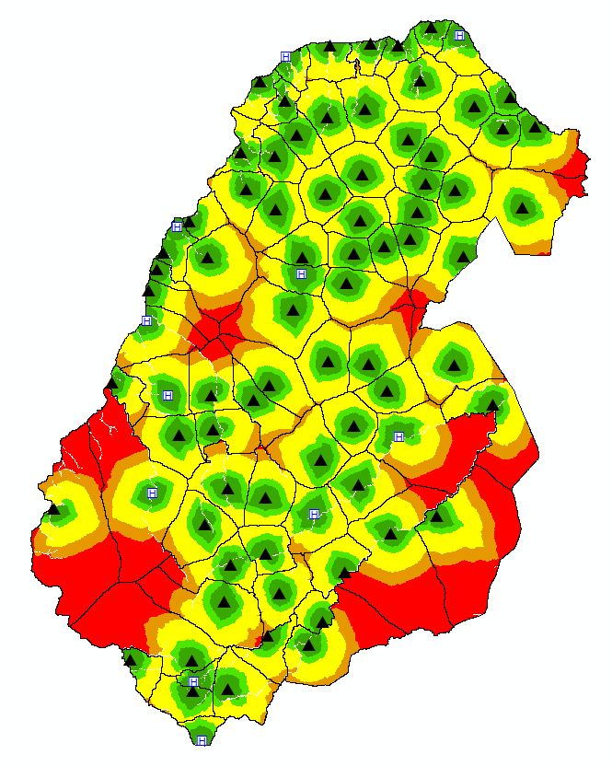
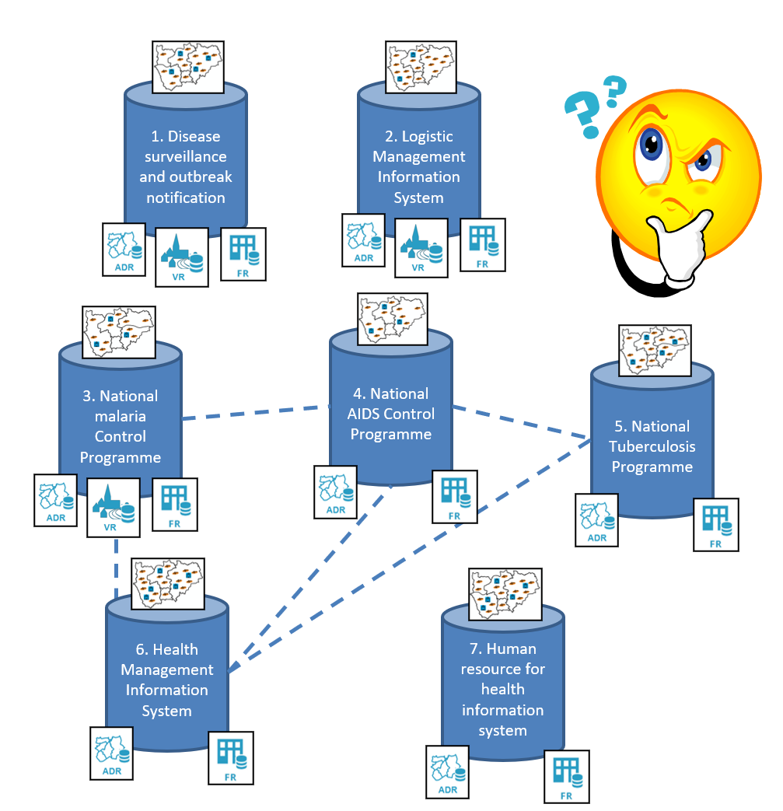
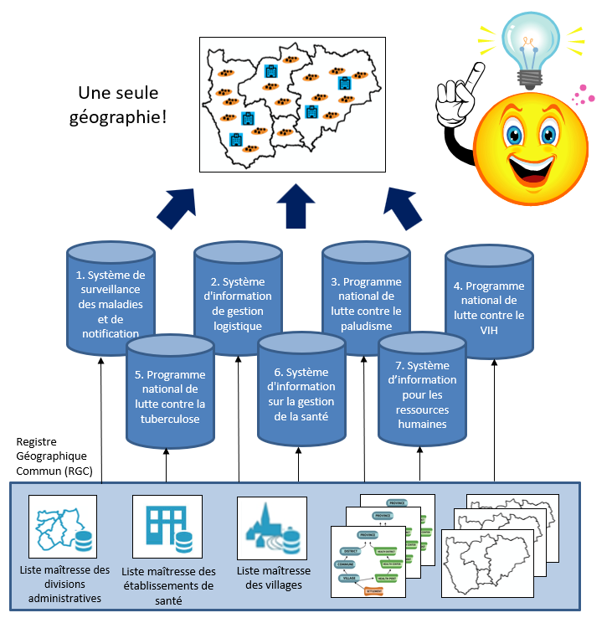
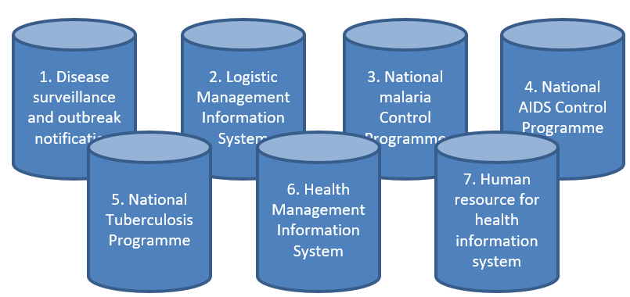
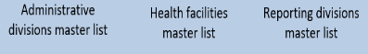
The vision behind the geo-enablement
Passing from this …
… to this
One Geography!
Common Geo-Registry (CGR)
Each information system maintains and uses a different geography which is not cost-effective and does not allow benefiting from the power of geography, geospatial data and technologies.
All information systems use the same geography over time, which not only reduces duplication of effort and costs, but also takes full advantage of the power of geography, geospatial data and technologies.
5

Slide 6
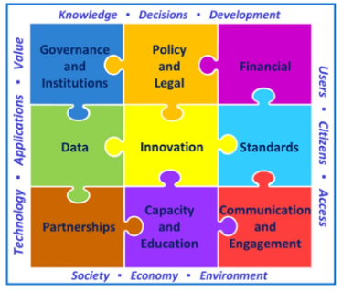
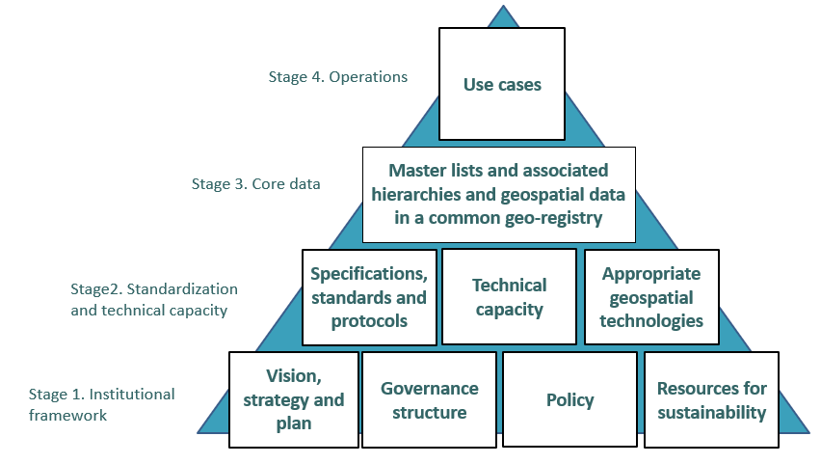
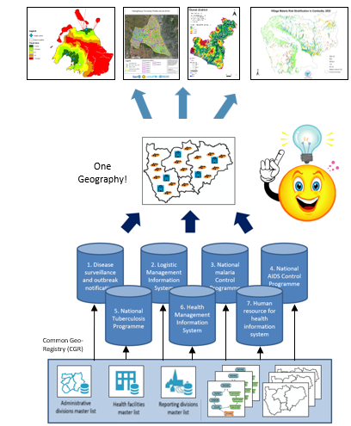
The HIS geo-enabling framework
9 elements that must be in place and sustained over the long term for a HIS to be considered geo-enabled
Aligned with the United Nations Integrated Geospatial Information Framework (UN-IGIF) – Cross sectoral framework
Each stage supports the next one towards an operational use of geography, geospatial data and technologies to support the implementation of health programs
6

Slide 7
The HIS geo-enabling framework
The place of the 5 main applications of geospatial data and technologies
Thematic mapping
Population estimation and spatial distribution
Geographic accessibility, service localization, and route optimization modeling
Georeferenced Master Lists
Navigation, tracking and geographic coordinate collection using a GNSS
Apart from the georeferenced master list and the collection of geographic coordinates which are also key to the core data stage of the framework, all these application are enabling the use cases
7

Slide 8
The HIS geo-enabling framework
A Clear vision, strategy, and action plan for the management and use of geospatial data and technologies have been defined.
A governance structure supporting the vision, strategy, and action plan has been established.
Sufficient technical capacity has been developed to support the proper management and use of geospatial data and technologies.
Geospatial data specifications, standards, and protocols have been defined and are being implemented to ensure the availability and quality (completeness, uniqueness, timeliness, validity, accuracy, and consistency) of geographic information across the whole data lifecycle.
The master lists for the core geographic objects (health facilities, administrative divisions and villages, and reporting divisions) and their associated hierarchies and geospatial data have been developed, made accessible, and an updating mechanism put in place for each of them using a common geo-registry.
The appropriate geospatial technologies have been identified and are being used in accordance with good geospatial data management practices.
Use cases (applications) supporting health programs (communicable diseases surveillance, malaria elimination, health service coverage, disaster management, etc.) towards reaching SDG 3 are being implemented and documented.
Policies supporting and enforcing all the above as well as geospatial data accessibility have been released.
The necessary resources to ensure long term sustainability have been identified and secured.
8

Slide 9
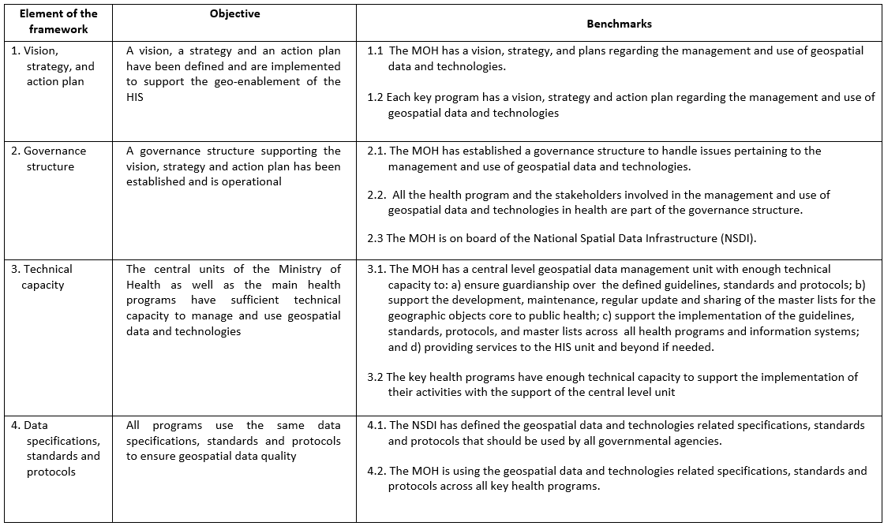
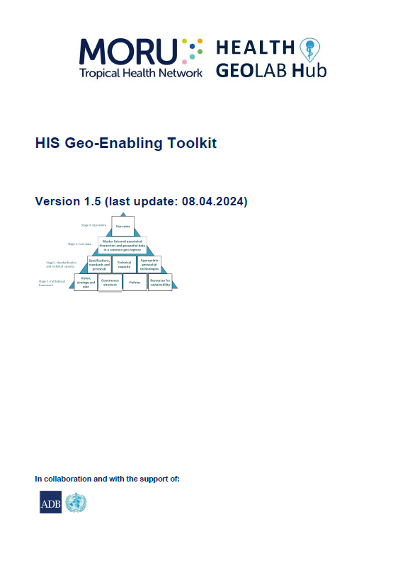
The HIS geo-enabling framework – Objectives and benchmarks
Used to assess the current level of geo-enablement in each country and as the basis for developing the action plan to fill existing gaps
9
9

Slide 10
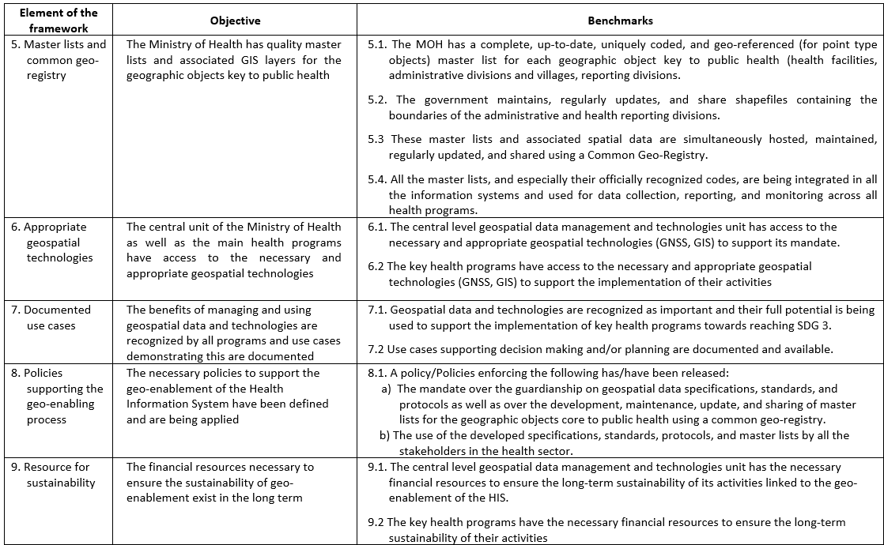
The HIS geo-enabling framework – Objectives and benchmarks
Used to assess the current level of geo-enablement in each country and as the basis for developing the action plan to fill existing gaps
10
10

Slide 11
The HIS geo-enabling framework - Origin
1
Situation in countries of the Asia-Pacific region (2017)
Has received a GIS training (mainly in data collection and thematic mapping)
Has access to a GIS software
Generates thematic maps, but spatial analysis and modelling are very limited
Important gaps for the elements guaranteeing the quality, effectiveness and long-term sustainability of data and information products
11
11
1 Source: https://www.adb.org/publications/building-capacity-geo-enabling-health-information-systems
11

Slide 12
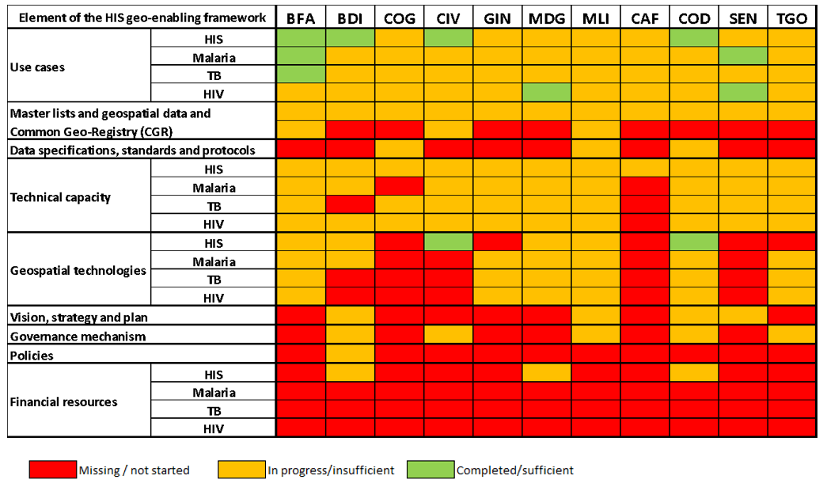
The HIS geo-enabling framework - Origin
Situation in French speaking African countries (2023)
Stage 4. Operations
Series of use cases that have not been institutionalized
Stage 3. Core data
Stage 2. Standardization and technical capacity
BFA = Burkina Faso, BDO = Burundi, COG = Republic of Congo, CIV = Ivory Coast, GIN = Guinea, MDG = Madagascar, MLI = Mali, CAF = Central African Republic, COD = Democratic Republic of the Congo, SEN = Senegal, TGO = Togo
Stage 1. Institutional framework
Important gaps for the elements guaranteeing the quality, effectiveness and long-term sustainability of data and information products and this across programs
12
12
12

Slide 13
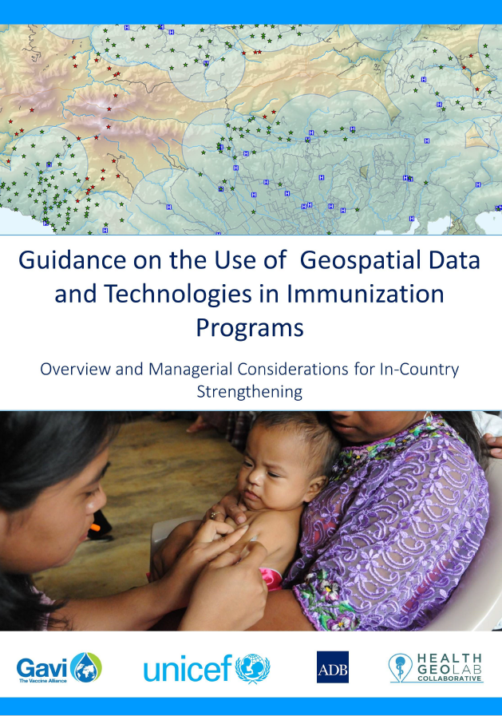

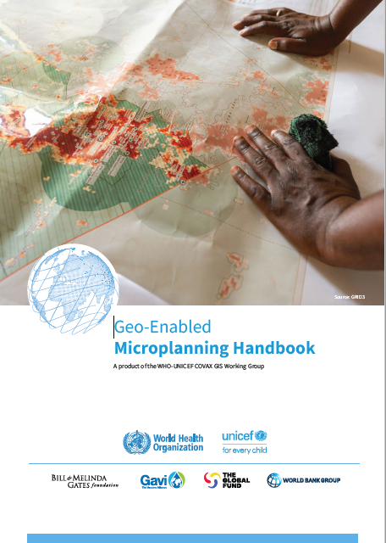
Guidelines including/based on the HIS geo-enabling framework
2018
2021
2023
Framework used by UNICEF, GAVI, WHO and the Global Fund to support the management and use of geospatial data and technologies in countries.
1 https://www.unicef.org/media/58181/file
2 https://www.gavi.org/news/document-library/leveraging-geospatial-technologies-and-data-strengthen-immunisation
3 https://drive.google.com/file/d/1jj779zww4herWOESAd9mXqVE1YfQehtH/view?usp=sharing
13

Slide 14
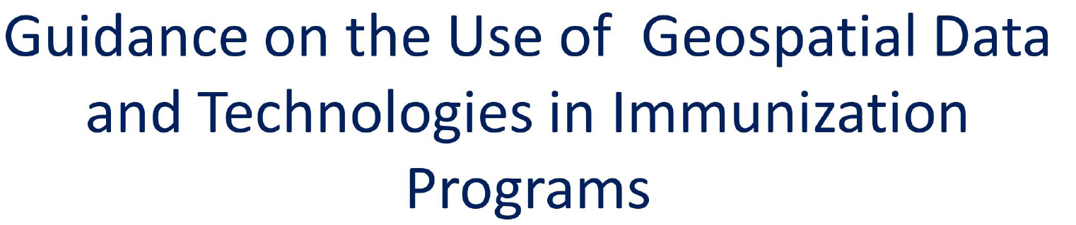


The HIS geo-enabling framework in the 3 guidelines
Objective/purpose | Provide a non-technical introduction to the role of geospatial data and technologies in immunization programs and propose a process-based framework to guide decision-makers and planners in strengthening the management and use of geospatial data and geospatial technologies in immunization program in countries. | Provides information, steps and important considerations for the process of selecting, planning and budgeting geospatial data and technology applications for immunization. | Provide health officials with guidance on how to integrate geospatial data and technologies – in particular, geographic information systems (GIS) – into the microplanning process. The handbook also provides evidence on the benefits of geo-enabled microplanning
Target audience | All stakeholders interested in advocating for or investing in the management and use of geospatial data and technologies in immunization programs. | In country immunization programs willing to invest in the use of geospatial data and technology applications | Public health programme managers/ designers (country relevant staff, health officials at national and subnational level) and technical experts (GIS and other technical staff supporting microplanning efforts)
Promotion Resource mobilization Technical implementation
Complementary while presenting some overlap
Applicable to other health programmes and microplanning across all of them
14

Slide 15
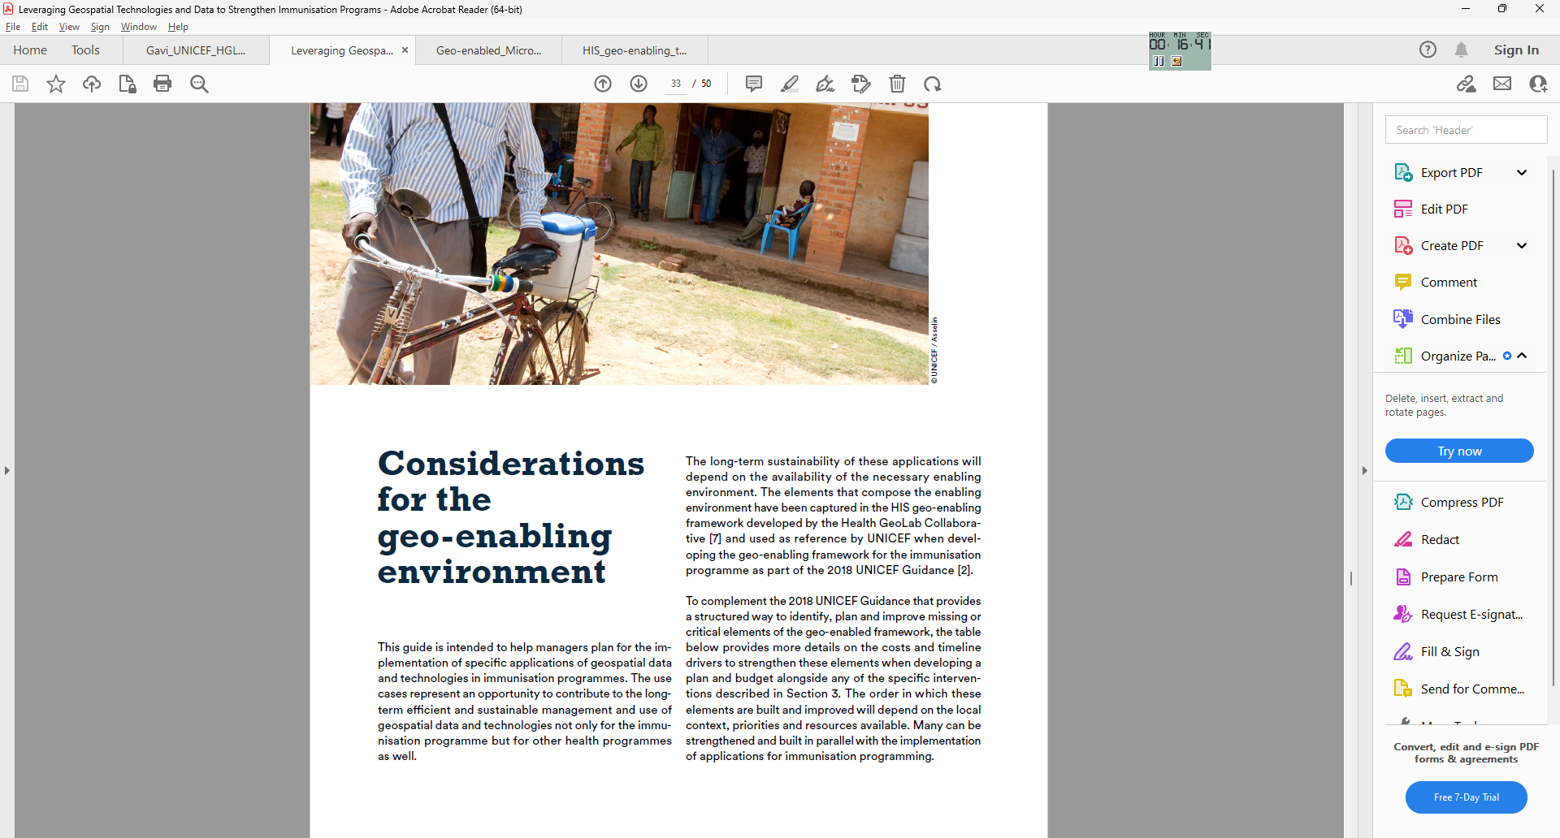
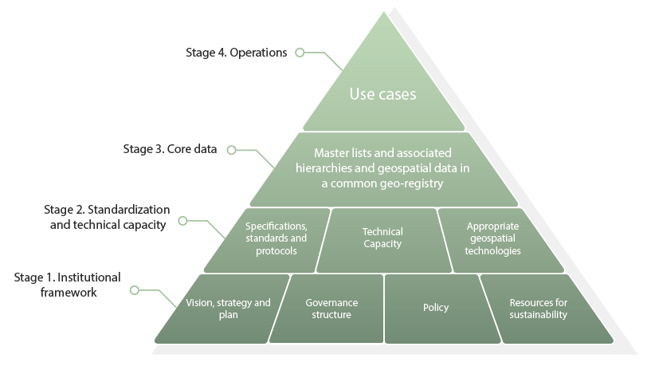
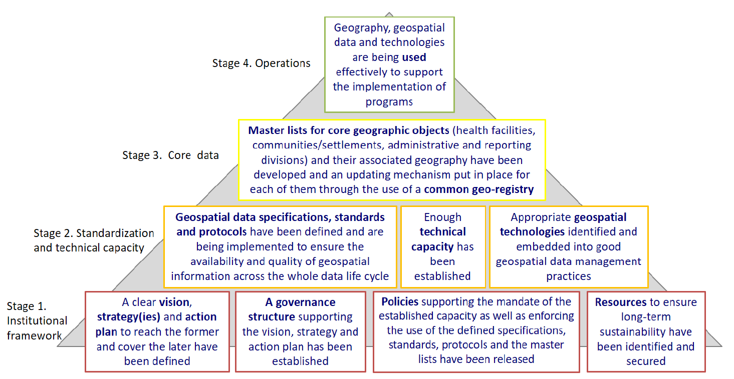
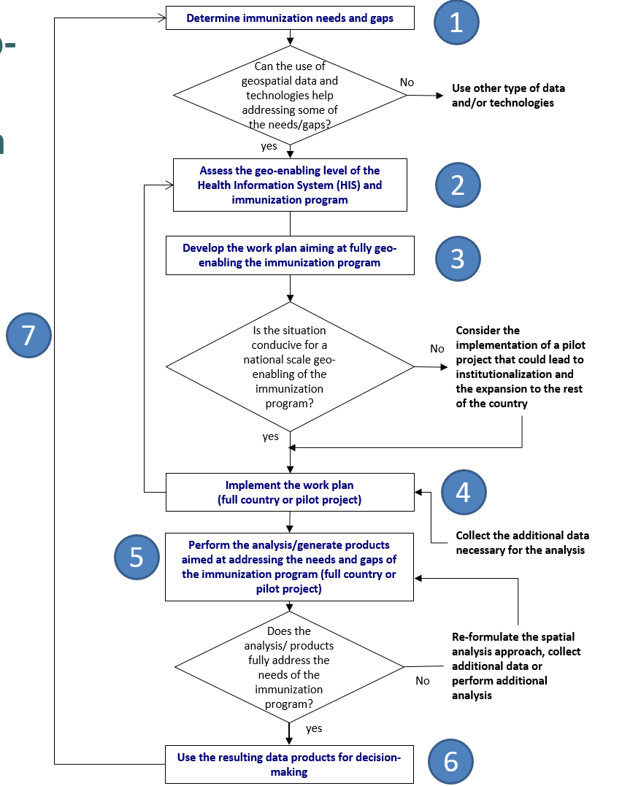
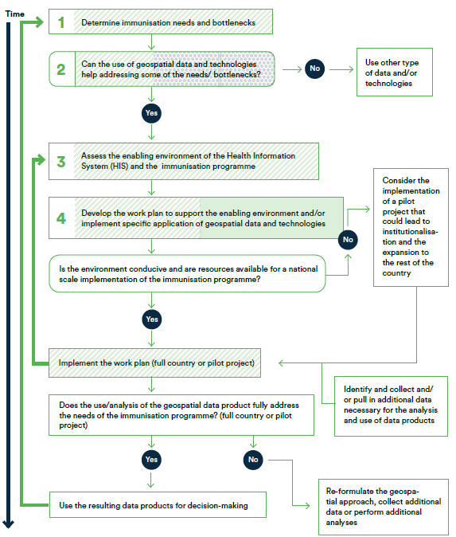
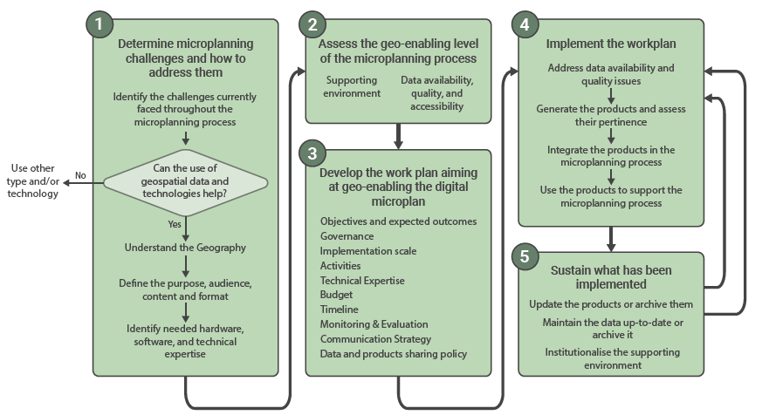
The HIS geo-enabling framework in the 3 guidelines
15

Slide 16

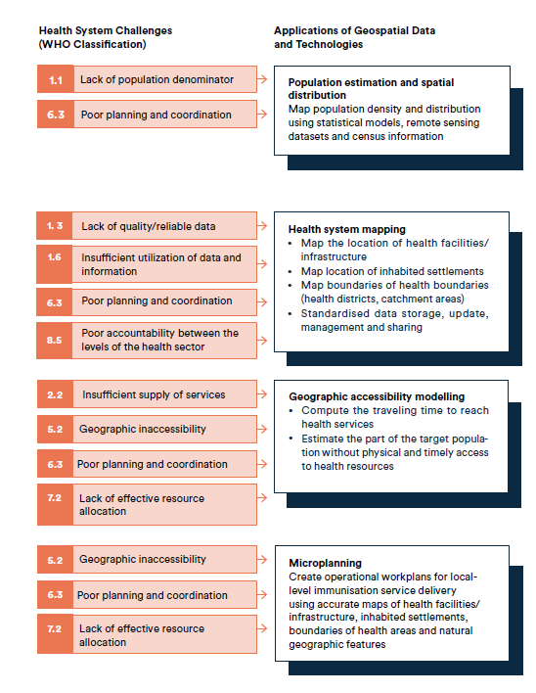
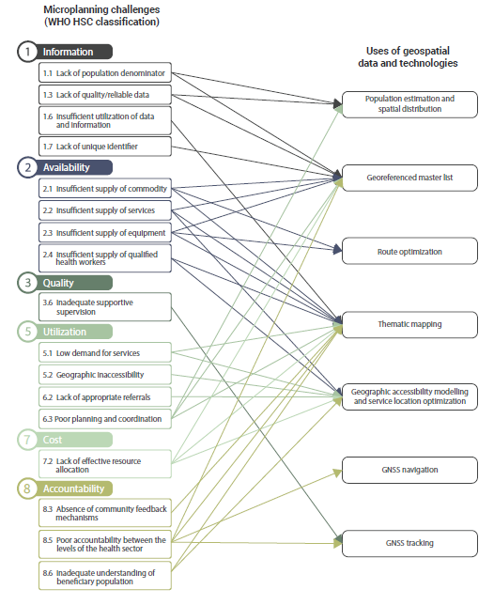
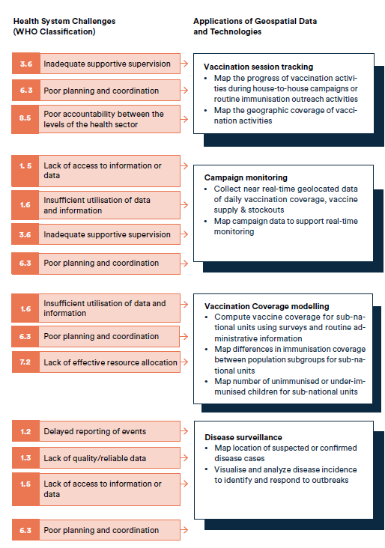
Additional useful tools – Challenges addressed by applications of geospatial data and technologies
16

Slide 17
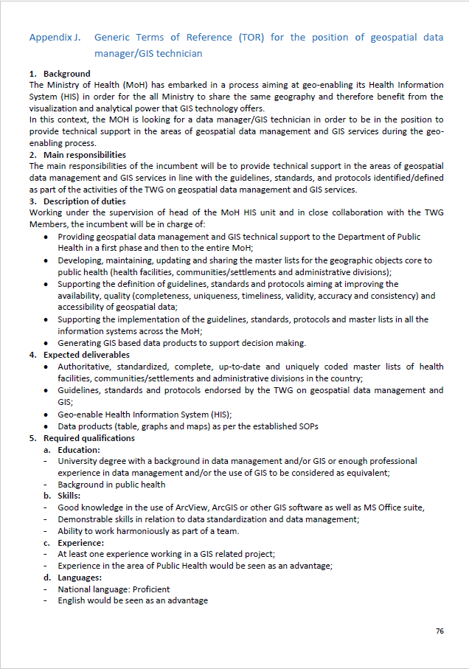
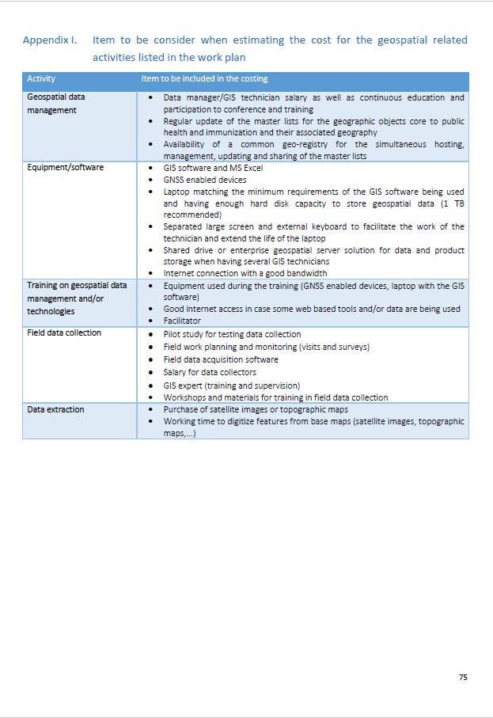
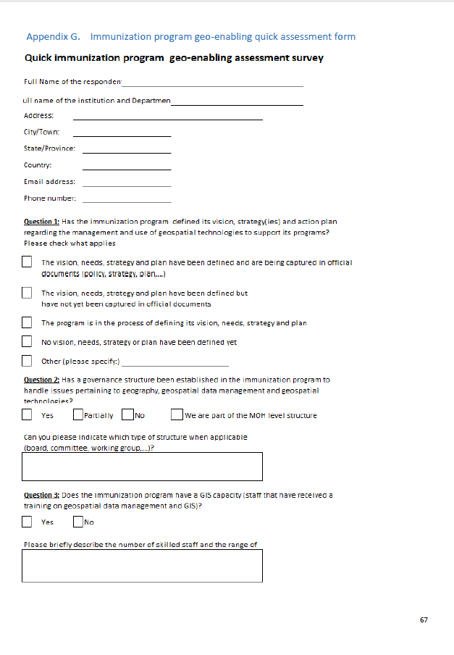
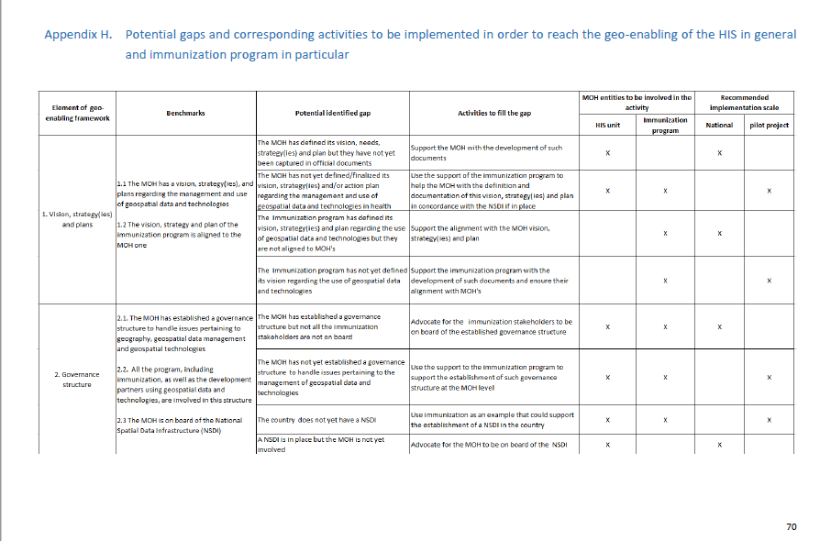
Additional useful tools – Program specific supporting material
Strategies, stakeholders’ involvement and implementation level to fill existing gaps
Terms of reference
Items for consideration when estimating costing
Quick assessment tool
Can be contextualized to be applicable to any health program
17

Slide 18
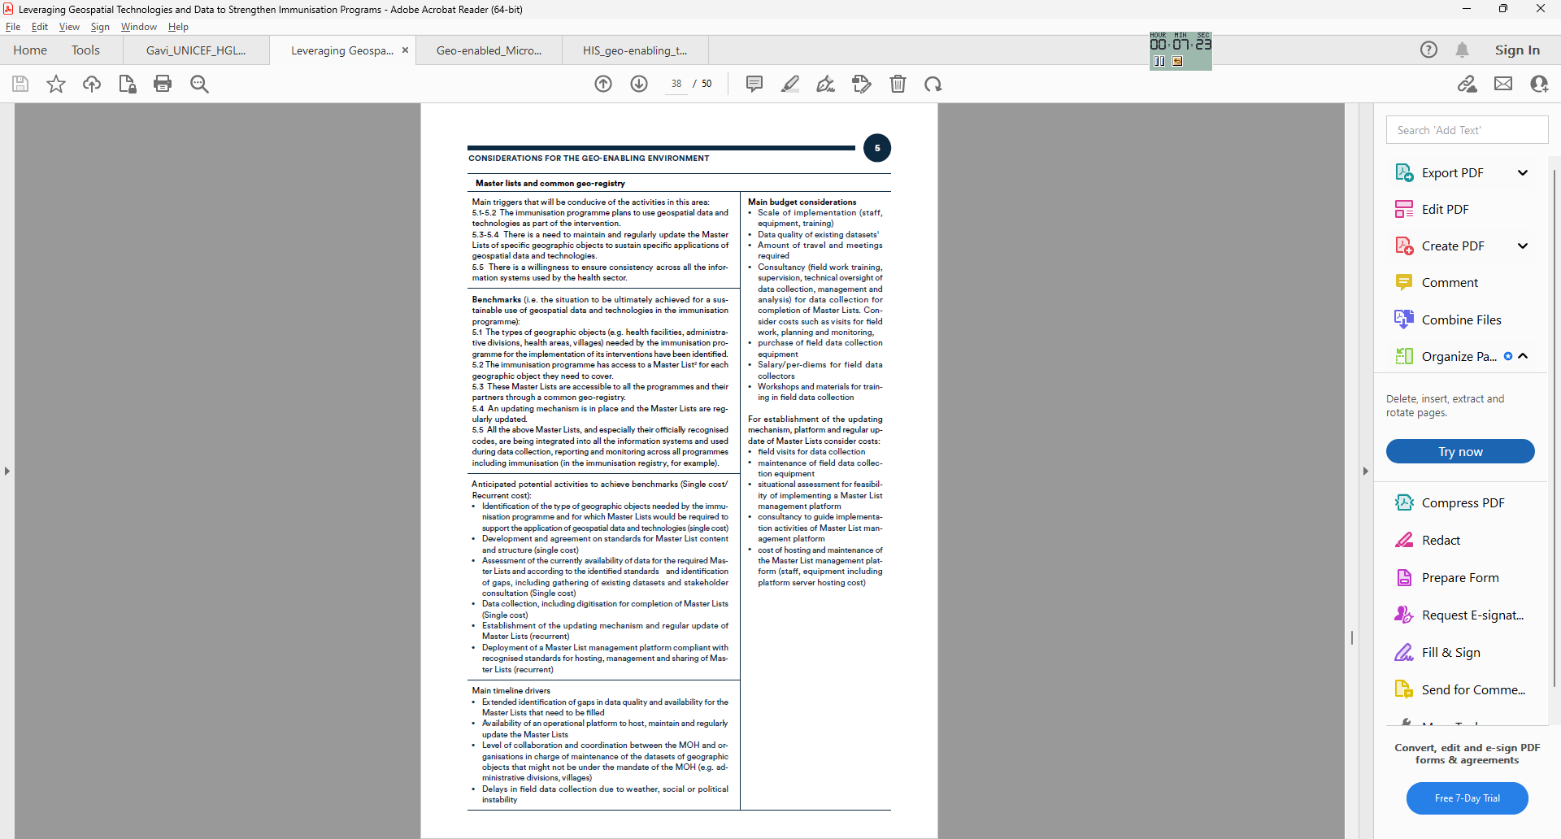
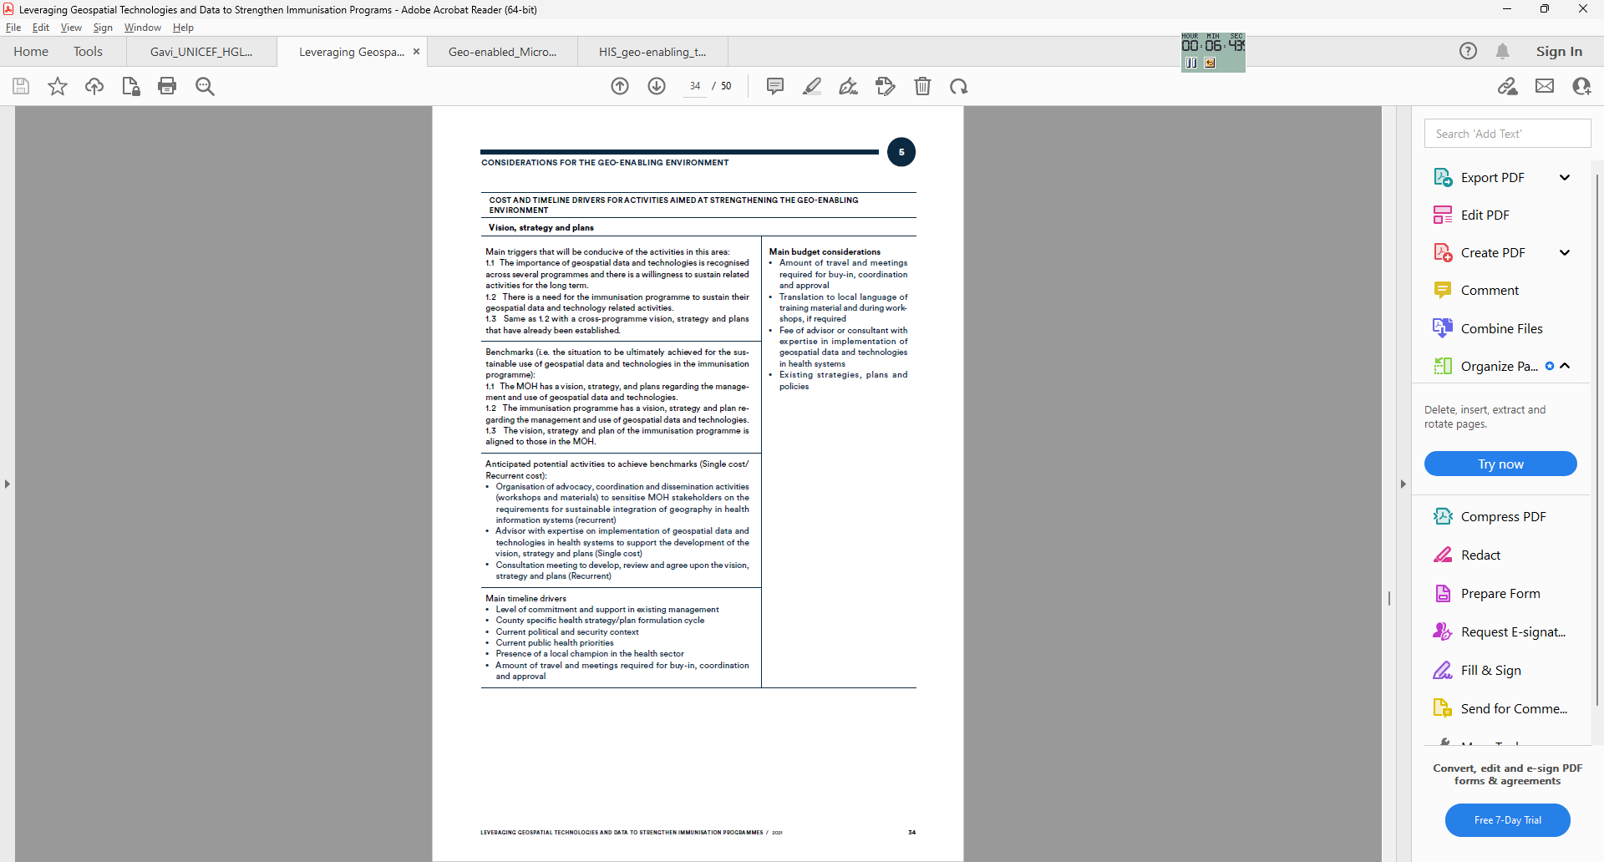
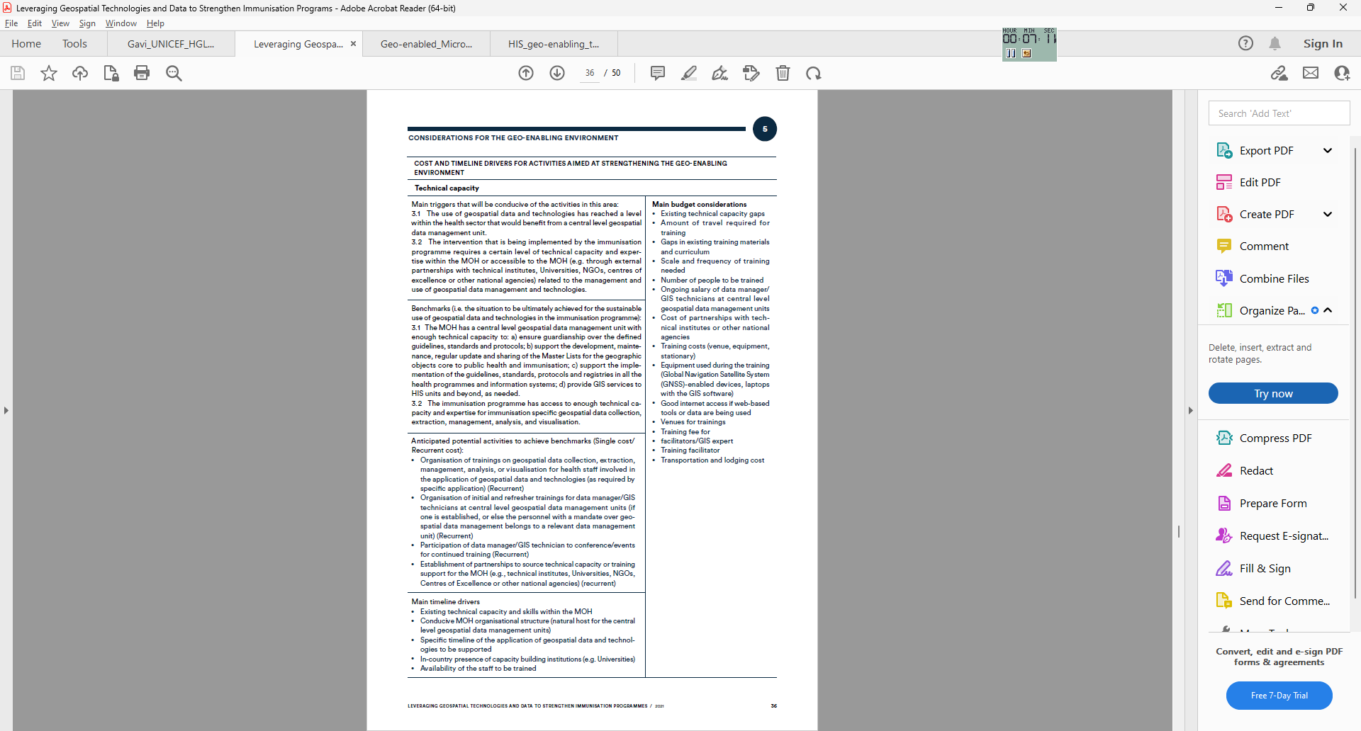
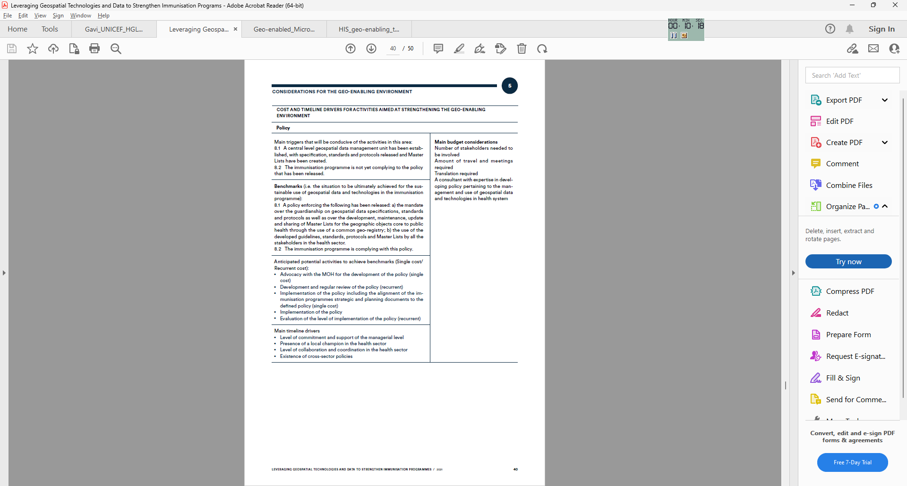
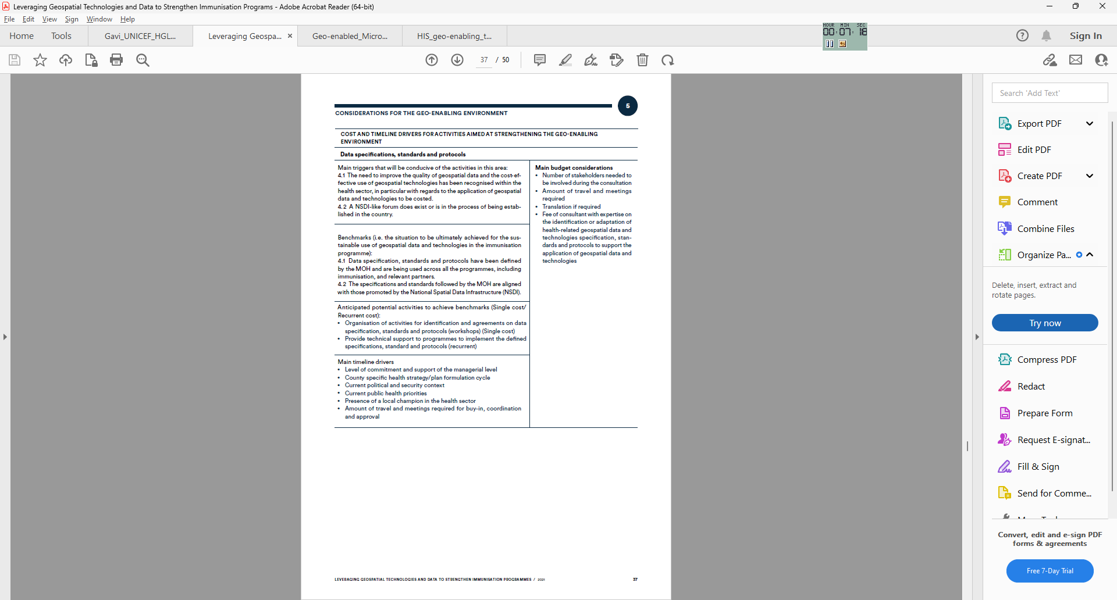
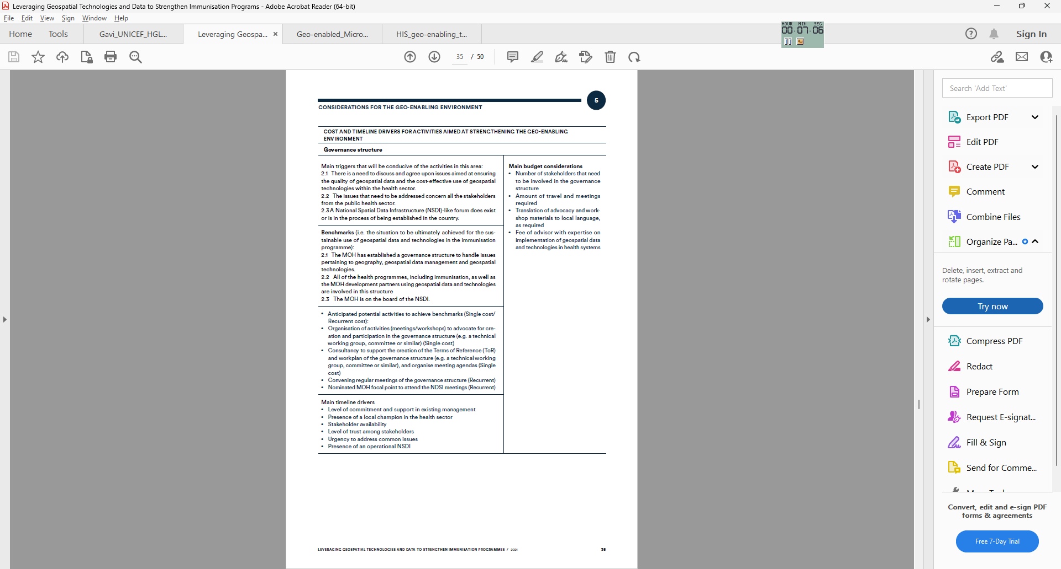
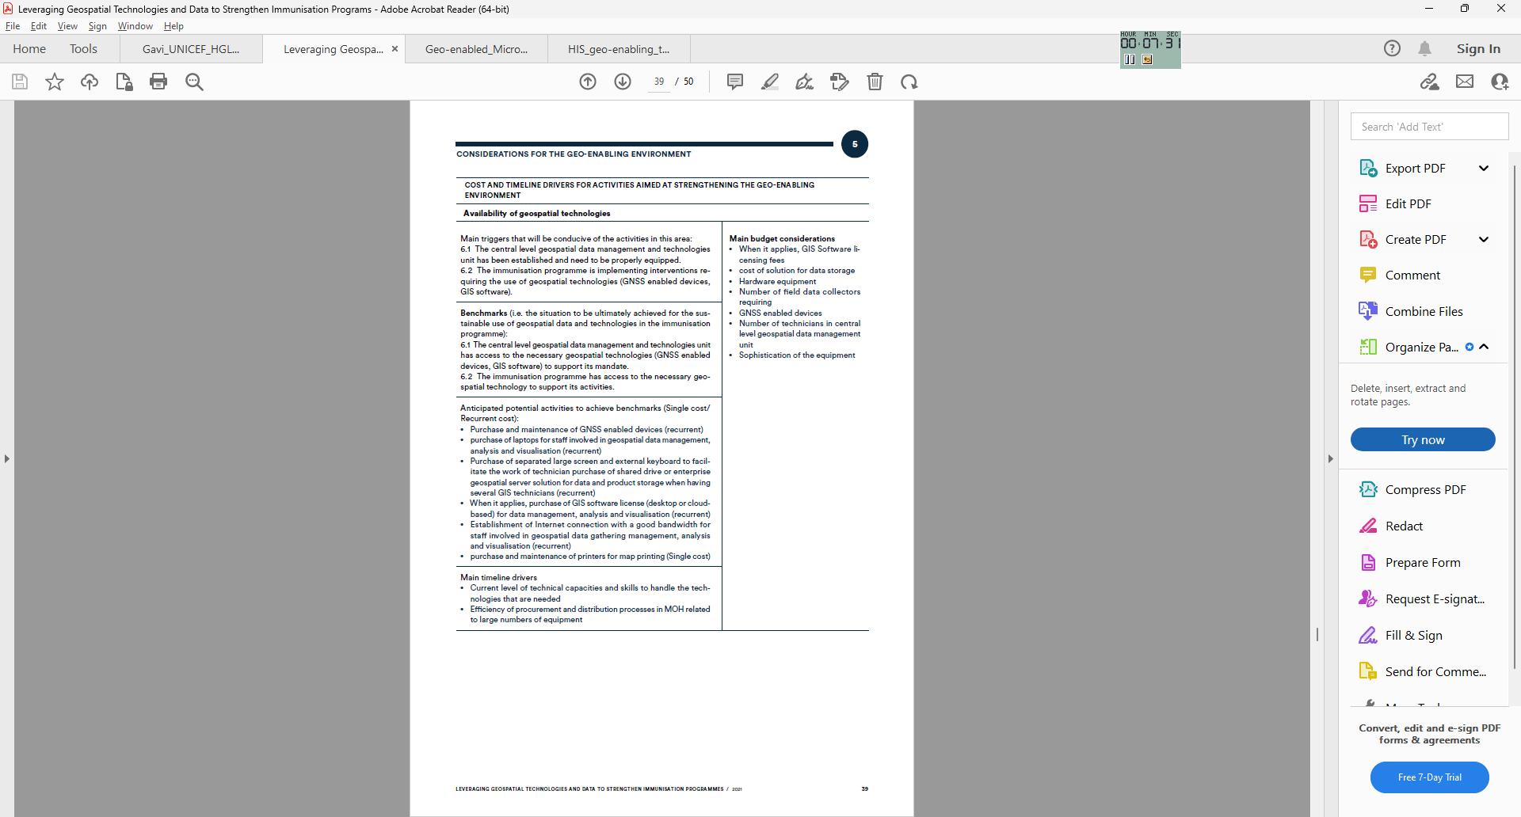
Additional useful tools - Cost and timeline drivers for activities aimed at strengthening the geo-enabling environment
Provided for 7 of the 9 components of the HIS geo-enabling framework
18

Slide 19







Example of in-country implementation
Myanmar (https://arcg.is/OCHOz)
Cambodia (https://arcg.is/0uviGj)
Viet Nam (https://arcg.is/1XmLjy)
Mongolia
(https://arcg.is/1O0u4r)
19

Slide 20
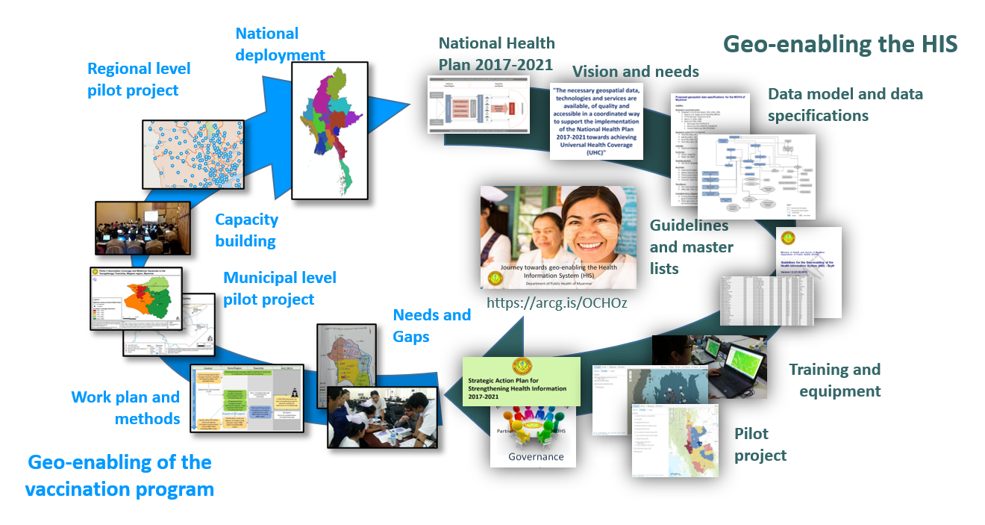
Example of in-country implementation - Myanmar
Supports the convergence of efforts

Slide 21
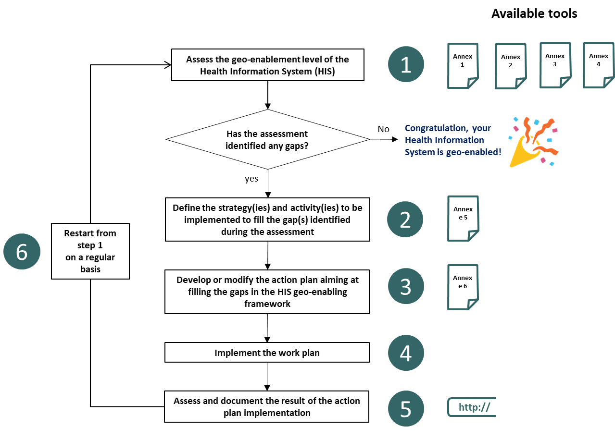
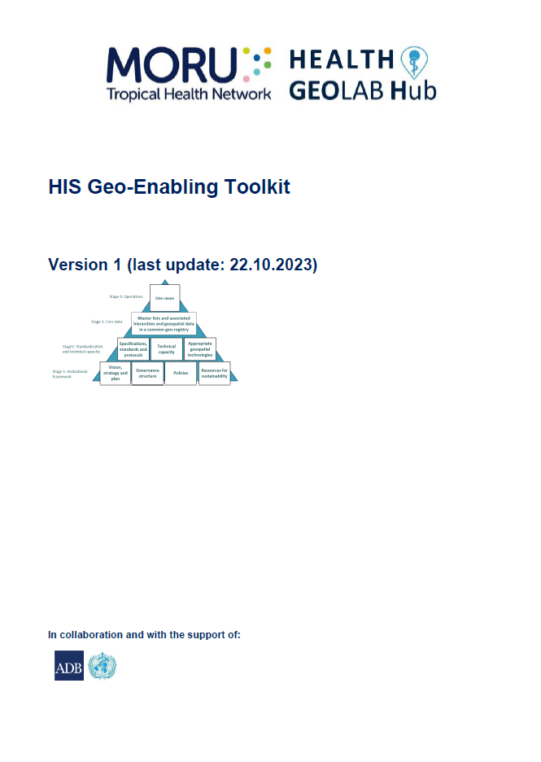
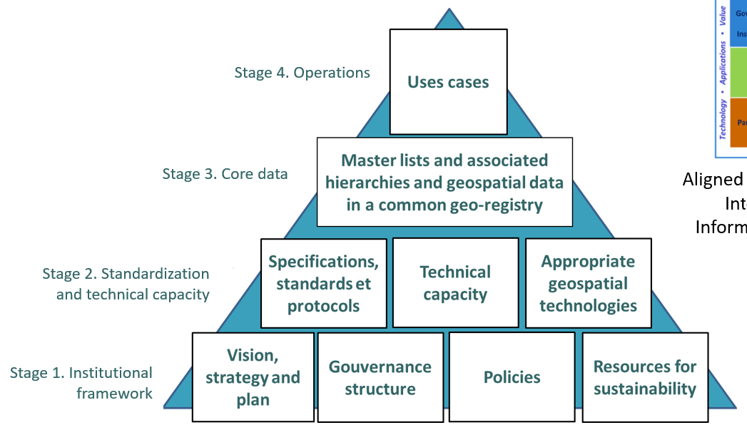
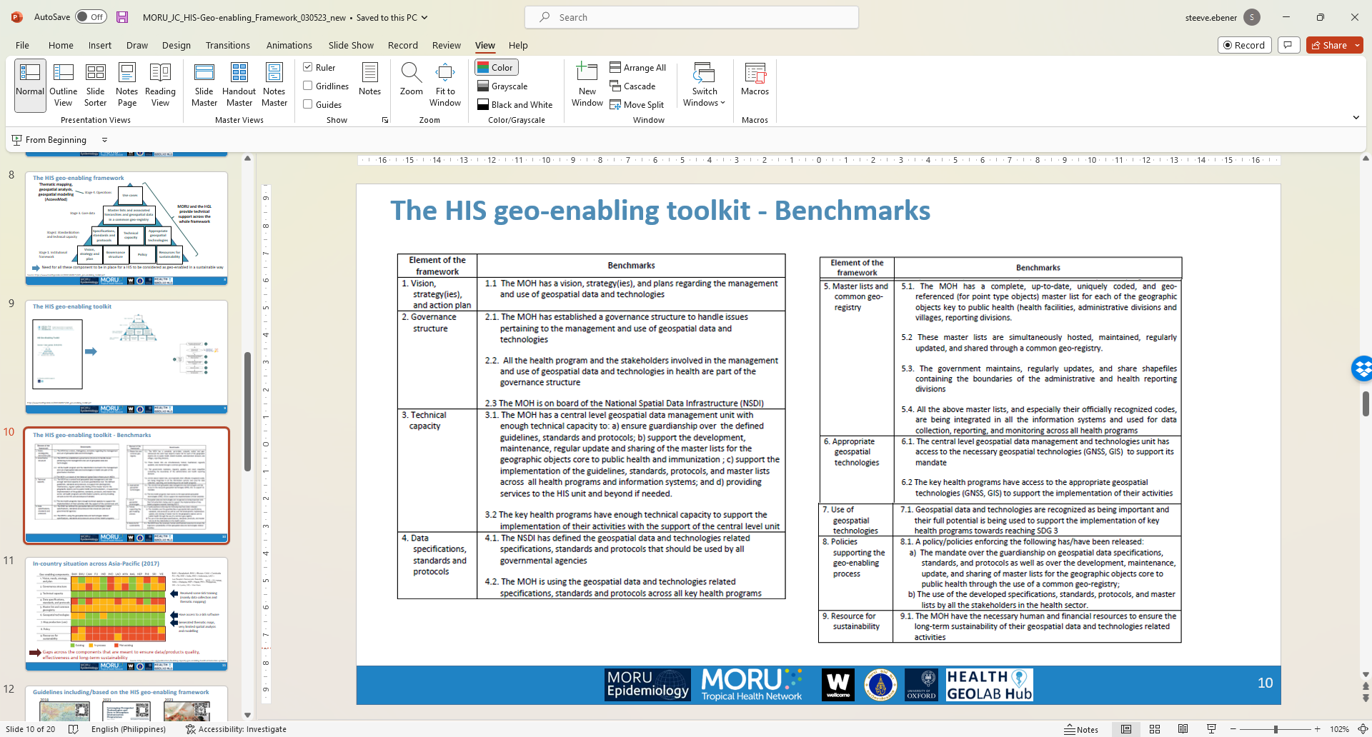



The HIS Geo-enabling toolkit
Designed as a tool to help countries assess their level of HIS geo-enabling and fill any gaps identified.
HIS geo-enabling framework pyramid
Implementation process and associated materials
Benchmarks
HIS Geo-enabling quick assessment questionnaire
Strategies, stakeholder engagement and level of implementation to address existing gaps
Action plan template
1 https://www.healthgeolab.net/DOCUMENTS/HIS_geo-enabling_toolkit.pdf

Slide 22
The HIS Geo-enabling Toolkit – Implementation process
Geo-enabling the HIS
Geo-enabling a program
Loop in both cases
Sources: 1. https://www.healthgeolab.net/DOCUMENTS/HIS_geo-enabling_toolkit.pdf; 2. https://www.unicef.org/media/58181/file;
22

