Slide 1
Session 1.3: Examples of application of geospatial data and technologies in public health

Slide 2
Geospatial data and technologies in Public Health
The use of geospatial data and technologies in public health helps solve issues in different public health programs such as:
Planning
Communicable diseases
Emergency management
Immunization
This session presents some overview examples of this in the Asia and the Pacific Region and beyond.

Slide 3
WHO National eHealth Strategy Toolkit
The WHO National eHealth Strategy Toolkit is an expert, practical guide that provides governments, their ministries, and stakeholders with a solid foundation and method for the development and implementation of a national eHealth vision, action plan and monitoring framework.
Although not an example of case study of geography in public health per se, it advocates and emphasizes the importance of geography in public health planning and e-health strategy.
https://apps.who.int/iris/handle/10665/75211

Slide 4
WHO National eHealth Strategy Toolkit
18 mention of the terms geographic or geographical

Slide 5
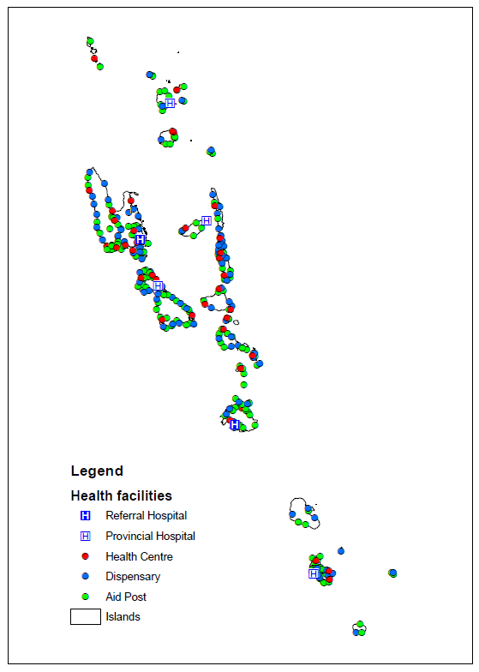
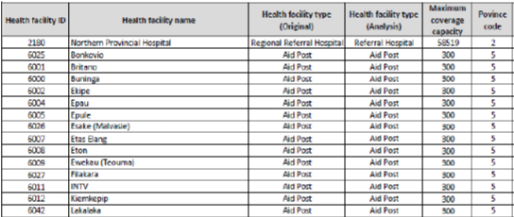
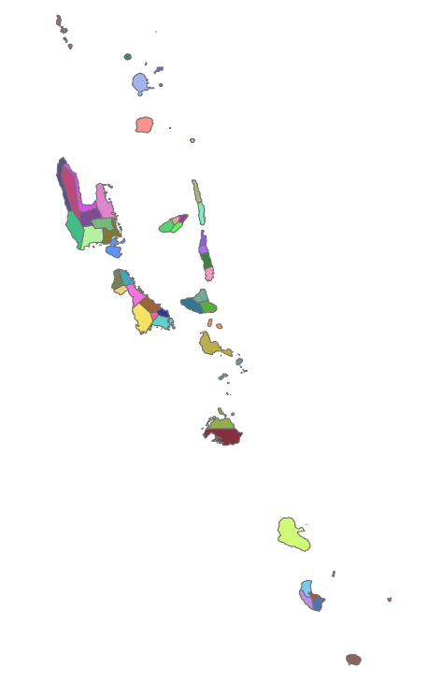
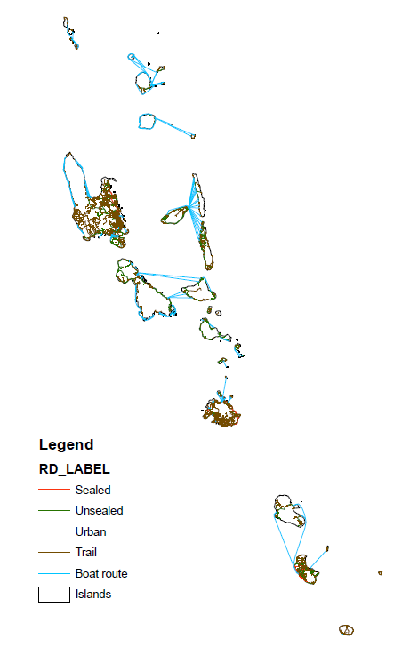
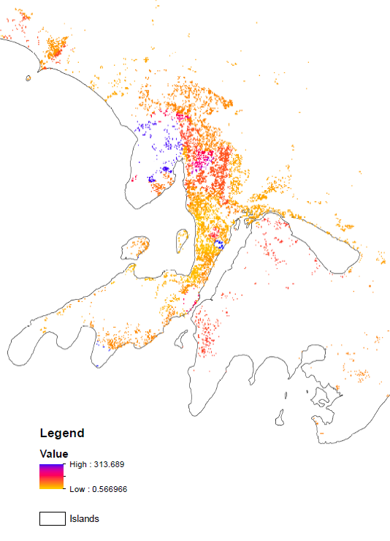
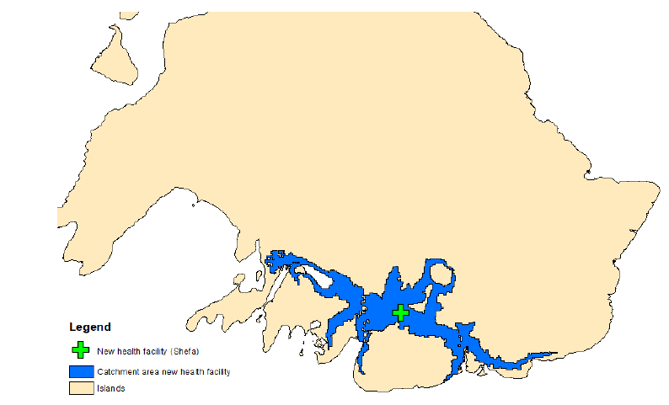
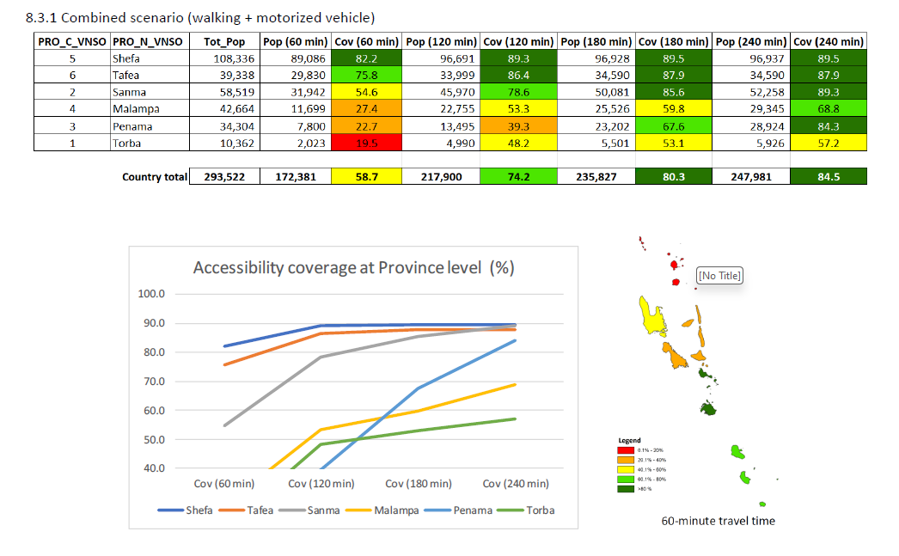
Planning - Accessibility analysis (Vanuatu)
Objective
Result
Ensure that the population has equitable geographic access to primary health care services
Administrative units
Transportation
network
Population
Method
Data compilation, quality assessment and improvement
Use of AccessMod to conduct different analysis aiming at evaluating the current level of accessibility of primary health care services, service referral and propose solutions for scaling up
Technical capacity strengthening
Improved geospatial data that can be used to support other programs
Updated georeferenced master list of health facilities
Reference: https://healthgeolab.net/KNOW_REP/Acc_Analysis_VUT_050224_FINAL.pdf
Accessibility analysis including scaling up scenarios
Rapid impact assessment maps to support the response to cyclone Harold 2020
5

Slide 6
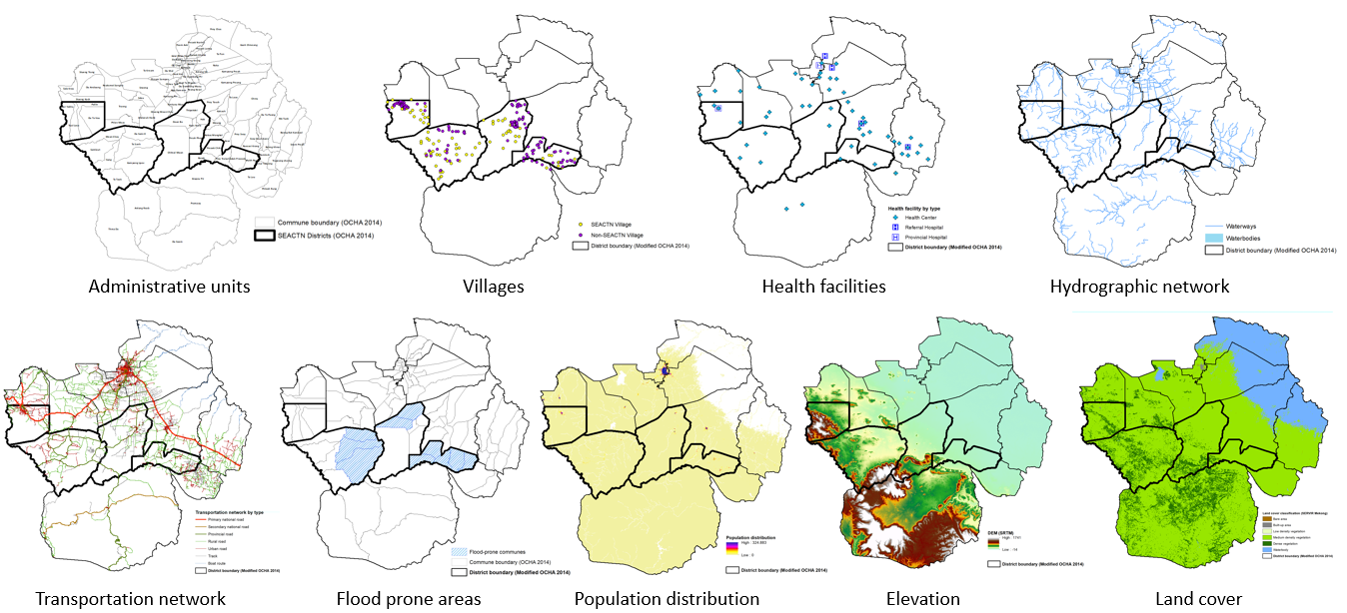
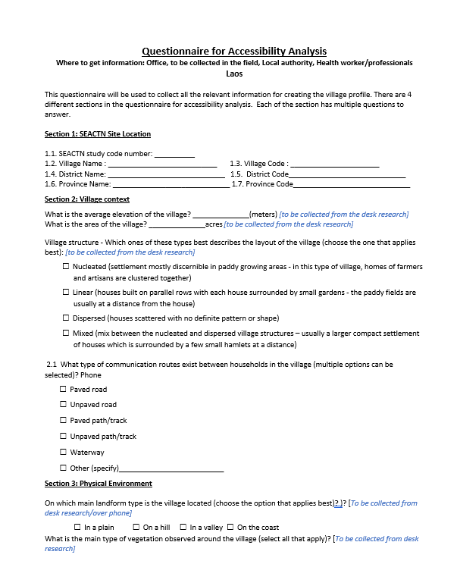
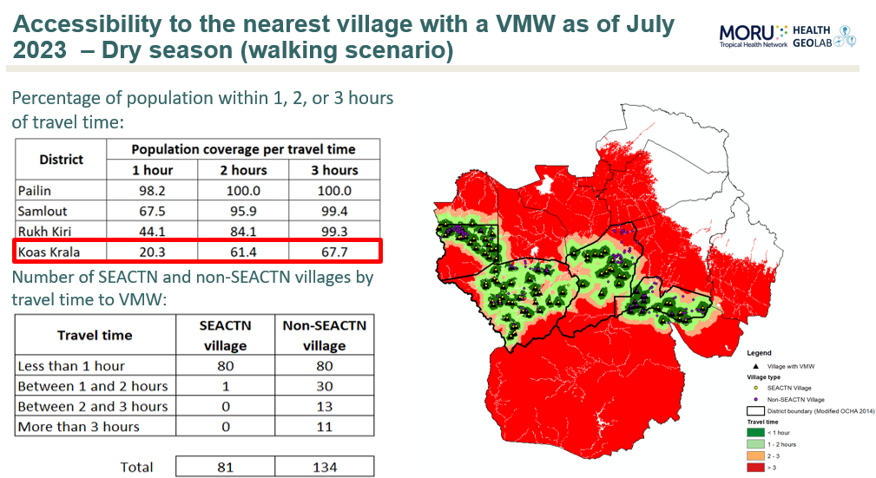
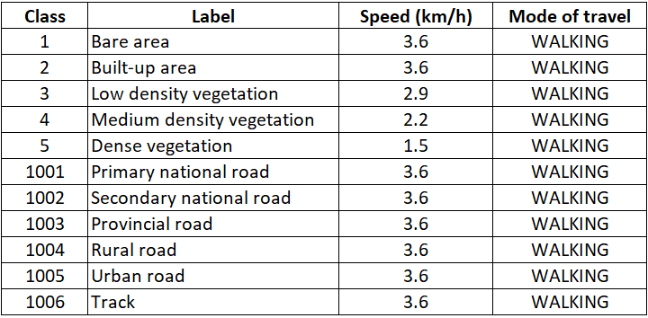
Planning - South and Southeast Asia Community-based Trials Network (SEACTN) (Bangladesh, Cambodia, Lao PDR)
Project implemented by MORU. Objectives of the accessibility analysis component is to guide the implementation of the SEACTN programme by:
Estimating the proportion of the total population that can physically access the different level of the existing health service delivery network within a given travel time (1, 2, 3 hours);
Identify areas which are hard to reach and where there is currently no SEACTN village health workers;
Estimating travel time between each SEACTN village (existing and proposed) and the nearest health facility; and
Defining the location of potential sites for new health facilities to increase population coverage and reduce the referral time between SEACTN villages and the nearest health facility.
Understand the referral pathways
Prepare the data for the accessibility analysis
Validate travel scenario through village profiling survey
Conduct the different analysis using AccessMod
Reference: https://seactn.org/
6

Slide 7
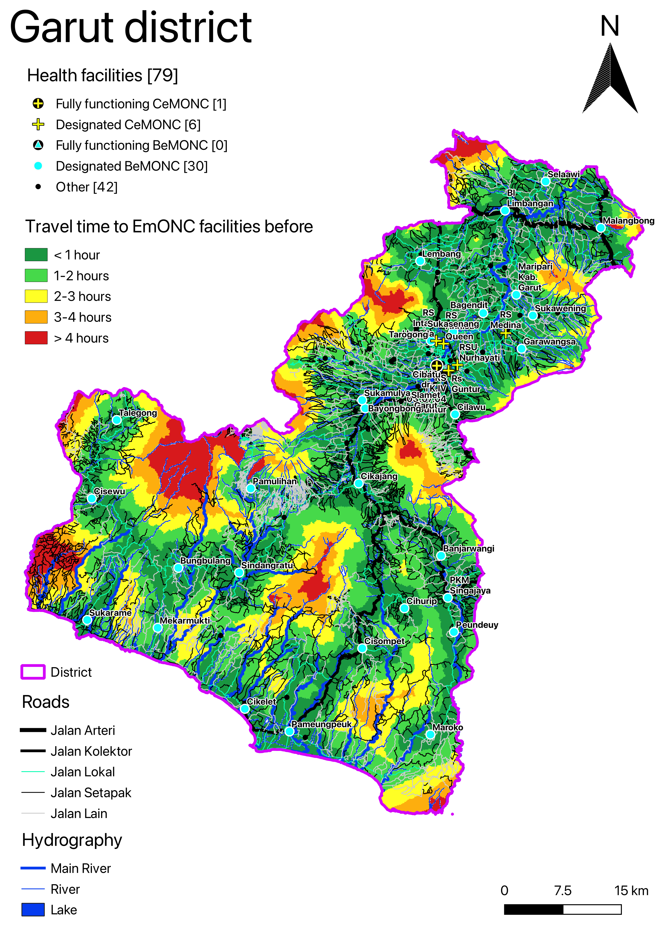
Planning - Prioritization of EmONC services (Indonesia)
Objective
Result
UNFPA has been using GIS-based approach to help countries establish or prioritize their national network of Maternity Units, especially EmONC services
Method
Data compilation, quality assessment and improvement
Technical capacity strengthening
Consultation to define local parameters
Use of AccessMod to conduct different analysis aiming at evaluating the current level of accessibility of EmONC services and test different scenarios to prioritize health facilities for a cost-effective delivery of services
Reference: https://www.unfpa.org/featured-publication/implementation-manual-developing-national-network-maternity-units
Before prioritization (37 EmONC)
82.5% pop coverage in 1 hour
95% pop coverage in 2 hours
After prioritization (16 EmONC)
77% pop coverage in 1 hour
93% pop coverage in 2 hours
7

Slide 8
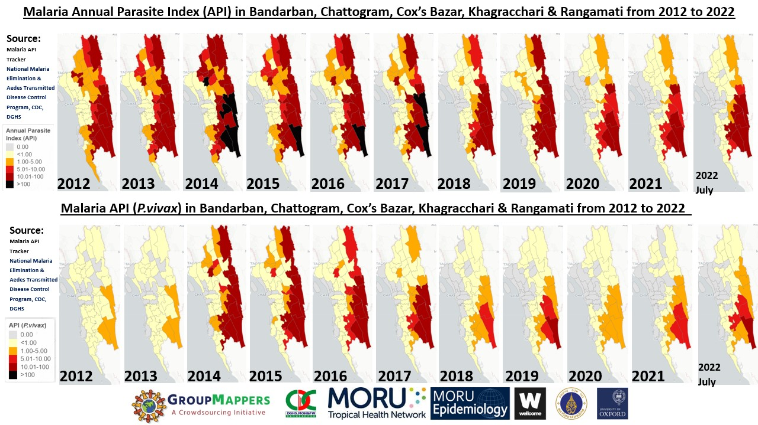
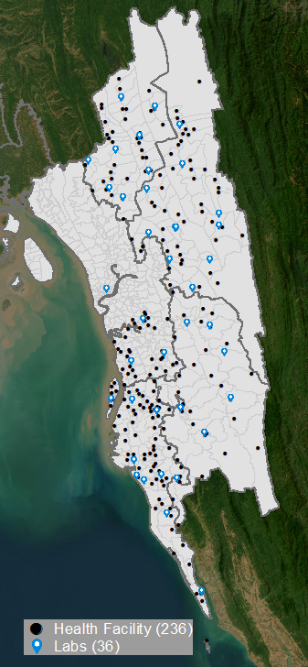
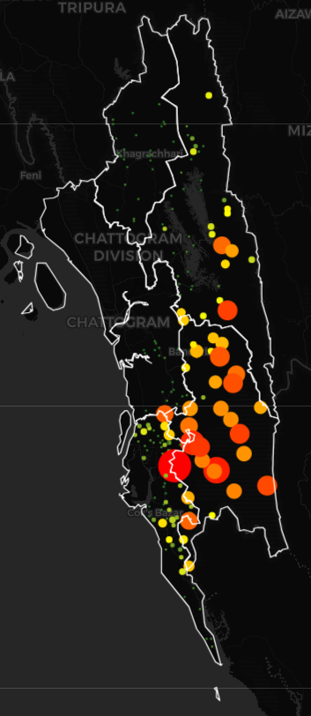
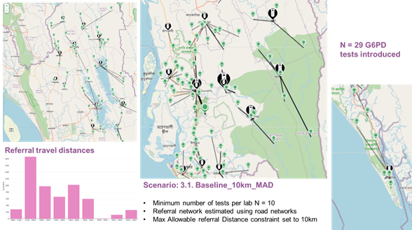
Planning - Diagnostic Network Optimization (DNO) (Bangladesh)
MORU and GroupMappers have been supporting the National Malaria Elimination Programme (NMEP) with the use of the OptiDx tool to model an evidence-based strategy for​ introducing G6PD diagnosis​ that best uses available resources to​ optimise access to testing by P. vivax patients
Objectives:
Assemble a comprehensive geospatial database of:
Health system infrastructure
P. vivax case loads
Economic cost associated with P. vivax disease and case-management in Bangladesh
Model the coverage and cost of potential scenarios for introducing G6PD testing
Prepare DNO outputs that can be included into strategic and operational plans and funding proposals by NMEP
Demand
Results
8

Slide 9
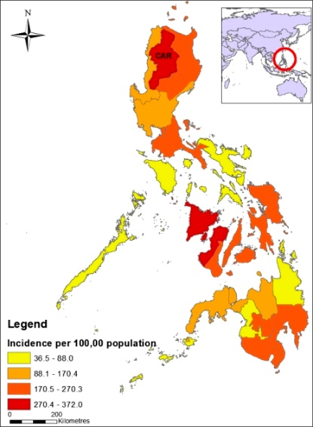
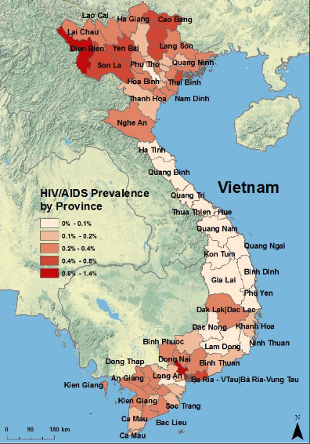
Communicable/Vector-borne diseases - Thematic mapping (Philippines, Lao PDR)
Thematic maps are being used to help visualizing the spread of diseases by different programs in countries
The Philippines has been using thematic maps to look at the distribution of dengue incidence at the subnational level, allowing to identify areas at risk and enables faster mobilization of resources.
Reference: https://www.ncbi.nlm.nih.gov/pmc/articles/PMC3335676/pdf/tropmed-86-753.pdf
Thematic maps have also been used to support health care planning for pandemic influenza in Lao PDR. By exporting simulation results into GIS software, maps geographical analysis of the distribution of resources.
Reference: Stein et al. BMC Public Health 12: 870 (2012) doi:10.1186/1471-2458-12-870
Vietnam has been using thematic maps to show prevalence of HIV/AIDS cases per province , show the correlation of HIV cases with Tuberculosis cases (as TB is one of causes of death among HIV infected people), and the relationship between the increase of infection and number of clinics in certain areas.
Reference: http://sites.tufts.edu/gis/files/2013/11/Wanlund_Anne.pdf
9

Slide 10
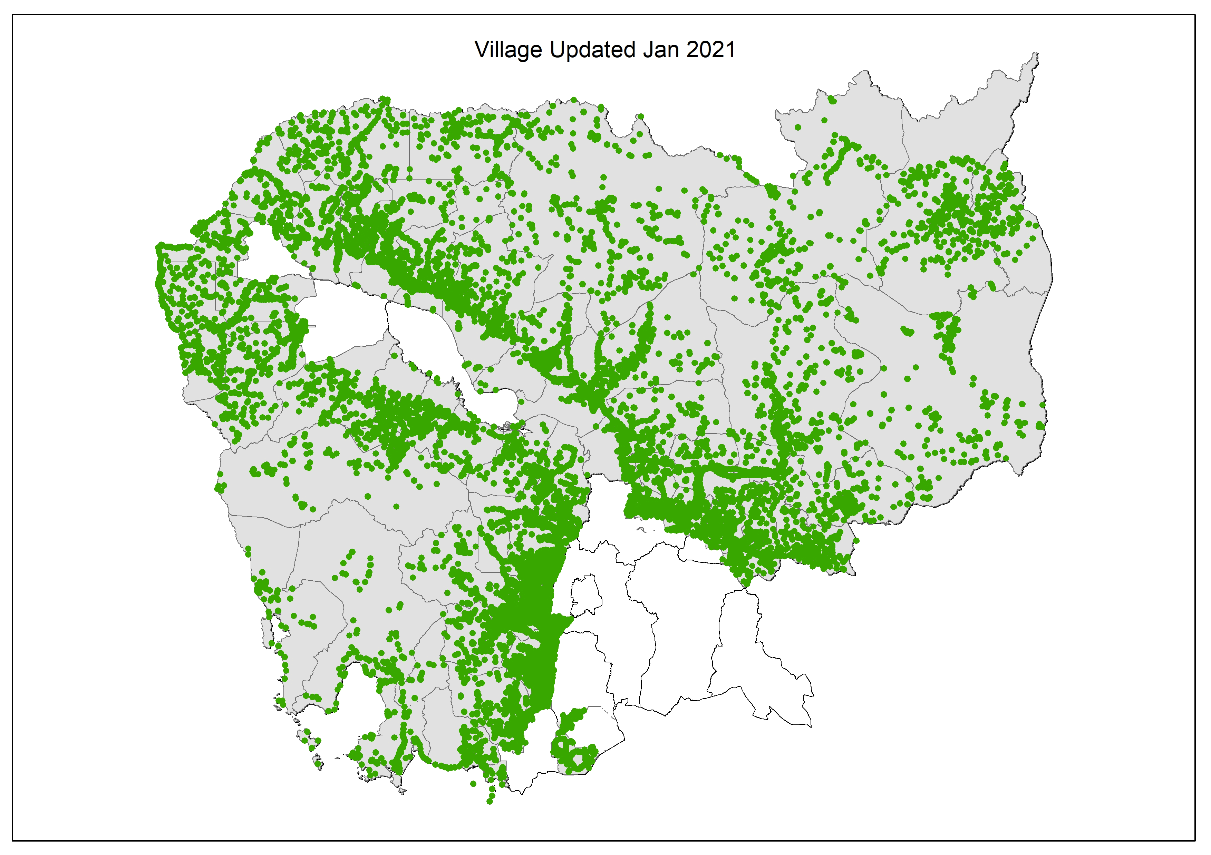
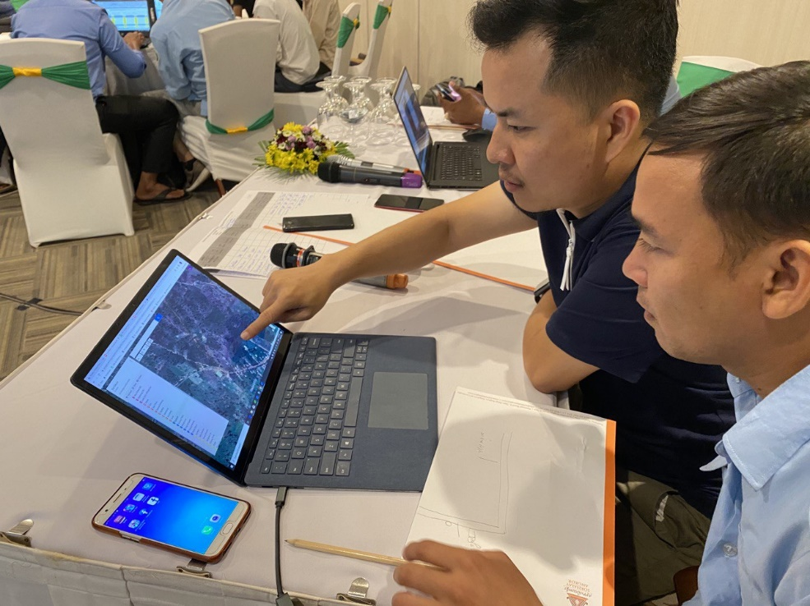
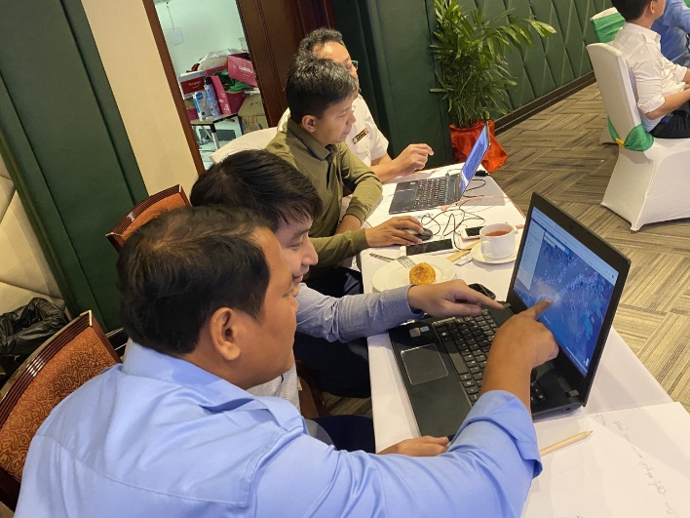
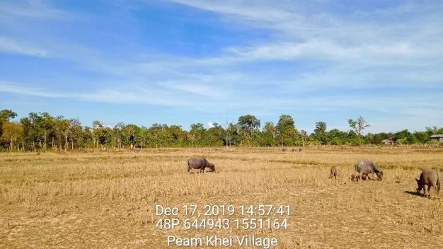
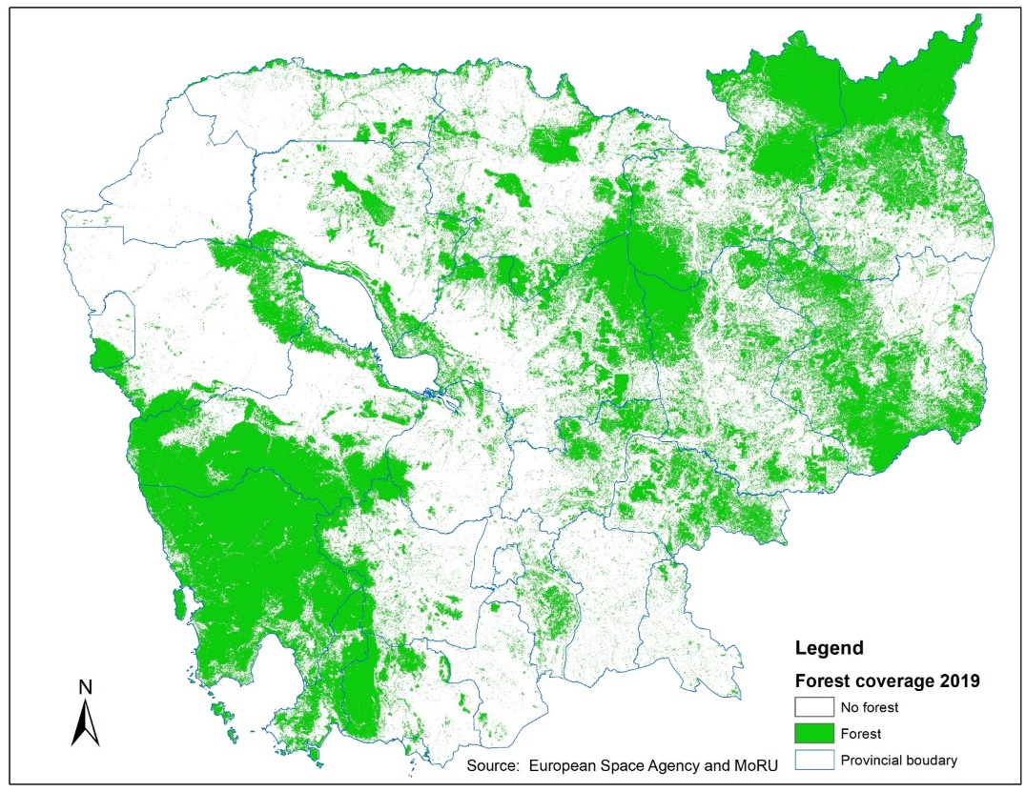
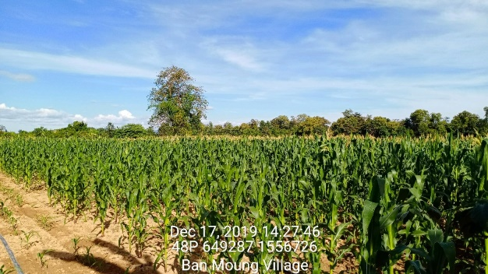
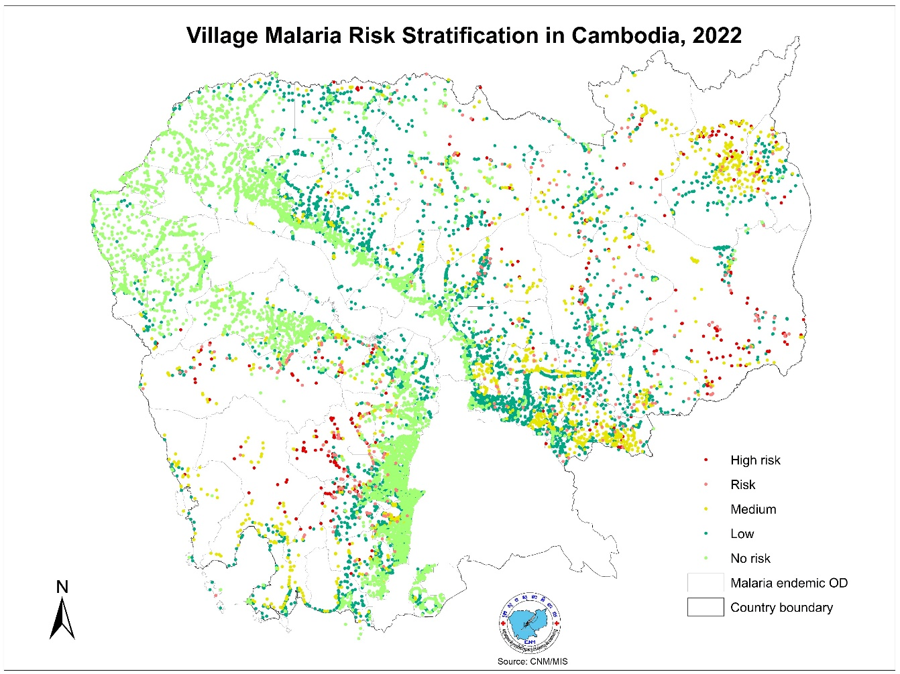
Vector borne diseases - Malaria stratification (Cambodia)
The National Center for Parasitology, Entomology and Malaria Control (CNM) with MORU’s support has been working on geo-enabling the microplanning of its malaria programme
Checking, correcting and updating the list and location of villages and health facilities as well as the boundaries of the Operational Districts for the Malaria endemic areas
ESA analysed imagery using ground truthing data collected by MORU and CNM to generate a new forest cover map
Stratifying malaria risk at the village level based on average reported API, percentage of forest coverage and distance to the nearest health facility using a tool built in the Malaria Information System
https://www.ajtmh.org/view/journals/ tpmd/95/6_Suppl/article-p97.xml
10

Slide 11
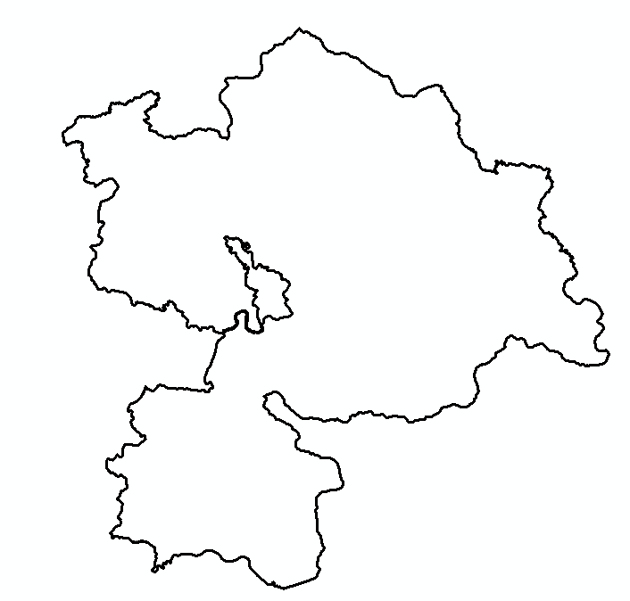
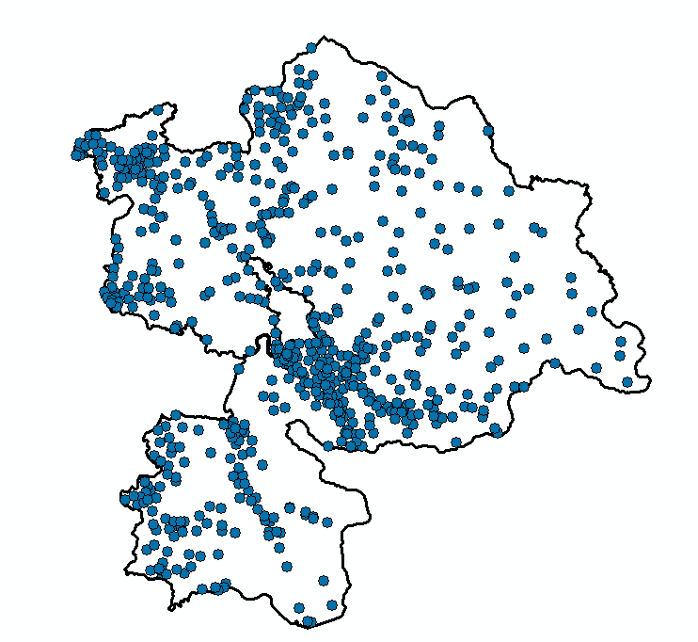
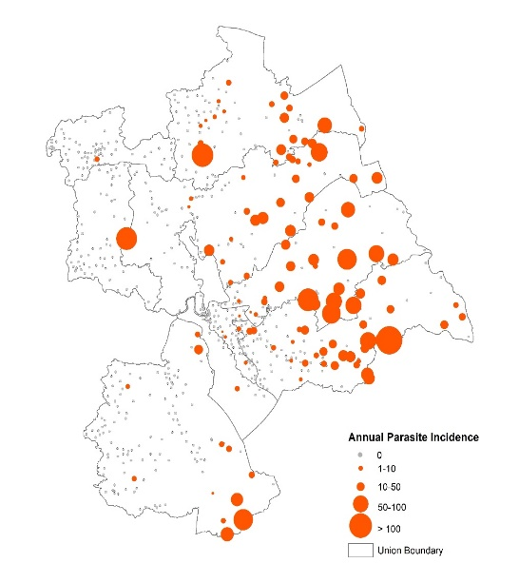
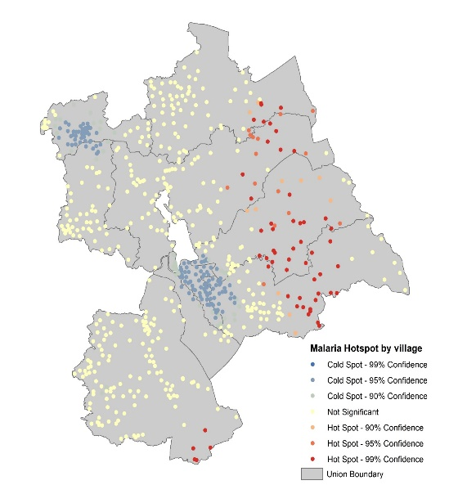
Communicable diseases - Malaria surveillance and risk mapping (Bangladesh)
The National Malaria Elimination Programme (NMEP) with the support of MORU and GroupMappers has been working on increasing the granularity of malaria surveillance and risk mapping
Enhance malaria data by transitioning from the Upazila (sub-district) to the settlement level
Before 2023
Now
Settlements Mapping
644 Settlements
Health Facilities Mapping
Digitalized Malaria Data Collection in Bandarban, BD
Baseline geospatial data for Accessibility Analysis
Settlement level API mapping (fine scale malaria risk)
Malaria hotspot map
Physical accessibility modeling
11

Slide 12
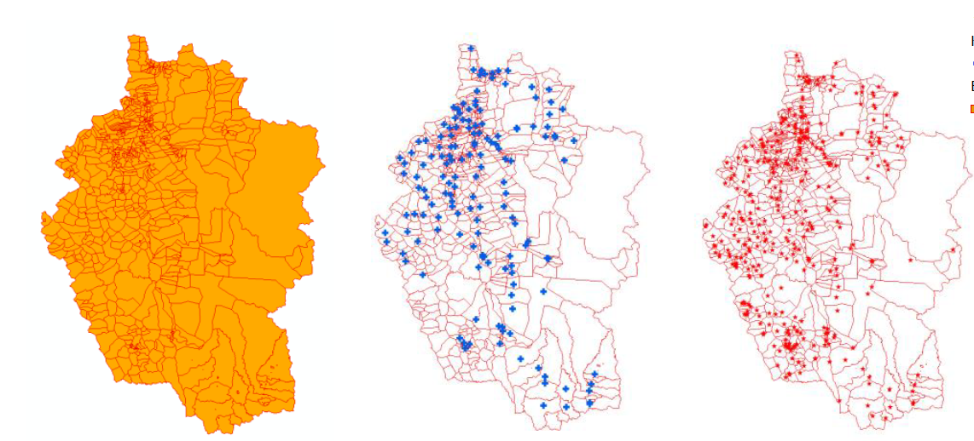
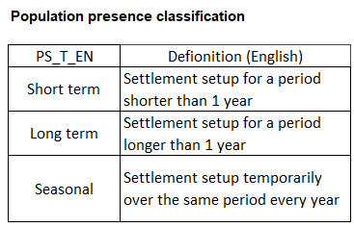
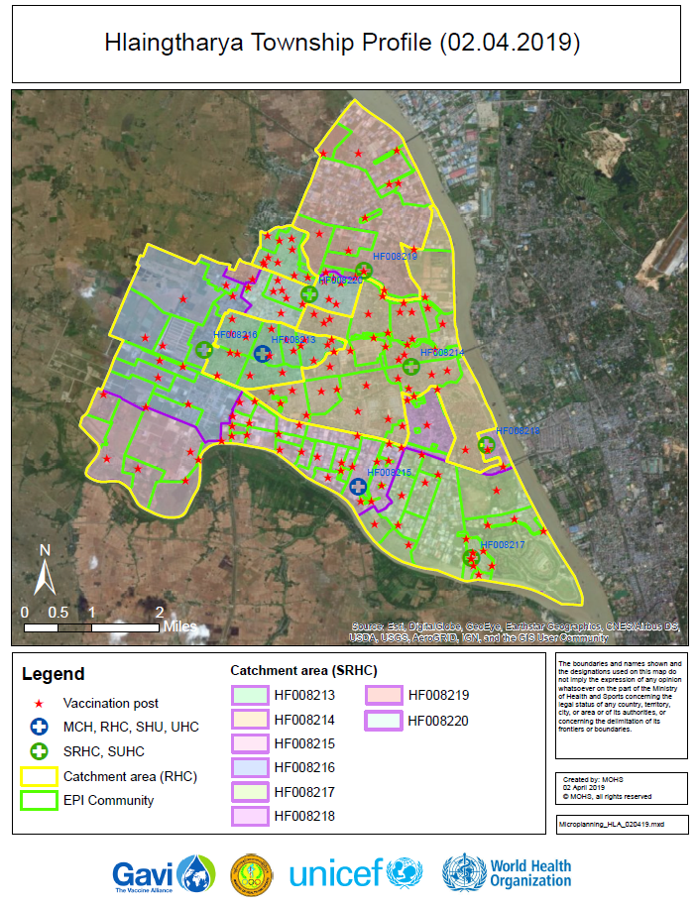
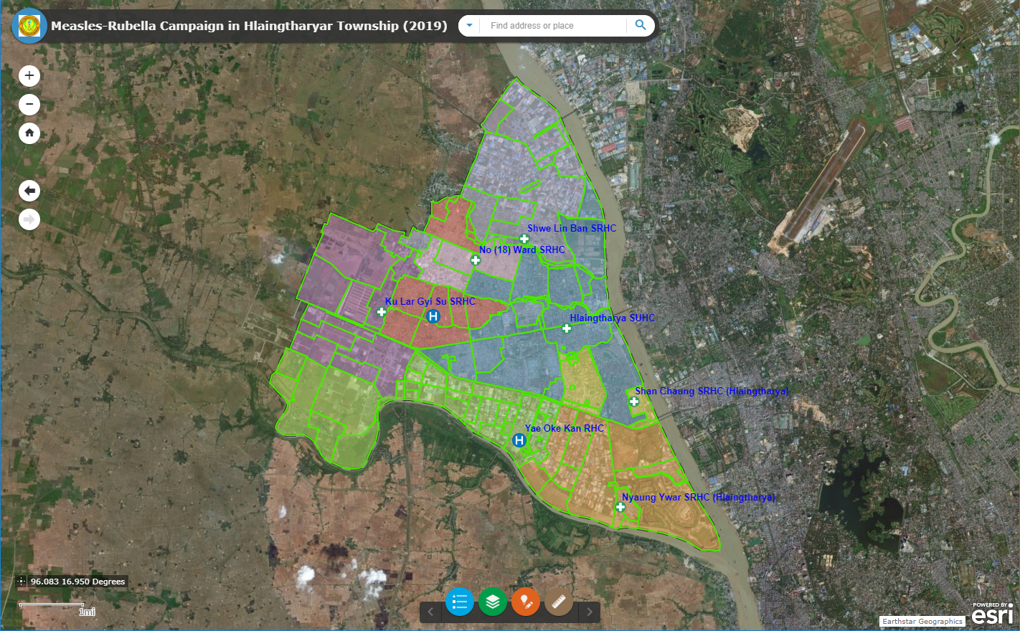
Immunization - Geo-enabled microplanning (Myanmar)
Objective
Result
Use of geospatial data and technologies to support routine immunization microplanning as well as monitoring and evaluation in 49 townships
Method
Establish/updated/complete the master list of EPI communities, vaccination posts and health facilities with geographic extent or location
New classification of EPI communities
Documentation of the routine immunization data ecosystem
Development of the master list of EPI communities, vaccination points and health facilities
Technical capacity strengthening
Collaborative mapping exercise with MOHS staff
Creation of electronic microplanning maps
Digital microplanning maps (pdf and online)
Modified routine immunization forms
Reference: https://bit.ly/3vyUuNL
12

Slide 13
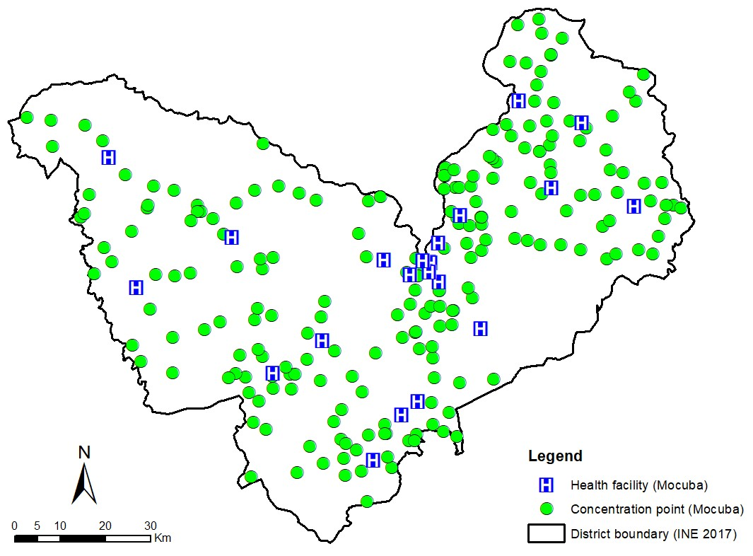
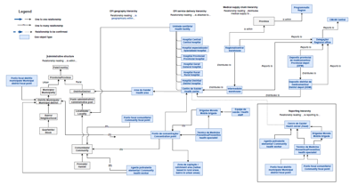
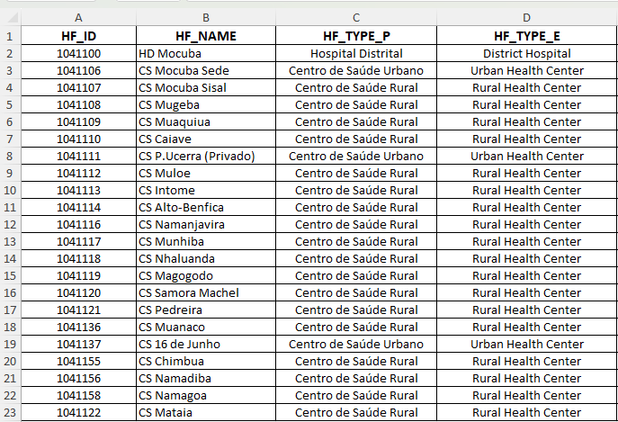
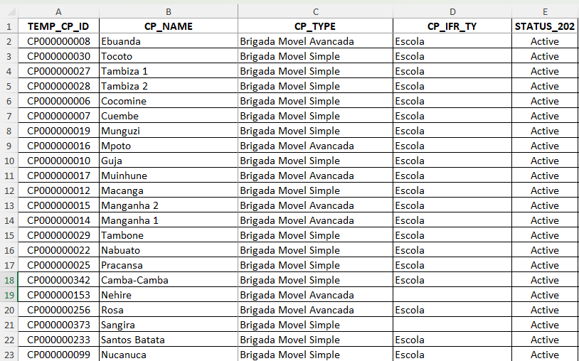
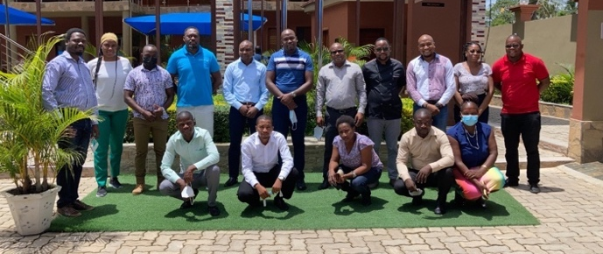
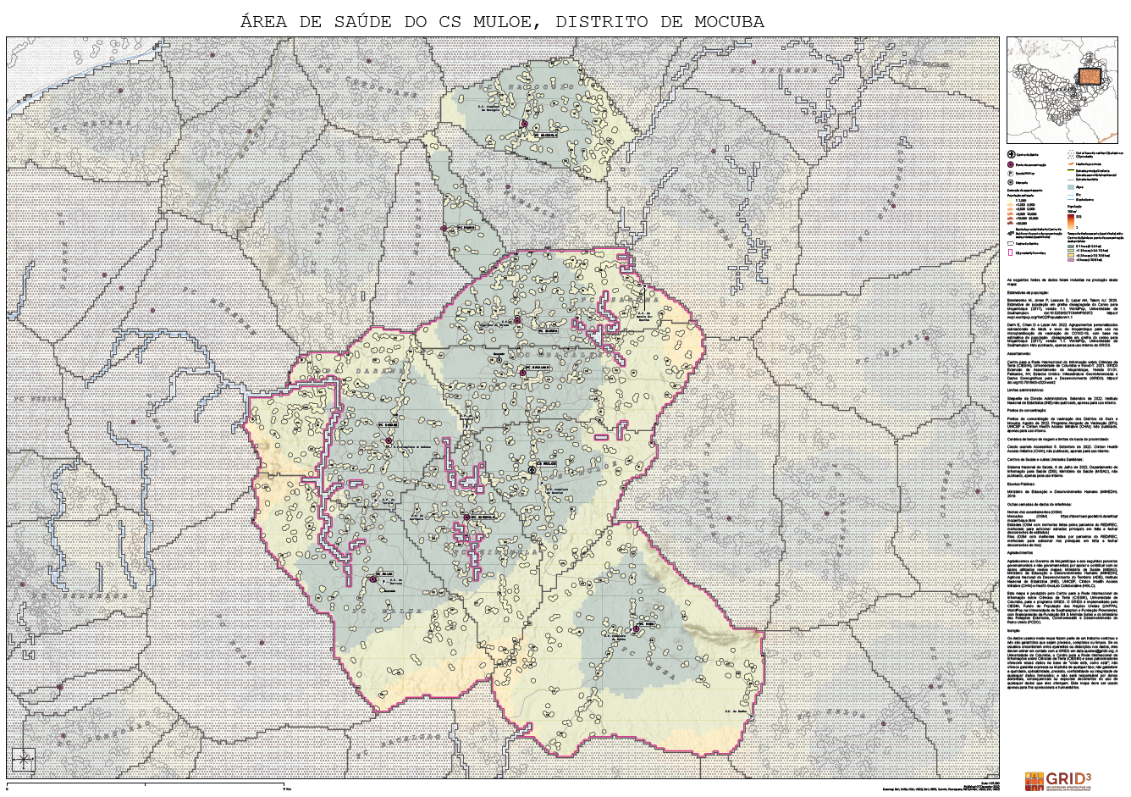
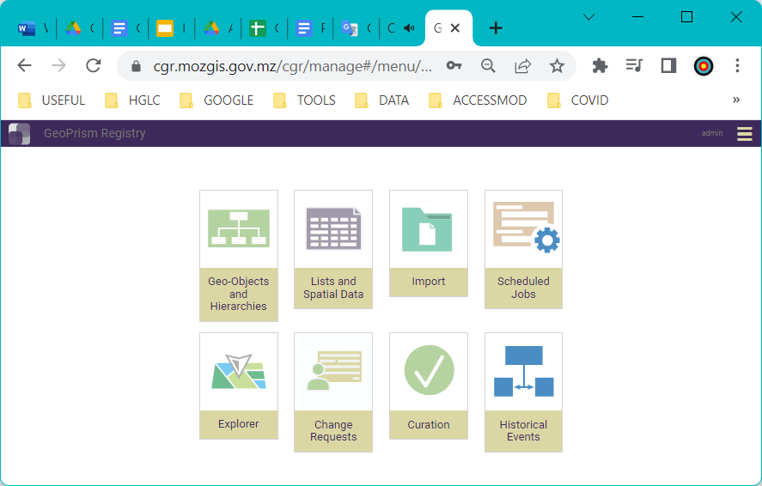
Immunization - Geo-enabled microplanning (Mozambique)
Objective
Result
Geo-enable routine immunization microplanning (implemented in 2 districts and about to be scaled up to another 36 districts)
Method
Immunization ecosystem data model
Georeferenced master list of health facilities and concentration points
Field data collection to collect geographic coordinates of health facilities and concentration points
Documentation of the routine immunization data ecosystem
Establishment and validation of the master list of health facilities and concentration points
Technical capacity strengthening and field data collection
Use of AccessMod to delimitate proximity basins and estimate population coverage
Creation of electronic microplanning maps
Deployment of a Common Geo-Registry
Improved method to estimate population coverage
Microplanning maps and population estimates for the optimization of the concentration point network
Deployment of the GeoPrism Registry platform (Common Geo-Registry) for the maintenance, regular update and sharing of master list and associated spatial data
Adjustment of the microplanning form
13

Slide 14
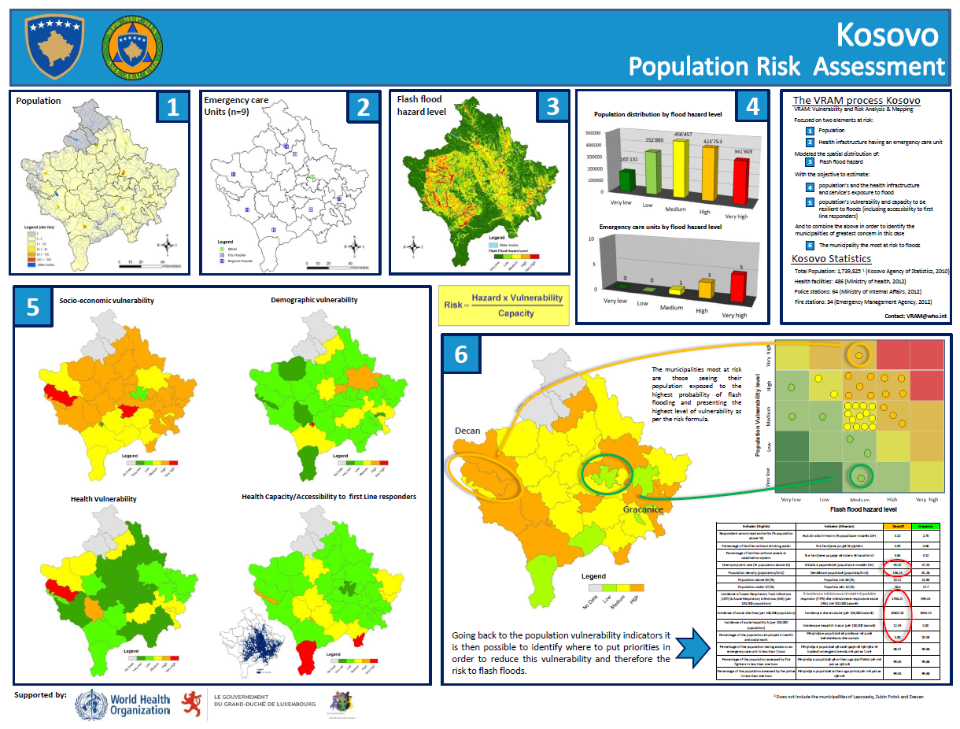
Emergency management - Vulnerability and risk analysis (Kosovo, North Macedonia)
GIS-based methods can be used to conduct geographically-based vulnerability and risk analysis.
The Vulnerability and Risk Analysis & Mapping (VRAM) approach has for example been implemented in different countries (e.g. Kosovo, North Macedonia) to support emergency preparedness of the health sector
Objectives :
Identify the health facilities and other infrastructures that will most likely not be operational during a disaster
Identify the geographic area(s) in which the population is most at risk to experience significant losses
The infrastructures and populations most at risk to experience damages and losses are located in areas where the hazard intensity and vulnerability are the highest and the coping capacity the lowest
Reference: http://tinyurl.com/ydab3jpd; http://tinyurl.com/2s3z2wnn
14

Slide 15
Other immunization related use case
https://www.gavi.org/news/document-library/leveraging-geospatial-technologies-and-data-strengthen-immunisation ; https://drive.google.com/file/d/1jj779zww4herWOESAd9mXqVE1YfQehtH/view?usp=sharing

Slide 16
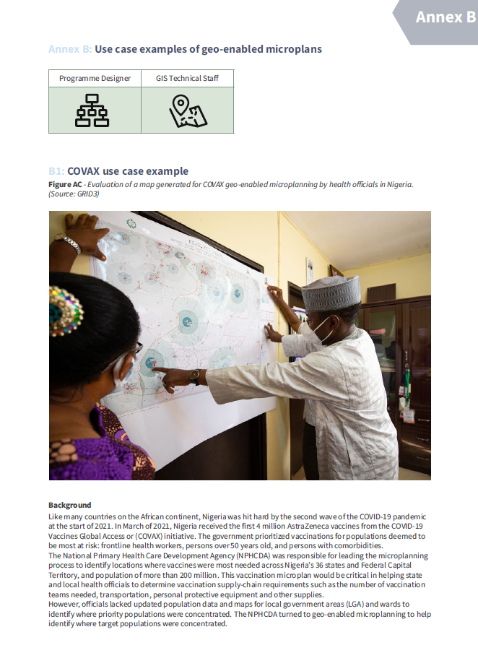
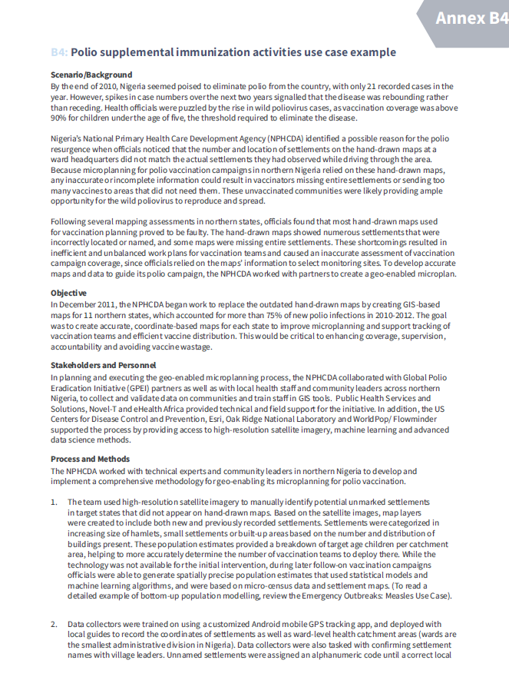
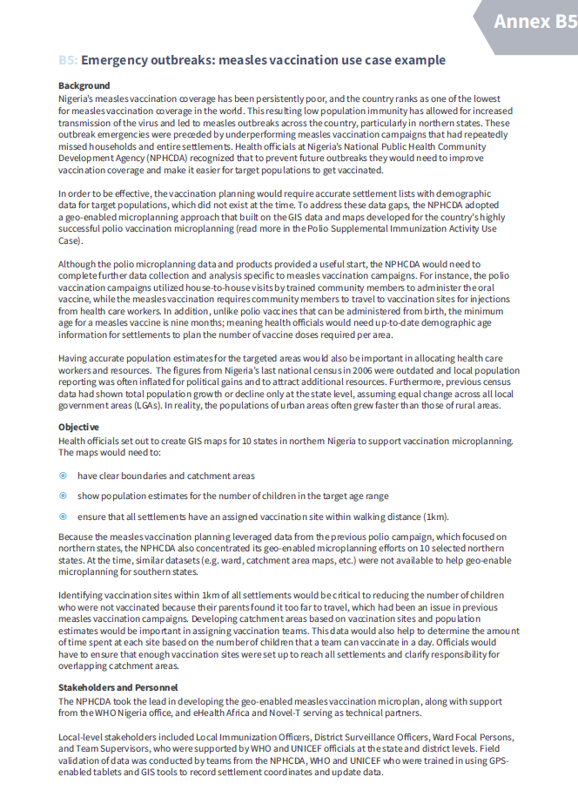
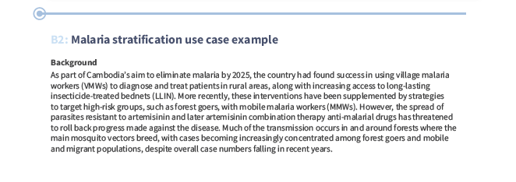
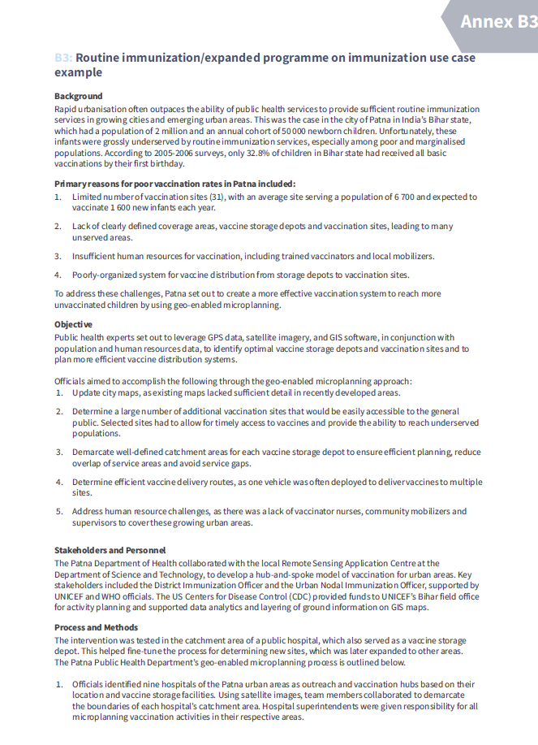
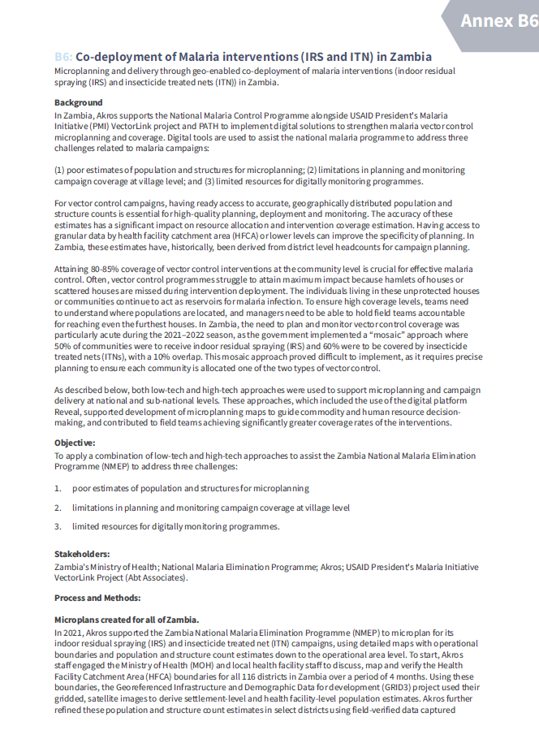
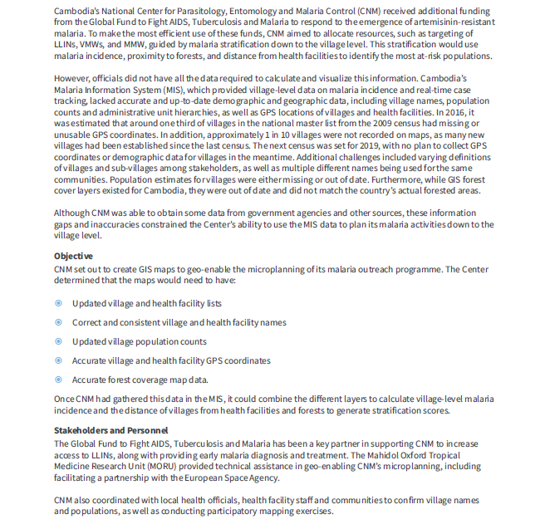
Other microplanning related use case
https://knowledge.unicef.org/resource/geo-enabled-microplanning-handbook
16

Slide 17
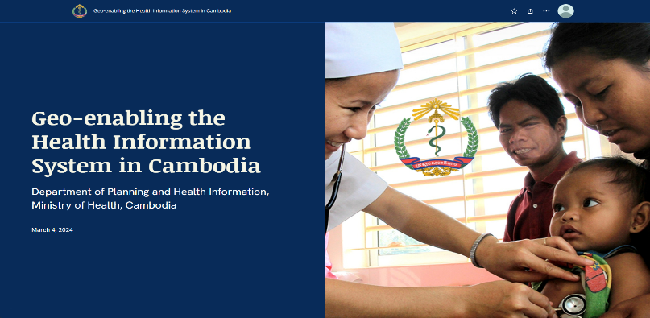
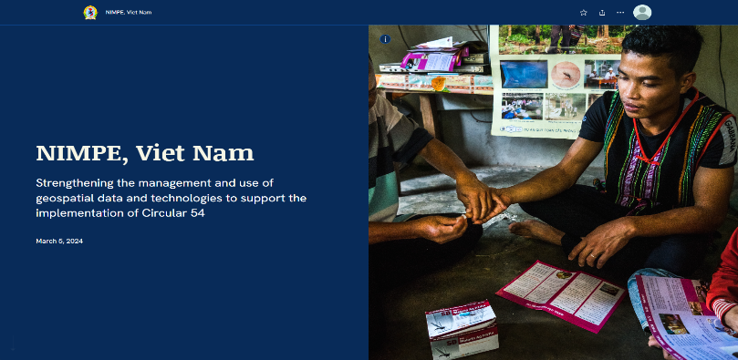
Other country specific use cases
Myanmar (https://arcg.is/OCHOz)
Cambodia (https://arcg.is/0uviGj)
Viet Nam (https://arcg.is/1XmLjy)
Mongolia
(https://arcg.is/1O0u4r)
17

