Slide 1
Session 1.2: The geographic dimension and the potential of geospatial data and technologies in public health

Slide 2
Public Health
“All organized measures (whether public or private) to prevent disease, promote health, and prolong life among the population as a whole.”¹
“the art and science of preventing disease, prolonging life and promoting health through the organized efforts of society” ²
The three main functions of public health are:
Risk assessment - The assessment and monitoring of the health of communities and populations at risk to identify health problems and priorities
Policy development - The formulation of public health policies designed to solve identified health problems and priorities
Assurance of services – To ensure that all populations have access to quality, timely, and cost-effective care
1 http://www.euro.who.int/__data/assets/pdf_file/0007/152683/e95877.pdf
2 Acheson, 1988; WHO: http://www.euro.who.int/en/health-topics/Health-systems/public-health-services

Slide 3
Risk Assessment
Biological
Technological
Population
Natural
Societal
Infrastructures
Services
The populations, infrastructures and services most at risk to experience losses or damages are located in geographic areas where the hazard and vulnerability are the highest and capacity the lowest.
There is a strong geographic dimension to risk and its assessment

Slide 4
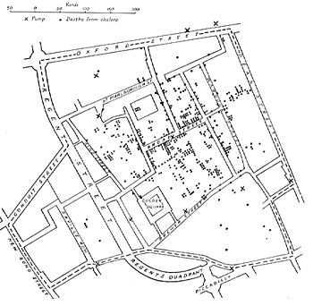
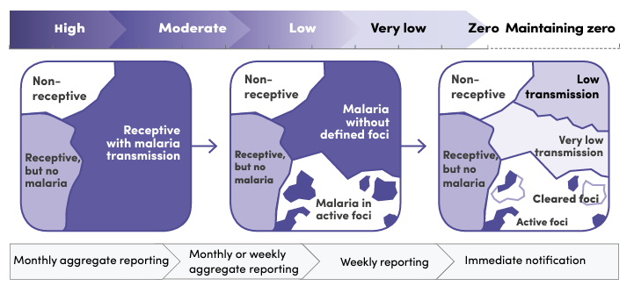
Risk Assessment
2
At the origin of modern epidemiology
“Study of the relationship between diseases and the factors likely to influence their frequency, distribution, and evolution. “ ¹
John Snow's original map showing clusters of cholera cases during the London epidemic of 1854.
2
The evolution of the geographical granularity of an intervention such as malaria elimination demonstrates the importance of this dimension in epidemiology
1 https://dictionnaire.lerobert.com/google-dictionnaire-fr?param=%C3%A9pid%C3%A9miologie
2 https://iris.who.int/bitstream/handle/10665/272284/9789241565578-eng.pdf?sequence=1

Slide 5
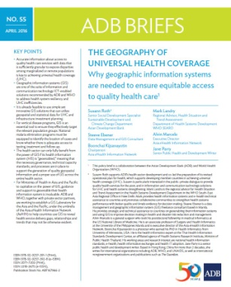
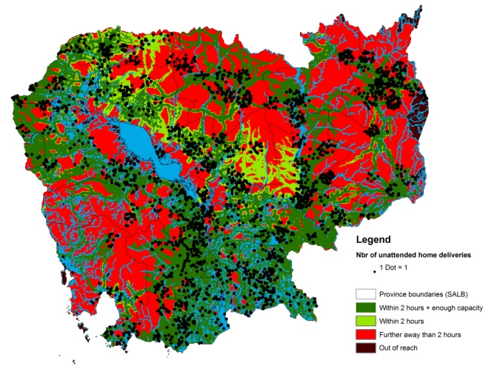
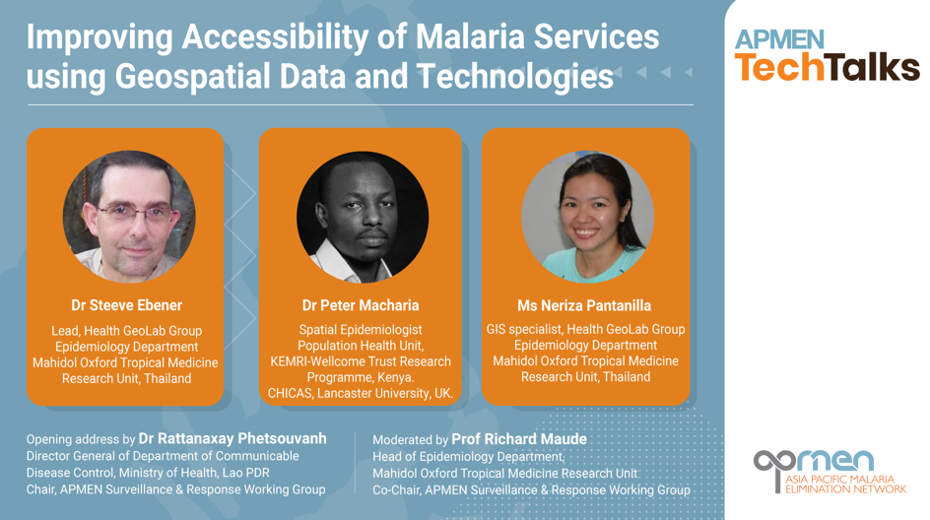
Assurance of services
Geography
1
Physical (geographical) access to health care is influenced by the location of the health services, the spatial distribution of the population and the environment between the two
A strong geographic aspect to the assurance of services
Allows a more comprehensive and systemic approach to Universal Health Coverage (UHC)
2
1 https://www.adb.org/publications/geography-universal-health-coverage
2 APMEN tech talk https://www.youtube.com/watch?v=pTsJJKCkFJQ

Slide 6
Accessibility to health care
“Universal Health Coverage means that all individuals and communities receive the health services they need without suffering financial hardship.”¹
Equitable access to quality health care is mediated by a number of factors that stand between the availability of services and actual effective service usage or coverage
2
The Tanahashi framework can be used to analyze health service coverage
The first three levels of this framework have a strong geographical dimension.
Tanahashi framework (1978)
1 https://www.who.int/news-room/fact-sheets/detail/universal-health-coverage-(uhc)
2 https://www.adb.org/publications/geography-universal-health-coverage

Slide 7
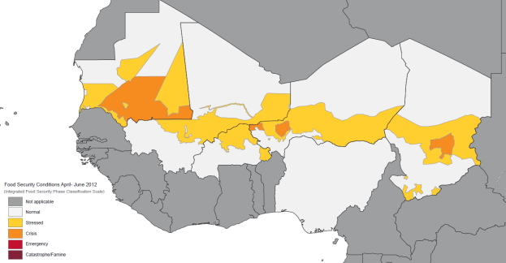
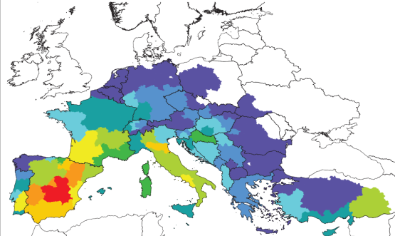
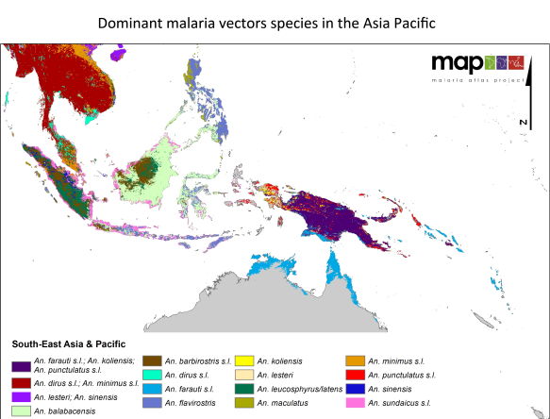
Policy formulation
A map is a powerful media to visualize and analyze the spatial distribution of public health related issues at this at all levels.
Support informed decision making and policy formulation

Slide 8
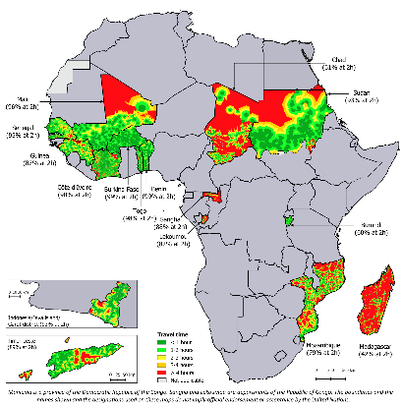
Policy formulation
2015
2019
2020
2021
1
2
5
4
3
Indicator used for policy formulation
2017- 2023
https://www.accessmod.org/
https://ij-healthgeographics.biomedcentral.com/articles/10.1186/s12942-015-0012-x
https://gh.bmj.com/content/4/Suppl_5/e000778.info
https://www.unfpa.org/featured-publication/implementation-manual-developing-national-network-maternity-units
https://www.who.int/publications/i/item/9789240040519

Slide 9
To summarize
Geography plays a key role in public health by offering :
A neutral “platform” for the integration, visualization, and analysis of data coming from different sources
A “tool” to support geographically-based decision making and therefore a more systemic and systematic approach to solving public health challenges
Geography is an important dimension that should be captured in any Health Information System

Slide 10
Geospatial data and technologies
Geospatial data
Also referred to as spatial data, information about the locations and shapes of geographic features and the relationships between them, usually stored as coordinates and topology.
Digital representation of geography (content)
Geospatial technologies
Refers to equipment used in visualization, measurement, and analysis of earth's features, typically involving such systems as Global Navigation Satellite System (GNSS), Geographical Information Systems (GIS), remote sensing (RS) and new emerging technologies like Common Geo-Registries (CGR)
Tools used to visualize, analyse and/or model geography and geographic phenomena in a digital form
Contributes to the digitalization of the health system

Slide 11
The most important use cases for the use of geospatial data and technologies in public health
Planning: Estimating population coverage, expanding the network of health facilities, optimizing routes
Communicable/vector-borne diseases: Risk mapping, microplanning, estimating population movements, identifying potential areas of reinfection, surveillance, monitoring, investigation and management of outbreaks,...
Immunization : Microplanning, campaign monitoring, disease surveillance, immunization coverage modelling,...
Emergency Management: Hazard and risk assessment/reduction, early warning, rapid initial assessment, response management, reconstruction planning,...
5 main applications supporting these use cases: Georeferenced master lists, thematic mapping, population estimation and spatial distribution, geographic accessibility modelling, GNSS navigation and tracking

Slide 12
Potential of geospatial data and technologies in public health
Health system challenges
(WHO classification)
1
2
3 Quality
1 Information
3.6 Inadequate supportive supervision
1.1 Lack of population denominator
5 Utilization
Applications of geospatial data and technologies
1.2 Late reporting of events
5.1 Low demand for services
Georeferenced Master Lists
5.2 Geographic inaccessibility
1.3 Lack of quality/reliable data
1.5 Lack of access to information or data
6 Efficiency
Population estimation and spatial distribution
6.2 Lack of or inappropriate referrals
1.6 Insufficient utilization of data and information
6.3 Poor planning and coordination
1.7 Lack of a unique identifier
6.4 Delayed provision of care
Geographic accessibility, service localization, and route optimization modeling
6.5 Inadequate access to transportation
2 Availability
2.1 Insufficient supply of commodities
7 Costs
Thematic mapping
7.2 Lack of effective resource allocation
2.2 Insufficient supply of services
8 Accountability
2.3 Insufficient supply of equipment
8.3 Absence of a Community feedback mechanism
Navigation, tracking and geographic coordinate collection using a GNSS
2.4 Insufficient supply of qualified health workers
8.5 Poor accountability between the levels of the health sector
Practiced during the course
1 https://drive.google.com/file/d/1jj779zww4herWOESAd9mXqVE1YfQehtH/view?usp=sharing
2 https://www.gavi.org/news/document-library/leveraging-geospatial-technologies-and-data-strengthen-immunisation
8.6 Inadequate understanding of the beneficiary population

Slide 13
Georeferenced master lists
Unique, authoritative, officially curated by the mandated agency, complete, up-to-date, and uniquely coded list of all the active (and past active) records for a given type of geographic feature/object (e.g. health facilities, administrative units, villages)
The information that allows to do the following for each of the records in the master list:
Uniquely identify (unique identifier, name)
Classify (type, ownership,…)
Locate (address, administrative division, geographic coordinates)
When it applies, contact (head name, phone number, email address,…)
Example for health facilities
Any other data element is to be considered programmatic attributes and managed outside the master list
Notes:
.

Slide 14
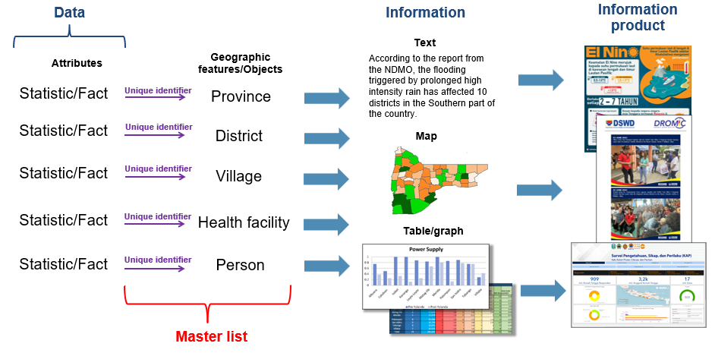
Georeferenced master lists – Role
Their place in the data to information products continuum

Slide 15
Georeferenced master lists – Role
They play a key role to ensure data quality across the 6 dimensions of data quality and this for both statistical and spatial data
Data quality dimension | The role of the master list is to ensure that:
Completeness | there are no data gaps
Uniqueness | there are no duplicates
Timeliness | the data represent the reality for each considered point in time
Validity | the syntax of the data element is respected across sources (format, name,…)
Accuracy | The data correctly describe the “real world” feature or event being described
Consistency | data is interoperable between sources
Reduce duplication of efforts and therefore cost by maintaining only one list instead of several ones
Support data interoperability and collaboration across partners as well as promote innovation and data use
Provide the denominator for the implementation of any programs or intervention

Slide 16
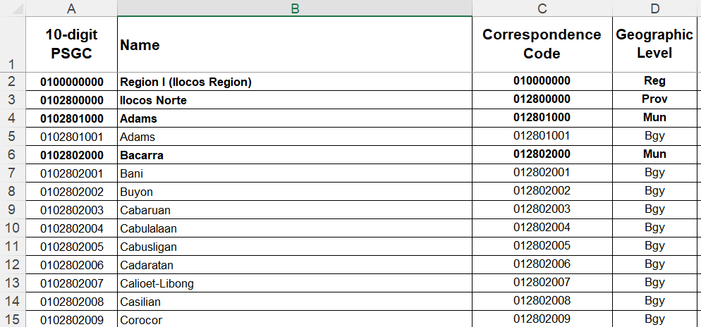
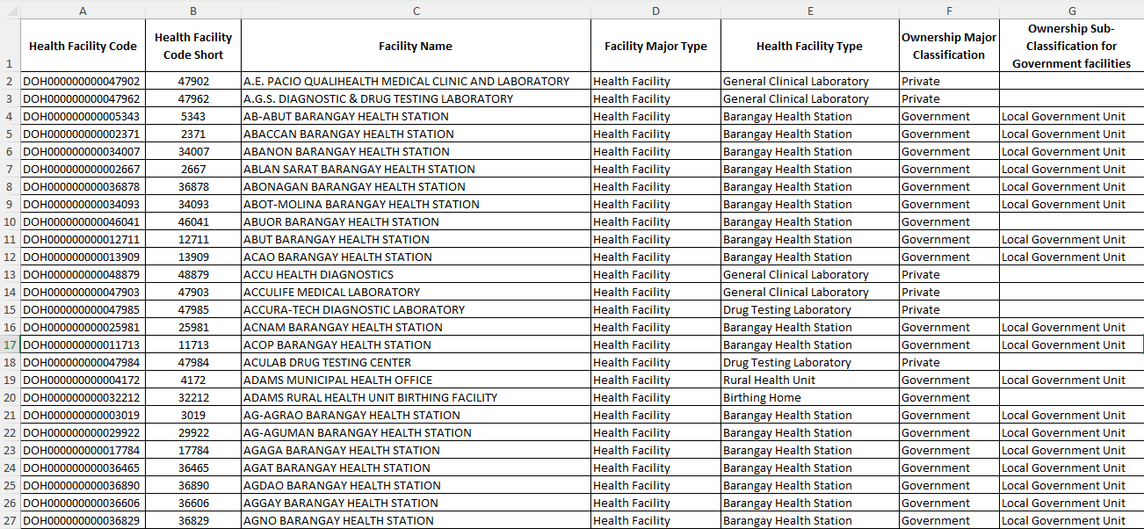
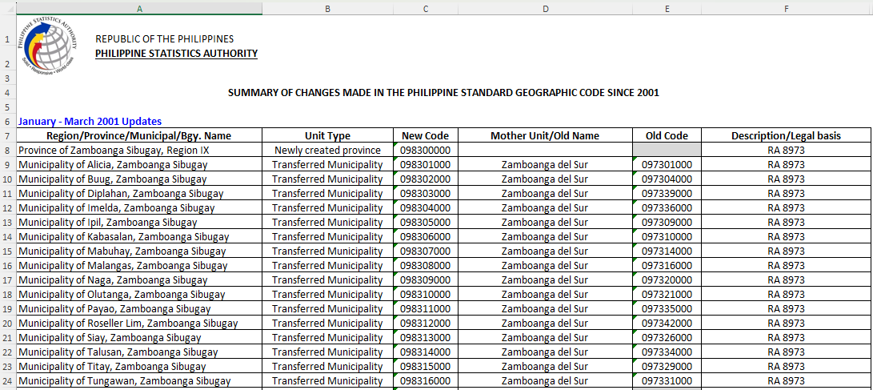
Georeferenced master lists – Example (Philippines)
https://psa.gov.ph/classification/psgc
https://nhfr.doh.gov.ph/Home
Master list of administrative units of the Philippines maintained by the Philippine Statistics Authority (PSA)
Master list of health facilities in the Philippines maintained by the Department of Health (DOH)
Released quarterly down to the 4th subnational level (42,001 Barangays as of 31 December 2023)
Updated on a regular basis (40,328 health facilities as of 01 April 2024)
Master list
Summary of changes

Slide 17
Population estimation and spatial distribution
Use of statistical models, remote sensing datasets, and sampled census or household survey information to create spatially accurate estimates of population density and distribution, often including age and sex disaggregation
https://www.youtube.com/watch?v=Z1XrHOt8w2A&t=8s

Slide 18
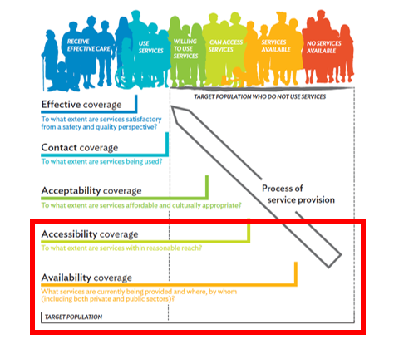
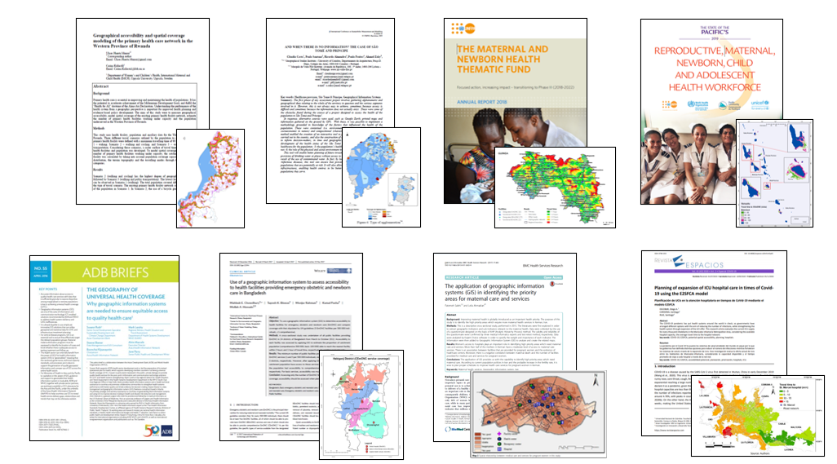
Geographic accessibility, service localization, and route optimization modeling
Advanced modelling approaches that help programs, and microplanning teams, assess and improve the planning, allocation, and delivery of resources
Geographic accessibility, service localization
Geography
Increasing bibliography on this topic, including in relation to COVID-19

Slide 19
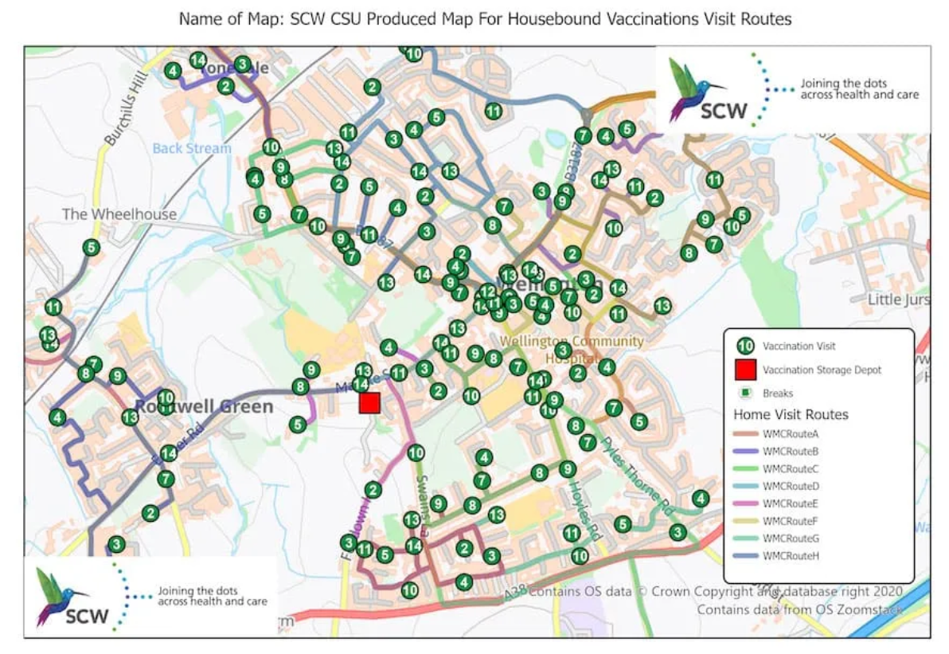
Geographic accessibility, service localization, and route optimization modeling
Route optimization modeling
Use of algorithms to calculate optimal routes based on various factors such as traffic flow, distance, travel time, vehicle types, and other user-defined parameters to generate the most efficient route for a given scenario
Benefits:
Cost efficiency (reduce fuel consumption, maintenance costs, operational expenses)
Time saving (on-time delivery)
Improved resource allocation (vehicles, personnel and time)
Environmental sustainability (reduce carbon emission)

Slide 20
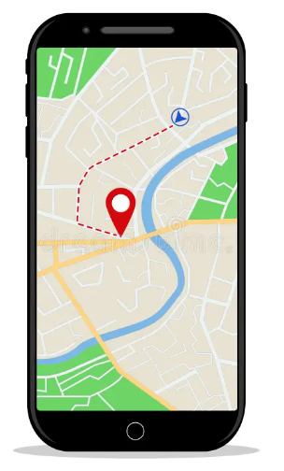
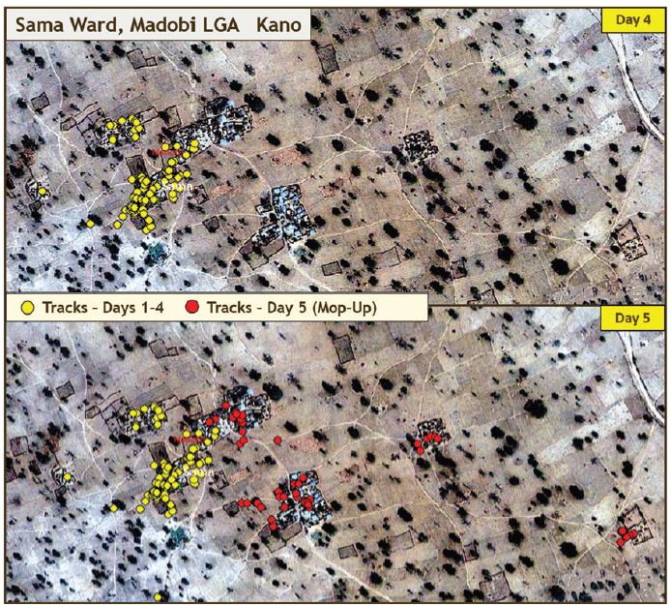
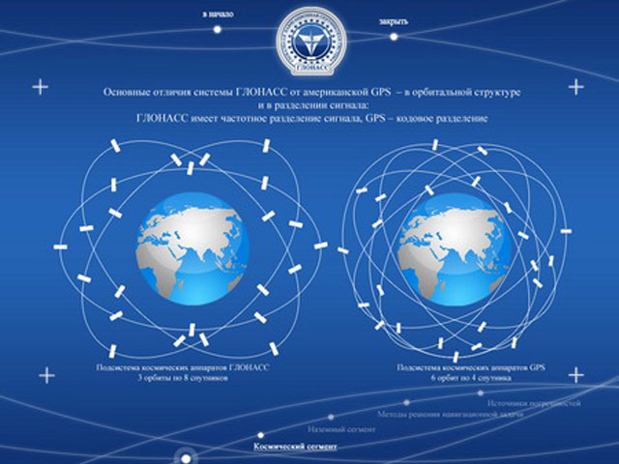
Navigation, tracking, and geographic coordinate collection using a GNSS
Use of a Global Navigation Satellite System (GNSS) enabled device to get to a particular location (navigate), track movements, or collect geographic coordinates (latitude, longitudes) in the field
Tracking to support Polio eradication in Nigeria ¹
Collection of geographic coordinates in the field
Navigation
Global Navigation Satellite System (GNSS)
1 https://www.researchgate.net/publication/266945980_Improving_Polio_Vaccination_Coverage_in_Nigeria_Through_the_Use_of_Geographic_Information_System_Technology/figures?lo=1

Slide 21
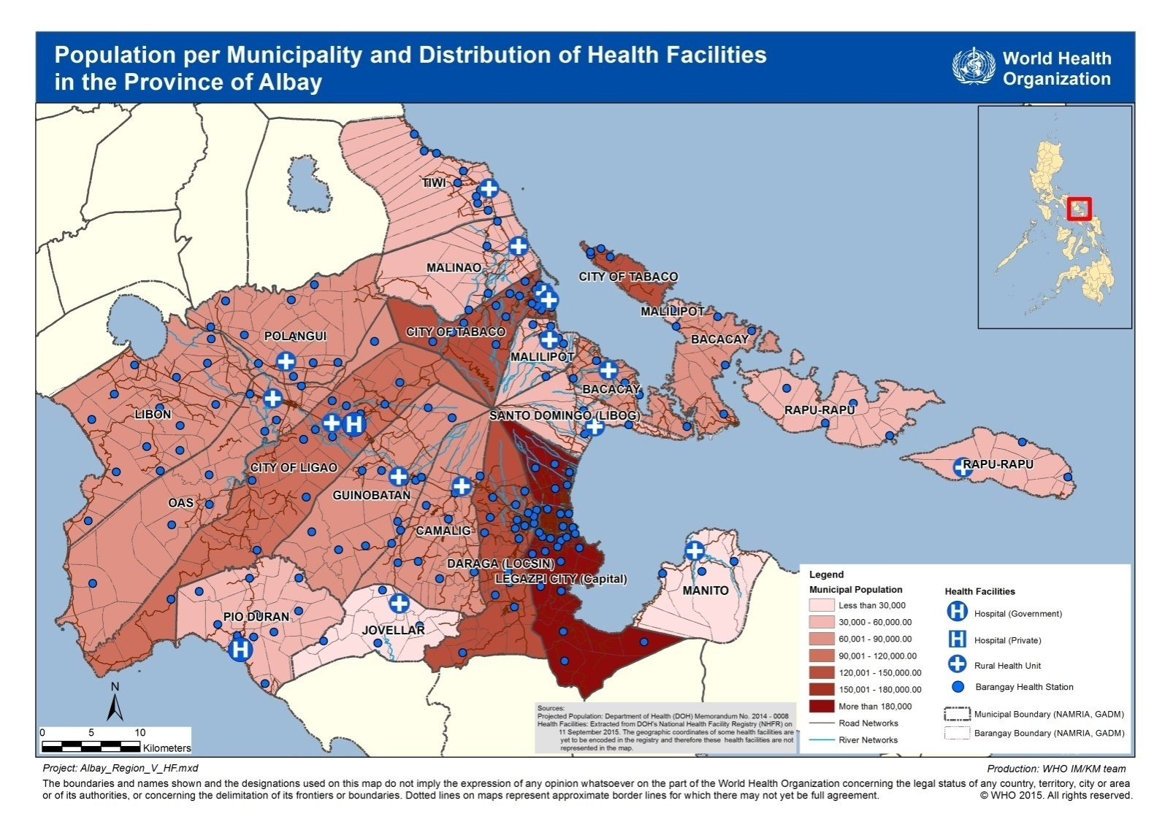
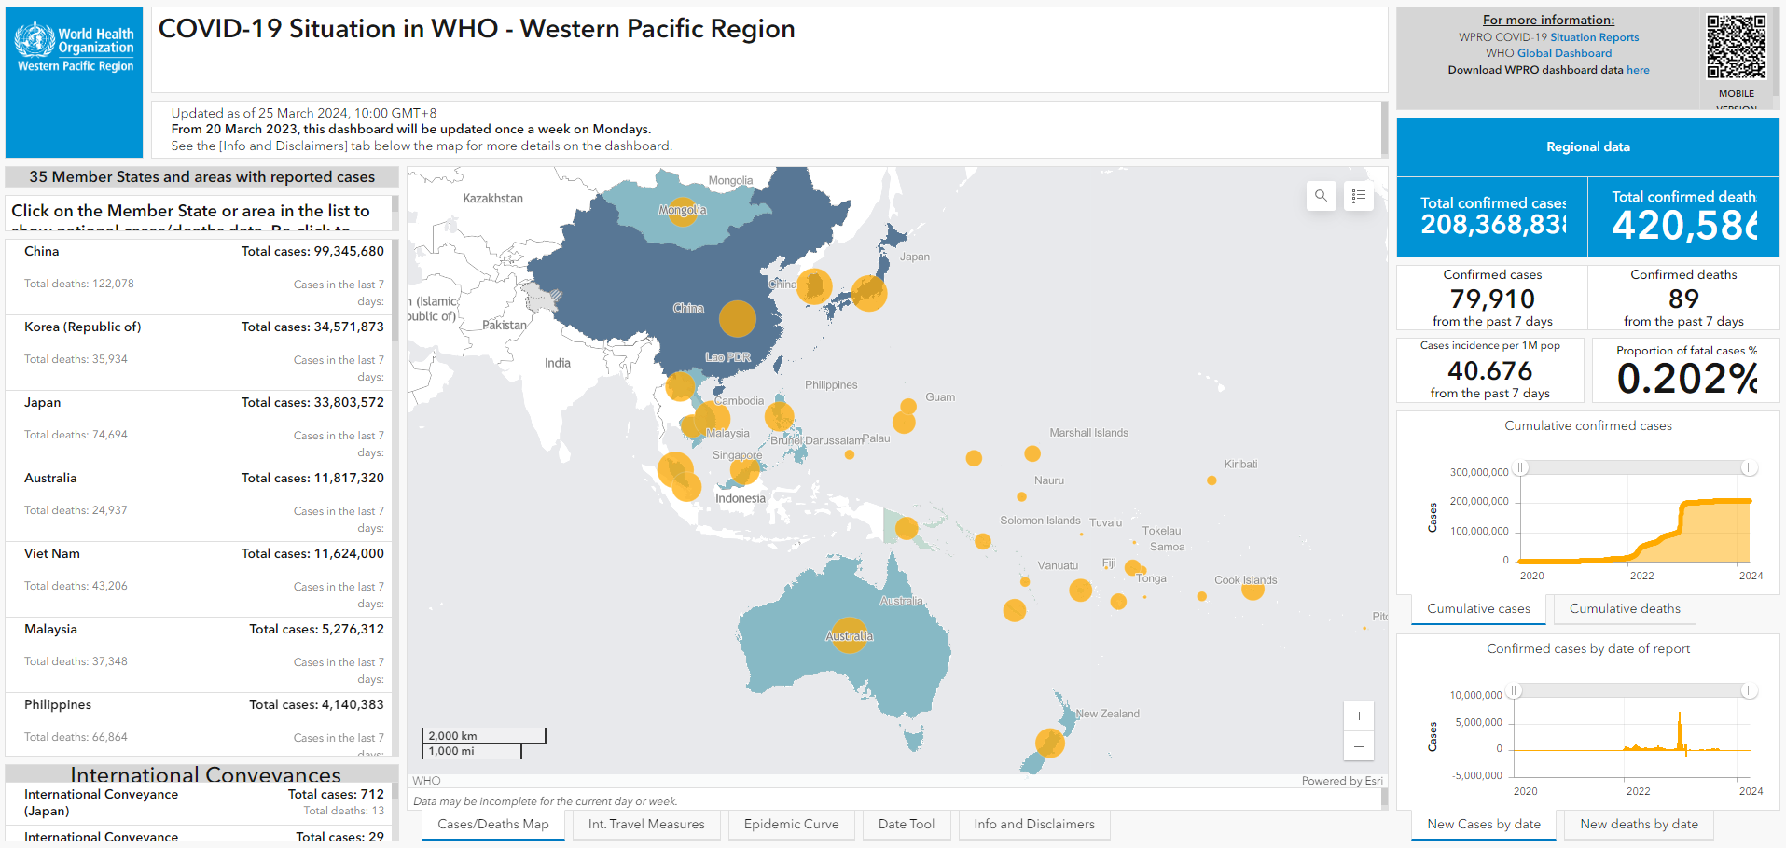
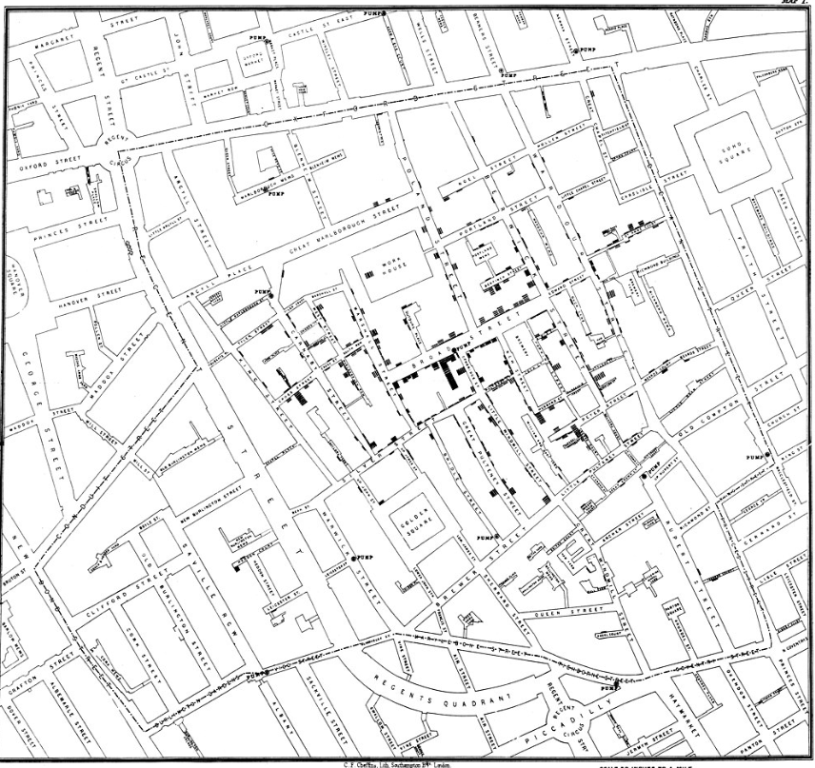
Thematic mapping
Creation of thematic maps designed to convey information about a single topic or theme, such as population density or health
Most used capability of a GIS software to portray the geographic distribution of one or more phenomena.
Static map
Involves the use of colors and/or symbols to visualize selected properties of geographic features.
Used in public health for
a very long time for visualizing
and analyzing health-related
Phenomena.
Dynamic map as part of a dashboard
John Snow's cholera map in London (published in 1854)

